Slide 1


感恩遇见，相互成就，本课件资料仅供您个人参考、教学使用，严禁自行在网络传播，违者依知识产权法追究法律责任。
更多教学资源请关注
公众号：溯恩高中英语
知识产权声明

Slide 2
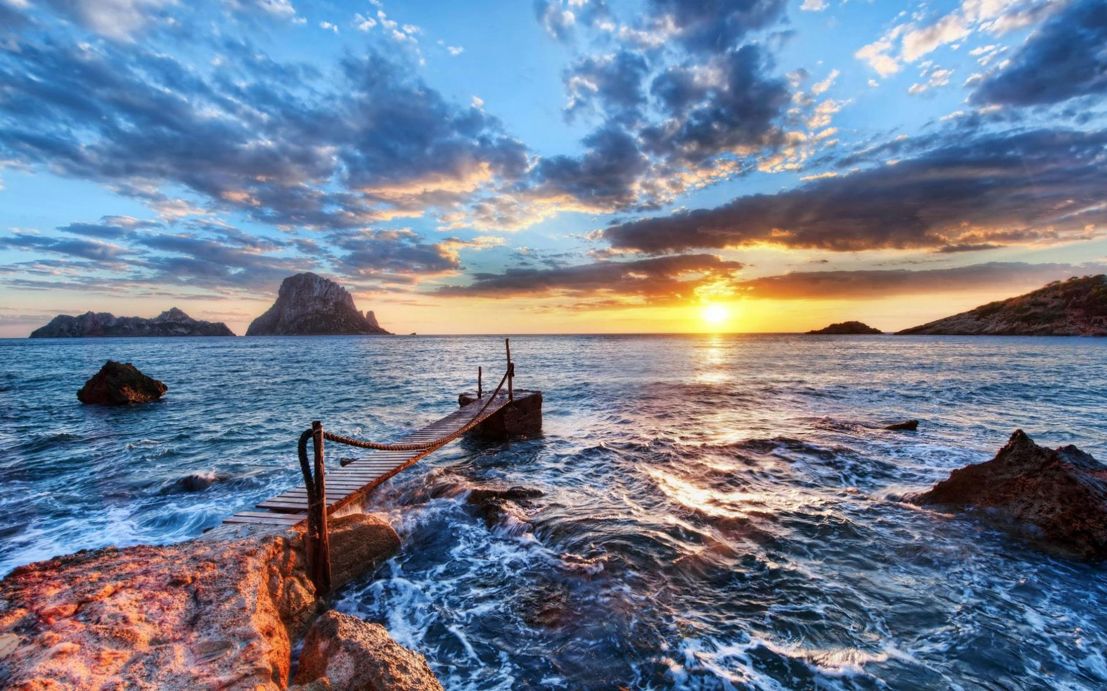
Natural
Disasters！
Listening & Speaking
Notes:
要将此标题动画幻灯片与新图像一起使用，只需 1) 将顶部半透明形状移到一侧，2) 删除占位符图像，3) 单击图片图标添加新图片，4) 将半透明形状移回原始位置，5) 更新幻灯片上的文本。

Slide 3
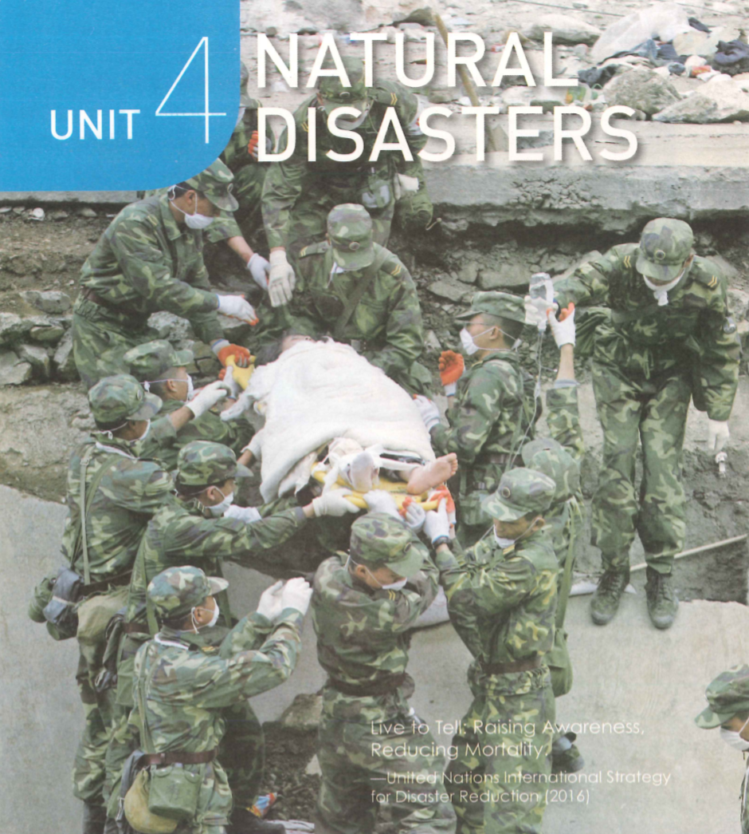
What’s going on in this photo?
The soldiers are rescuing the survivors of earthquake.
2.What ideas does this picture convey?
Live to tell:
Raising Awareness, Reducing Mortality.
—United Nations InternationalStrategy
for Disaster Reduction (2016)
[mɔːˈtæləti]
death rate

Slide 4
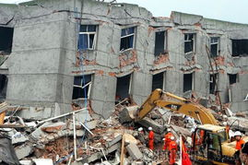
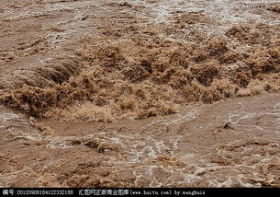
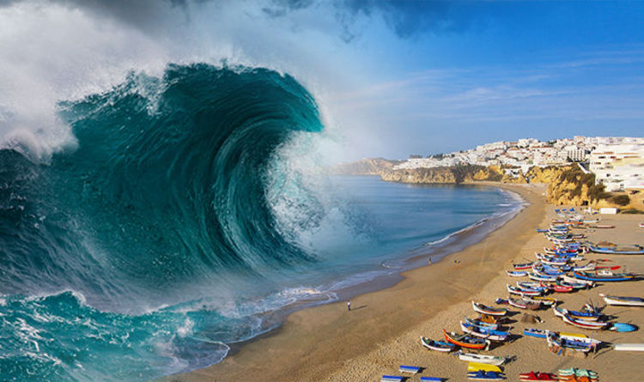
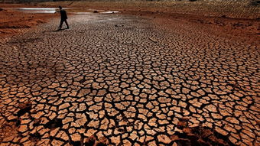
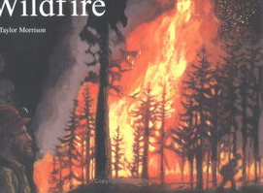
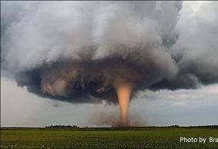
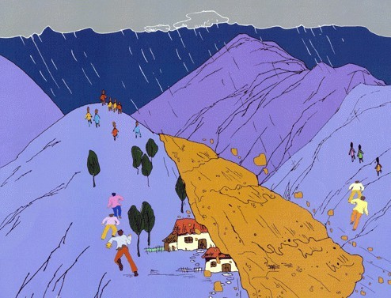
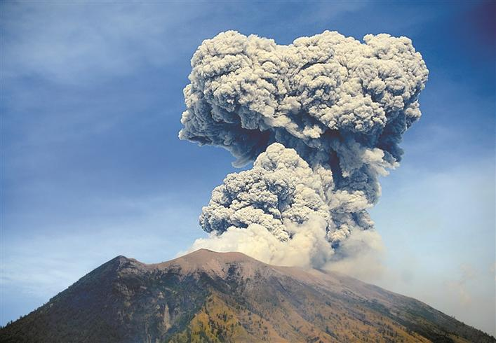
earthquake
flood
tsunami
drought
wildfire
tornado
volcanic eruption
landslide
What natural disasters can you think of?

Slide 5
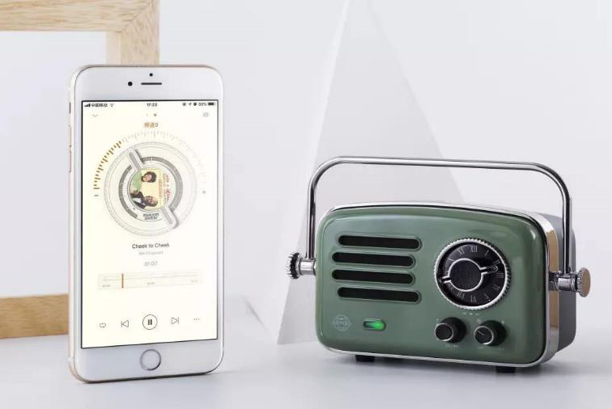
How do you learn about natural disasters?
news reports

Slide 6



Listen to the news reports and tick the disasters that you hear.
● earthquake ● tornado ● wildfire ●drought
● landslide ● tsunami ● flood ● volcanic eruption
Circle the key word(s) in the questions below and write the kind of information they refer to. Then listen again and answer the questions.

Slide 7
Question | Type of information | Answer
1. What was the magnitude of the earthquake in Ecuador? | number
2. How many people were killed or injured in Ecuador?
3. Where are the floods?
4.What are the rescue workers and soldiers doing in the flood-hit area?
5. When did people see the tornado in Memphis?
6.Which buildings were damaged in Seoul?
7.What caused the landslide in Seoul?
7.8
230 were killed /more than 1500 were injured
number
place
in China
worked to make people safe
activities
time
9:25 a.m.
a library and a supermarket
address
reason
a heavy rain

Slide 8

News report 1
Events
Time
Good morning, it's 17 April. A strong earthquake hit Ecuador yesterday. The 7.8-magnitude earthquake damaged many buildings, and early reports said that about 230 people were killed and more than 1,500 were injured. Volunteers and rescue workers are helping the survivors.
Effects
Rescue Work
What tenses are used here and Why?

Slide 9

News report 2
Good evening. Today is 27 March. More news about the floods in central China. The government is helping more than 12,000 people in Hunan and Jiangxi get away from the rising water. Homes and land have been destroyed, but no one has been killed. Rescue workers and soldiers are working day and night to make sure that people are safe. They are also bringing food and water to those whose homes were lost in the disaster.

Slide 10

News report 3
Breaking news, Saturday 12 August. A tornado was just seen in southern Memphis. Eyewitnesses said that at 9:25 a.m., the tornado destroyed four homes. A police officer tells us that at least one person has died. More tornados are possible, and the police advise avoiding the area.

Slide 11
Top News
News report 4
And in Seoul, a landslide damaged a library and a supermarket in a southern neighbourhood. The landslide was caused by the heavy rain that has fallen in Seoul over the past week. According to the police, no one was injured in the landslide, but several cars were damaged. Those are the top news for today, Wednesday 21 July.

Slide 12

Different Periods
Different expressions
Good morning, it's
Good evening. Today is... More news about ...
Breaking news, Saturday 12 August. …was just seen in... Eyewitnesses said that …
A police officer tells us that…
According to …,…
Those are the top news for today, Wednesday 21 July,
Top News

Slide 13


Let’s make news report

Slide 14


Earthquake
Wildfire
Flood
Wenchuan, China
Alberta, Canada
Colombo, Sri Lanka
● 14:28 Monday, 12 May
● Magnitude 7.8 (8.0)
● At least 8,500 killed (by 13 May)
● Rescue workers
(medical teams, troops,volunteers, etc.) organized quickly
● Began on 1 May
● 2,400 homes destroyed
● Almost 88,000 people evacuated
● Hundreds of firefighters arrived
● Planes, helicopters used to fight the fire
● No deaths, no injures
● Began in May
● 82 killed, 500,000 affected
● Rescue teams provide food and water
● Shelters set up by the government

Slide 15
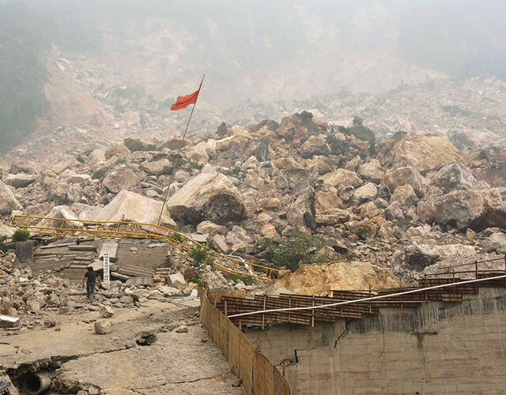
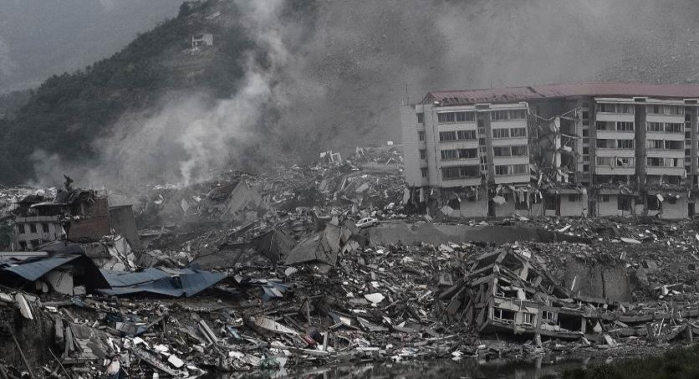
01
A possible Sample
News Report on Earthquake
Good morning. Today is 13 May. A huge earthquake hit Wenchuan, China yesterday. It has killed at least 8,500 people by now. The earthquake measured 7.8 on the Richter scale.Injured survivors have been moved to safety by rescue workers, including medical workers, troops, and volunteers, who organized quickly.
PPT模板下载：www.1ppt.com/moban/ 行业PPT模板：www.1ppt.com/hangye/
节日PPT模板：www.1ppt.com/jieri/ PPT素材下载：www.1ppt.com/sucai/
PPT背景图片：www.1ppt.com/beijing/ PPT图表下载：www.1ppt.com/tubiao/
优秀PPT下载：www.1ppt.com/xiazai/ PPT教程： www.1ppt.com/powerpoint/
Word教程： www.1ppt.com/word/ Excel教程：www.1ppt.com/excel/
资料下载：www.1ppt.com/ziliao/ PPT课件下载：www.1ppt.com/kejian/
范文下载：www.1ppt.com/fanwen/ 试卷下载：www.1ppt.com/shiti/
教案下载：www.1ppt.com/jiaoan/
字体下载：www.1ppt.com/ziti/

Slide 16
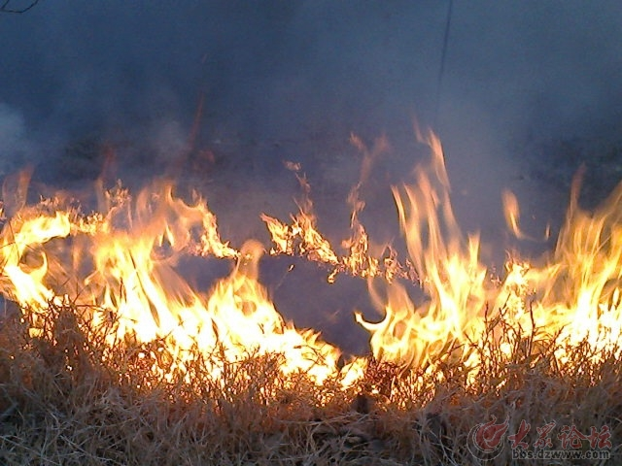
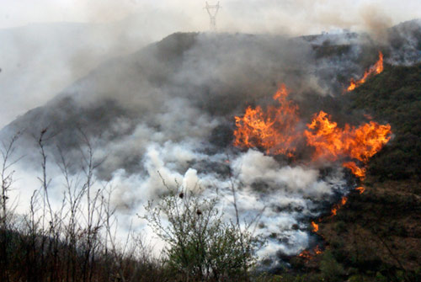
02
A possible Sample
News Report on Wildfire
A wildfire which began on 1 May in
Alberta, Canada, has destroyed 2,400 homes. Almost 88,000 people have been evacuated. Hundreds of firefighters along with planes and helicopters have arrived to help fight the fire. Luckily, there have been no deaths or injuries.
PPT模板下载：www.1ppt.com/moban/ 行业PPT模板：www.1ppt.com/hangye/
节日PPT模板：www.1ppt.com/jieri/ PPT素材下载：www.1ppt.com/sucai/
PPT背景图片：www.1ppt.com/beijing/ PPT图表下载：www.1ppt.com/tubiao/
优秀PPT下载：www.1ppt.com/xiazai/ PPT教程： www.1ppt.com/powerpoint/
Word教程： www.1ppt.com/word/ Excel教程：www.1ppt.com/excel/
资料下载：www.1ppt.com/ziliao/ PPT课件下载：www.1ppt.com/kejian/
范文下载：www.1ppt.com/fanwen/ 试卷下载：www.1ppt.com/shiti/
教案下载：www.1ppt.com/jiaoan/
字体下载：www.1ppt.com/ziti/

Slide 17
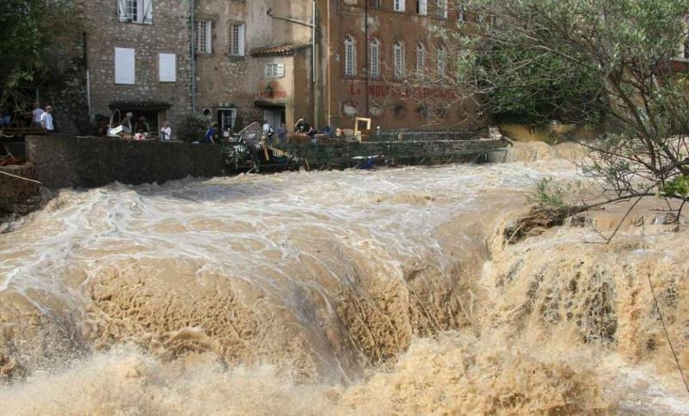
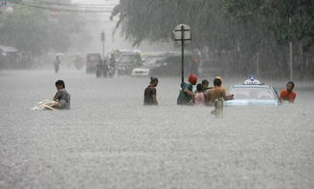
03
Post-listenin
A possible Sample
News Report on Flood
A flood in Colombo, Sri Lanka,
has killed 82 people. The flood,
Which began in May, has affected nearly 500,000 people. Rescue teams are
providing food and water,
and shelters have been set up by
the government.
PPT模板下载：www.1ppt.com/moban/ 行业PPT模板：www.1ppt.com/hangye/
节日PPT模板：www.1ppt.com/jieri/ PPT素材下载：www.1ppt.com/sucai/
PPT背景图片：www.1ppt.com/beijing/ PPT图表下载：www.1ppt.com/tubiao/
优秀PPT下载：www.1ppt.com/xiazai/ PPT教程： www.1ppt.com/powerpoint/
Word教程： www.1ppt.com/word/ Excel教程：www.1ppt.com/excel/
资料下载：www.1ppt.com/ziliao/ PPT课件下载：www.1ppt.com/kejian/
范文下载：www.1ppt.com/fanwen/ 试卷下载：www.1ppt.com/shiti/
教案下载：www.1ppt.com/jiaoan/
字体下载：www.1ppt.com/ziti/

Slide 18
Homework
1. Find the latest News
2.Report it and record it into a video.
Make your own video of reporting news
3. Send it to Dingding

Slide 19

Thank
you！
Lily
Notes:
要将此标题动画幻灯片与新图像一起使用，只需 1) 将顶部半透明形状移到一侧，2) 删除占位符图像， 3) 单击图片图标添加新图片，4) 将半透明形状移回原始位置，5) 更新幻灯片上的文本。

