Slide 1


感恩遇见，相互成就，本课件资料仅供您个人参考、教学使用，严禁自行在网络传播，违者依知识产权法追究法律责任。
更多教学资源请关注
公众号：溯恩高中英语
知识产权声明

Slide 2

赖会娣

Slide 3
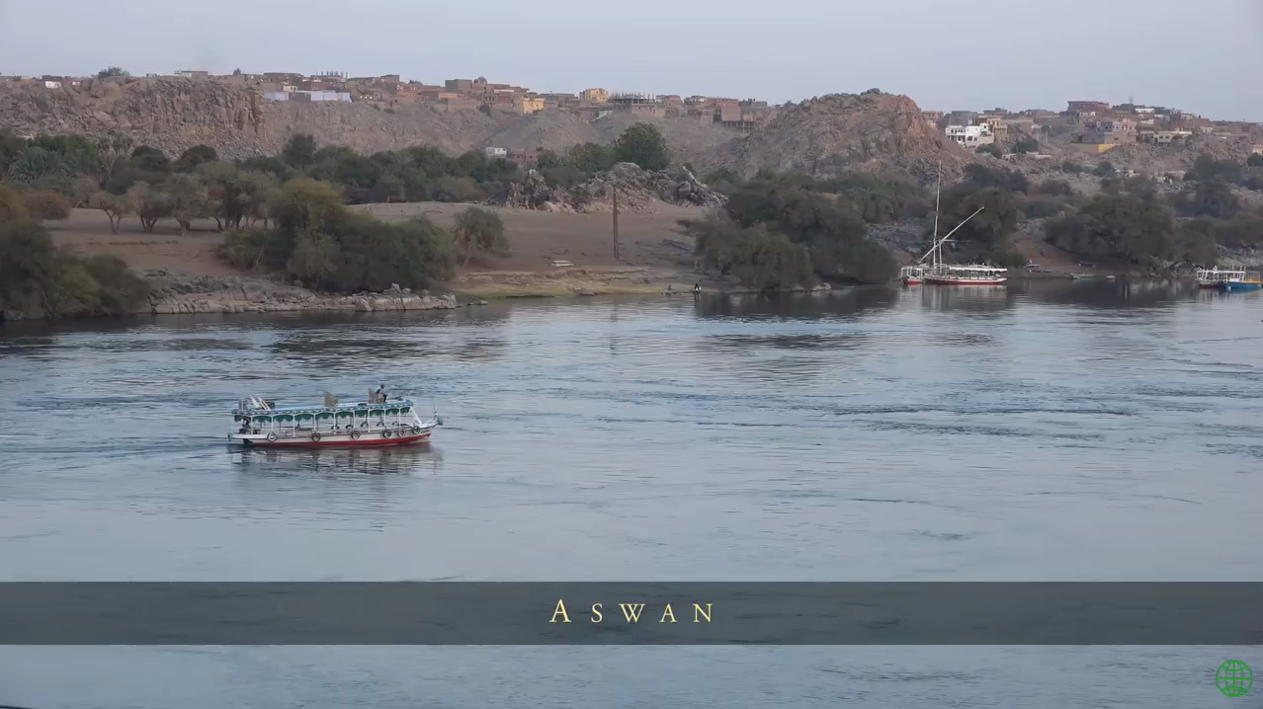
Warm-up

Slide 4
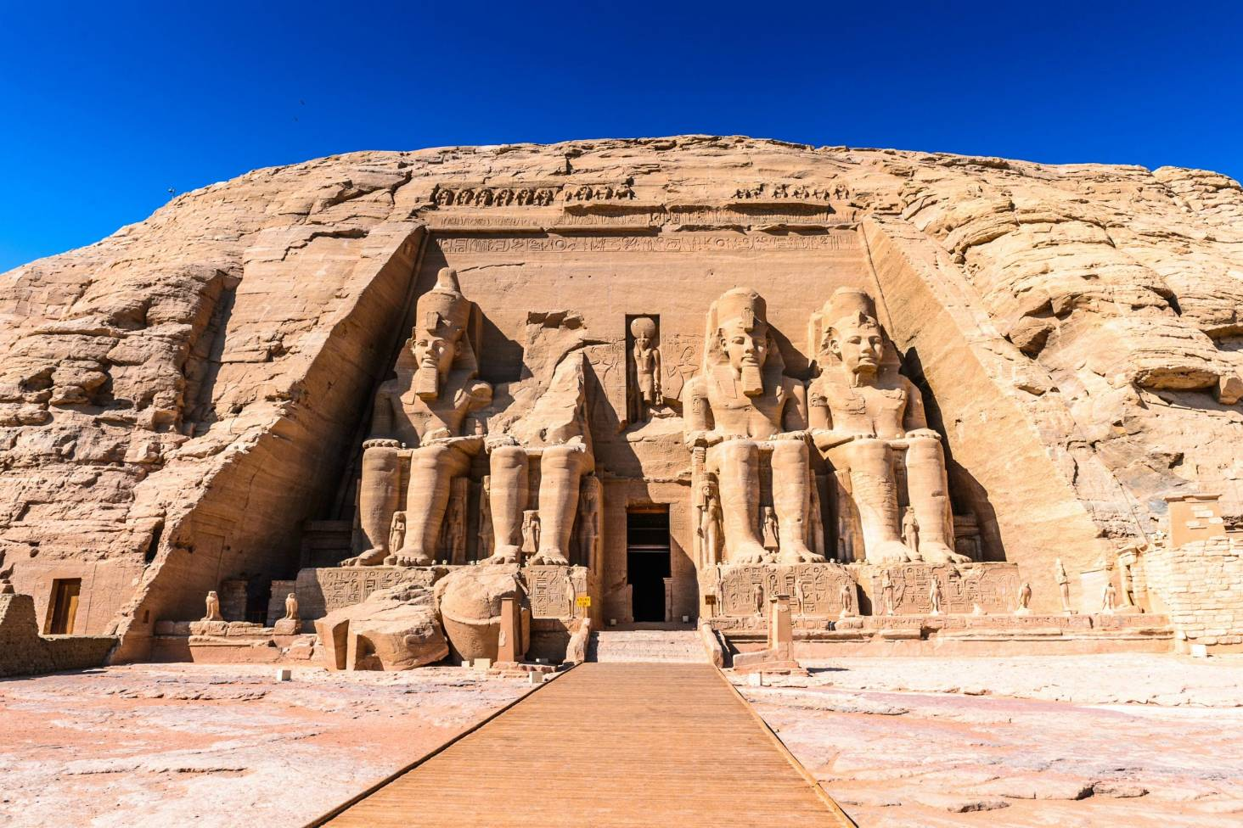
FROM PROBLEMS TO SOLUTIONS

Slide 5
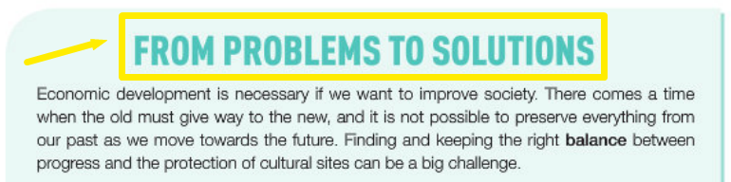
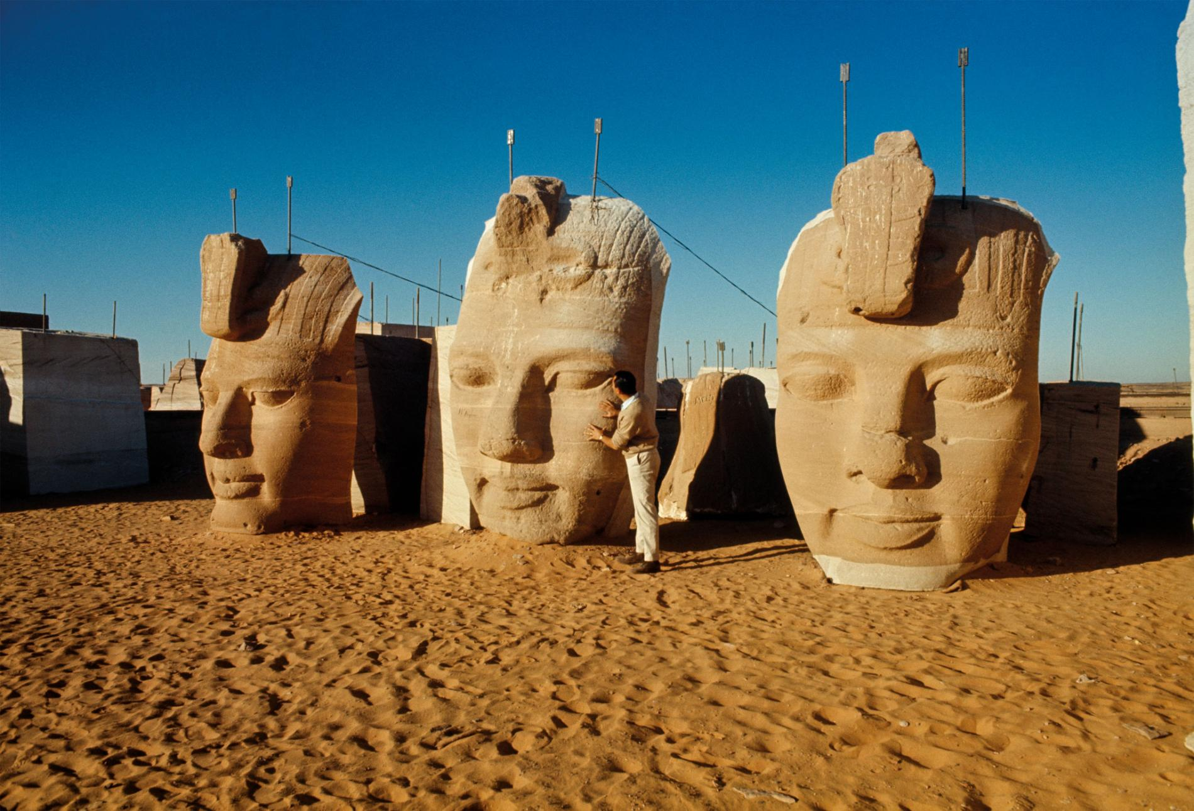

Look at the title and the pictures to predict the content of the text.
Pre-reading

Slide 6
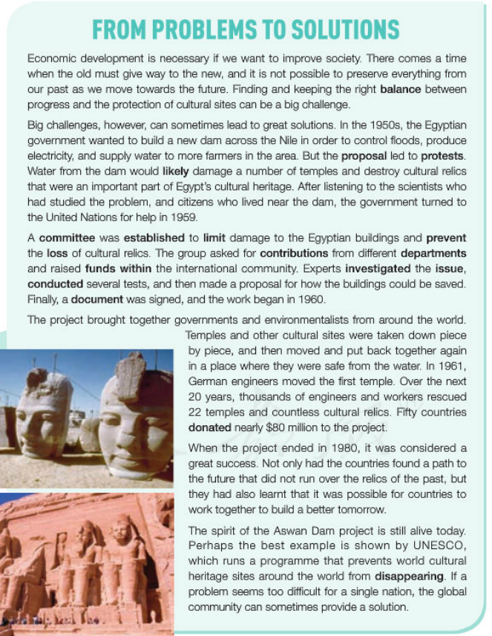
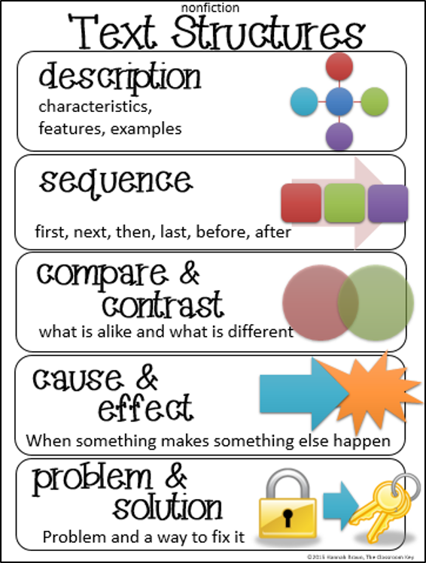
Skim the text for 3 minutes; choose the text structure.
While-reading
Task 1: Skimming
PROBLEM
SOLUTION

Slide 7
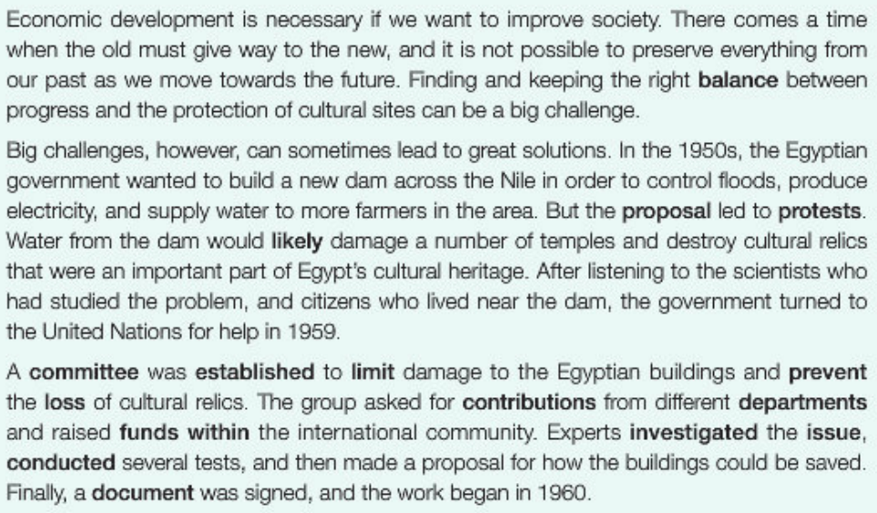
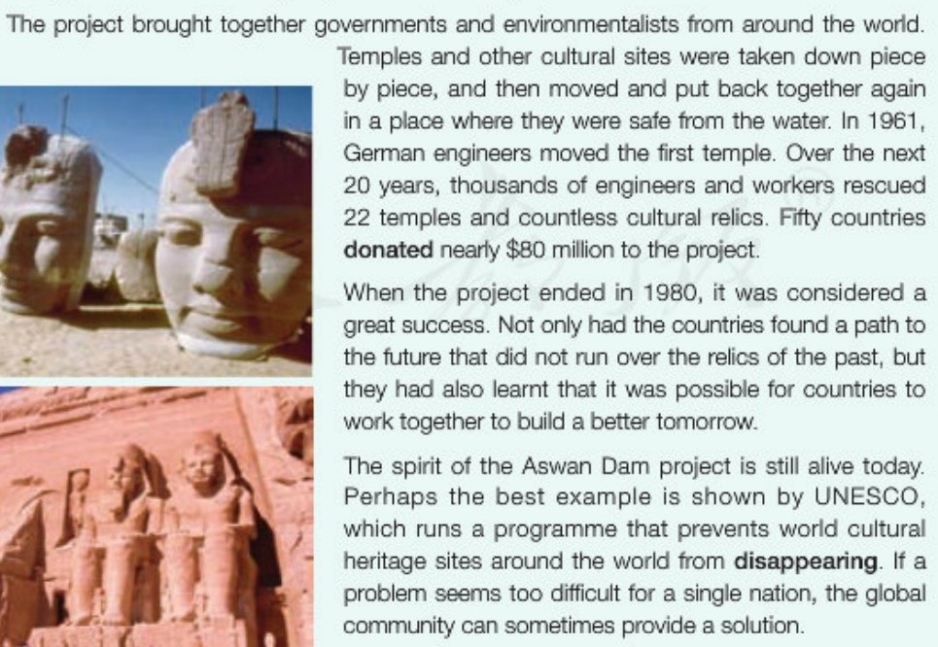
Scan the text for numbers; Circle them and guess what they mean.
Task 2: Scanning
amount
timeline
1950s
1959
1960
1961
1980

Slide 8
Task 3: Detailed reading
Economic development is necessary if we want to improve society. There comes a time when the old must give way to the new, and it is not possible to preserve everything from our past as we move towards the future. Finding and keeping the right balance between progress and the protection of cultural sites can be a big challenge.
Why sentence two is mentioned?
What word can be added to link sentence two and three? Why?
“Therefore.” Sentence two talks about the difficulty and hence being the reason of a challenge.
3. Which sentence is the topic sentence?
The last sentence.
What is the function of paragraph one?
To introduce the topic.
It is to provide some background information on protecting cultural sites.

Slide 9
Big challenges, however, can sometimes lead to great solutions. In the 1950s, the Egyptian government wanted to build a new dam across the Nile in order to control floods, produce electricity, and supply water to more farmers in the area. But the proposal led to protests. Water from the dam would likely damage a number of temples and destroy cultural relics that were an important part of Egypt’ s cultural heritage. After listening to the scientists who had studied the problem, and citizens who lived near the dam, the government turned to the United Nations for help in 1959.
1. Why didn’t the author put “however” at the beginning of sentence one?
It is used to echo “a big challenge” at the end of last paragraph for better transition in passage progression.
Which sentence is the topic sentence?
Sentence one.
How did the author support his view in this paragraph?
The author used an example of Egyptian government as supporting detail.
4. Before the building of the dam, what problems did the Nile river bring to the Egyptians?
There might be floods and droughts; not enough electricity.

Slide 10
Big challenges, however, can sometimes lead to great solutions. In the 1950s, the Egyptian government wanted to build a new dam across the Nile in order to control floods, produce electricity, and supply water to more farmers in the area. But the proposal led to protests. Water from the dam would likely damage a number of temples and destroy cultural relics that were an important part of Egypt’ s cultural heritage. After listening to the scientists who had studied the problem, and citizens who lived near the dam, the government turned to the United Nations for help in 1959.
5. Can you sort out the advantages and disadvantages of building the new dam?
6. How did the local government make a decision?
The government listened to the professional scientists’ advice and citizens’ opinion.
advantages (pros) | disadvantages / effects (cons)
a) to control floods | d) would likely damage many temples
b) to produce electricity | e) would destroy cultural relics
c) to supply water to more farmers

Slide 11
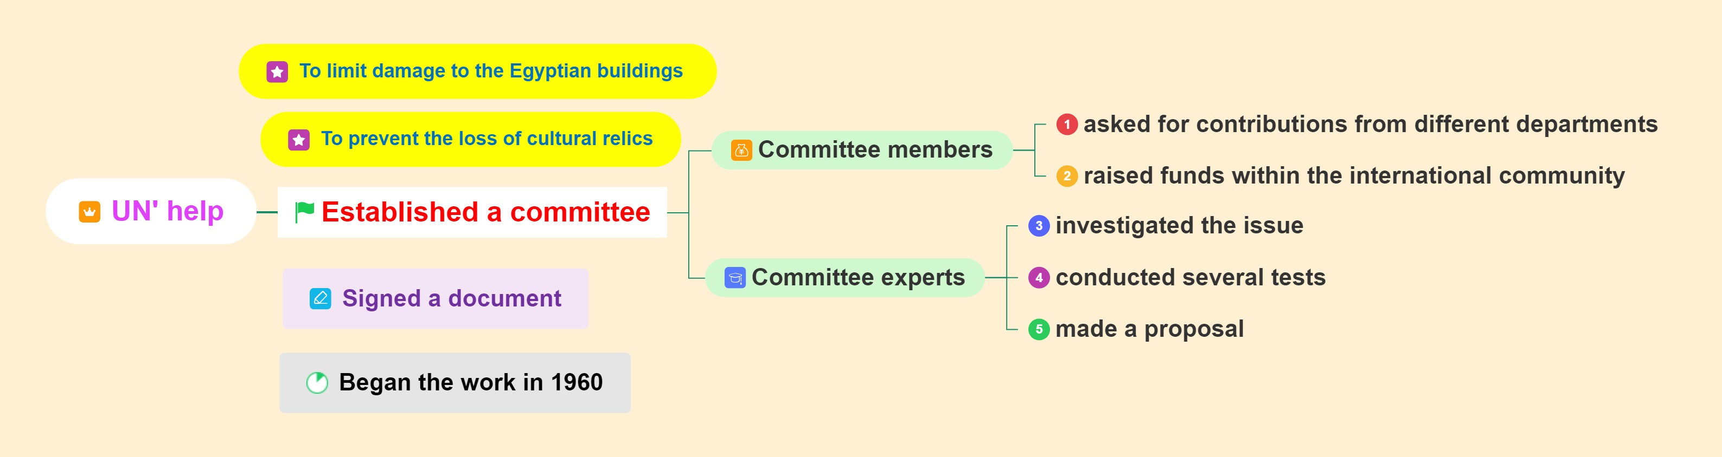
A committee was established to limit damage to the Egyptian buildings and prevent the loss of cultural relics. The group asked for contributions from different departments and raised funds within the international community. Experts investigated the issue, conducted several tests, and then made a proposal for how the buildings could be saved. Finally, a document was signed, and the work began in 1960.
1. Can you sort out UN’s specific ways to solve the problem with a mind map?
_________________________________
________________________
_______________________________
____________
________________________
__________________________
______
________________________
________________

Slide 12
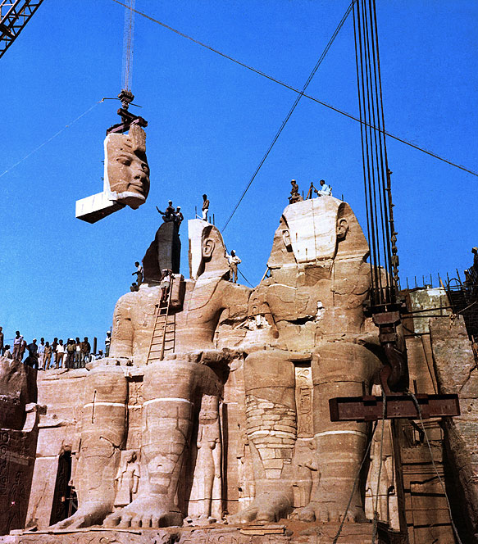
A committee was established to limit damage to the Egyptian buildings and prevent the loss of cultural relics. The group asked for contributions from different departments and raised funds within the international community. Experts investigated the issue, conducted several tests, and then made a proposal for how the buildings could be saved. Finally, a document was signed, and the work began in 1960.
2. So, what is the proposal for saving the buildings? Discuss in groups and guess.
Watch a video and confirm your assumptions.

Slide 13
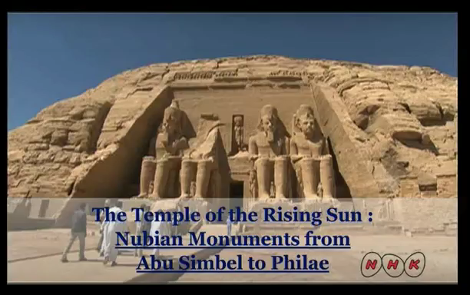

Slide 14
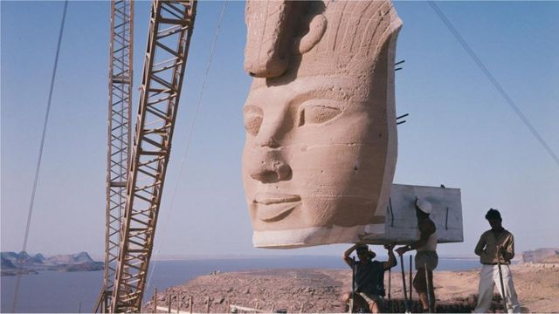
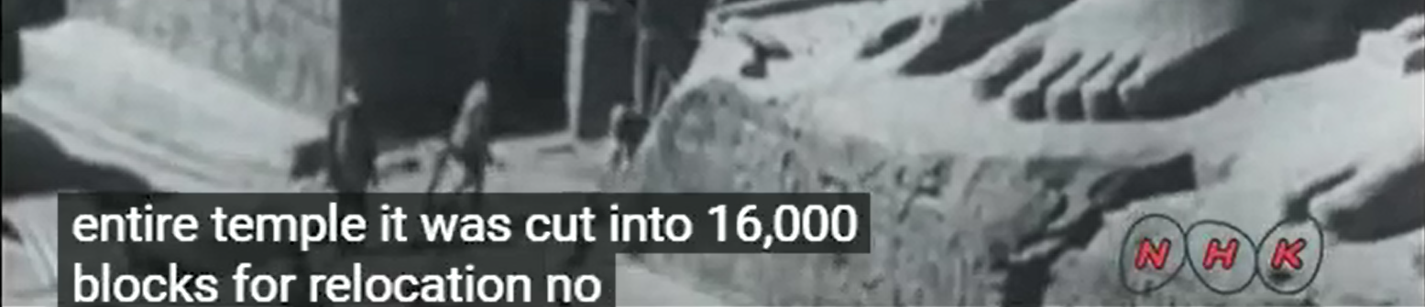

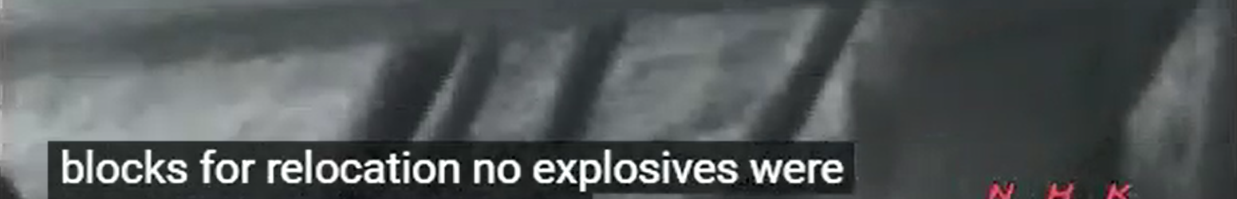
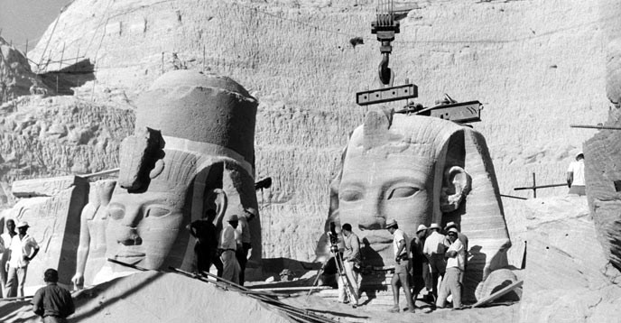
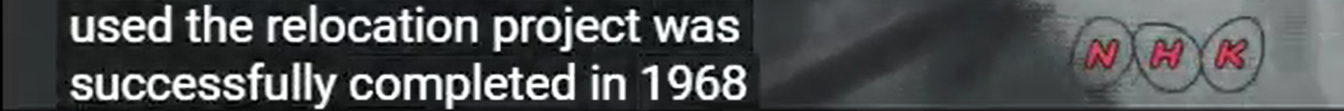
A committee was established to limit damage to the Egyptian buildings and prevent the loss of cultural relics. The group asked for contributions from different departments and raised funds within the international community. Experts investigated the issue, conducted several tests, and then made a proposal for how the buildings could be saved. Finally, a document was signed, and the work began in 1960.
2. So, what is the proposal for saving the buildings? Discuss in groups and guess.
Watch a video and confirm your assumptions.

Slide 15
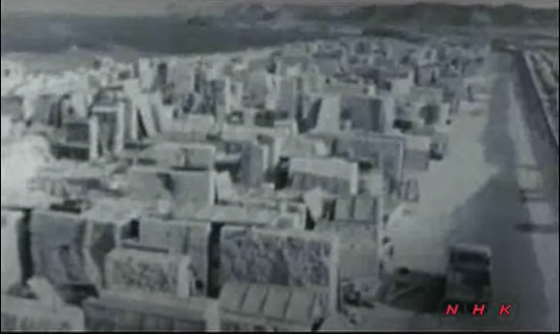
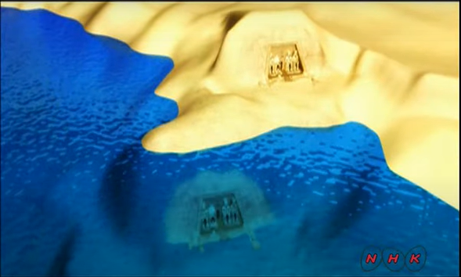
The project brought together governments and environmentalists from around the world. Temples and other cultural sites were taken down piece by piece, and then moved and put back together again in a place where they were safe from the water. In 1961, German engineers moved the first temple. Over the next 20 years, thousands of engineers and workers rescued 22 temples and countless cultural relics. Fifty countries donated nearly $80 million to the project.
1. What was the order of the huge movement? Please fill in the blanks.
Temples were taken down piece by piece.
They were moved and put back together again in a safe place.
______________________
________
_____

Slide 16
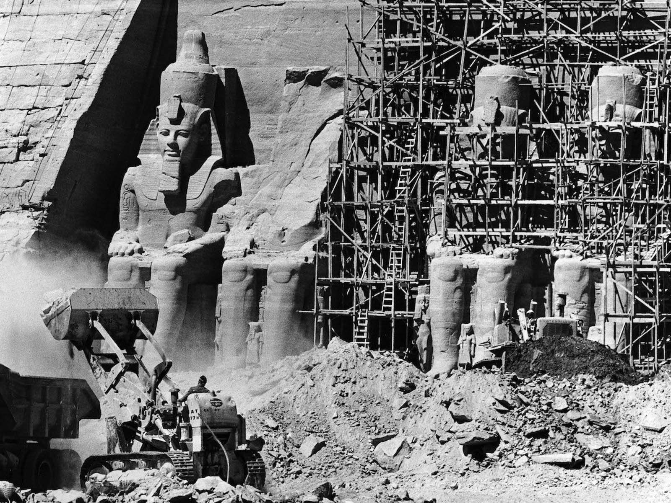
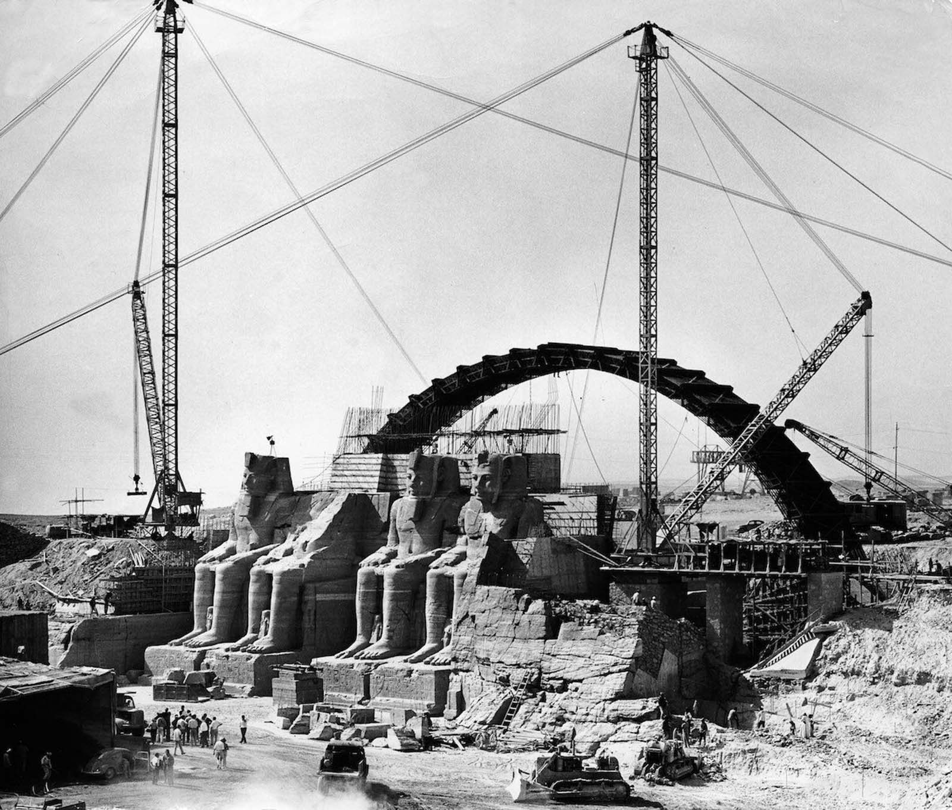
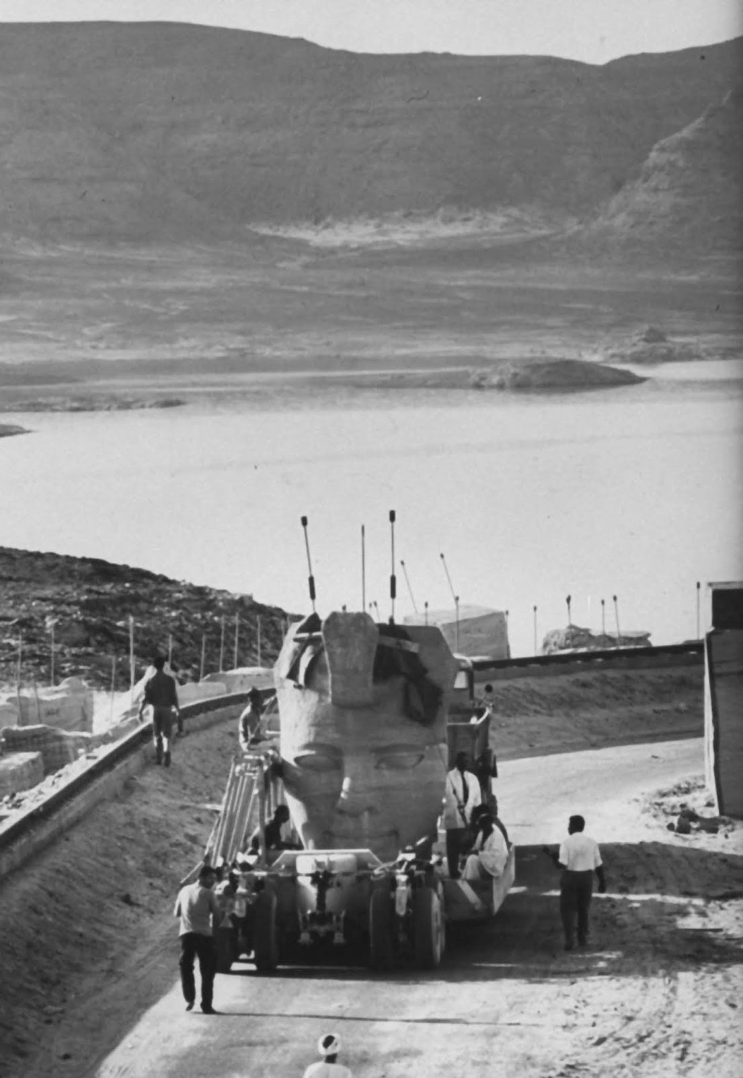
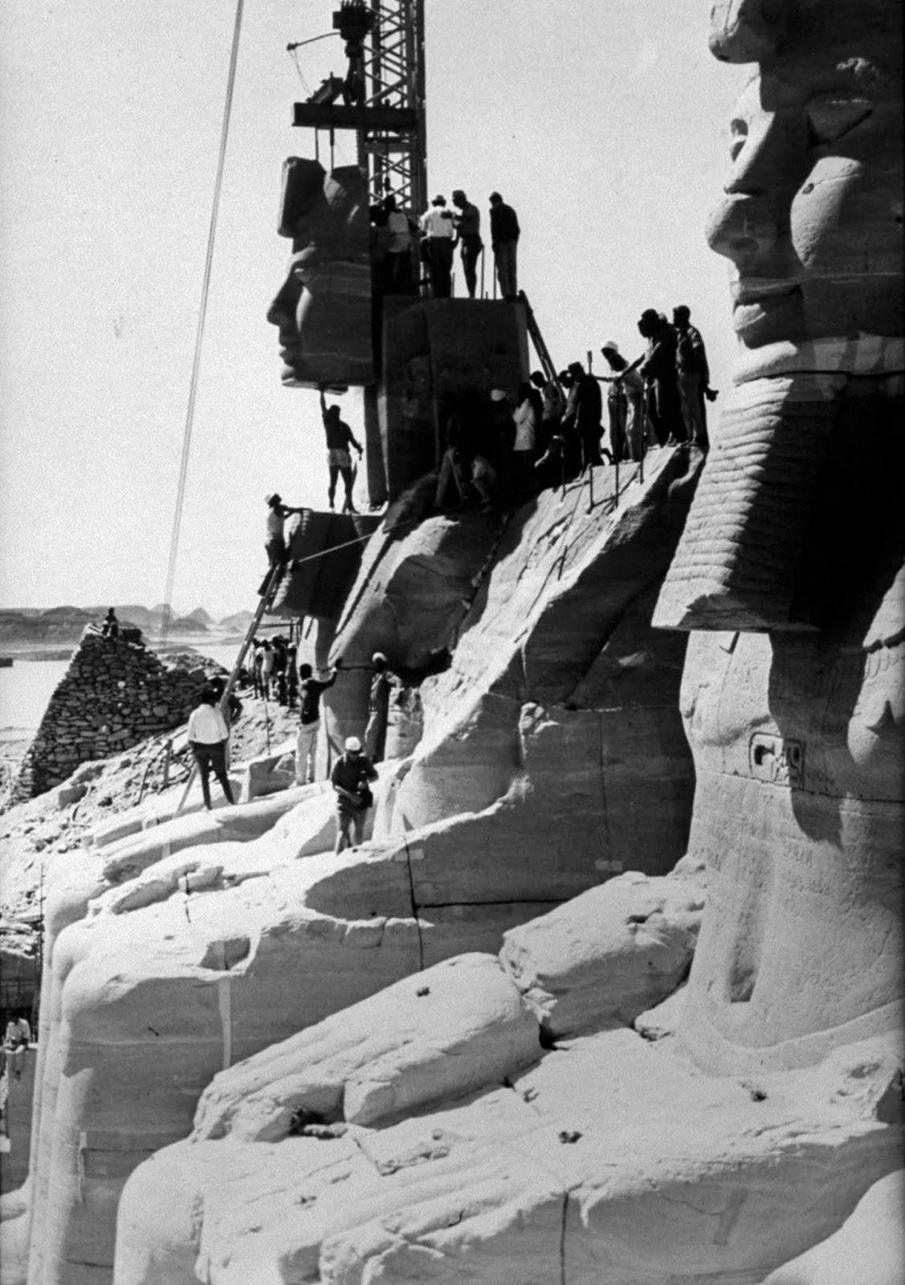
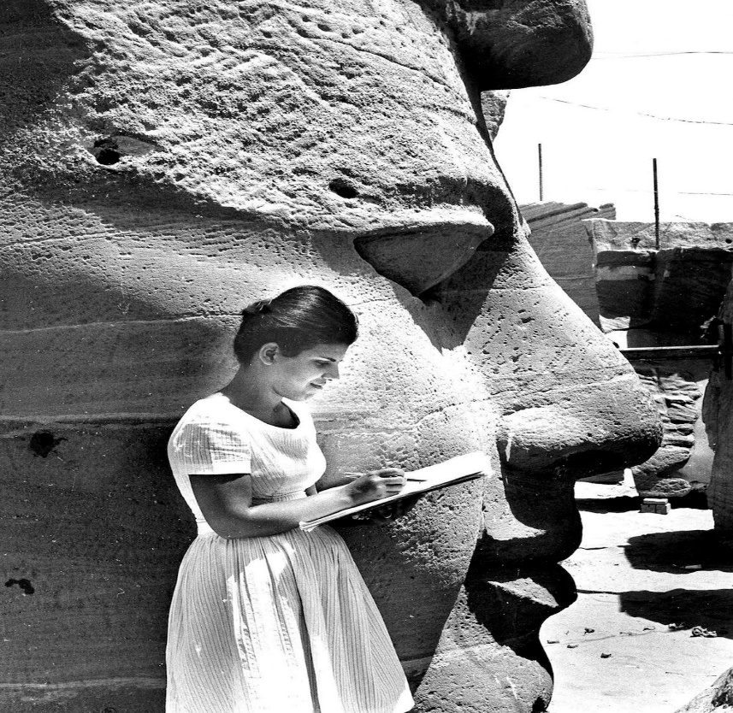
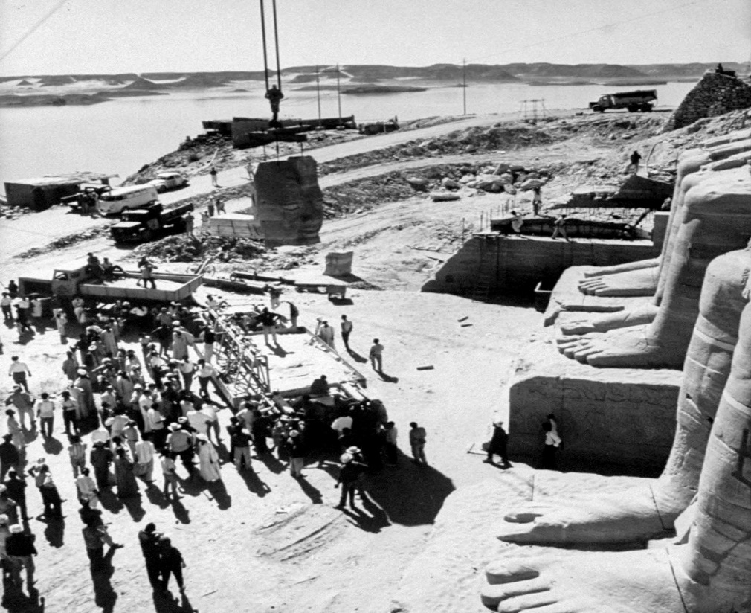
The project brought together governments and environmentalists from around the world. Temples and other cultural sites were taken down piece by piece, and then moved and put back together again in a place where they were safe from the water. In 1961, German engineers moved the first temple. Over the next 20 years, thousands of engineers and workers rescued 22 temples and countless cultural relics. Fifty countries donated nearly $80 million to the project.
2. What’s the function of using numbers in this paragraph?
Numbers and statistics are powerful evidence to strengthen the huge difficulty of the relocating process in this massive project.

Slide 17
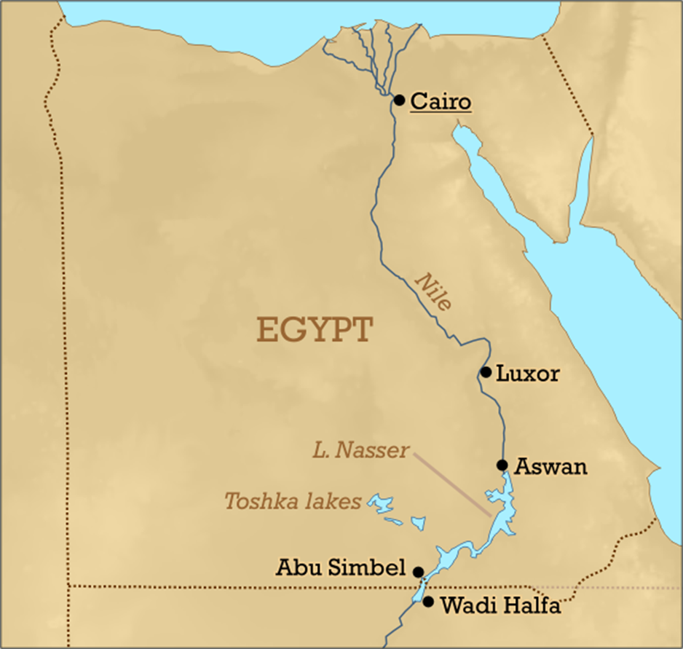
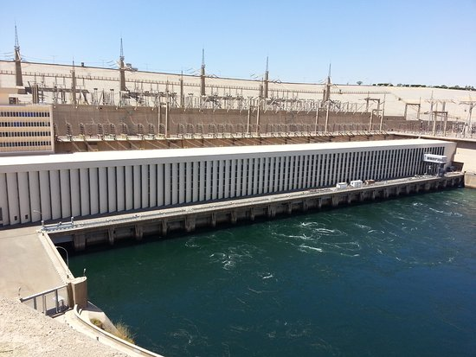
When the project ended in 1980, it was considered a great success. Not only had the countries found a path to the future that did not run over the relics of the past, but they had also learnt that it was possible for countries to work together to build a better tomorrow.
Which one is the topic sentence?
The first sentence is the topic sentence.
What type of details is used to support the author’s idea in this paragraph?
A. Facts B. Examples C. Explanation
What’s the use of “not only…but also…” structure in sentence two?
It is a partial inversion which is to highlight and to emphasize the right way to protect cultural relics.
C

Slide 18

The spirit of the Aswan Dam project is still alive today. Perhaps the best example is shown by UNESCO, which runs a programme that prevents world cultural heritage sites around the world from disappearing. If a problem seems too difficult for a single nation, the global community can sometimes provide a solution.
What is the spirit of the Aswan Dam project?
International cooperation.
What rhetorical device is used in the last sentence? What’s the function?
The final syllables of words “nation” and “solution” rhyme. It is to create a strong rhythm and rhythmic flow to the ending part that facilitates memorization.
What inspiration do we get from the last paragraph?
In the time of globalization, we live in the global village. That’s why we need international team work when needed. At present, fighting Covid-19 is a good example of this.

Slide 19
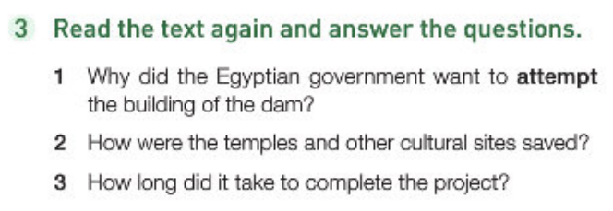
Post-reading
P5
To control floods, produce electricity, supply water to more farmers in the area. (Para. 2, Sentence 2)
Taken down piece by and piece, and then moved put back together again. (Para. 4, Sentence 2)
Almost 20 years. (Para. 4, last but one sentence)

Slide 20
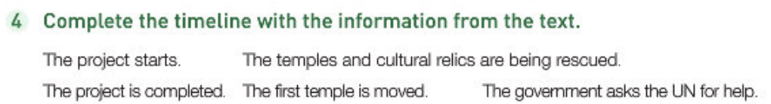
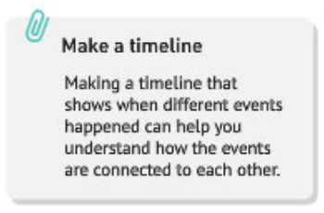
P5
1959
1960
1961
1961-1980
1980
ask for UN for help
start
1st temple removed
temples and relics rescued
completed

Slide 21
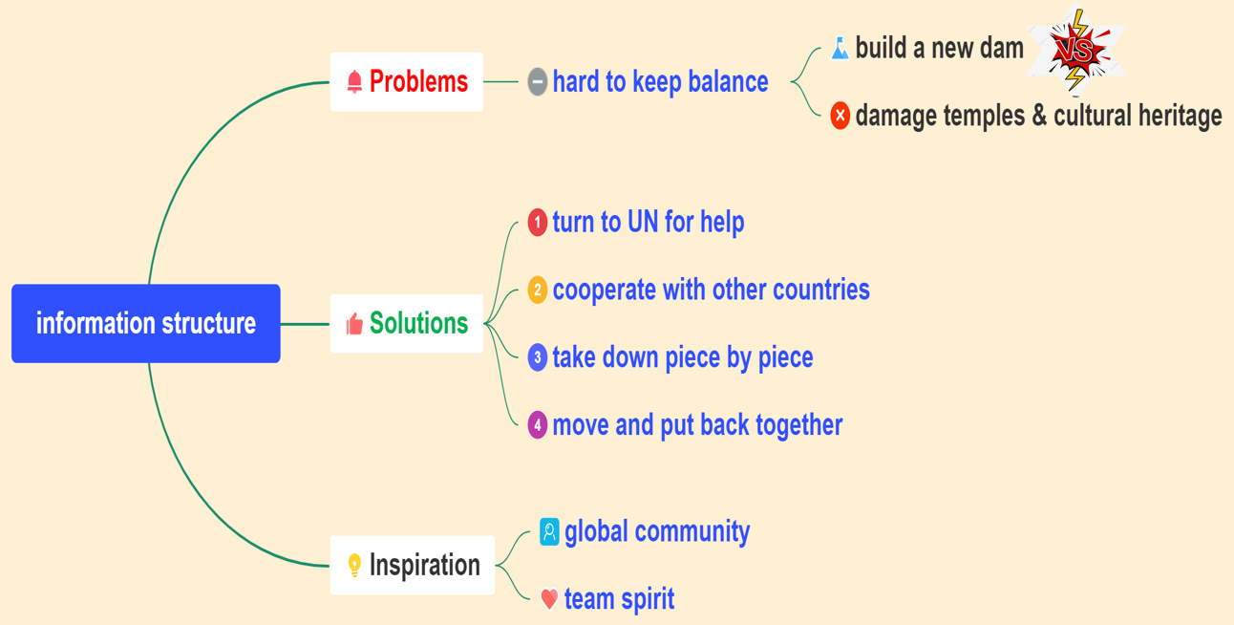
Discuss in groups.
Divide the passage into three parts.
Draw a mind map of the text.
Problems
Solutions
Inspiration

Slide 22

DEBATE
A lot of money was spent on protecting cultural heritage in China. Do you think it worthwhile or not?
It is worthwhile to protect cultural heritage.
It is not worthwhile to protect cultural heritage.

Slide 23

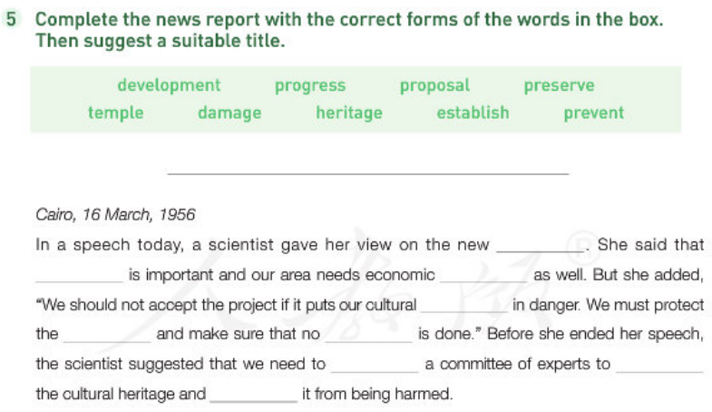
P5
(1)

Slide 24
(2)
Based on the debate, write an argument to show your view.
Include:
a topic sentence
at least three supporting details
a conclusion

