Slide 1


感恩遇见，相互成就，本课件资料仅供您个人参考、教学使用，严禁自行在网络传播，违者依知识产权法追究法律责任。
更多教学资源请关注
公众号：溯恩高中英语
知识产权声明

Slide 2

高中英语应用文写作系列
建议信
Rainbow
高中 英语

Slide 3

高中英语应用文写作系列
建议信
Why do we write advice letters?
Advice is a recommendation, guidance, an opinion, a suggestion or the wise words. One can ask for advice to anyone whom he/she thinks fit to offer guidance. Now the burden is on the adviser that what kind of recommendation he gives to the other. When your friend, your classmate, your cousin or your colleague asks you for personal or professional advice, it is your duty to be sincere and helpful.
高中 英语

Slide 4

高中英语应用文写作系列
建议信
How to Write an Advice Letter
Opening remarks
Paragraph 1 - thanks for letter/express understanding of the problem(s)
advice
Paragraph 2 - suggestion(s) + reason(s)
Closing remarks
Keep channels open for further consultation should the person require more help
高中 英语

Slide 5

高中英语应用文写作系列
建议信
How to Write an Advice Letter
Opening remarks:
- Thank you for your letter requesting …
- Thank you for writing me this letter. I'm sorry after hearing about your problem. Maybe I can give you some advice and things will get better soon.
- I am writing in reply to your letter asking for advice about…
- I was sorry to hear about your problem. Here's what I think you should do.
高中 英语

Slide 6


高中英语应用文写作系列
建议信
How to Write an Advice Letter
Advice
I strongly recommend that ...
If I were you I would ...
I would suggest that ...
Why don’t you ...
It would be a good idea to ...
The best advice I can give you is ...
What you should do is ...
高中 英语

Slide 7

高中英语应用文写作系列
建议信
How to Write an Apology Letter
Closing remarks
I hope this will be of help to you.
All in all I sincerely hope my advice can help you and brighten up your day. Please count on me whenever you encounter any obstacles in the future.
Hope my advice works. Write to me again if you have further problems.
Whatever route you take, I hope you will be able to work things out. You will always have my support.
高中 英语

Slide 8
高中英语应用文写作系列
建议信sample
Dear Mike,
Your recent letter describing your unpleasant work environment sounds as though you are experiencing a lot of frustration. I certainly understand your disappointment in not receiving a salary increase for the past two years, especially since your performance evaluations indicate that your work is better than satisfactory.
You asked advice about accepting a better-paying position with a rival company, but expressed reluctance about leaving a place where you have many friends. I can understand your dilemma. However, if the rival company is a local firm, you could consider changing jobs and still stay in touch with your friends. Those friendships could continue while you make new friends in a new work place. I think you need to take a long-range view and do what will give you the greatest professional advantage.
I am glad always to hear from you so please keep in touch and let me know what you decide.
高中 英语

Slide 9
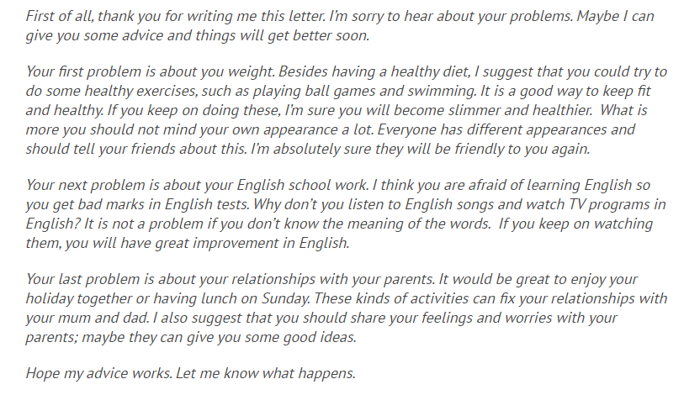
高中英语应用文写作系列
建议信sample
高中 英语

Slide 10

高中英语应用文写作系列
建议信
I am honored that you would ask for my advice regarding which college you should attend. I can only tell you about my experience attending State University in Springfield.
I had a very good experience there; the computer science department is the best in the state and the classes are small and personal. Compared with many other colleges, the cost of tuition is low. The social life at State is fun but not rowdy. If you are planning to study computer science, I think it would be a good choice. If you plan to study something else, I am not the best person to give advice.
Of course, there are many personal factors you must consider, but State University was certainly a good choice for me. I wish you the best of luck and have every confidence that you will make the right decision for you. Please contact me again if I can be of further assistance.
高中 英语

Slide 11
高中英语应用文写作系列
建议信
2017年北京高考卷作文
你的英国好友Jim所在学校组织学生来中国旅游，有两条线路可以选择：”长江之旅“和”泰山之行“。Jim来信希望你能够给她一些建议。请给她回信，内容：
1.你建议线路
2.你的理由
3.你的祝愿
高中 英语

Slide 12
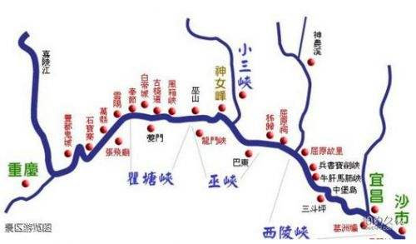
高中英语应用文写作系列
建议信
审题
书信体中的建议信：用跟建议有关的语言；
朋友之间的回信：不用太过正式的语言；
二选一：最后应该有一个你的推荐路线；
理由：你的推荐角度应基于Jim的兴趣爱好或者中国人推荐外国游客旅行线路的角度；
结尾：祝中国之行愉快，旅途愉快，或者相信这会是一段难忘的旅程等。
高中 英语

Slide 13
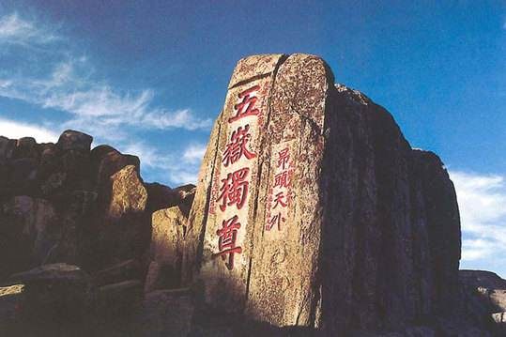
高中英语应用文写作系列
建议信
回信特征
I’m glad to receive your letter.
In your last letter, you mentioned your hesitation about your travel route choice between … and …
写信目的
Knowing in your last letter that you are coming to China soon, I’m more than delighted.
You told me in your last letter that you are at a loss about which travel route to take while in China. Here is my advice.
高中 英语

Slide 14
高中英语应用文写作系列
建议信
二选一
有些学生直接说：
I’m writing to offer you some advice about your travel route. If I were you, I would definitely choose the tour along the Yangtze River/the trip to Mount Tai.
个人感觉：
语言上没有什么毛病，但是从实际交际来看，如果对方让你二选一，你说当然选某个，你的潜台词是不是：这样简单的选择都要问，你傻啊？
高中 英语

Slide 15
高中英语应用文写作系列
建议信
二选一
所以比较能让对方接受的说法是：两个都很好，的确都很值得一游。这样的情况要二选一，你的犹豫是有道理的。我完全明白。
I can fully understand your hesitation. Both of the trips are highly recommended.
Both of the two scenic spots are well worth visiting.
It’s really a hard decision to make.
高中 英语

Slide 16
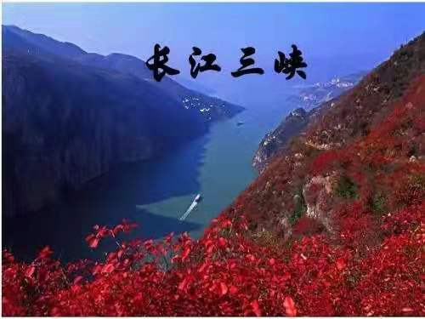
高中英语应用文写作系列
建议信
考虑一下Jim这个人的兴趣爱好
完全是你说了算
Since you are fond of relaxing travel,
I think the tour along the Yangtze River will be more suitable for you. Besides, you are always curious about the lives of the local people in China, and now you will have the golden opportunity to explore and experience while travelling along the River.
Travel Route A
The trip to the Yangtze River
高中 英语

Slide 17
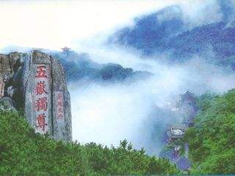
高中英语应用文写作系列
建议信
考虑一下Jim这个人的兴趣爱好
这个完全是你说了算，哈哈~~~
Since you are a keen lover of mountain climbing, I think climbing Mount Tai will give you an entirely different experience. Even better, enjoying a fantastic sunrise at the top of the mountain is bound to be a cherished memory in your lifetime.
Travel Route B
The trip to Mount Tai
高中 英语

Slide 18
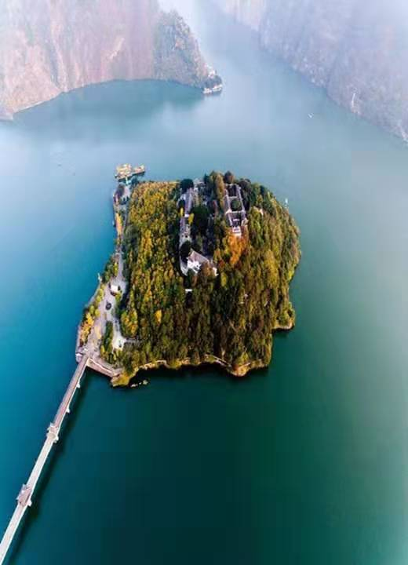
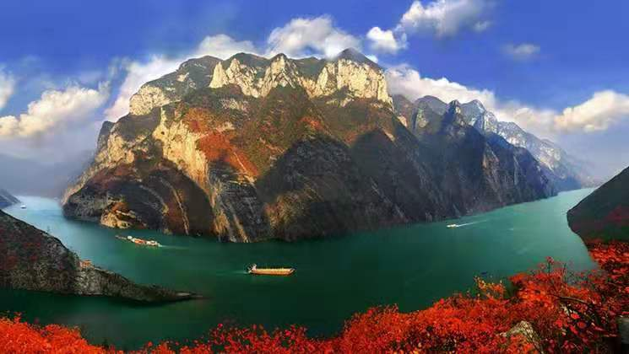
高中英语应用文写作系列
建议信
Some other reasons for your recommendation
You will be greeted with a fantastic view along the tour: lofty mountains, winding rivers, clean waters and unique landscape on the banks.
It will be a feast for your eyes.
Admiring the sunset on a luxurious cruise ship will surely be an unforgettable experience.
By the way, you will have a chance to taste the mouth-watering local flavor, which is totally different from that in your hometown.
高中 英语

Slide 19
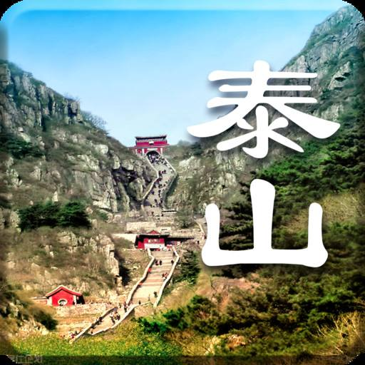
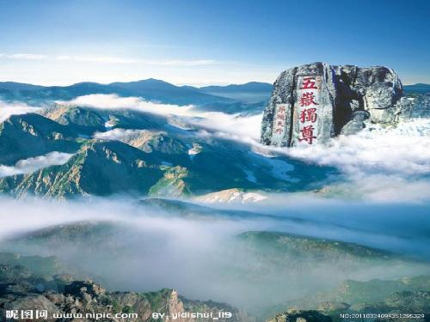
高中英语应用文写作系列
建议信
Some other reasons for your recommendation
It is no exaggeration to say that he who doesn’t reach the top of Mount Tai is not a true climber.
It’s no easy task to get to the top of the mountain, but when you eventually get there, you will find all your efforts worthwhile.
Overlooking the city beneath or surrounded by the fairy-tale-like cloud sea, you will undoubtedly feel rewarded.
Not only can you admire the most famous mountain in China, you can also visit the birthplace of Confucius, the first teacher in the world.
高中 英语

Slide 20
高中英语应用文写作系列
建议信
Best wishes
Hope you will have a good time in China.
Positive prediction
I guarantee you will have an enjoyable and unforgettable trip in China.
高中 英语

Slide 21
高中英语应用文写作系列
建议信
Dear Jim,
I`m so glad to know that you are coming to China.
You told me you are at a loss about your travel route. Of the two trips to the Yangtze River and Mount Tai, both are highly recommended. Taking your interest into consideration, I think the tour along the Yangtze River is the better choice. As the longest river and one of the mother rivers of Chinese civilization, the Yangtze will present you with amazing scenery with many well-known sightseeing spots, which will definitely be a feast for your eyes. Time permitting, you can also experience the lives of the local people along the river.
I guarantee you will have an enjoyable and unforgettable trip in China.
Yours,
Li Hua
高中 英语

Slide 22
高中英语应用文写作系列
建议信
Dear Jim,
I`m so glad to know that you are coming to China.
As for the two trips to the Yangtze River and Mount Tai, it’s really a hard decision to make, because both of the two places are well worth visiting, especially for people who come to China for the first time like you.
Since you are a keen lover of mountain climbing, I think climbing Mount Tai will give you an entirely different experience. Even better, enjoying a fantastic sunrise at the top of the mountain is bound to be a cherished memory in your lifetime. Time permitting, you can also visit the birthplace of Confucius, the first teacher in the world, which is about one and a half hour’s ride from Mount Tai.
I guarantee you will have an enjoyable and unforgettable trip in China.
Yours,
Li Hua
高中 英语

