Slide 1


感恩遇见，相互成就，本课件资料仅供您个人参考、教学使用，严禁自行在网络传播，违者依知识产权法追究法律责任。
更多教学资源请关注
公众号：溯恩高中英语
知识产权声明

Slide 2
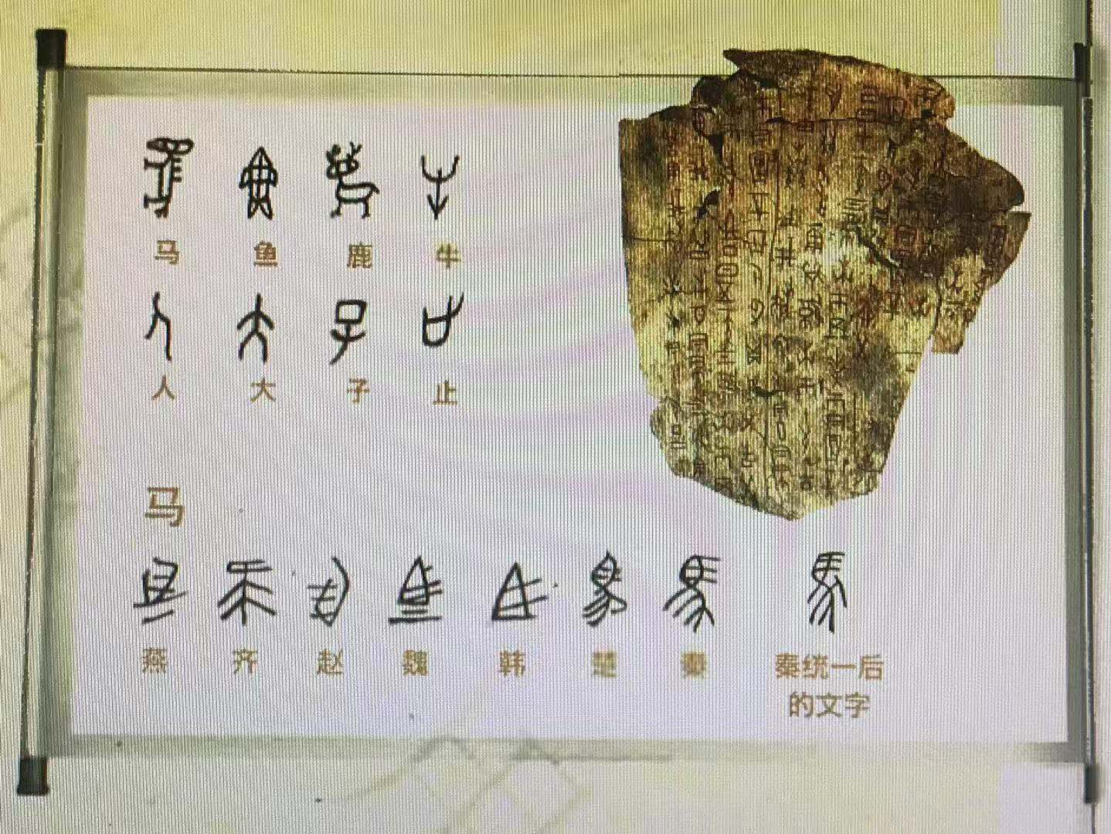
Welcome！
上虞区城南中学 陶江英

Slide 3
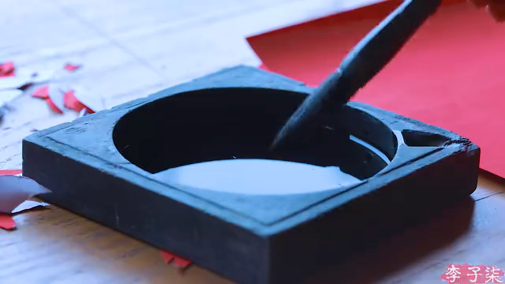


Lead in: free talk
Watch the video and think about what Li Ziqi is doing?
write spring couplets
Chinese traditions to celebrate the Spring Festival
do paper-cutting
Paste New Year pictures
hang lanterns
A(n)Big hit/ Internet celebrity
How much do you know about her?
Videos about Chinese culture
Make a great contribution to spreading Chinese culture
Billions of fans abroad
Spread Chinese culture

Slide 4
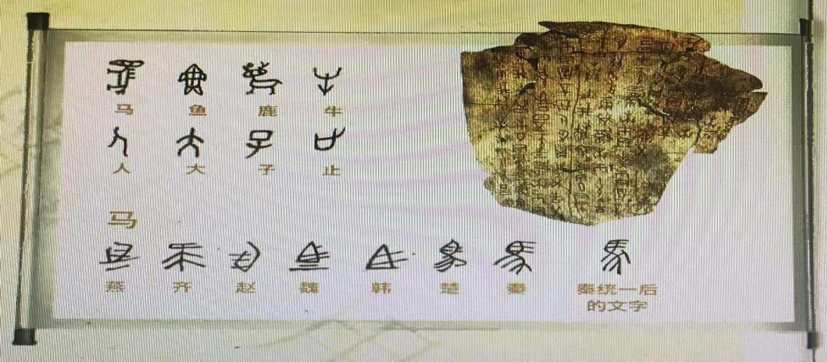
Task1 Prediction
Look at the title and picture below. Predict what the text will be about.
Topic
THE CHINESE WRITING SYSTEM:
CONNECTING THE PAST AND THE PRESENT
Focus

Slide 5
Task2 Skimming
Divide the text into TWO parts and find the main idea of each part.
Part1(Para.1)
Topic
The Chinese Writing System
Development &
Importance
Part3(Para.2-6)
What’s the writing style?
A.Narration(叙述文) B.Description(描述文) C.Exposition (说明文)

Slide 6
Task3 Scanning
Part1 Topic
①China is widely known for its ancient civilisation which has
continued all the way through into modern times, despite the many ups and downs in its history. There are many reasons why this has been possible, but one of the main factors has been the Chinese writing system.
ancient civilisation
passed down/survived
Why can Chinese ancient civilisation pass down?

Slide 7
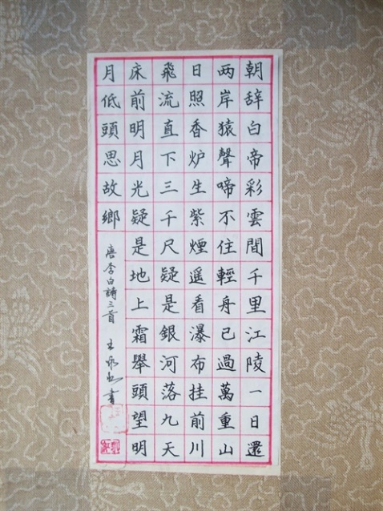
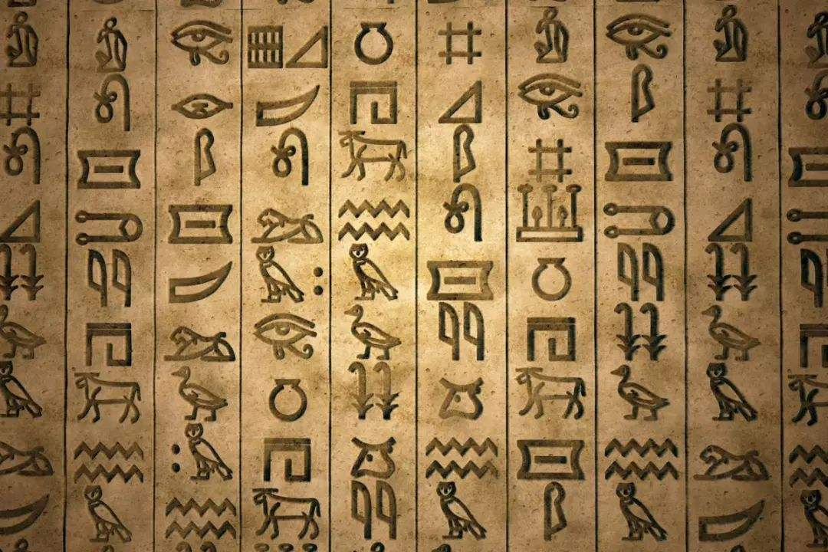
Task3 Scanning
Development
How did the Chinese writing system develop?

Slide 8


Task3 Scanning
Development
Scan
Scanning is looking at the text quickly to find specific information, such as dates or numbers.
At the beginning
picture-based
jiaguwen
Several thousand years ago
By the Shang Dynasty
Over the years
well-developed
different forms
The Qin Dynasty
one direction
Today
part of Chinese culture
Connect the past and the present

Slide 9
Task3 Scanning
Importance
How did written Chinese unify Chinese people divided by geography and dialects?
④Emperor Qinshihuang united the seven major states into one unified country where the Chinese writing system began to develop in one direction. That wrting system was of great importance in uniting the Chinese people and culture. Even today, no matter where Chinese people live or what dialect they speak, they can all still communicate in writing.
Connect people divided by geography

Slide 10
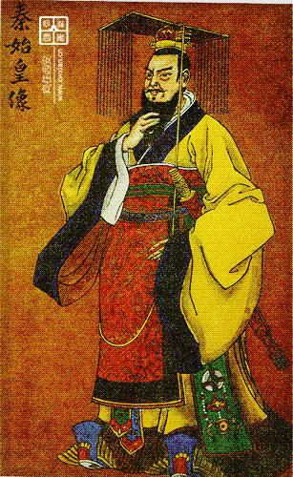
Further-thinking
1
Do you like Emperor Qinshihuang? Why?
founded the unified country
established the unified system
imposed severe punishment
Try to make comments from different perspectives.

Slide 11
Task3 Scanning
Importance
How does written Chinese connect Chinese people today with those of the past?
⑤Written Chinese has also become an important means by which China's present is connected with it's past. People in modern times can read the classic works which were written by Chinese in ancient times. The high regard for the Chinese writing system can be seen in the development of Chinese characters as an art form, known as Chinese calligraphy, which has become an important part of Chinese culture.
Connect language and art

Slide 12
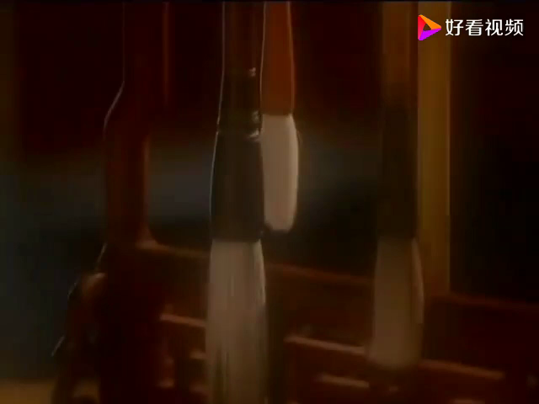

Further-thinking
With the development of new technology, some people think there is no need to learn calligraphy. Do you agree? Why？
2
a long history
a beautiful art form
part of China's culture/civilisation
show the character the “man behind the brush”
a way to relax/develop patience
…

Slide 13
Task3 Scanning
Importance
Why do more and more international students begin to learn Chinese?
⑥Today, the Chinese writing system is till an important part of Chinese culuture. As China plays a great role in global affairs, an increasing number of international students are beginning to appreciate China's culture and history through this amazing language.
Connect China and the world

Slide 14
Summary
topic
THE CHINESE WRITING SYSTEM:
CONNECTING THE PAST AND THE PRESENT
Connecting____________________________
people divided geographically
focuses
Connecting ___________________________
language and art
Connecting ___________________________
China and the world
The structure of an exposition (说明文)

Slide 15


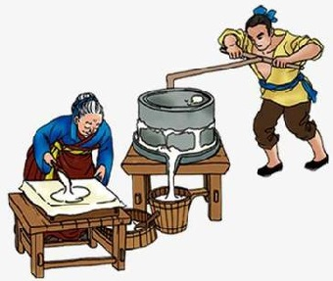
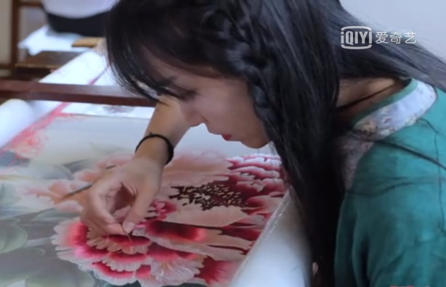
Task4 Discussion
The Chinese writing system is one factor that has helped the Chinese culture survive. What do you think are some of other factors?
Chinese painting
Beijing opera
Beijing duck
china
Hot Pot
tea
architecture
Traditional arts
Traditional food
wine
dumpling
…
mooncake
soya-bean milk
Shu embroidery
…
paper-cutting
01
Chinese people’s contributions

Slide 16

Task4 Discussion
As a Chinese teenager, what will you do to help to spread Chinese culture?
Possible answer:
Improve Chinese and English
Hold a positive attitude to...
Learn traditional arts if possible
Know about stories/legends about Chinese festivals
Introduce Chinese culture to foreigners if possible
…

Slide 17
HOMEWORK
Read the text again and recite the expressions you like.
Finish writing the following speech after class.
你校将举行一次主题为“传承中华文明，传播中国文化”的英语演讲比赛，请你写一篇演讲稿，内容包括：
如何传承（欣赏、学习）；
如何传播（介绍、交流）；
注意：
词数80左右；
可适当增加细节，以使行文连贯。

Slide 18
Thank You！

Slide 19
One possible version
Dear friends,
I’m really proud to share my opinions about Chinese culture. As Chinese teenagers, we should attempt to appreciate Chinese culture and have a good knowledge of it. Surely, it’s better to learn some traditional arts, like calligraphy.
Nowadays, China plays an increasingly vital role in global affairs. Therefore, it’s a good idea to introduce Chinese language, arts, foods and the stories behind to foreigners if possible. So we’d better learn both Chinese and English well to make the communication smoothly. Actually it’s our responsibility to connect China to the world more closely.
Thanks for your listening!
01

