Slide 1


感恩遇见，相互成就，本课件资料仅供您个人参考、教学使用，严禁自行在网络传播，违者依知识产权法追究法律责任。
更多教学资源请关注
公众号：溯恩高中英语
知识产权声明

Slide 2
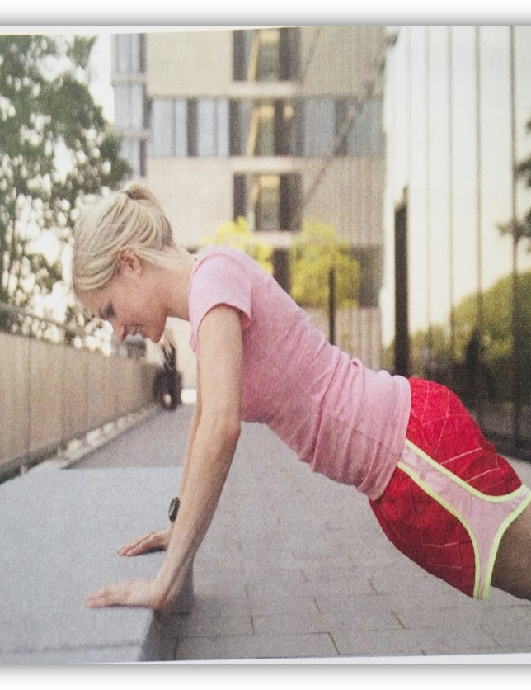
Going positive
Reading for writing
She looks fit,
energetic and…
She has suffered from some fitness problems.
The story of solving fitness problems.
Kayla

Slide 3
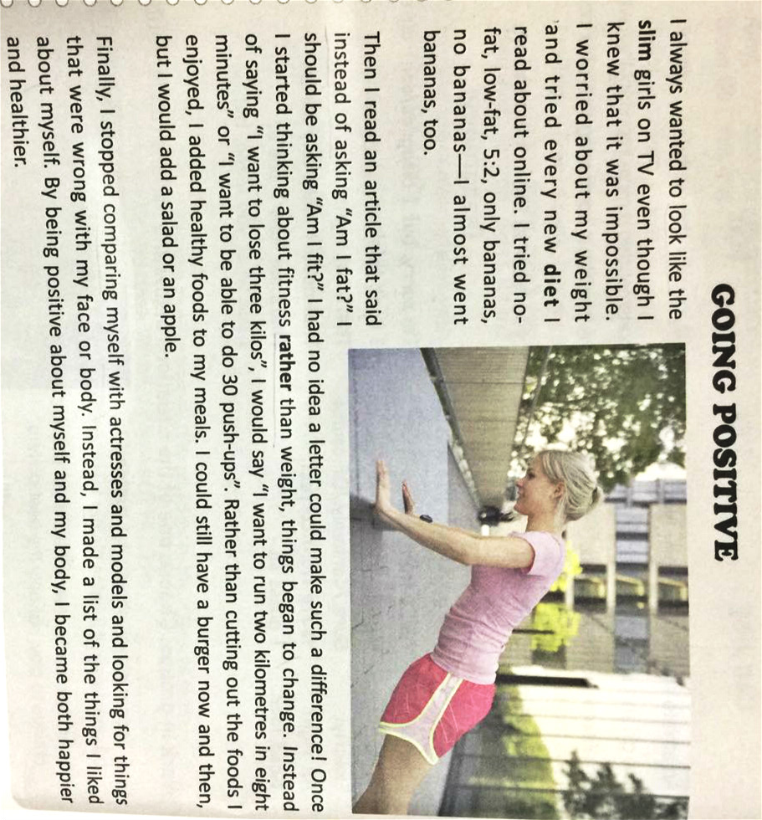
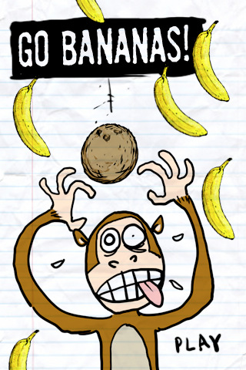

What problem did Kayla have in the past?
She was worried about her weight and appearance.
Lose one’s mind
Go crazy
What is Kayla’s tone of telling her problems?
A. humorous B. serious C. formal D. casual
I tried no fat, low-fat, 5：2, only bananas, no bananas – I almost went bananas, too.

Slide 4
What made her change her mind?
Her problems in the past
A turning point
Changes at present
The results

Slide 5
What are the differences between the past and the present?
The past
Contrast & Comparison
The present
Changes in thinking ways
my
weight
fitness
worried about ______
and tried __________.
think about _______
________________.
every new diet
rather than weight
lose
run
Push-ups
wanted to ____three kilos
_____the foods I enjoyed
want to ___or do 30_____
cut out
Changes in actions
add
____healthy foods to my meals
compared
__________myself with
actresses and models.
_________________
_________________.
made a list of things I liked about myself
Changes in life:
She became both happier and healthier

Slide 6
What expressions does Kayla use to describe the changes?

Slide 7
the language of contrast and comparison
Expressions to show similarities | Expressions to show differences:
more expressions to show similarities and differences
Instead of …;…make a difference;
…rather than …;
but..
…stopped comparing …with…
Instead,
I always… look like…
still; both… and…
be similar to…; the same as…;
have …in common with;
though/although/ yet/however;
in contrast with(与…对比之下);
on the other hand;
different from…; the difference is…

Slide 8
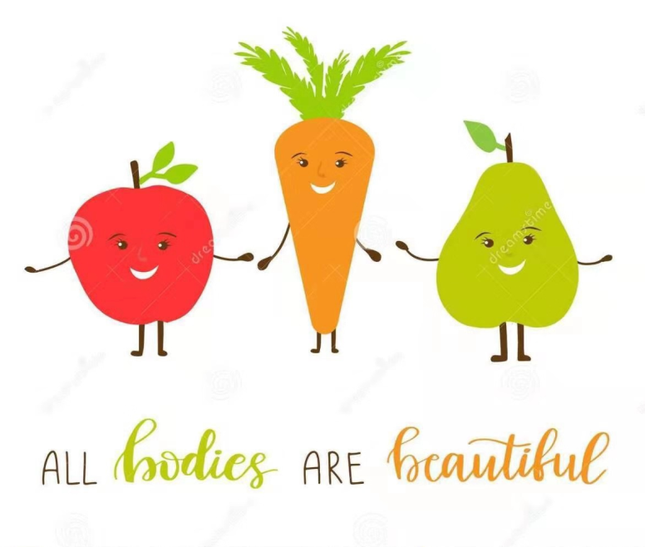


What do you think are the most important changes for her to be more positive and why?

Slide 9
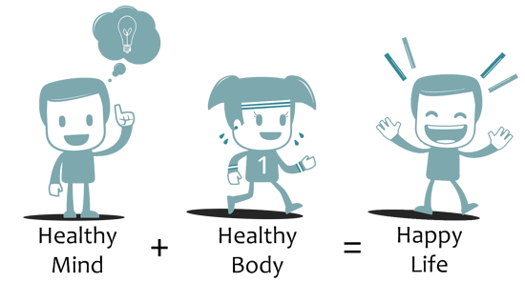
wellness

Slide 10

Where can we read Kayla’s story?
A wellness book
A high school class has a wellness book
in which they exchange ideas about health and fitness.

Slide 11
Write a page in a wellness book.

Slide 12
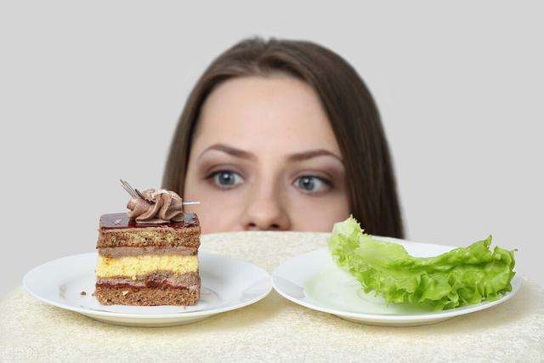
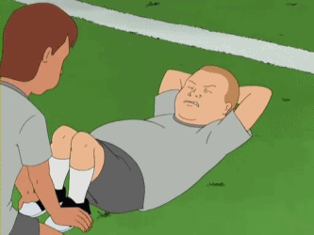
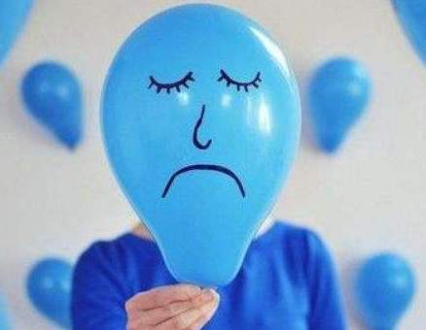
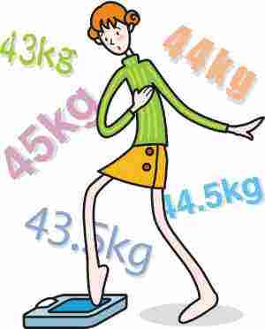
What health problems do you have?
Food:
Exercise:
No breakfast; always on diet;
lack of exercise;
hate sports;
can’t stick to doing exercises;
too picky about food; not have a balanced diet
too much junk food; Obesity(肥胖症)
Stress:
Self-confidence:
feel depressed(沮丧的)
can’t deal with stress;
can’t sleep well because of anxiety;
Can’t balance study and life
not confident about the figure(身形), the look, and even myself

Slide 13
Discussion
What changes will you make to solve it?
Food:
How can you make your meals healthier?
Exercise:
What can you do to make exercise more enjoyable and consistent 持续的?
Stress:
How do you manage your stress and balance your study and life?
Self-confidence:
What can you do to become more confident and feel better about yourself?

Slide 14
writing
Write a paragraph about changes you want to make to lead a more positive lifestyle, using an appropriate tone. ( 50-70 words)
Structure : your situation 1-2 sentences changes to make 3-4 sentences the outcome to achieve 1-2 sentences | First Draft _______________________________________ _______________________________________ _______________________________________ _______________________________________ _______________________________________ _____________________________________
Word Banks Instead, …; instead of; rather than; but/however/though; still

Slide 15
Exchange the drafts
Checklist for the editor
Does the writer use a good structure? (introduction, body, conclusion)
Does the writer use the language from the word bank?
Does the writer make any spelling mistakes?
Does the writer make any grammar errors?
Assignment for the writer
Improve your first draft taking into account the corrections and comments made by your peer.
Write a second draft with improvement.

Slide 16
One Possible Version
I always felt anxious and stressful at senior high school at first because I was afraid of being left behind. I was worried about so many things that I couldn’t sleep well and focus on my study.
Then, I read a book called “Who Moved Your Cheese” which made me realize that making changes can make a difference to life. Instead of just worrying about my study, I would make a schedule for my study and finish the to-do list. Rather than being anxious the whole day, I would do some exercises regularly and listen to music to relieve my stress and tiredness after studying, which also helped me feel more energetic.
Now, I stopped feeling upset about something new. Instead, I would also always remind myself to smile as often as possible and stay positive about everything that is going to happen.

Slide 17
Examples of Students’ Writing

Slide 18
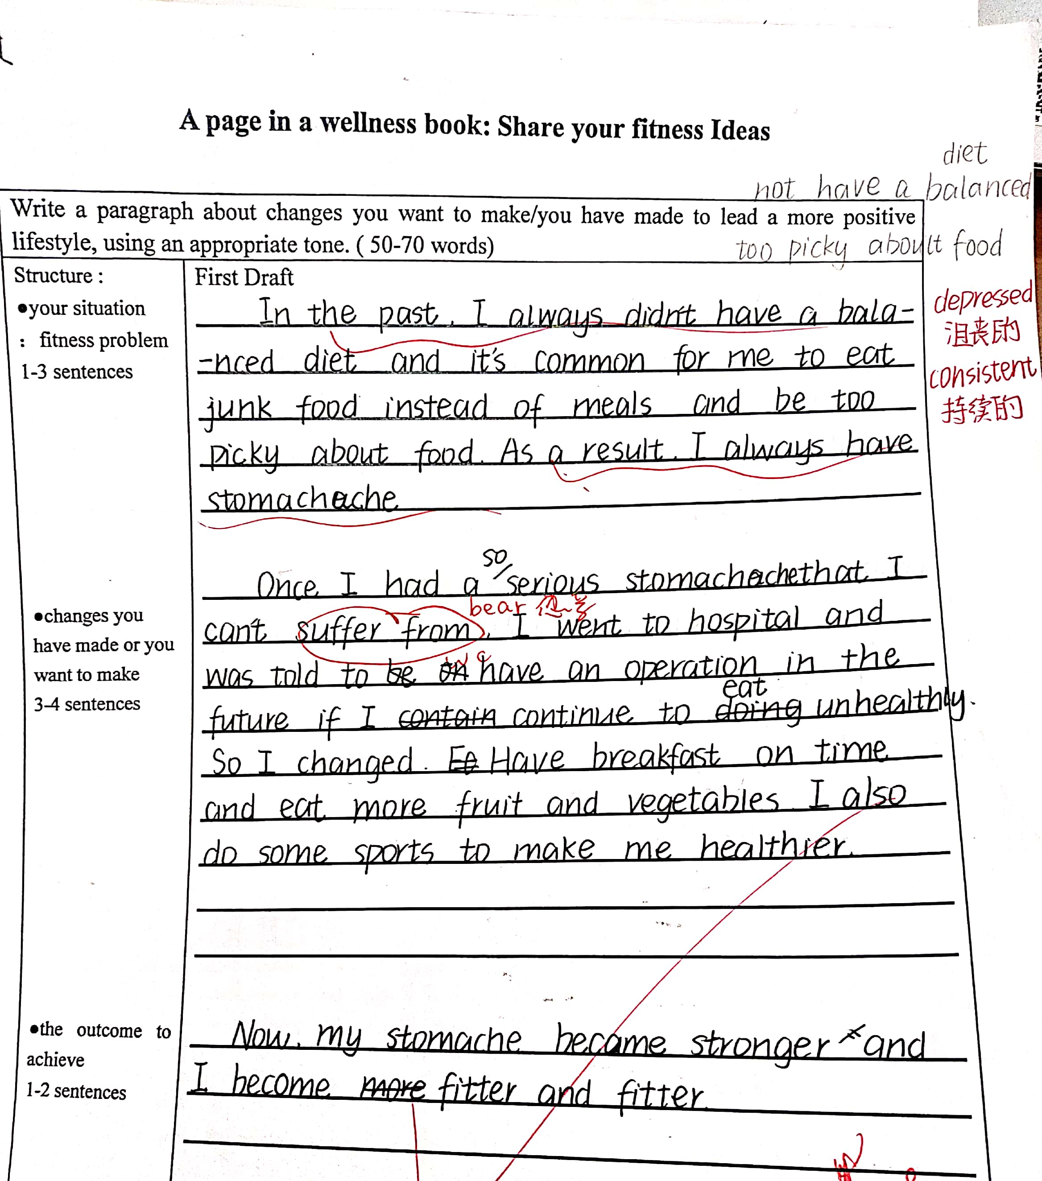
The problem in the past
Turning Point+ Changes at present
The result of changes

Slide 19
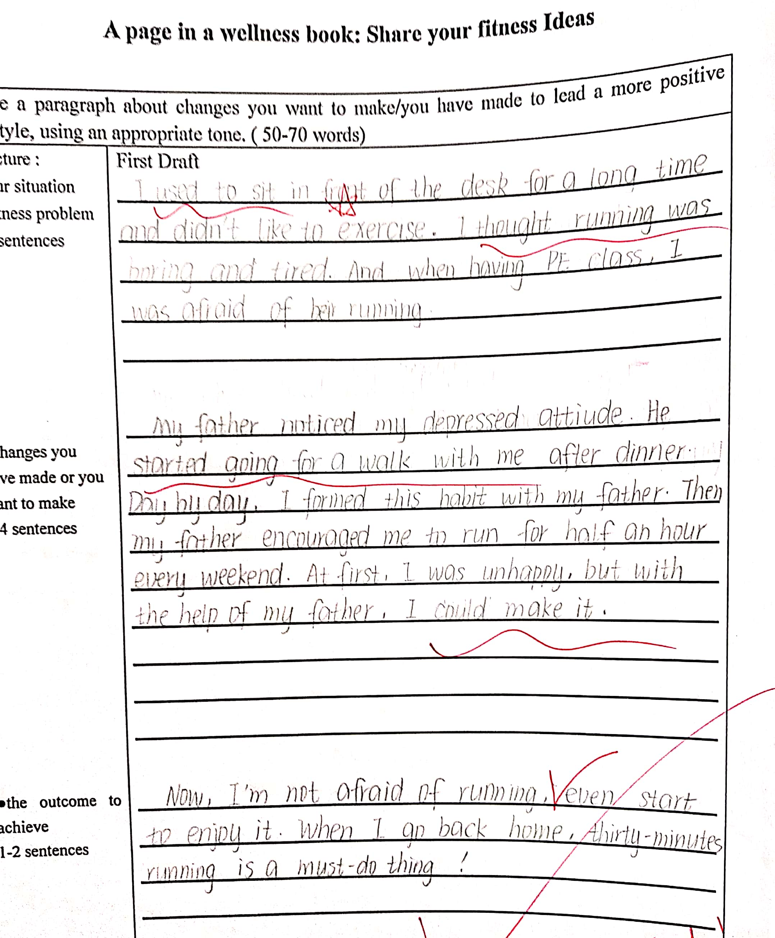
The problems about sports
Changes at present
The outcome of changes

Slide 20
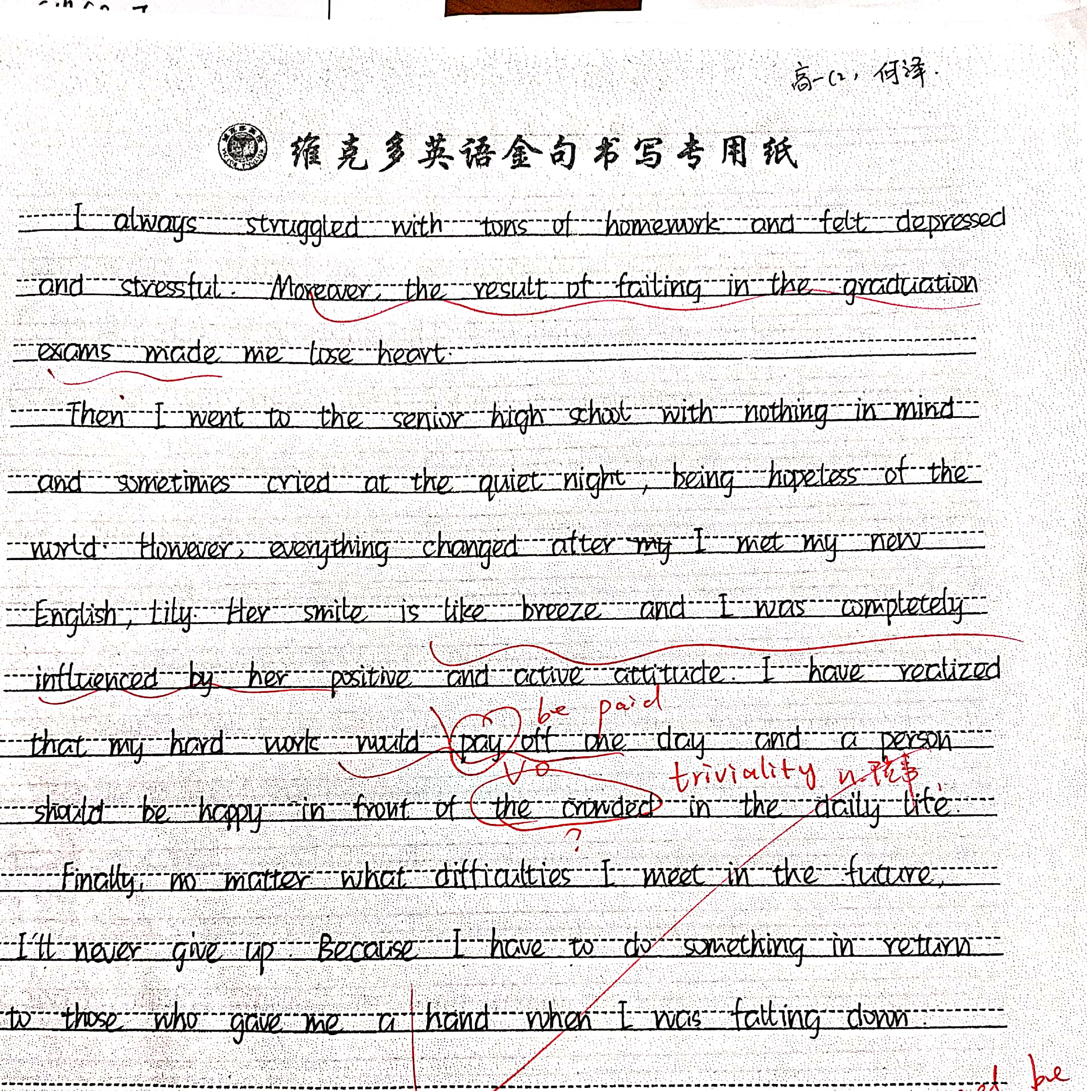
The Problems about stress in the past
Turning Point and changes
The results of changes

Slide 21

Be Positive,
think positive,
and positive things will happen!

