Slide 1


感恩遇见，相互成就，本课件资料仅供您个人参考、教学使用，严禁自行在网络传播，违者依知识产权法追究法律责任。
更多教学资源请关注
公众号：溯恩高中英语
知识产权声明

Slide 2
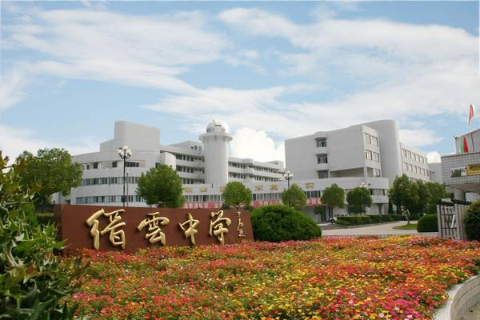
Welcome to Doreen’s class.

Slide 3
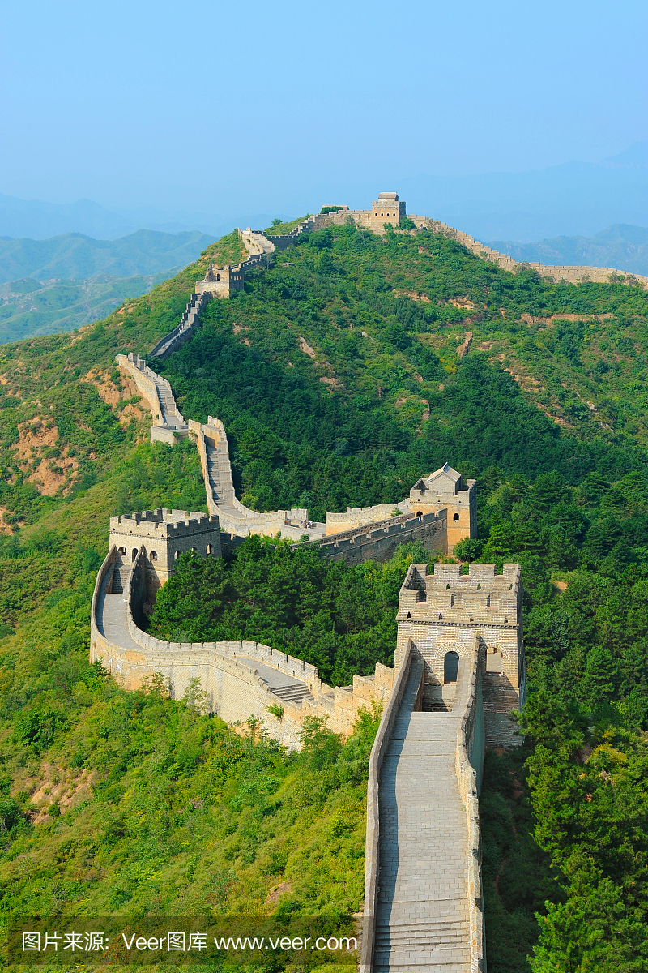
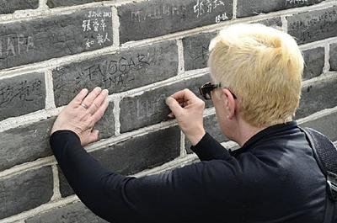
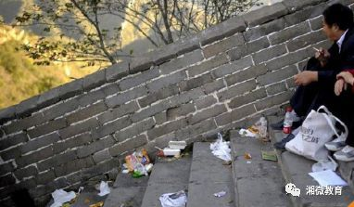
treasure of history
leave marks on
destroy
drop litter everywhere

Slide 4


Be a Good Tourist
Tourism can be both good and bad. Yes, it brings in money for the local economy and creates jobs for locals, but it may also bring some problems.
bring money
create job
broaden horizons
relax tourists
... ...
problems
Tip: Signal words like “however, but ”are always followed by important information.

Slide 5
problems
examples
Why?
suggestions
destroy tourist sites
used paint, rocks, to leave ugly marks
kindness and love
lack of
public spirit
to prove presence
One growing problem is tourists who want to prove that they have visited a destination. Tourists have used paint, rocks, or even keys to write on the Luxor Temple in Egypt,the Colosseum in Rome, Stonehenge in the UK, memorial stones at the bottom of Qomolangma, and many, many other places. Thousands of tourist sites are being destroyed by tourists who “love them to death.”I have three words for people like this: please stop it. If you want to leave a mark on the world, do it by changing someone's life with kindness and love. Pass kindness along to future generations, not destruction.
One growing problem is tourists who want to prove that they have visited a destination. Tourists have used paint, rocks, or even keys to write on the Luxor Temple in Egypt,the Colosseum in Rome, Stonehenge in the UK, memorial stones at the bottom of Qomolangma, and many, many other places. Thousands of tourist sites are being destroyed by tourists who “love them to death.”I have three words for people like this: please stop it. If you want to leave a mark on the world, do it by changing someone's life with kindness and love. Pass kindness along to future generations, not destruction.

Slide 6
problems
examples
Why?
suggestions
destroy tourist sites
used paint, rocks, to leave ugly marks
lack of
public spirit
kindness and love
disturb the locals
wander around
take pictures of
selfishness
consideration
party late
Another big problem in some places has been tourists disturbing the local people and life. Some tourists wander around and take pictures of local people without asking for their permission. For example, Chiang Mai University in Thailand and......Another example is ......Some tourists love to party there late into the night, making it difficult for locals to sleep.I have three words for tourists like this: please be considerate. Have fun in a way that does not disturb others.
Another big problem
I have three words for tourists like this:

Slide 7
problems
examples
Why?
suggestions
verbs
destroy tourist sites
used paint, rocks, to leave ugly marks
lack of
public spirit
kindness and love
wander around
take pictures of
party later
disturb the locals
selfishness
consideration
affect public order
walk in large groups
ignorance of rules
rule awareness
cause traffic problems
cross roads randomly
Facts speak louder than words.
The number of problems from tourists is endless.

Slide 8
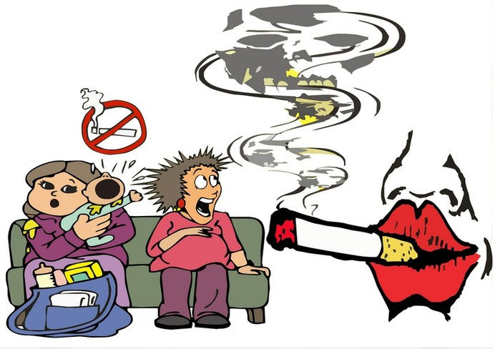
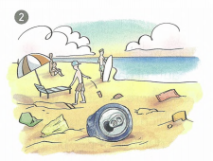
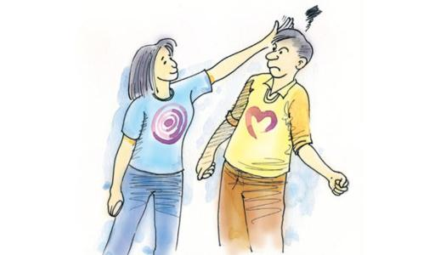
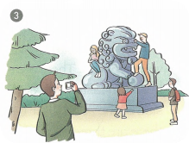
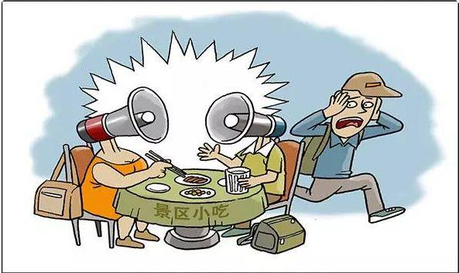
Discussion
Problems?
Examples?
（verb.）
Bad effects?
Suggestions?

Slide 9
terrible tourists
the best, kindest, most polite tourists
good tourists
problems
examples
suggestions
used paint, rocks, to leave ugly marks
lack of public spirit
destroy tourist sites
kindness and love
You
are not
one
!
wander around
take pictures of
party later
bad behaviours
disturb the locals
selfishness
consideration
affect public order
walk in large groups
ignorance of rules
rule awareness
cause traffic problems
cross roads randomly
... ...
... ...
... ...
The only way to solve the problem of the terrible tourist is to make sure that you are not one!
What does the writer say is the only way to solve the problem of the terrible tourist ?
local department
the whole society
government

Slide 10
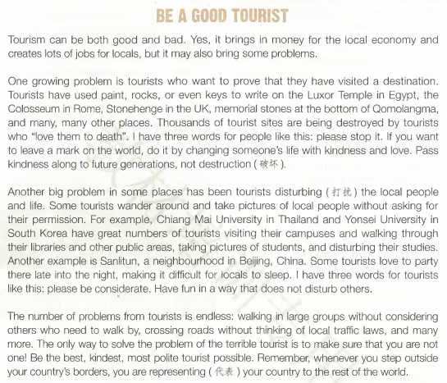
Test type :
A. Narration（记叙文）
B. Editorial （社评文）
C. Exposition （说明文）
Structure:
Purpose:
To call on readers to be good tourists.
topic
destroy
tourist sites
two specific problems
disturb
the locals
conclusion

Slide 11
Assignment：writing
随着旅游业的发展，不文明旅游现象变得越来越严重。假定你是学生会主席李华， 请你代表学生会写一封英文倡议信，向全体师生发出文明旅游的倡议。
1. 列举不文明旅游现象；
2. 分析不文明旅游造成的后果；
3. 发出几点倡议；
注意：1.词数80左右
2.演讲稿开头与结尾已经给出，且不计入总词数。
Dear teachers and students,
Part 1:The serious phenomenon.
Part 2:The bad effects.
Part 3:The appeal.
The Students' Union

Slide 12
One possible version
Dear teachers and students,
On behalf of the Students'Union, I'd like to appeal for your active involvement in being a good tourist.
Though tourism brings many benefits, it also causes some problems. For example, to prove their presence, some tourists destroy the tourist sites by using paint, rocks to leave ugly marks on. Worse still, some tourists wander around randomly and even party later, thus disturbing the locals.
It’s high time that we should be the best, kindest, most polite tourists. Let's join our hands and take action immediately.
The Students'Union

Slide 13
Thanks!
Notes:
本PPT模板部分元素使用了幻灯片母版制作。如果需要修改，点击-视图-幻灯片母版-修改；完成后关闭编辑母版即可。

