Slide 1


感恩遇见，相互成就，本课件资料仅供您个人参考、教学使用，严禁自行在网络传播，违者依知识产权法追究法律责任。
更多教学资源请关注
公众号：溯恩高中英语
知识产权声明

Slide 2
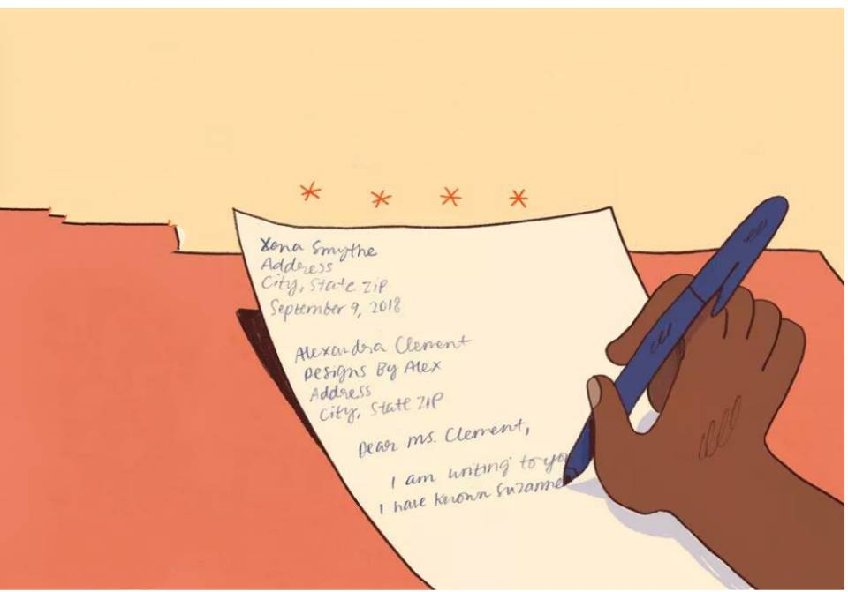
How to improve practical writing?

Slide 3
Homework-checking
假如你是李华，你班交换生Amy这两天因身体不适，未能到校上课，请给她写一封邮件，要点如下：
1. 表示安慰；2.询问她是否能参加下周六学校举行的足球比赛；3.邀请她下个月到你家共度端午节。
注意：1.词数80左右； 2.可适当增加细节，以使行文连贯。
type: a letter of inquiry and invitation;
content: 3 given points;
tense：simple present and future tense;
person: the 1st person; the 2nd person

Slide 4
Dear Army,
Knowing that you couldn't go to school because of your healthy problem, I'm writing to express my sincerely concerning to you.
Having healthy problem is an ordinary thing, so you shouldn't worry about it a lot. Moreover, the soccer ball games which you expect most will be hold in school next Saturday. I wonder if you can join it in this situation. Oltimately, the Dragon Boat Festival will coming! I sincerely invite you to celebrate it with me if you have free time. Hope that you can accept my invitation.
Looking forward to your early reply. Best wishes for you!
Dear Amy,
Knowing that you couldn't go to school because of your health problem, I'm writing to express my sincere concern to you.
The soccer game which you expect most will be held in our school next Saturday. I wonder if you can join in it in this situation. Ultimately, the Dragon Boat Festival is coming! I sincerely invite you to celebrate it with me if you have free time. Hope that you can accept my invitation.
Looking forward to your early reply. Best wishes for you!
Yours,
Li Hua
higher marks?
health problem
sincere
concern
the soccer
game
will be held in our school
join in it
Ultimately
is coming
....

Slide 5
Requirements
1.本题总分为15分，按5个档次给分。
2.评分时，先根据文章内容和语言初步确定其所属档次，然后以该档次的要求来衡量，确定或调整档次，最后给分。
3.词数少于60和多于100的，从总分中减去2分。
4.应注意的主要内容为：内容要点，应用词汇和语法结构的丰富性和准确性以及上下文的连贯性。
5.拼写与标点符号是语言准确性的一个方面，应视其对交际的影响程度予以考虑。英，美拼写及词汇用法均可接受。
6.若书写较差，以至影响交际，将分数降低一个档次。

Slide 6
Criteria
档 次 | 描 述
第五档 (13-15) | 完全完成了试题规定的任务。 —覆盖所有内容要点。 —应用了较多的语法结构和词汇。 —语法结构或词汇方面有些许错误，但为尽力使用较复杂结构或较高级词汇所致；具备较强的语言运用能力。 —有效地使用了语句间的连接成分，使全文结构紧凑。完全达到了预期的写作目的。
第四档 (10-12) | 完全完成了试题规定的任务。 —虽漏掉1、2个次重点，但覆盖所有主要内容。 —应用的语法结构和词汇能满足任务的要求。 —语法结构或词汇方面应用基本准确，些许错误主要是因尝试较复杂语法结构或词汇所致。 —应用简单的语句间连接成分，使全文结构紧凑。达到了预期的写作目的。
language:
correct
varied
authentic
content:
complete
specific
structure:
smooth

Slide 7
Common problems
How?
Dear Amy,
Knowing that you couldn't go to school because of your health problem, I'm writing to express my sincere concern to you.
The soccer game which you expect most will be held in our school next saturday. I wonder if you can join in it in this situation. Ultimately, the Dragon Boat Festival is coming! I sincerely invite you to celebrate it with me if you have free time. Hope that you can accept my invitation.
Looking forward to your early reply. Best wishes for you!
语言：
语言枯燥乏味
language:
varied
authentic
content:
complete
specific
structure:
smooth
内容：
1)形式化问候与祝愿
2)语气不得体
结构：
1)简单罗列要点
2)上下语意不连贯
Yours，
Li Hua

Slide 8
Beginning: 1. 表示安慰
Knowing that you couldn't go to school because of your health problem, I'm writing to express my sincere concern to you.
Knowing that you are absent from school because of illness, I am writing to express my deep care/sincere concern for you.
表达“安慰”的常用句型：
Knowing ..., I feel terribly sorry about that.
I’m very sorry to hear that....
I regret to hear that....
I'm much grieved to hear that....
I'm shocked to hear of....
I can't tell you how sorry/sad I felt when I heard that...
I am writing to express my deep sympathy/care for you.
(1) Use authentic expressions to communicate properly
① Knowing that you are absent from school because of illness, I feel terribly sorry about it.
② I'm so sorry to hear that you suddenly fell ill. Hopefully, you'll soon be all right.

Slide 9
Practice
1. 现在，我们很难放下手机专注于学习或工作。
Nowadays, it is difficult for us to put down our smartphone and pay attention to our study and work.
2. 在仪式上，我们对父母为我们所做的一切表达了谢意。
During the ceremony, we say thanks to our parents for what they have done for us.
Nowadays, it is a challenge / challenging/ tough for us to put down our smartphone and focus on/ devote ourself to study and work.
During the ceremony, we conveyed/expressed our appreciation / gratefulness to our parents for what they have done for us.
3.沉溺于手机会对我们的健康，尤其是眼睛造成伤害。
Being addicted to smartphones is harmful to our health, especially to our eyes.
Being addicted to smartphones is of great harm to / does harm to our health, especially to our eyes.
Notes:
词汇反映你知识贮存量的多少，也是衡量英语水平的一个重要标志。从评分标准可知，运用高级的词汇对提高书面表达的分数至关重要。大家先来看下面这些句子：

Slide 10
Body: 2.询问她是否能参加下周六学校举行的足球比赛；
The soccer games which you expect most will be held in our school next saturday. I wonder if you can join in it in this situation.
considering your condition
(2) Use varied structures to state clearly and smoothly
As scheduled, the football match which you expect most will take place/be held next Saturday. Considering your condition, I wonder if you can participate in/take part in it by then.

Slide 11
Practice
非谓语动词
二. 使用非谓语动词使句子简洁高档
1) I am deeply interested in traditional Chinese art and have received a good education in art. I have a good knowledge of Chinese paintings.
Deeply interested in traditional Chinese art and having received a
good education in art, I have a good knowledge of Chinese paintings.
倒装句
2) I can not only explain to the visitors the beauty of the paintings, but also tell the stories behind them.
Not only can I explain to the visitors the beauty of the paintings, but also tell the stories behind them.

Slide 12
名词性从句
3) I am quite satisfied that I have a good command of English, so I have
no difficulty communicating with others.
What satisfies me most is that my good command of English makes me have no difficulty communicating with others.
with 结构
4) As the Dragon Boat Festival was approaching, my family decided to hold a party to celebrate it.
With Teachers' Day approaching, my family decided to hold a party to celebrate it.
强调句/虚拟语气....

Slide 13
3.邀请她下个月到你家共度端午节。
coherence
Ultimately, the Dragon Boat Festival is coming! I sincerely invite you to celebrate it with me if you have free time. Hope that you can accept my invitation.
if you are available
Hopefully
(3) Use proper conjunctives to state logically
By the way, the traditional Dragon Boat Festival is coming next month. I sincerely invite you to celebrate it with me if you are available. Hopefully, you can accept my invitation.
By the way, ... is approaching/around the corner next month. My family and I are all expecting your coming to enjoy the authentic festive atmosphere with us. I sincerely hope you can accept my invitation/join us.

Slide 14
Common conjunctives
表比较 | like; similarly; on the contrary; equally important; compared with; in contrast...
表转折 | yet; while; nevertheless; whereas; although; despite the fact that; on the other hand; even so; instead; unlike; unfortunately…
表因果 | therefore; as a result/consequence; consequently; hence; accordingly; thanks to; due to; owing to; since; considering that…
表递进 | what’s more; what’s worse; worse still; moreover; furthermore; not only… but also...; additionally; in addition; apart from...
表次序 | at first; in the first place; first of all; to begin with; above all; then; next; first and foremost; afterwards; the most important of all; eventually; meanwhile; at the same time;
表总结 | in short/brief/conclusion/summary; to sum up; on the whole; in a word; in general; generally speaking...
表例证 | for example/instance; take…as an /for example; such as; especially...
副词 | hopefully; sadly; fortunately; unfortunately; surprisingly…

Slide 15
Fill in the blanks, using proper conjunctives.
1 ________________the Spring Festival is around the corner, I'm writing to invite you to spend it with my family _____________ __________ you can know more about it.
2. The whole family get together to enjoy delicious food, _____________ chicken, fish, dumplings to celebrate it, during which we visit our relatives and friends __________.
3. Nowadays/Currently, most students in our school read little English literature, ________________because they consider it too difficult, _______________ because they think it not necessary.
Since/As
in order that/
so that
such as
as well
not only
but (also)

Slide 16
Fill in the blanks, using proper linking words.
The reasons for my application are as follows.____________________ ____________, having been exposed to foreign teachers since a young age, I can communicate freely with others in English. _______________
____________________________________________________, years of being monitor makes me a brilliant organizer, which will help a lot to keep the exhibition in order. __________________________________ _________，my related knowledge will undoubtedly help the audience learn more about the unique Chinese art form. ___________________
________, my sense of responsibility will make me a qualified volunteer.
I'd appreciate it if you could take my application into consideration.
First and foremost/
First of all
Additionally/
What's more/In addition/ Furthermore/Moreover
The most important factor is that/
Above all
All in all/ In short/
In a word

Slide 17
Ending：表达祝愿
complete
specific
Looking forward to your early reply. Best wishes for you!
(4) Send specific wishes
May you recover soon. We are looking forward to your coming back.
Wish you speedy recovery. Don't hesitate to tell me if you could come.
I hope that by the time this letter reaches you, you will be feeling much better.

Slide 18
An improved-version
Dear Amy,
I am so sorry to learn that you suddenly fell ill. Hopefully you'll soon be all right.
As scheduled, our football match will take place next Saturday. I would greatly appreciate it if you could take part in it by then. By the way, our traditional Dragon Boat Festival is coming next month. My family and I are all expecting your coming to enjoy the authentic festive atmosphere with us.
Wish you speedy recovery. Don't hesitate to tell me if you could come.
Yours, Li Hua

Slide 19
Summary
How?
(1) Use authentic expressions to communicate properly
(2) Use varied structures to state clearly and smoothly
(3) Use proper conjunctives to state logically
language: varied/authentic
content: complete/specific
structure: smooth

Slide 20
Homework
假定你是李华，你校来自爱尔兰的外教Peter因病回国休假。请给他写一封电子邮件，内容包括:
1.询问近况；
2.分享班级最新消息；
3.表达祝愿。
注意:1.词数80左右；
2.可适当增加细节，以使行文连贯。

Slide 21

13-14分
Dear Peter,
We’ve been missing you badly since you had gone back to Ireland for health reasons. I’m writing on behalf of the whole class to extend our concern to you.
So have you got better now? The class atmosphere is much less active without your humor, but we do study hard and write an essay every other week as you hoped. Also, Mary and I had won the first prize in the school speech contest with your guidance through phone calls. Many thanks for that!
May you recover soon. We are looking forward to attending you class again!
Yours,
Li Hua
表达思念
语气委婉
目的明确
询问近况分享消息
围绕外教
表达感谢
衷心祝愿

Slide 22
Thank you!

