Slide 1


感恩遇见，相互成就，本课件资料仅供您个人参考、教学使用，严禁自行在网络传播，违者依知识产权法追究法律责任。
更多教学资源请关注
公众号：溯恩高中英语
知识产权声明

Slide 2
高中英语应用文写作
---感谢信(2)
letters of thanks
杭州二中 许丽君

Slide 3
Objectives
To know about the format and contents of thank-you letters;
To write appropriate thank-you letters, especially
pay attention to the tone and language.
To recognize what a good thank-you letter is like.

Slide 4
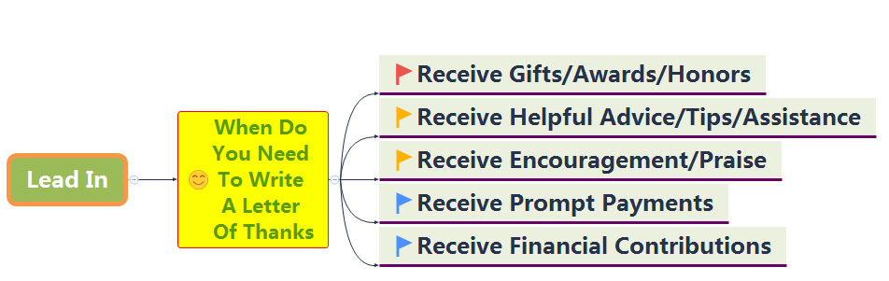

Slide 5
Write Thank-you Letters for
appreciation/congratulations/recognition
favors/kindness/assistance/special help/advice
gifts: business/personal
job interviews
expressions of sympathy
hospitality: business/ personal
contributions: memorials/charities
employee suggestions/outstanding efforts/ jobs done well

Slide 6
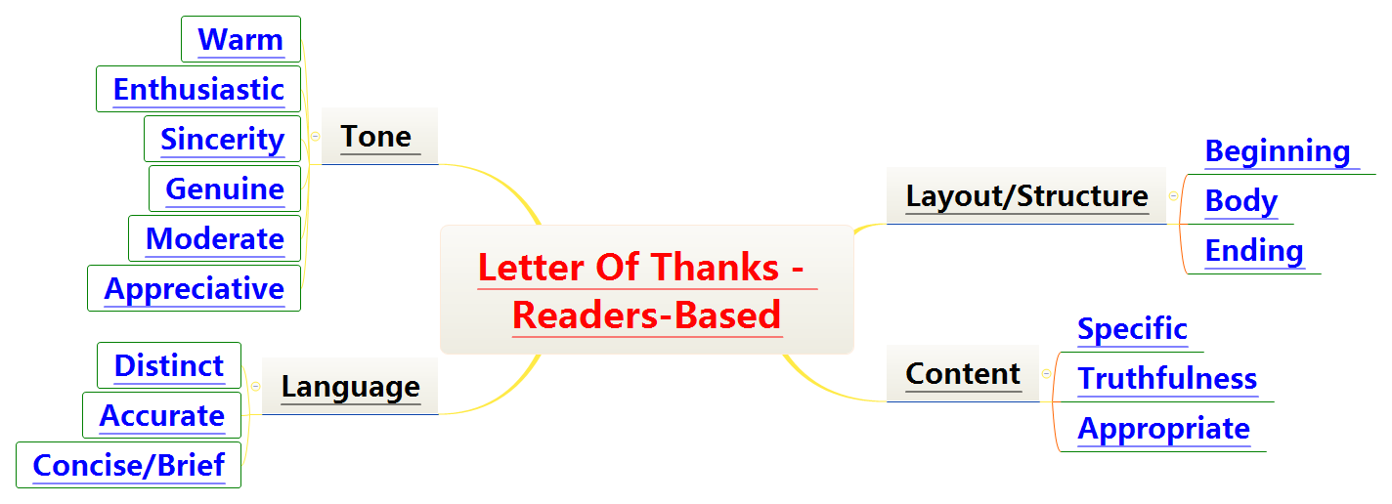

Slide 7
Format
What should be included in a letter of thanks?
Dear Sir,
Beginning ---purpose Why are you writing the letter?
Body---giving examples of assistance or guidance that you received --- describing about your personal experiences, your feelings, etc What do you thank him/her for?
Ending ---About the thankfulness and your wishes to reward
Yours faithfully
***

Slide 8
Layout
Letters of thanks
Readers-based
Part 1: Purpose of writing the letter
01
03
02
Part 2: Body Arrangements
Part 3: Ending
延迟符

Slide 9
Writing preparations
Part 1: Purpose of writing the letter
开头：表示开心，表达问候，对写信提供援助的事件主题进行点题并表达谢意。
1. I’m extremely grateful/thankful to you for your unselfish assistance during...
2. I’m writing to convey/express my gratitude for your kind/generous help during...
3. I’d like to take this opportunity to express my great appreciation for your timely help, patient guidance and positive support.

Slide 10
Writing preparations
Part 2: Body Arrangements
正文：向对方给予帮助的事件及达到的作用和效果进行有层次的描述和赞扬。
Your warmth has made our brief stay here pleasant and memorable.（make + sth. +adj. 结构）
We were deeply impressed by sth. /Sth. impressed us so much.（被动语态和主动语态的简单句）
What impressed us most was sth. （主语从句）
What impressed us most was that+句子（主语从句、表语从句）
It impressed us that +句子（主语从句）
句子，which impressed us a lot.（非限制性定语从句）

Slide 11
Part 3: Ending
结尾：表明再次的感谢及期待对方回信，并表达祝愿。
1. I will be more than pleased if I have the opportunity to repay your kindness by...
2. My true gratitude/ appreciation is beyond any words/ description.
3. Do call on me if I can ever return the favor.
4. We appreciate your taking the time to write us.

Slide 12
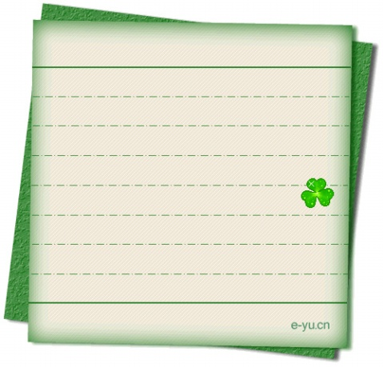
Useful words and expressions
appreciate
charming
cherished
classic
delighted
elegant
fascinated
favorite
flattered
grateful
generosity
gracious（亲切的，和蔼的） （magnificent）
hospitable
impressed
luxurious
memorable
overjoyed
over-whelmed

Slide 13
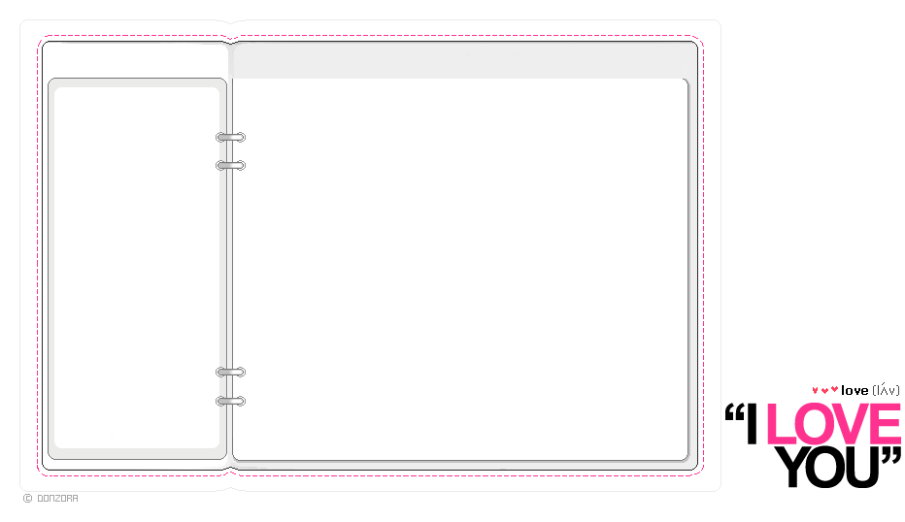

Writing help: Useful phrases
I will never forget
meant a great deal to me
more than a kind
one of the most memorable days of my trip
one of your usual inspired ideas
Please accept my gratitude/ our sincere appreciation
profoundly touched by
quite out of the ordinary
really appreciate your help
thoroughly enjoyed myself
we want you to know how much we value
What a joy it was to receive

Slide 14
Writing help: sentences
Thank you for your generous donation to…
Thank you so much for agreeing to speak to our study club.
I don’t know how I would have managed without your help.
Your support and patient guidance is greatly appreciated.
I sincerely appreciate your time and attention.
I’d like to express my appreciation for the knowledgeable and sympathetic care you gave me during my…

Slide 15
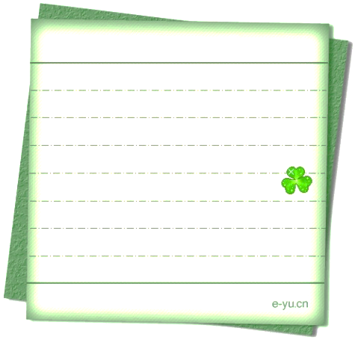
感谢信模板2
________________________________
Yours,
Li Hua
Dear______,
Many thanks for _______. I’m writing to you about my gratitude for ______.（开门见山交代感谢原因）
Without your help, _________(从反面衬托对方的作用). It’s very considerate of you to ________（从正面说明对方的作用）. I expect to have the opportunity to express my gratitude to your kindness and generosity. I feel it greatly honored and pleased if ________（提出回报对方的方式）. Would you please let me know? （希望对方给予回应）
Thank you again for what you have done. （再次表达感谢）
Writing
Yours Sincerely / Faithfully/ Truly,
________________

Slide 16
Assessment
Work in groups of four. Each member read the article and others comment on your classmate’s work. Then choose the best one out to show in the class. When discussing, you should pay attention to the following hints.
Purpose | Have you made the purpose of writing clear and evident?
Layout | Does the layout conform to the requirements?
Language | Are the sentences correct? Have you used the proper punctuation, words, sentence and paragraphs to express yourself?
Content | Have you included all the points of views? Are the details suitable?
tone | Have you shown your politeness and sincerity all through the writing?

Slide 17
Writing 3(美国朋友生日聚会感谢信）
假设你是李华，昨天参加了美国朋友David的生日聚会，请你给他写封信，表示感谢。要点如下：
简述生日聚会的盛况，表达对聚会的喜爱；
感谢他的热情款待；
对David的祝福。
注意：
1. 词数80左右；
2. 可以适当增加细节，以使行文连贯。

Slide 18
Format （美国朋友生日聚会感谢信）
Dear David,
Para 1: Writing purpose--show your gratitude
Para 2: Body: Detailed reasons and examples of your thanks (personal experiences and feelings about the party…)
Para 3: Ending: Express your appreciation again and show your expectation to reward.
Yours sincerely, Li Hua

Slide 19


Para 1 （美国朋友生日聚会感谢信）
Letters of Thanks
Para 1: Writing purpose--show your gratitude
I’d like to express/extend my grateful/hearty/authentic thanks/feeling to you.
2. Thank you for inviting me to your birthday party.

Slide 20
Para 2 （美国朋友生日聚会感谢信）
Letters of thanks
Para 2: Body Arrangements
Part 1: The warmth and hospitality of the host
01
03
02
Part 2: the feast and service that the host provided
Part 3: The impression and influence of the party

Slide 21
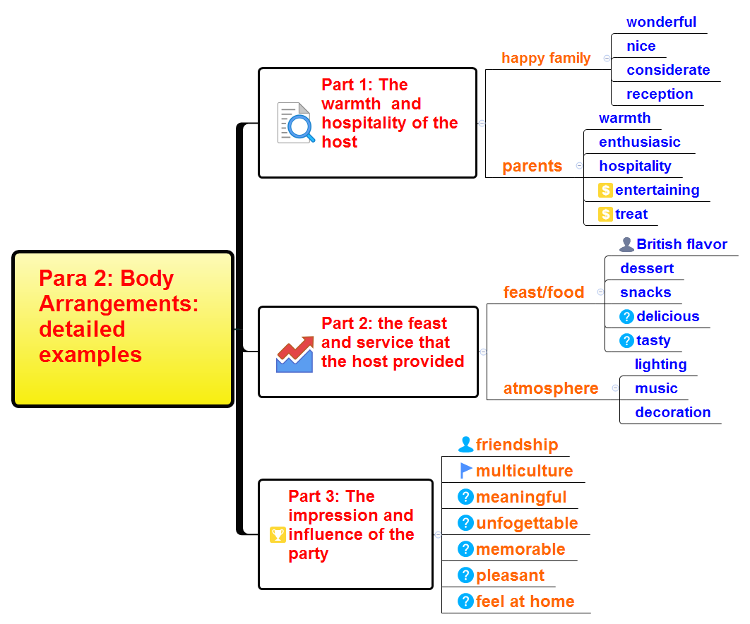
（美国朋友生日聚会感谢信）

Slide 22
Para 2 （美国朋友生日聚会感谢信）
Para 2: Body: Detailed reasons and examples of your thanks
(personal experiences and feelings about the party…)
Your warmth and kindness made my brief stay in your home pleasant and memorable.
It was so nice and considerate of you to have prepared us so many delicious British flavor.
What impressed me most was your parents warmth and hospitality.
Not only did the party you hosted enhance our friendship but also bridge us with multiculture.
5. What a meaningful and unforgettable feast I had!

Slide 23
Para 3 （美国朋友生日聚会感谢信）
Para 3: Ending: Express your appreciation again and show your expectation to reward.
1. Thanks again for your dinner and wish you all the best!
2. Please accept my sincere thanks again for... Wish you a healthy and happy life!
3. Your hospitality really means a lot to me. Good luck and stay well!
4. Words fail to express my deepest gratitude .Best wishes to you!

Slide 24


（美国朋友生日聚会感谢信） Writing Sample
Writing purpose--show your gratitude
Dear David,
I’d like to express my sincere gratitude to you. Thanks for inviting me to your birthday celebration last night, which brought me quantities of entertainment.
During the party, what impressed me most was your happy family. Both your parents deeply love you and showed their hospitality to all of us. I really appreciated it because it made me feel at home. And the dessert and other snacks you offered were tasty. Additionally, the light music and candle light created a nice and warm atmosphere where I was able to open my heart to your other friends like brothers and sisters.
Thanks again for your dinner. I’m in the expectation that you’ll be as joyful as last night forever, which will redmind me of the unforgettable experience that I have.
Yours ever,
Li Hua
Body: detailed examples of personal experiences and feelings about the party
The ending: about your gratitude and your expectation to reward

Slide 25
Homework
1. Write down your improved sentences .
2. Write another thanks letter.
如果你是红星中学高三(1)班学生李华，请根据下列内容在校刊上发表一封感谢信，表达你对因病耽误上学而得到老师和同学们帮助的感谢。
1. 上周你因发烧在家休息三天；
2. 休息时老师、同学打电话、发短信问候你；
3. 回校后同学借笔记给你，老师利用休息时间给你补课；
4. 对老师和同学表示感谢。

Slide 26
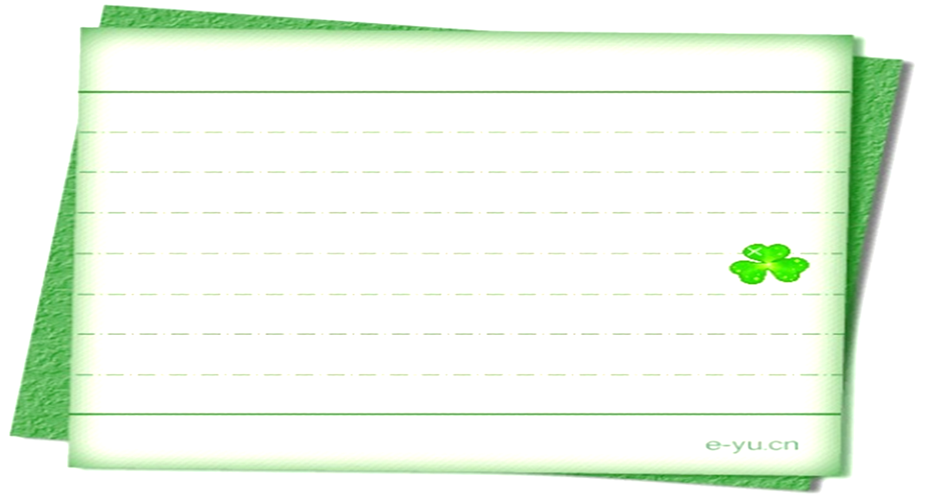

Writing Sample
I’m taking this opportunity to express my sincere thanks to teachers and classmates.
I had a fever and had to stay at home for three days last week, In the meanwhile, my teachers and classmates phoned or text messages to comfort me. My classmates offered me their notes and my teachers spent their spare time giving me lessons. With their unreserved help, I have made up what I missed out in class and did quite well in the monthly tests.
I’m so thankful to them for what they have done for me that my appreciation is far beyond the words I can express.
Yours,
Li Hua

Slide 27
THANK YOU

