Slide 1


感恩遇见，相互成就，本课件资料仅供您个人参考、教学使用，严禁自行在网络传播，违者依知识产权法追究法律责任。
更多教学资源请关注
公众号：溯恩高中英语
知识产权声明

Slide 2
2020学年第一学期
衢州五校期中联考
应用文讲评 —— 感谢信
浙江省常山一中
吴俊峰

Slide 3
1 提升写作高阶思维，有效交际4C原则

Slide 4
The thank-you letter
假定你是李华，是校学生会主席。上周日，你邀请了外教Mike来参加主题为“中西方文化交流”的英语角活动，请你给他写一封感谢信。要点包括：
1. 表达感谢：
2. 回顾Mike对活动的帮助；
3.表达祝愿。
注意：
1.词数80左右；
2.可适当增加细节，以使行文连贯。

Slide 5
How to write the genuine appreciation letter
假定你是李华，是校学生会主席。上周日，你邀请了外教Mike来参加主题为“中西方文化交流”的英语角活动，请你给他写一封感谢信。要点包括：
1. 表达感谢：2. 回顾Mike对活动的帮助；3.表达祝愿。
Format
Structure （3 paras）
Contents (4 key points)
Tone and language
An epistolary form requiring the complete form of the letter (title, body, conclusion, and closing)
① Background information of the letter (Thanks for Mike's attending
the English corner themed "Cultural Exchange between China and the West")
② Review Mike's help to the activity (Open-ended point)
③ Express wishes
1. Writing background information (Level 1 information); 2. Express gratitude;
3. Review Mike's help to the activity; 4. Express good wishes
The content should be true, and the appraisal be appropriate.
Speak in moderation and in narrative.

Slide 6
Information hierarchy
The first level of information directly affects the effectiveness of communication
信息层级性
第一层级信息直接影响交际的有效性
Information
Thanks for Mike's attending the English corner themed "Cultural Exchange between China and the West"
Level-1
Level-2
Express gratitude; Review Mike's help to the activity; Express good wishes
Level-3
Title, body, conclusion, and closing

Slide 7

4 “C” principles of practical writing
Character
Content
the status of identification
reasonable expansion of details
Causality
Completeness
make sentences logical
cover all the key points

Slide 8
Character-the status of identification
1. Who are you?
You're Li Hua, president of Students' Union.
2. What topic may you bring up when organizing English Corner themed "Cultural Exchange between China and the West"?
overcome the awkward cultural differences when learning Enlish
understand cultural differences in the mind is really important as the world globalizes
lack knowledge and skills to manage cultural differences that exist between China and the West
假定你是李华，是校学生会主席。上周日，你邀请了外教Mike来参加主题为“中西方文化交流”的英语角活动，请你给他写一封感谢信。要点包括：
1. 表达感谢；2. 回顾Mike对活动的帮助；3.表达祝愿。

Slide 9
Content - reasonable expansion of details
3. How did Mike help you as a foreign teacher?
appreciate literary works
intrduce diverse cultures
4. Why are you writing a letter to express your gratitude?
For Mike's passion and patience, professional attitude, profound knowledge and genuine concern.
假定你是李华，是校学生会主席。上周日，你邀请了外教Mike来参加主题为“中西方文化交流”的英语角活动，请你给他写一封感谢信。要点包括：
1. 表达感谢；2. 回顾Mike对活动的帮助；3.表达祝愿。

Slide 10
Causality- make sentences logical
messed up with cross-culture understanding obstacles
The whole
sentence
Part 1- Difficulties
Causes
Messed up with cross-culture understanding obstacles, we appreciated literary works and savoured authentic English under your guidance, embracing diverse cultures. With cross-cultural notions and visions exchanged, our knowledge scope was enriched and our friendship has been flourishing!
the English corner themed "Cultural Exchange between China and the West"
appreciate literary works and embrace diverse cultures, savour authentic English.
Part 2 - Helps
Effects

Slide 11
Causality- make sentences logical
The whole
sentence
Part 1- Difficulties
Causes
in desperate need of the guidance of western literature
As non-native English speakers, we are in desperate need of the guidance from someone like you with profound knowledge and deep insight into the English literature. The English Corner activity ended up well because of your constructive suggestions that stimulated our interest. It was your speech that delighted the atmosphere here, making the activity more fascinating.
the English corner themed "Cultural Exchange between China and the West"
your constructive suggestions stimulated our interest;
your speech delighted the atmosphere
Part 2 - Helps
Effects

Slide 12
Causality- make sentences logical
Bridging cultural understanding and mutual learning between the west and the east
The whole
sentence
Part 1- Helps
Causes
Bridging cultural understanding and mutual learning between the west and the east by your patienct guidance, we broadened our horizon and enhanced awareness of global citizen, learning more than fun from the academic atmosphere and colorful activities !
the English corner themed "Cultural Exchange between China and the West"
Part 2 - Improvement
Effects
broadening horizon, becoming a global citizen

Slide 13
Completeness-cover all the key points
How many key points? What are they?
写信目的
表达感谢
for your being part of our English Corner activity last Sunday, with the theme of "Cultural Exchange between China and the West"
1
2
I am writing to extend my sincere gratitude
回顾Mike对活动的帮助
3
4
表达祝愿
Attached the letter is an auspicious Chinese knot. May every moment full of joy!
Use causality to describe 1-2 difficulties and helps.

Slide 14
2 应用文高分作文，必作于细成于严

Slide 15
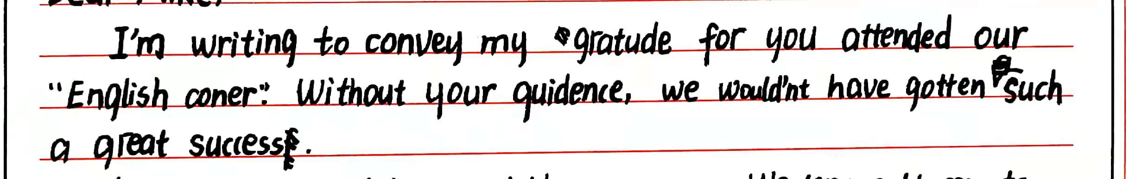
高分作文作于细：夯实基础，表意清楚，语法无误，句型正确
动词、介词错误 to you for attending
拼写错误 gratitude
拼写错误 Corner; guidance
词组错误, 汉式思维 made
评讲反馈
为了具备较强的语言运用能力，达成有效交际，我们要夯实基础，语言准确，写作时注意人称、数、时态等英语思维，避免汉式英语；能够准确使用大纲重点词汇和短语，做到表意清楚，语法无误，句型正确，地道自然。

Slide 16
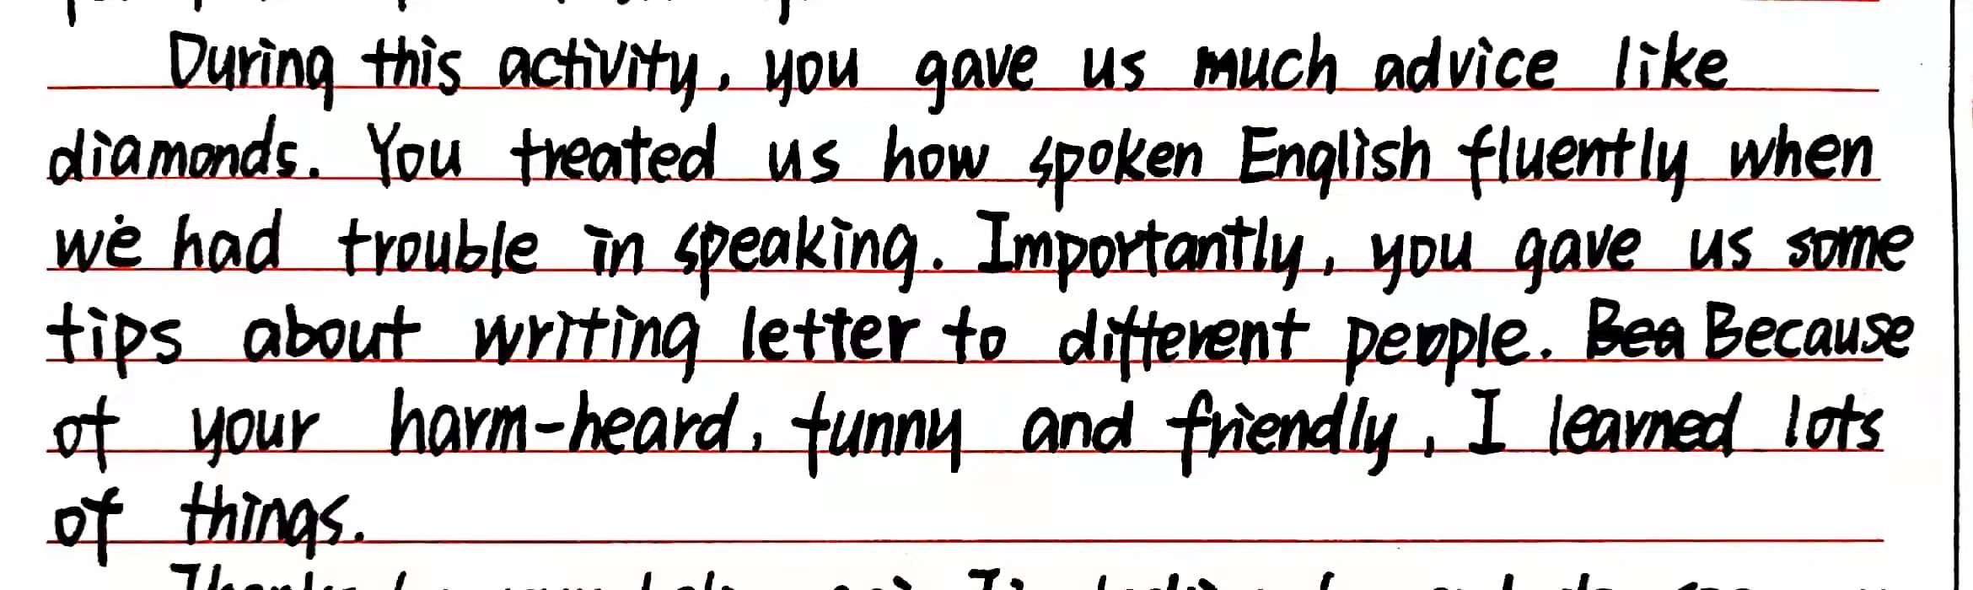
高分作文作于细：夯实基础，表意清楚，语法无误，句型正确
受读后续写描述性语言的影响，在应用文写作中使用描述性的句子过于繁琐和夸张，给人不真实的感觉
没能按照第一层级信息拓展交际内容，凸显“中西方文化交流”的英语角主题活动
评讲反馈
在写作实际中，很多学生忽视背景信息，只关注内容要点和写作文体，习惯于死记硬背和仿写范文，暴露了新课标理念不强，角色代入能力不足，对第一层级隐藏信息解读不透等问题。

Slide 17
One possible version
Dear Mike,
I'm writing this letter to extend my hearty gratitude for your presence at the English Corner last Sunday, which proved to be successful with your assistance.
Without your help, we students couldn't have known so much first-hand knowledge about Western cultures, especially the festival part you shared with us, which impressed us deeply. Apart from it, if it had not been for your patient guidance, some students wouldn't have managed to express themselves in English for the first time and build confidence.
Again, I'd like to express my thanks to you and wish you all the best!
Yours,
Li Hua
评讲反馈
Can you comment on this composition?

Slide 18
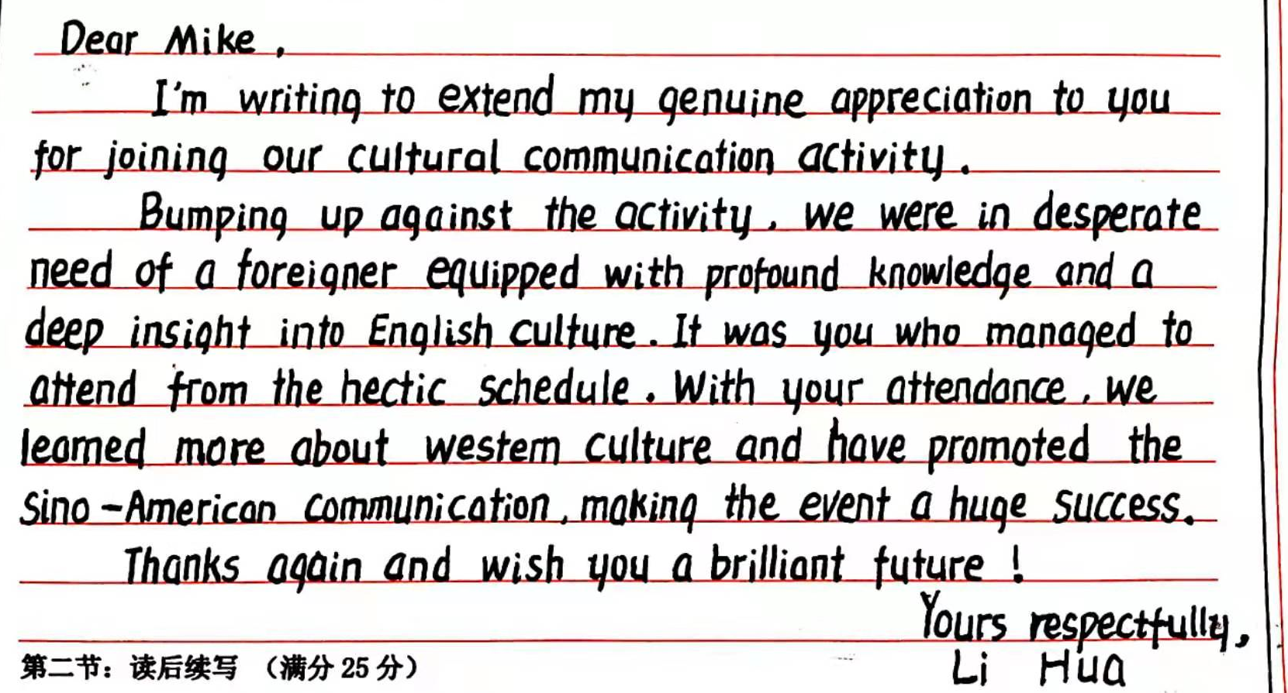
高分作文成于严：内容真实，评誉恰当，用语适度，叙事精练
criteria
1.完全完成了试题规定的任务;
2.覆盖所有内容要点;
3.应用了较多的语法结构和词汇;
4.语法结构或词汇方面有些许错误,但是因尽力使用较复杂结构或较高级词汇所致;具备较强的语言运用能力;
5.有效地使用了语句间的连接成分,使全文结构紧凑;
6.完全达到了预期的写作目的。
评讲反馈
Can you comment on this student's composition?

Slide 19
THANK YOU

