Slide 1


感恩遇见，相互成就，本课件资料仅供您个人参考、教学使用，严禁自行在网络传播，违者依知识产权法追究法律责任。
更多教学资源请关注
公众号：溯恩高中英语
知识产权声明

Slide 2






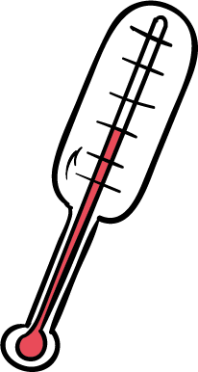
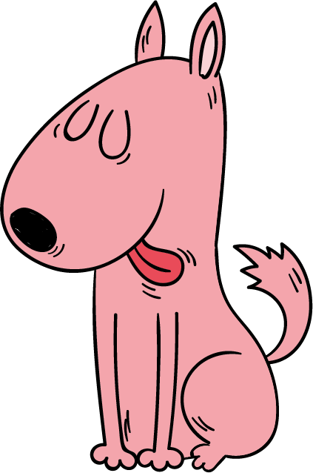
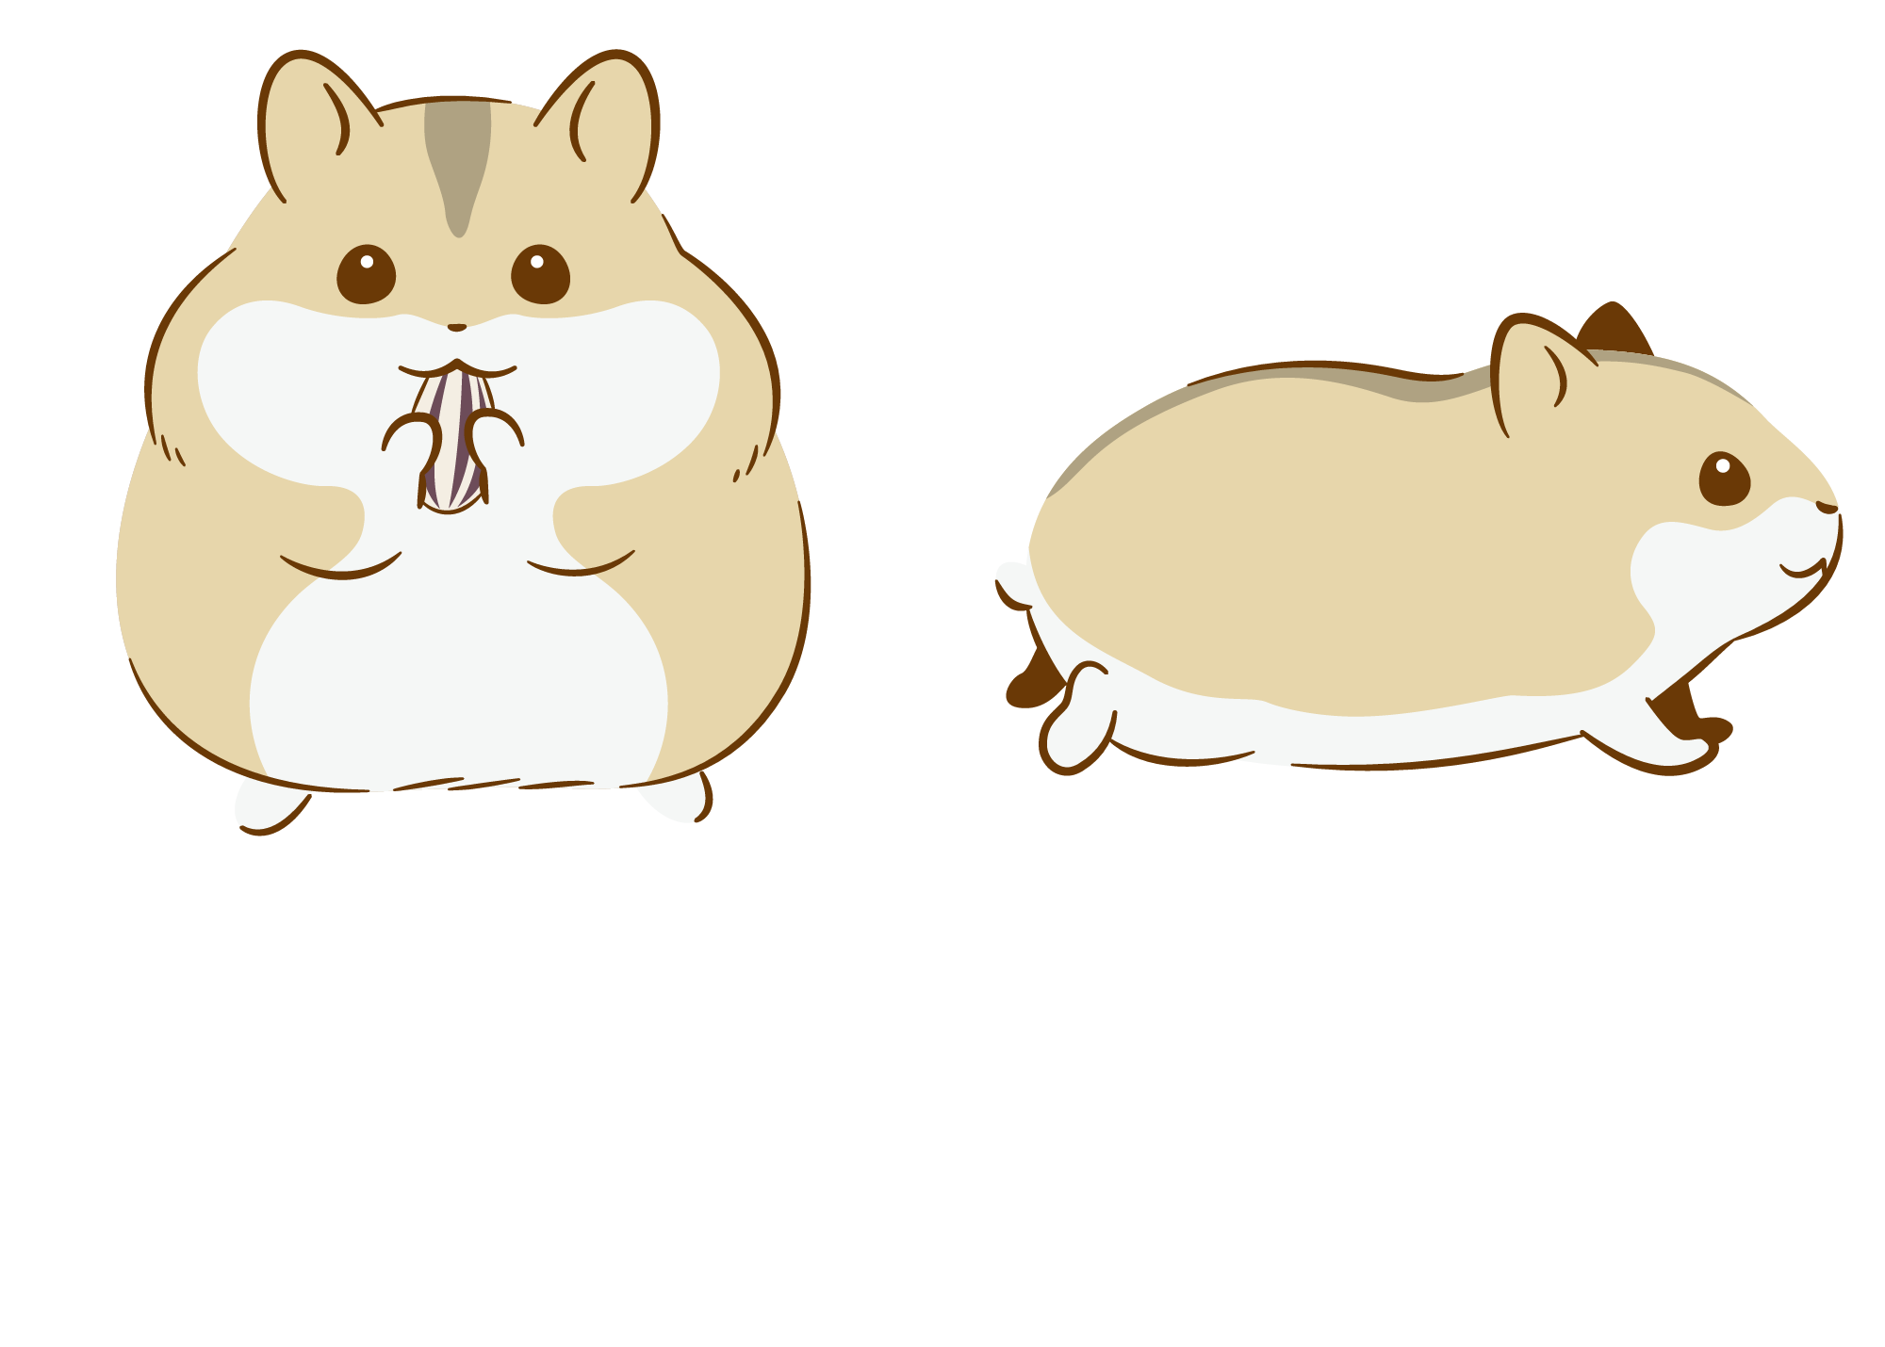


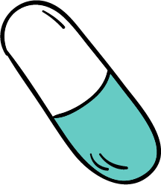
Summary writing
上溪中学 朱旭丽

Slide 3
[1] Antibiotics, insulin, organ transplantation, HIV treatments—it reads like an A to Z of medical progress. But the major progress has something in common: they were all developed and tested by using animals. Actually, animals are used for research in a variety of fields. Whether or not humans should use animals for testing purposes, however, is a controversial subject.
[2] Animal testing allows researchers to develop new medicine and treatments, advancing the field of medicine and improving the health of society. For example, many drugs used to treat or prevent cancer, HIV, diabetes, etc, have resulted from tests performed on animals. Many supporters of animal testing support the practice for this reason, even if they do not support testing, or other non-essential substances on animals. No one chooses to use animals where there is no need. In fact, animal research has contributed to 70 percent of Nobel prizes for physiology or medicine.
[3] Animal testing also enables scientists and researchers to test the safety of medicine. Drugs, for example, may create significant risks to humans, so testing them on animals first gives researchers a chance to determine their safety before human trials are performed. While scientists understand the differences between humans and animals, the similarities are considered significant enough to produce relevant data that they can then apply to humans. Animal testing reduces harm to humans and saves lives, not only because the exposure to risky substances is minimized, but because some new medicine and treatments have positive effects on humans’ overall quality of life.
[4] However, a significant number of animals are harmed or die as a result of experiments and testing. Those who object to animal testing consider this a very important point, because saving humans from suffering is no excuse for the death of laboratory animals.

Slide 4
Step 1. Read for the topic, style and structure
① Read for the topic:
opinions about animal testing
② Read for writing style:
Q: What's the writing style of the passage?
√
A.Narration B. Argumentation C. Exposition
③ Read for structure:

Slide 5
[1] Antibiotics, insulin, organ transplantation, HIV treatments—it reads like an A to Z of medical progress. But the major progress has something in common: they were all developed and tested by using animals. Actually, animals are used for research in a variety of fields. Whether or not humans should use animals for testing purposes, however, is a controversial subject.
[2] Animal testing allows researchers to develop new medicine and treatments, advancing the field of medicine and improving the health of society. For example, many drugs used to treat or prevent cancer, HIV, diabetes, etc, have resulted from tests performed on animals. Many supporters of animal testing support the practice for this reason, even if they do not support testing, or other non-essential substances on animals. No one chooses to use animals where there is no need. In fact, animal research has contributed to 70 percent of Nobel prizes for physiology or medicine.
[3] Animal testing also enables scientists and researchers to test the safety of medicine. Drugs, for example, may create significant risks to humans, so testing them on animals first gives researchers a chance to determine their safety before human trials are performed. While scientists understand the differences between humans and animals, the similarities are considered significant enough to produce relevant data that they can then apply to humans. Animal testing reduces harm to humans and saves lives, not only because the exposure to risky substances is minimized, but because some new medicine and treatments have positive effects on humans’ overall quality of life.
[4] However, a significant number of animals are harmed or die as a result of experiments and testing. Those who object to animal testing consider this a very important point, because saving humans from suffering is no excuse for the death of laboratory animals.
opinions about animal testing
//
support of animal testing
/
objection of animal testing
//

Slide 6
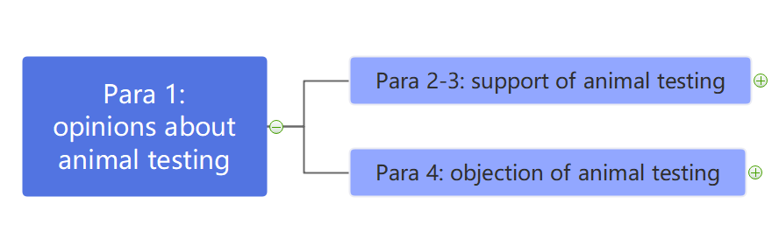
Step 2. Draw the outline map
？
Find out the key points of each paragraph and try to enrich the outline map.

Slide 7
Para 1. opinions on animal testing
[1] Antibiotics, insulin, organ transplantation, HIV treatments—it reads like an A to Z of medical progress. But the major progress has something in common: they were all developed and tested by using animals. Actually, animals are used for research in a variety of fields. Whether or not humans should use animals for testing purposes, however, is a controversial subject.e.
[1] Antibiotics, insulin, organ transplantation, HIV treatments—it reads like an A to Z of medical progress. But the major progress has something in common: they were all developed and tested by using animals. Actually, animals are used for research in a variety of fields. Whether or not humans should use animals for testing purposes, however, is a controversial subject.

Slide 8
Para 2. support of animal testing
[2] Animal testing allows researchers to develop new medicine and treatments, advancing the field of medicine and improving the health of society. For example, many drugs used to treat or prevent cancer, HIV, diabetes, etc, have resulted from tests performed on animals. Many supporters of animal testing support the practice for this reason, even if they do not support testing, or other non-essential substances on animals. No one chooses to use animals where there is no need. In fact, animal research has contributed to 70 percent of Nobel prizes for physiology or medicine.

Slide 9
Para 2. support of animal testing
[2] Animal testing allows researchers to develop new medicine and treatments, advancing the field of medicine and improving the health of society. For example, many drugs used to treat or prevent cancer, HIV, diabetes, etc, have resulted from tests performed on animals. Many supporters of animal testing support the practice for this reason, even if they do not support testing, or other non-essential substances on animals. No one chooses to use animals where there is no need. In fact, animal research has contributed to 70 percent of Nobel prizes for physiology or medicine.
[2] Animal testing allows researchers to develop new medicine and treatments, advancing the field of medicine and improving the health of society. For example, many drugs used to treat or prevent cancer, HIV, diabetes, etc, have resulted from tests performed on animals. Many supporters of animal testing support the practice for this reason, even if they do not support testing, or other non-essential substances on animals. No one chooses to use animals where there is no need. In fact, animal research has contributed to 70 percent of Nobel prizes for physiology or medicine.
cause(reason1)
effect(result)
？

Slide 10
Para 2. support of animal testing
[2] Animal testing allows researchers to develop new medicine and treatments, advancing the field of medicine and improving the health of society. For example, many drugs used to treat or prevent cancer, HIV, diabetes, etc, have resulted from tests performed on animals. Many supporters of animal testing support the practice for this reason, even if they do not support testing, or other non-essential substances on animals. No one chooses to use animals where there is no need. In fact, animal research has contributed to 70 percent of Nobel prizes for physiology or medicine.
Some people support animal testing because it allows researchers to ...

Slide 11
Para 3. support of animal testing
reason2
[3] Animal testing also enables scientists and researchers to test the safety of medicine. Drugs, for example, may create significant risks to humans, so testing them on animals first gives researchers a chance to determine their safety before human trials are performed. While scientists understand the differences between humans and animals, the similarities are considered significant enough to produce relevant data that they can then apply to humans. Animal testing reduces harm to humans and saves lives, not only because the exposure to risky substances is minimized, but because some new medicine and treatments have positive effects on humans’ overall quality of life.
[3] Animal testing also enables scientists and researchers to test the safety of medicine. Drugs, for example, may create significant risks to humans, so testing them on animals first gives researchers a chance to determine their safety before human trials are performed. While scientists understand the differences between humans and animals, the similarities are considered significant enough to produce relevant data that they can then apply to humans. Animal testing reduces harm to humans and saves lives, not only because the exposure to risky substances is minimized, but because some new medicine and treatments have positive effects on humans’ overall quality of life.

Slide 12
Para 4. opposition of animal testing
cause
[4] However, a significant number of animals are harmed or die as a result of experiments and testing. Those who object to animal testing consider this a very important point, because saving humans from suffering is no excuse for the death of laboratory animals.
[4] However, a significant number of animals are harmed or die as a result of experiments and testing. Those who object to animal testing consider this a very important point, because saving humans from suffering is no excuse for the death of laboratory animals.
[4] However, a significant number of animals are harmed or die as a result of experiments and testing. Those who object to animal testing consider this a very important point, because saving humans from suffering is no excuse for the death of laboratory animals.
effect

Slide 13
Para 4. opposition of animal testing
[4] However, a significant number of animals are harmed or die as a result of experiments and testing. Those who object to animal testing consider this a very important point, because saving humans from suffering is no excuse for the death of laboratory animals.
Some people object to animal testing because a significant number of animals are harmed or die as a result of experiments and testing.

Slide 14
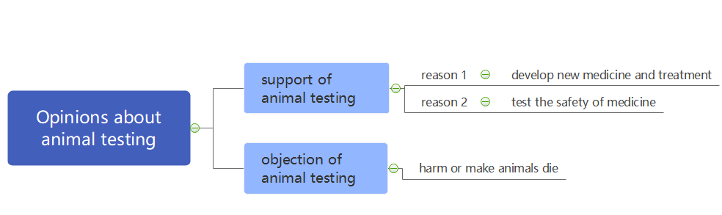
The outline map of the whole passage
？

Slide 15
Step 4. Rewrite the sentences by using some skills
Para 1: Whether or not humans should use animals for testing purposes, however, is a controversial subject.
Para 2-3: Some people support animal testing because
reason 1: It allows researchers to develop new medicine and treatments, advancing the field of medicine and improving the health of society.
reason 2: It enables scientists and researchers to test the safety of medicine.
Para 4: Some people object to animal testing because a significant number of animals are harmed or die as a result of experiments and testing.

Slide 16
Para 1: Actually, animals are used for research in a variety of fields. Whether or not humans should use animals for testing purposes, however, is a controversial subject.
Para 1: Actually, animals are used for research in a variety of fields. Whether or not humans should use animals for testing purposes, however, is a controversial subject.
Diversify(多样化) the sentence patterns
Language database—raising arguments
Opinions vary greatly when it comes to ...
Opinions on ... differs/are divided.
Mixed opinions exist on ...
There is much controversy over ...
It’s controversial whether ...
...has caused quite a stir among the general public.
Different arguments arise about ...
Opinions on the use of animals for testing purposes are divided.
It’s controversial whether animals should be used for testing purposes.
Different arguments arise about whether animals should be used for testing purposes.
Change the sentence patterns

Slide 17
Para 4 Some people object to animal testing because a significant number of animals are harmed or die as a result of experiments and testing.
Para 4 Some people object to animal testing because a significant number of animals are harmed or die as a result of experiments and testing.
object to:
change the part of speech(转换词性):
objection
use synonyms(同义替换):
against, oppose, be opposed to, disapprove
use converse expression(反义表达):
few/not many people support
a significant number of:
a large number of, an enormous number of, a large quantity of, a great many ...
harm or die:
cause harm to, be harmful to, cause death ...
because/ as a result of:

Slide 18
Language database—cause & effect
Effect + Cause:
She has been absent from work due to illness.
We are still dealing with problems resulting from errors made in the past.
because of/owing to/due to/as a result(consequence) of…
result from/be caused by...
...is also the direct consequence of...
Cause + Effect:
It seemed that water was to blame for this disease.
Hard work leads to success.
bring about/contribute to/result in...
be responsible for/be a leading cause of...
...lead to the fact that.../ ...is the contributing cause why.../ ...is one of the reasons accounting for...
Due to the fact that.../ On account of the fact that..

Slide 19
Para 4 Some people object to animal testing because a significant number of animals are harmed or die as a result of experiments and testing.
Some people are against animal testing owing to the fact that it causes harm even death to an enormous number of animals due to experiments and testing.
On account to the fact that experiments and testing cause harm even death to a large number of animals, some people are opposed to animal testing.

Slide 20
Para 2-3: Some people support animal testing because
reason 1: It allows researchers to develop new medicine and treatments, advancing the field of medicine and improving the health of society.
reason 2: It enables scientists and researchers to test the safety of medicine.
_____________________________________________________________________________________________________________________________________________________________________
？

Slide 21
Para 2-3: Some people support animal testing because
reason 1: It allows researchers to develop new medicine and treatments, advancing the field of medicine and improving the health of society.
reason 2: It enables scientists and researchers to test the safety of medicine.
Some are in favor of/advocate animal testing owing to/ due to/ on account of the fact that it not only contributes to the medical development and the improvement of people’s health but also examines the safety of medicine without risking humans’ lives.

Slide 22
Step 5. Polish the summary with linking words.
additionally, besides, furthermore, moreover, apart from, along with...
but, however, instead, nevertheless, on the one hand/ on the other hand, in contrast, in spite of...

Slide 23
Step 5. Polish the summary with linking words.
Although animals are used in various researches, it’s controversial whether animals should be used for testing purposes. On the one hand, some advocate animal testing for it not only contributes to the medical development and the improvement of people’s health but also examines the safety of medicine without risking humans’ lives. On the other hand, some oppose it because it causes harm even death to an enormous number of animals due to testing.

Slide 24
How to write a good summary
1
Read for topic, style & structure
2
Draw the outline map
Use synonyms
Use converse expression
3
Figure out the key points of each part
Change of words
Change the part of speech
Rewrite the sentences by using some skills
4
Change the sentence patterns
Polish the summary with the linking words
5
Change of sentences
Diversify the sentence patterns

Slide 25

Thank you!

