Slide 1


感恩遇见，相互成就，本课件资料仅供您个人参考、教学使用，严禁自行在网络传播，违者依知识产权法追究法律责任。
更多教学资源请关注
公众号：溯恩高中英语
知识产权声明

Slide 2
高中英语应用文写作
---感谢信(1)
杭州二中 许丽君

Slide 3
Objectives
To know about the format and contents of thank-you letters;
To write appropriate thank-you letters, especially
pay attention to the tone and language.
To recognize what a good thank-you letter is like.

Slide 4
When do you need to write a letter of thanks?
Lead in
Receive gifts/awards/honors
Receive helpful advice/tips
Receive encouragement/praise
Receive prompt payments
Receive financial contributions
...

Slide 5
Write Thank-you Letters for
appreciation/congratulations/recognition
favors/kindness/assistance/special help/advice
gifts: business/personal
job interviews

Slide 6
Write Thank-you Letters for
expressions of sympathy
hospitality: business/ personal
contributions: memorials/charities
employee suggestions/outstanding efforts/ jobs done well

Slide 7
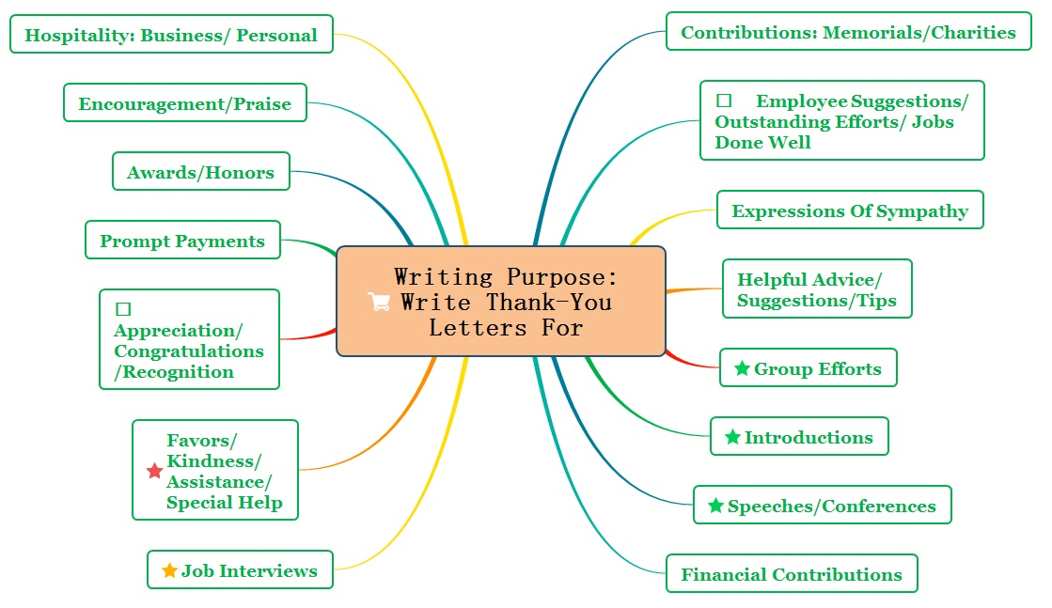

Slide 8
Letters of thanks
要点齐全
content
条理清楚
layout
语言准确
language
交际得体
tone

Slide 9
Layout
Letters of thanks
Readers-based
Beginning
01
03
02
Main Body
Closing/ending
延迟符

Slide 10
Layout
感谢信
感谢信：感谢他人的款待、帮助、馈赠及对慰问信和祝贺信的回复。信件需写明感谢他人的原因，信件感情要真挚，措辞得体。
Structure:
第一段：表达感激之情并说明理由；
第二段：详细表述并赞赏对方给予的援助；
第三段：再次阐述谢意并表示回报愿望。

Slide 11
Writing preparations
Part 1: Purpose of writing the letter
开头：表示高兴，表达问候，对写信提供帮助的事件主题进行点题并表示谢意。
I wish to thank you from the bottom of my heart for...
I’d like to convey in this letter my heartfelt thanks to you for your selfless help.
On behalf of..., I’d like to extend my sincere gratitude for your tender care and unreserved help.

Slide 12
Writing preparations
Part 2: Body Arrangements
正文：向对方给予帮助的事件及达到的作用和效果进行有层次的描述和赞扬。
You really added greatly to my convenience and pleasure of the whole trip.
I appreciate it more than I can say./ I can never thank you enough.
Many thanks for all the things you have done in helping us to...
It was so nice/ kind/considerate/ thoughtful of you to have done sth. （It is + adj. + of sb. + to do sth.结构）
It was your unreserved/selfless help that enabled me to do sth.（强调句）

Slide 13


Part 2: Body Arrangements
Writing preparations
In addition , Therefore, In short , once, as well, also, to be honest, what’s more, however, meanwhile…
Natural
transitions
Express your gratitude in an enthusiastic, appreciate way
The content must be true, the appraisal be appropriate, not exaggerated, which sources from line.
(内容真实，评誉恰当)
Suitable
Details?
Speak in moderation, and in narrative (用语适度，叙事精炼)

Slide 14
Writing preparations
Part 3: Ending
结尾：表明再次的感谢及期待对方回信，并表达祝愿。
It was kind and generous of you to do this for me, and I appreciate it more than I can say.
I wish there were a better word than “thanks” to express my appreciation for your generous help.
Thanks again for your kind help./ Again, I would like to express our sincere thanks to you.

Slide 15

Useful words and expressions
priceless
remarkable
striking
satisfying
spectacular
tremendous
incredible
thoughtful
touched
timely
thrilled
tasteful
terrific
valuable
unique
wonderful
well-made

Slide 16
Writing help: Useful phrases
a rare treat
absolutely perfect choice for me
appreciate your confidence/interest/kind words
charming of you
cannot tell you how delighted I was
convey my personal thanks to everyone who
derived great pleased from
heartfelt/hearty thanks
how kind/dear/thoughtful/sweet of you to
how much it meant to us
I am very much obliged to you for
It was a great pleasure

Slide 17

Writing help: sentences
All of us were touched by your thoughtfulness.
How dear of you – we are delighted!
I appreciate your advice more than I can say.
I can’t remember when I’ve had a better/more pleasant /relaxing /enjoyable time.
I’ll cherish your gift always.
Special thanks to the doctors and the nurses at your hospital.
Thank you for including me in this memorable/special event.

Slide 18

感谢信模板1
Dear______,
Purpose：
①I am writing to extend my sincere gratitude for ______(感谢的原因).
Body-examples of assistance or help：
②If it had not been for your assistance in ______(对方给予的具体帮助), I fear that I would have been ______(没有对方帮助时的后果). ③Every one agrees that it was you who ______(给出细节).
Closing-wish for continuous success, some forward-looking remark
Again, I would like to express my warm thanks to you! Please accept my gratitude.
Yours Sincerely / Faithfully/ Truly,
________________

Slide 19
Assessment
Work in groups of four. Each member read the article and others comment on your classmate’s work. Then choose the best one out to show in the class. When discussing, you should pay attention to the following hints.
Purpose | Have you made the purpose of writing clear and evident?
Layout | Does the layout conform to the requirements?
Language | Are the sentences correct? Have you used the proper punctuation, words, sentence and paragraphs to express yourself?
Content | Have you included all the points of views? Are the details suitable?
tone | Have you shown your politeness and sincerity all through the writing?

Slide 20
Writing 1(悉尼大学录取感谢信)
对象：who (relationship)
文体：what
第一节 应用文写作（满分15分）
假定你是李华, 外教Mr White去年十月推荐你去悉尼大学深造，现在你已经被悉尼大学录取。请给他写一封邮件表示感谢，内容包括：
1. 告知录取消息，表达感谢；
2. 回顾Mr White对你的帮助；
3. 表达祝愿。
注意：
1. 词数80左右；
2. 可以适当增加细节，以使行文连贯。
参考词汇：推荐信 recommendation
悉尼大学 Sydney University
目的： Why
达意
涵盖
要点

Slide 21
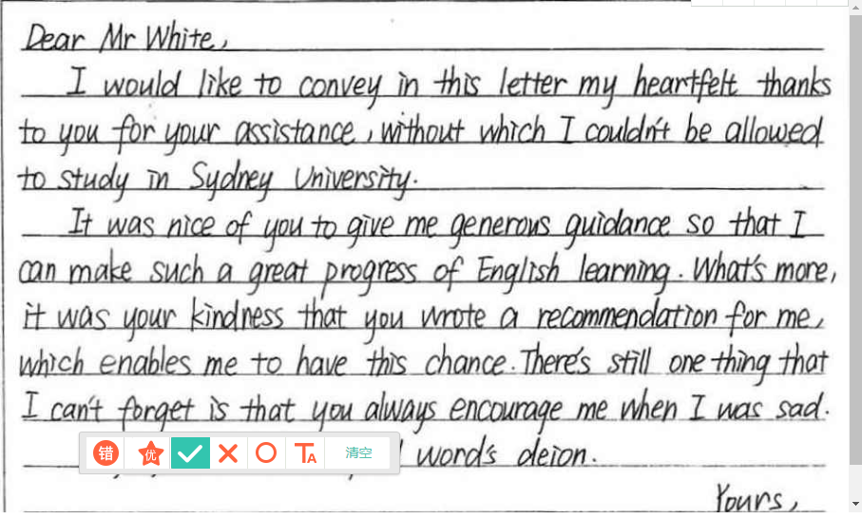
Student version
Discovery
verbal mistake
use the wrong phrase
use improper sentence pattern
wrong form of the tense
Spelling mistake

Slide 22
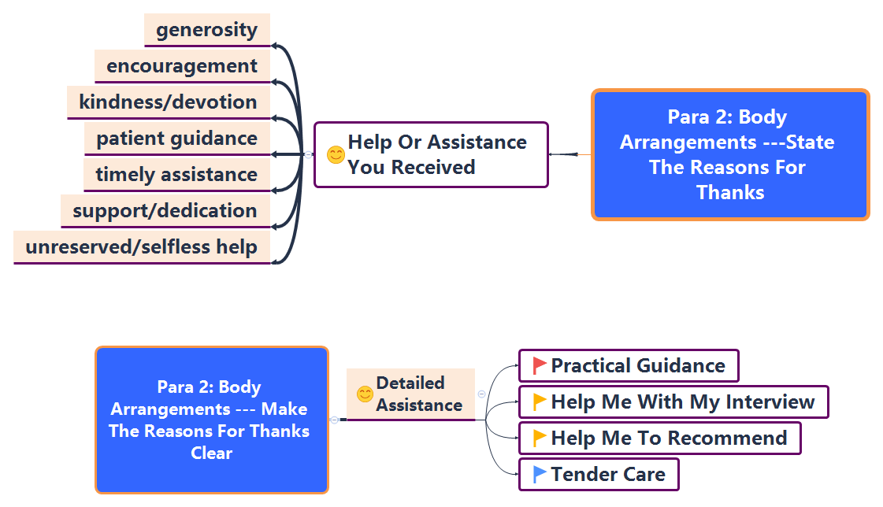
Writing 1(悉尼大学录取感谢信)

Slide 23

Possible version
Writing 1(悉尼大学录取感谢信)
Dear Mr White,
I am writing to extend my sincere appreciation for your generous help, without which I wouldn’t have been admitted to Sydney University.
It was your support and encouragement that made me overcome the difficulty in my application last October. Not only did you write a letter of recommendation for me to Sydney University, but also you gave me detailed and practical guidance on how to fill the application forms. What impressed me most is that you even spent several weekends helping me with my interview,
My true gratitude is beyond description. Thanks again and wish you all the best!
Yours sincerely,
Li Hua

Slide 24
Writing 2 (伦敦之行招待-感谢信)
对象：who (relationship)
文体：what
假如你是李华，在伦敦游玩期间你的英国朋友Anne招待了你。请你给她写封信，表示感谢。要点如下：
简述你的伦敦之行；
感谢她的招待；
邀请她来北京旅游。
目的： Why
达意
涵盖
要点

Slide 25
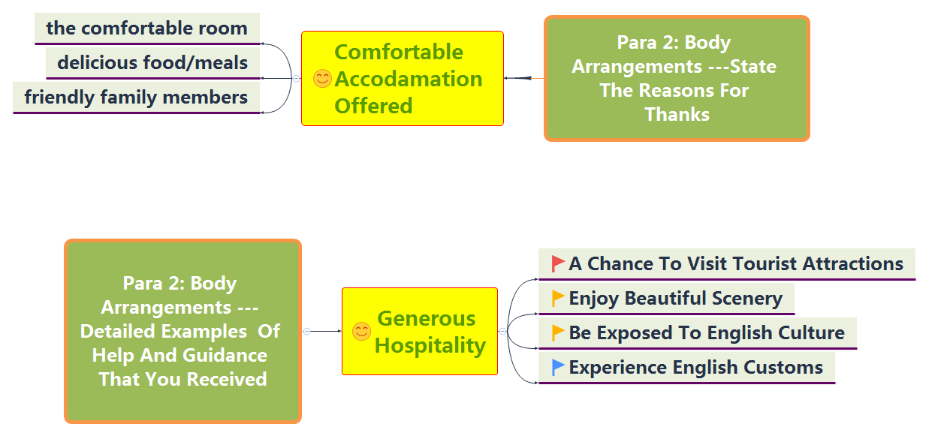
Writing 2 (伦敦之行招待-感谢信)

Slide 26
Possible version
Writing 2 (伦敦之行招待-感谢信)
purpose--show your gratitude
Dear Anne,
I’d like to convey/express my sincere appreciation for your unreserved help and tender care during my stay in London, without which I wouldn’t have enjoyed it so much.
During the week, the comfortable room, delicious meals and especially your friendly family members all made me feel at home, leaving me lasting memories. Moreover, guided by you, It was my honor to get a chance to visit those tourist attractions in London and be exposed to such an amazing culture as well as beautiful scenery. It was your generous help that enabled me to have a better understanding of your country and culture.
Thanks again for your kind assistance and I will be more than happy to have the opportunity to repay your kindness by showing you around Beijing.
Yours,
Li Hua
examples of assistance or guidance that you received
The ending

Slide 27


