Slide 1
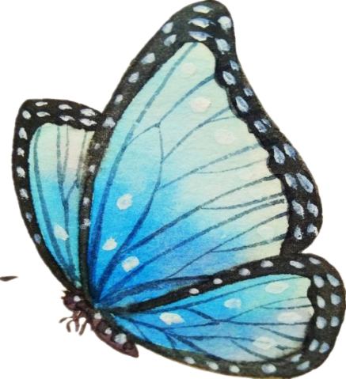

读后续写微写作：
丰富多彩的结尾方式
Micro-writing: To complete a story with a variety of endings
余杭区树兰高级中学 郭合英

Slide 2


CONTENTS
1
2
3
4
Learning
objects
The Roles
of the Endings
The Application
Different Styles of Endings
The Model Essays

Slide 3

The roles of the endings
成功的结尾在读后续写中起着至关重要的作用。精彩的结尾能使读者更加深入、透彻地理解文章内容，进一步领会文章的主旨, 亦能唤起读者的思考与共鸣，增强文章的感染力。在结构上，成功的结尾不仅能够起到总结上文而且还能首尾呼应，使文章结构完整；在内容上，成功的结尾不仅能深化主题起到画龙点睛的作用还可以言有尽而意无穷，留下想象的空间，增强感染力。

Slide 4
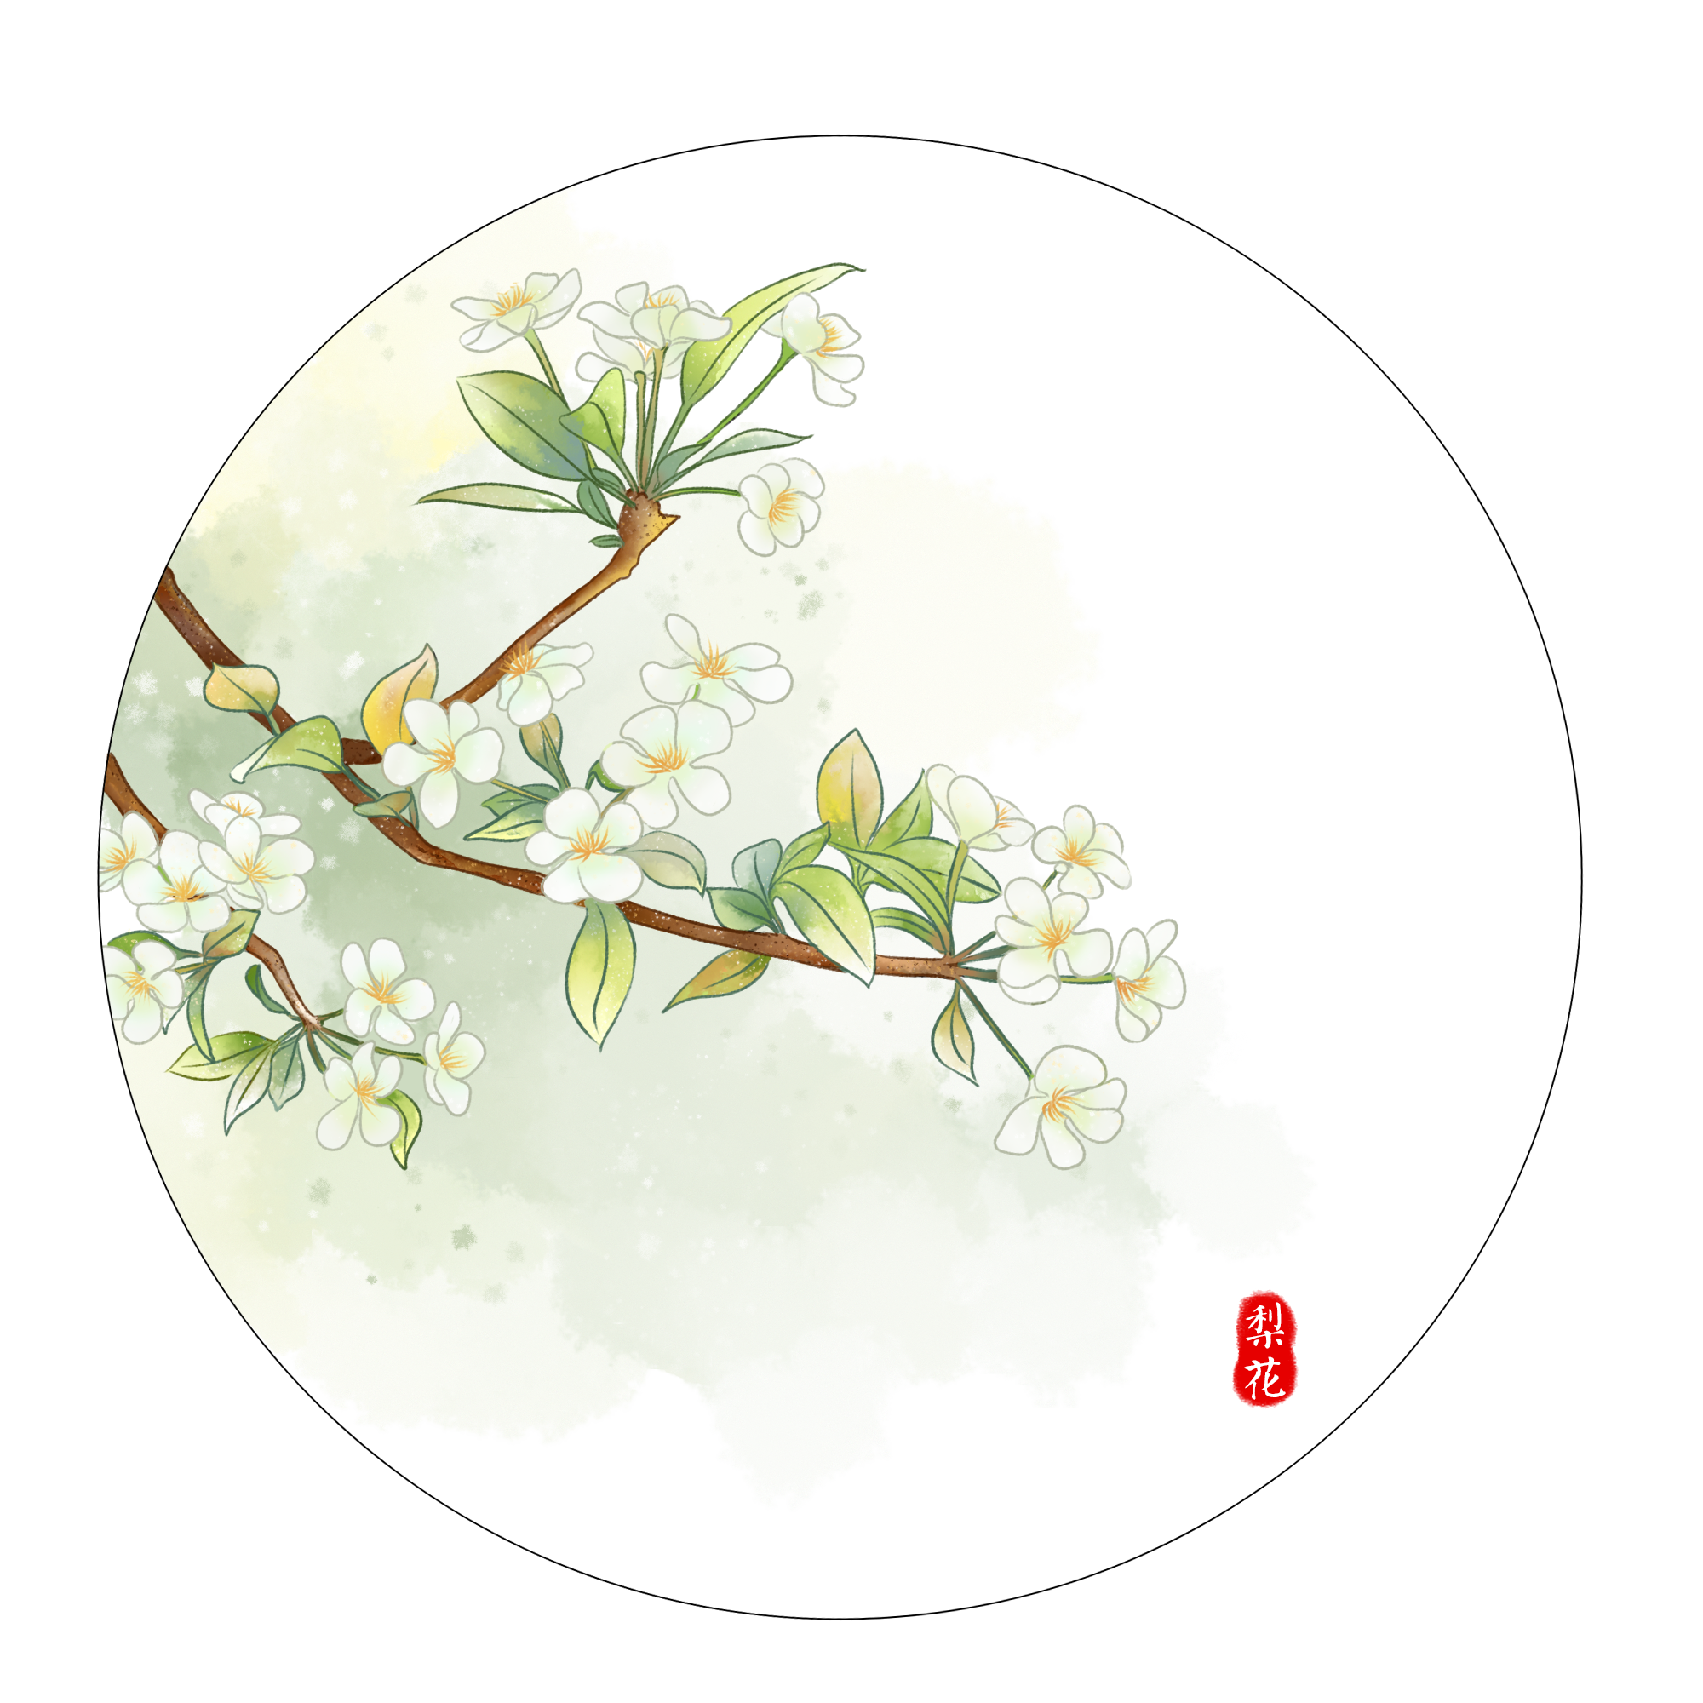
Different Classification of Endings
⑩画面定格式结尾
⑨欧亨利式结尾
⑧回忆式结尾
⑦对话式结尾
⑥留白式结尾
⑤悬念式结尾
④首尾呼应式结尾
③主题升华式结尾
②融情于景式结尾
①自然式结尾

Slide 5

高考链接---2020年7月浙江高考读后续写
第二节 读后续写（满分25分）
阅读下面短文，根据所给情节进行续写，使之构成一个完整的故事。
One fall，my wife Elli and I had a single goal：to photograph polar bears. We were staying at a research camp outside “the polar bear capital of the world”-the town of Churchill in Manitoba，Canada.
Taking pictures of polar bears is amazing but also dangerous. Polar bears-like all wild animals-should be photographed from a safe distance. When I'm face to face with a polar bear，I like it to be through a camera with a telephoto lens. But sometimes，that is easier said than done. This was one of those times.
As Elli and I cooked dinner，a young male polar bear who was playing in a nearby lake sniffed，and smelled our garlic bread.
The hungry bear followed his nose to our camp，which was surrounded by a high wire fence. He pulled and bit the wire. He stood on his back legs and pushed at the wooden fence posts.

Slide 6
Terrified，Elli and I tried all the bear defense actions we knew. We yelled at the bear，hit pots hard，and fired blank shotgun shells into the air. Sometimes loud noises like these will scare bears off. Not this polar bear though-he just kept trying to tear down the fence with his massive paws（爪子）.
I radioed the camp manager for help. He told me a helicopter was on its way，but it would be 30 minutes before it arrived. Making the best of this close encounter（相遇），I took some pictures of the bear.
Elli and I feared the fence wouldn't last through 30 more minutes of the bear's punishment. The camp manager suggested I use pepper spray. The spray burns the bears' eyes，but doesn't hurt them. So I approached our uninvited guest slowly and，through the fence，sprayed him in the face. With an angry roar（吼叫），the bear ran to the lake to wash his eyes.

Slide 7

注意：
1. 所续写短文的词数应为150左右；
2. 至少使用5个短文中标有下划线的关键词语；
3. 续写部分分为两段，每段的开头语已为你写好；
4. 续写完成后，请用下划线标出你所使用的关键词语。
Para 1 .
A few minutes later , the bear headed back to our camp. _______________
________________________________________________________________
Para 2.
At that very moment , the helicopter arrived . ________________________
________________________________________________________________

Slide 8


自然式结尾：即用事情的结果作为文章的结尾,事物叙述完了,
文章随之结尾.
高考链接---2020年7月浙江高考读后续写
结尾：At that very moment, the helicopter arrived. It resembled a bright light sparking our life. Several persons jumped out of the helicopter with specialized clothes which were able to defend against the bear in case of being hunted. They went across the fence, running to the bear. The bear was put into a cage. With the assistance of them, Elli and I were saved.
点评：根据故事的情节自然发展，简单、自然，没有套话和空话， 只要把事情讲清楚就可以了。

Slide 9
融情于景式结尾：用现实的景色描写来表达人物内心的情感，
达到不言情而情自溢的效果。
高考链接---2020年7月浙江高考读后续写
结尾: (前面略）Eventually, we were saved. A ripple of joy swept over me. Looking around, I felt I had never seen such white snow and breathed such fresh air.
点评：“I had never seen such white snow and breathed such fresh air.”作者融情于景，将自己被救后的心情淋漓尽致地表达出来。

Slide 10
主题升华式结尾：总结归纳文章的主题，用哲理性语言结尾，使文章具有一定的思想性。可以是大家熟悉的名言警句，也可以是自已组织的哲理性语言。
高考链接---2020年7月浙江高考读后续写
结尾：At that very moment, the helicopter arrived. Catching sight of the helicopter, a ripple of hope creeping into my heart, I yelled out with my all strength, “Here! Help us!” Having found us, the helicopter quickly took action to help us out. So the bear failed to attack us, we were both in safety. Out of danger, I breathed with relief, hugging my wife tightly. It was the hunger that made the bear have the courage to attack us. It dawns on me that animals are to us what water is to fish. To protect the environment is to protect ourselves. It is time for us to take measures to protect our surroundings and give the bear a safe home.
点评：以感悟结尾。通过这件事，作者得到了什么样的人生感悟或启发。

Slide 11
首尾呼应式结尾：指在开头和结尾的内容上要有着极其密切的关系，
是对同一情况做出解释、说明、交代的。呼应可以使文章浑然一体，
更具有突出的作用。内容上也要协调一致，前后呼应。
高考链接---2020年7月浙江高考读后续写
开头: One fall，my wife Elli and I had a single goal：to photograph polar bears. We were staying at a research camp outside “the polar bear capital of the world”-the town of Churchill in Manitoba，Canada.
结尾1：Eventually, we achieved our goal with such an exciting and dangerous experience!
结尾2：Though we lost our camp, we got the most valuable things: lots of close photographs of the polar bear!
点评：这篇读后续写的开头写到我的妻子Elli 和我有一个目标：去拍北极熊。续写结尾的时候可以写目标的实现，和开头提出的目标首尾呼应，达到深化主题的目的。

Slide 12
悬念式结尾: 文章开头部分，先将疑问悬在那儿，让人念念不忘，存有种种猜想，在蓄积了长时间后，再解开“悬念”，写出结局。悬念式结尾方式，可以造成情节的曲折有致, 牢牢地吸引读者，取得出奇制胜的效果。
设悬念
高考链接---2020年7月浙江高考读后续写
结尾: At that very moment, the helicopter arrived. One of the rescuers with a gun ran to the roaring bear, firing a bullet at it. It fell down to the ground, dead. We were safe. However, looking at “the dead bear”, Elli couldn’t resisted sobbing. Her happiness gave way to sorrow. The rescuer seemingly related to her, grinning with delight and told her that the bear wasn’t really dead and it just
fell asleep. Actually, the bullet was just “ a drugged medicine ”. Hearing this, so happy were we that we took advantage of the chance to take some photos. We determined to make use of the photos to call on more persons to protect the earth's environment.
解悬念
点评：由 “a gun fire dead ”设置悬念，让人以为熊被打死了，然后解开悬念，射出的只是“ a drugged medicine ”给人虚惊一场。

Slide 13

留白式结尾：第一种结局留白 在写作中的作用就是留下让读者
思考参与情景的空间 是一种加深主题的手法给了想象空间又在前
文中有所提示 ；第二种是情节留白让读者自由补白随意想象。
高考链接---2020年7月浙江高考读后续写
结尾：At that very moment, the helicopter arrived. Shocked by the noise, the bear stopped and turned around, seeing the persons equipped with the guns, and he ran away, disappearing in the woods as if he knew who they were. We finally got our breath and Elli and I embraced tightly with still pounding hearts. After we calmed down, the local persons told us that the bears were losing their homes and food because of human activities and climate changes. On the way back home, I checked the precious pictures in the camera, lost in thought. This experience would be remembered forever.
点评：“lost in thought” 给读者留下想象空间：到底是当地人的话让他陷入了沉思呢还是此次死里逃生的经历让他陷入了沉思呢？

Slide 14

对话式结尾：很显然是以对话方式结尾，但前提是需要立意佳，
否则会弄巧成拙。
高考链接---2020年7月浙江高考读后续写
结尾： At that very moment, the helicopter arrived. The sound of it lit up our mind and we both took a deep breath. The bear was arrested into a cage and we were rescued successfully. I embraced my wife tightly, saying “Honey, don’t worry, and we are safe now.” Elli answered with tears welling up in her eyes, “Yes, but the animals are losing their homes. Returning home, we should post the pictures of the bears on the Moments to appeal to more people to protect our surroundings to give the animals safe homes ”
点评：以对话方式结尾，而且立意佳。

Slide 15
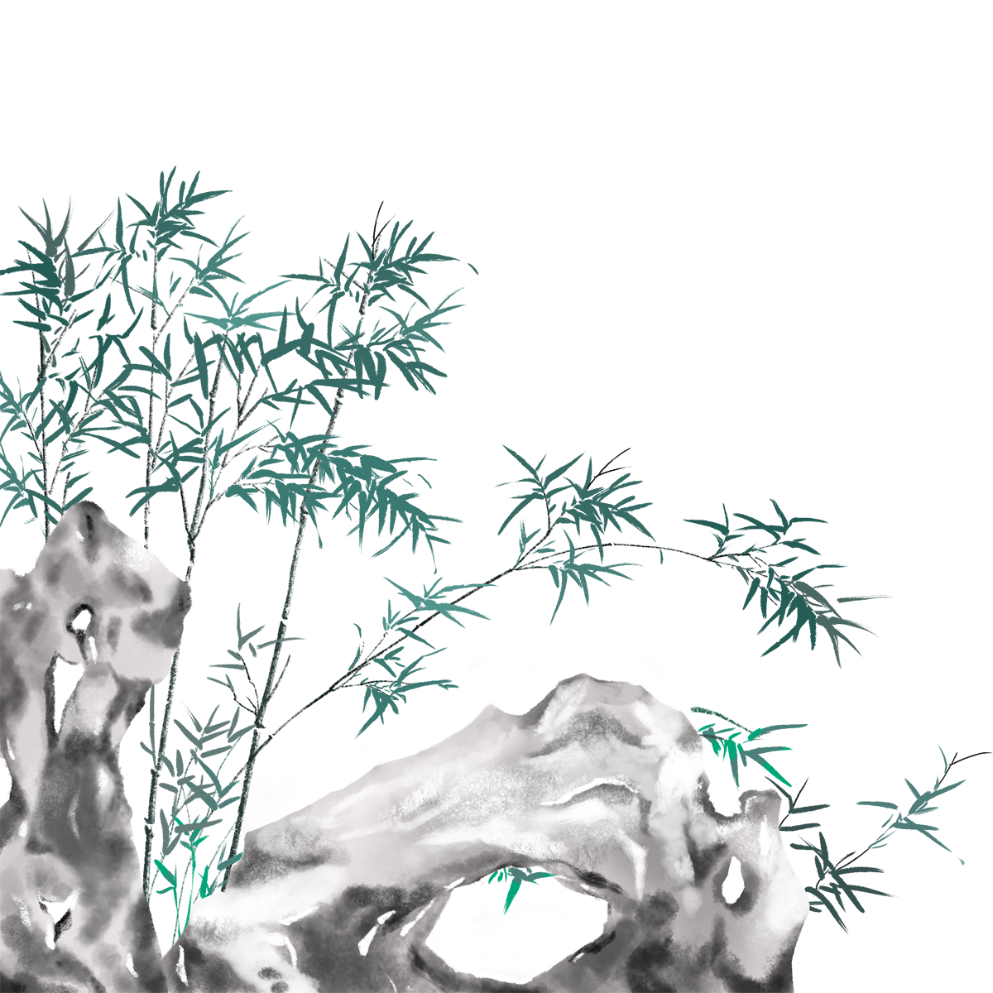
回忆式结尾：顾名思义就是以回忆的方式结尾。它能深化文章主旨,突出作者的思想,烘托出温暖的氛围,更能感染读者,产生共鸣!
高考链接---2020年7月浙江高考读后续写
结尾：… The fact was that we were safe. But now, every time I saw the pictures in my camera, my heart pounded quickly. The breathtaking scene suggested itself to me: The hungry bear was throwing itself at us with roar. The thought of the scene pained me. It was time to take measures to protect our surroundings to give animals a peaceful and safe home.
点评：以回忆的方式结尾，让情景再现，从而引出主题：是时候采取措施保护环境，给动物们一个宁静安全的家园。

Slide 16

欧亨利式结尾：在文章情节结尾时突然让人物的心理情境发生出人意料的变化，或使主人公命运陡然逆转，出现意想不到的结果，既在意料之外，又在情理之中，给人以出乎意料的感觉，又不得不承认他的合情合理。
高考链接---2020年7月浙江高考读后续写
结尾：At that very moment, the helicopter arrived. The rescuers shouted that we should keep a safe distance from the bear. Then we dragged ourselves away from the dangerous animal, less worried. In a flash, they arrived quickly, only to find that the bear had relieved its anger possibly due to the garlic bread. They dropped their jaws in amazement and tried to compose us down. Elli and I hugged each other, joyful tears streaming down our faces! Eventually, we shared the pictures with the rescuers in return for their timely help.
点评：营救人员本来是来救他们的，但出乎意料的是，当他们赶到现场时，夫妻已经安然无恙了。他们两个已经用自己的“大蒜面包”救了自己，这既在意料之外，又在情理之中。

Slide 17

画面定格式结尾：以特定的画面结尾。这个画面既可以是开头画面的
再现（相同画面再现，要么给人“物是人非”的沧桑感，渲染悲凉的气氛，
要么给人大团圆的喜庆感），也可以是其它的画面，映衬人物当时的心情。
高考链接---2020年7月浙江高考读后续写
结尾：At that very moment, the helicopter arrived. With a heavy load taken off my mind, I bit my lips tightly to hold back my tears, gripped Elli’s hands tightly and ran into the helicopter. Unable to stand the tremendous deafening noises from the helicopter, the bear escaped from my camp. Meanwhile, I lay on the plane with my heart pounding violently, eyes fixed on drifting cloud out of the window. Had it not been for the prompt rescue, I would have been a ghost, drifting in the air like the cloud. What a narrow escape!
画面
心情
点评：结尾将画面定格在“躺在飞机上，眼睛盯着窗外飘忽不定的云”，映衬了此时的心情是受惊吓之后的“心有余悸”。

Slide 18

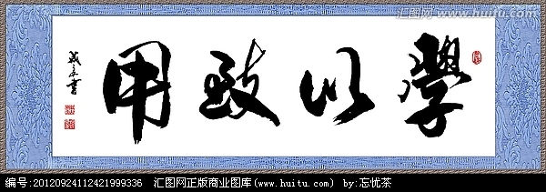
判断下面段落采用了哪种结尾方式？
欧亨利式结尾
At that very moment, the helicopter arrived. The loud noise from it scared the bear off. Seeing the bear ran away, not until that time did we really realize we were safe, paralyzing on the ground with a ripple of excitement running through our whole body. The wildly pounding heart sped down. Suddenly, Elli and I thought of our goal----to photograph the bear. Knowing the rescuers would save us, we gathered our courage and used the garlic bread to tempt the bear back. While it was swallowing the bread, We took a lot of pictures with our camera. Back to the camp, we still wore a mixed expression of excitement and panic. What a narrow escape!

Slide 19
判断下面段落采用了哪种结尾方式？
主题升华式结尾
I crashed through the kitchen door, sobbing, mum rushed over. Looking at me shivering with coldness, she asked me in surprise, “what had happened?” Before I answered, she quickly took off my wet coat and gave me a hot bath. After then, she asked me to rest on the bed. I sobbed out my grievances to her. Fuming with rage, she told Harry off. His head drooping, Harry was fear-ridden, saying nothing. So ashamed was he that he could feel the blood rush to his face. Scolded as he was, he didn’t change himself thoroughly and I changed myself root and branch. After that, the pond put a brand in my heart that I could never erase. It was “the pond” that made me understand at times we should say “No” to others in the first place. I didn't try to please others any more to put my ass on the line.

Slide 20
判断下面段落采用了哪种结尾方式？
画面定格式结尾
God also felt sad and sighed to the butterfly, “Do you regret what you have done?” The butterfly cleaned her tears on the face，“No.” God felt a bit relieved and said，“Tomorrow you can become human again.” But she shook her head and said, “No, I want to be a butterfly for the rest of my life...” Then the butterfly would stay together with her lover forever. On the top of the mountain, she seemed to enjoy the sunrise and the sunset happily with them.

Slide 21
判断下面段落采用了哪种结尾方式？
主题升华式结尾
As a proverb says, ‘Every coin has its two sides.’ Making full use of your strength is your achievement. Please remember that in no case will you give up especially in trouble. God is fair to everyone.”
留白式结尾
The beggar hesitated for a moment, and then he decided to open it. He declared aloud, “Who cares? He wanted me to have it anyway. I might as well enjoy it now.” With that, he unwrapped the white tissue paper, but to his surprise, there was no hard rock candy inside. Instead, into his fingers fell a shiny white pearl worth thousands of dollars.

Slide 22
判断下面段落采用了哪种结尾方式？
对话式结尾
Regretted and sad, Mike began crying.
“What had happened?” Mike couldn’t believe his ears--- it was Jack.
“People aren’t very friendly.” Mike answered with tears in his eyes.
Jack just held Mike’s hand and said: “You just have to give them a chance. Anyway, I’ll accompany you to the end.”
自然式结尾
Finding the man a robber, the police arrested him and threw him into prison.

Slide 23
判断下面段落采用了哪种结尾方式？
首尾呼应式结尾
开头：A funny thing happened to Arthur when he was on the way to work one day.
结尾：What a funny day.
回忆式结尾
Mike was a frozen statue when he watched Jack walking away. Memories came flooding back. Two years earlier, it was he that accompanied Jack to walk along down the hall and to walk into the gym.

Slide 24
判断下面段落采用了哪种结尾方式？
悬念式结尾
Para2: “Mom,” the kids asked, “Who was that? Why did you give her our flowers? Is she somebody’s mother?” I was curious, too. But my wife said she didn’t know the old woman. But it was Mother’s Day, and who wouldn’t be cheered by flowers? “Besides,” she added, “I have all of you, and my mother, even if she is far away. That woman needed those flowers more than I did.” This satisfied the kids, and left me thinking. I bought half a dozen young lilacs bushes and planted them around our yard. Every Mother’s Day our kids gather beautiful lilacs. And every year I remember that smile on a lonely old woman’s face, and the kindness that put the smile there.
回忆式结尾

Slide 25
结尾方式无好坏之分，
得体就好
读后续写不同的结尾方式给人的感觉不同。自然式结尾使续写故事娓娓道来，条理清晰；欧亨利式结尾能使平淡无奇的故事情节陡生波澜，撞击读者的心灵，产生震慑的力量；伤感的结尾令人回味，引人思考；高兴的结尾给人以欣慰愉悦之感；留白式结尾给读者留下想象空间，可以让读者进行艺术的再创作。悬念式结尾让读者带着疑问去揭晓谜底。总之，结尾方式无优劣之分，只要运用得体都是好的，同学们在续写时可以根据自己的喜好进行选择。

Slide 26

Thank you

