Slide 1


感恩遇见，相互成就，本课件资料仅供您个人参考、教学使用，严禁自行在网络传播，违者依知识产权法追究法律责任。
更多教学资源请关注
公众号：溯恩高中英语
知识产权声明

Slide 2
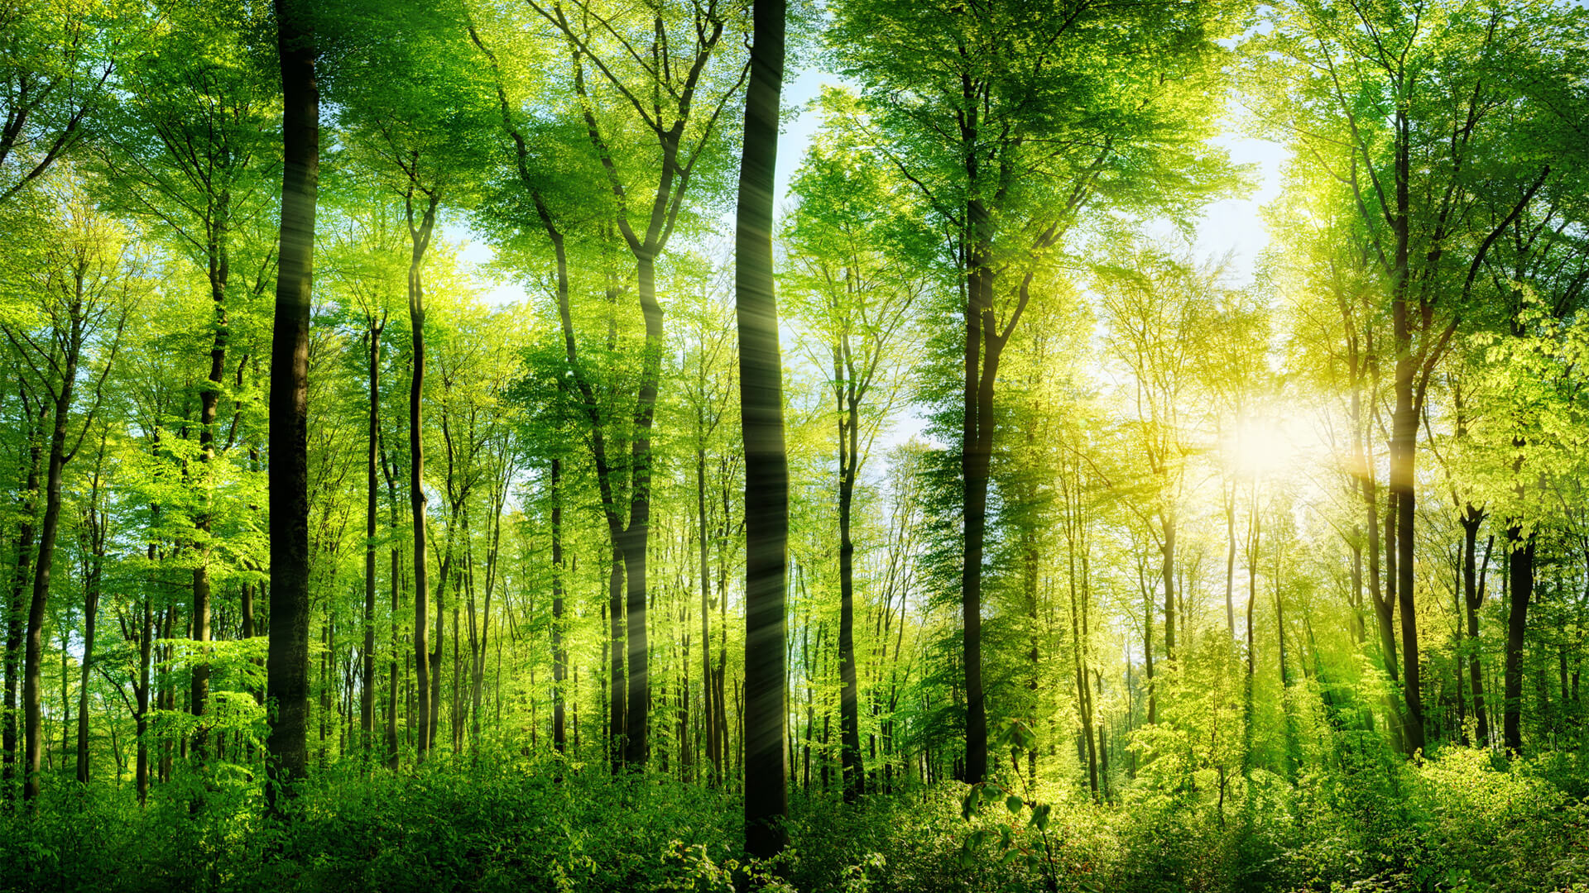
Unit 4
Natural Disasters
Listening and Speaking Report natural disasters

Slide 3
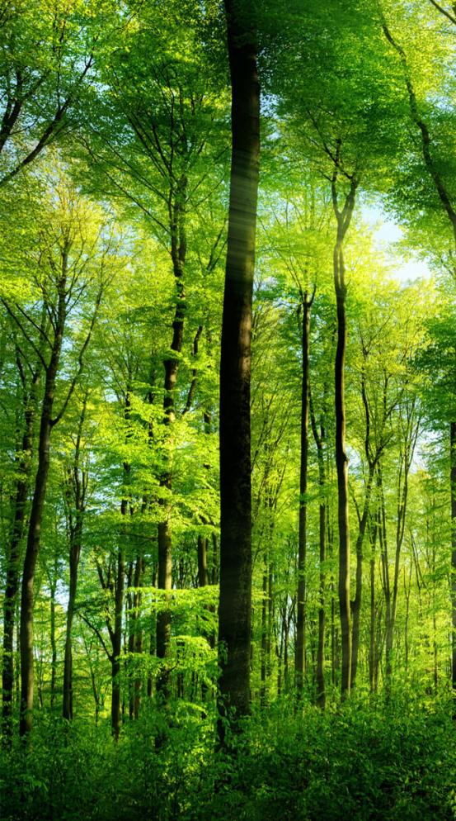
学习目标
01
知道一些基本的自然灾害有哪些
02
掌握本课时的基本语言点如rescue，damage等
03
掌握听力技巧之精听细节
04
能独立进行新闻报道

Slide 4
Preview-checking
1. n.灾难；灾害
2. n.旱灾；久旱
3. vi.& vt.(使)滑行；滑动
4. n.洪水；v.淹没；大量涌入
5. n.(地)震级；重大
6. n.& vt.营救；救援
7. vt.损害；破坏n.损坏；损失
8. vt.摧毁；毁灭
9. vt.疏散；撤出
10. n.直升机
11. vt.影响；(疾病)侵袭；深深打动
12. n.避难处；vt.保护；掩蔽vi.躲避(风雨或危险)
13. n.死；死亡 → v.死 → adj.死的
disaster
drought
slide
flood
magnitude
rescue
damage
destroy
evacuate
helicopter
affect
shelter
death
die
dead

Slide 5
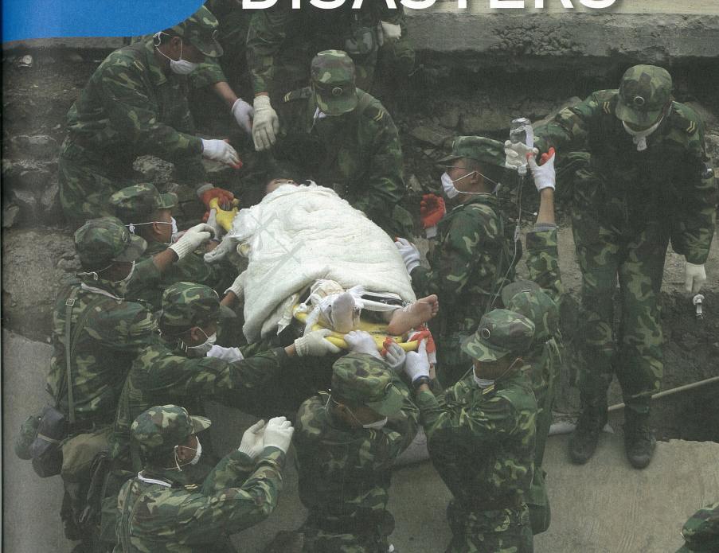
Warming-up
rescue workers
（soldiers）
are rescueing
1. What can you see in the picture？
survivor
（the injured）
2. What happened？
from the ruins
An earthquake hit the area.
When we are in trouble, Chinese soldiers always come to our rescue immediately.

Slide 6
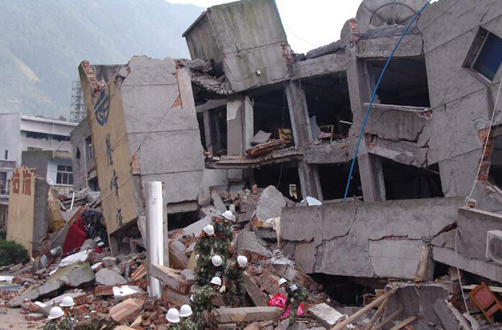
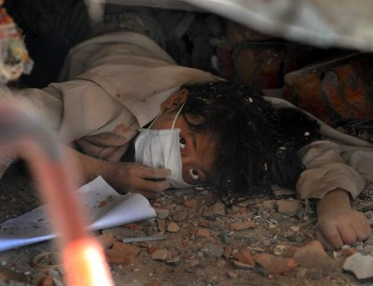
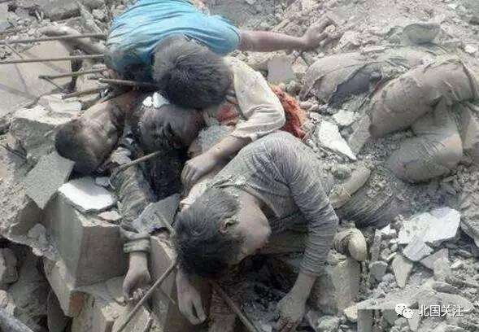
Warming-up
3. What does the earthquake bring to us？
i. It destroys/damages the duildings
do damage to the duildings
ii. people are trapped in the ruins
What do you want to know about natural disasters?
iii. people suffer a great loss
iv. people lost their lives
Natural disasters are cold,
but love exists among us.
soldiers play an important role in...

Slide 7
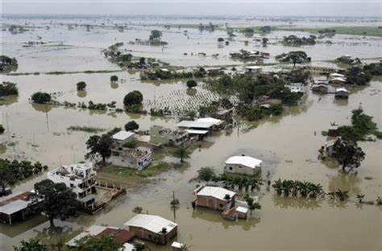
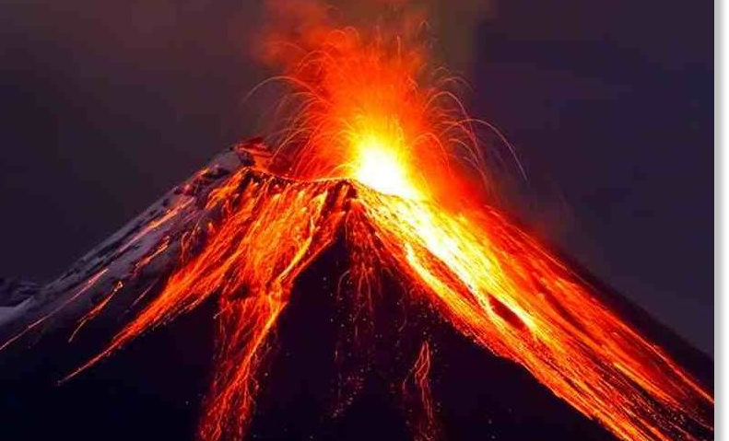
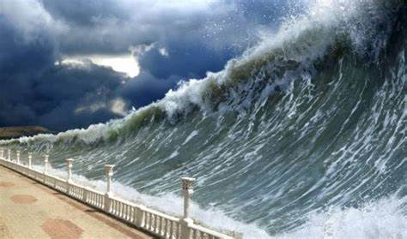
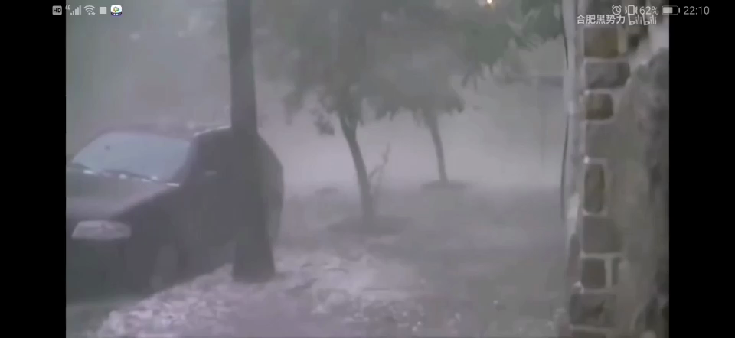
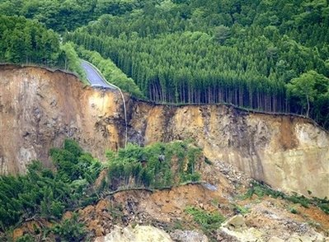
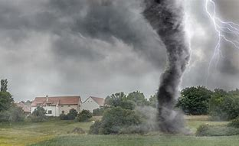
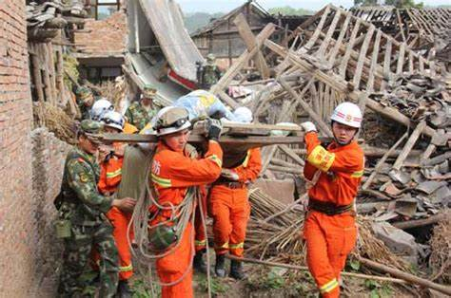
Lead-in
How many types of natural disasters can you see? What are they?
What sources can the information of natural disasters?
volcanic eruption
flood
tsunami
landslide
tornado
earthquake
natural disasters

Slide 8

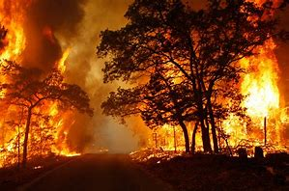
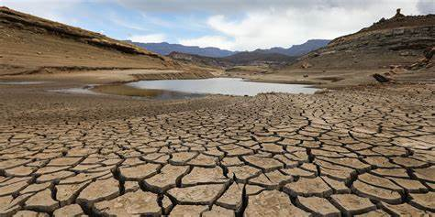
Listening
I. Listen to the news reports and tick the disasters you hear.
earthquake
tornado
wildfire
drought
landslide
tsunami
flood
volcanic eruption

Slide 9
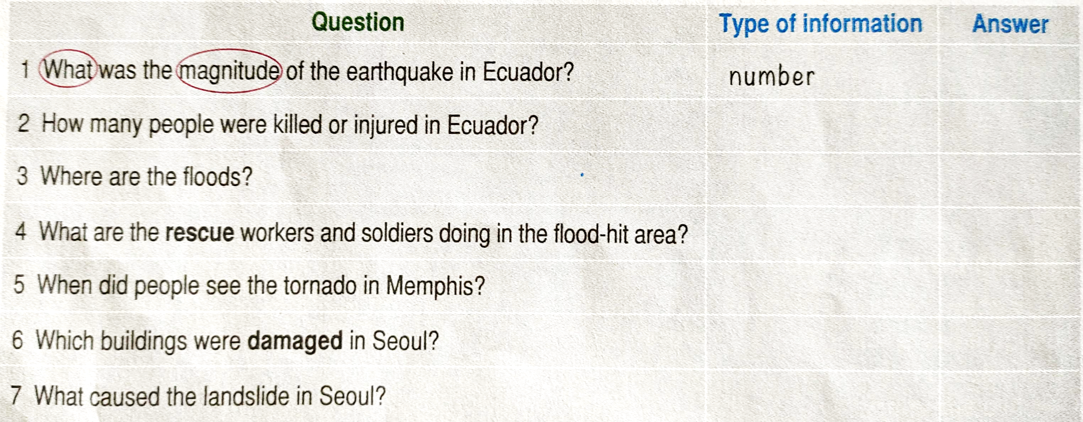
Listening
What should we pay attention to?
It is up to the questions.
Think about what you are listening for before you listen:
numbers, dates, times, addresses, activities, people or places, reasons, etc.
News Report 1
number
place
News Report 2
activities
News Report 3
time
place
News Report 4
reason

Slide 10
Listen for Details
News Report 1
Listen to the news report 1 and choose the right anwsers.
Q1: What was the magnitude os the earthquake in Ecuador?
A. 7 B. 7.8 C. 8.7
Q2: How many people were killed or injured?
A. 150;23 B. 15000;2300 C. 230; 1500

Slide 11
Listen for Details
News Report 2
Listen to the news report 2 and fill in blanks.
Place + damage + rescue work
Good evening. Today is 27 March. More news about the floods in central China. The government is helping more than 12,000 people in Hunan and Jiangxi get away from the rising water. Homes and land have been destroyed, but no one has been killed. Rescue workers and soldiers are working day and night to make sure that people are safe. They are also bringing food and water to those whose homes were lost in the disaster.

Slide 12
Listen for Details
News Report 3
Listen to the news report 3 and fill in blanks.
time + damage
Breaking news, Saturday 12 August. A tornado was just seen in southern Memphis, the USA. Eyewitnesses said that at 9:25 am, the tornado destroyed four homes. A police officer tells us that at least one person has died. More tornados are possible, and the police advise avoiding the area.

Slide 13
Listen for Details
News Report 4
Listen to the news report 4 and answer the queations.
Q1: Which buildings were damaged in Seoul?
Q2: What caused the damage?
Q3: What other damage did the landslide do to Seoul?
A library and a supermaket
It was caused by the heavy rain.
No one was injured, but several cars were damaged.

Slide 14
Listening
News=
time
+disaster&place
+damage
+rescue work
Good morning, it's 17 April. A strong earthquake hit Ecuador yesterday. The 7.8­magnitude earthquake damaged many buildings, and early reports said that about 230 people were killed and more than 1,500 were injured. Volunteers and rescue workers are helping the survivors.
Good evening. Today is 27 March. More news about the floods in central China. The government is helping more than 12,000 people in Hunan and Jiangxi get away from the rising water. Homes and land have been destroyed, but no one has been killed. Rescue workers and soldiers are working day and night to make sure that people are safe. They are also bringing food and water to those whose homes were lost in the disaster.
Breaking news, Saturday 12 August. A tornado was just seen in southern Memphis, the USA. Eyewitnesses said that at 9:25 am, the tornado destroyed four homes. A police officer tells us that at least one person has died. More tornados are possible, and the police advise avoiding the area.

Slide 15

Reporting
News=
time
+disaster&place
+damage
+rescue work
Earthquake
Good morning. Today is 13 May. A huge earthquake hit Wenchuan, China, yesterday afternoon. The 7.8 magnitude earthquake demaged buildings. And according to an early report, at least 8,500 people were killed and thousands of people were injured. Rescue workers, soldiers, medical teams and volunteers were working day and night to make sure that people are safe. They also bring food and water to those who lost homes in the disaster.
Wenchuan, China
● 14:28 Monday, 12 May
● Magnitude 7.8 (8.0)
● At least 8,500 killed (by 13 May)
● Rescue workers
(medical teams, troops, etc.) organized quickly

Slide 16
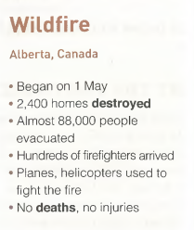
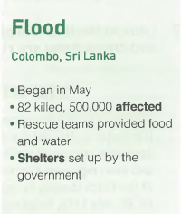
Reporting
News=
time
+disaster&place
+damage
+rescue work
Good evening, today is 3 May. More news is about the wildfire in Alberta, Canada. The huge wildfire began on 1 May and 2,400 homes have been destroyed. The government is helping almost 88,000 people evacuate from the fire. Hundreds of firefighters are working hard to put out the fire and planes, helicopters are used to fight the fire. Up till now, no deatha and injuries have benn reported.
Good evening, today is 3 May. More news is about the wildfire in Alberta, Canada. The huge wildfire began on 1 May and 2,400 homes have been destroyed. The government is helping almost 88,000 people evacuate from the fire. Hundreds of firefighters are working hard to put out the fire and planes, helicopters are used to fight the fire. Up till now, no deatha and injuries have benn reported.
shelter survivors from other dangers.
take shelter from the rain.

Slide 17
课堂总结
01
你知道哪些自然灾害？
02
这节课讲了哪几个词的用法，分别是什么？考试会怎么考？
03
一篇灾难新闻报道的构成是怎样的？，新闻用语有哪些？
04
精听细节时，你要注意什么？

