Slide 1


感恩遇见，相互成就，本课件资料仅供您个人参考、教学使用，严禁自行在网络传播，违者依知识产权法追究法律责任。
更多教学资源请关注
公众号：溯恩高中英语
知识产权声明

Slide 2

Reading
The spirit of Christmas
瑞安市上海新纪元高级中学 潘慧愉

Slide 3
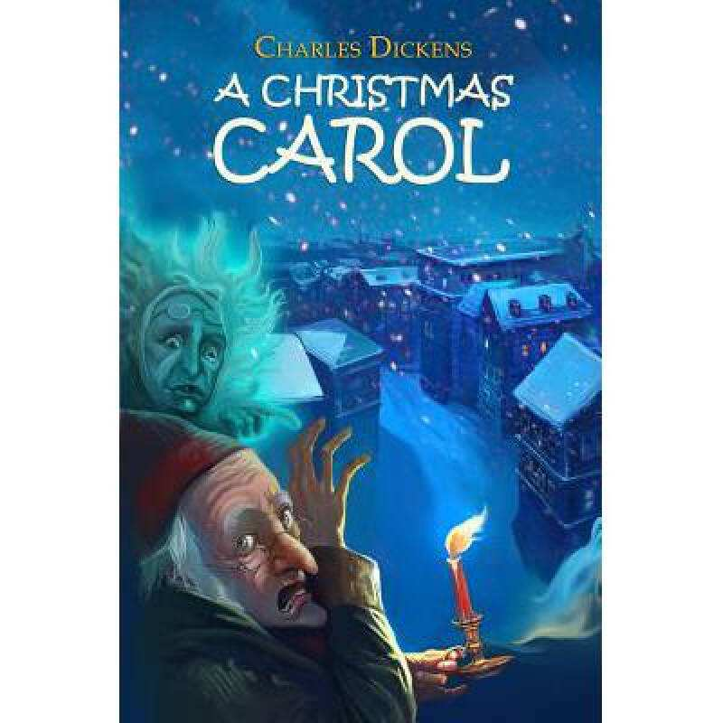
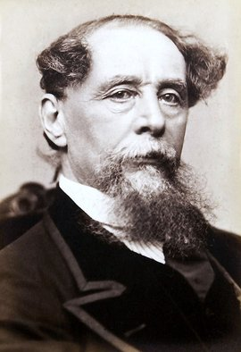
What comes to your mind when you see this word?
What may the story talk about?
Christmas
What is the meaning of Christmas?
As for me, Christmas means shopping/ a big dinner…
A Christmas Carol

Slide 4

Read for brief information
A Christmas Carol
__________
Scrooge
Main character （主要人物）
What was he like in the past？
What is he like now? | He happily ______________ He also gives__________________ He now treats __________________
He never____________________
He is _____________________
He doesn’t __________________
laughs or smiles
mean and only thinks about himself
inferring (推断）
It means you have to “read between the lines” to get the meaning that are not clearly stated in a text.
treat others nicely
cares about whether he can make more money
A: 吝啬的 B: 友好的
C: 乐于助人的 D:粗心大意的
He just _________________
Unhappy
Christmas
Feeling :__________
infer
He hates___________
He decides to______
change
根据阅读材料中所提供的信息，
推断出未知的信息。
celebrates Christmas with his relatives
What do you think of him?
gifts to people in need
Happy
Feeling :__________
everyone with kindness and warmth
Sharing and giving love and joy to people around us.
The true meaning of Christmas:_______________________________________

Slide 5
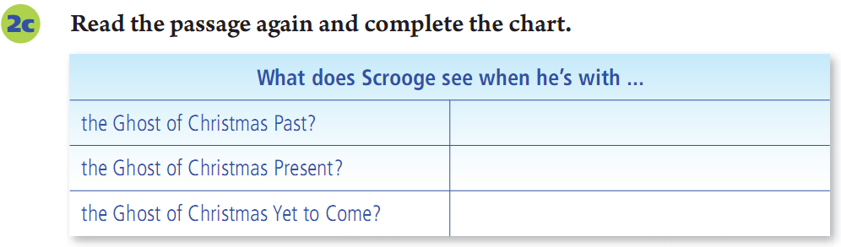
What made Scrooge change?
Read Para3 and complete the chart
Let sb think of
Three ghosts visit him
He sees the ghost of Jacob Marley
remind sb of sth
Happy
his happier days as a child
Marley used to be just like Scrooge, so he was punished after he died.
infer
how others are spending Christmas this year
Unhappy
A: Something bad happens
B: Something good happens
he is dead but nobody cares
Scared

Slide 6
inferring (推断）
What was Jacob Marley like?
Yes or No
1. He is mean and only thinks about himself .
2. He treats others nicely .
3. He just cares about whether he can make more money .
Yes
infer
No
Yes
Marley used to be like Scrooge .

Slide 7
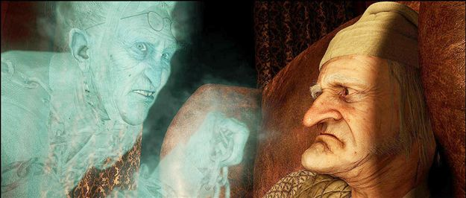
He warns Scrooge to change his ways if he doesn’t want to end up like him.
infer
He also tells Scrooge to expect three spirits to visit him.
Does Jacob Marley want to help Scrooge？ How do you know?
Jacob Marley
Scrooge

Slide 8
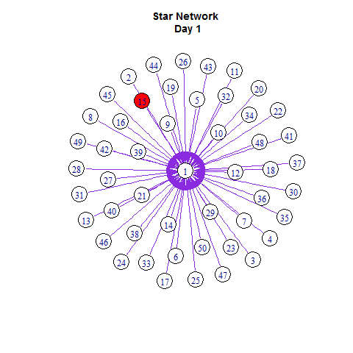

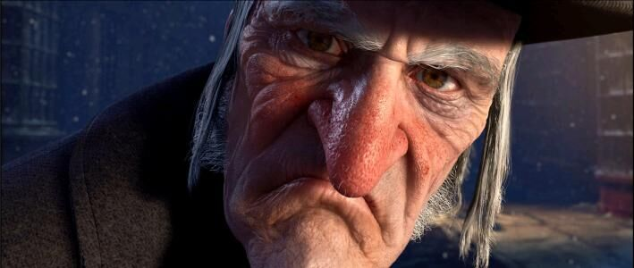
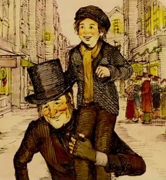
Why is Scrooge the main character?
inferring (推断）
Spreading love makes you happy.
True meaning (spirit) of Christmas
A: Because he wants to punish others.
B: Because he learns to spread love and joy.
C: Because he wants to make more money.
Scrooge in the past
Scrooge at present

Slide 9
What does Scrooge do after he wakes up on Christmas Day?
inferring (推断）
Group Work
He went to church,_________________________
______________________________________________________________________________________________________________________________________________________________________________________________________________________________________________________and found that everything could bring him pleasure.

Slide 10
What does Scrooge do after he wakes up on Christmas Day?
inferring (推断）
Group Work
He went to church, and walked about the streets, and watched the people hurrying to and fro(匆忙来回), and patted children on the head, and questioned beggars, and looked down into the kitchens of houses, and up to the windows, and found that everything could bring him pleasure.
Let’s learn to spread our love and joy everywhere we go

Slide 11
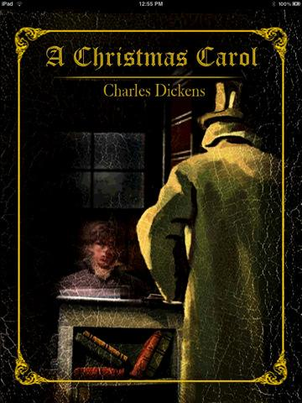
Read some more about this story
Homework
Writer & main Characters
Story( briefly简要的)
Favorite part(sentences...)
Your opinion & feeling

Slide 12

Thank you

