Slide 1


感恩遇见，相互成就，本课件资料仅供您个人参考、教学使用，严禁自行在网络传播，违者依知识产权法追究法律责任。
更多教学资源请关注
公众号：溯恩高中英语
知识产权声明

Slide 2
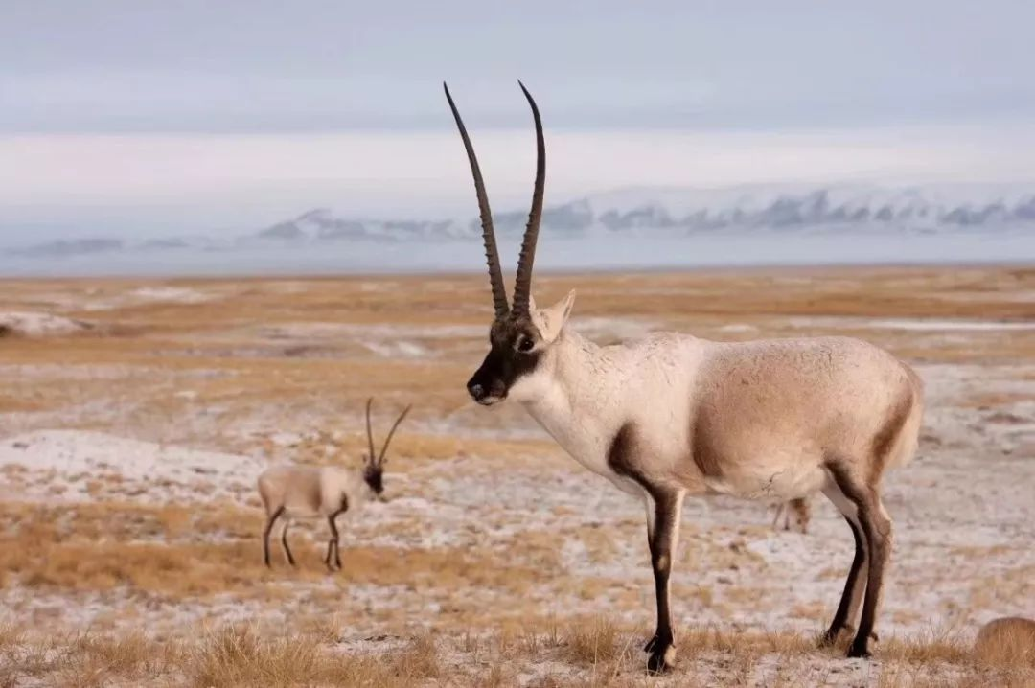
Module Two Unit Two
Wildlife Protection
嵊州市高级中学

Slide 3
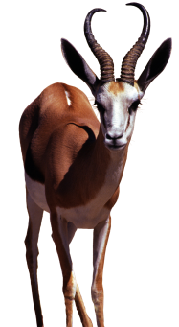
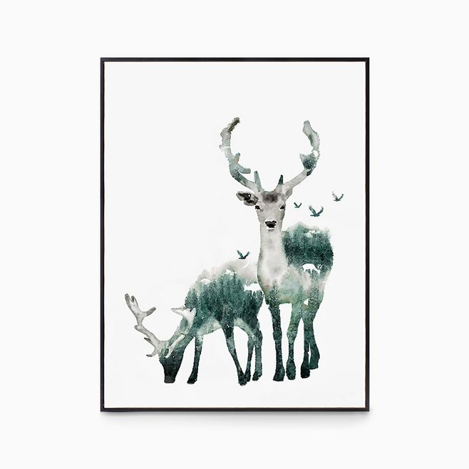
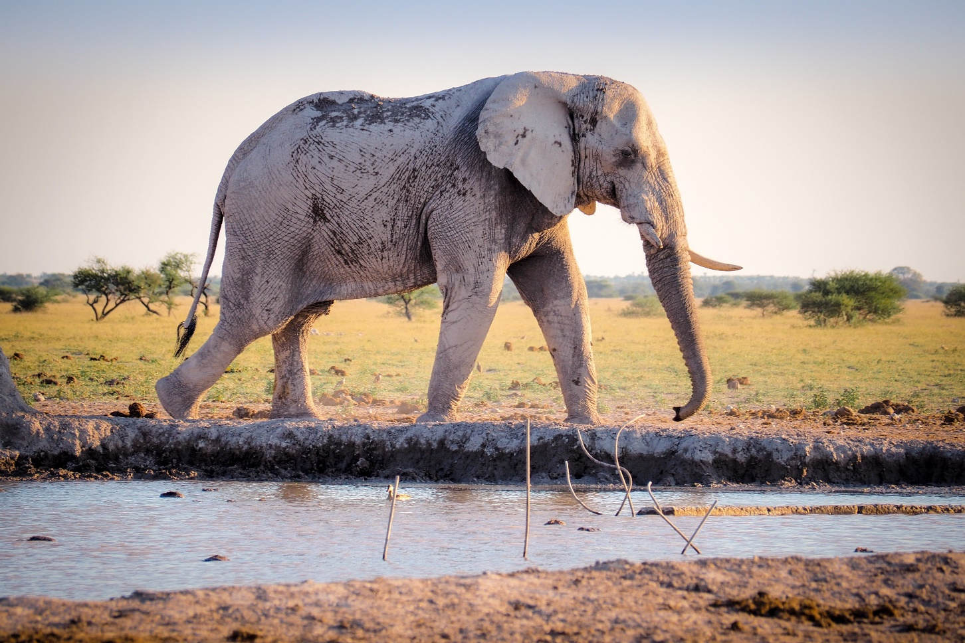
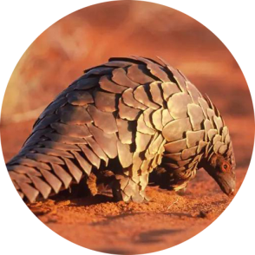
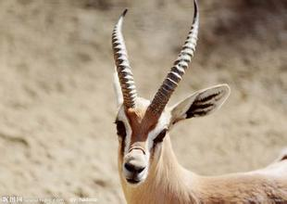
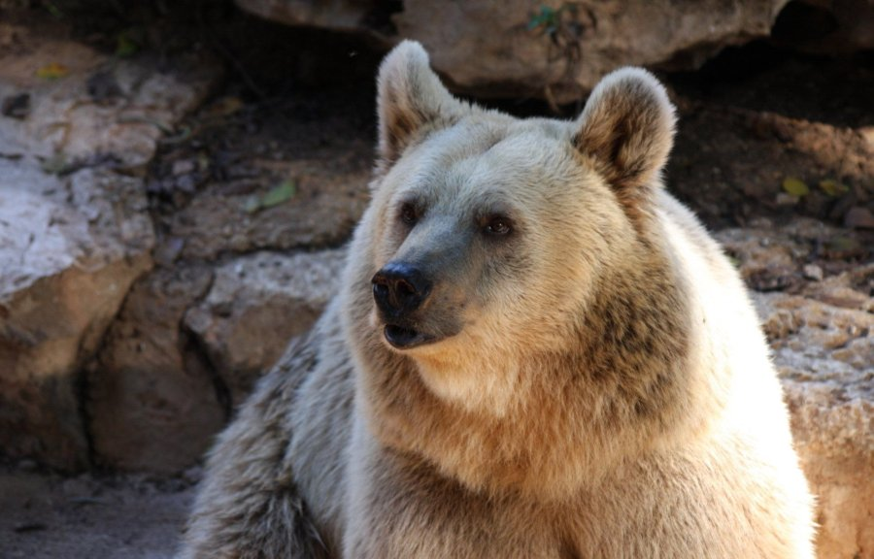

Warm up & Lead in
What do you think about the animals when you see these pictures?
Beautiful
Graceful
(优雅的)
Natural
Harmonious
(和谐的)
Precious
(珍贵的)
Lovely
Fierce
(凶猛的)
Wildlife is living in harmony in their wild habitats and enjoy themselves.

Slide 4
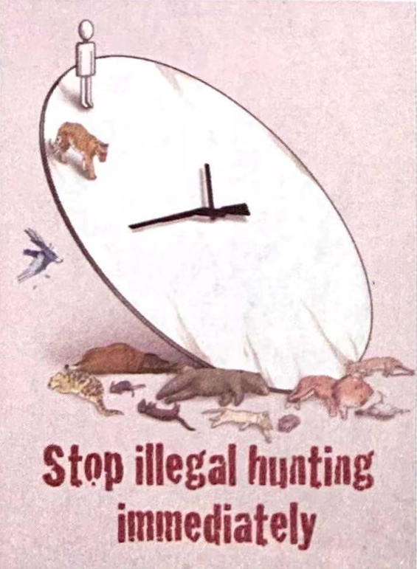
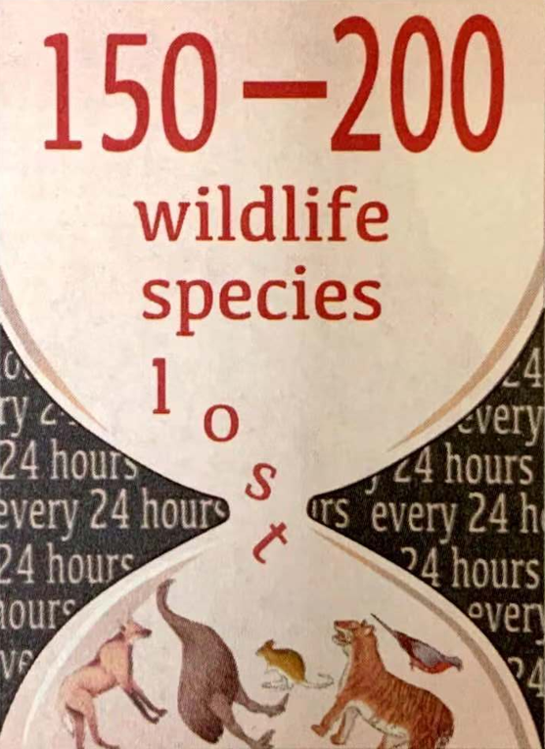
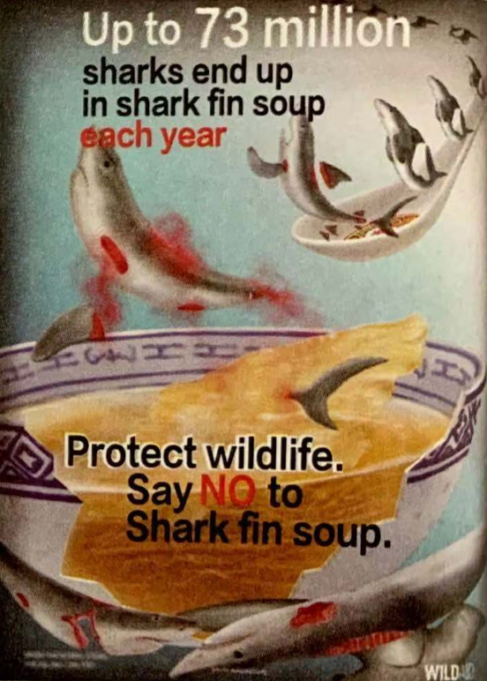
Warm up & Lead in
However, how do you feel when you see these pictures?
illegal hunting
wildlife species loss
sharks end up in shark fin soup
Our planet's wildlife is dying out at an alarming rate. Between 150 and 200 species are becoming extinct every day. This mass extinction is caused by hunting, habitat loss, and pollution. We must make people aware of the problem and help protect the endangered wildlife before it's too late.

Slide 5
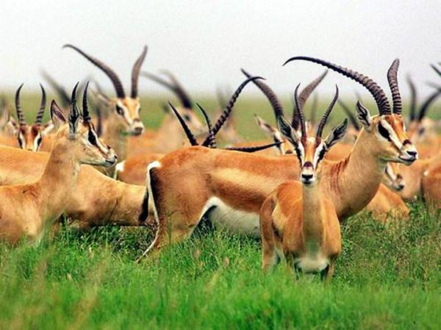
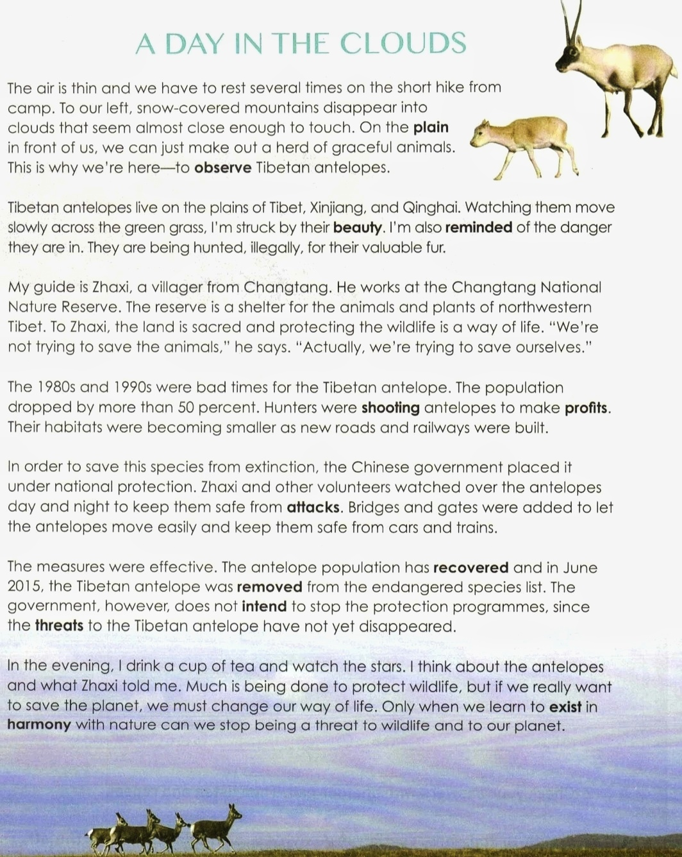
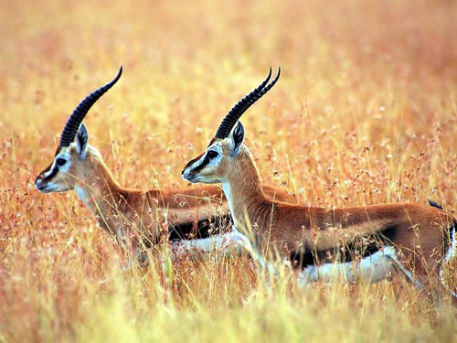
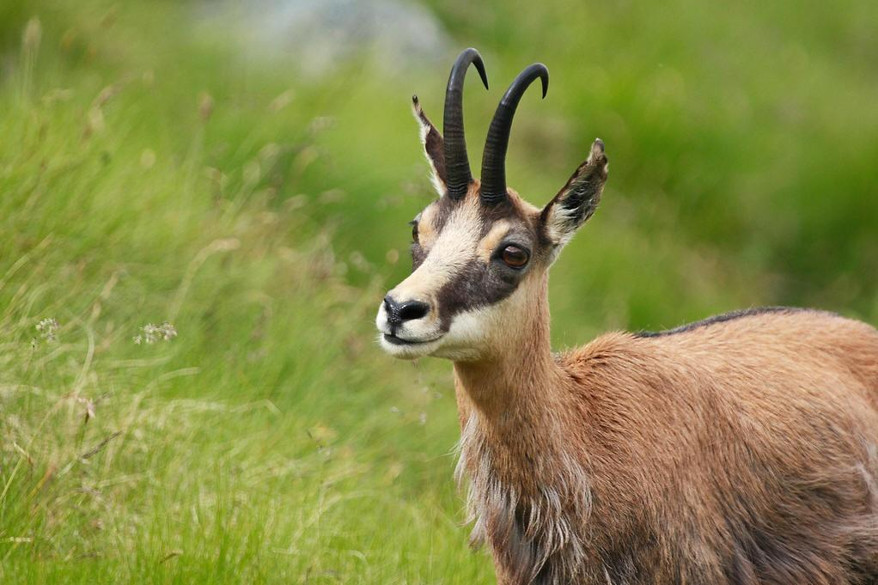
Warm up & Lead in
Predict
& Skim
What will the text mainly talk about?
What is the animal?
What is the meaning of the title?
A Day in the Clouds
Time
Place
Journal
(日志)
Who
What
How
see
hear
do
think
The conclusion

Slide 6
Warm up
& Lead in
Predict
& Skim
Read & Comprehend
Read the passage, get the main ideas & match them
Tibetan antelopes are in danger.
His guide thinks that the land is sacred and protecting the wildlife is a way of life.
Bad times for the Tibetan antelope.
Human beings must change the way of life in order to save the planet.
The Chinese government and volunteers took effective measures to protect the Tibetan antelope.
The effective measures have helped the population of Tibetan antelopes recover.
The writer visited Changtang in order to observe Tibetan antelopes.

Slide 7
Warm up
& Lead in
Predict
& Skim
Read & Comprehend
Focus on the key words and divide the parts
The writer visited Changtang in order to observe Tibetan antelopes.
Part One: Introduction
Paragraph 1: Introduction
Tibetan antelopes are in danger.
Paragraph 2: The present problem
His guide thinks that the land is sacred and protecting the wildlife is a way of life.
Paragraph 3 A protector
Paragraph 4 The bad times
Bad times for the Tibetan antelope.
Part Two: Body part
The Chinese government and volunteers took effective measures to protect the Tibetan antelope.
Paragraph 5 Protective measures
The effective measures have helped the population of Tibetan antelopes recover.
Paragraph 6 Effect
Human beings must change the way of life in order to save the planet.
Part Three: Conclusion
Paragraph 7 Reflection

Slide 8
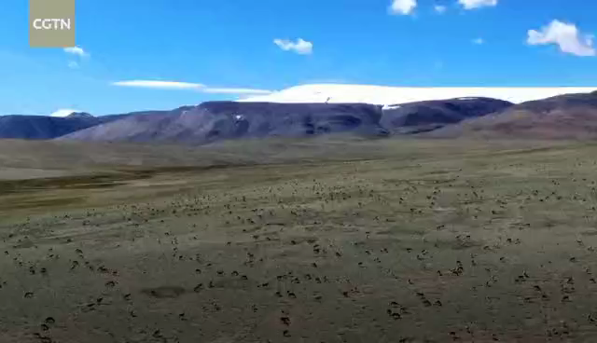
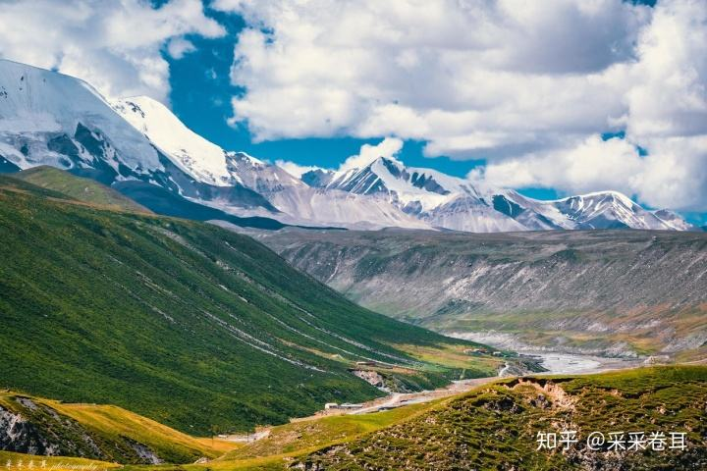
Warm up
& Lead in
Predict
& Skim
Read & Comprehend
Part One: Introduction: What can you see in the video?
What other things does the author see and feel in paragraph One?
Pleased
snow-covered mountains disappear into clouds
literal meaning
The air is thin and we have to rest...
The altitude there is very high and there is a little oxygen.
a herd of graceful animals
the mountains
the blue sky & the clouds
the plain
the grass
implied meaning

Slide 9
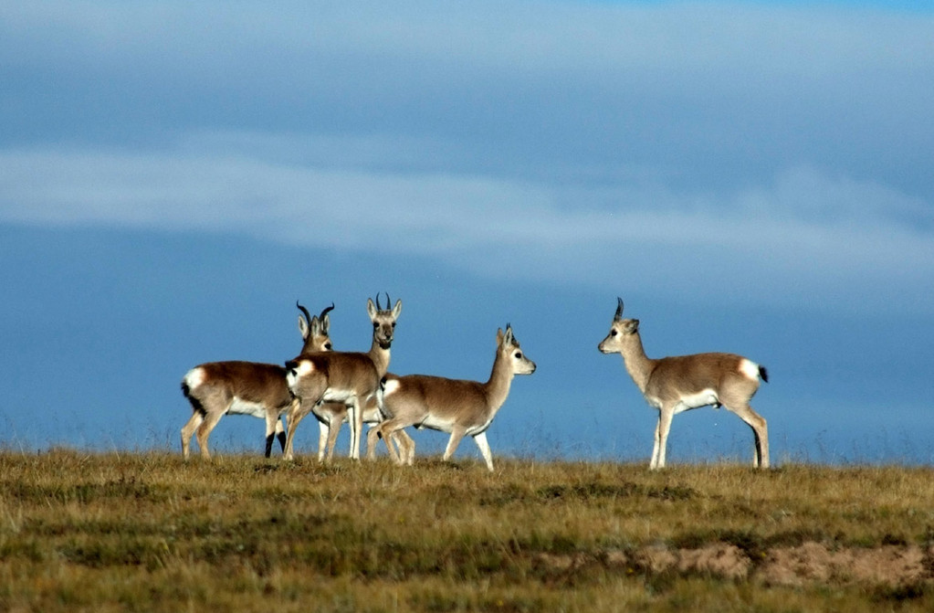
Warm up
& Lead in
Predict
& Skim
Read & Comprehend
Part Two: Body part(Para2-3) The present situation
The present situation: Make a profile(简历) for the animals
The profile
The name
Habitats
Appearance
Situaton
I am struck by their beauty.
Tibetan antelopes
I am deeply impressed
by their beauty.
On the plain of Tibet, Xinjiang, and Qinghai
Graceful, beautiful
I am also reminded of the
danger they are in.
They are in danger.
They are being hunted, illegally, for their valuable fur.
I am also aware of the
danger they are in.
ConcernedWorried

Slide 10
Warm up
& Lead in
Predict
& Skim
Read & Comprehend
Part Two: Body part(Para2-3) The present situation
The present situation
What does Zhaxi do?
What is Zhaxi's attitude towards protecting wildlife?
Zhaxi works at the Changtang National Nature Reserve which is a shelter for the animals and plants of northwestern Tibet.
literal meaning
The land is sacred and protecting the wildlife is a way of life.
We are not trying to save the animal. Actually, we're trying to save ourselves.
Wildlife is important to the planet we are living on.
Whether the wildlife exists affects our life.
implied meaning
We should protect the animals to keep the balance of the ecosystem.
Humankind should live in harmony with the wildlife.
Respectful
Relieved

Slide 11
Warm up & Lead in
Predict
& Skim
Read & Comprehend
Part Two: Body part(Para4-6)
Hunters were shooting...
The past problems
population
Their habitat were becoming...
population
bad times
effective
VS
the 1980s and 1990s
To save this species from extinction
in June 2015
Worried
Relieved
The Chinese government placed...
The measures
Zhaxi and other volunteers watched over...
Bridges and gates were added...
The Tibetan antelope was removed from the endangered species list.
The effects
Follow-up measures
The Chinese government does not intend to stop the protection programmes...
threads
Worried
illegal hunting
pollution
habitat destruction
...

Slide 12
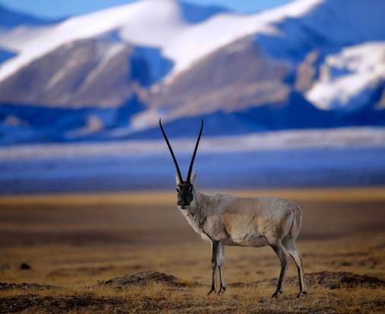
Warm up & Lead in
Predict
& Skim
Read & Comprehend
Part Three: Conclusion & reflection
Writer's reflection
What can we do to stop being a thread to wildlife?
We must change our way of life and learn to exist in harmony with nature.
Your reflection
Positive
Responsible
We are expected to have a greener lifestyle to reduce pollution.
We are supposed to stop buying goods made from endangered animals.
We need to realise that we are part of nature and can not separate from it.
We should take our responsibilities to protect the wildlife and keep a balance between human beings and wildlife animals.
One can measure the greatness and the moral progress of a nation by looking at how it treats its animals. ——Mahatma Gandhi

Slide 13
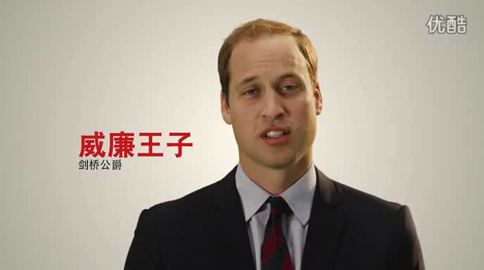
Warm up & Lead in
Predict
& Skim
Read & Comprehend
Think further
Prince William, David Beckham and Yao Ming are expressing their wishes as fathers. Watch this piece of video and get the answer.
When the buying stops, the killing can too. --- WildAid
We all have a responsibility to protect endangered species, both for their sake and for the sake of our own future generations.
------Loretta Lynch
It's a very rare opportunity in history for us to get second chances to save an endangered species.

Slide 14
Thank you!

