Slide 1


感恩遇见，相互成就，本课件资料仅供您个人参考、教学使用，严禁自行在网络传播，违者依知识产权法追究法律责任。
更多教学资源请关注
公众号：溯恩高中英语
知识产权声明

Slide 2
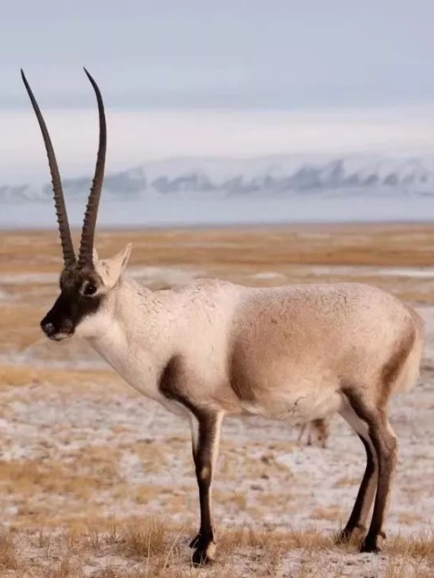
Module Two Unit Two
Wildlife Protection
嵊州市高级中学 尹娟

Slide 3
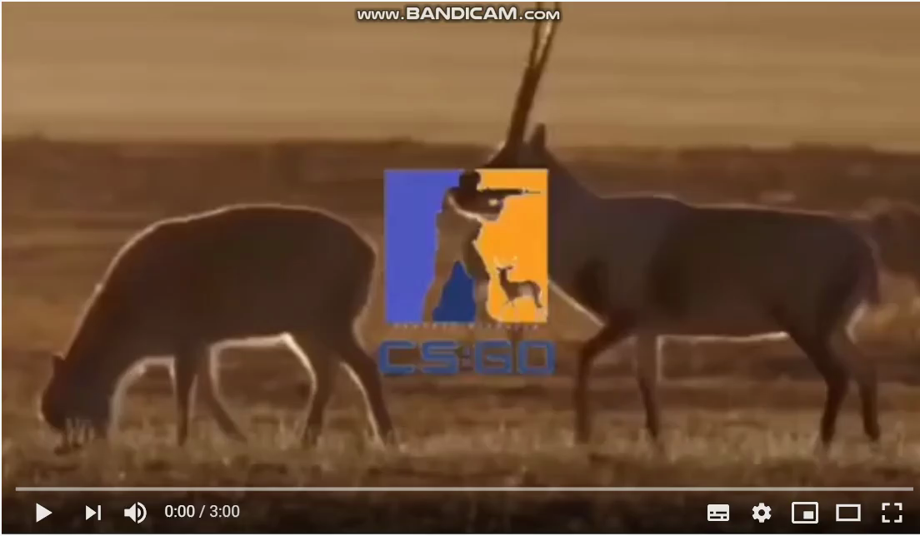
Warm up
What do you know about this animals?

Slide 4
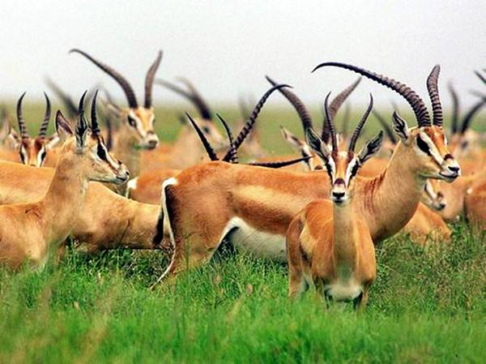
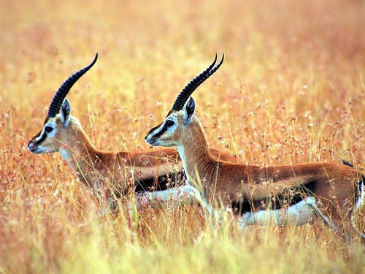
Predict and Skim
snow-covered mountains
The author's
Zhaxi's
on the plain
Tibet
Whose day is it?
Where do they go?
A Day in the Clouds
Why do they go there?
What do they see?
To observe Tibetan antelopes
A herd of graceful animals
They move slowly across...

Slide 5
Read and Comprehend
Maintenance(维护) of peace
How does the author observe the Tibetan antelopes?(Para1-3)
The Place
(Environment/Habitat)
The Action/
Appearance
The things the author does when observing
The air is thin
graceful
have to rest several times
snow-covered mountains disappear into clouds
move slowly across the green grass
can just make out a herd of ...
on the plains of Tibet, Xinjiang, and Qinghai
beautiful
Watching..., I'm struck by their beauty
the green grass
I'm also reminded of the danger ...
Changtang National Nature Reserve
Unique/ Special
Worthwhile to protect
live in harmony in nature
observe by seeing/feeling/hearing

Slide 6
Read and Comprehend
How does the author observe the Tibetan antelopes?(Para2.4.5.6.7)
The Tibetan antelope was removed from the endangered species list.
Hunters were shooting...
Their habitat were becoming...
population
exist in harmony with nature
population
bad times
good times
change our way of life
the 1980s and 1990s
in June 2015
in the future
The Time
To save this species from extinction
a day now
The Chinese government placed...
They are in danger.
Zhaxi and other volunteers watched over...
They are being hunted, illegally, for their valuable fur.
Bridges and gates were added...
Human's constant efforts to protect Tibetan antelope

Slide 7
Read and Comprehend
Objections(反对) to hurting the Tibetan antelopes.
How does the author observe the Tibetan antelopes?(Para1-7)
The relationship between human beings and Tibetan antelopes
harmonious
P1
P2
P3
P4
P5
P6
P7
We observe the Tibetan antelopes.
I'm struck by their beauty.
harmonious
People illegally hunt Tibetan antelopes for their fur.
disharmonious
Zhaxi protects and saves the Tibetan antelopes.
harmonious
Hunters were shooting antelopes to make profits. Their habitats were becoming smaller as new roads and railways were built.
disharmonious
The Chinese government / Zhaxi and other volunteers take measures to protect the antelopes
harmonious
The Chinese government continue to protect the antelopes.
harmonious
Much is being done to protect wildlife. We must change our way of life, and live in harmony with nature.
harmonious

Slide 8
Read and Comprehend
Nation joint efforts
What else does the author observe to protect Tibetan antelopes?(Para3,5,6,7)
placed it under national protection
Government
Official
participation
continue to protect the antelopes
works
protects
saves
watches over
The things he does
keeps them safe from attack
Respect for nature
Zhaxi
The feelings he has
The land is sacred and protecting the wildlife is a way of life.
Individual
participation
The idea he expresses
We are not trying to save the animal. Actually, we're trying to save ourselves.
Youth like you
？
Youth's
participation
change our way of life
exist in harmony with nature

Slide 9
Read and Comprehend
Appeal for awareness
After a day's observation, what does the author think about the future?
In the evening, I drink a cup of tea and watch the stars. I think about the antelopes and what Zhaxi told me. Much is being done to protect wildlife, but if we really want to save the planet, we must change our way of life. Only when we learn to exist in harmony with nature can we stop being a threat to wildlife and to our planet.
We are expected to have a greener lifestyle to reduce pollution.
More can be done in the future.
We are supposed to stop buying goods made from endangered animals.
We need to realise that we are part of nature and can not separate from it.
We should take our responsibilities to protect the wildlife and keep a balance between human beings and wildlife animals.

Slide 10
Conclusion and further thinking
A(n)___________ Day in the Clouds
The author observes Tibetan antelopes
The Place (Environment/Habitat)
The necessity to protect Tibetan antelopes
The Action/ Appearance
The Time
The author observes Zhaxi
The things he does
The possibility for individuls to protect Tibetan antelopes
The feelings he has
The idea he expresses
The urgency to protect Tibetan antelopes/ wildlife
The author thinks about the future

Slide 11

Conclusion and further thinking
Human's constant efforts
H
Appeal for awareness
A
A Day in the Clouds
Respect for nature
Harmony
R
Tibet
Sacred land
Humans
Maintenance(维护) of peace
M
The place with high altitude
Wildlife
O
Nature
Objections(反对) to hurting
The paradise for the wildlife
Planet
Nation joint efforts
N
Love
Y
Youth's participation

Slide 12
Assignment
With all these efforts, suppose the author goes back to Tibet to observe the antelopes several years later, what will be the enviornment and the relationship between human beings and the Tibetan antelope? Please describle the situations with the useful expressions in the text.
snow-covered mountains; a herd of graceful animals;
move slowly across the green grass; observe Tibetan antelopes;
Watching..., I'm struck by their beauty; can just make out a herd of ...
exist in harmony with nature; The land is sacred.
I drink a cup of tea and watch the stars... the paradise for the wildlife

Slide 13
Thank you!

