Slide 1


感恩遇见，相互成就，本课件资料仅供您个人参考、教学使用，严禁自行在网络传播，违者依知识产权法追究法律责任。
更多教学资源请关注
公众号：溯恩高中英语
知识产权声明

Slide 2
HD
4K
25FPS
REC
Welcome to My Class
嵊州市高级中学 尹 娟
MENU

Slide 3
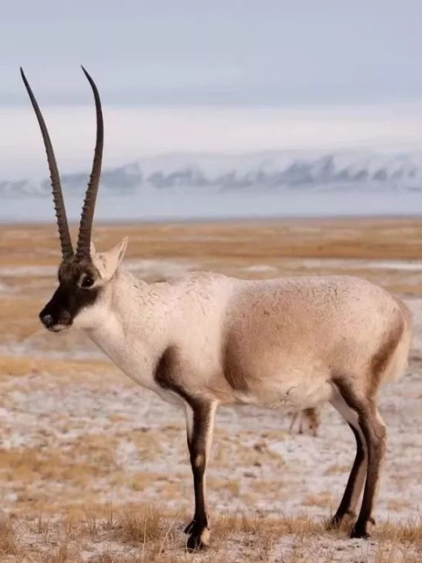
Tibetan antelope
A Day in the Clouds

Slide 4

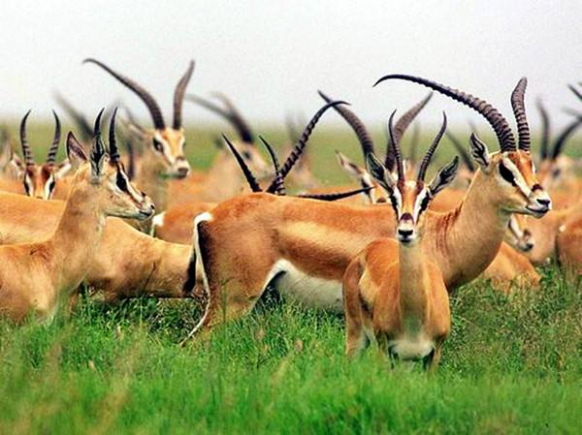
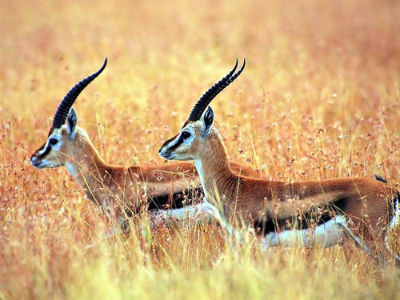
A Day in the Clouds
One day, I go to the “clouds” to observe Tibetan antelopes with my guide, Zhaxi.
Qs: 1. What does “in the clouds” refer to?
2. What do we know about Zhaxi?
3. What do I see in the clouds?

Slide 5
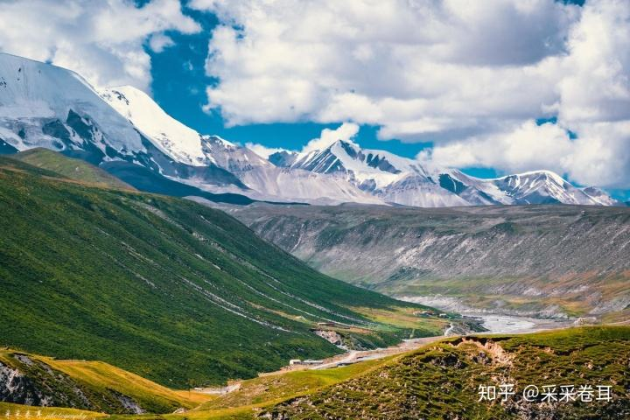
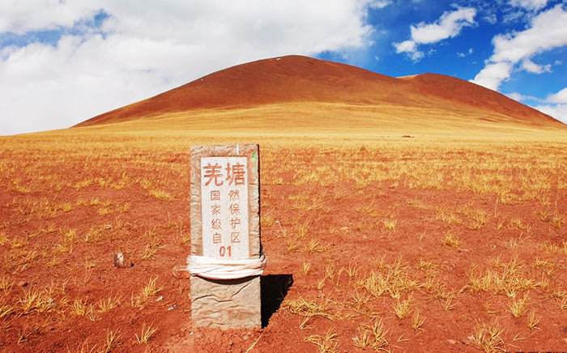
Respect for nature
What does “in the clouds” refer to?
In the snow-covered mountains with a high altitude.
What do we know about Zhaxi?
villager
The land is sacred and protecting the wildlife is a way of life.
the Changtang National Nature Reserve.
guide
We’re not trying to save the animals. Actually, we're trying to save ourselves.
volunteer
protector

Slide 6
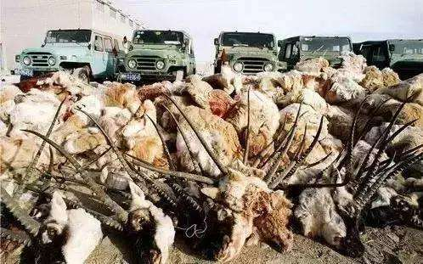
What do I see in the clouds?
a herd of graceful animals
move slowly across the green grass
How do I feel when I see these animals and views?
I’m also reminded of the danger.
I’m struck by their beauty.
They are being hunted, illegally, for their valuable fur.
Maintenance(维护) of beauty

Slide 7
What was their situation in the past?
Human's constant efforts to protect Tibetan antelopes
the 1980s and 1990s
bad times
The Chinese government placed...
population
Zhaxi and other volunteers watched over...
Hunters were shooting...
Bridges and gates were added...
Their habitats were becoming...
To save this species from extinction
National joint efforts
in June 2015
The Chinese government does not intend to stop the protection programmes...
population
The Tibetan antelope was removed from the endangered species list.
threats
illegal hunting
habitat destruction
...
Much is being done to protect wildlife.
More can be done to protect wildlife and to save the planet.

Slide 8
More can be done to protect wildlife and to save the planet.
Zhaxi
Saving the animals means saving ourselves. Protecting the wildlife is a way of life.
Tibetan antelopes
Appeal for awareness
I
change our way of life
exist in harmony with nature
Wildlife
We
We are supposed to stop buying goods made from endangered animals.
Youth’s participation
Objections(反对) to hurting the wildlife
Nature
We are expected to have a greener lifestyle every day to reduce pollution.
We need to realise that we are part of nature and can not be separated from it.
Our planet
Human beings
Human beings should take responsibilities to protect the wildlife and keep a balance between human beings and wildlife animals.
Harmony

Slide 9
Human’s constant efforts
H
Appeal for awareness
A
Humans
Respect for nature
R
Nature
M
Maintenance(维护) of beauty
O
Objections(反对) to hurting
National joint efforts
N
Youth’s participation
Y

Slide 10
A Day in the Clouds
Day
Evening
A(n)___________ Day in the Clouds
significant; valuable; meaningful; fantastic; exciting; fascinating; excellent; instructive; educational; marvellous...
what we see
Journal
what we learn
what we think

Slide 11
Assignment
Another day, the author goes back to Tibet to observe the antelopes. Please write another journal for him to describe the situations with the useful expressions in the text.
what he sees
snow-covered mountains；
a herd of graceful animals；
move slowly across the green grass；
what he learns
exist in harmony with nature
change our way of life
...
what he thinks
The land is sacred.
I'm struck by their beauty.
...

Slide 12
Thank you!

