Slide 1


感恩遇见，相互成就，本课件资料仅供您个人参考、教学使用，严禁自行在网络传播，违者依知识产权法追究法律责任。
更多教学资源请关注
公众号：溯恩高中英语
知识产权声明

Slide 2
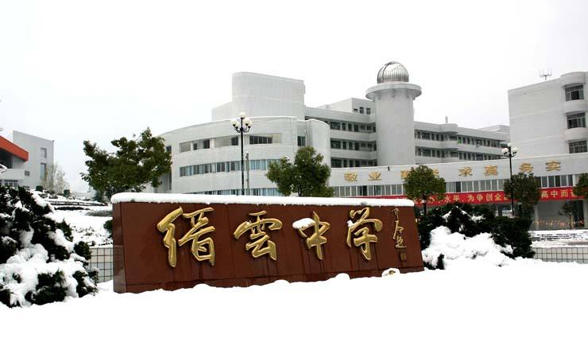
Letter of
Invitation
浙江省缙云中学 李晓慧

Slide 3






Analysis of the letter
邀请信各类原由
常见邀请信要点
中国节日
时间+地点
学校活动
(当评委、做讲座、校庆、出席开/闭幕式等)
活动目的
invitation
活动内容
室外活动
(野餐、爬山、球赛等)
活动意义
聚餐、晚会等

Slide 4
（2020学年第一学期期中杭州地区）假定你是李华，你校将组织一场为贫困地区学生献爱心的捐助活动，请你代表学生会写一封邮件邀请你校外教John出席开幕式，内容包括：
1.时间、地点；
2.活动内容；
3.活动意义。
注意：
1.词数80左右；
2.可适当增加细节，以使行文连贯。

Slide 5
Vocabulary building
邀请：invite sb to do sth/some place
代表学生会：on behalf of/represent the Student Union
组织一场活动：launch a campaign/ organize an activity
计划，安排: be scheduled for/be fixed/be due to start/
be held/be arranged to do sth
目的是: be aimed at arousing (aim to arouse) students' interest in...and broaden their international vision/with the purpose(aim) of
广泛的,多样的：have a wide range of/a wide variety of/ various/diverse/abundant/plentiful /with an abundance of/…
带来的意义: deepen one’s insight into/have a deeper understanding of…/have a good taste of.../serve as(provide) a platform for/immerse sb in a fantastic aura/leave sb an deep impression on.../a feast for the eyes/develop(cultivate) a sense of responsibility

Slide 6


1
时间和地点

Slide 7
常用地点短语
in the stadium/gym,
in the Student Activity Center,
in the school /lecture hall,
at the school auditorium（礼堂，会堂）,
on the playground

Slide 8
时间表示法(钟点/星期/月/日/年)
in December, 2020
on December 3rd, 2020
on Thursday, December 3rd, 2020
at 7:00 pm on December 3rd, 2020
at 7:00 on the evening of December 3rd,2020
at 7:00 pm on Thursday, December 3rd, 2020
at 7:00 on Thursday evening, December 3rd, 2020
from 2:00 pm to 4:30 pm on Thursday, December 3rd, 2020

Slide 9

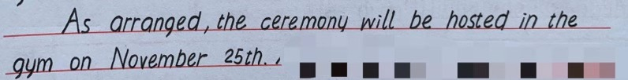
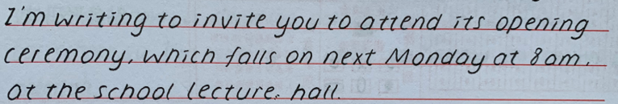

How do you like the following expressions?
写清具体的时间段
先写钟点后写星期
先写地点后写时间

Slide 10
Expressions for time and place
①The activity is scheduled to be launched in the stadium
next Friday afternoon from 2:00 to 5:00.
②The ceremony will start at the school auditorium at 3:00
pm on July 1st and last (for) approximately two hours.
③Launched by our school , it will be held in the school
lecture hall next Monday from 9:00 am to 11:00 am.
④To get everyone involved, the activity will fall at the
school library at 6:00 next Friday evening.

Slide 11
2
活动内容

Slide 12
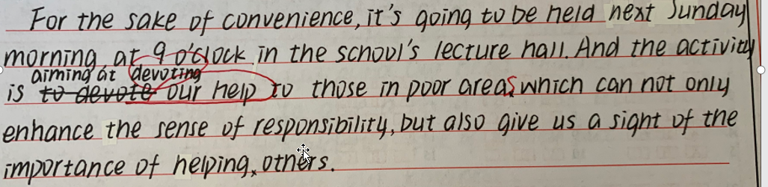
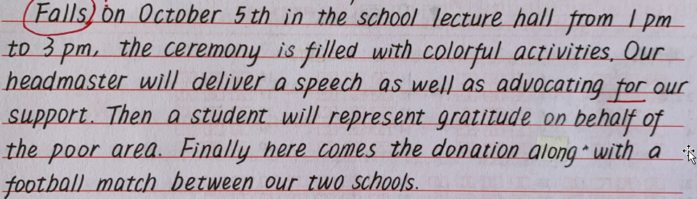
几乎没有涉及具体的活动内容
①
②
③
④
⑤
活动内容要点过多，挑选两个重点描述即可

Slide 13
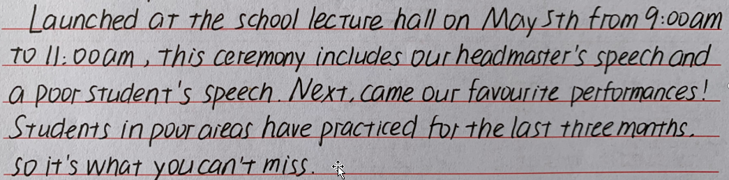
活动内容是否符合主题“捐赠活动”？

Slide 14
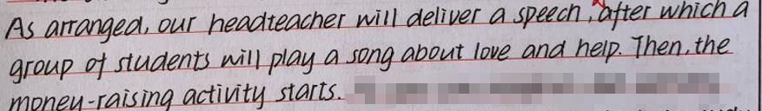
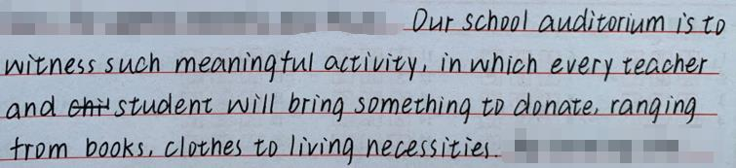
How to organize activities?
Then comes the money-raising activity.
a
money
Firstly, a video about the life of the targeted students will be shown. Then, those present are encouraged to make a donation, ranging from money to books.
具体详细地写出活动内容

Slide 15
3
活动意义

Slide 16
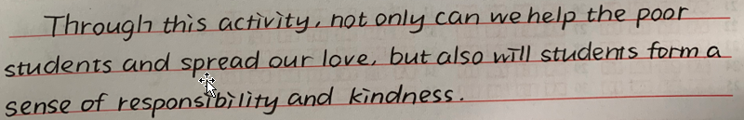
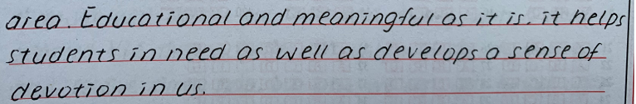
正确使用倒装结构
..., but students will also form a sense of responsibility.
Educational and meaningful as it is =
Though it is educational and meaningful, ...
思维逻辑不通顺

Slide 17
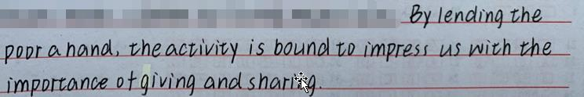
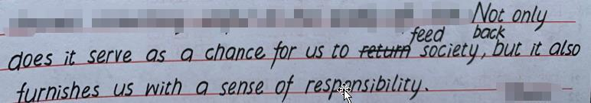
Expressions for positive effects
Not only does it help those in need, but it also provides a platform for us to deliver our concern.

Slide 18
4
邀请信的开头和结尾

Slide 19
常用于邀请的句子：
l I’m writing to you _____________… to invite you to …
I would like to see your ___________ 出席 at …
I _____ ____ ________ 很高兴 to invite you to …
It is with the greatest pleasure that I write to
_______________ [ˈkɔ:diəli] 热诚地，诚挚地 invite you to…
It gives me the greatest pleasure to invite you to...
on behalf of
presence
take the pleasure
eagerly/cordially

Slide 20
常用于希望接受邀请的句子：
l I really hope you’ll be able to ____ __ over here.
l It would be great if you could make it.
l If you don’t have any _____ __________ ____…,
we look forward to the pleasure of your ________.
l Please ________ 确认 your participation at your
earlier ___________. 方便时
l We should be very pleased if you could ______
us ______ your presence. 很荣幸有你的到来
make it
prior appointment on
company
confirm
convenience
honor
with

Slide 21
5
学生习作

Slide 22
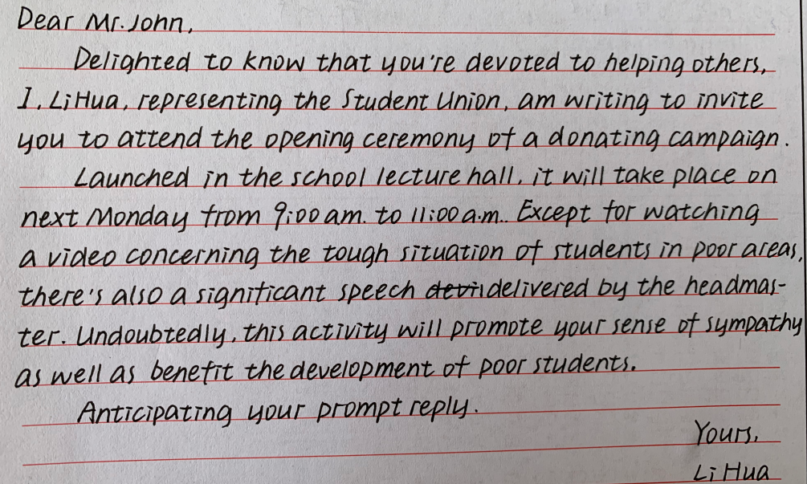
教师点评：
①书写清楚漂亮；
②全篇行文较为流畅；
③首段清楚地表达了写作的背景与目的；
④活动的内容表达较为具体详细，不足之处在于没有写到具体的捐赠这一活动。
⑤活动的意义表达稍显欠缺。
Launched by our school, the activity is scheduled in the gym
from 9:00 am to 11:00 am next Monday.
Apart from
raise the awareness of helping others.
responsibility

Slide 23
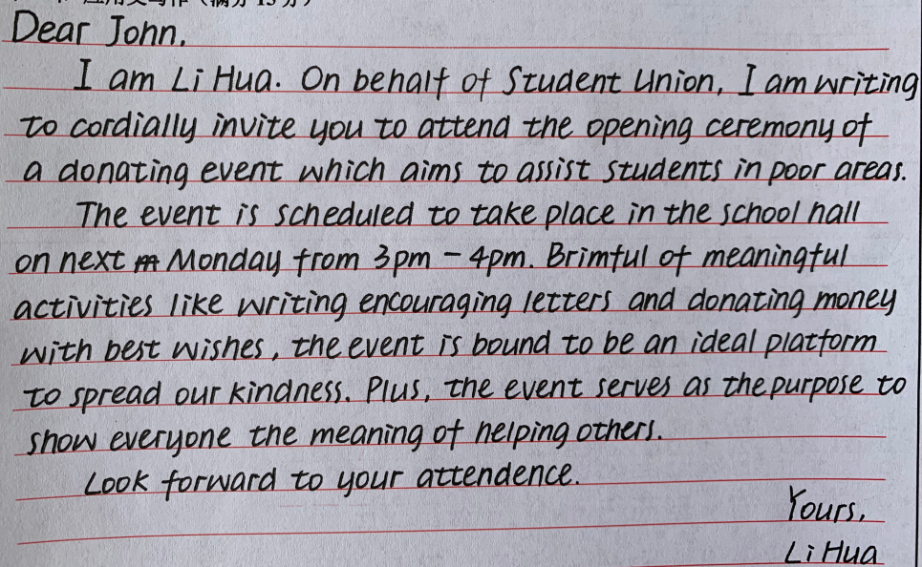
教师点评：
①书写清楚漂亮；
②全篇行文较为流畅；
③首段清楚地表达了写作的背景与目的以及适当增加了活动目的；
④活动的内容表达较为具体详细，并与活动的意义巧妙地结合在一起。
donation
to
attendance

Slide 24
6
下水作文

Slide 25
Dear John，
I'm writing to you on behalf of the Student Union to attend the opening ceremony of a donation campaign.
Aimed at showing love to the students in poverty-stricken areas, the activity is scheduled to be launched in the stadium next Friday afternoon from 2:00 to 5:00. Firstly, a video about the life of the targeted students will be shown. Then, those present are encouraged to make a donation, ranging from money to books. Not only does it help those in need, but also it provides a platform for us to deliver our concern.
Looking forward to your arrival.
Yours,
Li Hua

Slide 26
7
高考邀请信

Slide 27
2017年6月全国高考浙江卷·书面表达(满分15分)
假定你是李华，计划组织一次郊游，请给你的英国朋友Chris写封邮件邀请他参加。内容包括：
1. 参加者；
2. 时间、地点；
3. 活动：登山、野餐等。
注意：
1. 词数80左右；
2. 可以适当增加细节，以使行文连贯。

Slide 28
Dear Chris,
I'm Li Hua and I'm writing to extend earnest(认真的, 重要的, 热心的) invitation for your participation in the outing organized by me. Aiming to gain a better acquaintance (相识; 熟人)with exotic (异国的, 外来的) culture, I have asked teenagers I know all over the world to get actively involved in this event.
For the sake of convenience, the outing falls in Hong Kong at 9 am, on July 16. Brimful (盈满的; 满到边际的)of intriguing (有趣的) activities like climbing and having a picnic, this outing is bound to be a huge success.
A response at your earliest convenience will be highly appreciated.
Yours,
Li Hua

Slide 29
2017年11月全国高考浙江卷·书面表达(满分15分)
假定你是李华，得知外教Mr. Hall寒假不回国，想邀请他到你家过春节。请你给他写一封信，内容包括：
1.时间；
2.一同过节的家人；
3.活动。
注意：
1.词数80左右；
2.可以适当增加细节，以使行文连贯。

Slide 30
语言积累
剪纸： Paper Cutting 贴对联： paste the couplet
压岁钱：give lucky money to children
拜年： pay a New Year call/ visit
风俗
家庭盛宴：the family banquet/ feast
火锅：Hot Pot 北京烤鸭 : Beijing Roast Duck
吃
越剧：Yue Opera
品尝地方风味小吃：taste local flavor snacks
欣赏民间工艺：appreciate folk arts and crafts
玩

Slide 31
语言积累
1. The most energetic and important festivals are the ones
that look forward to the end of winter and to the
coming of spring. At the Spring Festival in China,
people eat dumplings, fish and meat and may give
children lucky money in red paper. There are dragon
dances and carnivals, and families celebrate the Lunar
New Year together. (NSFC Module3 Unit1 FESTIVALS AND
CELEBRATIONS)
2.Festivals let us enjoy life, be proud of our customs and
forget our work for a little while. (NSFC Module3 Unit1
FESTIVALS AND CELEBRATIONS)
教材

Slide 32
Dear Mr. Hall,
Hearing that you’re not going to go back to your country in the coming winter vacation, I’m writing to invite you to spend the Spring Festival with my family together.
If you consider accepting my invitation, I’ll ask my parents to pick you up next Monday and drive you straight to my house where my brother, sister and grandparents will all be in. The Spring Festival plays a significant role in every Chinese life, so various activities are indispensable不可缺少的 in adding flavour to the festival. We’ll have a big feast together, gathering around the table and praying for next year’s good luck. After the meal, a lucky charm 护身符and a red pocket which contains lucky money will be given to everyone and some lucky words are said to each other. Everything will overflow with happiness then.
I sincerely hope that you can accept my earnest invitation and can reply to me at your earliest convenience.
Yours,
Li Hua

Slide 33
2019年6月全国高考卷III·书面表达(满分15分)
假定你是李华，你校将举办音乐节。请写封邮件邀请你的英国朋友Allen参加，内容包括：
1.时间；
2.活动安排；
3.欢迎他表演节目。
注意：
1.词数80左右；
2.可以适当增加细节，以使行文连贯。

Slide 34
〖写作思路〗
邀请Allen参加学校即将举办的音乐节，考生需要对语境提供的背景信息和时间及活动安排等要点进行必要整合，同时需要对要点进行适当拓展，以在内容和语言表达上更加丰富和多样性。

Slide 35
〖话题词汇〗
a music festival, after-school activities, pop, rock, jazz, folk, classical, blues, R&B, ballet, country music, rock and roll, soul music, instrument, piano, drum, guitar, violin, musician, conductor, band, perform, audience, stage, concert, musical，performance, talent show, talk show
在平时的学习中，要注意话题词汇的积累。

Slide 36
〖试题趋势〗
跟去年类似，今年的书面表达要求考生写邮件，告知英国朋友音乐节的情况 (属音乐活动范畴)。近年来，书面表达的考查越来越贴近中学生的日常生活，更加重视语言的应用，回归了英语作为语言功能的本质。因此，在备考时，要集中看一些与日常生活和学习息息相关的话题，如学校生活、体育运动、语言学习、节假日及活动等，并密切关注社会时事，按照话题网络化复习，效果会更佳。

Slide 37
Dear Allen,
How is everything going? Our school will hold a music festival next Saturday morning in the school hall to enrich students’ after-school life. As an organizer, I’m writing to invite you to join us.
The opening ceremony will start at 9:00 am, and the schoolmaster will deliver a speech. Following the speech is a one-hour lecture with the title of “A Brief History of Chinese Music” by Professor Guo, after which there will be various fantastic performances played by talented students. You are particularly welcome to show up on stage, which will definitely add color and fun to our festival.
Looking forward to your early reply.
Yours,
Li Hua

Slide 38
THANKS

