Slide 1


感恩遇见，相互成就，本课件资料仅供您个人参考、教学使用，严禁自行在网络传播，违者依知识产权法追究法律责任。
更多教学资源请关注
公众号：溯恩高中英语
知识产权声明

Slide 2

Languages Around the World
Listening & Speaking

Slide 3
学习目标
At the end of the class students will be able to
1. know the officially used languages in the UN，understand the diversity of world language
2. get their listening skills trained by intensive listening
3. know the usage of pronouns in the listening material
4. can express the language they are interested in and the reasons

Slide 4


Preview-checking
It is known to us all that _______(pick) up a language is not always easy. But there are still ________(数十亿）of people who hold positive ______ (态度）to language learning. When ________(提及）to language learners, English may have the most learners, most of whom are ______(本地人）of China. So are you positive bout learning something in ________(涉及）to language.
picking
billions
attitude
referring
natives
reference

Slide 5


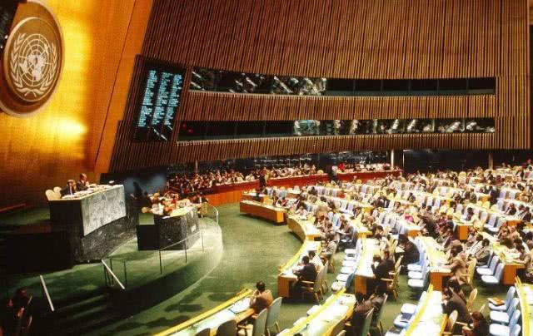

Warming-up
——Let’s enjoy
Who？
Yi
What？
was delivering a speech
Where？
Do you know other official languages of the UN?
in the United Nations_{(U.N)}
English

Slide 6

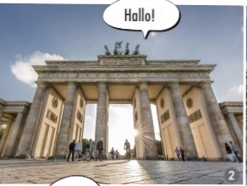
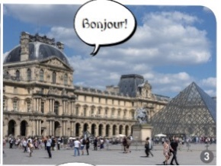
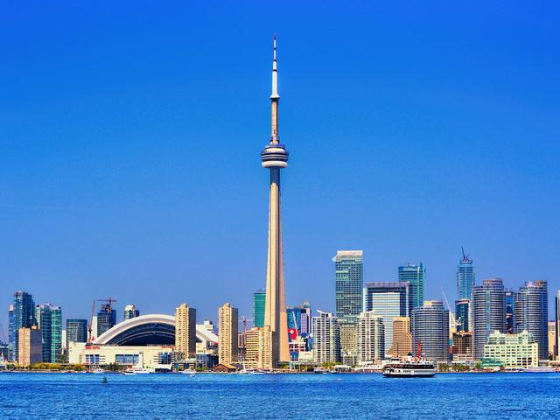



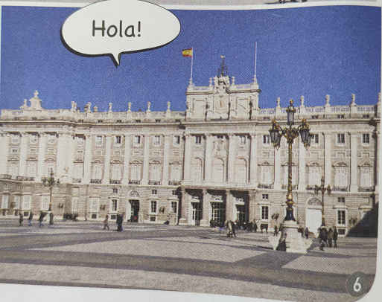
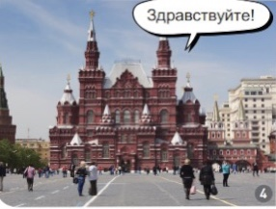
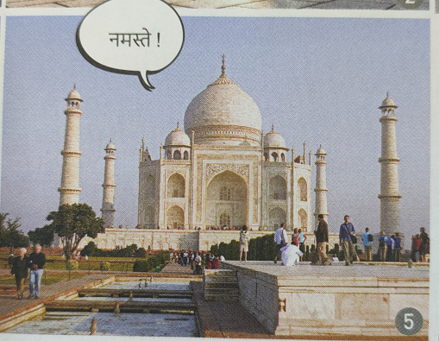


Lead-in
——Let’s know languages
hello
Brandenburg Gate
Germany
Louvre Museum
France
CN tower
Canada
France Russia Germany Spain Canada India
Red Square
Russia
Taj Mahal
India
Royal Palace
Spain

Slide 7

Lead-in
——Let’s know more & try
Which language will you choose to speak？
Japan
Japanese
korea
Korean
If there is a chance，I will choose to speak _______ as my second language.
Which languages did the UN choose?
Thailand
Thai
Italy
Italian
Egypt
Arabic

Slide 8

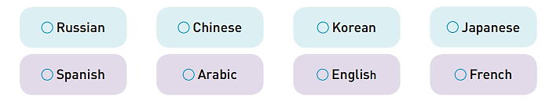
Listening
——Listen for the gist
1. What is the main topic of this speech?
Which two languages has the most native speakers
The official languages of the UN.
Learning a foreign language.
The number of languages around the world.
Pay attention to the first sentence
2. What languages are officially used in the UN?

Slide 9
Listening
——Listen for details
1. How many languages are there in the world?
2. How many billion people speak the UN’s official languages as their
native or second language?
3. What is the attitude of the speaker towards foreign language learning?
Nearly 7000
What’s others’ attitude?
Why do they learn languages?
Around 2.8 billion
useful
It's _______ to learn at least one other foreign languages, if possible.

Slide 10
Listening
——Listen for details
refer to Who?
For the general reason:

Slide 11
Listening
——Listen for details
For various reasons:
Who | Language | Reason
Some students | one of … | Because of ________________
An American girl |  | Because her ____________ are from _______
Another young lady |  | She had several ______ from ______ spoken countries.
friends and family
grandparents
Danish
Denmark
French
friends
French
Going on：Why do you want to learn that language?
The reason why I choose to study ______ is that _____

Slide 12
Street Interview
hello
1. There are 6 interviewers and 32 interviewees in our class.
2. Suppose you are an interviewer on the street, and you need to interview at least 5 people(students) about the language they want to study and the reasons, and then report in front of the class.

