Slide 1


感恩遇见，相互成就，本课件资料仅供您个人参考、教学使用，严禁自行在网络传播，违者依知识产权法追究法律责任。
更多教学资源请关注
公众号：溯恩高中英语
知识产权声明

Slide 2

Unit 5
Languages around the world
Listening & Speaking

Slide 3

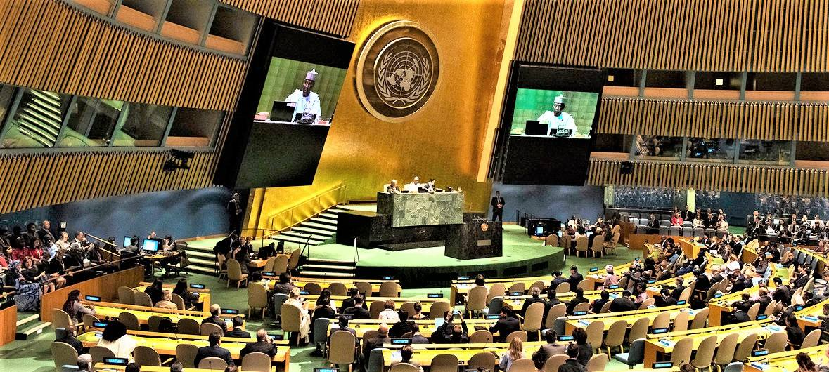
Look and Discuss
A UN General Assembly meeting
where?
French, Spanish, Chinese, Arabic, Russian, English
What languages do you think are officially used there?
What does it show?

Slide 4
Journey of life
One language sets you in a corridor for life. Two languages open every door along the way.
---Frank Smith
Opportunities and paths
The importance
of knowing more languages?
Language is the blood of the soul into which thoughts run and out of which they grow.— Oliver Wendell Holmes
If you talk a man in a language he understands, that goes to his head. If you talk to him in his own language, that goes to his heart. -----Nelson Mandela

Slide 5





Explore
Languages around the World

Slide 6


How do you greet others?
What do you say？
How do people in another country greet each other?

Slide 7
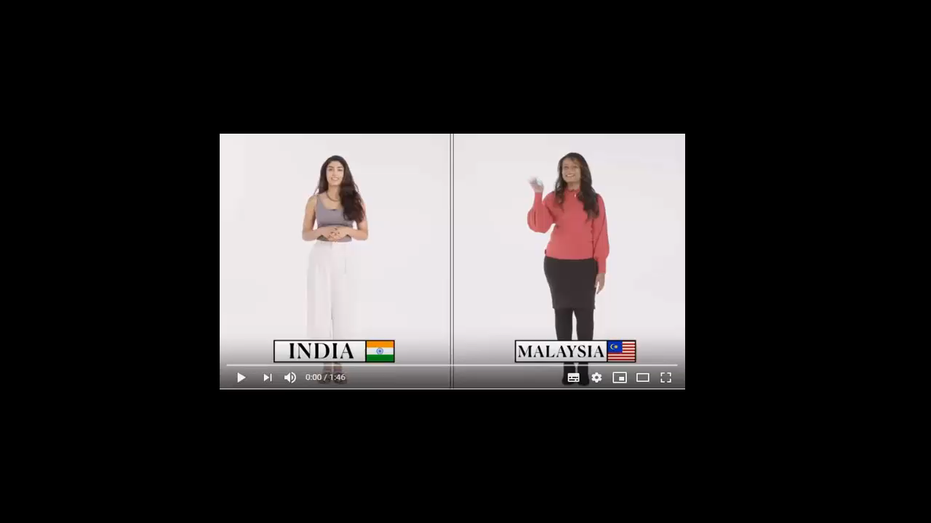

Slide 8
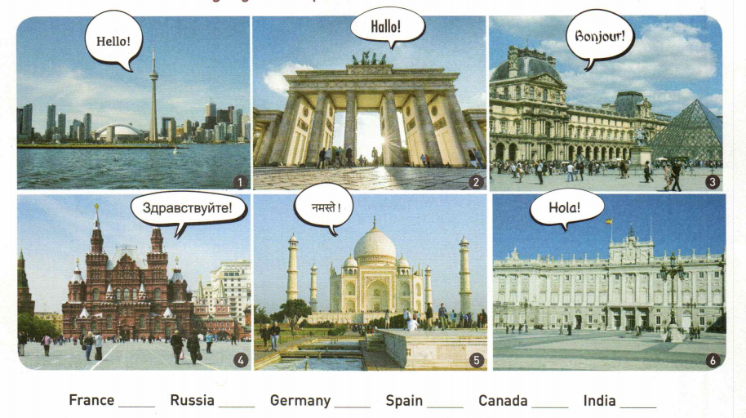
Match each photo with the correct country name.
Which languages are spoken in these countries?
English,
French
German
French
CN tower
Canada
Brandenburg Gate
Germany
Louvre Museum
France
Russian
Hindi,
English
Spanish
Red Square
Russia
Taj Mahal
India
Royal Palace
Spain
3
4
2
6
1
5

Slide 9

Listen to a speech, circle the official languages of the UN and tick the two languages with the most native speakers.
Russian Chinese Korean Japanese
Spanish Arabic English French
√
√

Slide 10
Listen for Gist
What is the main topic of this speech?
How many languages are there in the world?
How many billion people speak the UN’s official languages as their native or second language?
Learning a foreign language.
Nearly 7,000.
Around 2.8 billion.
Many People are learning foreign language

Slide 11


Listen for details.
Reference : Pay attention to what Pronouns refer to.
Who | Why they learn a foreign language
 | They think it means better job chances in the future.
One American girl
Another young lady started learning French
What is the attitude of the speaker towards foreign language learning?\
Students choose to study one of the languages spoken at the UN.
Because her grandparents were from Denmark.
Because she had several friends from African countries where French is spoken.
A. Objective B. Skeptical C. Supportive D. Unconcerned
Wise and Useful

Slide 12

Listen for Characteristics of a speech
Let’s focus on the listening text

Slide 13
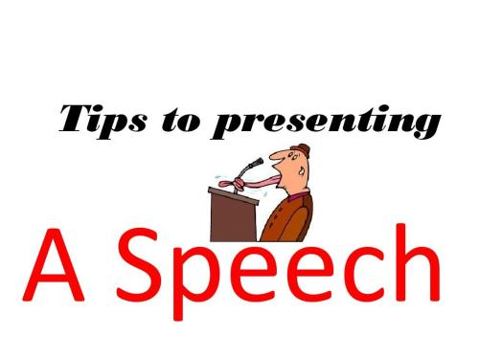
To attract readers’ attention
Exploring languages around the world
To some students, it seems that the only foreign language to learn is English. There are, however, nearly 7,000 languages in the world. After Chinese, the language with the most native language speakers isn't English — it's Spanish! Learning English is very useful, but it is wise to learn at least one other foreign language, if possible.
There are many reasons why people learn a foreign language. Many students choose to study one of the languages that are spoken at the UN. As they think it means better job chances in the future. The UN has six official languages: Arabic, Chinese, English, French, Russian, and Spanish. They are spoken by around 2.8 billion people as their native or second languages.
Some students, though, choose to study a language because of family or friends. One American girl chose to learn Danish because her grandparents were from Denmark. When she was little, her grandpa used to read letters to her in Danish from their relatives in Denmark. Another young lady started learning French because she had several friends from African countries where French is spoken.
What do you think? Which other language would you choose to study and why?
Characteristics of a speech
To show the opinions with facts
To inspire listeners’ empathy and ideas
What do you think? Which other language would you choose to study and why?

Slide 14
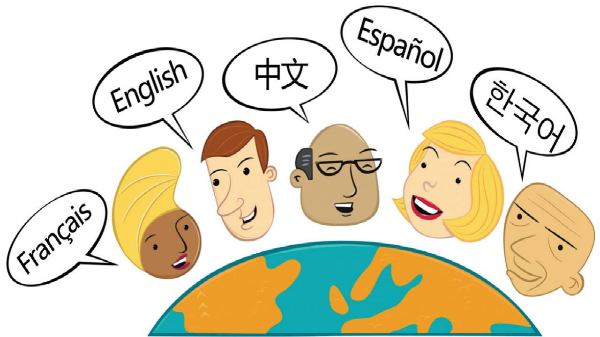
Work in pairs or groups. Discuss with you partners:
What do you think? Which other language would you choose to study and why?

Slide 15


What roles do Languages play in our life?
“Let it Go” in different language versions

Slide 16
Know more languages;
Know more about the world!

