Slide 1


感恩遇见，相互成就，本课件资料仅供您个人参考、教学使用，严禁自行在网络传播，违者依知识产权法追究法律责任。
更多教学资源请关注
公众号：溯恩高中英语
知识产权声明

Slide 2

PRACTICAL WRITING
林嘉禾
杭州学军中学

Slide 3
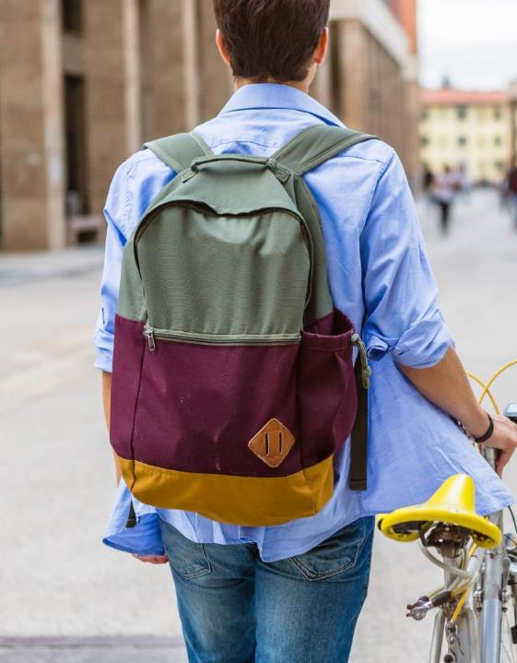
Read & interpret
假定你是李华，下学期你将作为交换生（exchange student）去加拿大一所高中学习，住在Lynn家里。请给Lynn写一封邮件，内容包括：
介绍自己（self-introduction）
告知到达时间（time of arrival）
询问该做何准备（inquiry of preparation）

Slide 4
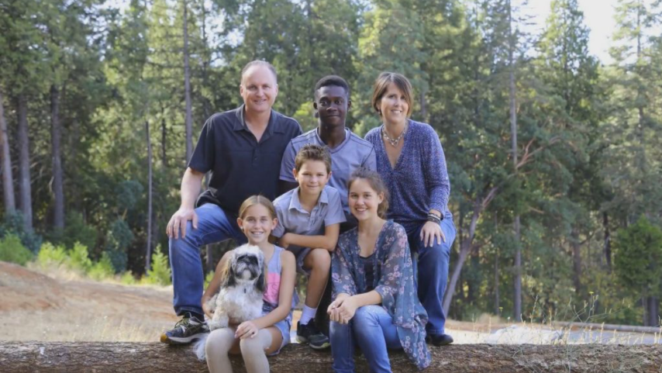
Cultural background
What is a host family?
Do they get paid?
Why they would be willing to host?

Slide 5
A host family
People of all ages and from all walks of life volunteer to serve as host families.
Grandparents, families with younger children, single-parent families and traditional two-parent families
There is no "typical" host family.

Slide 6

Read & interpret

Slide 7
Read & interpret
介绍自己（self-introduction）
告知到达时间（time of arrival）
询问该做何准备（inquiry of preparation）
I’m writing to….
Introduce myself
Inform you of my arrival
Inquire relevant information
Extend my gratitude
This letter is of multiple purposes

Slide 8
Do you know who “you” are and whom you are addressing to?
假定你是李华，下学期你将作为交换生（exchange student）去加拿大一所高中学习，住在Lynn家里。
Li Hua
Lynn
An exchange student from China
A native Canadian
Study in the local high school
Share a flat with others
Offer academic instructions

Slide 9

Identity and why it matters
Li Hua | Lynn
Guest | Host
Around 17-year-old | Not given
Student | Not given
Roommates?
Friends?
Your school?

Slide 10
Identity and why it matters
Make sure you understand the social distance between “you” and Lynn.

Slide 11
Make an outline

Slide 12
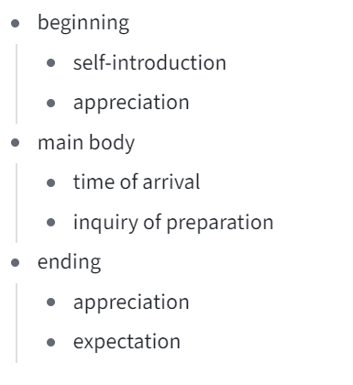
I’m Li Hua, an exchange student from China. I’m sorry that I have to bother you for the next few months.
apology vs appreciation
I’m an outgoing and active boy who enjoys listening to music. I believe we will have a lot of topics in common if you like music, too.
How detailed my self-introduction should be?
Should I emphasise my personality/hobby?

Slide 13
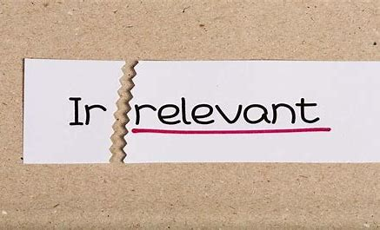
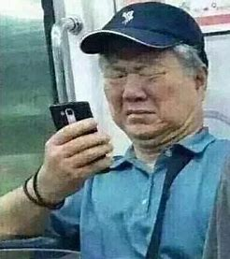
What specific document is needed to ensure a smooth immigration?
Can you tell me the study pattern of the high school in Canada?
I’m one of the top students in my old school.

Slide 14
Polish your language

Slide 15
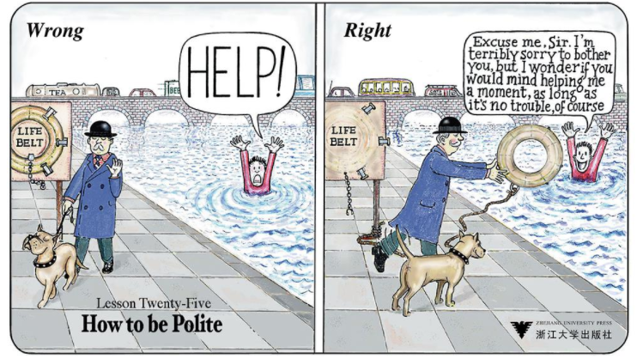
How to be polite
unrealistic
Excuse me, Sir, I’m terribly sorry to bother you, but I wonder if you would mind helping me a moment, as long as it’s no trouble, of course.

Slide 16
How to be polite
Positive politeness strategies | Negative politeness strategies
Compliments Common ground Discourse markers (please) etc. | Questioning Hedging Presenting disagreements as opinions

Slide 17
How to be polite
"
"Professor, I was wondering if you could tell us about the Chamber of Secrets."
(Hermione in Harry Potter and the Chamber of Secrets, 2002)
Hedging and questioning
'Laurence,' said Caroline, 'I don't think I'm going to be much help to you at Ladylees. I've had enough holiday-making. I'll stay for a couple of days but I want to get back to London and do some work, actually. Sorry to change my mind but--'
Presenting disagreements as opinions

Slide 18
How to be polite
Useful expression
If you don’t mind, could/would you …
If it’s not a problem, could/would you …
By any chance, could/would you …
I wonder if you could/would…
I would be much grateful if you could…
I would appreciate it if you could…

Slide 19
How to be polite
How would you feel if you were Lynn?
In order to reward your reception, I’ve prepared some small gifts for you.
To convey my genuine gratitude for your reception, I hope you wouldn’t mind the present I sent together with this letter.
I want a list of necessary items to be attached.
If it’s not of too much trouble, would you attach a list of necessary items for me to prepare in advance?

Slide 20
How to be polite
How would you feel if you were Lynn?
More information about Canadian life is also anticipated to be offered.
I would be grateful if the relevant details regarding to the local climate and culture are provided.
Though I have acquired basic information from the Internet, I’m still wondering if you could offer me suggestions from a native’s perspective.

Slide 21
How to be polite
Overly polite——hypocritical
Insufficiently polite——rude
The more the merrier?

Slide 22
Dear Lynn,
I’m Li Hua, an exchange student from China. I’m delighted to know that I will live with your family next term. There are something that I may disturb you.
I have booked a flight which will arrive in Canada at 3 p.m. next Monday. Please forgive me if I cause any inconvenience for you. Besides, I wonder what I should prepare for the coming days, since I don’t want to bother you too much.
I’m looking forward to your reply.

Slide 23
There are something that I may disturb you.
I’m _______ there are things I may ________ bother you with.
2. Please forgive me if I cause any inconvenience for you.
Please ________________if this is a bad time for you/ if this would cause you any inconvenience.
3. …since I don’t want to bother you too much.
I would feel ______________ if I should add too much burden.

Slide 24
There are something that I may disturb you.
need to
I’m _______ there are things I may ________ bother you with.
afraid
2. Please forgive me if I cause any inconvenience for you.
let me know
Please ________________if this is a bad time for you/ if this would cause you any inconvenience.
3. …since I don’t want to bother you too much.
terribly sorry
I would feel ______________ if I should add too much burden.

Slide 25
I’m afraid there are things I may need to bother you with.
Use hedging (缓冲) and emphasise necessity.
Please let me know if this is a bad time for you/ if this would cause you any inconvenience.
Offer to adjust the plan instead of simply asking for forgiveness.
I would feel terribly sorry if I should add too much burden
Make use of subjunctive mood (虚拟语气).

Slide 26
Revise your first draft

Slide 27
Dear Lynn,
I’m Li Hua, an exchange student from China. I’m happy to know that I’ll be staying with your family in the next few months while I’m studying at the local high school. Thank you for having me!
I’m due to start my study in September, so I booked a flight to Toronto on August 26th, arriving at 10 o’clock local time. I’m wondering if there is anything I can prepare in advance so as to transfer smoothly into the life in Canada? What’s more, please don’t hesitate to inform me of the house rules. I would be awfully sorry if my presence should become a mere intrusion.
Your kindness means a dear lot to me. Looking forward to meeting you in Canada!
Yours sincerely,
Li Hua
Now how would you feel if you were Lynn?

Slide 28

Follow the steps
Keep asking yourself:
Read & interpret
Make an outline
Polish your language
How would you feel if you were the one receiving the letter?

Slide 29
Thank you
Emily

