Slide 1


感恩遇见，相互成就，本课件资料仅供您个人参考、教学使用，严禁自行在网络传播，违者依知识产权法追究法律责任。
更多教学资源请关注
公众号：溯恩高中英语
知识产权声明

Slide 2


Phyllis
Huzhou No. 5 High School

Slide 3
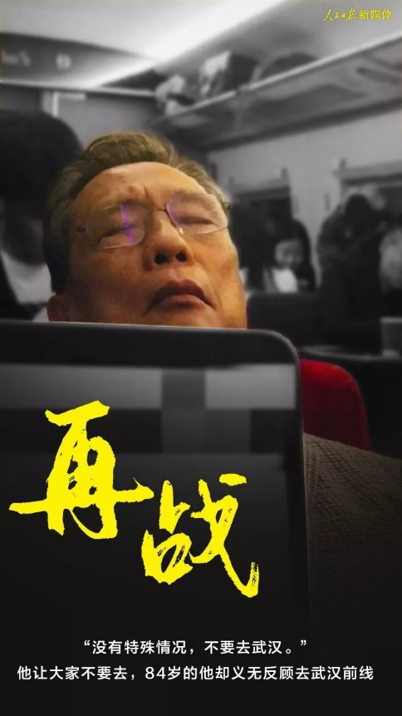
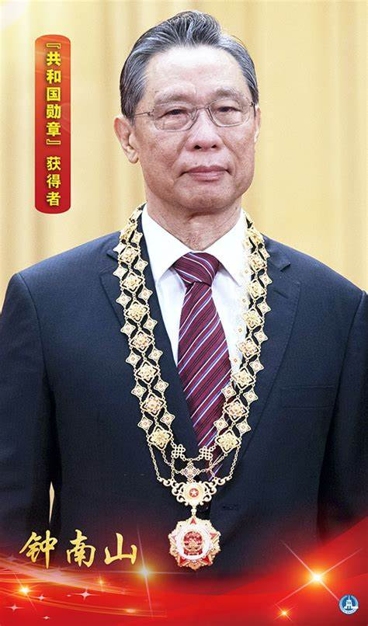
It is morals and virtues that direct Dr Zhong in making hard choices in his life.
“the backbone of China”

Slide 4
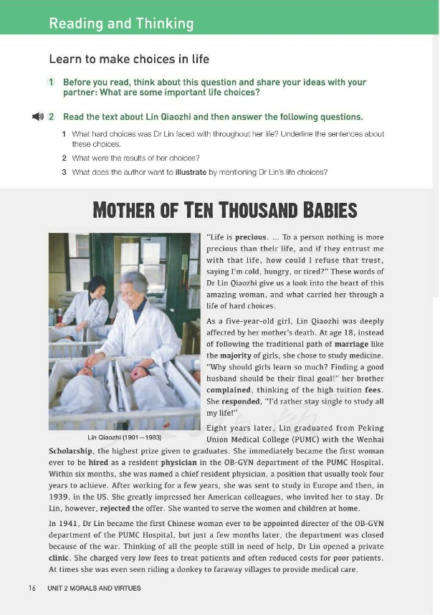
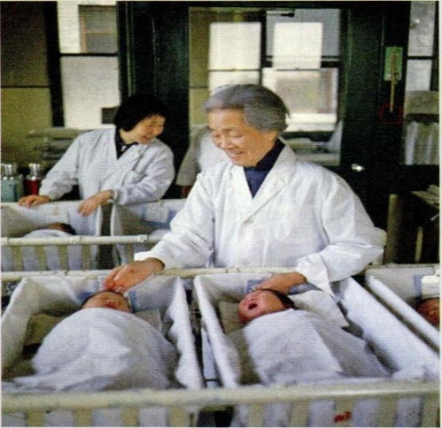
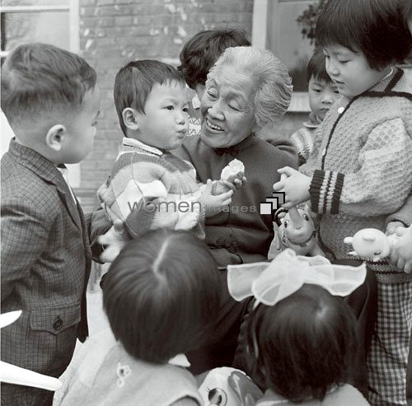
B3U2 Morals and Virtues
Reading and Thinking
Preview & Predict
Q1: What do you already know about this lady?
Q2: What do you expect to read about this lady?
Lin Qiaozhi
(1901-1983)
biography

Slide 5
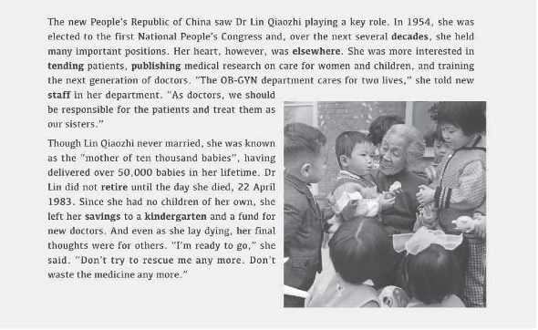
Fast reading
Para.1: The _________ guides Dr Lin through the choices in life
principle
Para.2: The life as a _________
student
physician
Paras.3-6: The life as a ________

Slide 6
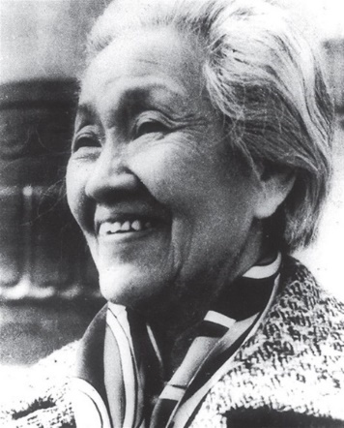
Close reading
“life is precious, ... To a person nothing is more precious than their life, and if they entrust me with that life, how could I refuse that trust, saying I’m cold, hungry, or tired?”
Dr Lin’s main life principle is to ____________________
always put others first.

Slide 7
Close reading
Dr Lin’s hard choices in her life | Time | Choices | Results
The 1st Choice
The 2nd Choice
The 3rd Choice
The 4th Choice
At age 18
She chose to study medicine instead of finding a husband.
She took the entrance exam and entered Peking Union Medical College.
She rejected the offer to stay in the US.
She went back to China to serve the women and children.
In 1939
She continued to provide medical care for the people in need for help, especially the poor patients.
During the war
She opened a private clinic.
From 1954 to 1983
She was more interested in tending patients, publishing medical research and training the next generation of doctors
She was known as the “mother of ten thousand babies”.

Slide 8
Critical reading
Which choice impresses you most? | What can you learn from the choice?

Slide 9
Critical reading
Which choice impresses you most? | What can you learn from the choice?
The 4th choice:
Dr Lin was more interested in tending patients, publishing medical research on care for women and children, and training new doctors.
I will decide upon my major definite purpose (to be a good teacher) in life and then organize all my activities around it.

Slide 10
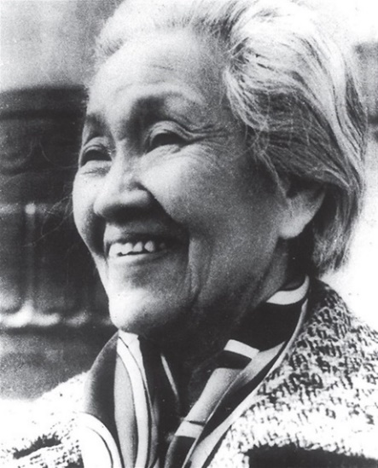
Critical reading
over 50,000 babies
50,000
no children of her own
0
What kind of person do you think Dr Lin was?

Slide 11

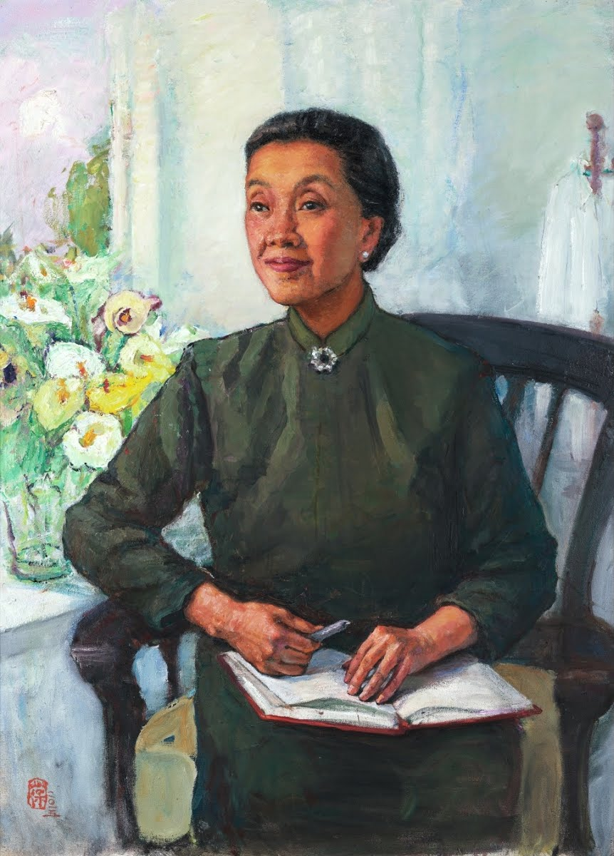


Summary
rejected the offer
charged low fees
left savings to a kindergarten and a fund for new doctors
love for others
served women and children
tended patients
treated them as sisters
patience for patients
won the highest scholarship
published medical research
trained the next generation of doctors
enthusiasm for study/work
Notes:
使用方法：
【更改文字】：将标题框及正文框中的文字可直接改为您所需文字
【更改图片】：点中图片》绘图工具》格式》填充》图片》选择您需要展示的图片
【增加减少图片】：直接复制粘贴图片来增加图片数，复制后更改方法见【更改图片】
【更改图片色彩】：点中图片》图片工具》格式》色彩（重新着色）》选择您喜欢的色彩
下载更多模板、视频教程：http://www.mysoeasy.com

Slide 12

Summary
love for others
patience for patients
It is morals and virtues that direct Dr Lin in making hard choices in her life.
enthusiasm for study/work
Notes:
使用方法：
【更改文字】：将标题框及正文框中的文字可直接改为您所需文字
【更改图片】：点中图片》绘图工具》格式》填充》图片》选择您需要展示的图片
【增加减少图片】：直接复制粘贴图片来增加图片数，复制后更改方法见【更改图片】
【更改图片色彩】：点中图片》图片工具》格式》色彩（重新着色）》选择您喜欢的色彩
下载更多模板、视频教程：http://www.mysoeasy.com

Slide 13
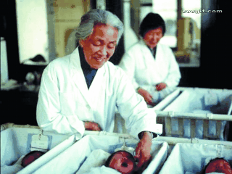
Review
That’s the real meaning of “morals and virtues”.
The main life principle of Dr Lin is ___________________________________________.
her devotion to others without any thought of herself

Slide 14
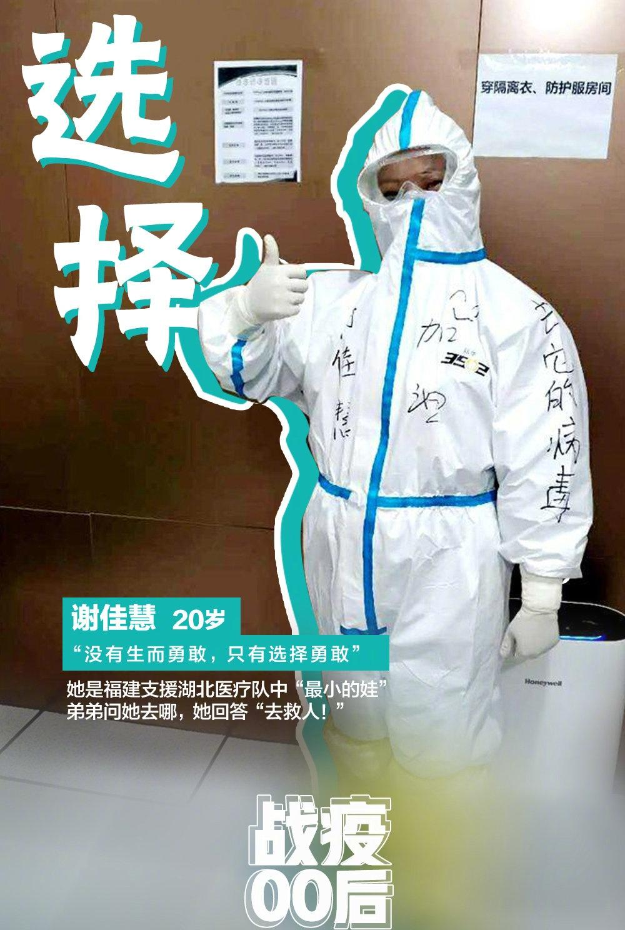
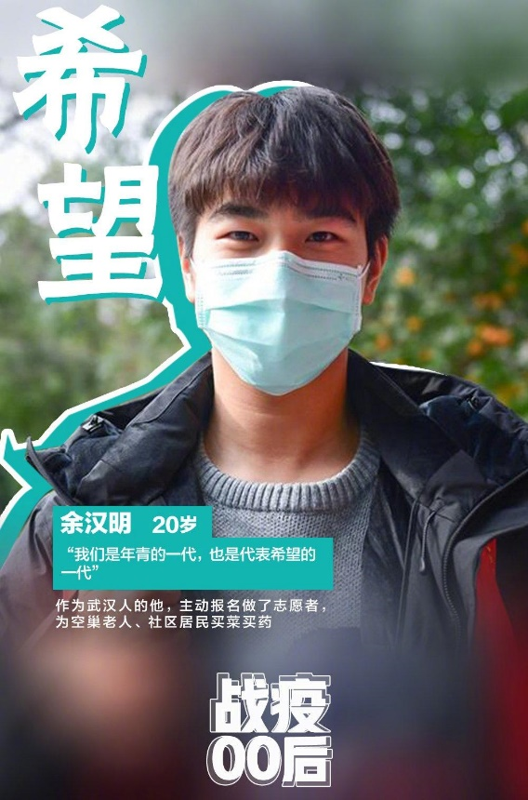
“the backbone of China”
“the young backbones of the times”

Slide 15

Discussion
We don’t have many chances to make big choices, but from making some small choices in daily life, we can still decide all by ourselves what to do.
Can you think of some examples about small choices?
I will choose to... because...

Slide 16
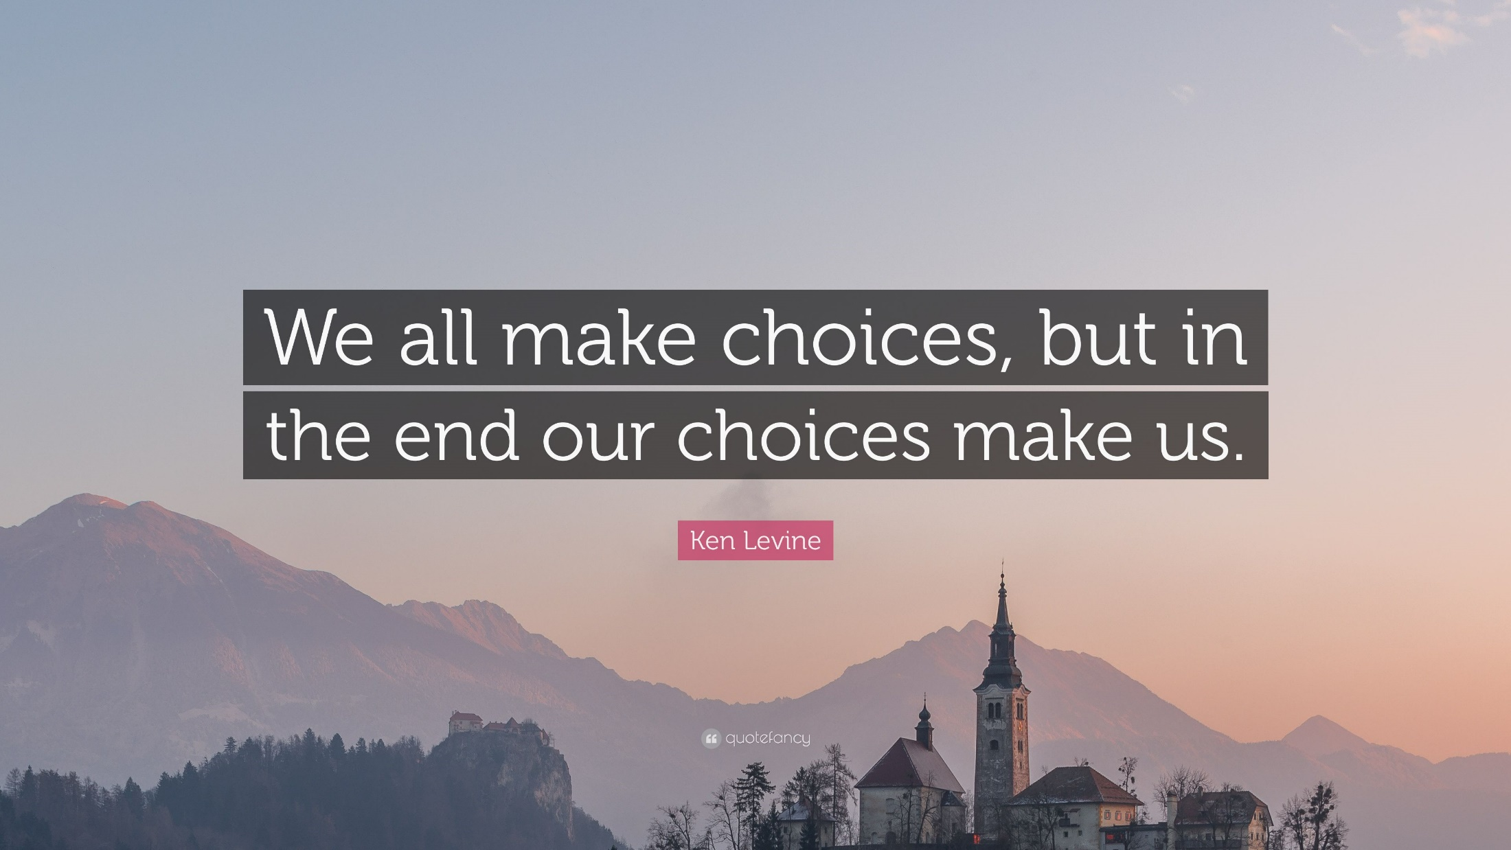

Slide 17

Assignment
Write a summary entitled “Dr Lin in My Eyes” (around 60 words).

Slide 18
One possible version:
Lin Qiaozhi, a specialist in women’s diseases, lived from 1901 to 1983. She remained single throughout her life. She had devoted her whole life to helping women of China. As a student, she was diligent; as a physician, she was outstanding. The main principle of Lin Qiaozhi was her devotion to others without any thought of herself. (57 words)

Slide 19


