Slide 1


感恩遇见，相互成就，本课件资料仅供您个人参考、教学使用，严禁自行在网络传播，违者依知识产权法追究法律责任。
更多教学资源请关注
公众号：溯恩高中英语
知识产权声明

Slide 2
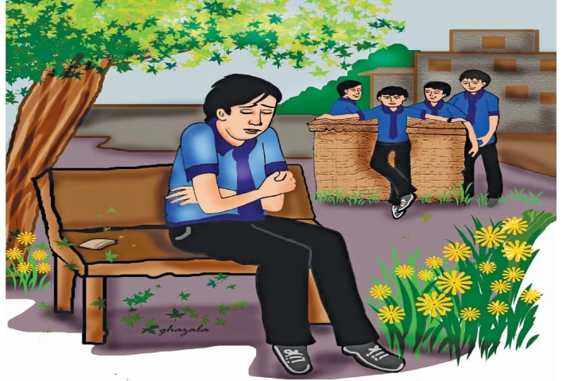

山水联盟2020年12月考试读后续写讲评
Honesty Won’t Let You Down

Slide 3
Reading
Asad was a 13-year-old boy who was very honest and hardworking. Recently, he had entered a new school so he had no friends yet, On Monday morning, he was nearly late for school. The night before, his family attended his cousin’s wedding and reached home late, which was why he couldn’t get up on time as usual.
At school, Asad could not pay attention to anything and wanted the bell to ring so that he could buy something to eat. After a few hours, when the bell rang, Asad quickly opened his schoolbag to find his money, but just then he remembered that he had left for school in a hurry in the morning and forgotten to take money, He looked under his books, hoping to find some money but there was nothing.
Not knowing what to do, he walked out of the classroom and sat on a bench in front of the canteen. He saw a few of his classmates there, among them was Fahad. He was one of the richest kids in his class but he was a very arrogant boy who thought everyone else was a loser. But as Asad was new, he didn’t know much about Fahad.
When he went towards Fahad and asked if he could borrow some money for his lunch, Fahad laughed a lot and said, “I knew you were a loser, maybe a beggar? "Fahad laughed out so loud that other kids also heard and made fun of the situation. He didn’t answer Fahad, and slowly walked back towards an empty bench.

Slide 4
Reading
Reading
When he reached the bench, he noticed something lying near it. It was a wallet. He picked it up and recognized it as Fahad's, as he remembered Fahad showing it to his friends and telling that his uncle bought it for him from the UK. There was quite a lot of money inside for a kid.
Para 1: At first, Asad wanted to Keep it a secret and punished Fahad.______________________
______________________________________________________________________________
Para 2: Then Fahad said, “Why are you giving it back?”________________________________ ______________________________________________________________________________

Slide 5
Understanding the story
Asad, an _______ and hardworking boy, was a newcomer to the school without friends around. One day he was in such a ________that he forgot to take ______ with him. As a result, he had either to ____ _____food or borrow money from Fahad, an arrogant boy who was one of the richest boys and thought everyone else was _________.
Naturally, Fahad _______ ______his request and even laughed at him, which made him __________ (embarrass). Left alone on the bench in front of the canteen, he quite ______________ spotted a wallet on the bench. He immediately recognized it _________ to Fahad, with a lot of money inside.
honest
hurry
money
go without
losers
turned down
embarrassed
accidentally
belonged

Slide 6
Understanding the story
problem --- solution --- problem --- solution --- problem --- solution
Story line
Story line
new,
no friends,
no money
borrow… from Fahad
F refused the request, laugh at
Spotted F’s wallet
What to do with the wallet
？
Emotion line
hopeful
excited
？
lonely, helpless
unhappy, embarrassed
torn

Slide 7
Design the plot: top sentence
Para 1: At first, Asad wanted to Keep it a secret and punished Fahad.
Para 2: Then Fahad said, “Why are you giving it back?!”
1. Did Asad change his mind at the last minute? What made him change his mind?
2. What was his new idea?
3.How did he give back the wallet and what was Fahad’s reaction?
What happened before Fahad asked the question?
1.How did Asad explain the whole thing? And how did he feel?
2. Did Fahad believe his explanation? And what did he do?
3. Asad’s reflections./ What did they each learn from the incident?

Slide 8
续写参考思路：
Paragraph 1: At first, Asad wanted to keep it a secret and punished Fahad.
思路1：我内心纠结 --- 做诚实的人这一信念让我做出归还的决定 ---我追上去，归还钱包--- Fahad不解地拿了回去；
思路2：我想看他出丑，作为对我嘲笑的报复 ---理智（做个诚实人）让我把钱包还给他。
Paragraph2: Then Fahad said, "Why are you giving it back?"
思路1：我解释了我内心的想法 ---- 被触动，他对我表示感谢，对所有人表示歉意 --- 请我们吃午餐，成为好朋友；
思路2：Fahad怀疑我的动机 ---我解释原因 ---借我钱，成了好朋友 – 反思：honesty伴我同行。

Slide 9
Design the plot: underlined words
friends
money
lunch
wallet
borrow
laugh
richest
honest
as usual
quickly
With the money back, Fahad treated them to dinner at the canteen. More than that, they became true friends.
Asad was glad that returning the wallet not only enabled him to borrow money but also made the first friends in this new school.
Fahad sincerely apologized to Asad for laughing at him, calling him a beggar and loser.
Though he was one of the richest child in the school, he now realized that an honest person true friends were the richest, indeed.
All of the kids, especially Asad, was fully aware that being honest won’t let him down.
Tip: Underlined words combined with the top sentences can help to develop the plot in an organized way.

Slide 10
Design the plot: abstract noun-- message
friends, money, lunch, wallet,
borrow, laugh, richest, honest, as usual, quickly
Honest --- Being honest -- Honesty
Being honest not only helped him gain others’ trust but also made new friends in this new school.
Asad congratulated himself on making the right decision, making the school life ahead no longer lonely.
The belief “Being honest won’t let you down” will stick with him through the tough days ahead.
Asad scratched his head, not knowing how to respond to Fahad’s apologies, but he knew he was, has been and will be honest.
Tip: The underlined abstract noun can serve as a message or reminder of the story at the end.

Slide 11
Make a good ending
A. Message点睛式：
Being honest not only helped him gain others’ trust but also made new friends in this new school a brand new life beginning to unfold before him.
More examples:
It was my contribution and kids' laughter that made the day a festival.
This experience taught me that at times, the decisions are made for you—and that whatever happens is always for the best.
And it dawned on me that giving/sharing sometimes can bring more pleasure than receiving

Slide 12
Make a good ending
B. 环境描写烘托式：
Bathed in the warm noon sunshine, Asad couldn’t help smiling, glad that his simple honesty was rewarded with such a large circle of nice friends!
More examples:
Outside the window, the birds perching on the top of the branches chirruped happily, as if celebrating my wise choice.
Seeing all these boys bathed in the festive atmosphere, I realized that my trip to the orphanage was enjoyable and rewarding.

Slide 13
Make a good ending
C. 展望将来式：
With more friends around, Asad was convinced that a brand new life was waiting for him to explore.
More examples:
These words helped me win the competition today, and I'm convinced that they will definitely shape my future as well.
Many years have passed since Spotty left us, but the valuable lesson he taught me will remain in my memory.
I’m convinced that somewhere in the world, there must be a Mr. Right waiting for me to enjoy the beautiful sunrise and appreciate the splendid sunset together.

Slide 14
Make a good ending
D. 回首反思式：
Looking back, Asad congratulated himself on making the right decision, which helped him turn over a chapter of life.
More examples:
The precious tricycle not only helped me through that tough period, but also carried father’s love forward into the far, far future.
The lady could have imagined that her small kindness should be rewarded in such a generous way!
These words helped me win the competition today, and I'm convinced that they will definitely shape my future as well.
Looking back, I truly understood that even a dandelion could shine brilliantly against a sea of beautiful roses.

Slide 15
Make a good ending
E. 自然过程式：
By being honest and saying the truth, not only did Asad get some money to buy lunch when Fahad lent him some, but he was also able to make new friends.
On the other hand, Fahad’s life changed, all his pride and selfishness went away and he learned an important lesson, that “Honesty won’t let you down.”
More examples:
When my speech concluded with a thank-you, thunderous applause filled every corner of the room, indicating that I had made it and overcome my stage fright.
And would they like another adventure like this, only Jack and Harry would tell!
After Rebecca calmed down, they set out on their way back to where Pa was waiting, bathed in the setting sun. What an experience!

Slide 16
Language accumulation-- embarrassment
He smiled in an awkward and apologetic way.
She put her hands to her cheeks in embarrassment.（动作+情感名词）
She stood beside her chair, surprised and embarrassed.（动作+情感形容词）
The blood rushed into his face.（身体动作）
So embarrassed was she that she stood there clumsily, feeling the blood rush to her face.
She lowered her body, hesitated for a moment, wondering how to hide her inner embarrassment.
She opened her mouth, her face turning red.
Suddenly, she looked up, embarrassment written in her red face.独立主格
All the air seemed to disappear and she felt as if the whole world were watching her.（环境描写）

Slide 17
Language accumulation– 纠结
An inner voice asked me to buy the pair of boots I desired, but another voice came into my mind almost simultaneously, urging me to buy some decorations and feasts for the family.
Feeling quite torn between buying myself.... and my family ...., I could hardly make the decision.
Being torn as to whether to risk everyone's safety to save the dog out, he suddenly thought that the dog might be the best friend and comfort to the boys in the war. A ripple of excitement ran through his body, “Come and grab my hand!” he ordered.

Slide 18
下水作文
At first, Asad wanted to keep it a secret and punished Fahad. At least he could afford the lunch now. However, another voice popped up, urging him to give it back to Fahad, which made him feel torn. “I should never keep the wallet at the cost of my honesty, and Fahad would be extremely embarrassed without any money in the presence of so many classmates!” Asad convinced himself. Once he made up his mind, he accelerated his pace and caught him up. “Fahad, it’s your wallet and I found it on the bench.” Taking over the wallet, Fahad stared into Asad’s eyes with a puzzled look written on his face. (98)
描写内心纠结的经典句式 +定语从句
高级词块：in the presence of, afford, pop up, at the cost of,, accelerate等等。
分词作状语+独立主格结构

Slide 19
下水作文
Then Fahad said, “Why are you giving it back?” He even looked into his wallet, obviously doubtful about Asad’s act. Calmly and patiently Asad explained, “I had originally wanted to keep it secret as a punishment for your arrogance, but being honest matters more to me.” Hearing what Asad had said, Fahad felt his face burning with shame. He bent, thanking Asad for saving him from the embarrassing situation and apologizing to the classmates around for calling them losers. “And the lunch is on me. You all are my friends!” Fahad announced. (88)
动作与内心活动结合，使句子丰富
句子副词置于句首，令人眼前一亮
情感表现与动作组合描写，再加上现在分词的运用，高级而又有画面感，
长句子把握得不错，采用对称的结构，读起来有韵律美。
高级词块：originally, matter, burn with shame, be on sb.等等。

Slide 20




