Slide 1


感恩遇见，相互成就，本课件资料仅供您个人参考、教学使用，严禁自行在网络传播，违者依知识产权法追究法律责任。
更多教学资源请关注
公众号：溯恩高中英语
知识产权声明

Slide 2

M1Unit5
Languages around the world
Reading for writing

Slide 3

Teaching objectives
By the end of the class, you will be able to:
1
know common trouble student’s have with English learning
2020
2
have a good understanding of how to write a blog about English learning problems and recommendations with various expressions
3
know your trouble with English learning and form positive attitude to it

Slide 4

Lead-in
1. What's the poster about?
English Learning
Strategies
2. Where can we exchange ideas?
Any trouble with English learning?
Any personal secret?
On a forum
A public website to meet for open discussion
open your computer
&
Register for our forum
How to organise your speech on an online forum?
Website:http://bbs.wwenglish.org/

Slide 5
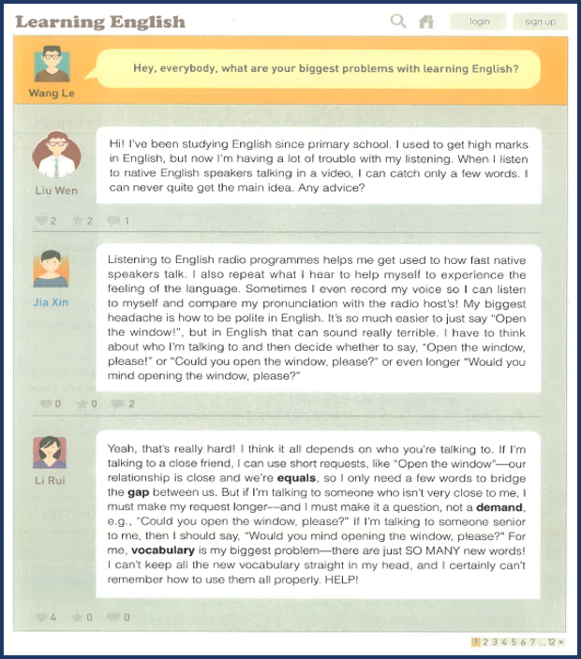
Read for main idea
1. Who puts forward the question “What are your biggest problem …”?
Wang Le
2. Who replies to the question?
Liu Wen, Jia Xin, Li Rui
3. What is the blog mainly about?
What are their problems?
Problems & Recommendations
What recommendations come up in the blog?
English learning

Slide 6


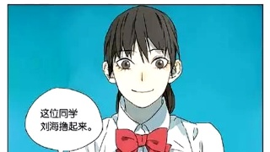

Read for details
Read and fill in blanks
Name | Trouble | Recommendation
listen to English radio programmes
—— Jia Xin
have trouble with Listening
How do they organize their trouble and recommendations？
Liu Wen
depends on who you are talking to
——Li Rui
how to be polite in English
Jia Xin
remembering
new vocabulary
Liu Rui
How do they organize their trouble and recommendations？

Slide 7
Read for organisation
Taking Jia Xin’s post for example
Advice
Listening to English radio programmes
Listening to English radio programmes helps me get used to how fast native speakers talk. I also repeat what I hear to help myself to experience the feeling of the language. Sometimes I even record my voice so I can listen to myself and compare my pronunciation with the radio host’s! My biggest headache is how to be polite in English. It’s so much easier to just say “Open the window!”, but in English that can sound really terrible. I have to think about who I'm talking to and then decide whether to say, “Open the window, please!” or “Could you open the window, please?” or even longer “Would you mind opening the window, please?”
I also repeat what I hear to help myself to experience the feeling of the language.
Sometimes I even record my voice so I can listen to myself and compare
my pronunciation with the radio host’s!
Supporting details （how to do)
trouble
My biggest headache is how to be polite in English.
It’s so much easier to just say “Open the window!”, but in English that can sound really terrible. I have to think about who I'm talking to and then decide whether to say, “Open the window, please!” or “Could you open the window, please?” or even longer “Would you mind opening the window, please?”
Example
（he has experienced)
Jia Xin

Slide 8
Read for organisation
How do they organize their trouble and recommendations？
Trouble:
Problem+example（they have met in study）
Putting forward advice:
Doing sth would be a wise choice.
I think that...
I recommend that you should…
It’s a good idea to
It’s highly suggested that…
It’s of great importance to…
If I were you, I would …
Putting forward problems:
I have trouble with ...
My biggest problem is...
...is my biggest headache.
I don't know how to...
How do the students put forward their problems and advice?
Advice:
Advice + supporting details
(How to do)

Slide 9
Discussion & Drafting
Express your trouble and offer recommendations to your partners’ trouble. Then choose one problem from your partner and writer a blog about it.
A sample:
A: What are your biggest problems with learning English?
B: …is the biggest headache for me. I have no idea… Some times I believe… but in effect, I fail to…
A: If I were you, I would… It’s important to … That works for me.
While writing, you should
Discribe the problem clearly
(problem+example, using various expressions)
b. Write one or two ideas on solving the problem
(advice+supporting details, using various expressions)

Slide 10
Exchange Drafts
Assess each other's work according to the checklist.
General content:
· Does the writer give a clear description of the problem?
· Is the advice clearly explained?
· Does each sentence relate to the main idea?
Basic writing skills:
· Does the writer use pronouns to refer to things or people correctly?
· Does the writer use correct spelling, punctuation, and capitalisation?
· Are there any grammar mistakes?
Get your draft back and revise it.

Slide 11
Sample
Advice + supporting details
Problem+example
Part of a letter of advice
Reading others' articles would be a wise choice to improve your writing.If you read a number of good writing articles, you will learn how to use various sentences to express themselves, and present information in an excellent way. If I were you, I would also keep a diary. That works for me. Besides, it is natural that the beginners make mistakes while writing.But don't worry. Finding out why you made the mistakes will help vou avoid the same mistakes and enable you to write better. For me, grammar is my biggest headache. It's so complex and difficult that I have no idea when and how to use it properly.
Can you add a beginning and an ending to the writing to make it a complete lette of advice?

Slide 12
Sample
a letter of advice
I'm sorry to hear that you are having trouble with your writing. I understand quite well you are anxious now,because I have a similar problem. Here comes my recommendations
Reading others' articles would be a wise choice to improve your writing.If you read a number of good writing articles, you will learn how to use various sentences to express themselves, and present information in an excellent way. If I were you, I would also keep a diary. That works for me. Besides, it is natural that the beginners make mistakes while writing.But don't worry. Finding out why you made the mistakes will help vou avoid the same mistakes and enable you to write better. For me, grammar is my biggest headache. It's so complex and difficult that I have no idea when and how to use it properly.
Hope that you will find my suggestions useful, and look forward to your reply.

