Slide 1


感恩遇见，相互成就，本课件资料仅供您个人参考、教学使用，严禁自行在网络传播，违者依知识产权法追究法律责任。
更多教学资源请关注
公众号：溯恩高中英语
知识产权声明

Slide 2
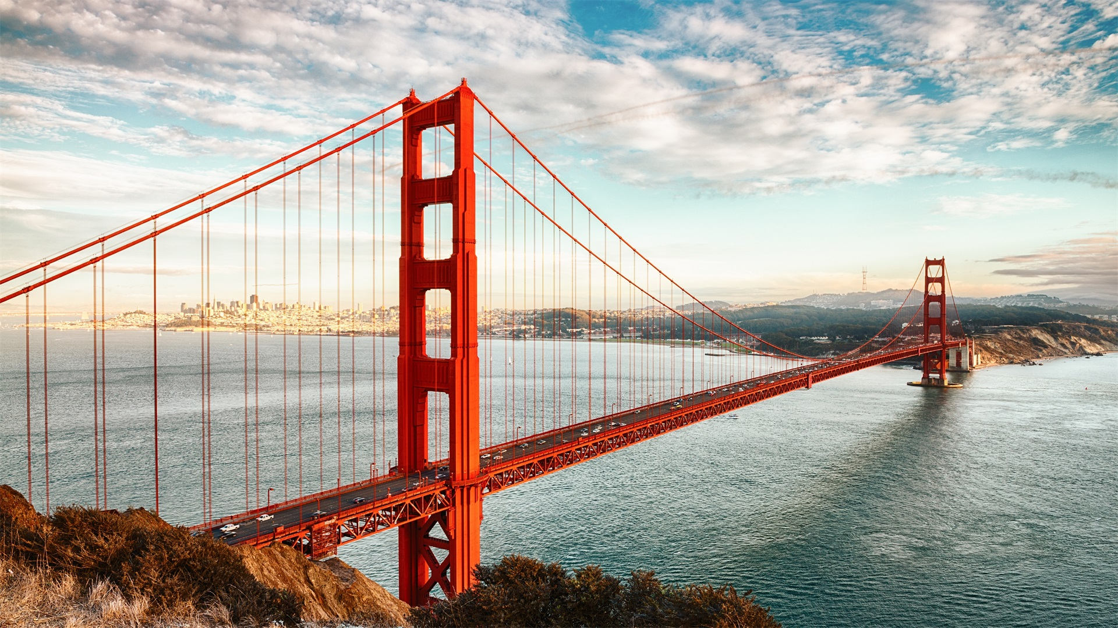

San Francisco , a city with diverse cultures
嵊州市高级中学 严美灵

Slide 3
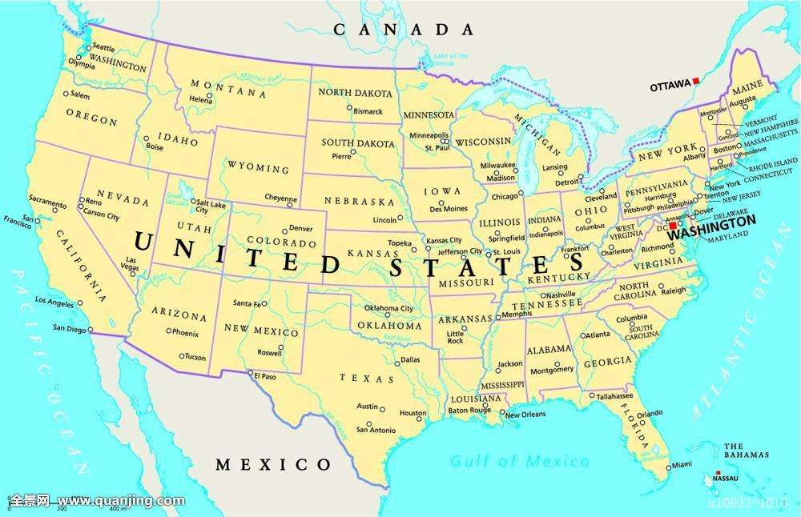
CALIFORNIA
SAN FRANCISCO

Slide 4
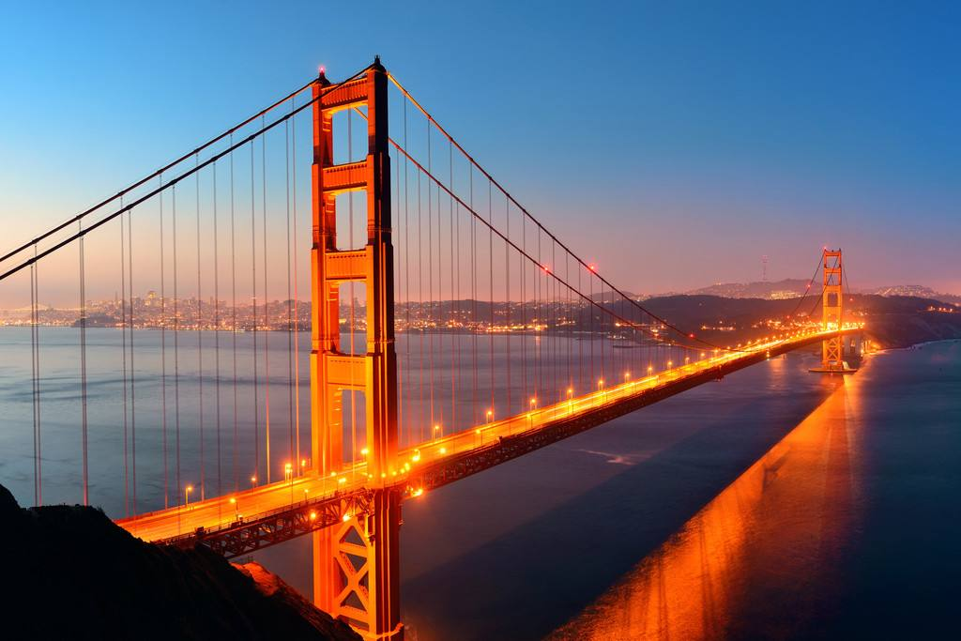
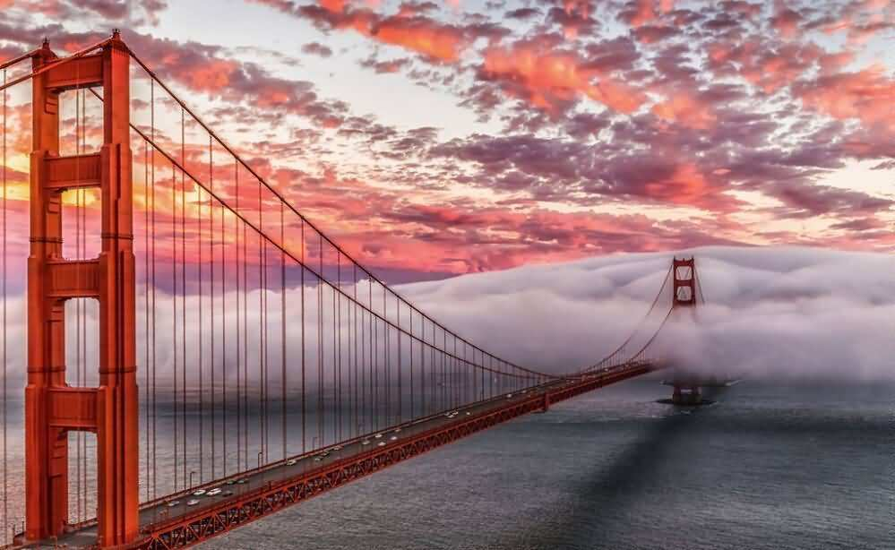
Golden Gate Bridge

Slide 5
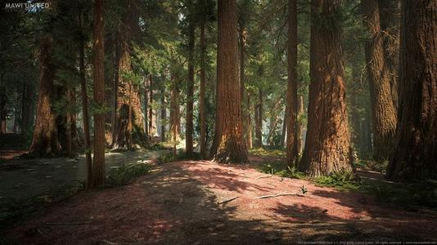
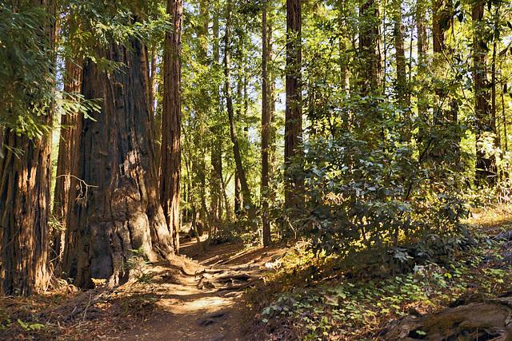
Redwood Forest

Slide 6
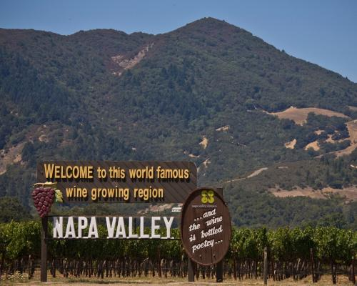
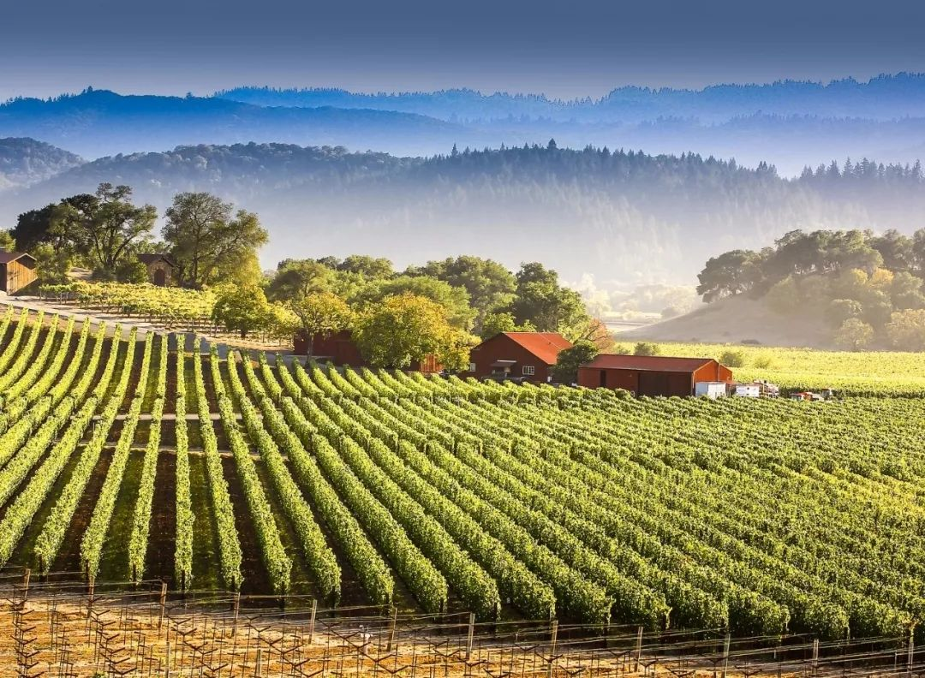
wine country of Napa Valley

Slide 7
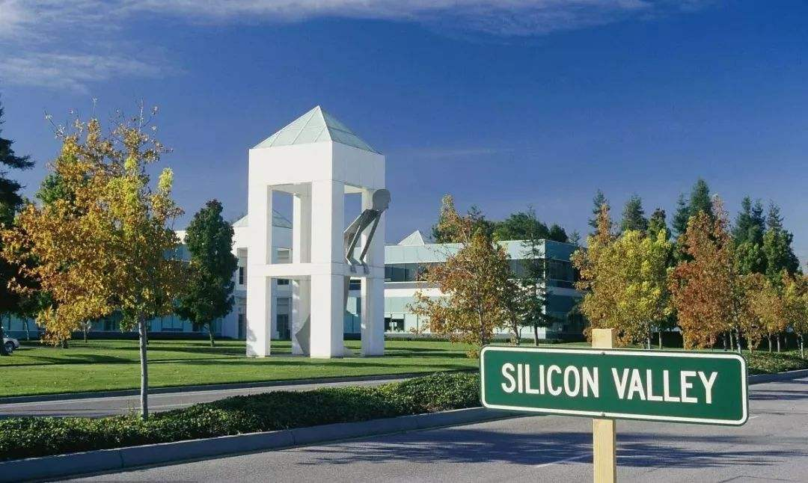
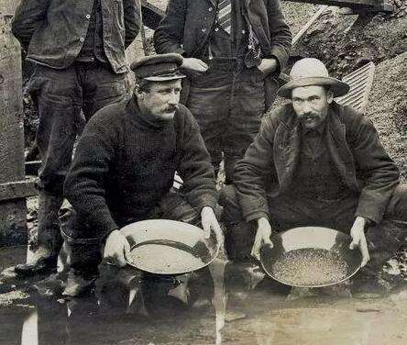
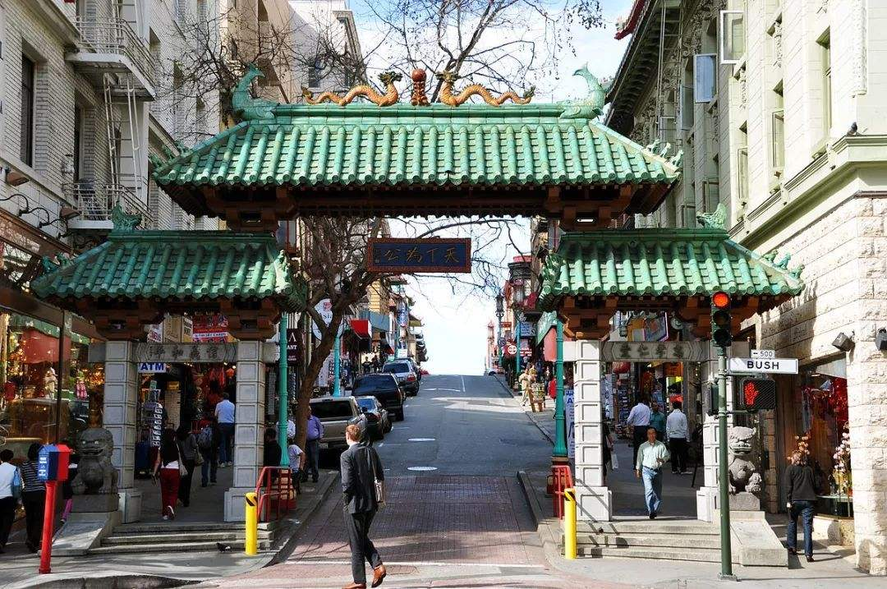


Slide 8
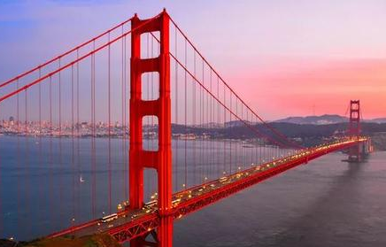
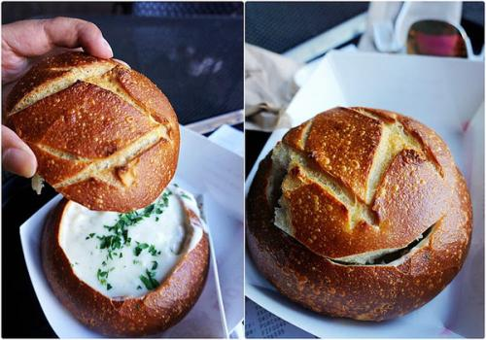
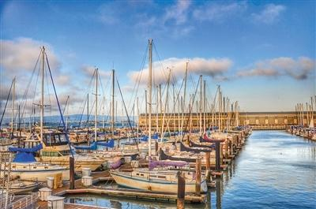
Prediction: What might she write about in the text?

Slide 9

First reading for basic information
Who: _________
Where: visit ________________
When:______________
What: Li Lan recorded
_____________________________________
How the author develops the travel journal: in _____ order.
A travel journal
Li Lan
San Francisco, US
Wednesday, 21 June
what she saw and did and how she felt.
time

Slide 10
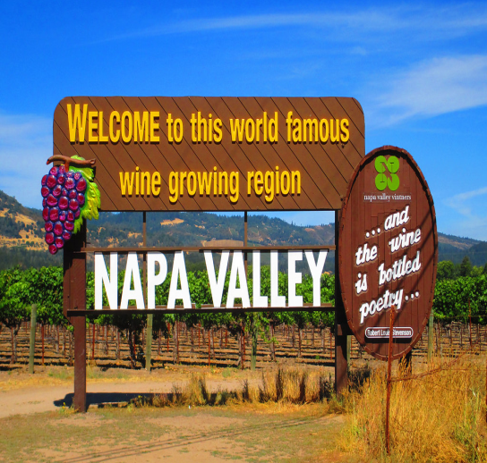
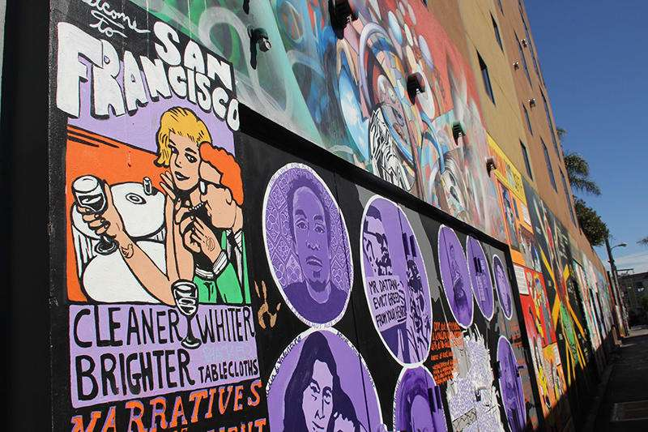
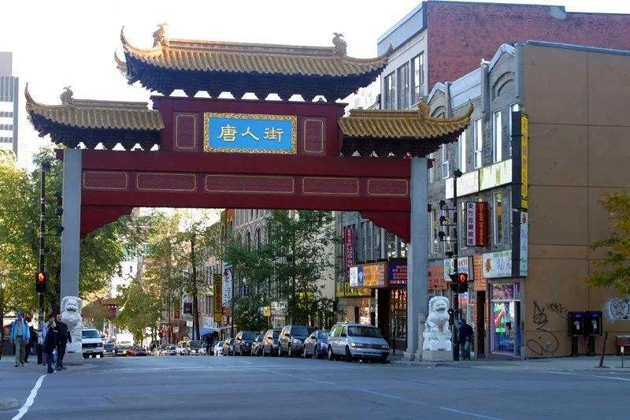
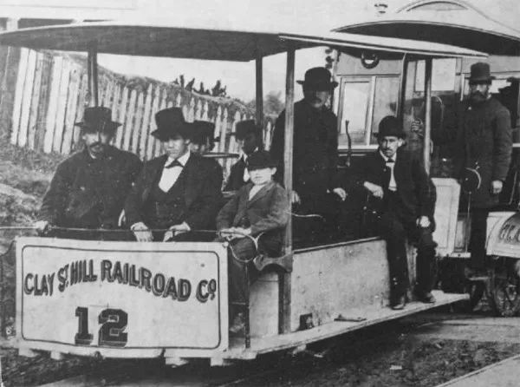
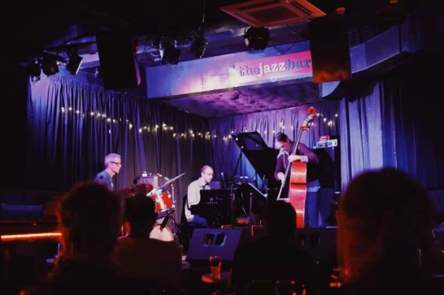
Li Lan’s route
Mission
District
wine country of
Napa Valley
Redwood Forest
Chinatown
museum
jazz bar

Slide 11
Second reading for detailed information
Parts | Feelings | What I saw and did
Para.1: city of San Francisco
Para.2: Mission District
Para.3: local museum
Para.4: Chinatown
Para.5: Richmond District
amazed, impressed
And what a city…rebuild itself after the earthquake… so many beautiful old buildings…on top of big hills… offering great view…
I walked around looking at the street art for a few hous…quite modern and lively…delicious…A real mix of cultures here!
interested
The museum did a really good job…immigrants left their own country…carried a bit of home in their hearts…built a new home here.
touched
happy
…so many good cafes and restaurants…beautiful china plates…Whate good food!
eager to know
Can't wait!

Slide 12
Third Reading for thinking
First impression
Para 1. What impressed the writer first about San Francisco?
Today was my first day back in San Francisco after camping in the Redwood Forest and visiting the wine country of Napa Valley. I have to admit that it definitely feels good to be back in the city again. And what a city—a city that was able to rebuild itself after the earthquake that occurred in 1906. There are so many beautiful old buildings—many siting on top of big hills, offering great views of the city, the ocean, and the Golden Gate Bridge.

Slide 13
What a great city—a city that was able to rebuild itself after the earthquake that occurred in 1906.
There are so many beautiful old buildings– many sitting on top of big hills, offering great views of the city, the ocean, and the Golden Gate Bridge.
The city is brave, tough and strong.
The city is attractive, beautiful and spectacular.
Inner spirit
Outside beauty
San Francisco
It definitely feels good to be back in the city.

Slide 14
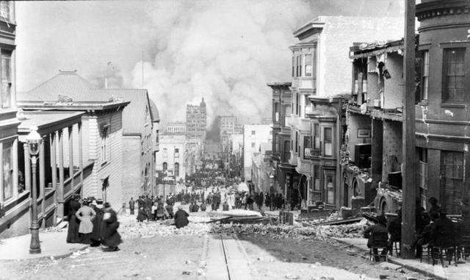
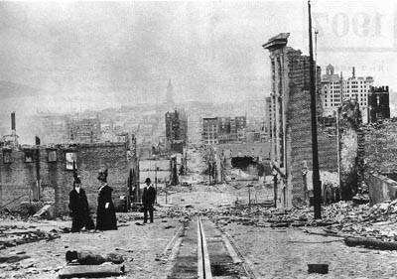
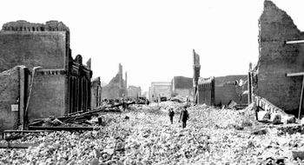
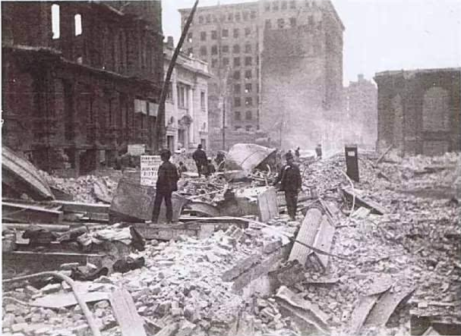
1906 San Francisco earthquake

Slide 15
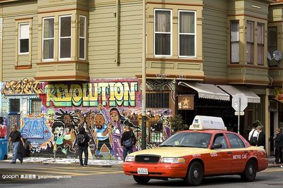
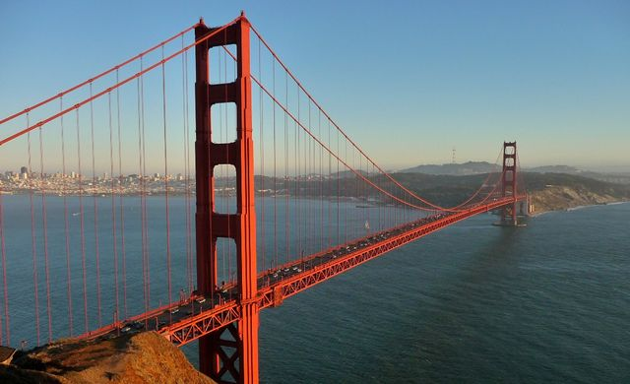
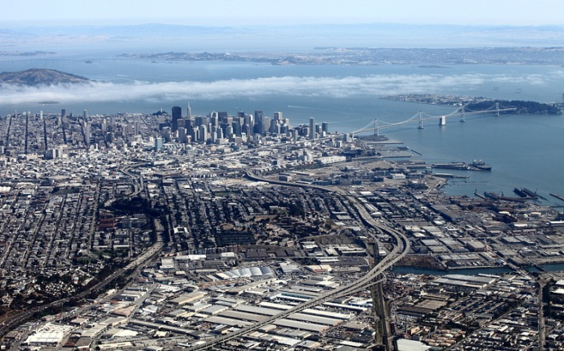

Slide 16
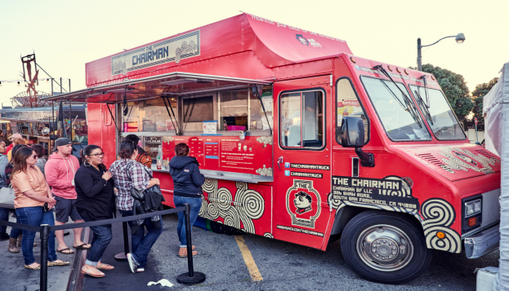
Para.2
What is so special about the Mission District?
My hotel is near downtown，in the Mission District，one of the oldest parts of the city. Many of the people living here are from Mexico or Central America. This district used to be a poor area of town，but is now a centre for art，music，and food. In fact，an art movement called the“Mission School”started here. It’s influenced by graffiti art and comic art. I walked around looking at the street art for a few hours. It was quite modern and lively. Afterwards，I ate some delicious Mexican-Chinese noodles from a food truck. A real mix of cultures here!
the oldest parts
from Mexico or Central America
poor area of town
a centre for art, music, and food
by graffiti art and comic art
Mexican-Chinese noodles

Slide 17
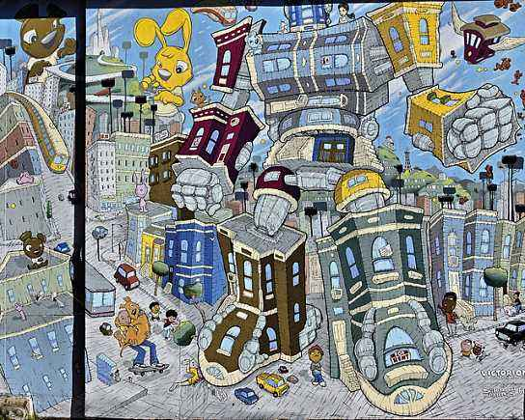
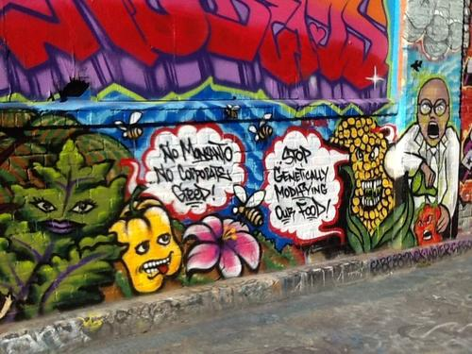
Mission District
graffiti art and comic art
涂鸦艺术和漫画艺术

Slide 18
Experience: Where we live
Many of the people living here are from Mexico or central America.
Mix of people
A real mix of cultures here.
This district used to be a poor area of town, but is now a centre for art, music, and food.
Openness creation
acceptance
It’s influenced by graffiti art and comic art.
Ethnic diversity
I ate some delicious Mexican-Chinese noodles from a food truck.
Mix of food
A modern, lively ,creative and open city

Slide 19
Experience: What we eat
Rich in varieties
I went to Chinatown. There were so many cafes and restaurants to choose from. I selected a Cantonese restaurant that served its food on beautiful china plates. What great food.
Ethnic diversity
Experience: Entertainment
Tomorrow evening, I am going to a jazz bar in the Richmond District. Can’t wait.
A music originated from black people

Slide 20
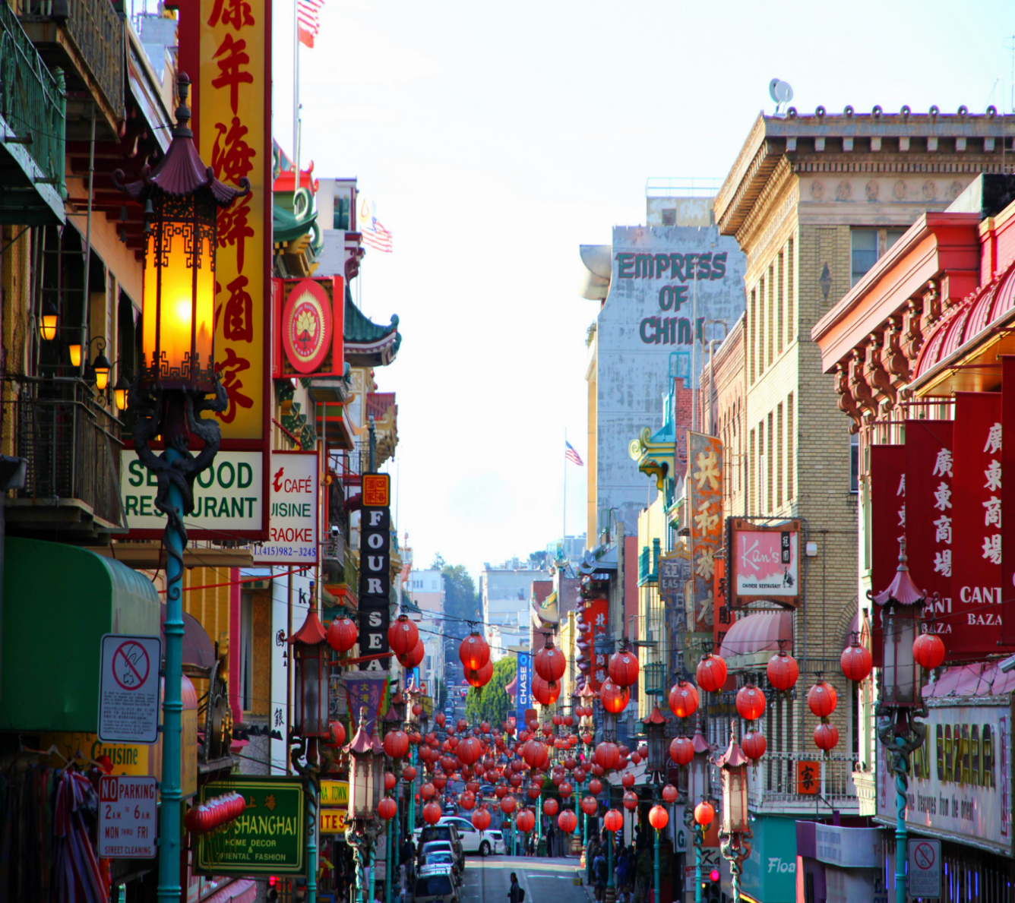
Chinatown
jazz bar

Slide 21
Para 3: Exploration:
Why there are so many immigrants?
In the afternoon，I headed to a local museum that showed the historical changes in California. I learnt that America got California from Mexico in 1848. In the same year，gold was discovered near San Francisco，which started a gold rush. Over 300，000 people came from all over the world to seek their fortune，and San Francisco quickly became a big city. Many Chinese arrived during this period. To earn a living，some opened up shops and restaurants in Chinatown. Many others found jobs on farms，joined the gold rush，or went to build the railway that joined California to the eastern region of the country. The museum did a really good job of showing how America was built by immigrants from different countries and cultures. When these immigrants left their countries，they carried a bit of home in their hearts，and built a new home here.
historical changes
300,000 people came from all over the world
some
Many others
When
These immigrants left their countries, they carried a bit of home
in their hearts, and built a new home here.

Slide 22
Exploration :what did I learn from the local museum?
1.America got California from Mexico in 1848.
Historical changes
2. In the same year, gold was discovered near San Francisco, which started a gold rush.
Over 300000 people came from all over the world to seek their fortune, and San Francisco quickly became a big city.
A larger city and a larger population

Slide 23
To earn a living, some opened up shops and restaurants in Chinatown. Many others found jobs on farms, joined the gold rush, or went to build the railway that joined California to the eastern region of the country.
Immigrants’ joint efforts to build a new home
pioneers
adventurous
brave
hardworking
Carried a bit of home in heats
The pioneering spirit
Built a new home here

Slide 24
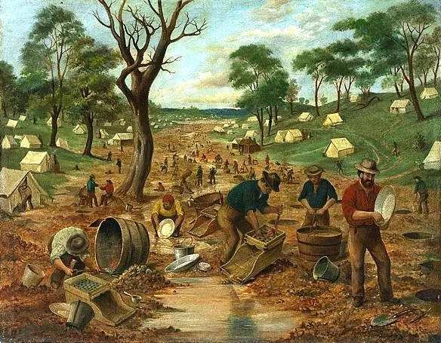
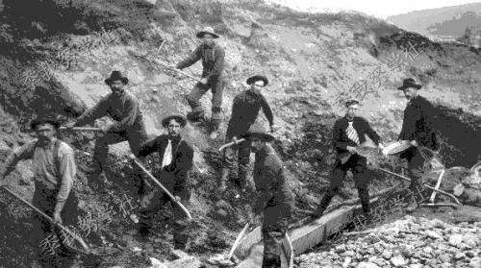
Gold Rush

Slide 25
Thinking
people from Mexico or Central America
Expression
a jazz bar
immigrants from all over the world
Diverse
cultures
cafes and Chinese restaurants
To experience
Attitude
To respect
To explore
To appreciate

Slide 26
Homework
Writing: Write down a travel journal.
Last week, I went to …, which was
an unforgettable experience.
……

Slide 27
Last week, I went to …, which was…
Tips:
1. Structure: In order of time
2. Content: What I saw and how I felt
3. Expressions: Beautiful words and sentences
in the late afternoon
in the early evening
…
modern and lively
charming, impressive,
wonderful, fantastic
excited, impressed…
I have to admit that it definitely feels good to…； offer great views of…； what great food； I walked around looking at…

Slide 28
One possible version
Last week, I visited Yue Opera Town, which is in the beautiful Shijiaao Village in the southwestern Shengzhou, in Zhejiang Province. In the early morning I arrived at Yue Opera Town. The Town has several indoor and outdoor stages in traditional style. Lots of classical Yue operas and other traditional local operas are performed regularly there all the year. I have to admit that it definitely feels good to watch opera performance lively. In the afternoon, I headed to the snack street, where there are so many unique Shengzhou’s local snacks. What great food! Especially I am impressed with the steamed bun which is famous throughout the country. Afterwards I walked around looking at the unique souvenirs which show our traditional culture in the nearby shops. What a marvelous experience for me.

