Slide 1


感恩遇见，相互成就，本课件资料仅供您个人参考、教学使用，严禁自行在网络传播，违者依知识产权法追究法律责任。
更多教学资源请关注
公众号：溯恩高中英语
知识产权声明

Slide 2
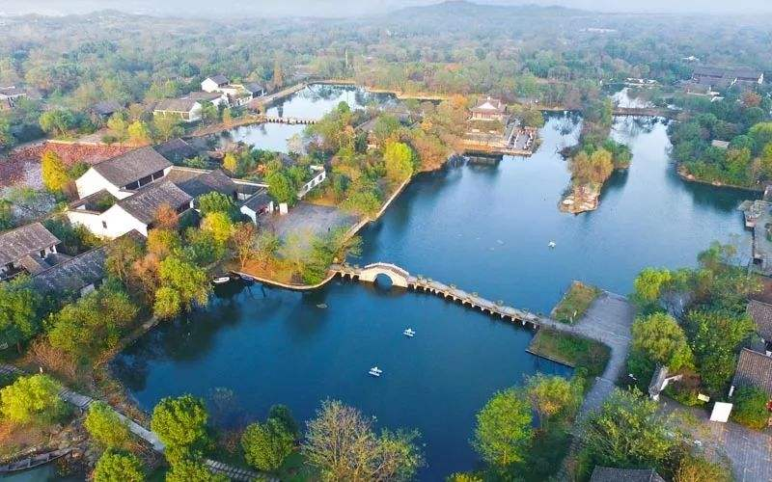
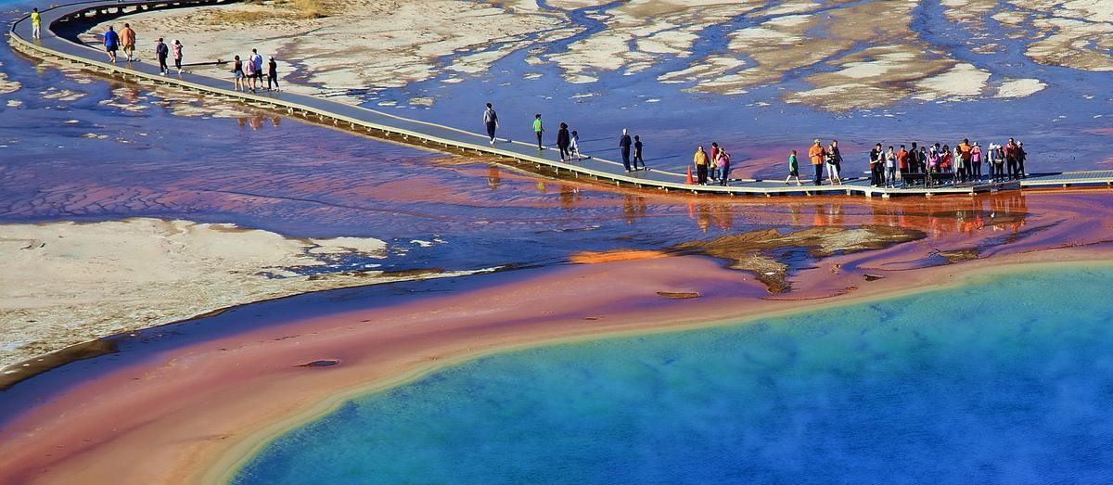
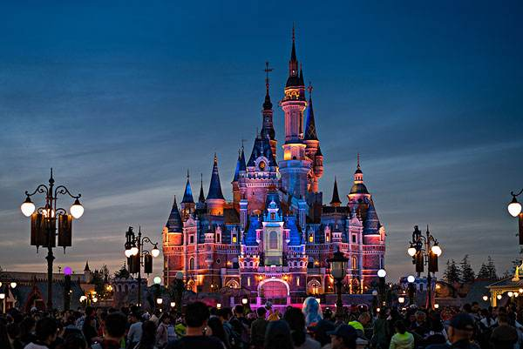
Fascinating Parks
Unit 3
A national park is not a playground. It's a sanctuary for nature and for humans who will accept nature on nature's own terms.
——Michael Frome

Slide 3
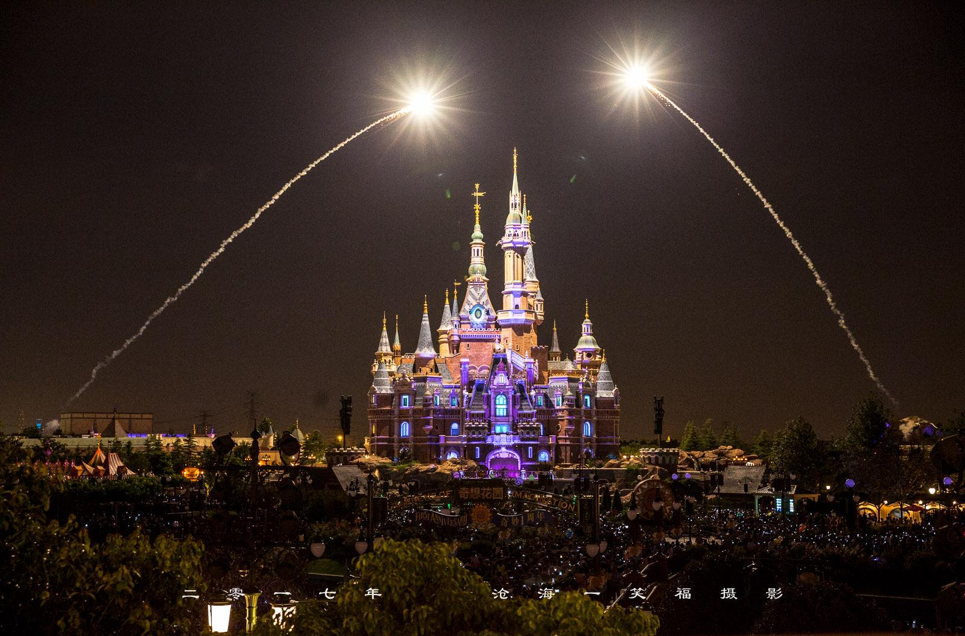
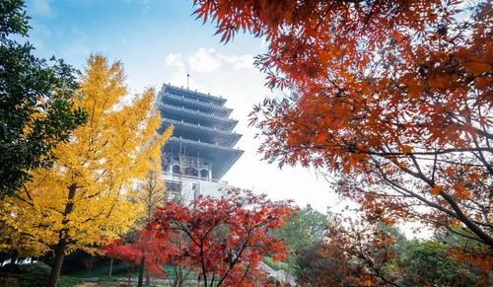
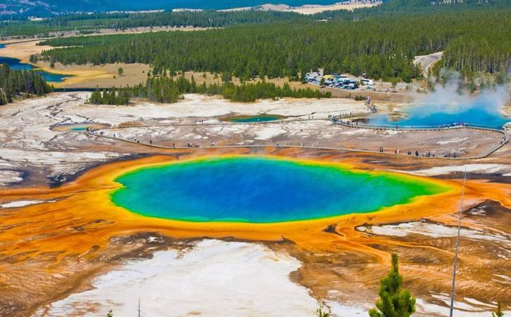
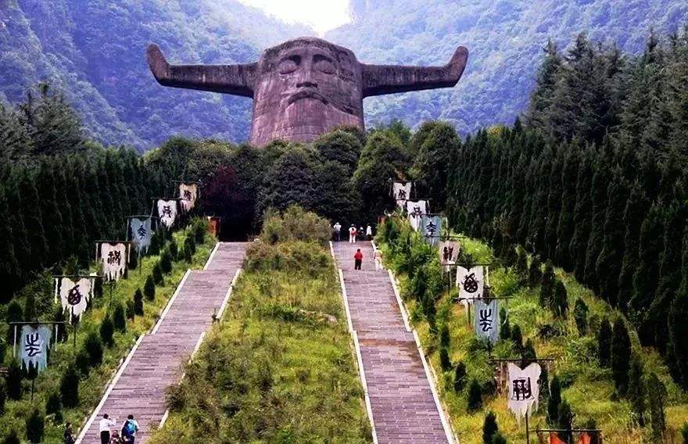
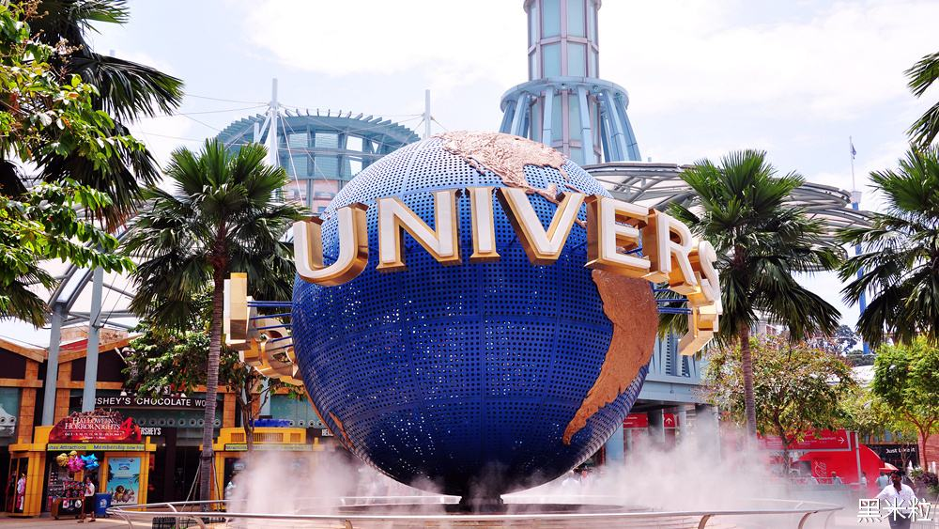
I. Discussing and Sharing
What's national parks? Do you know the first national park?
1. Have you ever been to a park? What impressed you most?
2. Do you know the following parks?

Slide 4
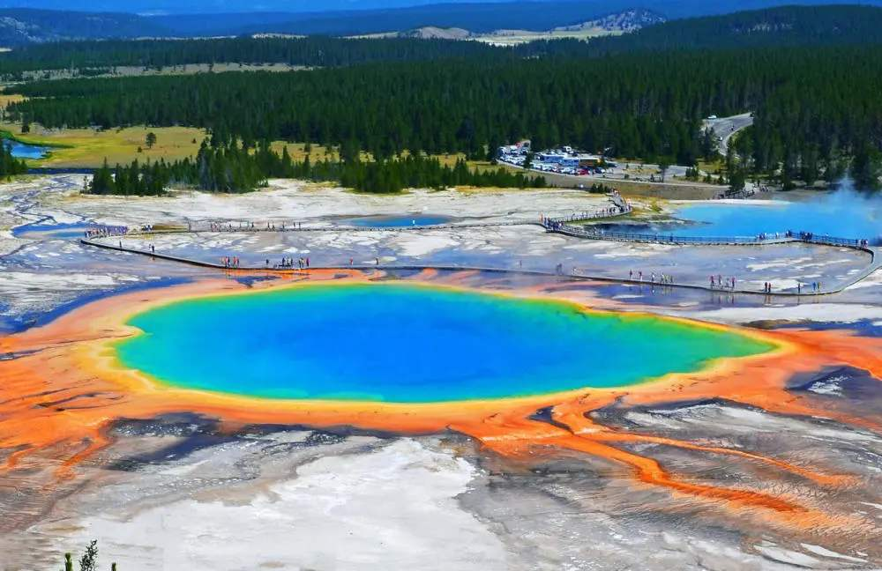
II. Viewing and Listening
1. Watch a video about the Yellowstone National Park and answer the
following questions.
(1) What's a national park?
(2) How many national parks are there worldwide?
(3) When was the Yellowstone National Park established?
(4) How many people it each year?
(5) What's the most special about its landscape?
(6) What kind of animal can you see there?
(7) What leisure activities can you enjoy there?

Slide 5
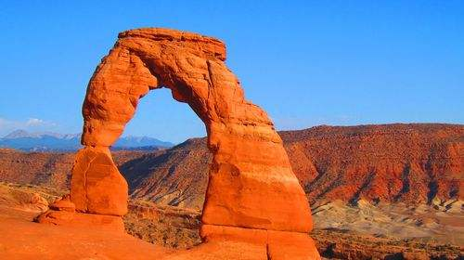
2. Answer to the listening questions
(1) What's a national park?
(2) How many national parks are there worldwide?
(3) When was the Yellowstone National Park established?
(4) How many people it each year?
A national park is an area of lan that is owned and protected by a national government due to its natural beauty or its importance to history or science. which helps preserve the beauty of nature and wildlife.
About 12000
In 1872
More than 3 million

Slide 6
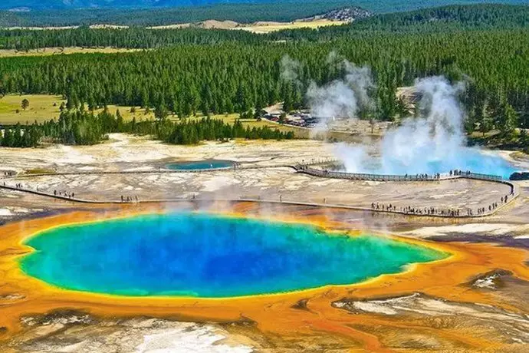
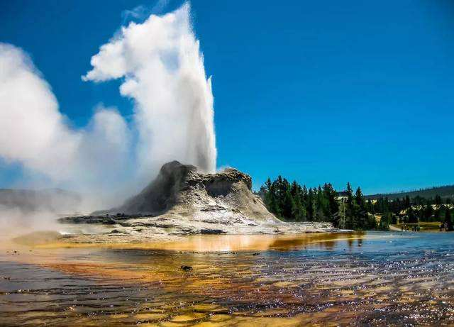
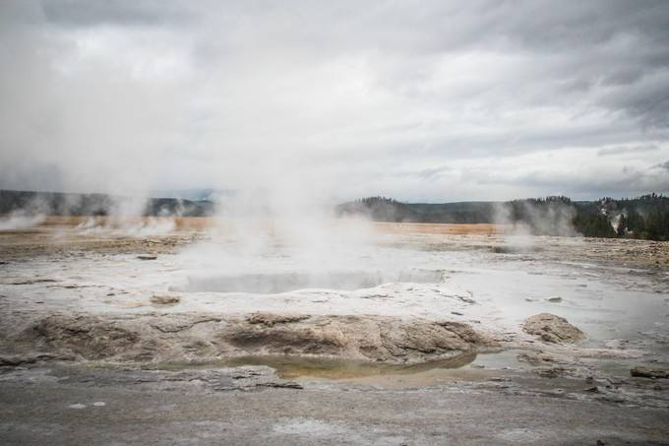
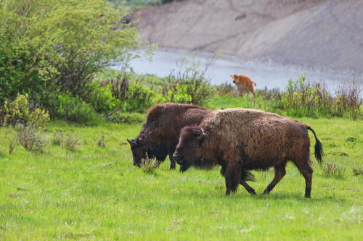
(5) What's the most special about its landscape?
(6) What kind of animal can you see there?
(7) What leisure activities can you enjoy there?
hotspring
geyser
mudpot
Wild animals such as black bear and buffalo
Hiking, camping, gishing, horseback riding...

Slide 7
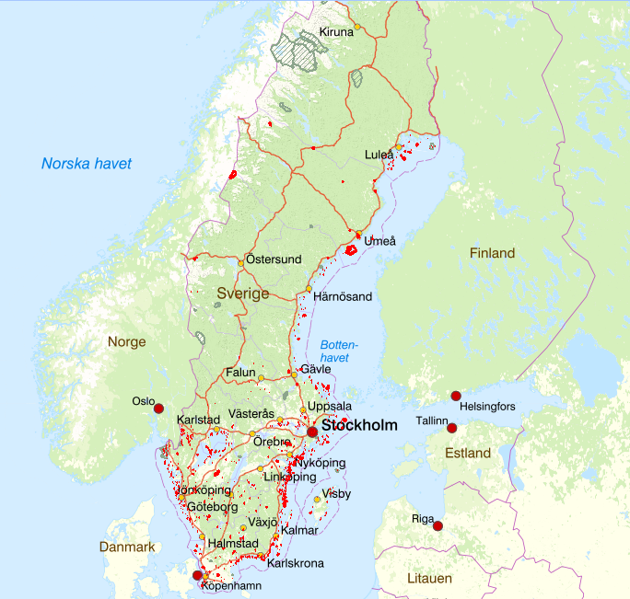
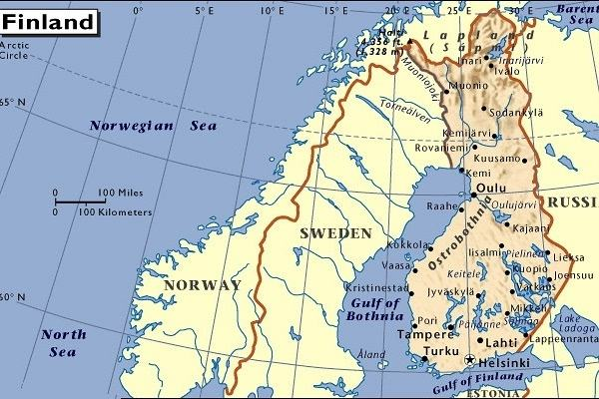
III. Viewing and Predicting
1. Do you know the geographic
position of Sweden?
2. Read the map and disucss
what natural scenery you
would expect to enjoy in
Sarek National Park.
· Scandinavian Peninsula
· Stockholm (capital)
· the Arctic Circle
a sun that never sets
luxuriant forest
glacier
Geographic position of Sweden
reindeer
aborigine
...

Slide 8
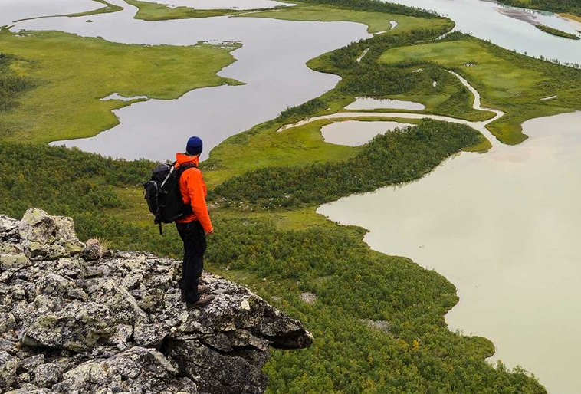

IV. Reading and Thinking
1. Go through the text quickly and answer the following questions:
(1) Where would you most likely to read this text?
(2) What's probably the author? How do you know?
In a travel magazine or travel journal
A hiker or explorer
· ...wind buffeting the cloth of my tent...I leave my tent... (paragraph 1)
· ...my breakfast is...dried meat, and some sweet and sour berries... (paragraph 3)
· I must carry all of my food and suppiles with me; my bag weighs about 30 kilograms.(paragraph 4)

Slide 9
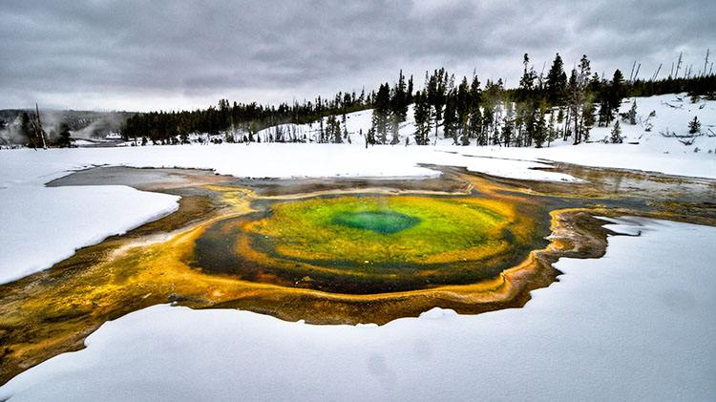
2. Subtitles give a short summary of what is in a section of a passage. Now
read the text and try to come up with a proper subheading for each
paragraph. Give reasons for your choices.
Paragraph 1
Paragraph 2
Paragraph 3
Paragraph 4
3. When creating subtitles, what should we take into consideration?
A Summer Where the Sun Never Sleeps
A Land of Mountains and Ice
What's the function of subtitles?
Man at Peace with Nature
A Land of Adventure
· content
· main idea of a paragraph
· language
· text type
· target readers

Slide 10
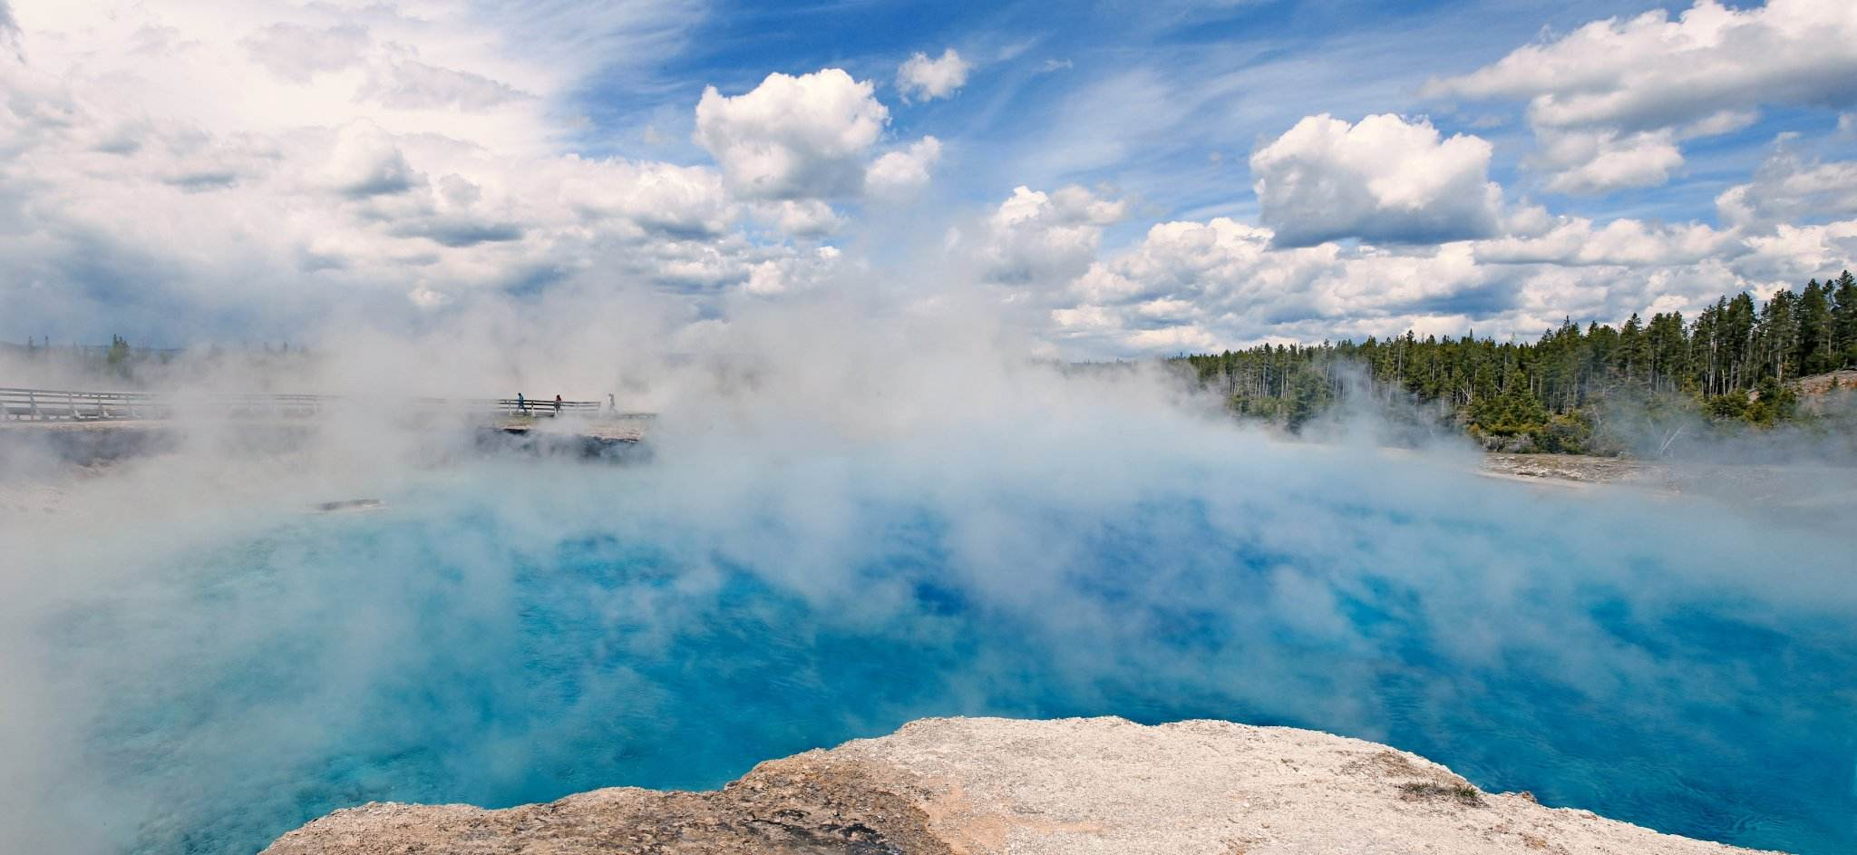
· A Land of Mountains and Ice
Sarek mountains used to be covered by vast sheets of ice. Around 9,000 years ago, this ice melted, leaving behind about 100 glaciers. Soon after, reindeer began to arrive. Following the reindeer were the Sami people, who made this territory their home. Getting here is quite difficult, so apart from the Sami very few people have ever seen Sarek. In 1909, Sarek was made a national park in order to keep the land in its natural state. Though the Sami are allowed to continue their traditional way of life in the park, no one else can live here, and all new development is banned within park boundaries.
4. How does the author organize his introduction to
the history of Sarek? Try to find the indicators.
By sequence of time
5. In introducing its history, why does the author add “Getting here is quite difficult,
so apart from the Sami very few people have ever seen Sarek” which seems irrelevant?
Transitional sentence. To state part of the reason why Sarek was set as a national park
6. From this paragraph, how would you describe Sarek National Park?
· remote
· original
· natural

Slide 11
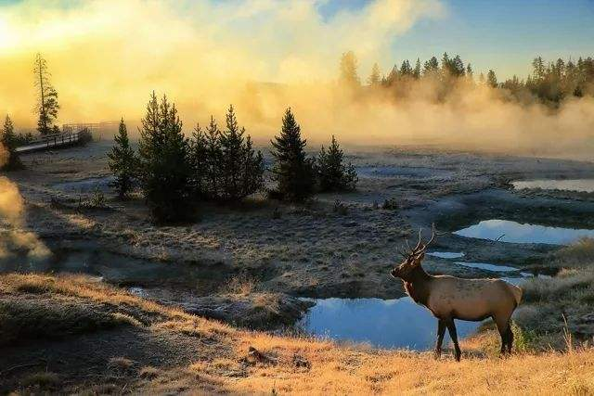
· Man at Peace with Nature
For hundreds of years, looking after reindeer was a way of life for the Sami. They used the reindeer's meat for food, their bones for tools, and their skin for making clothes and tents. Since reindeer were always on the move, the Sami would pick up their tents and accompany them. Today, most Sami have houses in villages near Sarek and live a modern life just like their neighbors. But every spring, a small number of Sami still follow their reindeer into the valleys of Sarek, living in tents or old cottages and enjoying their traditions.
7. Why does the author say “looking after reindeer was a way of life for the Sami”?
· Utilizing reindeer for daily uses.
· Adjusting lifestyle based on reindeer's habits.
8. How does the Sami live nowadays in Sarek?
· Some stick to the traditional lifestyle and some settled down in villages .
9. How do you understand the subtitle “Man at Peace with Nature”?
10. From this paragraph, how would you describe Sarek National Park?
· traditional
· harmonious

Slide 12
11. If you are going to write a travel jourmal, from what aspects will you
describe your experience?
the Sun
is brightly shining (Para. 1)
spreading out before me, branches of the Rapa River flow through the va below (Para. 1)
the RapaRiver
at the far side of the valley, an ancient Sami cottage is visible (Para. 2)
sight
cottage
close by, there are a few reindeer feeding on grass (Para. 2)
reindeer
the sky
...alone under this broad sky... (Para. 4)

Slide 13
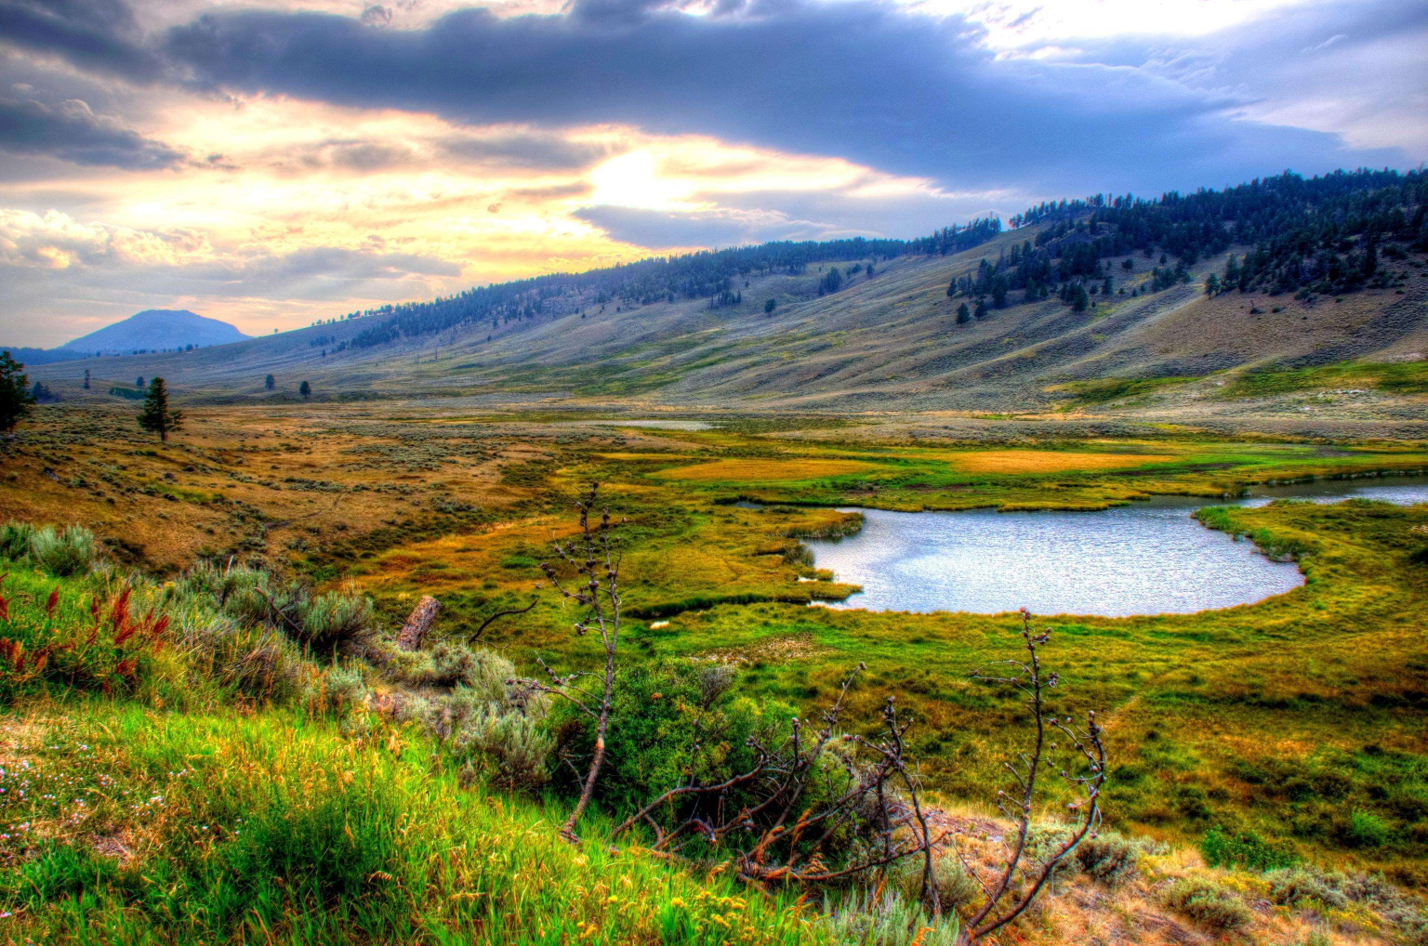
the sound of the wind buffeting cloth of my tent (Para. 1)
sound
the wind
bread
flat bread warmed over a fire (Para. 3)
Why does the author describe his experience from these senses?
taste
meat
dried reindeer meat (Para. 3)
berries
some sweet and sour berries (Para. 3)
bag
my bag weighs about 30 kg (Para. 4)
touch
sweat
...full of sweat (Para. 4)
smell
the air
...breathing the fresh air... (Para. 4)
· To vividly express his feelings in the journey.
· To describe the journey in a more all-round way.

Slide 14

12. What does the author think of his journey?
I must carry all of my food and supplies in my bag which weighs about 30 kilograms.
Such a beautiful and wild place makes me feel blessed to be alive.
Like yesterday, it will be full of sweat and hard work.
The broad sky, the fresh air, the great adventure, what could be better?
· challenging
· arduous
· exhilarating
· beautiful
13. According to the title and two pictures, what does the author think of
Sarek? Why does he say it is “hidden”?
Would you like hiking in Sarek National Park?
treasure: beautiful natural scenery and anbundant resources like plants and animals
I'm in the remote far north of Sweden in Sarek national Park, a place with no roads or towns. (Para. 1)
Getting here is quite difficult, so apart from the Sami very few people have ever been Sarek. (Para. 2)
· a treasure land yet to be explored by yourself

Slide 15
V. Pondering and Sharing
1. According to the text, why does the author go hiking in the Sarek national
Park?
2. If you are going to hike in the Sarek National Park, what preparations
would you make? Why do you do so?
3. Choose one of the following topic and write a short passage applying the
technique of “five senses”.
1) A visit to West Lake
2) Taking the subway in morning rush
3) Setting off fireworks on New Year's Eve
4) Running 1000m in the sports meeting

Slide 16
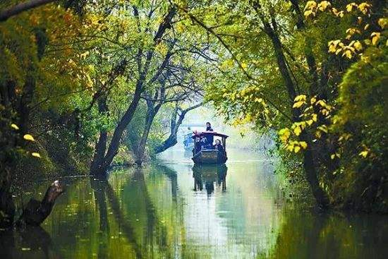
· Sample
Last weekend, my friend and I paid a visit to Xixi National Wetland Park. The moment we walked through the main gate, we could smell the fragrant flowers in the spring breeze. We enjoyed walking for a little while until we reached the nearest pier, where we spotted many traditional bamboo boats. We rented one and asked the boatman for rowing the boat ourselves. It was hard work and I felt the sweat on my back after 10 minutes. After the boat tour, we went to Hezhu Street for various local snacks. I really liked the sticky rice cakes. But my friend said it was too sugary. He liked the salty fried fish best which tasted crunchy. It was amazing to see the Hezhu Tower cast a lengthening
shadow against the setting sun.

Slide 17
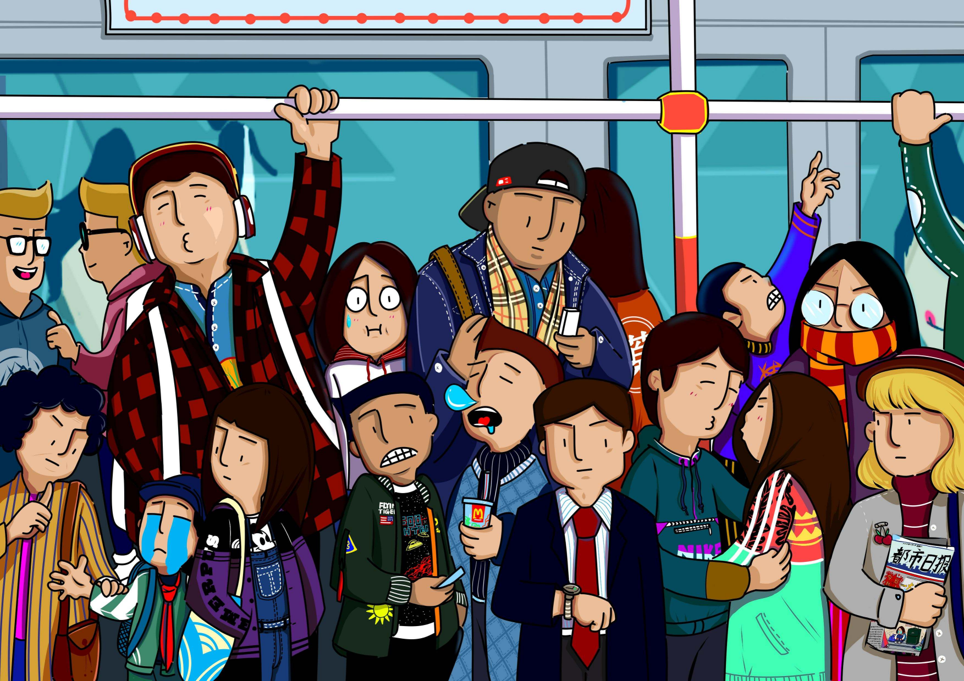
· Sample
When the subway train finally arrived, I groaned, seeing how crowded it was. The door opened and I was hit in the face by the smell of sweaty bodies. I elbowed my way inside, swinging my backpack off my shoulder to squeeze in between two people. Their bodies were warm against my arms, and I soon felt sweat on my upper lip. I put on my headphones and turned up the music. The loud notes drowned out the rest of the noise, and I felt the muscles in my shoulders relax. I shoved a hand deep into my backpack and pulled out a chocolate bar. The chocolate was melting a little, but it still tasted like heaven. maybe it wasn't such a bad day after all.

