Slide 1


感恩遇见，相互成就，本课件资料仅供您个人参考、教学使用，严禁自行在网络传播，违者依知识产权法追究法律责任。
更多教学资源请关注
公众号：溯恩高中英语
知识产权声明

Slide 2
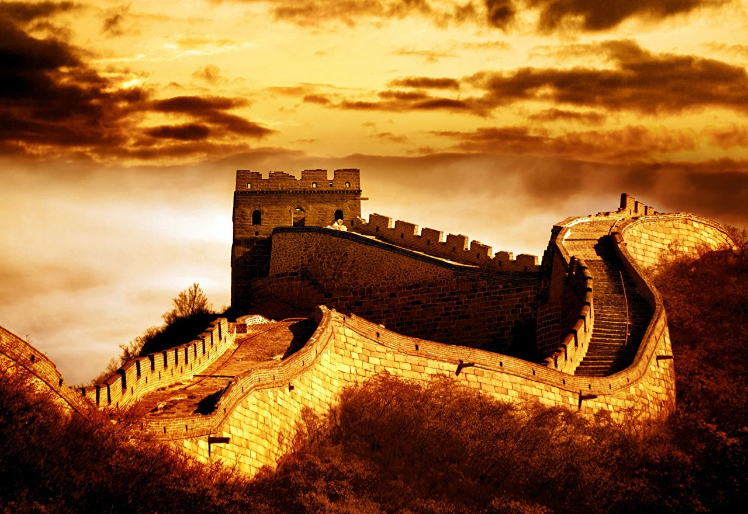
M2U1 Cultural Heritage
a. something existing from the past or has been passed down from prvious generations
b. It continues to be important.
Listening & Spesking

Slide 3
Learning Objectives
At the end of the class, students will be able to:
a. know some Chinese cultural heritage, especially Mount Tai
b. get their listening skills trained by listening for the gist, listening for details and using context to guess words.
c. improve their cultural awareness and pride

Slide 4

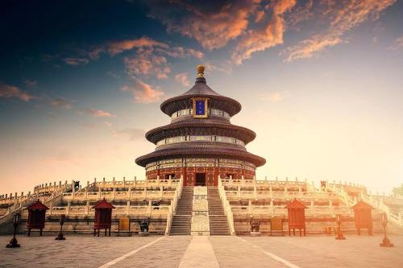
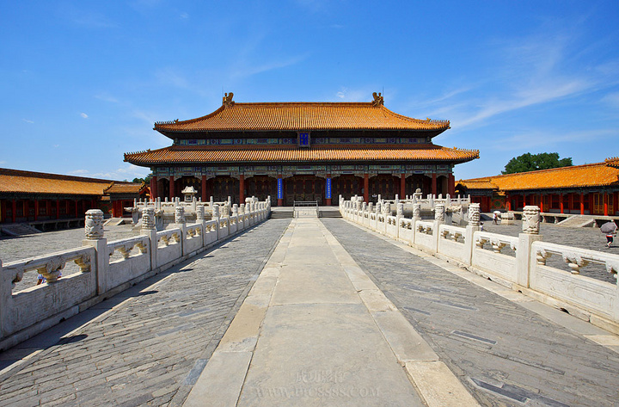
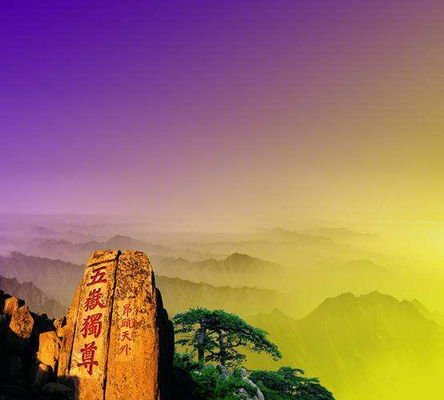
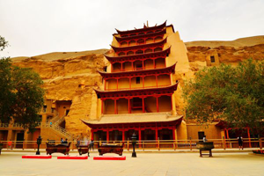
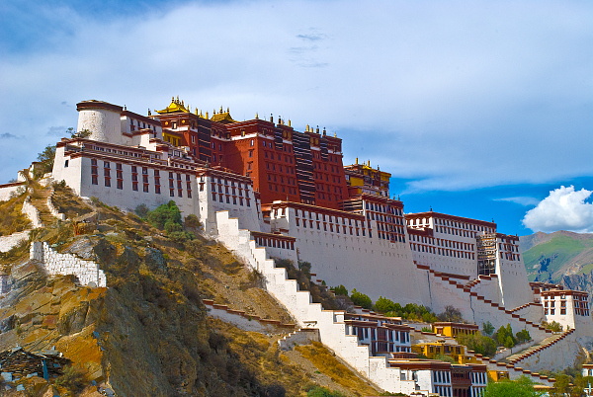
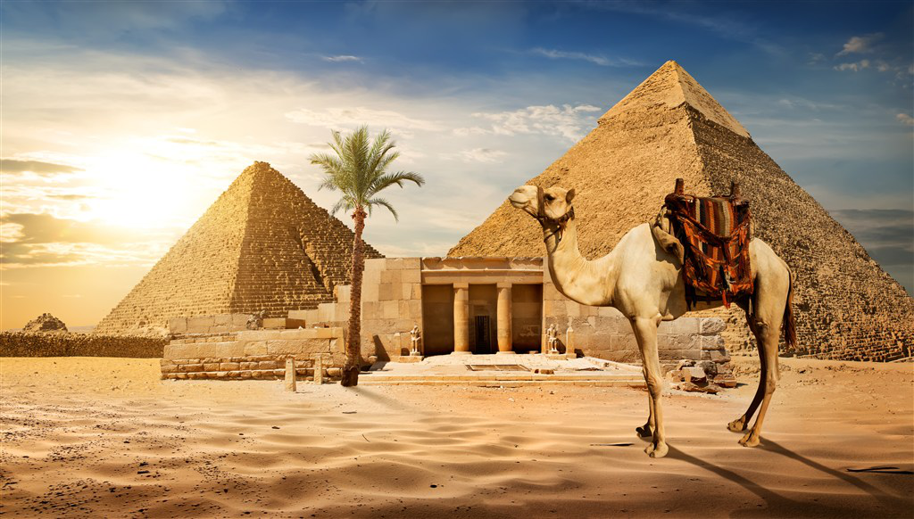
Memory Challenge
What cultural relics/heritages do you see?
Potala Palace
Temple of Heaven
China is really a treasure nation
Mogao Caves of Dunhuang
Mount Tai
The Great Pyramid
The Fobidden City

Slide 5

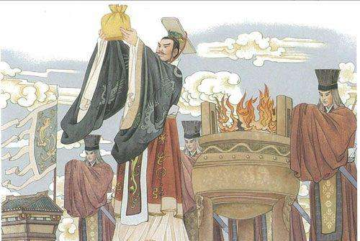

Lead-in
What do you know about Mount Tai?
a. It is one of the Five Sacred Mounts
Mount Tai, Mount Hua, Mount Heng
Mount Heng, Mount Chong
We should value and preserve cultural relics.
b. It lies in Shangdong Province
c. There is a verse discribing Mount Tai
“会当凌绝顶，一览众山小”
Splendid
d. It is the symbol of right and royal Majesty

Slide 6
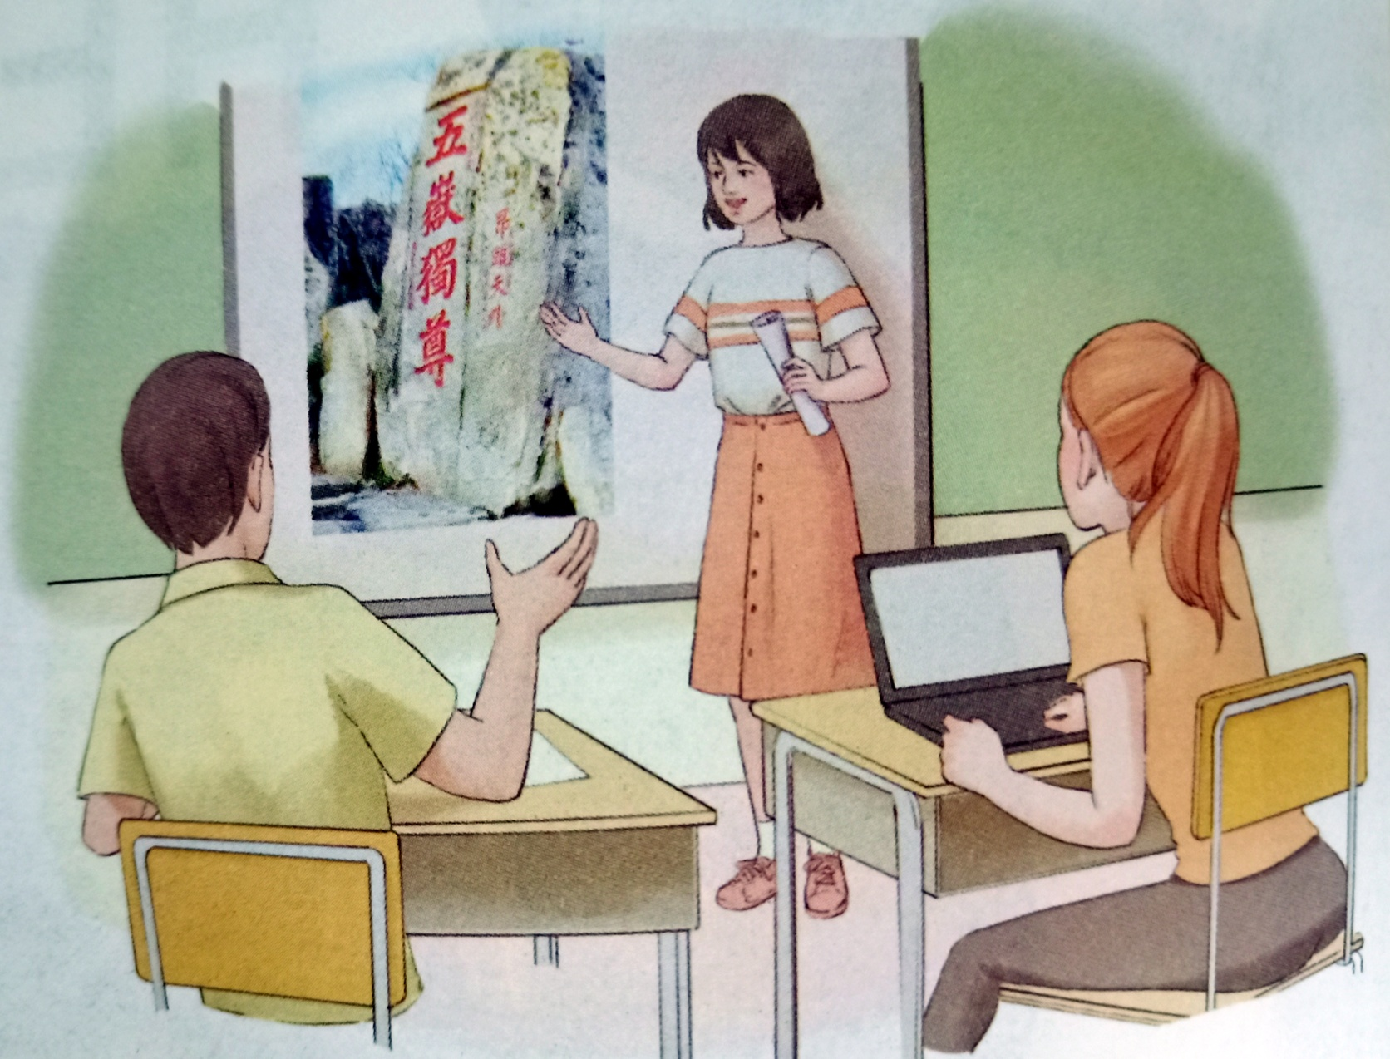
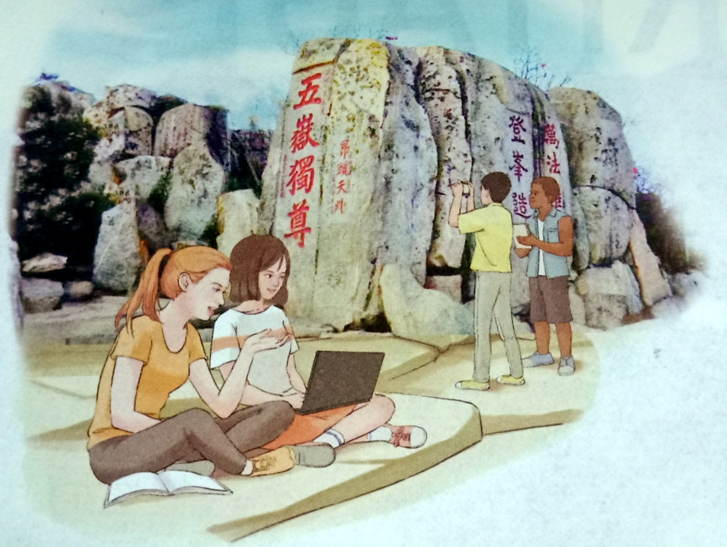
?
Lead-in
Take part in a youth project
How to preserve Mount Tai from being damaged
Who?
= the preservation of Moun Tai
Why?
Where?
Who?
What?
What?
In the former picture,the two girls are looking for information about Mount Tai in books and on the Internet. The two boys are taking photos of the rock carving at Mount Tai and taking notes.
Preparation
In the latter picture, the students are discussing Mount Tai. The girl is working on her computer.

Slide 7
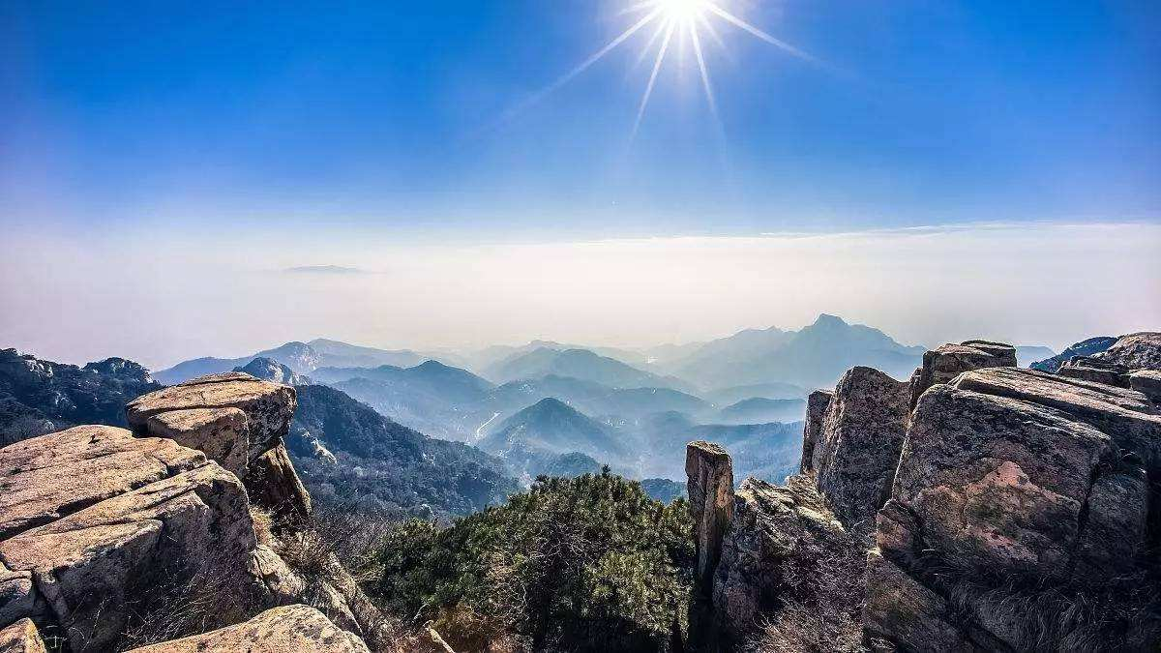

Listen for the gist
What's the main idea of the conversation?
key words
A. Students from different countries are
working creatively to protect a temple in China.
B. Youths from seven countries are working
together to protect cultural relics on Mount Tai.
C. Doing a project on cultural heritage protection
in China is interesting and exciting.
√
a. part of an international youth project
b. senior high school students
c. have been protected
d. Mount Tai
The conversation happened between _________ and ________________.
a reporter
some of the youths

Slide 8
Listen for details
Listen again and help the reporter to complete the interview notes.
who
International youth project, ___ high school students from 7 countries
Mount Tai, one of the most _______ mountains in China
It has been _______ for more than 3,000 years
22 temples, around 1,800 _____ with writing on them
Dai Temple on _________ over 6,000 _____
23
Why?
famous
protected
What?
stones
Mount Tai
steps

Slide 9
Listen for details
Listen and answer questions
Youth Project
Who
What
Why
23 Youths from seven countries
____________
An example of how people preserve their cultural heritage
Creat an app
____________
________________________
____________
which contains pictures and texts
____________

Slide 10
Listen for inference
Can you help me guess the meaning of the following words? (preserve,promote,cypress)
Use context clues to guess words
Definition
EXAMPLE
The palace was destroyed years ago. By studying old photos of the former palace, they have made the new one look exactly like the old one.
Clues: destroyed years ago; studying old photos; made the new palace like the old one
Guess: The former palace means “the palace that
_____________________________”.
:Meaning is explained in the sentence.
Example
:Example of the word is used in the sentence or nearby sentences.
Antonym
:Word with the opposite meaning is used in the sentence or nearby sentences.
Synonym
was built before but was destroyed
:Word with a similar meaning is used in the sentence or nearby sentences.

Slide 11
Listen for inference
Reason | Preserve | Promote | Cypress
The word is an example of a group/type I know.
The word is explained by the speaker.
The word means the opposite of a word I know.
The word means the same as a word I know.
I know the general meaning of the word.
The speaker gives an example of the word.
√
√
√
The mountain and the temples have been protected for over 3000 years, so ...
We want to promote Mount Tai; taht is, we want to tell...
that were planted on Mount Tai

Slide 12
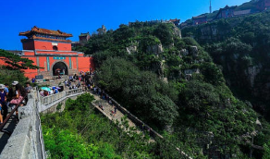
Post-listening
Help the reporter to complete the news report based on what you hear and the interview notes.
How is a news report organised?
Title
International Youth Camp Members Create Mount Tai App
Tai'an, 18 June 2019. A group of high school students who are taking part in an international youth camp at Mount Tai are creating a(n) ___ about China's most famous mountain. The purpose of the camp is
to _______ Mount Tai by introducing
it to young people in a fun and easy
way. The students are making an app
about Mount Tai and taking photos of
the _______ and stones. The
volunteers also visit middle schools in the area in order to talk to local teenagers. Liu Bin, a member of the camp, says that he is _____ to help Mount Tai as people have done for more than 3,000years.
International Youth Camp Members Create Mount Tai App
Tai'an, 18 June 2019. A group of high school students who are taking part in an international youth camp at Mount Tai are creating a(n) ___ about China's most famous mountain.
Lead
(main content)
app
Title
News report
promote
news lead: where, who, what
Details
Body
temples
details: why, how,
what
proud

