Slide 1


感恩遇见，相互成就，本课件资料仅供您个人参考、教学使用，严禁自行在网络传播，违者依知识产权法追究法律责任。
更多教学资源请关注
公众号：溯恩高中英语
知识产权声明

Slide 2

Unit 5 Languages around the world
-by Lily

Slide 3

A survey
Vocabulary???
Grammar???
When you learn English, which confuses you most?
Writing???
culture???
listening???
pronunciation

Slide 4

Watch the Video. What language is they speaking?
Why are there so many varieties of English?

Slide 5
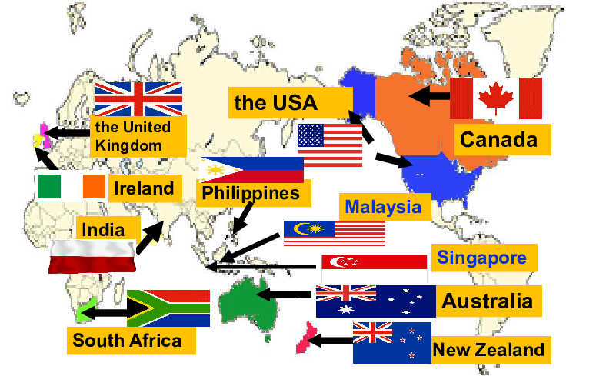
English is the ______one with the most native speakers
third
dialects
Varieties of English

Slide 6

Activity1: Listen to the first part of the talk and answer questions.
1. What are the different kinds of English mentioned?
2. In what ways are these kinds of English different from each other?
3. For who can these differences cause confusion?
British English, American English, Australian English
Vocabulary, pronunciation and grammar
Non-native English speakers

Slide 7
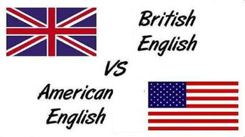
Activity2: Listen to the conversation between an American and her British friend. Tick the words that the student is confused by.
semester/term restroom/toilet
gas/petrol subway/underground
√
√

Slide 8
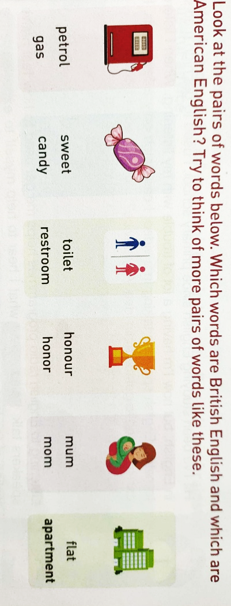
Activity3: Talking
Which words are British English and which are American English?
British
American

Slide 9

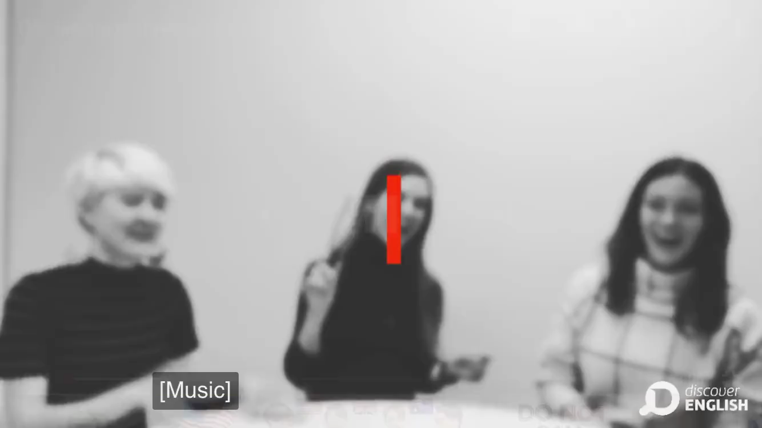
Find More examples that show the differences among
Take notes of the examples as much as possible.

Slide 10

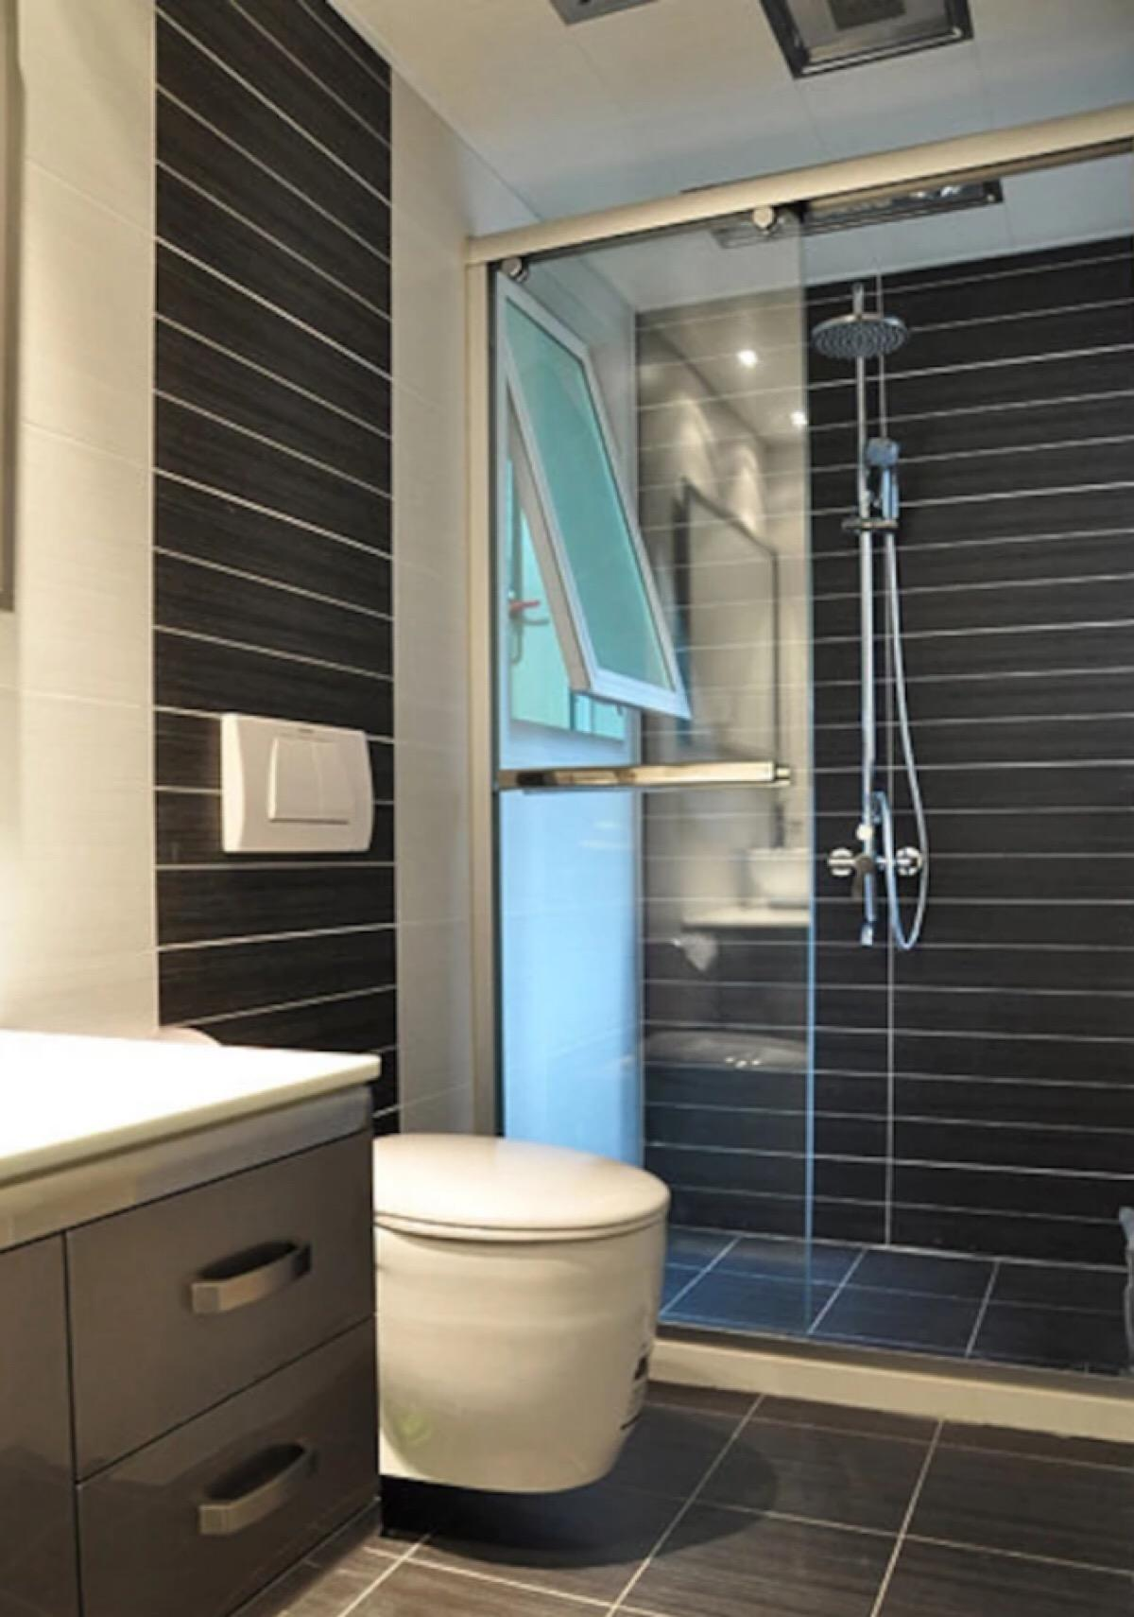

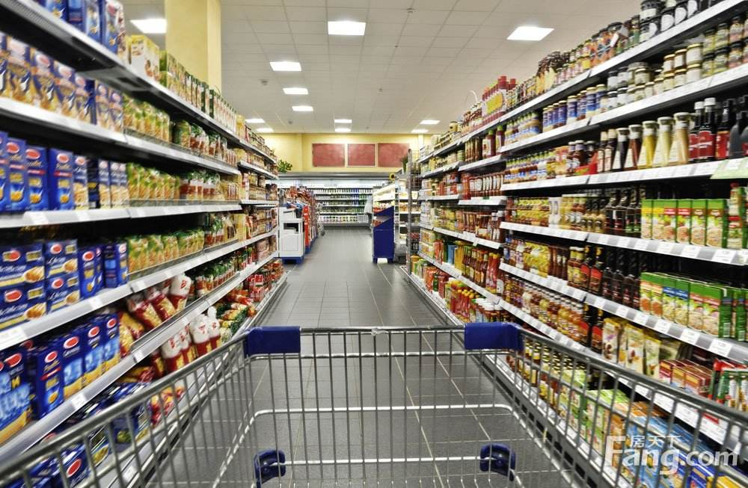
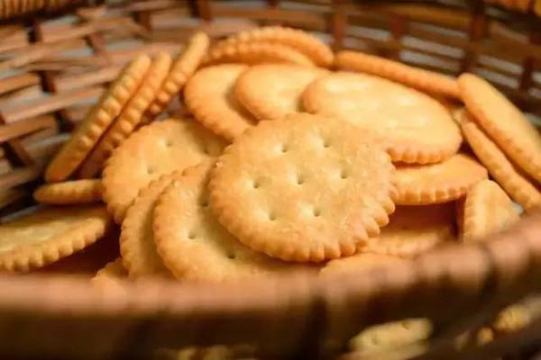
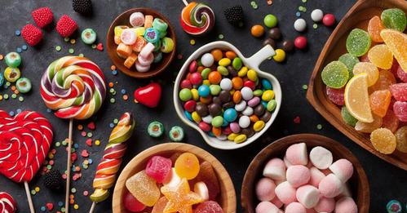


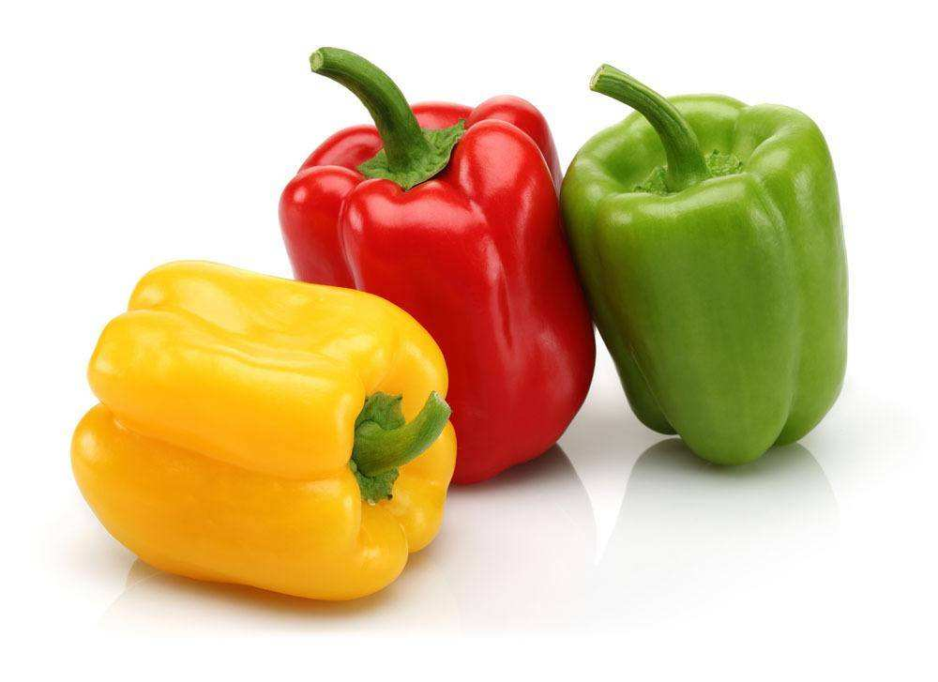
BE: flat
AE: apartment
Australia :unit
BE: bathroom
AE: restroom
Australia : dummy
AE: Mickey D’s
Australia :Mac’s
BE: shops
AE: grocery stores
Australia :supermarkets
BE: biscuits
AE: cookies
Australia : biccy
BE: sweets
AE: candy
Australia : lollies
BE: downtown
AE: city center
Australia : CBD
BE: swimming costumes
AE: swimming suits
Australia : swimmers
BE: pepper
AE: bell pepper
Australia : capsicum

Slide 11
What differences can be found between the BE ,AE and Aus E?
Will such differences be barriers in their communication?
Differences | British English | American English | Australian English
Without obvious [r]
With obvious [r]
With obvious [r]
Pronunciation
Spelling
biscuit
cookies
Very unique; simpler
Oh! My God.
Intonation
More various
More various
Such differences can cause some misunderstandings in their communication but they can clear it up.
Different words
flat
apartment
dummy

Slide 12
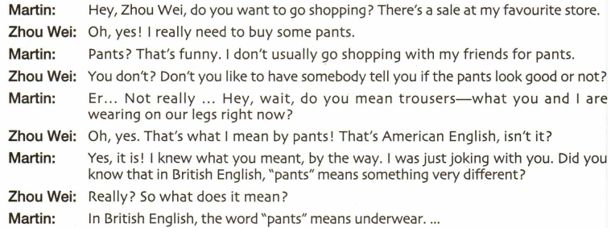
Activity4: Role-play and Read the conversation.
What misunderstanding has happened?
In American English, “pants” refers to trousers. But the word “pants” means underwear in British English.

Slide 13
What kind of interesting misunderstandings will happen in their communication?
How can we clear it up?
Ask for clarification(解释澄清).

Slide 14
Find out the expressions to ask for clarification.
Confusion
You don't?
That's what I mean by pants.
Clarification
I knew what you mean by the way.
Really? What does it mean?

Slide 15

More expressions for clarification:
Do you mean…?
I’m sorry. Would you mind repeating…?
I beg your pardon.
So am I right in saying…?
So what you’re really saying is…

Slide 16

Assignment： make a conversation Role-play
1.Choose one or two pairs of words in Activities 3 and make a conversation.
Use the expressions for clarification.

Slide 17
BE: flat
AE: apartment
Australia :unit
BE: bathroom
AE: restroom
Australia : dummy
AE: Mickey D’s
Australia :Mac’s
BE: shops
AE: grocery stores
Australia :supermarkets
BE: biscuits
AE: cookies
Australia : biccy
BE: sweets
AE: candy
Australia : lollies
BE: downtown
AE: city center
Australia : CBD
BE: swimming costumes
AE: swimming suits
Australia : swimmers
BE: pepper
AE: bell pepper
Australia : capsicum

Slide 18

Possible Example:
The misunderstandings caused by the differences between AE & BE.

Slide 19
Possible dialogue
Martin: Hey, Zhou Wei, do you want to go shopping? There’s a sale
at my favorite store.
Zhou Wei: Oh, yes! I really want to buy some books.
Martin: Really? I know there is a bookshop on the first floor.
Zhou Wei: I beg your pardon. Is the bookshop on the first floor?
But I know it is on the second floor.
Martin: I know what you meant. That’s American English, isn’t it?
Zhou Wei: Yes, am I right in saying that?
Martin: Of course, they have the same meaning.
Zhou Wei: So, let’s go .

