Slide 1

感恩遇见，相互成就，本课件资料仅供您个人参考、教学使用，严禁自行在网络传播，违者依知识产权法追究法律责任。
更多教学资源请关注
公众号：溯恩高中英语
知识产权声明

Slide 2
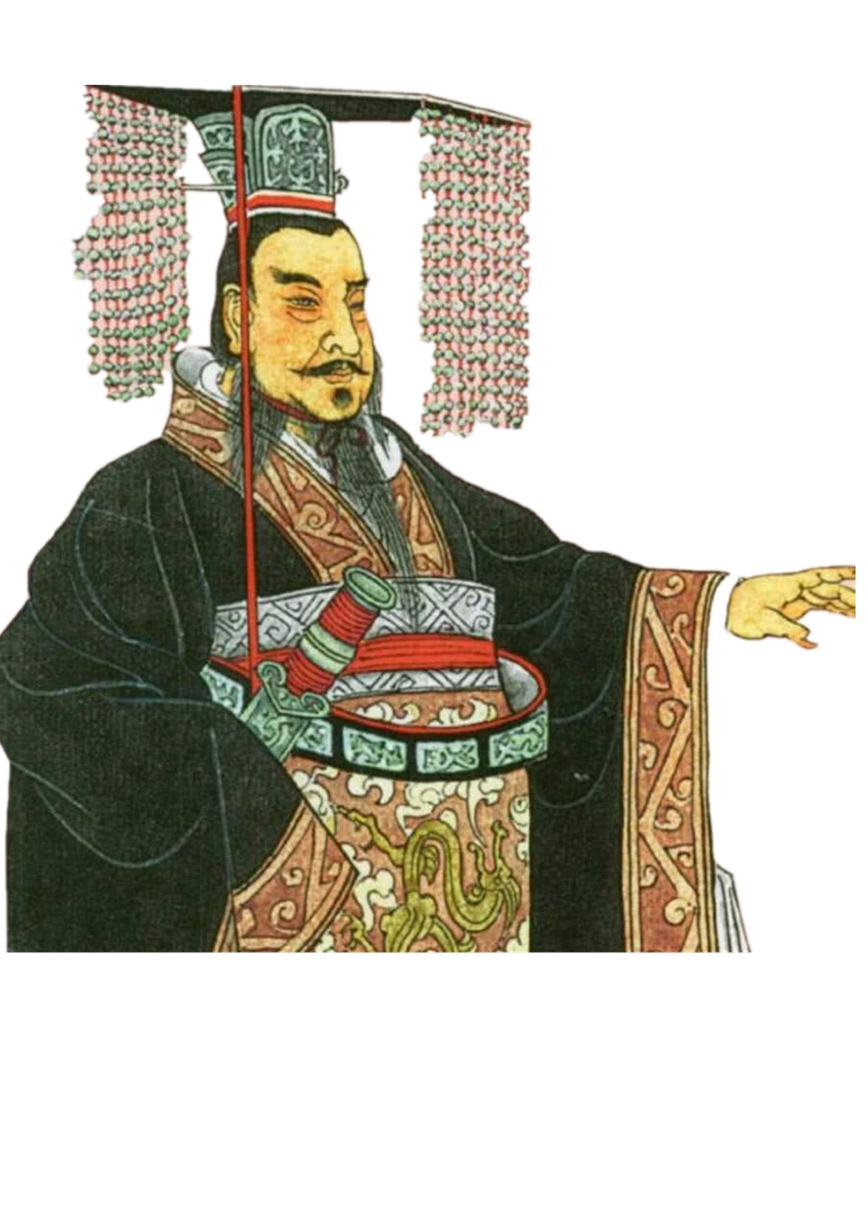
Q
How does written Chinese
unify Chinese people divided
by geography?
founded the unified country
People can communicate in writing.
a unified system was established

Slide 3

Unit 5 Languages Around The World
单县一中 种秀娟

Slide 4
Learning Objectives:
  To have a better understanding of the development of Chinese characters and its importance.
  To introduce the development of Chinese characters in English.
  To improve the ability of skimming, scanning, analyzing discourse and thinking logically.
  To enhance national confidence and pride.

Slide 5





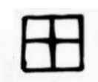


Lead in: Quiz
口
水
日
力
田
火
月
山
Notes:
这个部分应该是通过一个Game来展示吧？

Slide 6

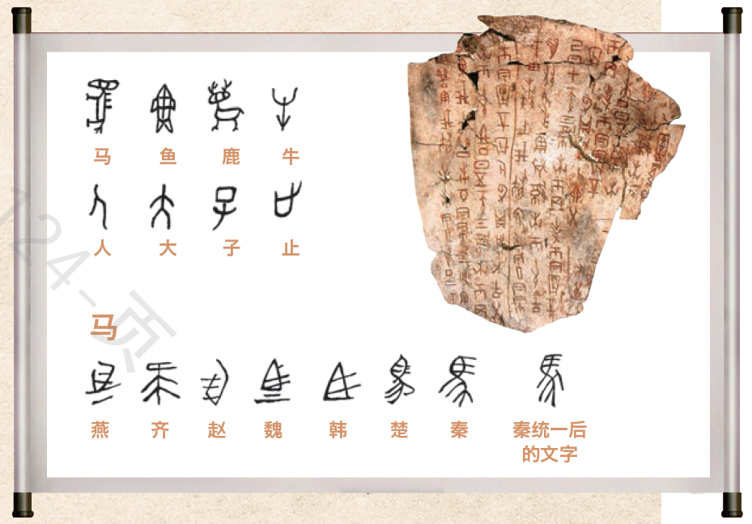
Reading for Prediction
What will the text talk about?
The development of the
Chinese writing system

Slide 7
Reading for Structure
Divide the text into 3 parts and find the main idea.
Part1
Topic
the Chinese writing system
Para 1
Part2
History
Para 2-3
Part3
Importance
Para 4-6
What’s the writing style?
Narration B. Argument C. Exposition
记叙文 议论文 说明文

Slide 8
Reading for Details
Read the text carefully and
make a detailed mind map about the
development of Chinese writing system.

Slide 9

By the Shang Dynasty
(around 1600-1046 BC)
a well-developed
writing system
At the beginning
a picture-based language
Over the
years
varieties of dialects and characters
01
02
03
Today
( In modern times)
It is still an important part of Chinese culture.
05
04
Qin Dynasty
(221-207 BC)
a unified system
Time order

Slide 10

Reading for Details
Find the sentences explaining
how the Chinese writing system is related to
Chinese culture.

Slide 11
No matter where Chinese people live or what dialect they speak, they can still communicate in writing.
Connect Chinese people divided by geography
Written Chinese has also become
an important means …
Influences
The high regard for the Chinese writing
system…, known as Chinese Calligraphy,…
As China plays a greater role in global
affairs, an increasing…

Slide 12
No matter where Chinese people live or what dialect they speak, they can still communicate in writing.
Connect Chinese people divided by geography
Written Chinese has also become
an important means …
Functions
Connect the past and the present
The high regard for the Chinese writing
system…, known as Chinese Calligraphy,…
Connect the language and the art
As China plays a greater role in global
affairs, an increasing…
Connect China and the world

Slide 13
Reading for Conclusion
As a Chinese teenager,
how to spread Chinese culture?
Improve our Chinese and English.
Hold a positive attitude to Chinese culture.
Have a good knowledge of Chinese culture.
Learn some traditional arts when interested.
Introduce Chinese culture to foreigners .
01

Slide 14
Reading for Thinking
food
Other factors
arts
festivals
places

Slide 15

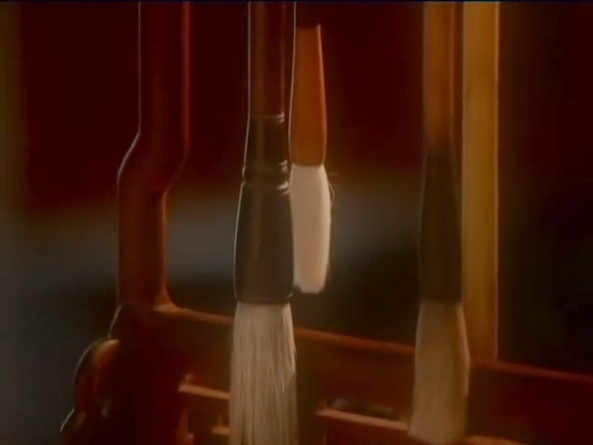
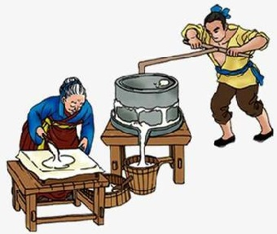
Reading for Cooperation
Group Work:
Make a poster on Chinese traditional culture!
festivals
food
places
arts
Notes:
此处给出一些制作Poster的指导，比如图片示范等

Slide 16
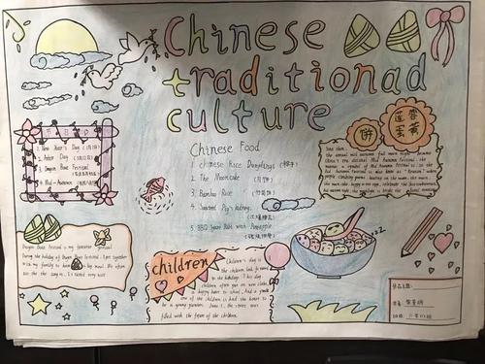
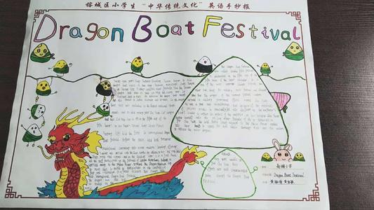
title
content
illustration(插图)

Slide 17
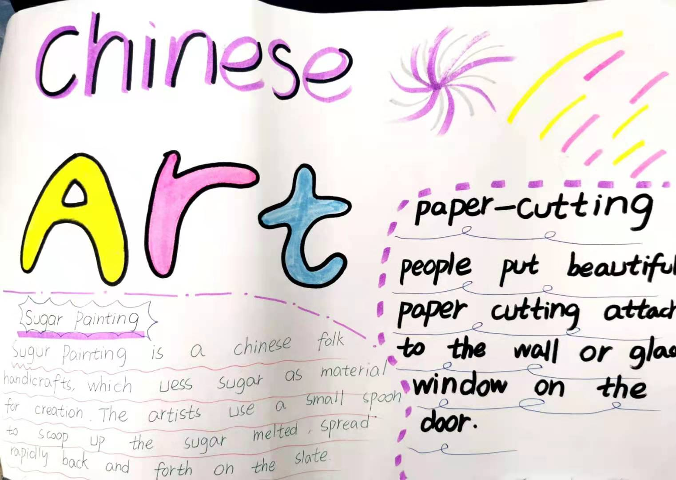
Presentation
Group 1

Slide 18
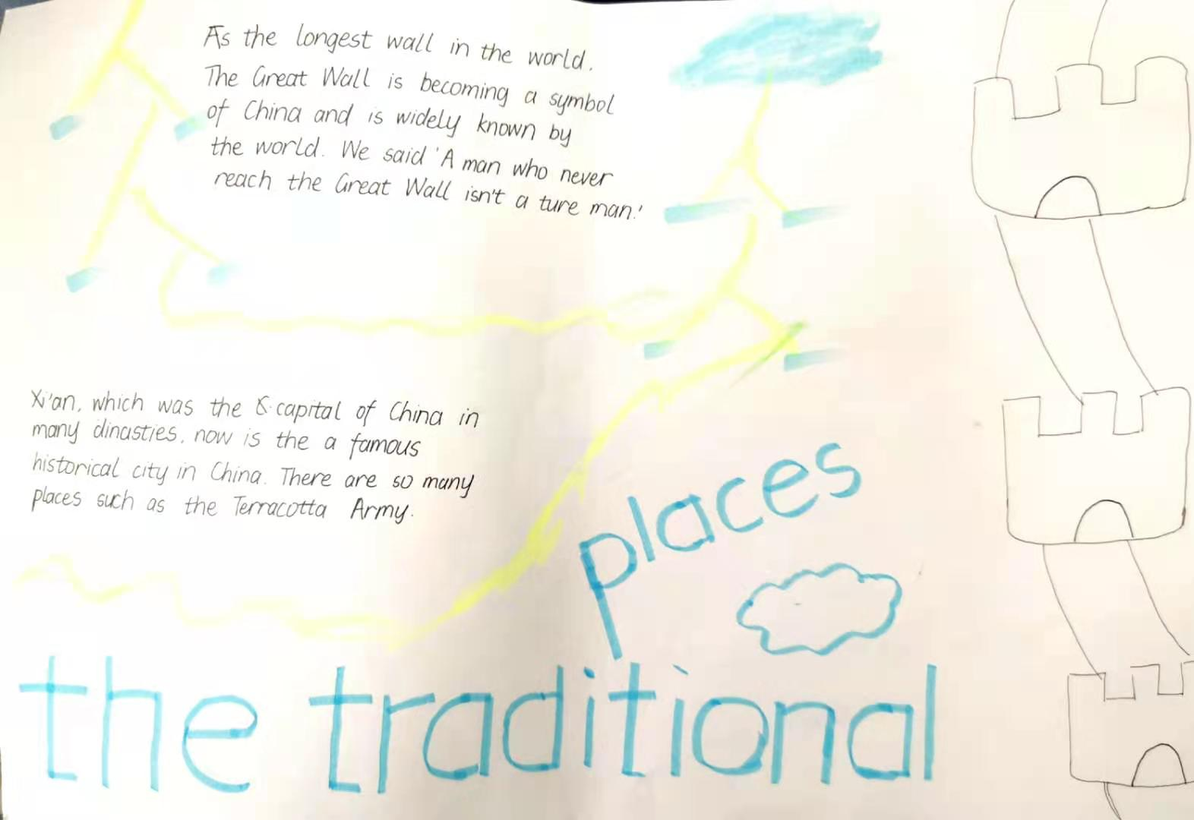
Presentation
Group 2

Slide 19
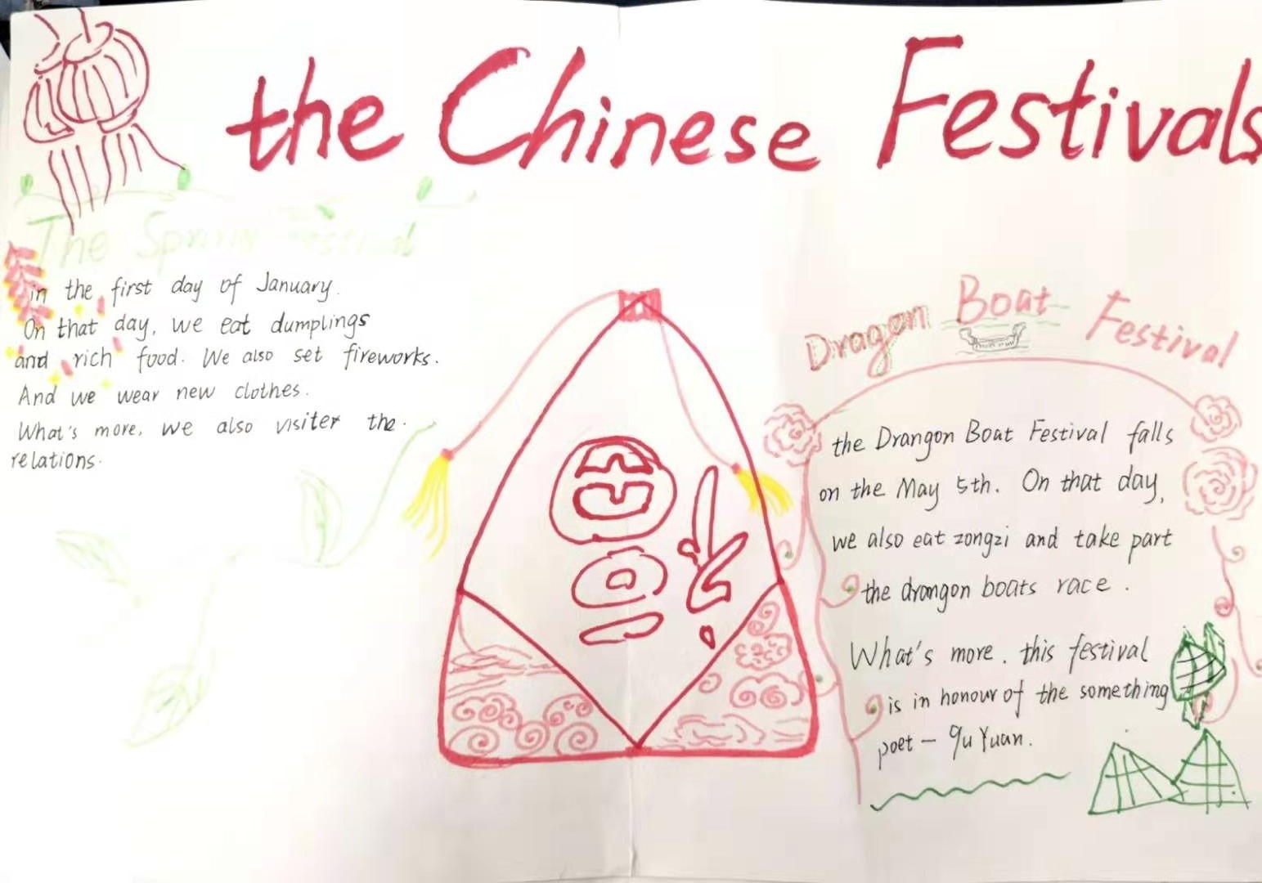
Presentation
Group 3

Slide 20

Presentation
Group 4

Slide 21

讲好中国故事
传播中国文化
Notes:
接下去展示一些学生的poster制作

Slide 22
Thank you for your listening!

