Slide 1


感恩遇见，相互成就，本课件资料仅供您个人参考、教学使用，严禁自行在网络传播，违者依知识产权法追究法律责任。
更多教学资源请关注
公众号：溯恩高中英语
知识产权声明

Slide 2
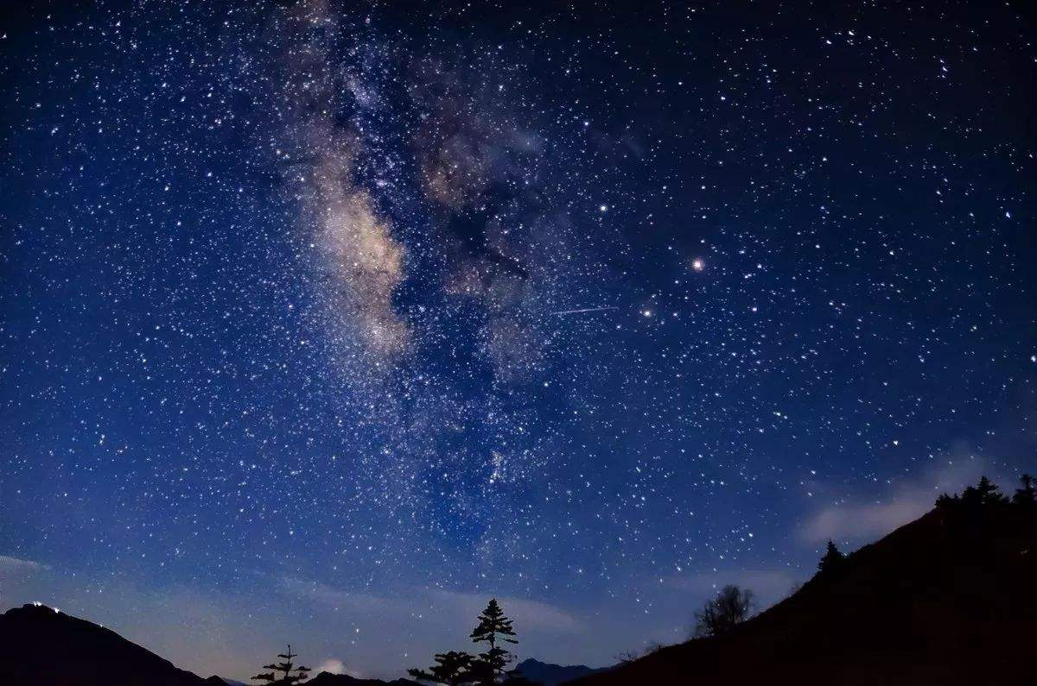
Space exploration
Reading and thinking

Slide 3
Looking up at the stars, I ……
exploration
The vast space is waiting for humans’ ___________.
Space exploration

Slide 4
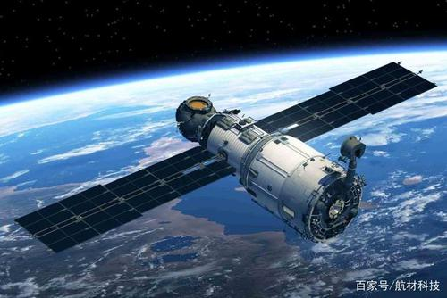
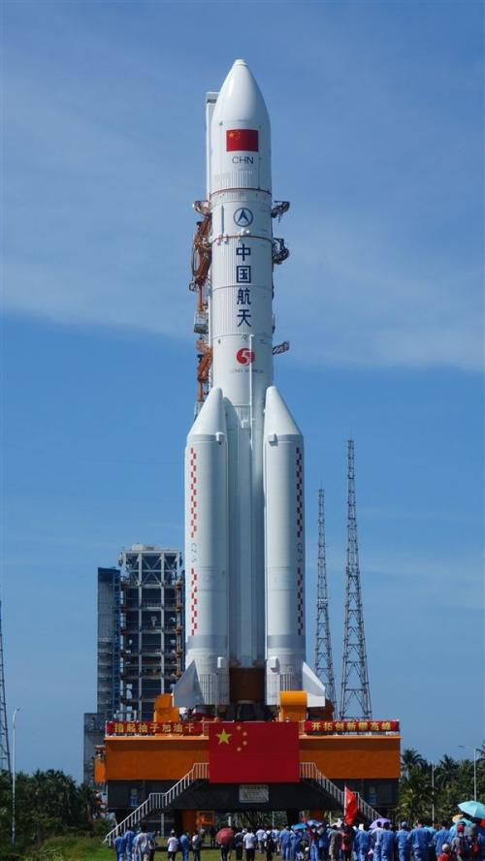
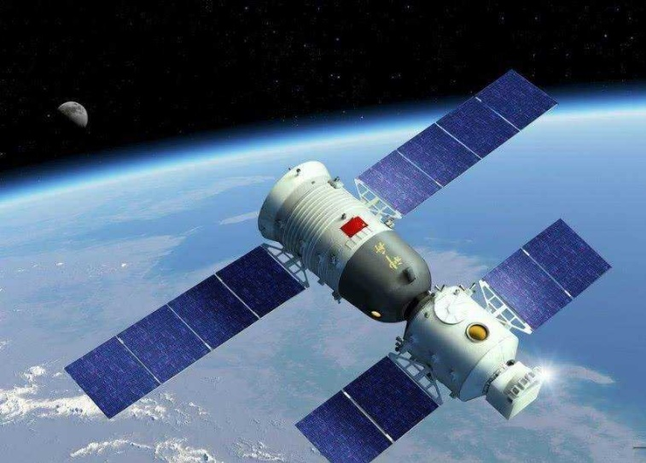
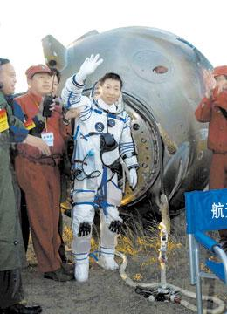
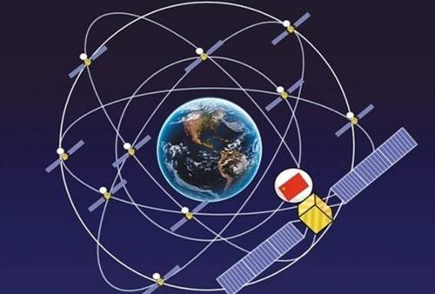
space vehicles
航天器
satellites
Shenzhou 5
spacecraft
(pl. spacecraft)
space vehicles
With the help of _____________, such as _______, __________, mankind is exploring space. Some spacecraft are _________, which have carried _________ into space. They will be ________ by rockets, after which they will ________around the earth along the _________.
satellites spacecraft
manned spacecraft
manned
astronauts
astronauts
be launched by
launched
orbit
rockets
orbits
orbit n./v.

Slide 5
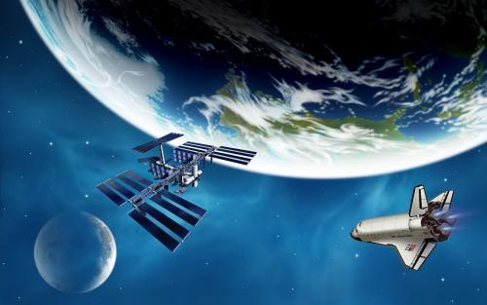
Reading
1. What kind of passage is it?
A. A piece of news.
B. A popular science article.
C. A travel journal.
D. A novel.

Slide 6
Para. 1
“Are we alone? What’s out there?” Looking up at the stars, people have always wanted to learn more about space, and scientists work hard to find answers. They make vehicles to carry brave people into space to find out the secrets of the universe.
__________________________________________________________________________________________
curiosity of people about space
make vehicles to…
wish to discover…
They also really wish to discover other planets that are suitable enough to support life.
It is the curiosity of…that …

Slide 7
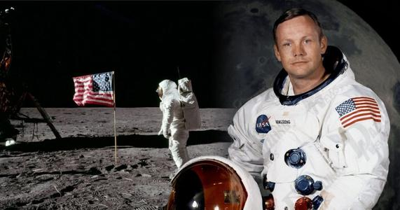

Para. 2
After many experiments, they succeeded in making rockets that could escape Earth’s gravity.
The Sputnik
orbited around..
Yuri Gagarin
first person to space
That’s one small step for a man,
a giant leap for mankind.
Oct 4, 1957
Apr 12, 1961
.
VS
The USA
Before the mid-20th century
The USSR
Jul 20, 1969
Sep 5, 1977
Neil Armstrong
stepped to the moon firstly
Voyager 1
to study deep space
and still transmits …
an impossible dream
a reality
determination
…
?
Sep 5, 1977

Slide 8
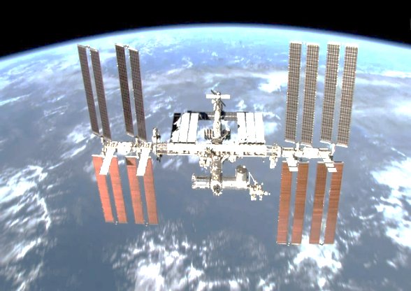
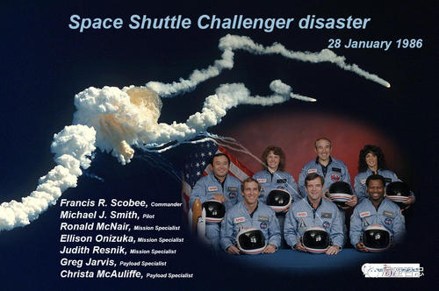
Para. 3
Although scientists try to make sure nothing goes wrong, accidents can still happen.
Disasters
Desire
…died
never died
The International Space Station
Despite the …, humans’ …for space exploration never died. For example, …. Thus, greater achievements are made.

Slide 9
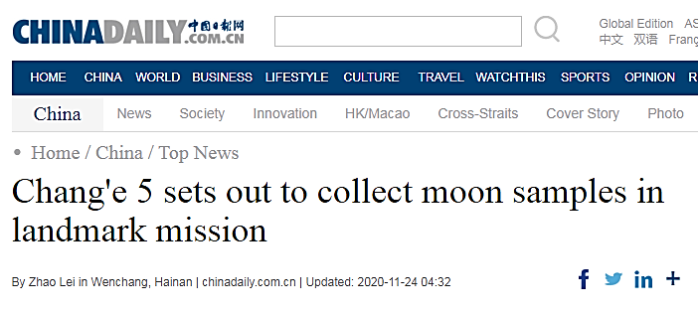
Shenzhou 5…Yang Liwei… orbited the earth…
Para. 4
time
This paragraph develops in the order of ___________.
Time | Spacecraft/ Vehicle; Astronauts ; Missions
In 2003
Then
followed by…
After that, / Afterwards
More recently
China’s space programme started later than those of Russia and the US, but it has made great progress in a short time. China became the third country in the world to independently send humans into space in 2003, when Yang Liwei successfully orbited Earth in the Shenzhou 5 spacecraft. Then Shenzhou 6 and 7 completed a second manned orbit and the first Chinese spacewalk, followed by the vehicle Jade Rabbit being sent to the moon to study its surface. After that, China launched the Tiangong 2 space lab into space and Tianzhou1 to dock with it. This signalled one step further in China’s plan to establish a space station in the future. More recently, China has sent Chang’e 4 to explore the surface of the far side of the moon to make measurements and observations.
Shenzhou 6 & 7…completed …and …
Jade Rabbit… be sent to the moon to study the surface
Tiangong 2 space lab was launched into space and Tianzhou 1 to dock with it
Sent Chang’e 4 to explore the surface of the far side of the moon to make…
remarkable achievements

Slide 10
Para. 4
China’s space programme started later than those of Russia and the US, but it has made great progress in a short time. China became the third country in the world to independently send humans into space in 2003, when Yang Liwei successfully orbited Earth in the Shenzhou 5 spacecraft. Then Shenzhou 6 and 7 completed a second manned orbit and the first Chinese spacewalk, followed by the vehicle Jade Rabbit being sent to the moon to study its surface. After that, China launched the Tiangong 2 space lab into space and Tianzhou1 to dock with it. This signalled one step further in China’s plan to establish a space station in the future. More recently, China has sent Chang’e 4 to explore the surface of the far side of the moon to make measurements and observations.
China’s space programme started later than those of Russia and the US, but it has made great progress in a short time.
…lead(s) to the
remarkable achievements

Slide 11
Para. 5
The future of space exploration remains bright.
There are endless efforts for further study and exploration from countries.
Scientists’ hope:
enable us to understand how the universe began
help us survive well into future
Your hope?

Slide 12
Analyse the structure and summarize the passage
curiosity
Out of _________ about space, scientists from different countries, such as the USSR, the USA, and________, have made remarkable ____________ with undying__________. Undoubtedly, the________ of space exploration is bright.
China
achievements
desire
future

Slide 13

Space: The Final Frontier
!
?
Frontier:
is the limit of sth. especially the limit of a place or field for people to learn or explore.
Voice your opinion: (pair work)
Is space the “final” frontier?
What other frontiers will be explored?
(underground; the deep sea; the Arctic; new life forms; new civilizations)

Slide 14
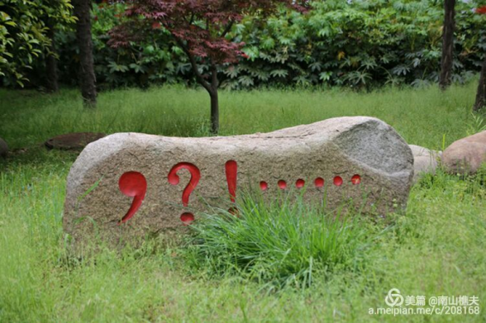
exploration
Frontier is limited, while _____________ is limitless;
Books are limited, while _____________ is limitless;
_______ is limited, while ____________ is limitless;
…
knowledge
Time
learning
As a student in Senior Two, what are you eager to explore?
What qualities can help us to explore the limitless with the limited?

Slide 15
Assignment
Write down your detailed plans of your limitless exploration.
The following should be included:
you ambition
qualities needed
actions to take

