Slide 1


感恩遇见，相互成就，本课件资料仅供您个人参考、教学使用，严禁自行在网络传播，违者依知识产权法追究法律责任。
更多教学资源请关注
公众号：溯恩高中英语
知识产权声明

Slide 2
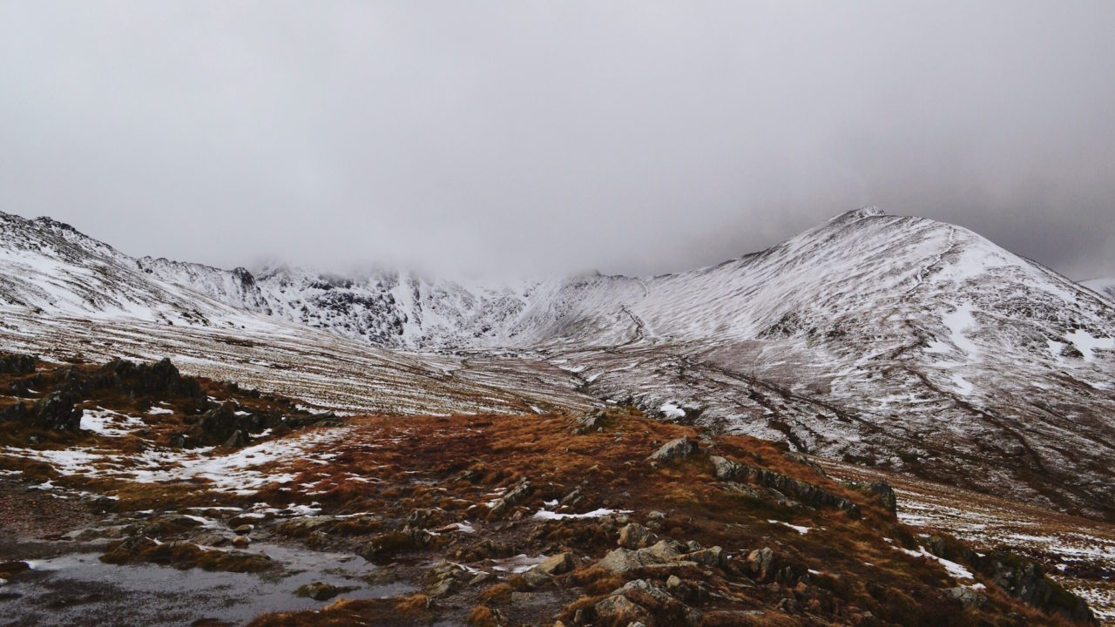
Z20联盟2021届高三第二次联考读后续写讲评
The Honest Mistake
Thinker, Tiantai High School

Slide 3
Karie double-checked the words on her spelling test. If she got 100 percent today, she’d win her class's First-quarter Spelling Challenge and a brand new dictionary. Plus, Ms. Smith had promised to do a handstand(倒立) if anyone got a perfect score.
Two more words to go. Q-u-i-c-k-l-y. H-o-n-e-s-t-y. Wait! She’d spelled honesty, not honestly! She erased the t-y and wrote l-y before handing in her paper.
“I‘ll correct these while you're at the break, " Ms. Smith said.
After the break Karie moved restlessly in her seat, tapping her pencil.
Ms. Smith walked to the front of the room and cleared her throat. Then, as if she were an Olympic gymnast(体操运动员)，Ms. Smith threw both her feet into the air. “Congratulations， Karie! You did it!” she announced while upside down. The whole class erupted! Ms. Smith presented Karie with her prize. Kane smiled broadly as she read the note on the dictionary: To Kaire, for her perfect performance.
“Everything OK?” Mom asked as Karie burst through the front door after school. “Everything’s PERFECT! Karie shouted, showing Mom her spelling test and prize. Mom hugged her "Put the test on the fridge so Dad can see it when he gets home."
“And Casper, too. “ Karie lifted up her cat. ”Can you spell quickly. Casper? And honesly, and…”
Karie‘s stomach tumbled (翻滚) to the floor. Honesly? H-O-N-E-S-L-Y!
“Karie, what's the matter?” asked Mom. “I don't feel so good, “ Karie said, putting Casper down and squeezing the test paper into her backpack.
“Probably too much excitement." Mom rubbed her back. "How about some tea?"
Karie swallowed. " How do you know? A t is exactly what I needed."
Karie dragged herself to her bed after some tea. How could she tell the whole class she didn’t deserve the prize? That Ms. Smith did the handstand for nothing?
Paragraph 1: Soon Karie heard her dad come in with the smell of pizza floating in the air.___ _____
Paragraph 2: Ms. Smith was unlocking the classroom door when Karie got to school the next morning. .

Slide 4
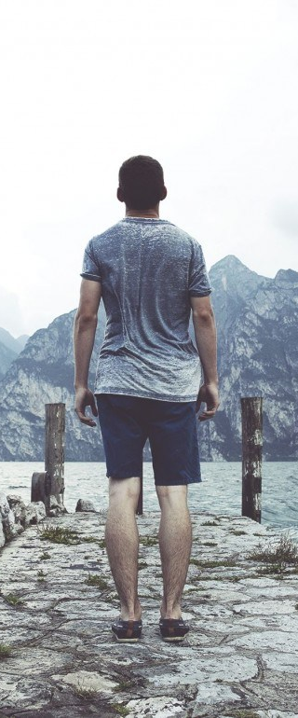
Understand the story
In a spelling test, Kaire handled it carefully, double-checking the words she spelled and making corrections. Nervously but expectantly, she heard Mr. Smith’s announcement that she had got a perfect score and was rewarded with a dictionary and Ms. Smith’s handstand in the presence of the whole class.
Back home, while excitedly chatting with her mother, she suddenly realized that she had a mistake: She misspelled the word honestly. She struggled inside, wondering whether to tell the truth to the teacher or not the next day……
Notes:
To change the image behind the Mock up.
Select the layer - > Right Click -> Send to Back -> Delete the image -> Drag & Drop your Own Picture -> Send to Back (again)

Slide 5
①Karie double-checked the words on her spelling test. If she got 100 percent today, she’d win her class's First-quarter Spelling Challenge and a brand new dictionary. Plus, Ms. Smith had promised to do a handstand(倒立) if anyone got a perfect score.
②Two more words to go. Q-u-i-c-k-l-y. H-o-n-e-s-t-y. Wait! She’d spelled honesty, not honestly! She erased the t-y and wrote l-y before handing in her paper.
③“I‘ll correct these while you're at the break, " Ms. Smith said.
④After the break Karie moved restlessly in her seat, tapping her pencil.
⑤Ms. Smith walked to the front of the room and cleared her throat. Then, as if she were an Olympic gymnast(体操运动员)，Ms. Smith threw both her feet into the air. “Congratulations， Karie! You did it!” she announced while upside down. The whole class erupted! Ms. Smith presented Karie with her prize. Kane smiled broadly as she read the note on the dictionary: To Kaire, for her perfect performance.
⑥“Everything OK?” Mom asked as Karie burst through the front door after school. “Everything’s PERFECT! Karie shouted, showing Mom her spelling test and prize. Mom hugged her "Put the test on the fridge so Dad can see it when he gets home."
Beginning：
Para 1- 4
________________ ___________________________________________________
Karie misspelled the word honestly in a spelling test.
Rising action：
Para 5- 6
_________________ ______________________________________________________
Karie won the spelling test and was rewarded.

Slide 6
⑦ “And Casper, too. “ Karie lifted up her cat. ”Can you spell quickly. Casper? And honesly, and…”
⑧ Karie‘s stomach tumbled (翻滚) to the floor. Honesly? H-O-N-E-S-L-Y!
⑨“Karie, what's the matter?” asked Mom. “I don't feel so good, “ Karie said, putting Casper down and squeezing the test paper into her backpack.
⑩“Probably too much excitement." Mom rubbed her back. "How about some tea?"
⑪ Karie swallowed. " How do you know? A t is exactly what I needed."
⑫ Karie dragged herself to her bed after some tea. How could she tell the whole class she didn’t deserve the prize? That Ms. Smith did the handstand for nothing?
Paragraph 1: Soon Karie heard her dad come in with the smell of pizza floating in the air.________
Paragraph 2: Ms. Smith was unlocking the classroom door when Karie got to school the next morning.
Climax：
Para 7- 12
___________________ ____________________________________________________________
Karie suddenly realized the mistake she had made in the test.
Falling action：??
Ending
/Resolution：??

Slide 7
Language learning
1.仔细检查
2.一本崭新的词典
3.还剩下两个单词
4.在短歇期间
5.转笔
6.清清嗓子
7.颠倒的
8.给Karie颁奖
9.从前门闯进
10.举起，托起
11.把考卷塞进背包里
12.尽力忍住，克制自己
13.（气味）飘浮在空气中
1.double check
2.a brand new dictionary
3.two words to go, two words left
4.at the break/interval
5.spin one’s pencil
6.clear one’ throat
7.upside down
8.present Karie with a prize
9.burst through the front door
10.lift up
11.squeeze the test paper into the backpack
12.swallow hard
13.float in the air

Slide 8
Appreciate beautiful sentences
1.After the break, Karie moved restlessly in her seat, tapping her pencil.
2. Then, as if she were an Olympic gymnast, Ms. Smith threw both her feet into the air.
3. The whole class erupted!
4. Karie’s stomach tumbled（翻滚）to the floor.
5. Karie dragged herself to her bed after some tea.
通过moved restlessly in her seat和tap her pencil两个动作形象地描写出的紧张nervousness。
运用比喻的修辞手法as if she were an Olympic gymnast可以让读者更好地理解后半句话。
Erupt 一词传达了教室里的轰动场面，也可以用burst, explode等。
这个动作形象地描写出Karie对这错误的惊愕和抗拒。
Drag一词生动表达了这错误对她造成的心理打击。

Slide 9
Design the plot
Paragraph 1: Soon Karie heard her dad come in with the smell of pizza floating in the air.________
Paragraph 2: Ms. Smith was unlocking the classroom door when Karie got to school the next morning.
Q1: What did Dad see and sense about Karie’s act?
Q2: What did Dad do and say about the situation?
Q3: What was Karie’s final decision about the mistake?
Karie decided to tell the truth to Ms. Smith.
Father convinced Karie to tell Ms. Smith the truth.
Q1: How did Karie confess the whole thing to Ms. Smith?
Q2: How did Ms. Smith react to the unexpected smartly?
Q3: Karie’s reflection.

Slide 10
Design the plot
Paragraph 1: Soon Karie heard her dad come in with the smell of pizza floating in the air.________
Paragraph 2: Ms. Smith was unlocking the classroom door when Karie got to school the next morning.
Plot 1：Dad邀请Karie喝咖啡, karie哭了--- Dad询问发送了什么事---Karie犹豫地向Dad说了—Dad安慰并建议Karie跟老师说明真相；
Plot 2: Dad想用咖啡来奖励Kaire--Dad看到Karie伤心哭泣，询问真相—了解情况后，给与Karie安慰和建议。
Plot 1：Karie向Ms. Smith坦白了事情---不但没有收回奖品，而且在全班同学面前表扬了Karie，因为她的honesty---Karie暗自庆幸虽然拼错了单词，却收获了信任；
Plot 2: Karie向Ms. Smith坦白了事情---不但没有收回奖品，而且在全班同学面前表扬了Karie，因为她的honesty---Ms. Smith因为她的疏忽又一次做了个倒立，全班鼓掌喝彩。

Slide 11
Language accumulation – nervousness/ restlessness
1. His heart beating wildly, he could feel his palms sweaty/ sweating.
Her heart was pounding as she stepped closer to Ms. Smith.
Her heart raced and her mind went blank.
2. She pretended to be calm, but her trembling voice gave me away.
She paced up and down in front of the office with her face burning with shame.
3. Beads of perspiration汗珠 trickled/dripped down her face.
Sweats pour/trickle/stream down one's back/face.
4.He was so worried/ nervous that he simply walked up and down the room.
5. The thought of meeting Ms. Smith the next morning made her wide awake, tossing and turning in bed for a whole night.

Slide 12
Language accumulation – comfort
1.He patted him on the shoulder, comforting that everything would turn out fine.
2. Dad threw his arms around Karie....
3.He stroked his fingers through her hair, comforting, “Things are going to be fine.”
4. Lovingly gathering the girl into his arms, Dad waited silently and comforted gently until she calmed down.
5. Mom put her arms around Abby and hugged her tight. “Your time will come.”
6. Mom squeezed her hand as they pulled out of the parking lot.
7. She couldn’t help sobbing, tears rolling down like a broken string of beads.
8. She said in a low voice, with her face burning red .
9. She told Ms. Smith the truth , with her heart beating crazily.

Slide 13
下水作文：
Soon Karie heard her dad come in with the smell of pizza floating in the air. “Would you like a coffee, honey?” In this way Dad hoped to appreciate Karie’s amazing performance in the spelling test, but what greeted him made him confused: cuddling in the room corner, Karie looked very sad, tears floating on her face. Immediately, Dad rushed over and gathered his princess into his arms. Hesitantly, Karie shared what had happened with her trusted father and asked for his advice. Thinking for a moment, the “sly” Dad simply asked Karie to decide on her own. Though feeling torn between the title and the honesty, she finally chose the latter. (96)
点评：
1.这段文章读起来如行云流水般流畅，故事情节干脆利落，非常适合学生去欣赏、体会和模仿。
2.语言方面非常注重表达的多样化。主语从句、独立主格结构、句子性副词、现在分词、状语从句的运用都比较自然、到位。
3.句子之间的过渡采用语言连结、主位推进等手段，使得句际关系不突兀。
4.文章里有几个词用得特形象，如greet, float, sly等，值得好好琢磨。

Slide 14
下水作文：
Ms. Smith was unlocking the classroom door when Karie got to school the next morning. “ Morning, Early bird!” Ms. Smith smiled at her. Though hesitating for a while, Karie plucked his courage and confessed to Ms. Smith that he had actually made a spelling mistake in the test the day before. With these words, she handed over the test paper and the prize. “I’m really sorry, Ms. Smith…” She stood there nervously, wondering what Ms. Smith would do. But never could she have imagined that Ms. Smith put the dictionary back into his hands, saying, “Though you spelled the word honestly wrong, but you did the honesty right. I’m proud of you!” More than that, Ms. Smith once more did a handstand in the presence of the whole class. “ This time for myself. A punishment for my carelessness,” she joked. (125)
点评：
1.这段文章的故事情节有点曲折，导致字数稍多，可以削减一个情节片段。不过语言还是适合学生去体会和模仿的。
2.语言方面非常注重表达的多样化。宾语从句、倒装结构、现在分词的运用都比较自然、到位。
3.高级词块和复杂结构的运用也为这段文章加分，如plucked his courage，in the presence of和never could she have imagined等等。
4.文章结尾的设计很有特点，既体现了老师的睿智、风趣，也很好地呼应了前文。

Slide 15
参考范文：
Soon Karie heard her dad come in with the smell of pizza floating in the air. “Where’s your spelling test paper, sweetheart?” Dad asked, gazing at her eagerly. Karie gulped before trying to answer. “I…,” she fumbled in her backpack, took out the paper and handed it unwillingly to her Dad. When Dad was admiring the perfect 100 on the paper, he spotted “honesly”. Dad frowned, “ Probably you don’t deserve the prize.” Immediately, the scene flashed back when a cashier in the pizza shop gave them too much change by mistake, her father went straight back to return the unexpected money instead of keeping it. She soon understood what she should do.
Ms. Smith was unlocking the classroom door when Karie got to school the next morning. “You’re an early bird,” Ms. Smith smiled at her. Hands slightly trembling, Karie gave Ms. Smith her test paper as well as the dictionary. Karie confessed her spelling mistake in the test, a pink flush spreading over her cheeks. “I see.” Even though Ms. Smith tried to contain her emotions, surprise registered on her face. For a moment, Ms. Smith stood quietly reading the note on the dictionary. Then she picked up a pen, crossed out the word “perfect” and wrote “honest” instead before handing the prize back to Karie. “I get to keep this? Honestly?”Karie’s jaw dropped. “For ‘honestly’, no.” Ms. Smith grinned. “But for honesty, yes.”

Slide 16
基于相同文本的读后续写1：2020.11山东潍坊期中考
Karie double-checked the words on her spelling test. If she got 100 percent today, she’d win her class' First-Quarter Spelling Challenge and a brand new dictionary. Plus, Ms. McCormack had promised to do a handstand if anyone got a perfect score.
Three more words to go. N-i-c-e-l-y. Q-u-i-c-k-l-y. h-o-n-e-s-t-y. Wait! Shed spelled honesty, not honestly. She hurriedly erased the t-y and wrote l-y before handing in her paper.
Ms. McCormack graded the test papers at the break. Meanwhile, Karie sat restlessly in her seat with her fingers crossed. Then. Ms. McCormack walked to the front of the room and cleared her throat. As if she were an Olympic gymnast, Ms. McCormack's feet flipped( 空翻)into the air
“ Congratulations. Karie! You did it!" she announced while upside down.
The whole class burst into applause! Ms McCormack righted herself and presented Karie with her prize. Karie grinned as she read the label on the box:
To Karie Carter, for her perfect first-quarter score in spelling.

Slide 17
“Everything OK? " Mom asked as Karie burst through the front door after school. Karie didn't answer. As if by magic, she took out her spelling test paper and prize and showed them to her mother. Mom hugged her, asking her to put the test paper on the fridge so that Dad could see it when he got home.
Karie took another look at the test paper before putting it on the fridge.
Her hands stopped in the mid air. She just couldn’t believe her own eyes. Honesly?
YES! H-O-N-E-S-L-Y
Mom sensed something unusual and asked why. Karie stuffed the test paper into backpack and explained that she was just too excited. Mom brought her some tea. Yes, a"t” s exactly what she needed.
After drinking a little, Karie plodded(重步走 )down the hall, lost in thought. How could he tell the class she hadn’t earned the prize after all? That Ms. McCormack did the handstand for nothing?
注意
1.续写词数应为150左右 2.请按如下格式在答题卡的相应位置作答。
Para1: Later Dad came in with excitement.____________________________
Para2: The next morning, Karie went to school earlier than usual. ____________________

Slide 18
参考范文：
Later Dad came in with excitement. “Where’s your spelling test, Karie?” Dad asked eagerly. Karie looked away from her father. Anyhow, she reluctantly went to the room and pulled out the test paper. Dad fixed his eyes on the paper, a pleasant smile lifting the corner of his mouth. “I’m proud of you, sweetie. We need to celebrate it tonight.” Karie pretended to be smiling all the time. Meanwhile a sense of guilt rose up inside her. Feeling she didn’t deserve the prize, she had a sleepless night for the first time in her life.
The next morning, Karie went to school earlier than usual. Ms. Mc Cornack was unlocking the classroom. “You are an early bird.” Ms. McCormack said. Karie’s hands trembled. She handed her teacher the spelling paper and the dictionary. “I can’t keep this. I misspelled ‘honestly’ and you didn’t catch it.” For a moment, the teacher stood quietly reading the label on the dictionary. Then picking up her pen, she crossed out the word ‘perfect’ and wrote ‘honest’ before returning the dictionary to karie. “ Keep this. But for honesty.”

Slide 19
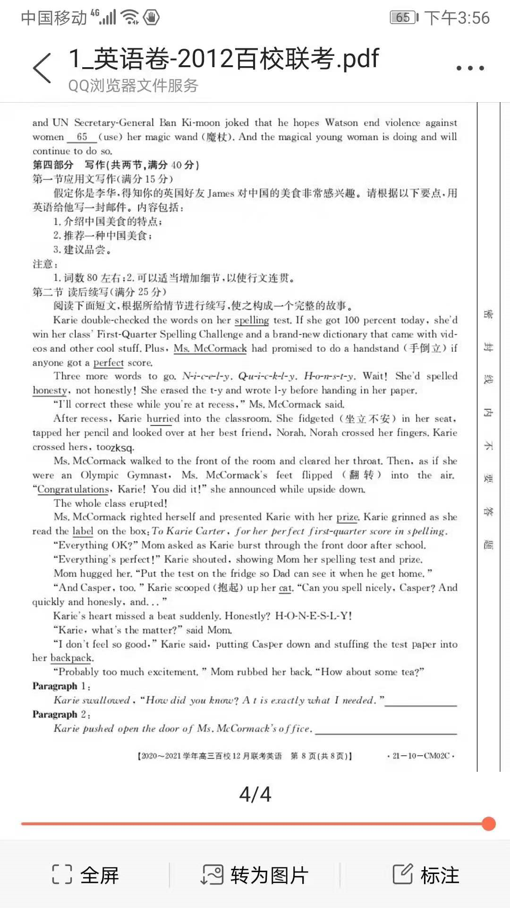
基于相同文本的读后续写2：2020-2021学年高三百校联考

Slide 20
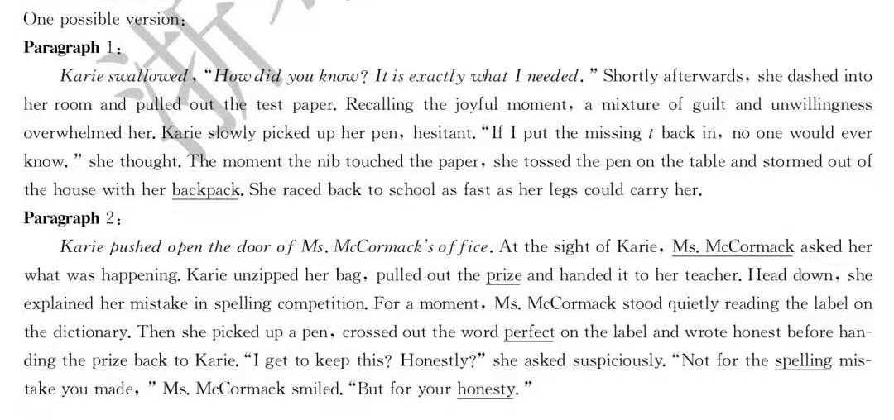
参考范文：

Slide 21



Each of us holds a unique place in the world. You are special no matter what others say or what you may think. So forget about being replaced.
You can not be!

