Slide 1


感恩遇见，相互成就，本课件资料仅供您个人参考、教学使用，严禁自行在网络传播，违者依知识产权法追究法律责任。
更多教学资源请关注
公众号：溯恩高中英语
知识产权声明

Slide 2

高考英语阅读理解 专项突破1
· 主旨大意
· 推理判断
· 词义猜测
· 细节理解
· 语篇连贯

Slide 3
第一课
主旨大意
(叙事文)

Slide 4

一、主旨大意三题型
· What’s the text mainly about?
· What’s the main idea of the text?
· What does the story mainly tell us?
1. 文章大意
2. 文章标题
3. 写作目的
1
· What is the best title for the text?
· What can be a suitable title for the text?
· What’s the main purpose of the passage?
· What’s the author’s purpose in writing the text?

Slide 5
二、个人故事
你知道“个人故事”类语篇有哪些组成部分吗？
浙江卷对“个人故事”的考查：
1
2020.1 | A篇 | 通过回忆一位图书管理员来体现“我”与妈妈对读书的热爱
2019.6 | A篇 | 讲述了Zac在古董店和网上寻找一些旧的军队奖章并将它们送还给原主人的暖心故事
2017.11 | A篇 | “我”在兼职送报纸时通过倾听帮助Mrs. Stanely走出悲伤和孤独，由此感悟到邻里之间应该相互关心，学会倾听。
2016.10 | A篇 | Kate克服重重困难及时阻止了一辆将要通过断桥的特快列出，挽救了许多人的生命
所选择的语篇不仅要能够让学生接触到真实、多样的语篇材料，更要引导学生通过语篇学习丰富生活经历，体验不同情感，树立正确的世界观、人生观和价值观。

Slide 6
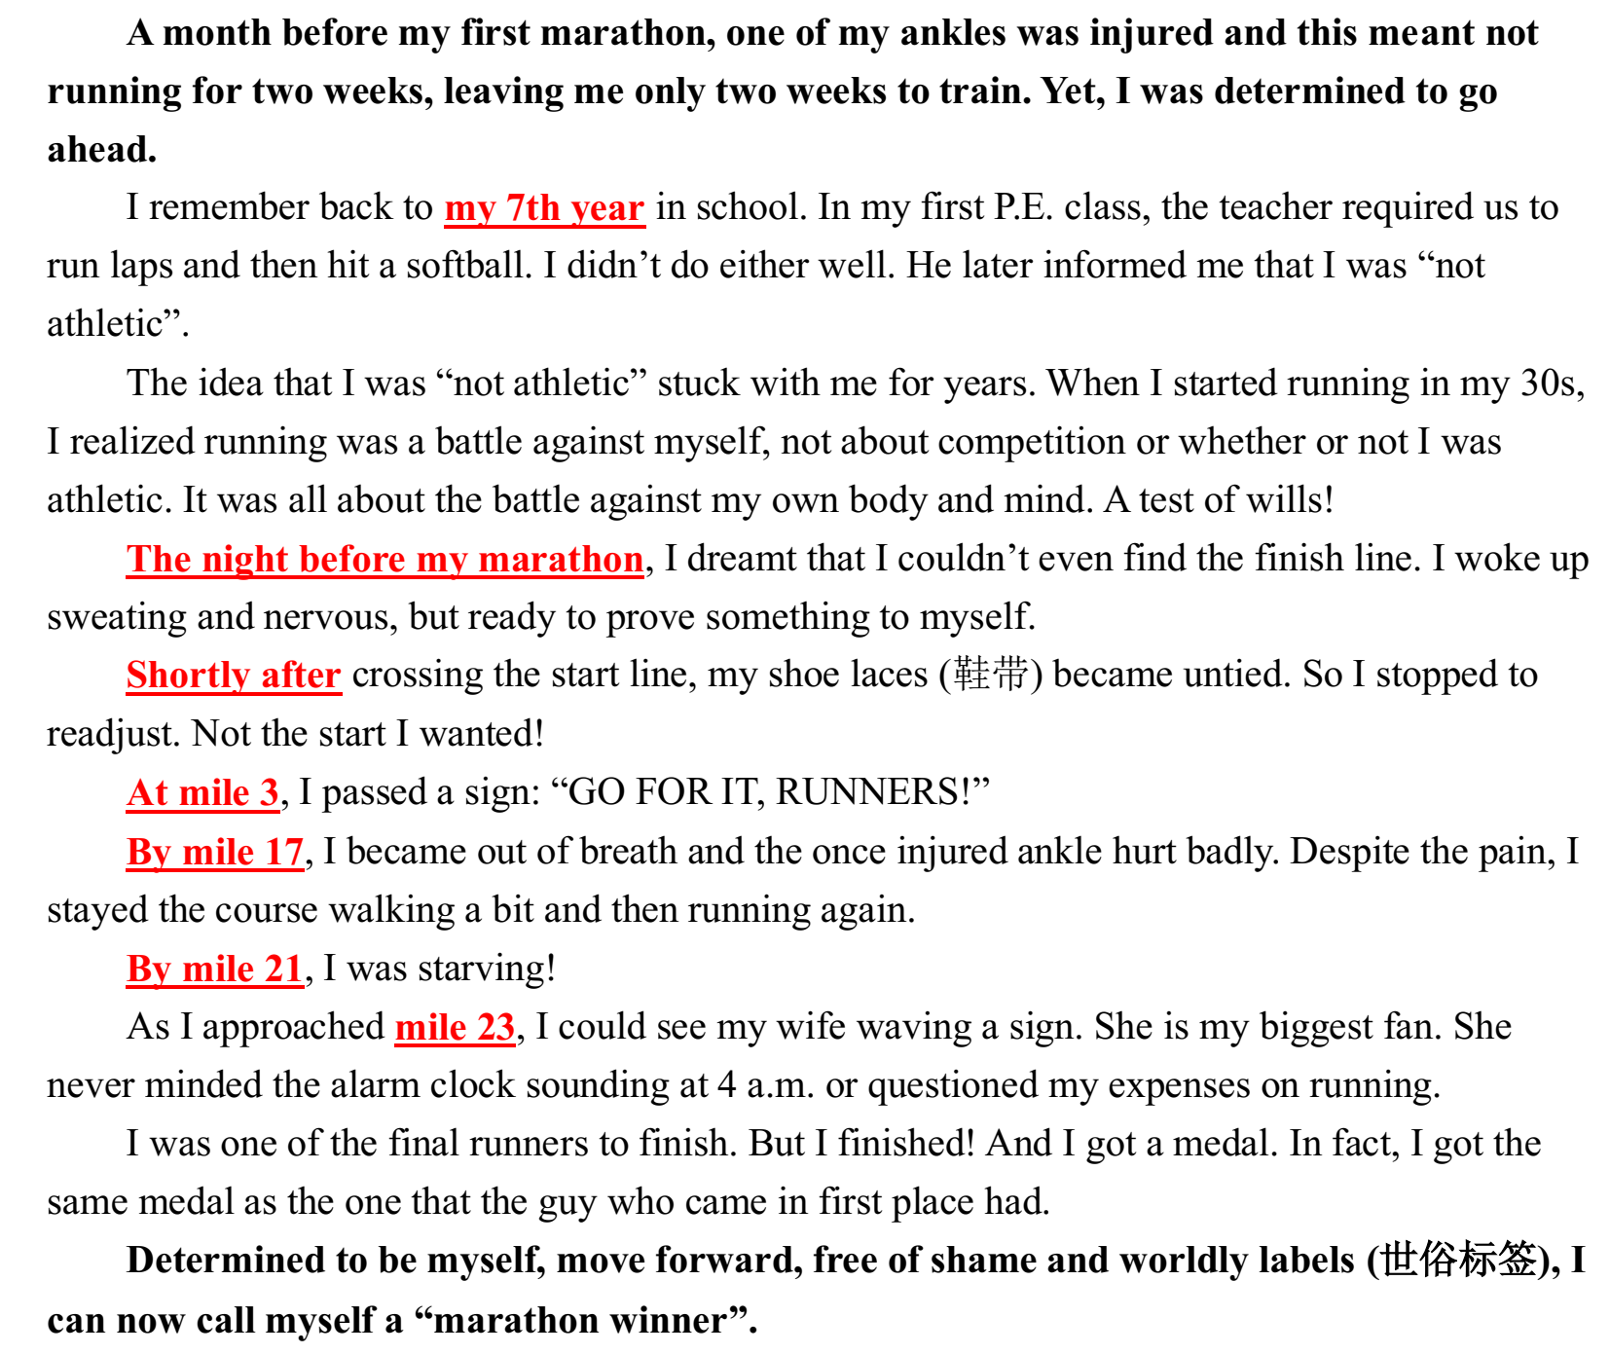
2.“个人故事”类语篇的结构
指向
进展
结局
回应
点题:
故事大意（标题/首段）
指向:
故事铺垫（5W）
进展:
故事本身（中间部分，按时间推进）
回应:
点题升华（结尾部分）
结局:
故事的完结

Slide 7
3.“个人故事”类语篇文章大意题
对回应的考查
A month before my first marathon, one of my ankles was injured and this meant not running for two weeks, leaving me only two weeks to train. Yet, I
was determined to go ahead.
…
I was one of the final runners to finish. But I finished! And I got a medal. In fact, I got the same medal as the one that the guy who came in first place had.
Determined to be myself, move forward, free of shame and worldly labels (世俗标签), I can now call myself a “marathon winner”.
A month before my first marathon, one of my ankles was injured and this meant not running for two weeks, leaving me only two weeks to train. Yet, I was determined to go ahead.
…
I was one of the final runners to finish. But I finished! And I got a medal. In fact, I got the same medal as the one that the guy who came in first place had.
Determined to be myself, move forward, free of shame and worldly labels (世俗标签), I can now call myself a “marathon winner”.
39. What does the story mainly tell us?
A. A man owes his success to his family support.
B. A winner is one with a great effort of will.
C. Failure is the mother of success.
D. One is never too old to learn.
Tips：
找到故事“回应”
理解选项内涵
内涵体现“回应”

Slide 8
▶Practice
As CanCandy’s success grows, so does Moore’s credibility as a young entrepreneur (创业者). Moore is enthusiastic about the candy she created, and she’s also positive about what the future might bring. She hopes that every kid can have a clean mouth and a broad smile.
Meanwhile, with her parents’ help. Moore is generally able to live a normal teenager life. Although she founded her company early on in life, she wasn’t driven mainly by profit. Moore wants to use her talent to help others find their smiles. She donates 10% of AlieCandy’s profits to Big Smiles. With her talent and determination, it appears that the sky could be the limit for Alice Moore.
As CanCandy’s success grows, so does Moore’s credibility as a young entrepreneur (创业者). Moore is enthusiastic about the candy she created, and she’s also positive about what the future might bring. She hopes that every kid can have a clean mouth and a broad smile.
Meanwhile, with her parents’ help. Moore is generally able to live a normal teenager life. Although she founded her company early on in life, she wasn’t driven mainly by profit. Moore wants to use her talent to help others find their smiles. She donates 10% of AlieCandy’s profits to Big Smiles. With her talent and determination, it appears that the sky could be the limit for Alice Moore.
37. What does the story mainly tell us?
A. Fame is a great thirst of the young.
B. A youth is to be regarded with respect.
C. Positive thinking and action result in success.
D. Success means getting personal desires satisfied.
对回应的考查

Slide 9
4.“个人故事”类语篇标题选择题
5. What could be the best title for the passage
A. My First Marathon. B. Winning is Everything.
C. Ways to Run a Marathon D. The Magic of Winning
“事件型”标题
就事论事
“升华型”标题
就事说理
A month before my first marathon, one of my ankles was injured and this meant not running for two weeks, leaving me only two weeks to train. Yet, I was determined to go ahead.
…
I was one of the final runners to finish. But I finished! And I got a medal…Determined to be myself, move forward, free of shame and worldly labels (世俗标签), I can now call myself a “marathon winner”.
A month before my first marathon, one of my ankles was injured and this meant not running for two weeks, leaving me only two weeks to train. Yet, I was determined to go ahead.
…
I was one of the final runners to finish. But I finished! And I got a medal…Determined to be myself, move forward, free of shame and worldly labels (世俗标签), I can now call myself a “marathon winner”.
My First Marathon
The Meaning of “Winning”
1. 区分“事实型”和
“升华型”标题；
2. 找准“就事论事”或
“就事说理”

Slide 10
▶其他题目
1. A month before the marathon, the author
_______.
A. was well trained B. felt scared
C. made up his mind to run D. lost hope
A month before my first marathon, one of my ankles was injured and this meant not running for two weeks, leaving me only two weeks to train. Yet, I was determined to go ahead.
I remember back to my 7th year in school. In my first P.E. class, the teacher required us to run laps and then hit a softball. I didn’t do either well. He later informed me that I was “not athletic”.
The idea that I was “not athletic” stuck with me for years…
…
I was one of the final runners to finish. But I finished! And I got a medal. In fact, I got the same medal as the one that the guy who came in first place had.
2. Why did the author mention the P.E. class
in his 7th year?
A. To acknowledge the support of his teacher.
B. To amuse the readers with a funny story.
C. To show he was not talented in sports.
D. To share a precious memory.
3. How was the author’s first marathon?
A. He made it. B. He quit halfway.
C. He got the first prize.
D. He walked to the end.

Slide 11
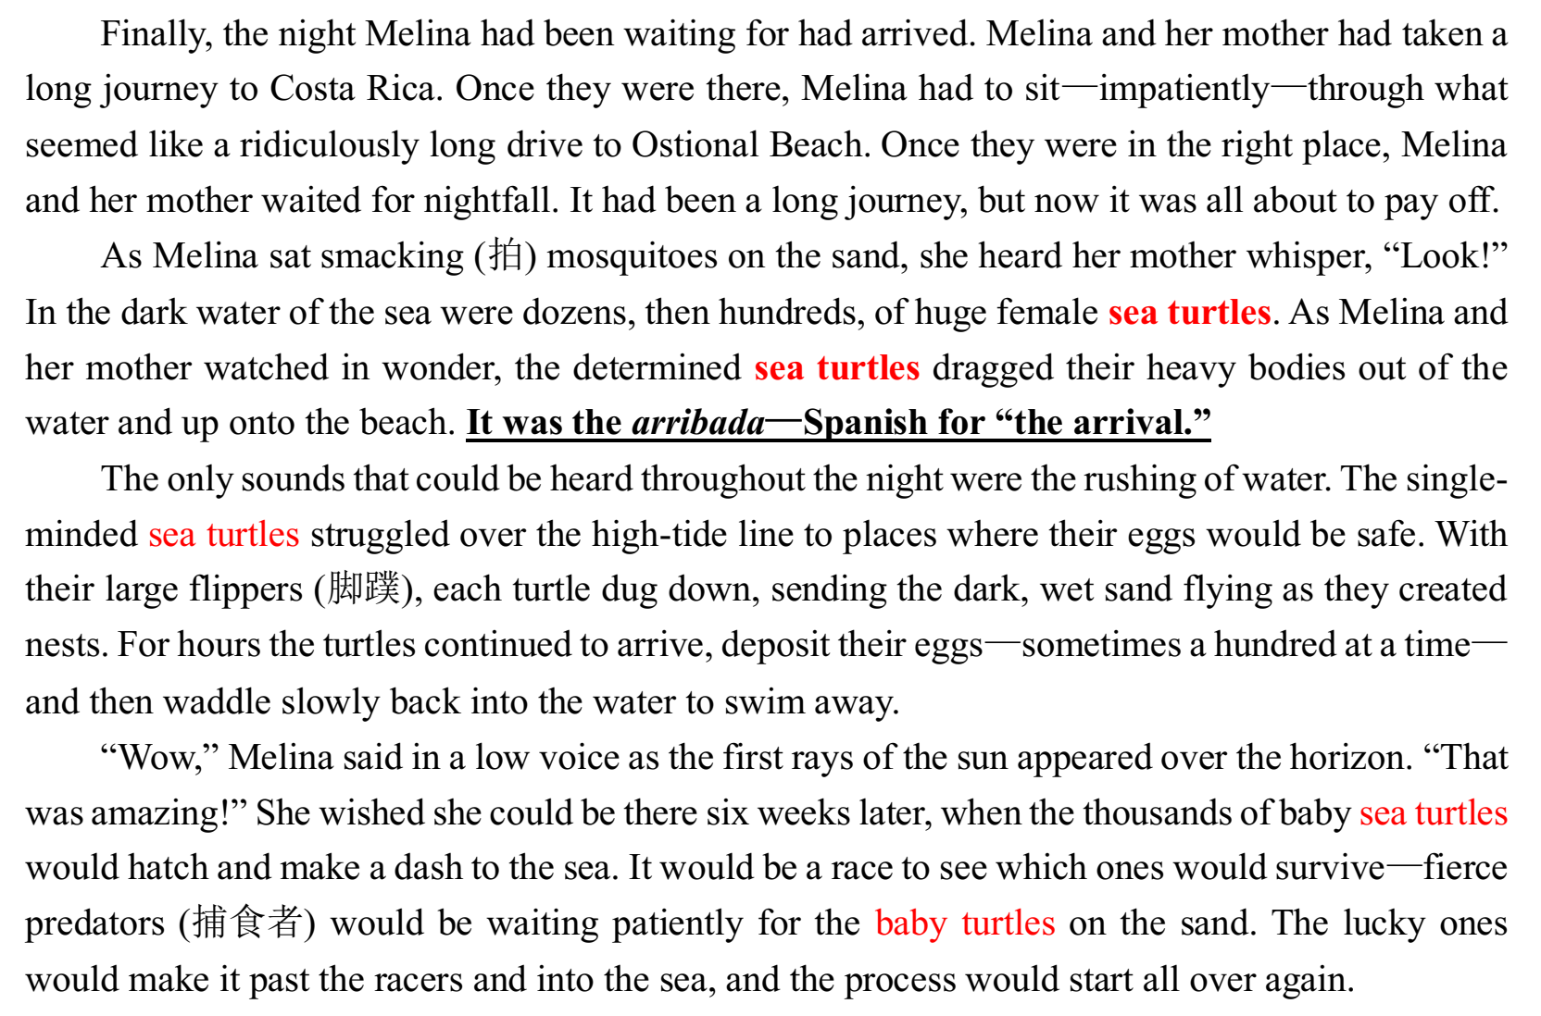
▶Practice
指向: 故事铺垫
（Mom, I, Beach, nightfall）
进展:
故事本身（中间部分，按时间推进）
2. The arrival of turtles;
3. What the turtles did
4. My reaction and expectation
23. What’s the best title for the text?
A. Funny Baby Turtles.
B. Turtles Avoiding Predators.
C. Turtle Landing Watching.
D. Waiting for Baby Turtles.

Slide 12
▶Practice
Finally, the night Melina had been waiting for had arrived. Melina and her mother had taken a long journey to Costa Rica. Once they were there, Melina had to sit—impatiently—through what seemed like a ridiculously long drive to Ostional Beach. Once they were in the right place, Melina and her mother waited for nightfall. It had been a long journey, but now it was all about to pay off.…
The only sounds that could be heard throughout the night were the rushing of water. The single-minded sea turtles struggled over the high-tide line to places where their eggs would be safe. With their large flippers (脚蹼), each turtle dug down, sending the dark, wet sand flying as they created nests. For hours the turtles continued to arrive, deposit their eggs—sometimes a hundred at a time—and then waddle slowly back into the water to swim away.
21. How did Melina feel toward the drive to
Ostional Beach?
A. Cheerful. B. Dull.
C. Sad. D. Awkward.
22. What did the female turtles do first after
they came out of the water?
A. They couldn’t wait to dig their nests.
B. They began looking for food.
C. They crawled above the high-tide line.
D. They rested briefly on the beach.

Slide 13
5.“个人故事”类语篇主旨大意题考查点
· What’s the text mainly about?
· What does the story mainly tell us?
1. 文章大意
2. 文章标题
回应
· What can be a suitable title for the text?
关注首位两段，尤其是尾段回应升华部分
就事论事→
就事论理

Slide 14
三、人物介绍
全国卷和浙江卷对“人物介绍”的考查：
1
2018.6 | A篇 | 主要介绍了英国小说家狄更斯的文学成就。
2017.11 | A篇 | 主要介绍了美国著名画家Benjamin在成名前克服艰苦条件学习绘画的故事
2017. | B篇 | 主要介绍了好友Paul Newman和我们之间的经历往事和珍贵友谊
《课程标准》在“文化知识”中提出：了解英美等国家主要的文学家、艺术家、科学家、政治家及其成就、贡献等，学习和借鉴人类文明的优秀成果。
你知道“人物介绍”类语篇有哪些组成部分吗？

Slide 15
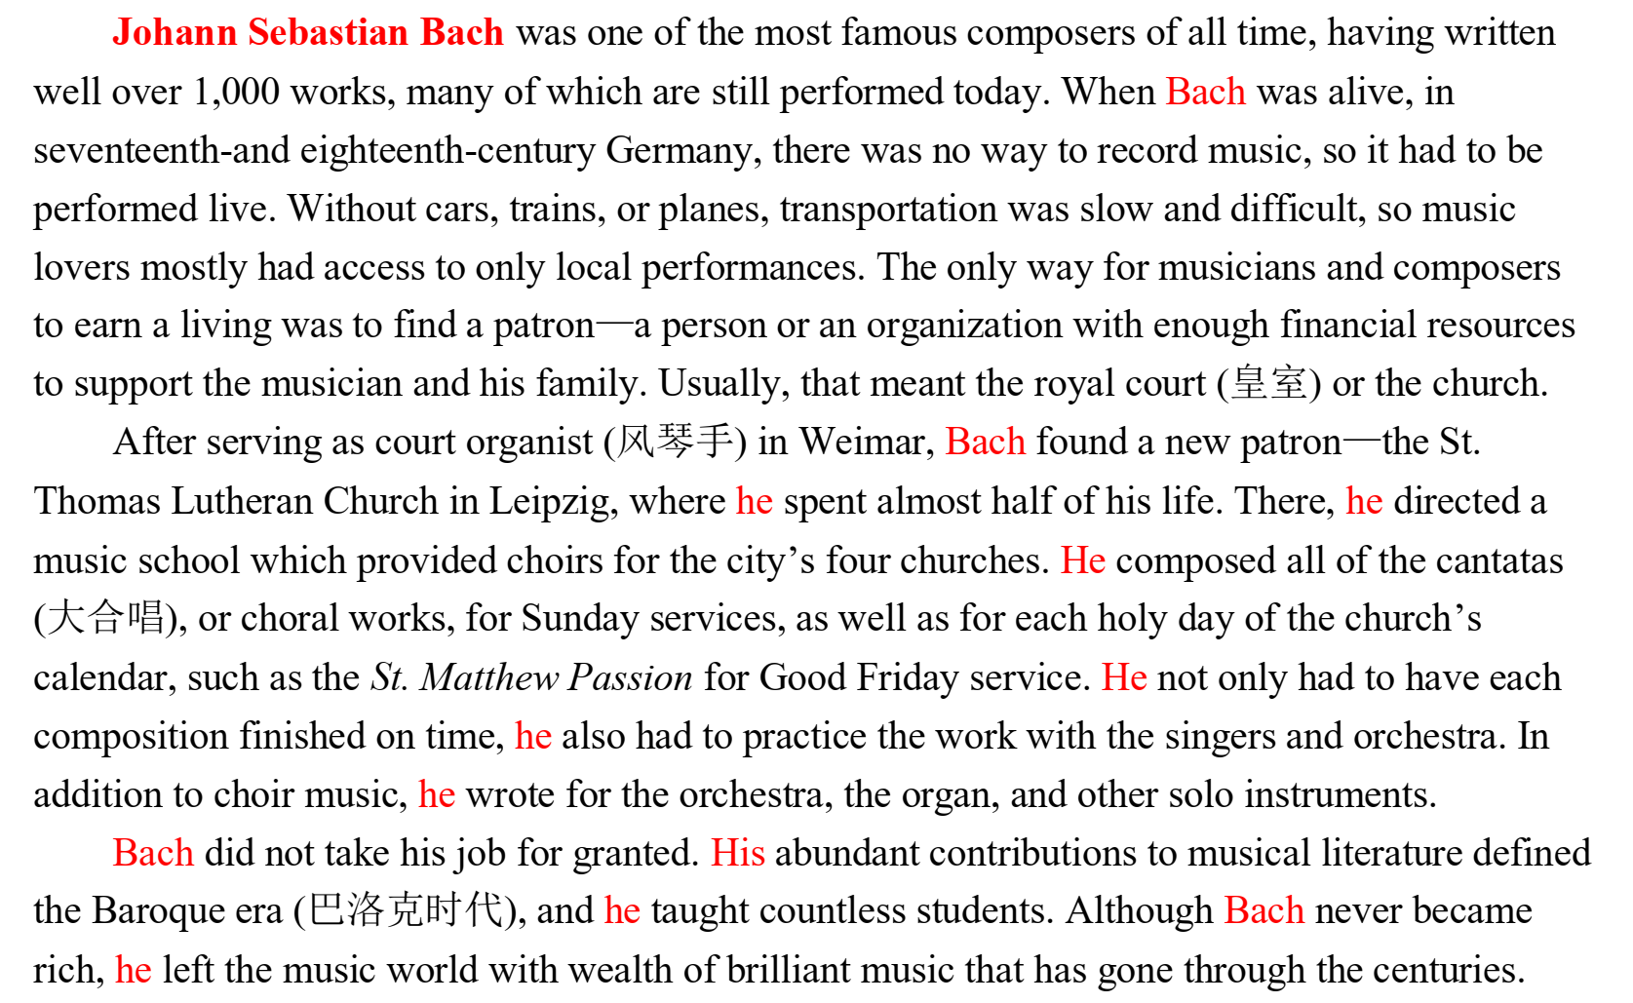
2.“人物介绍”类语篇的结构
时代背景:
（首段）
时代背景
人物成就:
（中间）
人物生平
成就贡献
优点品质
人物影响:
（结尾）

Slide 16
3.“人物介绍”类语篇写作目的题
Johann Sebastian Bach was one of the most famous composers of all time, having written well over 1,000 works, many of which are still performed today. When Bach was alive...
After serving as court organist in Weimar, Bach found a new patron…where he spent almost half of his life. There, he directed a music... He composed all of the…He…
Bach did not take his job for granted. His abundant contributions to…
Johann Sebastian Bach was one of the most famous composers of all time, having written well over 1,000 works, many of which are still performed today. When Bach was alive...
After serving as court organist in Weimar, Bach found a new patron…where he spent almost half of his life. There, he directed a music... He composed all of the…He…
Bach did not take his job for granted. His abundant contributions to…
27. What’s the author’s purpose in writing the text?
A. To remember a great composer.
B. To discuss the importance of music.
C. To promote music of the Baroque era.
D. To introduce how musicians made a living.
找准“人物生平”和“人物贡献”，写作目的与人物本身最直接

Slide 17
▶Practice
I first met Pal Newman in 1968, when George Roy Hill, the director of Butch Cassidy and the Sundance Kid, introduced…
The friendship that grew out of the experience of making that film and The Sting four years later had its root in the fact that although there was an age difference, we both came from a tradition of theater and live TV…
We shared the belief that if you’re fortunate enough…
I last saw him a few months ago. He’d been in and out of the hospital. He had I both knew what the deal was, and we didn’t talk about it. Ours was a relationship that didn’t need a lot of words.
27. What’s the author’s purpose in writing the text?
A. To show his love of film. B. To remember a friend.
C. To introduce a new movie. D. To share his acting experience.

Slide 18
4.“人物介绍”类语篇文章大意题
时代背景
26. What’s the text mainly about?
A. Bach’s ways of earning a living.
B. Musicians of the Baroque era.
C. Bach’s life and musical achievement.
D. Bach’s influence on the
development of music.
人物生平
1. 抓住“人物生平”和“人物贡献”；
2. 找准选项关键词
人物影响

Slide 19
▶其他题目
Johann Sebastian Bach was one of the most famous composers of all time, having written well over 1,000 works, many of which are still performed today. When Bach was alive, in seventeenth-and eighteenth-century Germany, there was no way to record music, so it had to be performed live. Without cars, trains, or planes, transportation was slow and difficult, so music lovers mostly had access to only local performances. The only way for musicians and composers to earn a living was to find a patron—a person or an organization with enough financial resources to support the musician and his family. Usually, that meant the royal court (皇室) or the church.
24. How did composers make a living during the Baroque era?
A. They worked for a patron. B. They performed in local concerts.
C. They taught music in public school. D. They sold compositions to churches.

Slide 20
▶其他题目
After serving as court organist (风琴手) in Weimar, Bach found a new patron—the St. Thomas Lutheran Church in Leipzig, where he spent almost half of his life. There, he directed a music school which provided choirs for the city’s four churches. He composed all of the cantatas (大合唱), or choral works, for Sunday services, as well as for each holy day of the church’s calendar, such as the St. Matthew Passion for Good Friday service. He not only had to have each composition finished on time, he also had to practice the work with the singers and orchestra. In addition to choir music, he wrote for the orchestra, the organ, and other solo instruments.
25. What can we infer from Paragraph 3?
A. Bach focused his works on one kind.
B. Bach produced few works at that time.
C. Bach’s some works were for religious use.
D. Bach failed to compose for a certain period.

Slide 21

5.“人物介绍”类语篇标题选择题
“事实型”标题
请你思考下，“人物介绍”类语篇的标题有什么特点？应以哪一种为主？
“升华型”标题
1. 抓住“人物”
2. 谱写“成就”
Bach’s Life and Musical Achievement
Bach: Greatest Composer Ever

Slide 22
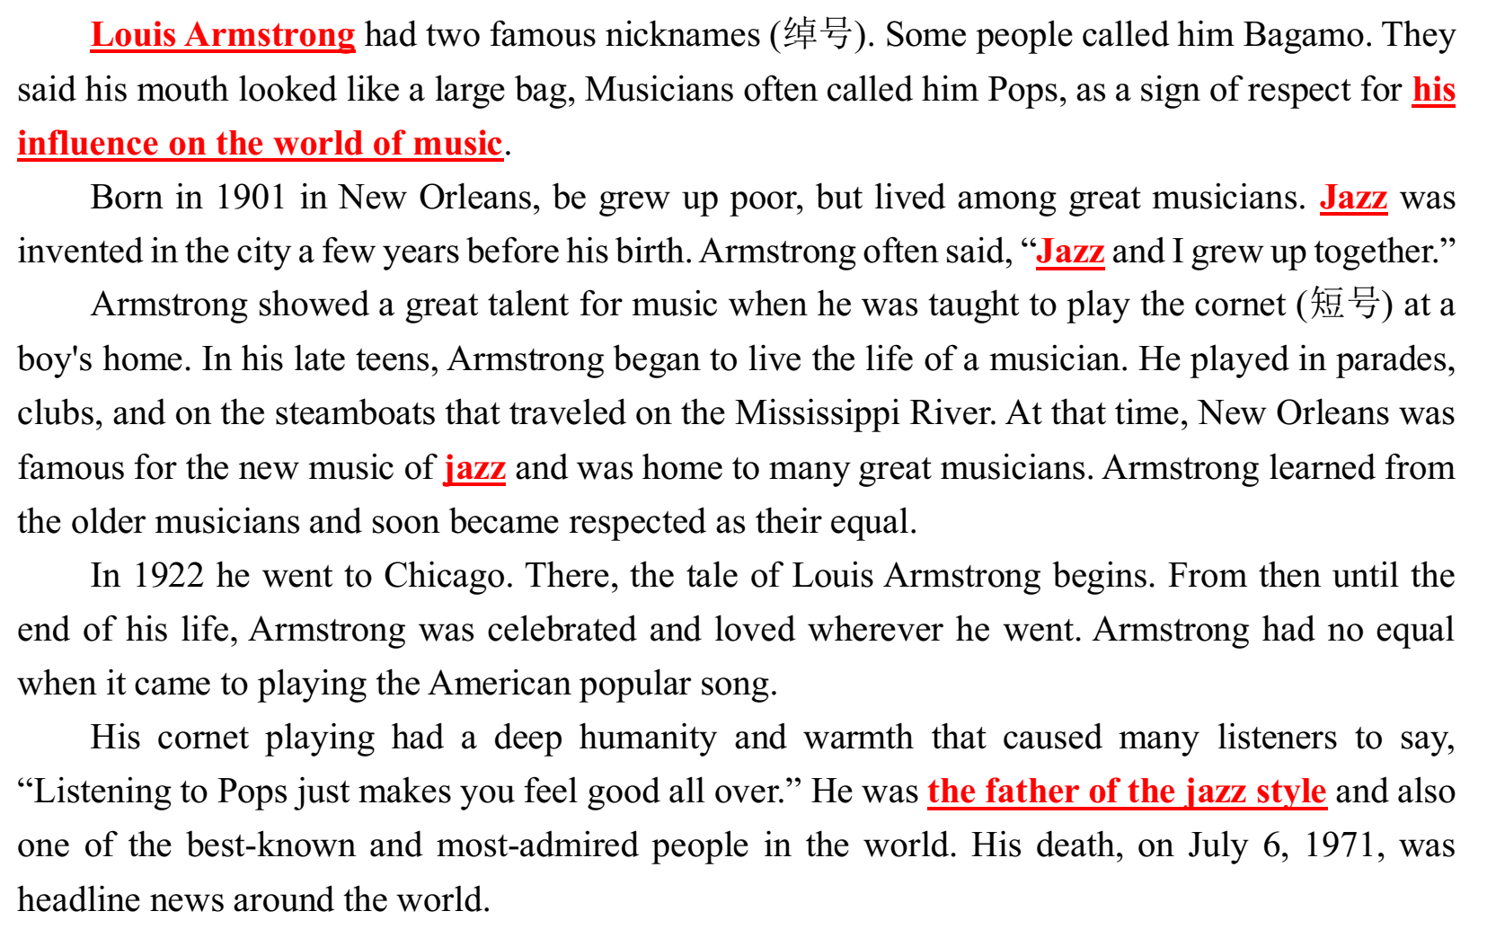
▶Practice
引出人物
1. 抓住“人物”
2. 谱写“成就”
4. Which would be the best title for
the text?
A. The Invention of the Jazz Music
B. The Father of the Jazz Style
C. The Making of a Musician
D. The Spread of Popular Music
人物生平
人物贡献

Slide 23
▶Practice
Louis Armstrong had two famous nicknames (绰号). Some people called him Bagamo. They said his mouth looked like a large bag, Musicians often called him Pops, as a sign of respect for his influence on the world of music.
…
Armstrong showed a great talent for music when he was taught to play the cornet (短号) at a boy's home. In his late teens, Armstrong began to live the life of a musician. He played in parades, clubs, and on the steamboats that traveled on the Mississippi River. At that time, New Orleans was famous for the new music of jazz and was home to many great musicians. Armstrong learned from the older musicians and soon became respected as their equal.
1. Armstrong was called Pops because he
_____.
A. looked like a musician
B. was a musician of much influence
C. showed an interest in music
D. travelled to play modern music
2. The third paragraph is developed _____.
A. by space
B. by examples
C. by time
D. by comparison

Slide 24
6.“人物介绍”类语篇主旨大意题考查点
to introduce
to remember
1. 写作目的
2. 文章标题
3. 文章大意
· What’s the main purpose of the passage?
· What can be a suitable title for the text?
· What’s the text mainly about?
人物生平
成就贡献

Slide 25
四、小结
指向
就事论事
进展
文章标题
个人故事
就事说理
结局
主旨大意题
（叙事类）
回应
文章大意
to introduce
to remember
时代背景
写作目的
人物生平
人物介绍
文章标题
文章大意
成就贡献
优点品质

