Slide 1


感恩遇见，相互成就，本课件资料仅供您个人参考、教学使用，严禁自行在网络传播，违者依知识产权法追究法律责任。
更多教学资源请关注
公众号：溯恩高中英语
知识产权声明

Slide 2

Unit 5 Languages around the world
Write a blog about English study
授课人：林玲

Slide 3

Free Talk
What's your biggest problem with learning English?
remember vocabulary
...
dare not speak English
understand a text
extended writing
pronounce correctly
watch English movies

Slide 4

Free Talk
Who do you often ask for help when you meet these problems?
1
Friends
2
Parents
3
Teachers
4
E-friends
5
...

Slide 5
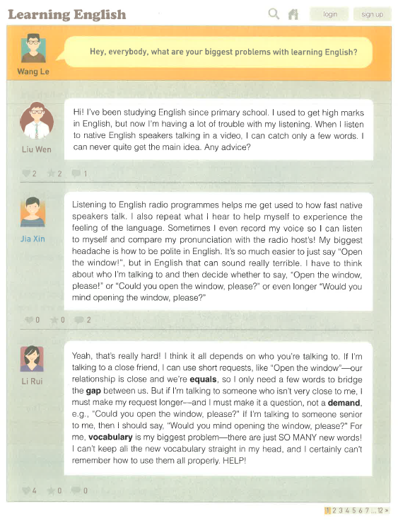
Reading and Discovering
Read the blog from online forum and answer.
Online forum?
Tone (语调）?
An Internet-based place to exchange ideas about one problem
formal or casual
√

Slide 6
Orgnization
Problem
What does each of the students write about?
Give advice+Problem
Give advice+Problem

Slide 7
Reading and Discovering
Name | Problem | Advice
Liu Wen
Jia Xin
Li Rui
Jia Xin’s advice
have trouble with listening to totally get the main idea
◎ listen to English radio programs
◎ repeat what you hear
◎ record your voice and compare it with the
radio host’s
Li Rui’s advice
how to be polite in English towards different people
◎ use short requests for close friends
◎ use longer requests for people who are not
so close
◎ use more polite phrases for people senior
to you
Your advice
can't remember new vocabulary and use it
◎ sort out words based on topics
◎ learn word formation
◎ make a short story
◎ ...

Slide 8
Expressions
◎Expressions used to state the biggest problem
◎Expressions used to give advice

Slide 9
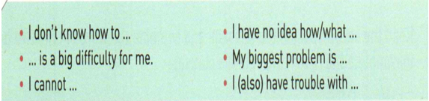
More Expressions
Introducing the biggest problem
Giving advice

Slide 10
Group Work
Work in groups of 4 to fill in the blank
Name | The biggest problem | Advice

Slide 11
Writing
... is a big difficulty for me. /...
When I ... I can ... but I cannot ...
State the biggest problem
For example, ...
details
I try to ... but...
...
Write a blog about English study
My classmates had some suggestions for me.
Advice
One was to ...
details
Then ... such as...
Another advice was...
...
Evaluation of the advice
I think ...

Slide 12
Exchanging ideas
Use the checklist to give feedback on your partner's draft.
General content | Did you give a clear description of the problem? Is the advice clearly explained? Does each sentence relate to the main idea?
Basic writing skills | Do you use pronouns to refer to things or people correctly? Do you use correct spelling, punctuation, and capitalization? Are there any grammar mistakes?

Slide 13
Sample Writing
I have trouble with phrasal verbs. There are so many of them and it seems impossible to work out the meanings just from the words. Some of the verbs even have different meanings. For example, put off can mean postpone, discourage (someone from doing something), and make someone dislike (something). I try to use phrasal verbs sometimes, but I usually use the wrong one!
My classmates had some suggestions for me. One was to use flash cards and to write down the phrasal verb on one side and a sentence using the phrasal verb on the other side. Then I can study them when I have time, like on the bus. Another suggestion was to use the phrasal verb in a sentence that is true for me, so that it's easy to remember. For example, I always put off doing my homework. I think my classmates gave me some good advice. Next time I hear a phrasal verb, I'll write it down and think of a sentence that uses the verb. Maybe I'll draw a picture too, to make it easier to remember.

Slide 14

Summary
The Internet Connects Us.

Slide 15
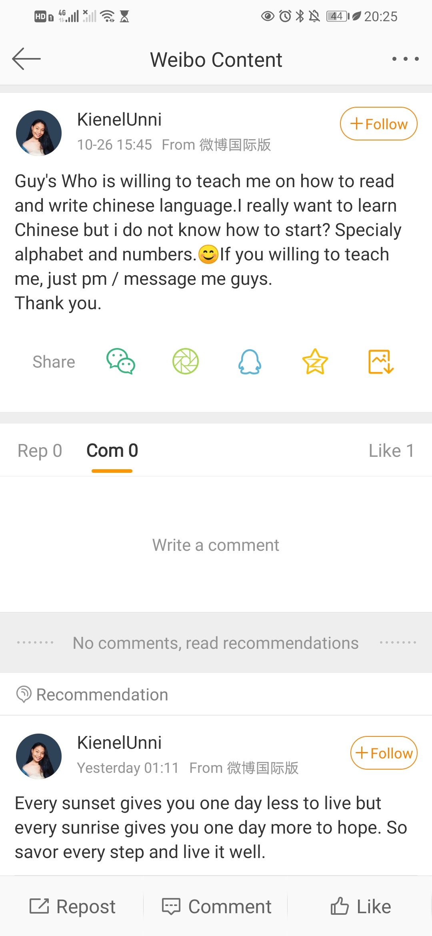
Homework
1. Revise your blogs again and hand them in.
2. Post your blog to give KienelUnni some advice on learning Chinese.
Links: https://m.weibo.cn/7502277407/4564303975286681

Slide 16
THANK YOU

