Slide 1

高考英语阅读理解 专项突破1
· 主旨大意
· 推理判断
· 词义猜测
· 细节理解
· 语篇连贯

Slide 2
第三课
主旨大意
(其他类说明文&议论文)

Slide 3
一、其他类说明文
浙江卷对“其他类型的说明文”的考查：
1
2019.6 | C篇 | 介绍了加利福尼亚州的大树的数量急剧下降这一现象，并分析了背后的原因。
2018.11 | A篇 | 介绍了伦敦的出租车及其背后蕴含的文化现象。
2018.6 | C篇 | 介绍了美国汽车的使用情况及期对美国文化产生的影响。
2016.10 | C篇 | 介绍了远程办公这一现象及员工和老板对其不同态度。
《课程标准》在“语篇类型”中提出学生要掌握的说明文：(1)地点、事物、产品介绍等；(2)现象说明、事理阐释等；(3)机构介绍、科技成果介绍、操作指南、使用手册等。

Slide 4
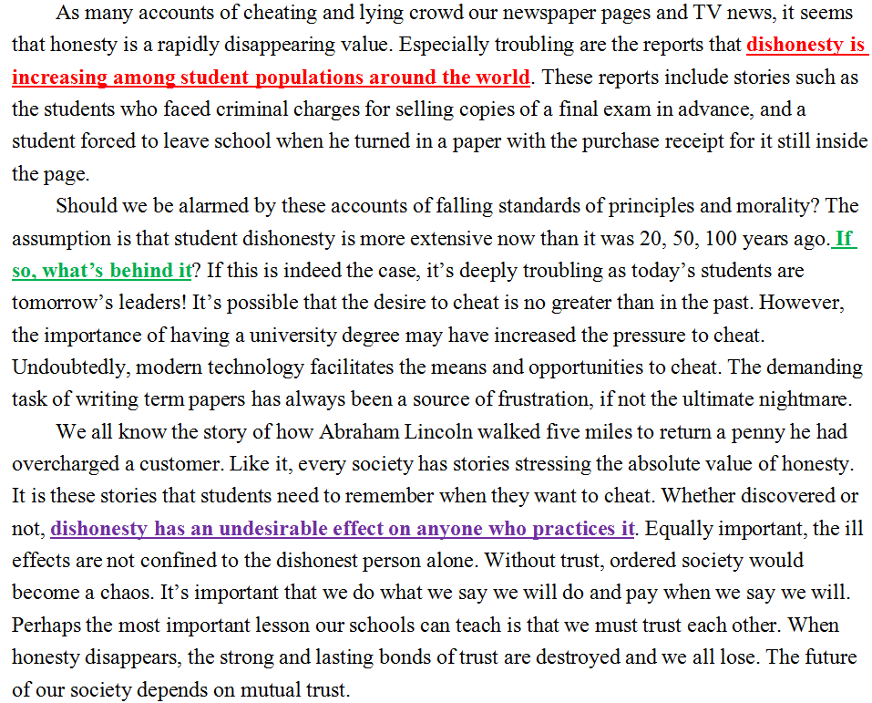
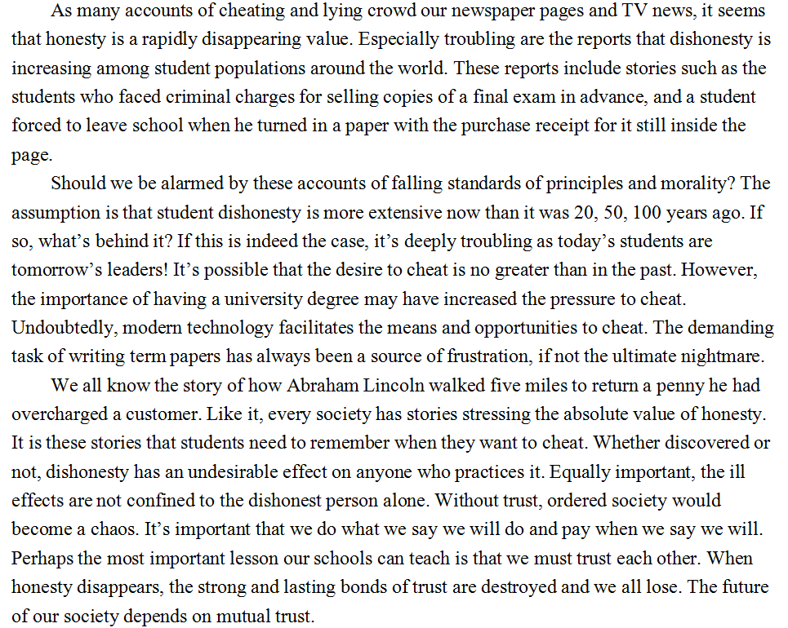
2.“现象说明”类说明文的组成部分
提出现象
(increasing dishonesty among students)
phenomenon
分析原因
(pressure from degree+ modern technology+ deanding paper)
analysis
说明重要性
(personal+societal level)

Slide 5
3.“现象说明”类说明文的展开模式
water crisis
five ways to solve it
Problem—Solution
phenomenon
Cause—Effect
water crisis
wasting water—no clean water
Compare—Contrast
analysis
similarity and difference
(water crisis in China and USA)
Sequence
events, steps, processes, stages
(water crisis at different stage)

Slide 6
4.“现象说明”类说明文的写作目的题
As many accounts of cheating and lying crowd our newspaper pages and TV news, it seems that honesty is a rapidly disappearing value. Especially troubling are the reports that dishonesty is increasing among student populations around the world...
Should we be alarmed by these accounts of falling standards of principles and morality? The assumption is that student dishonesty is more extensive now than it was 20, 50, 100 years ago. If so, what’s behind it?
...Whether discovered or not, dishonesty has an undesirable effect on anyone who practices it...
1. What’s the writer’s purpose in writing the text?
A. To explain the definition of honesty.
B. To expose the ill effects of dishonesty.
C. To make an appeal to people for honesty.
D. To reveal the severity of student cheating.
1. 找到“说明现象”
2. 分析“文章逻辑”
3. 确定写作目的

Slide 7
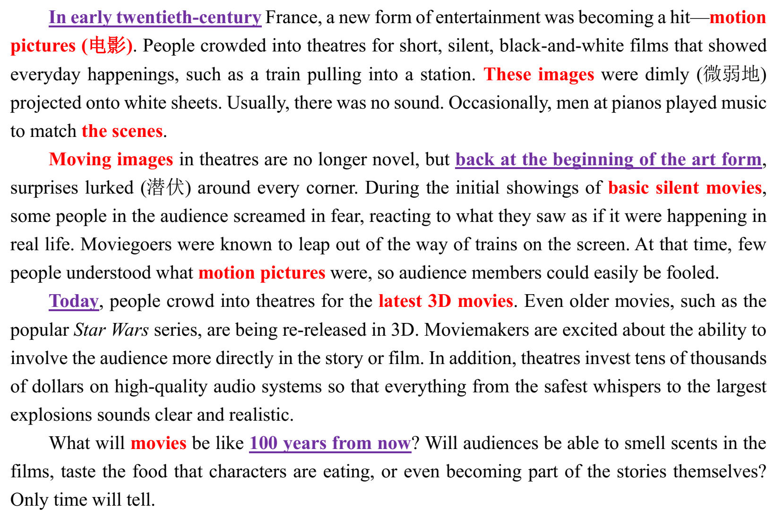
4.“现象说明”类说明文的写作目的题
介绍
时间顺序
1. 找到“说明现象”
2. 分析“文章逻辑”
3. 确定写作目的
(浅层/深层)
提出现象
29. What’s the author’s purpose in
writing the text?
A. To explain how realistic
movies are today.
B. To tell something about future
movie plans.
C. To introduce the history of
movie technology.
D. To compare movie theatres
over the last century.

Slide 8
▶Practice
To take the apple as a forbidden fruit is the most unlikely strory the Christians (基督教徒) have ever cooked up. For them, the forbidden fruit from Eden is evil (邪恶的). So when Columbus brought the tomato back from South America, a land mistakenly considered to be Eden, everyone jumped to the obvious conclusion. Wrongly taken as the apple of Eden, the tomato was shut out of the door of Europeans.
What made it particularly terrifying was its similarity to the mandrake, a plant that was thought to have come from Hell (地狱)...
Cautious Europeans long ignored the tomato, and until the early 1700s most of the Western people continued to drag their feet. In the 1880s...
But in the end tomatoes carried the day. The hero of the tomato was an American namd Robert Johnson, and when he was publicly going to eat the tomato in 1820...
To take the apple as a forbidden fruit is the most unlikely strory the Christians (基督教徒) have ever cooked up. For them, the forbidden fruit from Eden is evil (邪恶的). So when Columbus brought the tomato back from South America, a land mistakenly considered to be Eden, everyone jumped to the obvious conclusion. Wrongly taken as the apple of Eden, the tomato was shut out of the door of Europeans.
What made it particularly terrifying was its similarity to the mandrake, a plant that was thought to have come from Hell (地狱)...
Cautious Europeans long ignored the tomato, and until the early 1700s most of the Western people continued to drag their feet. In the 1880s...
But in the end tomatoes carried the day. The hero of the tomato was an American namd Robert Johnson, and when he was publicly going to eat the tomato in 1820...
4. What is the main purpose of the passage ?
A. To challenge people's fixed concepts of the tomato
B. To give an explanation to people's dislike of the tomato
C. To present the change of people's attitudes to the tomato
D. To show the process of freeing the tomato from religious influence

Slide 9
v
▶其他题目
In early twentieth-century France, a new form of entertainment was becoming a hit—motion pictures (电影). People crowded into theatres for short, silent, black-and-white films that showed everyday happenings…
Moving images in theatres are no longer novel, but back at the beginning of the art form, surprises lurked (潜伏) around every corner. During the initial showings of basic silent movies, some people in the audience screamed in fear, reacting to what they saw as if it were happening in real life. Moviegoers were known to leap out of the way of trains on the screen. At that time, few people understood what motion pictures were, so audience members could easily be fooled.
27. In the beginning, movies________.
A. had music B. were in color
C. became popular
D. contained surprises
该类题目在浙江卷中非常常见，实质是通过supporting details考topic sentence
28. The author mentioned moviegoers leaping
out of their seats to show ________.
A. how foolish audiences were
B. how different old theatres were
C. how scary movies from the past were
D. how unfamiliar movies were to viewers
then

Slide 10
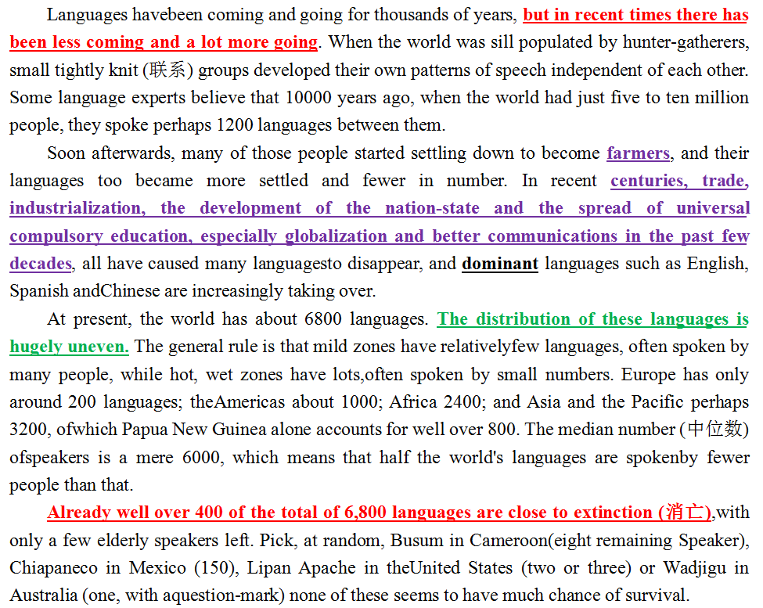
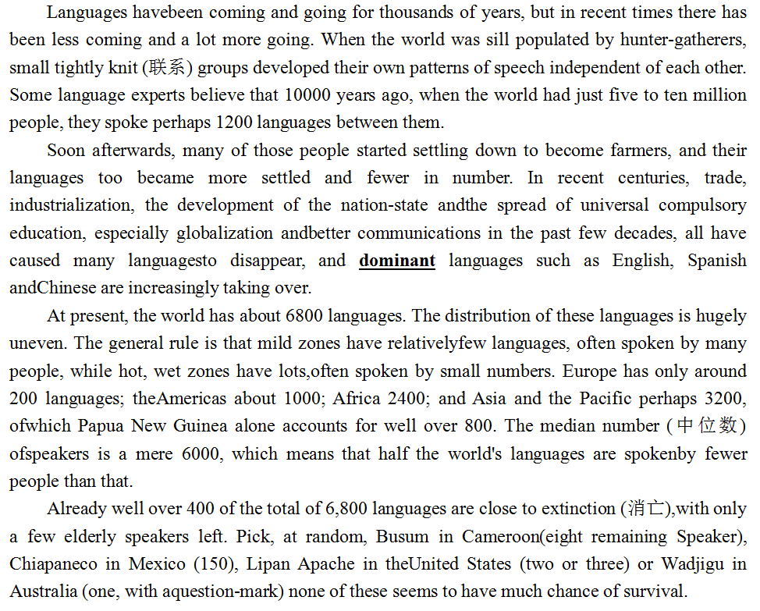
5.“现象说明”类说明文的文章大意题
语言消亡
（提出现象）
消亡原因1
（分析原因）
消亡原因2
（分析原因）
语言消亡
（说明现象）

Slide 11
5.“现象说明”类说明文的文章大意题
Languages havebeen coming and going for thousands of years, but in recent times there has been less coming and a lot more going.
Soon afterwards, many of those people started settling down to become farmers, and their languages too became more settled and fewer in number. In recent centuries, trade, industrialization, the development of the nation-state and the spread of universal compulsory education, especially globalization and better communications in the past few decades...
At present, the world has about 6800 languages. The distribution of these languages is hugely uneven...
Already well over 400 of the total of 6,800 languages are close to extinction (消亡),with only a few elderly speakers left....
1. What is the main idea of the text?
A. New languages will be created.
B. People’s lifestyles are reflected in fewer languages.
C. Human development results in fewer languages.
D. Geography determines languageevolution.
1. 找到“说明现象”
2. 分析“文章逻辑”
3. 确定文章大意

Slide 12
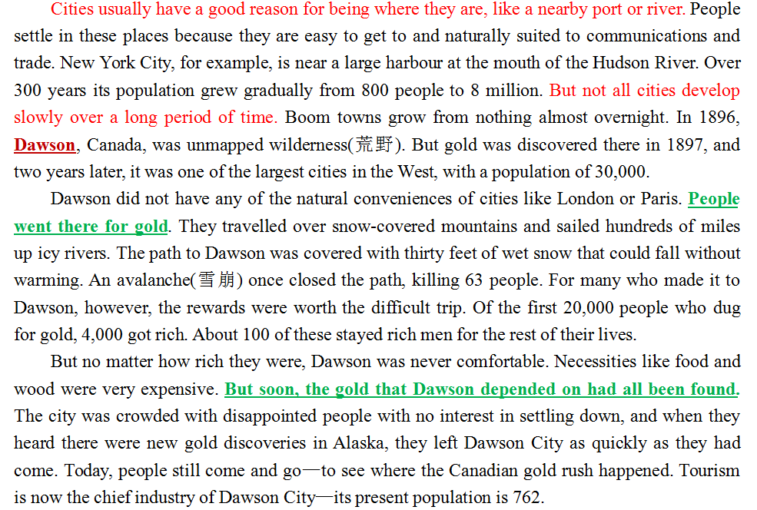
▶Practice
引出话题
引出主题
(Dawson)
1. 找到“说明现象”
2. 分析“文章逻辑”
3. 确定文章大意
分析原因
(淘金热)
4. What is the text mainly about?
A. The rise and fall of a city.
B. The gold rush in Canada.
C. Journeys into the wilderness.
D. Tourism in Dawson.
分析现状
(城市败落)

Slide 13
v
▶其他题目
Cities usually have a good reason for being where they are, like a nearby port or river. People settle in these places because they are easy to get to and naturally suited to communications and trade. New York City, for example, is near a large harbour at the mouth of the Hudson River. Over 300 years its population grew gradually from 800 people to 8 million...
...For many who made it to Dawson, however, the rewards were worth the difficult trip. Of the first 20,000 people who dug for gold, 4,000 got rich. About 100 of these stayed rich men for the rest of their lives.
...The city was crowded with disappointed people with no interest in settling down, and when they heard there were new gold discoveries in Alaska, they left Dawson City as quickly as they had come....
1.What attracted the early settlers to New York
City?
A. Its business culture. B. Its small population.
C. Its geographical position.
D. Its favourable climate.
2. What do we know about those who first dug
for gold in Dawson?
A. Two-thirds of them stayed there.
B. One out of five people got rich.
C. Almost everyone gave up.
D. Half of them died.
3. What was the main reason for many people to
leave Dawson?
A. They found the city too crowded.
B. They wanted to try their luck elsewhere.
C. They were unable to stand the winter.
D. They were short of food.

Slide 14
6.“现象说明”类说明文的标题选择题
这类语篇的文章大意题与标题选择题有何类似之处？
文章标题≈文章大意
现象说明
But not all cities develop slowly over a long period of time. Boom towns grow from nothing almost overnight. In 1896, Dawson...People went there for gold...But soon, the gold that Dawson depended on had all been found...Today, its population is 762.
The Rise and Fall of Dawson
Languages havebeen coming and going for thousands of years, but in recent times there has been less coming and a lot more going...Already well over 400 of the total of 6,800 languages are close to extinction (消亡),with only a few elderly speakers left....
The Dying of Languages

Slide 15
二、议论文
浙江卷对“议论文”的考查：
1
2018.11 | C篇 | 每年夏天，作者都计划着阅读名著，但总是放弃了，觉得游泳更有趣。今年暑假，作者读了《战争与和平》和《红与黑》，但是总觉得书中的内容离现实太远，阅读自己喜欢的小说离严肃文学太远，躺在草地上闭着眼睛享受愉快和平静才是最惬意的事情……
2018.6 | C篇 | 文章探讨了人们该用塑料袋还是环保袋或者两者都不使用，并分析了原因。
《课程标准》在“语篇类型”中提出学生要掌握的议论文：(1)论说文、评论等；(2)报刊社论、专栏文章、书评、影评或学术论文摘要等。

Slide 16
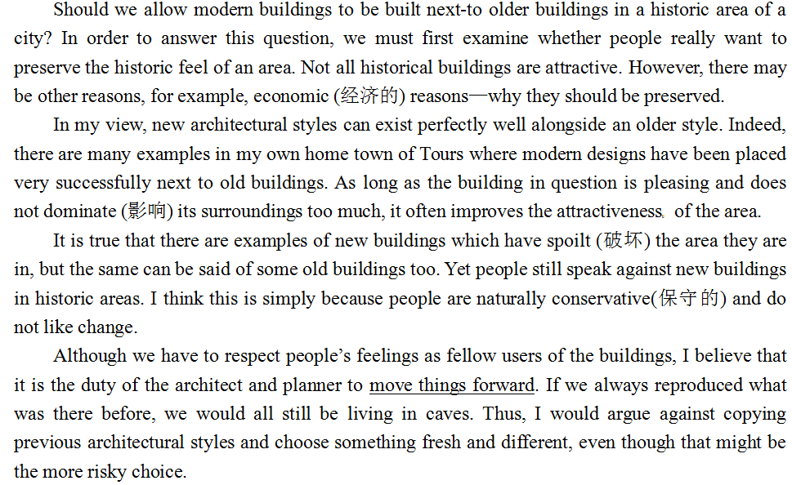
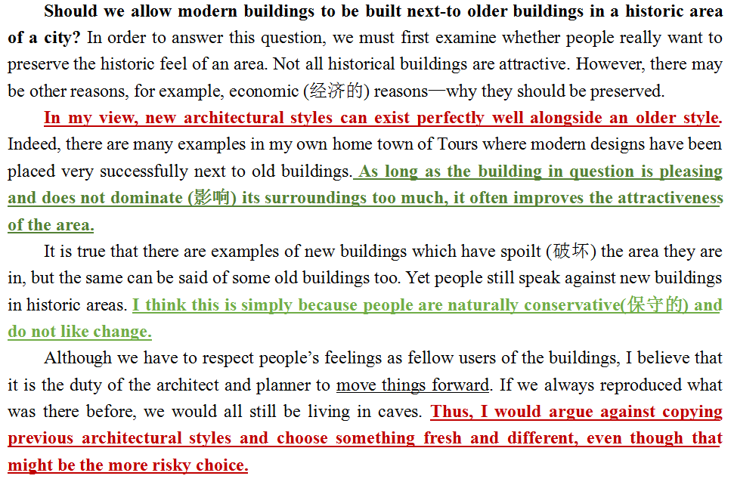
2. 议论文的组成部分
提出话题
提出论点
(build morden buildings next-to old ones)
说明理由（原因）
(improve attractiveness+
change people's attitude )
重申论点
(build morden buildings next-to old ones)

Slide 17
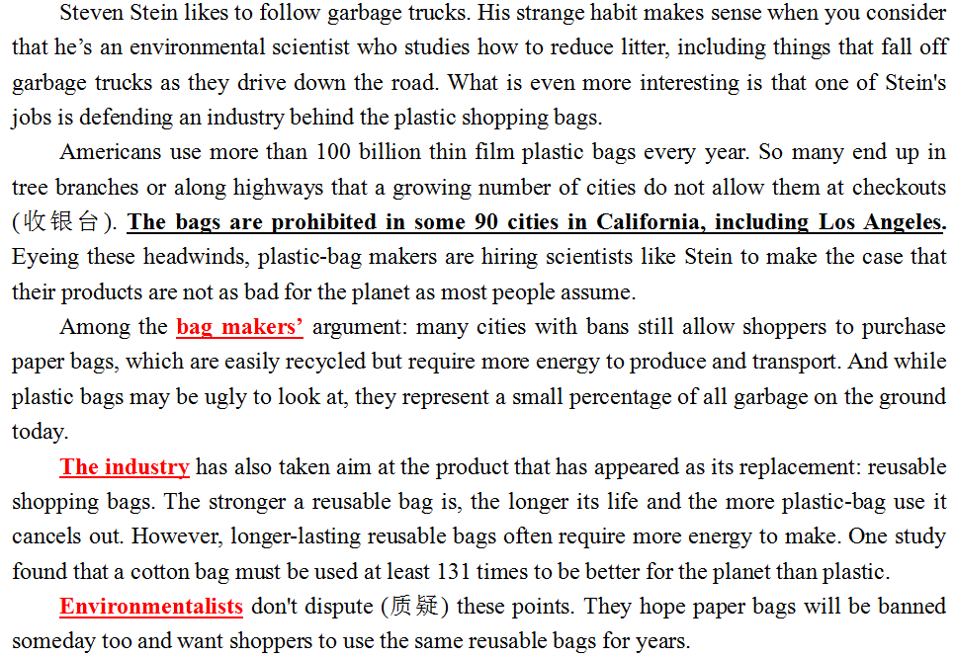
2.“议论文的组成部分
提出话题
陈述各方观点+理由
(bag makers;
the industry;
environmentalists)

Slide 18
↑
3.“现象说明”类说明文的展开模式
原因1
亮出论点
(put forward arguement)
原因2
重申论点
原因3
话题(topic)
原因1
陈述观点
(show others' argument)
正方
原因2
结
尾
原因1
反方
原因2

Slide 19
4. 议论文的写作目的题
Should we allow modern buildings to be built next-to older buildings in a historic area of a city? In order to answer this question, we must first examine whether people really want to preserve the historic feel of an area. Not all historical buildings are attractive. However, there may be other reasons, for example, economic (经济的) reasons—why they should be preserved.
In my view, new architectural styles can exist perfectly well alongside an older style...
...Thus, I would argue against copying previous architectural styles and choose something fresh and different, even though that might be the more risky choice.
to inform
to persuade
to entertain
4.What is the main purpose of the passage?
A.To explain why people dislike change.
B.To warn that we could end up living in caves.
C.To admit how new buildings have ruined their surroundings.
D.To argue that modern buildings can be built in historic areas.
1. 找到“话题”
2. 锁定“论点”
3. 确定写作目的

Slide 20
▶Practice
Eleven years of age is not too young to get a smart phone. First of all, a smart phone can come in handy for doing school assignments. Students can type, email, and share assignments with a phone. Eleven years of age is a perfect time to get a cellphone because students have to do research for homework assignments and projects. Secondly, children can use a smart phone to easily communicate with relatives, such as grandparents, who live far away. Finally, there are a lot of online news sources that are meant for young audiences, so smart phones can help children to be well informed, which is important.
Eleven years of age is not too young to get a smart phone. First of all, a smart phone can come in handy for doing school assignments. Students can type, email, and share assignments with a phone. Eleven years of age is a perfect time to get a cellphone because students have to do research for homework assignments and projects. Secondly, children can use a smart phone to easily communicate with relatives, such as grandparents, who live far away. Finally, there are a lot of online news sources that are meant for young audiences, so smart phones can help children to be well informed, which is important.
Q: What is the main purpose of the passage?
To argue that eleven-year-old children should get a smart phone.
The purpose of persuasive texts is to convince the reader to have a particular opinion about a topic.

Slide 21
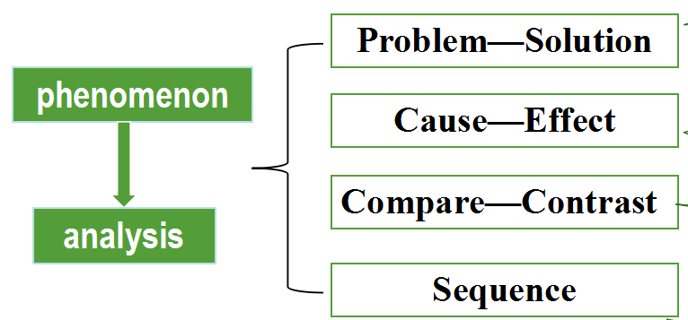
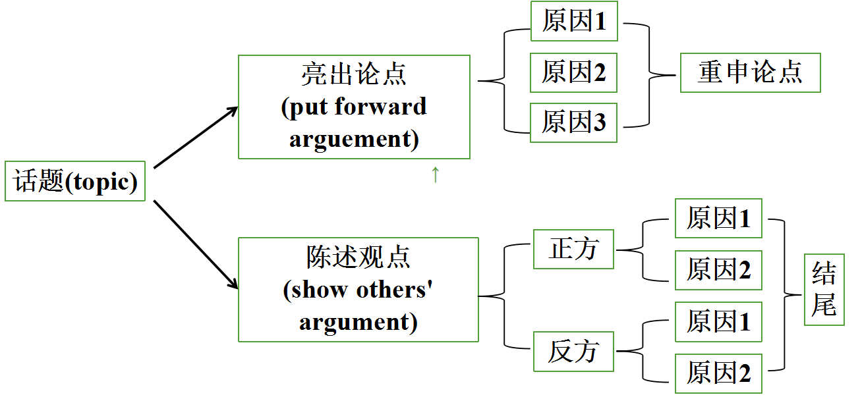
三、小结
“现象说明”类说明文
主旨大意题
（其他类说明
文&议论文）
议论文

