Slide 1


感恩遇见，相互成就，本课件资料仅供您个人参考、教学使用，严禁自行在网络传播，违者依知识产权法追究法律责任。
更多教学资源请关注
公众号：溯恩高中英语
知识产权声明

Slide 2

高中英语应用文写作—推荐信(1)
Letters of Recommendation
杭州二中 许丽君

Slide 3

教学目标： Teaching Goals
After Teaching this lesson, you will
learn about the layout and contents of letters;
write the recommendation letters completely
and correctly;
3. Polish your writing more accurate;
4. know what a good letter of recommendation is like.

Slide 4
Lead in
推荐的对象：Recommended Objects(人、物和活动)
Letters of Recommendation Include:
Person/human being/man
individuals
students
objects
ideas
books/newspaper/magazines
Scenic Spots
Chinese Traditional Culture

Slide 5
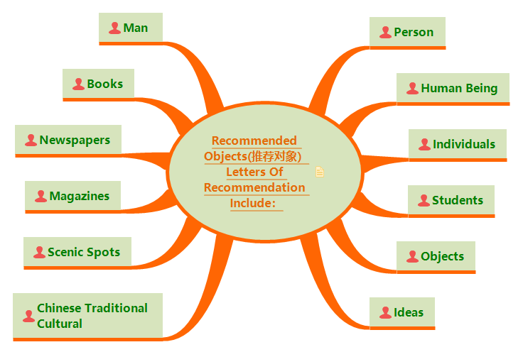

Slide 6

推荐的类别： Sorts of Recommendation
Recommend oneself（自荐）
Recommend someone else（推荐他人）

Slide 7
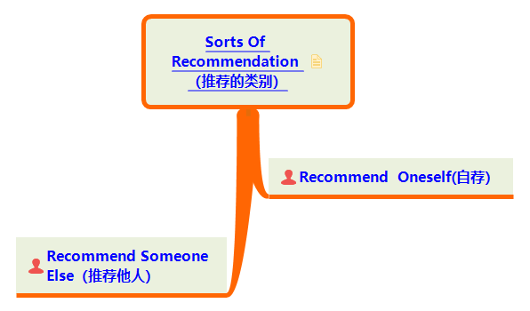

Slide 8
Write Letters of Recommendation for
New employees
Job seekers
colleagues/partners
Principals

Slide 9
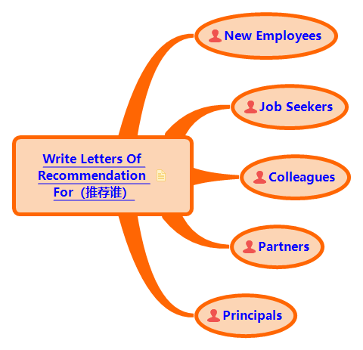

Slide 10
推荐信的文体简介
推荐信是向有关单位或个人推荐或介绍某人、物、事或活动的专用书信。推荐信从第三方的角度向用人单位或学校提供有关当事人的必要信息或推荐意见。这类书信使用广泛。信文语言简短准确，语气诚恳热情。推荐信包括以下内容：
应聘者的姓名，个人素质，工作态度和学习成绩；
与推荐人之间的关系；
推荐人态度明确地支持被推荐人。

Slide 11
推荐信的结构：
推荐信Structure:通常分为三部分：
开头段—(Greetings)+background + Purpose of writing the letter表明写作目的(背景+推荐)；
中间段—General—Part（总起句+➔（阐明推荐人的优点及推荐原因）➔列明推荐理由；
结尾段—--- I believe+I expect+I hope再次点明推荐，希望推荐能被考虑，采纳➔进一步联系

Slide 12
Layout
What should be included in a letter of Recommendation?
Dear ______,/To Whom it may concern
Beginning --- Purpose of writing the letter【开头—表明写作目的➔背景+推荐-brief/direct】
➢Why are you writing the letter of Recommendation?
Body Arrangements---【总起句➔（阐明推荐人的优点及推荐原因）➔列明推荐理由-detailed/-to the point】.
What do you recommend to your friends, partners, colleagues, cooperators, person in charge, classmates?
Ending --- 【再次点明推荐，希望推荐能被考虑，采纳➔进一步联系-conclusive/-powerful】
Yours faithfully/sincerely
***

Slide 13
推荐信的注意要点:
写推荐信时应当注意：
1). 语气真诚，礼貌，并尊重对方；
2). 审题后确定推荐信写作的重点，合理布局各部分的字数；
3). 推荐理由合情合理，多列几点，避免重复，增强说服力；
4). 正文部分阐明推荐理由前可以写一句表示理由的总起句。

Slide 14
Writing preparations
➢Part 1: (Greetings)+background + Purpose of writing the letter
（1）【首段】【开头—表明写作目的➔背景+推荐-brief/direct】
1. I have much pleasure in recommending Mr. X to you.
我很荣幸为你推荐…
2. Here are a few recommendations/My recommendations are as follows.
我的推荐如下。
3. I am happy to have the opportunity to recommend Mr. X to you for…
我很高兴有机会向你推荐…
4. I am writing this letter of recommendation at the request of Mr.…
应某人之邀我写这封推荐信。
5. Knowing that you are looking for…, I would like to recommend… who is responsible and rich in experience.
获知你在找…,我向你推荐既负责又经验丰富的XXX。

Slide 15
Part 2: Body Arrangements---General—Part
(2)【主体】篇中【总起句➔（阐明推荐人的优点及推荐原因）➔列明推荐理由-detailed/-to the point】
 1. Because the organization has people I am familiar with, I recommend you to go.
由于这个机构有我熟悉的人….., 我推荐你去……。
2. Learning that …, so it is strongly recommended that…
获知……, 所以强烈推荐你……
3. As it is a very good institution, I recommend it to you.(As +句子)
因为这个机构很好，我向你推荐。
 4. It’s a good way to broaden your horizon, through which you can learn various cultures of the world.
通过旅游，能开阔视野，更好地了解世界上不同的文化。
5.Since the Product is very good， I recommend you to use it. (Since +句子)
因为这个产品不错，我推荐你使用。
6. You would be provided an opportunity to do something interesting and creative. Meanwhile, it also offers you a source of pleasure.
你有机会做既有趣又富有创意的事情，同时也给你提供快乐的源泉。

Slide 16
Part 2: Body Arrangements---General—Part
【主体】---【总起句➔（阐明推荐人的优点及推荐原因）➔列明推荐理由-detailed/-to the point】
过渡性词汇 Natural transitions衔接词：➔
列明推荐理由时： firstly/secondly/thirdly/ first and foremore /in addition/ additionally/ what’s more /furthermore/ moreover/ most importantly
结尾段再次表明推荐时：in a word/ to sum up/ all in all/generally speaking…

Slide 17
Part 3: Ending--- I believe+I expect+I hope
【再次点明推荐，希望推荐能被考虑，采纳➔进一步联系-conclusive/-powerful】
【尾段】用以下句子表达“本人愿意郑重推荐或证明XXX能胜任XXX，恳请考虑或试用为盼”
1. I should appreciate it very much if you would consider my recommendation favorably.
我很荣幸你能认真考虑我的推荐。
2. I sincerely hope my recommendation will be of great help/benefit to you.
(be of +特定名词= be+形容词) 我真诚地希望我的推荐对你有帮助。
3. These are my recommendation and I hope you will give him favorable consideration.
我希望我的推荐能让你给予他有利的考虑。

Slide 18
Part 3: Ending--- I believe +I expect + I hope
4. I sincerely hope my recommendation will be taken into consideration/account and make a final decision.(较正式))
真诚希望你能考虑我的推荐并作出最后决定。
5. I feel sure you would not regret meeting Mr. XXX.
我相信你和XXX先生见面不会后悔。
6.If you need further information, don’t hesitate to contact me.
如果需要更多的信息，请与我联系。

Slide 19
Useful words and expressions:
推荐信中常用词语及表达方式：
常用褒义词描述被推荐人：
描述能力可以用：capable, talented, outstanding, competent, ambitious;
描述工作勤奋可以用：diligent, industrious, hardworking;
描述品行可以用：cheerful, honest, helpful, kind-hearted, generous, devoted, faithful, persistent, humorous, creative, inventive, etc.

Slide 20
Useful words and expressions:
cooperative
colleague
connections
contact
co-worker
creative
dependable
diligent
effective
efficient
(v.) recommend
(n.) recommendation
admirable
announce
approve
associate
capable
competent胜任的，能干的
candidate 候选人
considerate

Slide 21
Writing help: Useful phrases
be equal to the position胜任工作
be qualified for the job
take my recommendation into account /consideration
rank first排名第一
recommend/introduce sb to do
推荐,介绍
look for/search for/seek out 寻找
a suitable candidate合适人选
the best candidate 最佳人选
an ideal tutor理想的家教
equipped with/blessed with具有;拥有
have a great/brilliant command of
精通,掌握
have a good knowledge of 精通,掌握
be proficient in 在...精通
a wise choice 明智的选择

Slide 22
Writing help: sentences
♥ 1. I hold a firm belief that ... / I'm convinced that...
我坚信…
♥ 2. XXX is one of our most knowledgeable people when it comes to ….
当说到…时，XXX先生是知识最渊博，最有见识的人之一。
♥ 3. XXX was in my employ for ten years.
XXX先生在我手下曾任职10年。
♥4. The applicant is supposed to be equipped with the outstanding ability of writing and word processing.
申请人应具备杰出的写作和文字处理能力。
♥5. With Beijing ranking the top priority for any traveller to China because you can fully experience the charm of Chinese history and civilizaition. (主句+with伴随+原因状语)
北京在旅游城市中名列前茅，因为你可以充分体验中国历史和文明的魅力。

Slide 23
【推荐信写作模板1】：
Writing Purpose：
Dear ______,/To Whom it may concern (对象)
Beginning --- (Greetings)+background + Purpose of writing the letter【开头—表明写作目的➔背景+推荐-brief/direct】
➢Why are you writing the letter of Recommendation?
How is everything going? Knowing that you want to get some information about __________in our school, I am more than delighted to give you a rough sketch. (提出对方需要推荐的主题)．
Body Arrangements---General—Part【总起句➔（阐明推荐人的优点及推荐原因）➔列明推荐理由-detailed/-to the point】.
What do you recommend to your friends, partners, colleagues, cooperators, person in charge, classmates?

Slide 24
【推荐信写作模板1】：
To begin with, it is vital to ________ (推荐理由一). Besides, it is also beneficial to ________ (推荐理由二). In addition, it should be a good idea to________ (推荐理由三). You can also ________ (根据要求用不同的句式再次提出推荐) There is _______ in my school, where it is convenient to hold ______ events, such as _____, as well as ______. As for me, I like _______ best. Not only will it strengthen _______, but it also makes me _______ in my life.
As to ___________(其他推荐)，I recommend________(具体到某一方面). What’s more, _______(其他的推荐). I’m convinced _________ (预测可能的结果， 给收信人信心和决心。)
Ending --- I believe+I expect+I hope【再次点明推荐，希望推荐能被考虑，采纳➔进一步联系-conclusive/-powerful】
I hope you will find my recommendation useful and I really hope you can make it. Looking forward to your consideration. Wish you a great success! (表达愿望)
Yours Sincerely / Faithfully/ Truly,
________________

Slide 25
Evaluation:
Work in groups of four. Each student read the article and others comment on others’ article. Then choose the best one to present in the class. When you are discussing, you can pay attention to the following hints.
Goal | Have you made the purpose clear?
Framework | Does the structure conform to the requirements?
Language | Are the sentences brief and accurate? Have you used the proper punctuation, words, sentences and paragraphs to express what you recommend?
Main points | Is the article to the point?
Are the details suitable?

Slide 26
应用文写作— 推荐信
推荐信参考范文

Slide 27
Writing 1【推荐信范文1：(浙江温州中学模拟) 【推荐话题-推荐最喜爱的书】
第一节 应用文写作（满分15分）
假如你是高中生李华,请用英语给你的一位朋友写一封80词左右的信。信中包括以下内容:
(1)推荐一本你最喜爱的书;
(2)写出几点你推荐该书的理由。（至少两条）
注意: 1.词数80左右；
2. 可以适当增加细节，使行文连贯。
3. 开头和结尾已给出,不计入总词数。
【写作提示】
1.本文应用一般现在时。
2.写作要覆盖推荐书的名称及推荐理由。

Slide 28
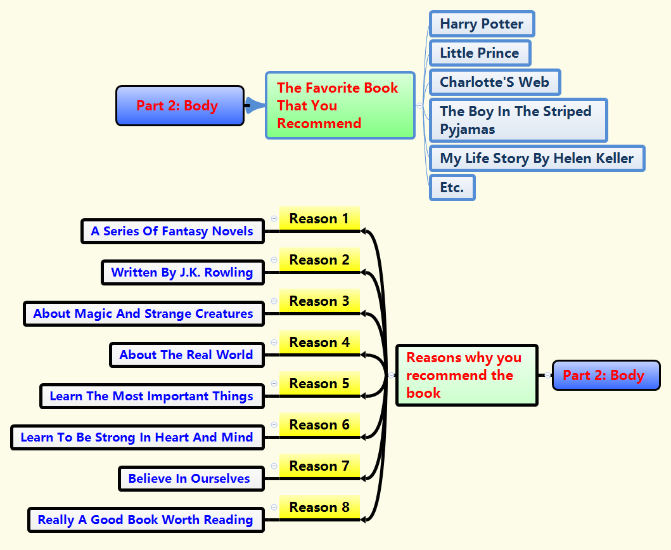
【推荐信范文1：(浙江温州中学模拟) 【推荐话题-推荐最喜爱的书】

Slide 29
Writing 1【推荐信范文1：(浙江温州中学模拟) 【推荐话题-推荐最喜爱的书】
【范文赏读1】Writing Sample：
Dear Jim,
I’m writing to recommend a book to you. My favorite book is Harry Potter, which is a series of fantasy novels written by J.K. Rowling. It is not only about magic and strange creatures, but also about the real world. By reading the book, you can learn that the most important things in life are love, friendship and to be brave. It teaches us that if we want to be happy and live a good life, it is not enough to be strong in heart and mind; we must also believe in ourselves and help others. I think Harry Potter is really a good book and worth reading.
Yours Sincerely / Faithfully/ Truly,
Li Hua

Slide 30
Writing 2【推荐信范文2：推荐话题- 我们应该感恩(thankful)】
第一节 应用文写作（满分15分）
国外某网站将举办新一轮网上讨论活动,正面向全球中学生征集话题。假设你是新华中学的学生李华，经常访问该网站。现请你用英文给该网站发送一封电子邮件，向其推荐话题。内容包括：
1·自我简介；
2·写信目的；
3·话题：我们应该感恩(thankful)；[来源:学.科.网Z.X.X.K][来源]
4·推荐的理由；
5·预祝活动成功。
注意：[来源:学科网]
1.词数80左右；
2.邮件格式已为你给出；
3.邮件中不能出现本人真实信息。
4. 可适当增加细节，以使行文连贯。

Slide 31
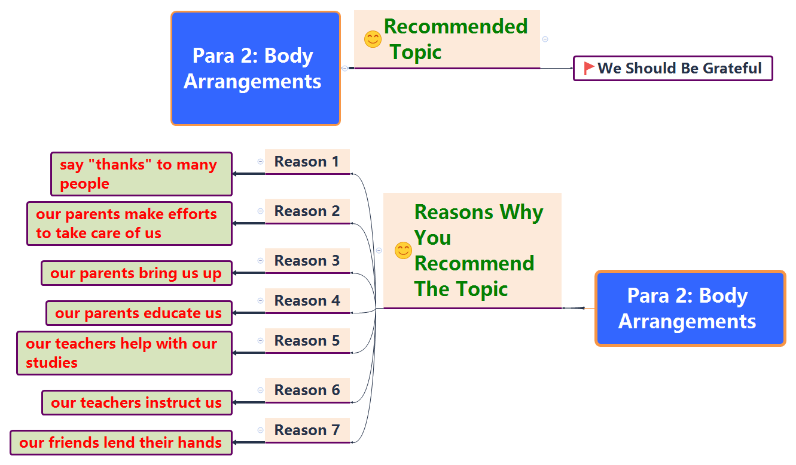
Writing 2【推荐信范文2：推荐话题- 我们应该感恩(thankful)】

Slide 32
Writing 2【推荐信范文2：推荐话题- 我们应该感恩(thankful)】
【范文赏读2】Writing Sample：
Dear Sir,
I’m a Chinese student named Li Hua from Xinhua High School, a loyal netizen of your website.
I’m writing to you to say something about the topic of the discussion, which will start recently. I suppose “Being thankful” is a proper topic. As is known, there are so many people we should say “thanks” to, such as our parents, teachers, friends etc. Our parents always make efforts to do whatever they can to bring us up, our teachers help us not only in our studies but also in our daily life, our friends and other people lend their helpful hands to us whenever possible. Everyone should be grateful! So I recommend the topic should be put forward for netizens to discuss.
Hoping this meaningful activity will be a great success!
Yours Sincerely / Faithfully/ Truly,
Li Hua

Slide 33
THANKS

