Slide 1


感恩遇见，相互成就，本课件资料仅供您个人参考、教学使用，严禁自行在网络传播，违者依知识产权法追究法律责任。
更多教学资源请关注
公众号：溯恩高中英语
知识产权声明

Slide 2
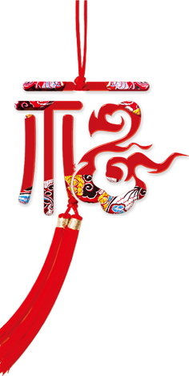
2021
usher out the old year
and
usher in the new year
辞旧迎新
new
year
h
a
p
p
y
Everything goes well
余杭区杭州二中树兰高级中学 郭合英

Slide 3
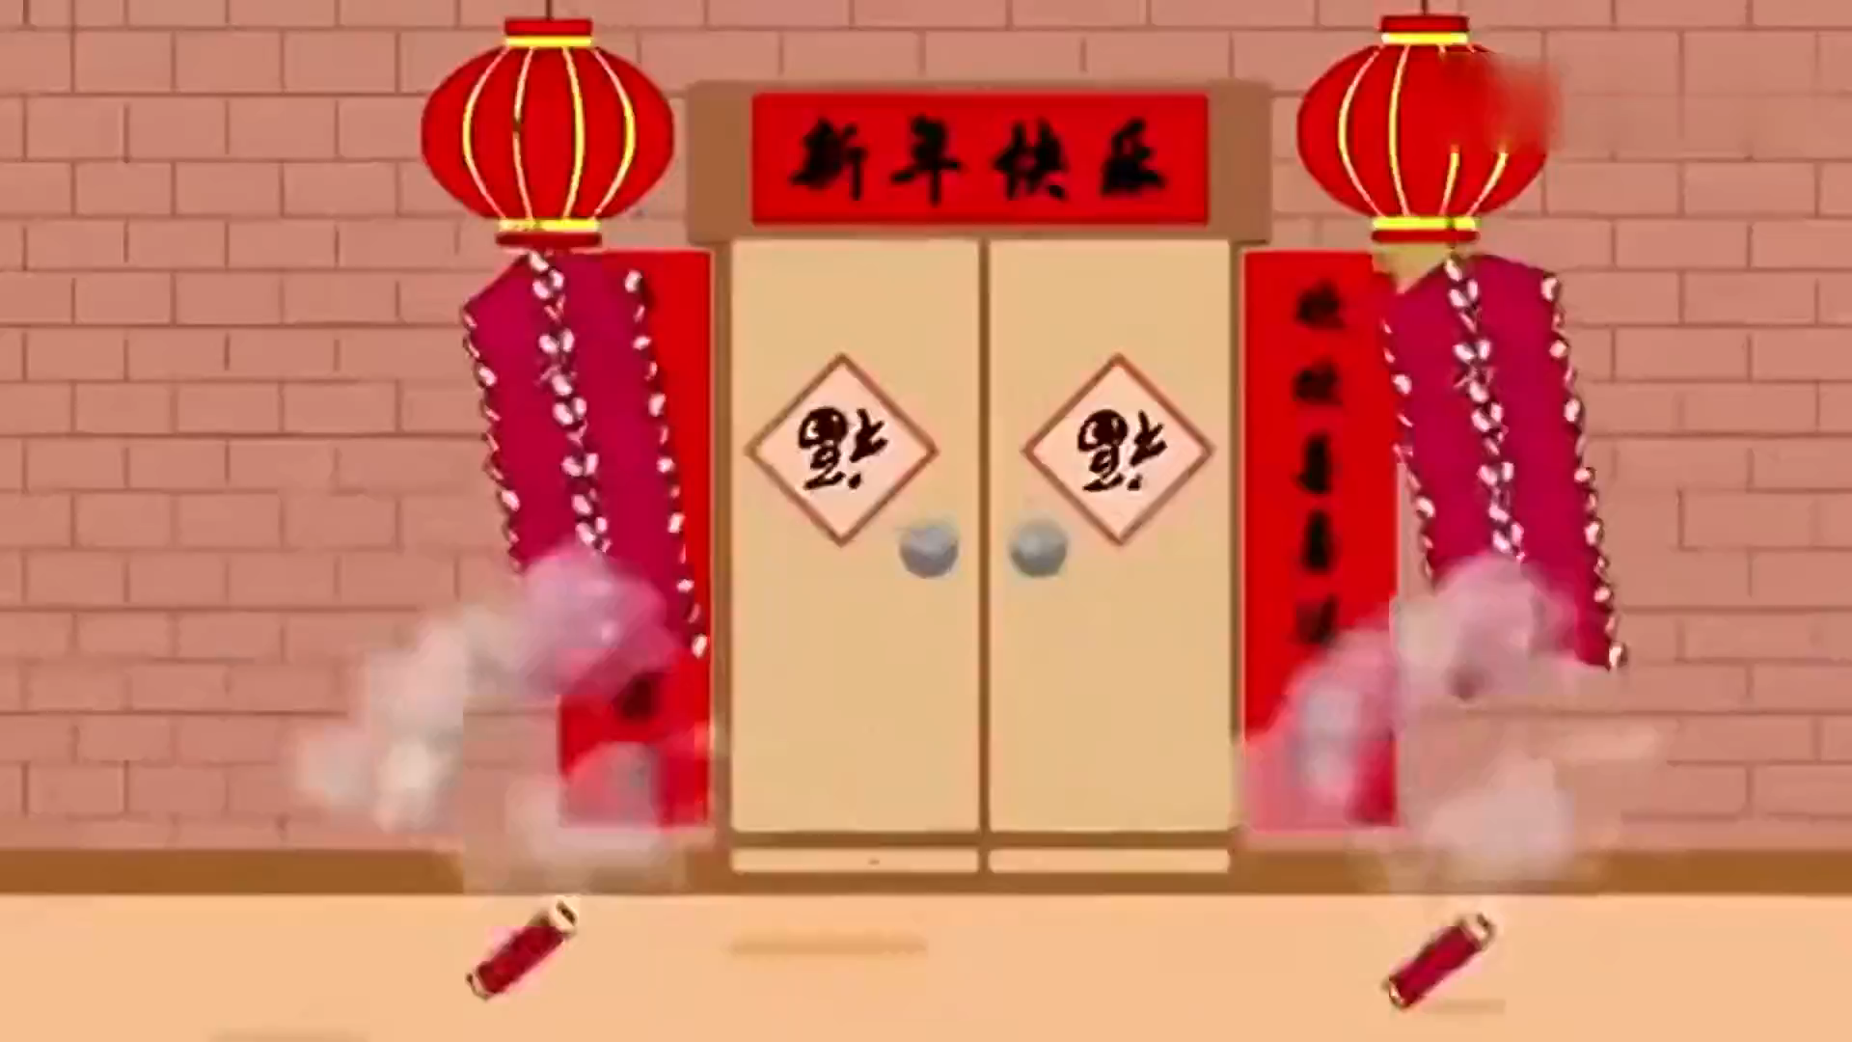

Slide 4
1. The introduction to the origin of New Year's Day
2. The legend of New Year's Day
contents
3. The evolution of New Year's Day in China
4. The differences between Spring Festival and New Year's Day
5. The interesting anecdotes on New Year’s Day all over the world
6. The wish of the New Year

Slide 5
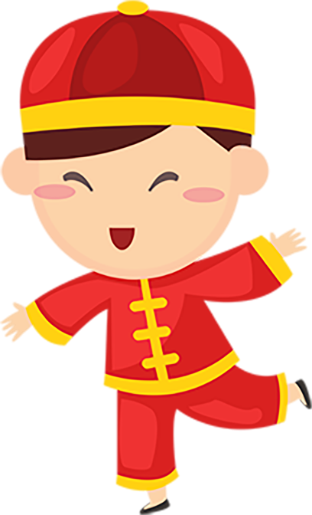
1. The introduction to the origin of New Year's Day

Slide 6
1. The introduction to the origin of New Year's Day
New Year's Day
New Year’s Day is the first day of the year. “Yuan” implicates the first and the beginning, and “Dan” refers to the time when a red sun just rises from the horizon. The ___1___ （mix）of “Yuan” and “Dan” indicates people will meet the new year with full of youthful spirit.
New Year’s Day is observed on January 1, the first day of the year on the modern Gregorian calendar （公历）as well as the Julian calendar （公历） ____2____(use) in ancient Rome. With most countries using the Gregorian calendar ____3____ their main calendar, New Year’s Day is the closest thing to ____4____ (be) the world‘s only truly global public holiday, often ____5____ (celebrate) with fireworks at the stroke of midnight as the new year starts, ____6____ represents a new beginning when people send off the old days and welcome the new ones. January 1 on the Julian calendar currently corresponds ____7____January 14 on the Gregorian calendar, and it is on that date ____8____ followers of some of the Eastern Orthodox churches celebrate the New Year. New Year's Day is a ____9____ (post) holiday in the United States. As the first day of the year, yuandan ____10____ (consider)to be the most important festival since the ancient times.
mixture
used
as
being
celebrated
which
to
that
postal
has been considered
Notes:
更多优质模板尽在当图网 http://www.99ppt.com/

Slide 7
2. The legend of New Year's Day
Notes:
更多优质模板尽在当图网 http://www.99ppt.com/

Slide 8
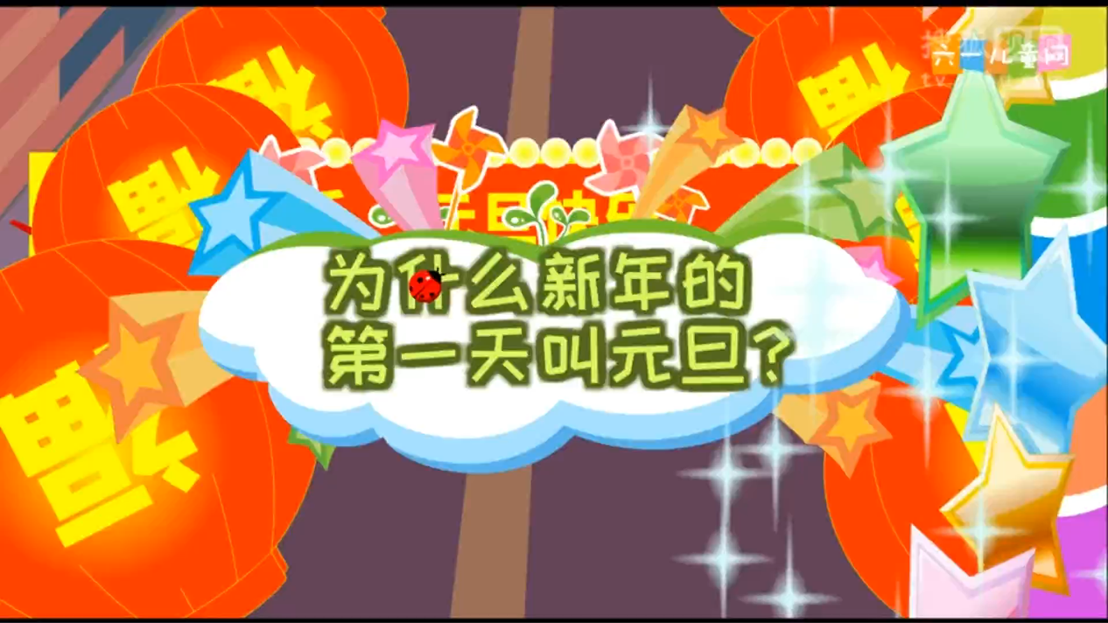

Slide 9
七选五：根据短文内容，从短文后的选项中选出能填入空白处的最佳选项。选项中有两项为多余选项。
In a legend about the prosperous era of Yao and Shun some 4000 years ago, when Yao was in power, he created many benefits for the people and was loved by them. ____1____ Yao did not pass on his throne to his son but to Shun who had both moral integrity and professional competence.
Yao said to Shun: "You must pass the throne to a right person. Then I will feel at peace when I die." Shun passed his throne to Yu, who was a hero because he could control flooding. ____2____
After Yao died, ____3____ and the first day of the 1st lunar month became known as Yuan Dan or Yuan Zheng.
____4____ Previous dynasties would organize celebrations and sacrifices on Yuan Dan, for example sacrificing to the immortals and their forefathers, writing Spring Festival scrolls, writing character fortunes and dragon dancing.
____5____ They observed it by making sacrifices to immortals and ancestors, pasting spring festival scrolls onto their houses, setting off firecrackers, staying up all night, eating dinners at reunions as well as putting on a "society fire".
These scenes are of such impact that the poet Xin Lan in the Jin Dynasty immortalized the scenes of Yuan Dan in his poem Yuan Zheng.
C
A
D
E
G

Slide 10

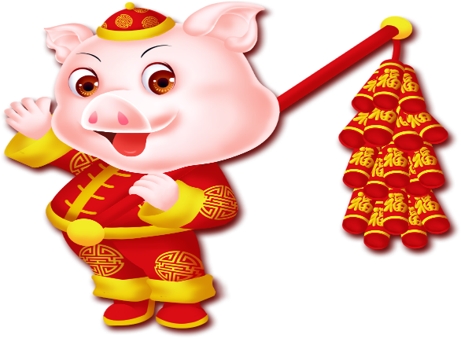
七选五：根据短文内容，从短文后的选项中选出能填入空白处的最佳选项。选项中有两项为多余选项。
A. Just like Shun, Yu also did a lot of good deeds for
the people and was revered by them.
B. This was why Yao handed over his throne to Shun.
C. However, since his son was not as capable as him.
D. Shun set the day he made sacrifices to the heavens
and gods as well as to the late Yao as the first day
of the year
E. This was Yuan Dan in ancient times.
F. People danced and sang on that day to celebrate it.
G. People also celebrated the day in other ways.

Slide 11
3. The evolution of New Year's Day in China
Notes:
更多优质模板尽在当图网 http://www.99ppt.com/

Slide 12
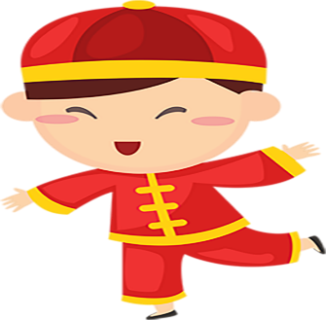

阅读理解: 阅读下面短文，从每题所给的 A、B、C 和 D 四个选项中，选出最佳选项。
Vocabulary:
1. elapse [iˈlæps] vi./ n.(时间)过去,消逝
2. Gregorian [greˈgɔːriən] a.罗马教皇格列高里的; 公历的
3. regulate [ˈregjuleit] vt.管理;调整;使有规则
4. pictographic [ˌpiktəuˈgræfik] a.古代石壁画的;(用)象形文字的;有象形文字特征的;
5. take office 就职
6. fall on + 日期(节日等) (节日等)适逢(某日)，正当(某日)。
E.g. His birthday falls on Sunday.他的生日恰逢星期日。
7. refer to ... as 把 ... 称为 ...； 把 ... 叫做 ...
E.g. ① People refer to him as the high priest. 人们称他为廉价杂志小说的专家。
E.g. ② I always refer to him as bookworm. 我总是把他当作书呆子。
8. name ... as 提名 ... 为 ...； 任命 ...
E.g. The president named him as Secretary of State. 总统任命他为国务卿。

Slide 13
阅读理解: 阅读下面短文，从每题所给的 A、B、C 和 D 四个选项中，选出最佳选项。
“Yuan ” means to start ."Dan" means not only the dawn of time, but also refers to the passed day. New Year's Day is the beginning of the year on the first day. “ New Year’s Day” first appeared in the “Book of Jin” and has elapsed 4000 years of history.
In ancient China, Yuan Dan was not the same on January 1st, as regulated in the Gregorian calendar. The date of Yuan Dan had been changed many times from the 1st of the 12th lunar month in Yin Dynasty to the 1st of the 1st lunar month in Han Dynasty. Yuan Dan fell on the first day of the first lunar month in Xia Dynasty, on the 1st of December in Shang Dynasty, on the first day of November in Zhou Dynasty, and after Qin Shi Huang unified the six kingdoms, he named the first day of October as the New Year's Day, since then it was successive ( "Historical Records"). In the first year of Emperor Wu , Sima Qian founded a "Taichu calendar “ and he referred to the first day of the first month as New Year's Day, which was used until the Revolution of 1911.
When Sun Yat-sen took office as the temporary President in Nanjing at the beginning of January of 1912, he set the 1st of the 1st lunar month as the Spring Festival while the 1st of January was set as the New Year, which was also called Yuan Dan.

Slide 14

After liberation, the Central Government of China issued a National Festival and Memorial Day Holiday that set January 1st as Yuan Dan, which was a one-day holiday for the whole country.
In order to distinguish the two New Years of both the lunar calendar and solar calendar, and as the "spring beginning" of the Lunar Calendar was always around the lunar New Year, the 1st of the 1st lunar month was called the Spring Festival.
Yuan means the beginning, the first. The beginning of a number is Yuan. Dan, which is a pictographic character in the Chinese language, means the time when the sun rises from the horizon, symbolizing the beginning of a day. When Yuan and Dan are combined, it means the first day of a New Year.
Yuan Dan is also called Three Yuan, the beginning of a year, the beginning of a month and the beginning of an hour. The word Yuan Dan was first used during the Three Emperors and Five Sovereigns era.

Slide 15

What are the meanings of “Dan” ?
A. It only means the dawn of time.
B. It means not only the dawn of time but also the passed day.
C. It means the beginning of the day.
D. It means a new year.
2. What can be inferred from Paragraph 2?
A. In ancient time , Yuan Dan was always the same day.
B. The date of Yuan Dan in Xia Dynasty and Shang Dynasty was the same day.
C. The New Year’s Day and the Spring Festival are the same day.
D. The date of Yuan Dan in Xia Dynasty was the same day in Emperor Wu.
3. What does the underlined word “successive” in Paragraph 2 mean?
A. successful B. continuous C. instructive D. worldwide
4. The passage is mainly organized in order of .
A. name B. space C. importance D. time
5. What’s the passage mainly discussing?
A. The legend of Yuan Dan. B. The origin of Yuan Dan.
C. The evolution of Yuan Dan.
D. The differences between Yuan Dan and Spring Festival.

Slide 16
4. The differences between Spring Festival
and New Year's Day
Notes:
更多优质模板尽在当图网 http://www.99ppt.com/

Slide 17

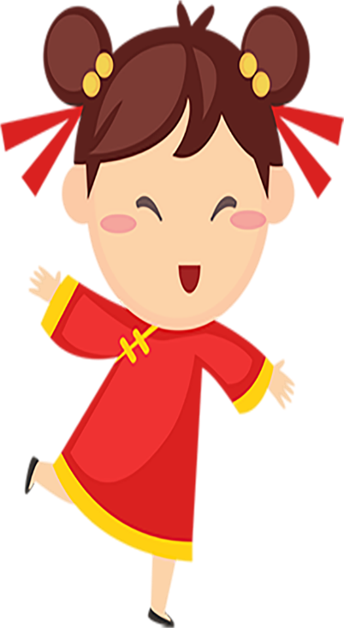
The differences between Spring Festival and New Year's Day
Discussion
“元旦” is called “New Year’s Day”
“春节” is called “Spring Festival ”
1. the difference in the name (名称不同)
New Year’s Day falls on January 1st by Gregorian calendar.
Spring Festival is observed from December 23th to January 15th by lunar calendar..
2. the difference in the date of celebration
（庆祝时间不同）
the differences
3. the difference in the degree of recognition
（重视程度不同）
In China, people pay more attention to Spring Festival because lunar calendar is the traditional calendar of China.
New Year’s Day is simply observed, and mainly there is a New Year’s party on CCTV.
There are a variety of activities to celebrate Spring Festival, including eating dumplings, getting together, pasting couplets, and giving lucky money to young generation and so on.
Three-day leave for New Year’s Day
Seven-day leave for Spring Festival
4. the difference in the vacation period
( 放假时间不同)
5. the difference in the style of the celebration
(庆祝方式不同)

Slide 18
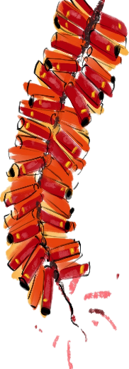
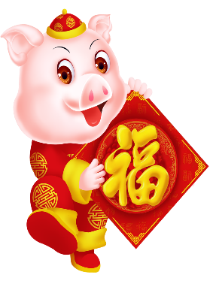
The differences between Spring Festival and New Year's Day
语篇填空：阅读下面材料，在空白处填入适当的内容（1个单词）或括号内单词的正确形式。
namely
Yuandan is the first day of the Gregorian calendar， ____1____ (name) January 1st every year. People will get ____2____ three-day leave, ____3____(send) messages all around. And they can have a short trip to somewhere or go shopping.
Spring Festival is the ____3____ (tradition) holiday of China, and it’s one of the most grand ____4____ (festival）in the whole year. People will get a seven-day leave, and it’s ____5____（long) than the Yuandan holiday. It ____6____ (fall) on the first day of the lunar year. During Spring Festival, people in China will get together, mop the windows ____7____ (make)them bright, sweep the ceiling, the walls, the floor, and decorate their home ____8____ Chinese knot and Fus on the first day of the lunar year. For the tradition, people will make a lot of dumplings, ____10____(preparation) some red envelopes, cook some traditional foods as well, for example, frying tofus, to have a big feast together and calculate good luck for the New Year.
a
sending
traditional
festivals
longer
falls
to make
with
prepare

Slide 19
5. The interesting anecdotes on New Year’s
Day all over the world
Notes:
更多优质模板尽在当图网 http://www.99ppt.com/

Slide 20
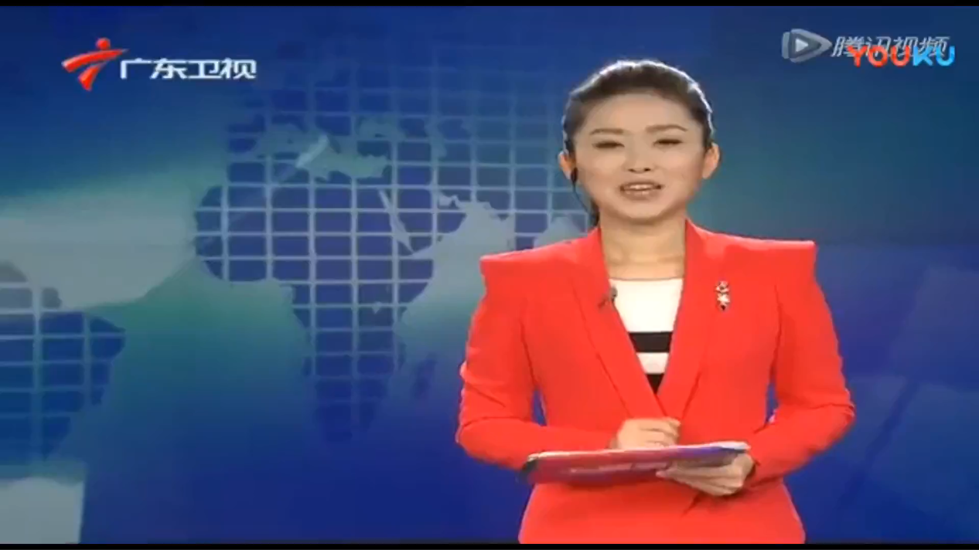
Notes:
更多优质模板尽在当图网 http://www.99ppt.com/

Slide 21
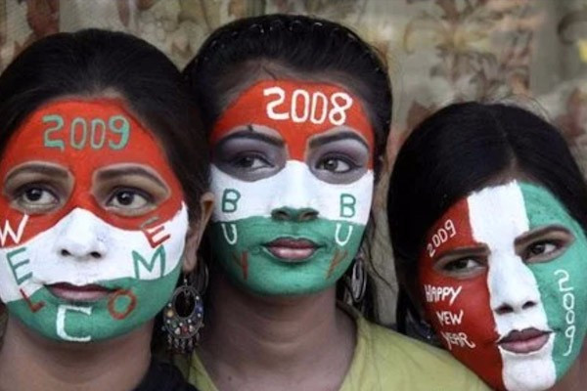
补全下面的句子。
New Year cry in India
印度元旦的哭声
印度有的地区，元旦早上，家家户户哭声不断，人人脸上涕泪横流。据说是感慨岁月的易逝和人生的短暂。
In India, some regions, people
did not celebrate the New Year, but cry New Year‘s Day morning. It is said
（lament） the fleeting years and transitory life.
not
only
on
to lament

Slide 22
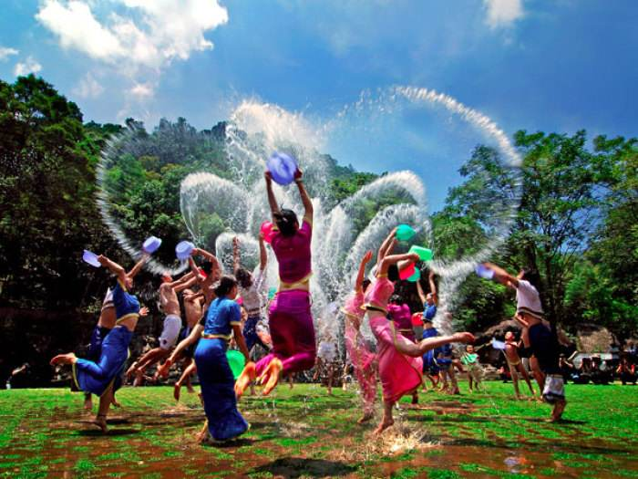
Water-Sprinkling Festival in Thailand
泰国泼水元旦
在新年第一天，泰国人都在窗台、门口端放一盆清水，家家户户都要到郊外江河中去进行新年沐浴。
On the first day of New Year’s Day, Thais place water in the windowsill and the entrance the door. Every household will go to the outskirts with the river the new year bath.
a
basin
of
to
for

Slide 23
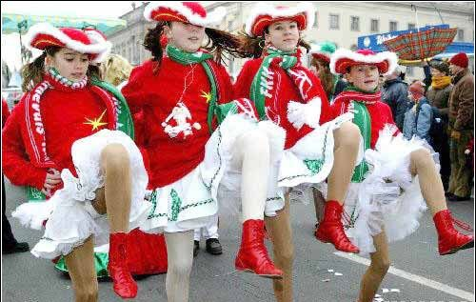
New Year's Day in Romania
罗马尼亚的元旦
元旦前夜，人们在广场上竖起高大的圣诞树，搭起舞台。市民们一边烧着焰火，一边载歌载舞。农村人拉着木犁，上面装饰着各种彩花，庆祝新年。
set
up
New Year‘s Eve, People a big Christmas tree and set up a stage in the square. The citizens are singing and dancing while they fireworks. Villagers pull wooden plows decorated colorful flowers the New Year.
set
off
with
to
celebrate

Slide 24
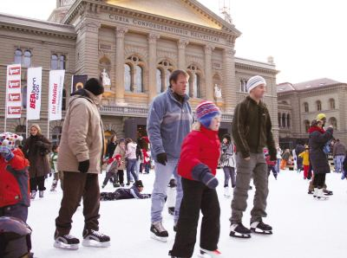
Swiss fitness on New Year's Day
瑞士健身元旦
瑞士人有元旦健身的习惯，他们有的成群结队去爬山，站在山顶面对冰天雪地，大声歌唱美好的生活；有的在山林中沿着长长的雪道滑雪，仿佛在寻找幸福之路；有的举行踩高跷比赛，男女老幼齐上阵，互祝身体健康。他们用健身来迎接新一年的到来。
working
out
Swiss people have the habit of on New Year's Day. Some of them go mountain-climbing in groups, standing on the top of the mountain, the ice and snow and singing loudly about the beautiful life; Some go skiing along the long trail in the mountains in search of happiness; Some hold stilt-walking competitions, and men, women, old and young battle together, each other good health. They welcome the coming of the New Year’s Day fitness.
facing
as
if
wishing
by
Notes:
更多优质模板尽在当图网 http://www.99ppt.com/

Slide 25
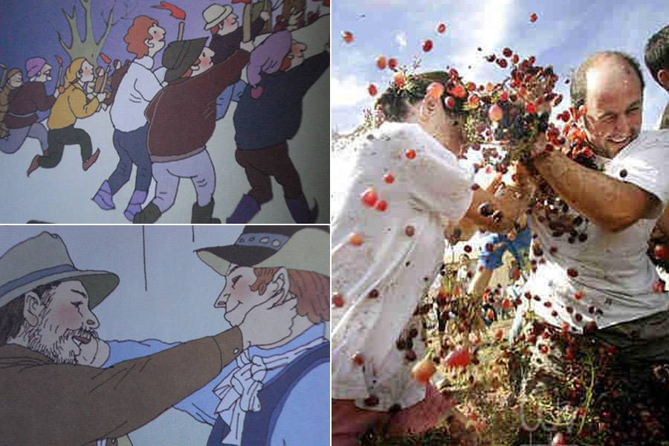
Ear-tugging on New Year's Day in Brazil
巴西揪耳朵元旦
巴西人在元旦这天，高举火把，蜂拥登山。巴西农村有一个独特的风俗习惯——便是互相揪耳，人们在元旦见面时，一定要相互使劲揪住对方的耳朵，表示祝福。
Brazilians on New Year's Day hold high torches, mountain crowding. There is a unique custom they pull each other's ear in Brazilian countryside. When they meet on the day, they are to grab each other
the ears a symbol of good luck.
climbing
that
sure
by
as
Notes:
更多优质模板尽在当图网 http://www.99ppt.com/

Slide 26
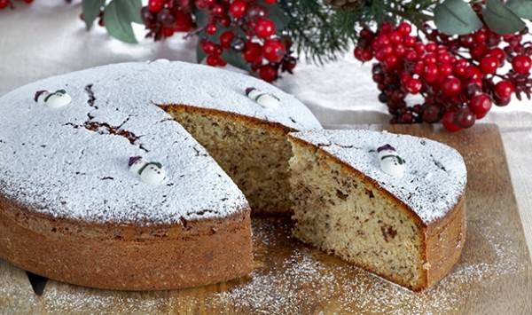
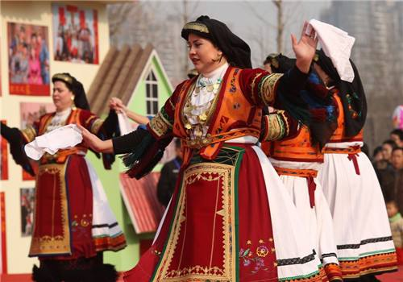
Greek cakes on the New Year's Day
希腊蛋糕元旦
On New Year's Day, everyone should make a big cake and a silver coin it.
The host will the cake pieces and give them to family members or visiting friends. eats the piece of cake
the silver coin in it is the one in the New Year, and everyone him
it.
元旦时，家家都要做一个大蛋糕，里面放一枚银币。主人将蛋糕切若干块，分给家人或来访的亲朋好友。谁吃到带有银币的那块蛋糕，谁就成了新年最幸运的人，大家都向他祝贺。
put
into
divide
into
Whoever
with
luckiest
congratulates
on

Slide 27
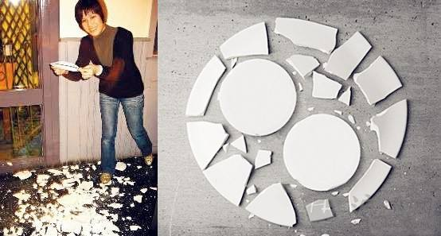
A broken Danish cup and saucer for a friend
丹麦杯盘碎片送朋友
丹麦人在元旦前夜，家家户户都要将平时打碎的杯盘碎片收集起来，待夜深人静时偷偷地送至朋友家的门前。元旦的早晨，如果谁家门前堆放的碎片越多，则说明他家的朋友越多，新年一定很幸运。
In Denmark, on New Year's Eve, every household will normally the cups and plates pieces and collect them, secretly sending them to a friend's door.
the morning of New Year’s Day, The ____ debris in front of their house someone has, the more friends they have, which also forebodes that they'll be lucky in the New Year.
break
into
On
more

Slide 28
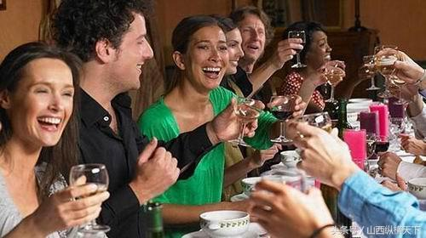
France: Finished off the fifth liquor luck
法国：喝光余酒交好运
法国人在新年到来之前，各家一定要把家中的余酒全部喝光，以致许多人喝得大醉。他们认为，元旦时如果家中还有剩余的酒，新一年里交厄运。
arrival
In France, before the of the new year, each family must all the remaining wine in the house, many getting drunk. In their , if there is any wine left in the house, the new year will
.
drink
up
opinion
pay
doom

Slide 29
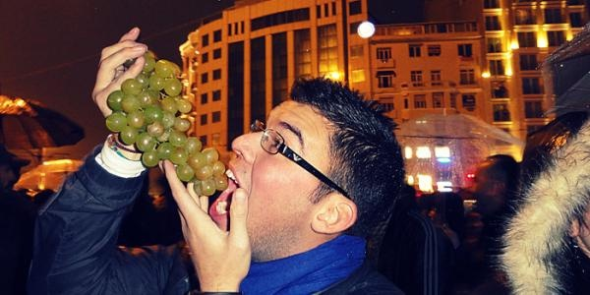
Spain: Eating Grapes in middle of the night
西班牙：半夜吃葡萄
西班牙人在元旦前夜全家团聚。到12点时，以教堂钟声为号，争着吃葡萄。每敲一下钟，必须吃下一颗葡萄，而且要连着吃下12颗，表示来年一帆风顺。
reunited
The Spaniards are with their families on New Year‘s Eve. They refer to the church bells as a signal, vying(竞争) with each other in eating grapes. Every knock about bell, you must eat a
grape, but also to a eating 12, which
the coming year will sail smoothly.
continuous
indicates
Notes:
更多优质模板尽在当图网 http://www.99ppt.com/

Slide 30
6. The wish of the New Year
Notes:
更多优质模板尽在当图网 http://www.99ppt.com/

Slide 31
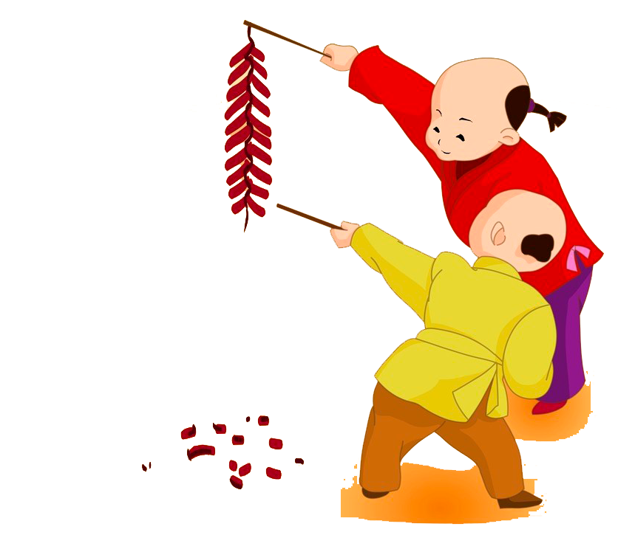
Enjoy the poems
New Year's Day
Wang Anshi
Amid the boom of firecrackers a year has come to an end,
And the spring wind has wafted warm breath to the wine.
While the rising sun shines over each and every household,
People would put up new peachwood charm for the old.
《元日》
（宋）王安石
爆竹声中一岁除， 春风送暖入屠苏。 千门万户曈曈日， 总把新桃换旧符。

Slide 32

Enjoy the poems
If It didn’t Bring you Joy,
Just Leave it Behind.
Let’s Ring in the New Year
With Good Things in Mind.
Let Every Bad Memory
That Brought Heartache and Pain.
And let’s Turn a New Leaf
With the Smell of New Rain.
Let’s Forget Past Mistakes
Making Amends for This Year.
Sending You These Greetings
To Bring You Hope and Cheer.
如果它没给你带来欢乐
就把它抛在脑后
让我们在新的一年里
牢记好事情
让我们心痛的
不好的回忆
让我们翻开新的一叶
带着春雨的芬芳
让我们忘记过去的错误
都在新一年得到弥补
发送一份新年祝福
愿它带给你希望和快乐。

Slide 33

Best wishes for the new year
Wishing you the best of luck in the new year.
Please extend my wishes of good luck to your family.
This year will be lucky for you.
I hope that next year will be luckier than the last one.
Wishing you luck this year and forever.
I hope that you comesintosa good fortune this year.
I hope you find your pot of gold.
Wishing peace and good luck throughout the years.
This year will be the best one yet.
恭贺新春
新年行大运。
请将我的祝福传达给你的家人。
今年将是你的幸运年。
我希望新年能比去年更为吉祥如意。
祝你年年好运。
祝你今年发大财。
祝你招财进宝。
年年如意，岁岁平安。
今年将是最幸福的一年。
Enjoy the poems

Slide 34
Enjoy the poems
Hope you will join with me in bringing in the new spring.
The coming of spring means the coming of new hopes.
May you have many dreams fulfilled.
We wish you a renewed hope in life.
Please join us to light off firecrackers.
We hope your family and my family can get together for a celebration like last year.
Wishing you and your family peace and prosperity for the coming year.
May the people of the nation live happily and wealthily this upcoming year.
May your reunion be happy throughout the year.
愿和你一起迎春接福。
春天的来临，象征新希望的到来。
祝你许多美梦都能成真。
我们祝福你再度燃起生命的希望。
让我们一起来燃放爆竹除旧岁。
我们希望你们全家与我们家能像去年一样，聚在一起共同庆祝新年。
祝福你与家人吉祥平安。
愿新的一年里国富民安。
愿你们的团圆夜充满喜悦欢乐。

Slide 35
【元旦的英文新年贺词】
Best wishes for the holidays and happiness throughout the New Year.
恭贺新禧，万事如意。
With very best wishes for your happiness in the New Year.
致以最良好的祝福，原你新年快乐幸福。
Please accept our wishes for you and yours for a happy New Year.
请接受我们对你及你全家的美好祝福，祝你们新年快乐。
May the coming New Year bring you joy, love and peace.
愿新年为你带来快乐，友爱和宁静。
Wishing you happiness during the holidays and throughout the New Year.
祝节日快乐，新年幸福。
A happy New Year to you. 恭贺新年。
Season’s greetings and sincere wishes for a bright and happy New Year!
献上节日的问候与祝福,愿你拥有一个充满生机和欢乐的新年。

Slide 36
【元旦的英文新年贺词】
I would like to wish you a joyous new year and express my hope for your happiness and good future.
祝新年快乐，并愿你幸福吉祥，前程似锦。
May the New Year bring many good things and rich blessings to you and all those you love!
愿新年带给你和你所爱的人许多美好的事物和无尽的祝福!
Rich blessings for health and longevity is my special wish for you in the coming year.
祝你在新的一年里身体健康，多福多寿。
Good luck, good health, hood cheer. I wish you a happy New Year.
祝好运、健康、佳肴伴你度过一个快乐新年。
With best wishes for a happy New Year!
祝新年快乐，并致以良好的祝福。
I hope you have a most happy and prosperous New Year.
谨祝新年快乐幸福，大吉大利。

Slide 37
【元旦的英文新年贺词】
1.生意兴隆: wish your business success
2.大吉大利: wish you good fortune and every success
3.恭喜发财: may prosperity be with you
4.年年有余: may you always get more than you wish for
5.新年新气象: as the New Year begins, let us also start a new
6.万事如意: hope everything goes your way
7.岁岁平安: may you start safe and sound all year round
8.财源广进: may a river of gold flow into your pocket
9.一帆风顺: wish you every success
10.鹏程万里: have a bright future
11.风调雨顺: timely wind and rain bring good harvest
12.国泰民安: wish our country flourishes and people live in peace
13. With best wishes for a happy New Year! 祝新年快乐，并致以良好的祝福。
14. I hope you have a most happy and prosperous New Year.
谨祝新年快乐幸福，大吉大利。
15. With the compliments of the season.祝贺佳节。

Slide 38
Homework
应用文写作
假如你是某校高二（8）班的学生李华，得知你的外国朋友Tom对中国的元旦习俗感兴趣，你想邀请他参加你们班的元旦晚会活动，请你给他写一封邮件, 告诉他具体的活动安排，内容包括：
晚会的时间、地点；
活动安排；
元旦祝福。
注意：1．词数80左右；
2．可适当增加细节，以使行文连贯。

Slide 39
Homework
One possible answer
Dear Tom,
Informed that you are engrossed in the customs of our Chinese New Year's Day, I would like to invite you to participate in the party in our class.
As is scheduled, the party falls on from 7 pm. to 9 pm. next Friday in Room 208. Several activities will be held, ranging from the knowledge competition about New Year’s Day to enjoying the breathtaking party performed by us, which will undoubtedly help you gain a glimpse into the unique Chinese traditions and customs. I hold the belief that the activities can never fail to make a deep impression on you. And your participation will undoubtedly add to our enjoyment. I hope you have a most happy and prosperous New Year.
Your favorable reply at your earliest convenience will be highly appreciated. Looking forward to your involvement.
Yours faithfully, Li Hua

Slide 40
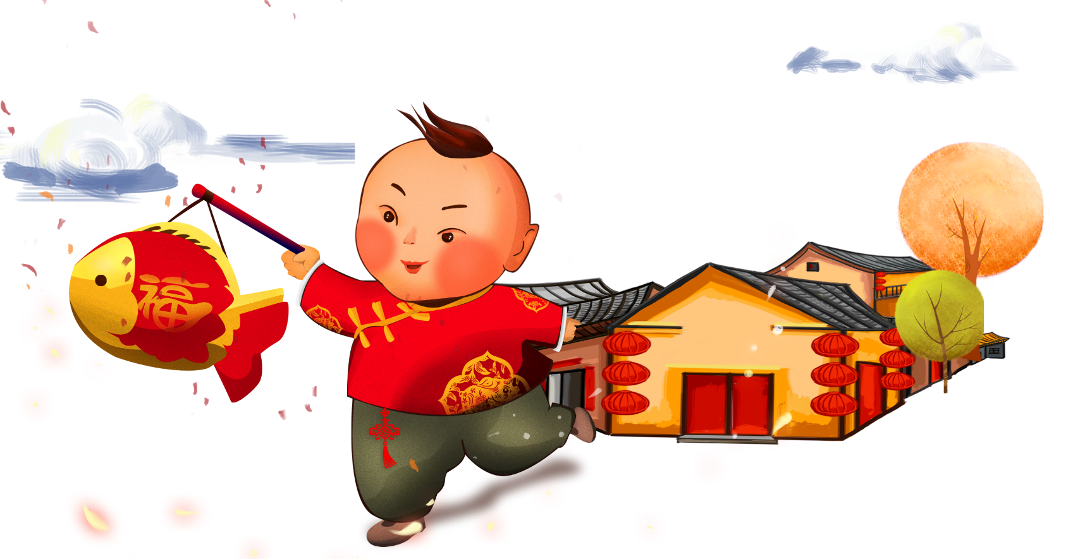
Thank you

