Slide 1


感恩遇见，相互成就，本课件资料仅供您个人参考、教学使用，严禁自行在网络传播，违者依知识产权法追究法律责任。
更多教学资源请关注
公众号：溯恩高中英语
知识产权声明

Slide 2
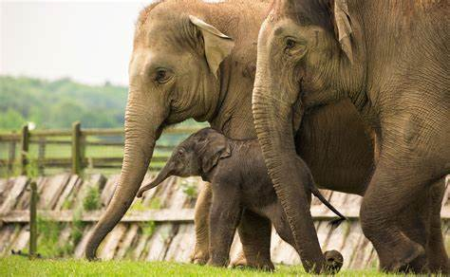
M2U2 Wildlife Protection
Listening & Speaking

Slide 3
Learning Objectives
At the end of the class, you will be able to
1. know some basic information about endangered species.
2. improve your ability of description of pictures.
3. train your listening skills by using visuals to predict content.
4. master the new words and phrases in this period

Slide 4
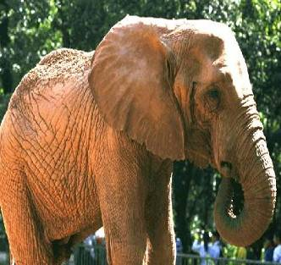
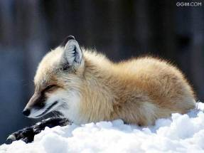

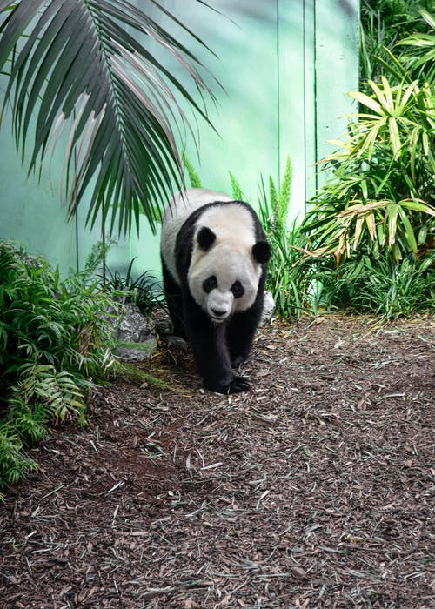
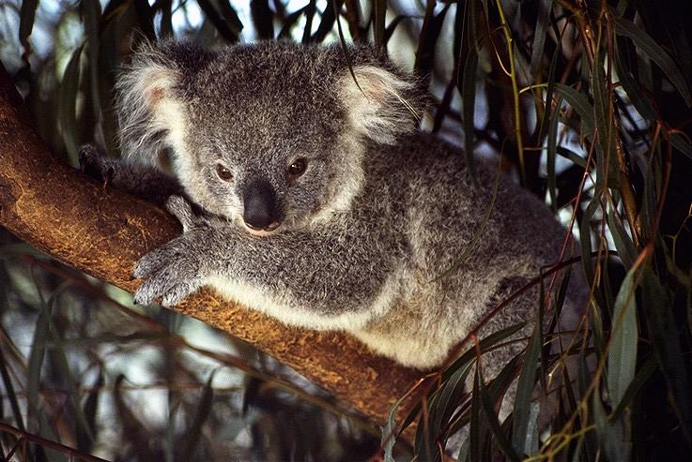
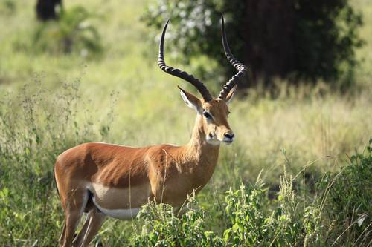
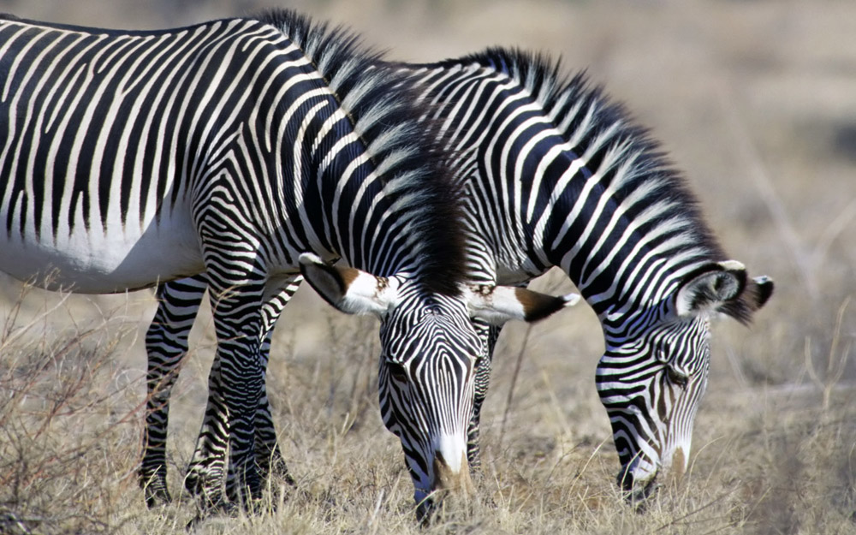
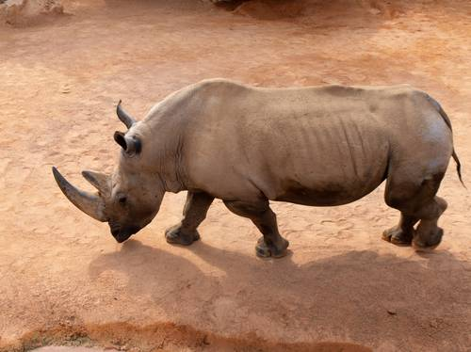
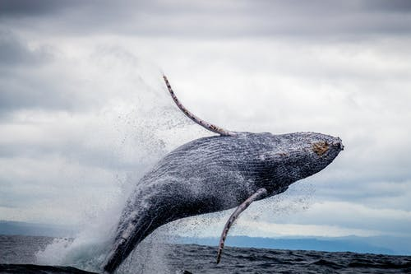


Lead-in
————Video Time
being hunted illegally by hunters
illegal trade
1. What problem is the species of wildlife facing?
2. What do the local authority and Wang Junkai do to protect these species?
antelope
They are in danger of disappearing.
dying out.
koala
zebra
—— endangered species
whale
rhino
danger_{n}
—endanger_{v}
—endangered_{adj}
giant panda
Authority：set up preserves/reserves
ivory
Wang：join the campign, call on people to protect endangered species
wraps

Slide 5
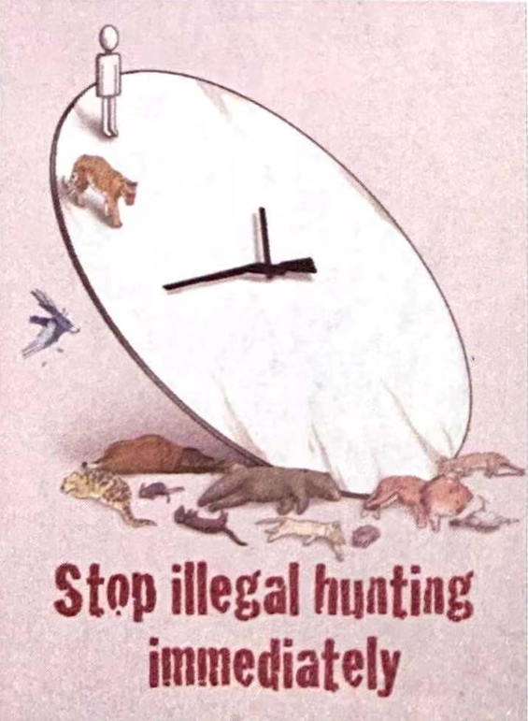
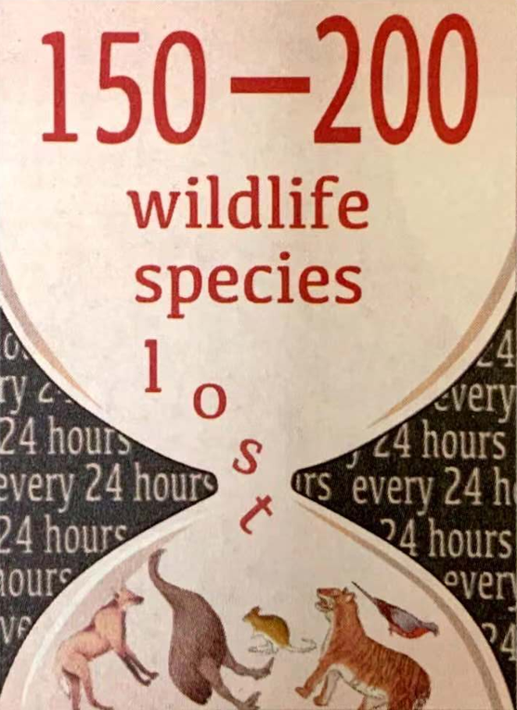
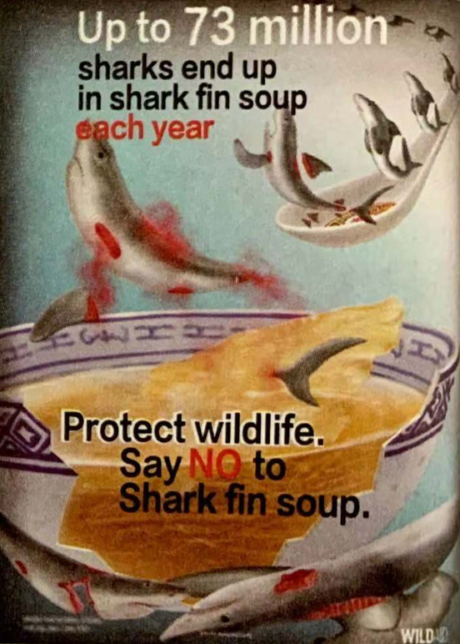
Lead-in
———— Let's know more present situation of endangered species
posters
a clock—counting the time
a tiger at “11 o’clock” position
a man at “12 o’clock” position
many dead bodies under the clock
words: stop illegal hunting immediately
a big bowl of shark fin soup
a big dying shark with its fin falling down, bleeding
dead sharks without fins
more sharks on a spoon
an hourglass
top: 150-200 wildlife species lost
down: “lost” falling down with some wildlife at the bottom (extinct wildlife)
background: every 24 hours
Sharks are dying out at an alarming rate.
message:
Up to 73 million sharks end up in shark fin soup each year.
Call on people to protect wildlife by stop having shark fin soup.
message:
Illegal hunting has resulted in the extinction of some animals. If we don’t stop it, human beings will be the next one to die out.
message:
There are 150-200 wildlife species lost every 24 hours. Call on people to pay attention to such a serious situation.
Sharks are dying out at an alarming rate.
What message does do these posters want to deliver?
Tip: pay attention to the pictures and words in the posters

Slide 6
Lead-in
———— Free talk: Which one moves you most? Why?
Based on these posters, what will we hear in the listening material?
Tip:Use visuals to predict content
In my perspective, picture 1 moves me most. When seeing this picture, I am alarmed to find that we, human beings, are also in danger of dying out.
In my perspective/As for me, picture ___ moves me most. When seeing this picture, ...

Slide 7
Listening
———— Revision of the new words
a. to chase animals and birds in order to kill or catch them
b. in danger
c. dead (for a species, not a single animal)
d. not allowed by the law
e. very soon before or after something
f. a type of animal or plant
g. the region where a plant or animal naturally grows or lives
h. a feeling of fear or worry because something bad or dangerous might happen
i. you know about something
illegal
hunt
immediately
species
endangered
extinct
alarm
aware of
habitat

Slide 8

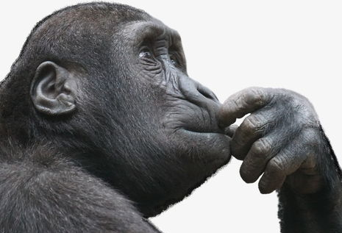
Listening
———— Listen and fill in blanks
Our plant's __________ is dying out at an alarming rate. Between 150-200 species are becoming extinct every day. This mass extinction is caused by hunting, habitat ____________, and pollution. We must make people aware of the problem and help __________ the endangered wildlife before it's too late.
wildlife
It's time for us to take measures to protect them
What
on Earth
Are We Doing
to Our Planet?
loss
protect

Slide 9
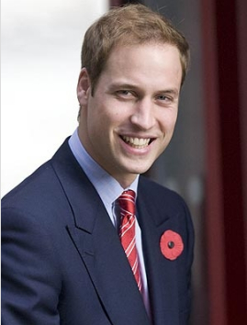

Listening
———— Listen and choose
1. How many elephants are killed every day?
A. 70 B. 20000 C. 54
2. What did Prince William say about China?
A. China has made a lot of progress.
B. China can become a global leader in wildlife protection.
C. China preserves its natural habitats well.
3. What is said at the very end? What does it mean to you?
In October 2015, I delivered a moving speech about endangered species on CCTV.
What does “Change begins with you” mean?
It means that if we want things to change, we must change ourselves first and not wait for others to change first. We must be the change we want to see in the world.
Prince William

Slide 10
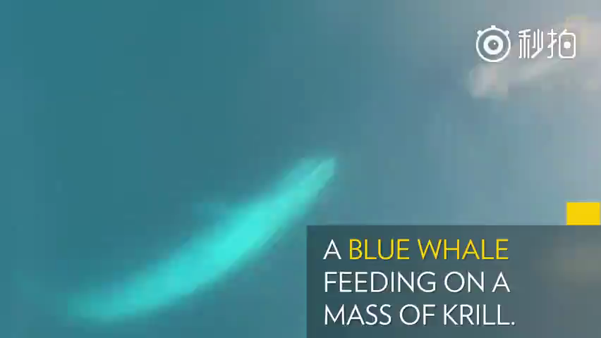
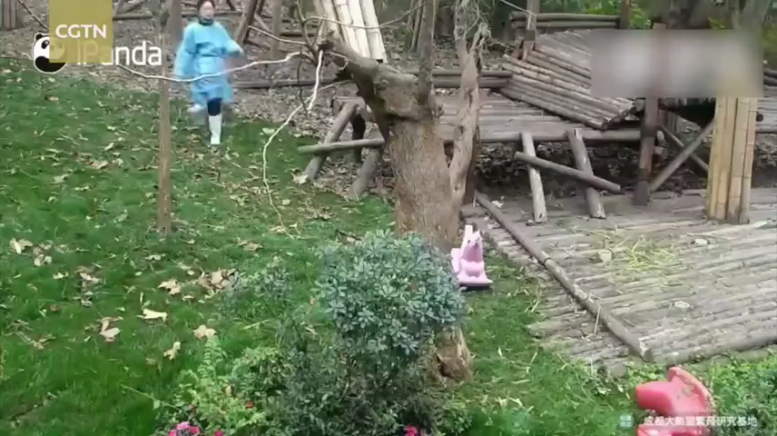
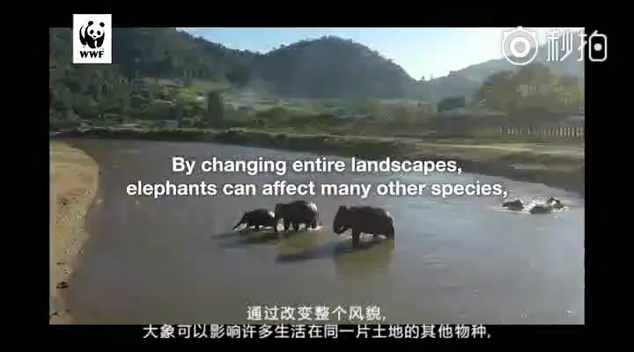
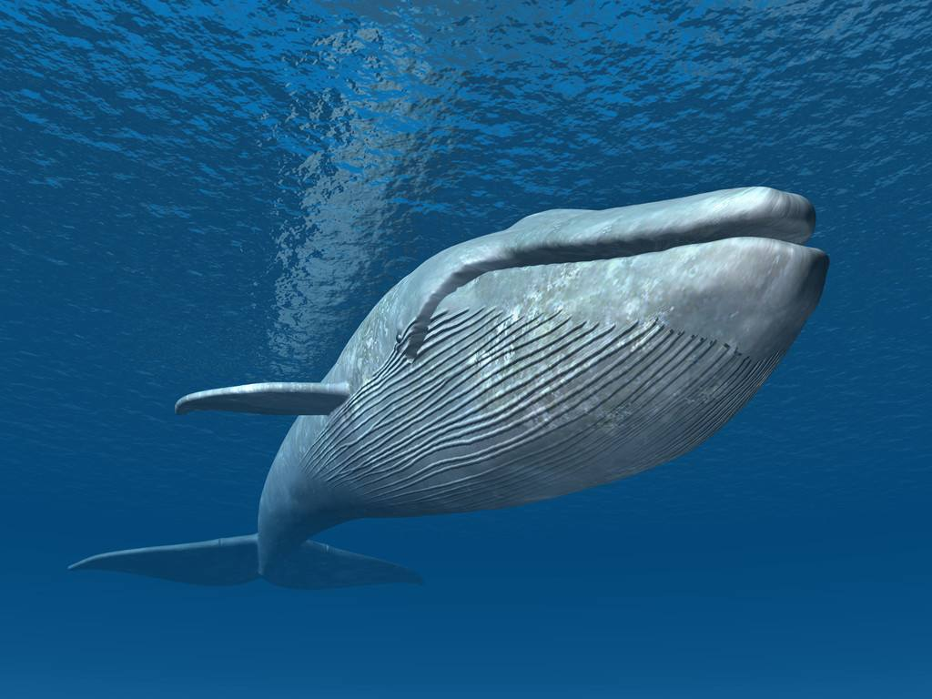
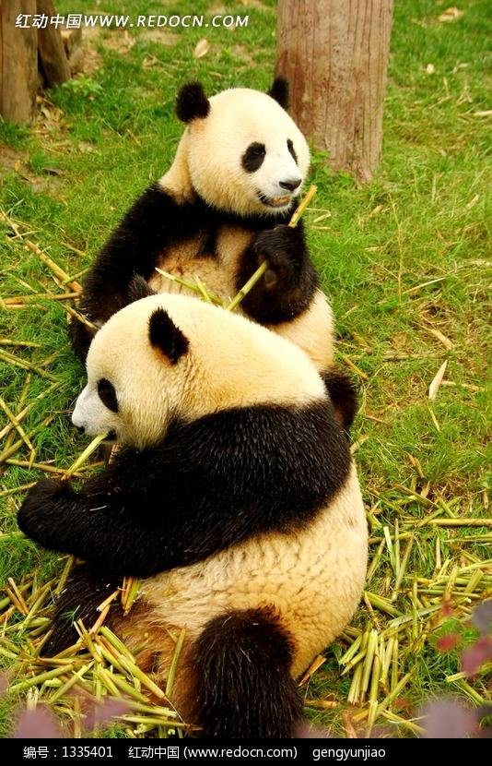
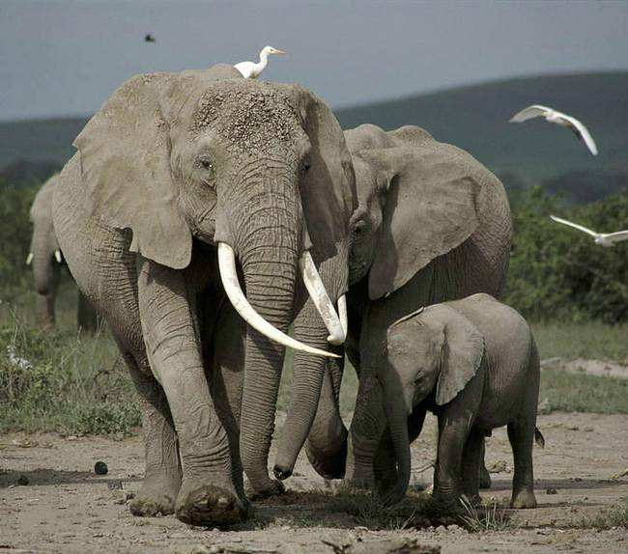
Post-listening
What do you know about the animals in the photos ? Make a short speech about any one of them.
You can organize the information in this way:
I’m concerned about… (an animal)
They are… (problems:illegal trade, habitat loss)
Some measures are being taken to help them... (measures)

