Slide 1

高考英语阅读理解 专项突破1
· 主旨大意
· 推理判断
· 词义猜测
· 细节理解
· 语篇连贯

Slide 2
第八课
任务型阅读

Slide 3

一、任务型阅读
考查考生理解语篇上下文逻辑关系的能力。要求考生根据所提供短文的内容（320词左右），从短文后提供的7个选项中为每个小题选出一个最佳选项。
1. 题型描述
理解文章的基本结构。英语文章讲究使用主题段和主题句。主题段通常在开头，简要概括文章中心思想；主题句可能在一段开头，也可能在中间或末尾，作用是交代该段的中心思想...各个段落通常由某些起连接作用的词连接，以使文章行文连贯。把握文章的文脉，就是要理解句与句，段与段之间的逻辑关系。
2. 考查能力

Slide 4
二、考点分布
时间 | 2016.10 | 2017.6 | 2017.11 | 2018.6 | 2018.11 | 2019.6 | 2020.1
体裁 | 说明文 | 说明文 | 说明文 | 说明文 | 说明文 | 说明文 | 说明文
主题 | 青少年如何丰富生活 | 如何做接头随机采访 | 如何记住所读的内容 | 如何和新邻居相处 | 社交方式要因人而异 | 披头士乐队的发展及影响 | 世界水日及节约用水
总字数 | 315 | 342 | 354 | 317 | 347 | 318 | 374
主旨句 | 31, 34 | 34 | 32 | 31, 34, 35 | 32 | / | 31, 34
过渡或细节注释 | 32, 33, 35 | 31, 32, 33, 35 | 31, 33, 34, 35 | 32, 33 | 31, 33, 34, 35 | 31, 32, 33, 34, 35 | 32, 33, 35
1. 变：说明文类型逐渐由单一的How-to模式向多元模式发展；
2. 不变：考点仍旧设置在主旨句和过渡或细节注释上；

Slide 5
三、解题方法
1. 利用语篇结构（体裁、篇章结构）解题；
2. 利用段落内句子之间的逻辑关系解题；
3. 利用词汇复现解题；
4. 利用指代关系解题；
5. 利用句子结构和标点符号解题；

Slide 6
1. 利用语篇结构解题
能识别语篇的类型和结构，辨识和分析语篇的文体特征。
说明文是一种以说明为主要表达方式的语篇类型。它通过对客观事物和事理进行总体说明并加以阐释。任务型阅读中比较常见的有“How-to”类型和“事物演变/说明介绍”两类，经常呈现“总分”、“递进”、“并列”式结构。
议论文是一种论述事理、提出主张的文体。文章通常由论点、论据、论证三部分构成。文本结构通常采用“三段论”式，即提出问题（引论）—分析问题（本论）—解决问题（结论）。
记叙文通常以记人、叙事为主，以人物的经历和事物发展变化为主要内容。通常按时间顺序推进。

Slide 7
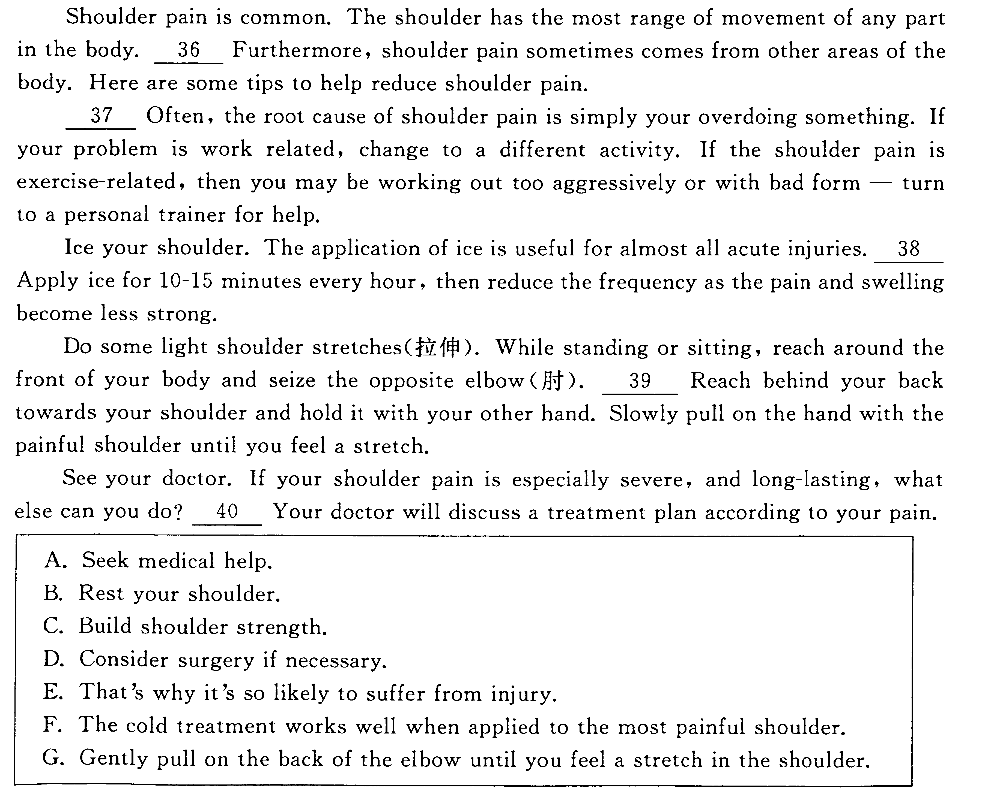
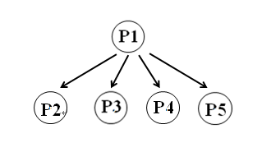
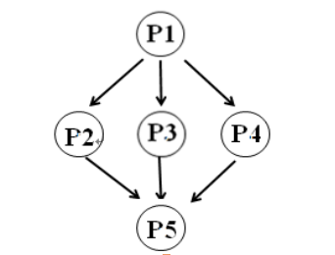
(1) 说明文: How-to类型
TOPIC SENTENCE
(Main Point)
Sub-
points
supporting details
conclusion

Slide 8
▶Practice
Move into a new home in a new neighborhood is an exciting experience. Of course, you want to make sure that you become an accepted and valuable part of your new neighborhood. The easiest way to accomplish this is to make sure you conduct yourself as a good neighborhood should. 1 .
Perhaps one of the most important things you can do ad a good neighbor is to keep your property neat, clean, and in good repair...
Second, take the overall appearance of the neighborhood seriously...
2 .If a neighbor is going to be out of town, offer to collect mail and newspaper. If a neighbor suffers an illness, offer to do the grocery shopping. Let them know that you are there to help in a way that is acceptable, while still respecting the privacy of your neighbor.
3 .By following the basic rules of respecting others, taking care of what belongs to you, and taking pride in the appearance of the neighborhood in general, you will quickly become a good neighbor that everyone appreciates.
tips, advice, how to?
Topic sentence
G
B
C
A. In general, keep an eye on their property while they are gone.
B. A good neighbor is also one who likes to help out in small ways.
C. Being a good neighbor is more or less about considerate behavior.
D. Sometimes neighbors may go to the supermarket together to do shopping.
E. Should you come across waste paper thrown out of a passing car, pick it up.
F. People tend to take pride in keeping everything in their street fresh and inviting.
G. Here are a few tips to help you win over everyone in the neighborhood quickly.

Slide 9
▶Practice
Reading is important. But the next step is making sure that you remember what you've read! 1 .
You may have just read the text, but the ideas, concepts and images may fly right out of your head. Here are a few tricks for remembering what you read.
● 2 .
If the plot, characters, or word usage is confusing for you, you likely won't be able to remember what you read. It's a bit like reading a foreign language. If you don't understand what you're reading, how would you remember it? But there are a few things you can do...Use a dictionary; look up the difficult words.
● 3 .
Does a character remind you of a friend? Does the setting make you want to visit the place? Does the book inspire you, and make you want to read more? With some books, you may feel a connection right away. But other books require a bit more work on your part. How willing are you to make the connections happen?
E
A
B
A. Are you confused?
B. Are you connected?
C. Practice makes perfect.
D. What's your motivation?
E. Memory is sometimes a tricky thing.
F. Marking helps you remember what you read.
G. You can do the same thing when you read the text!
小标题Tips：
找细节中的同义词
找细节中的复现词；

Slide 10
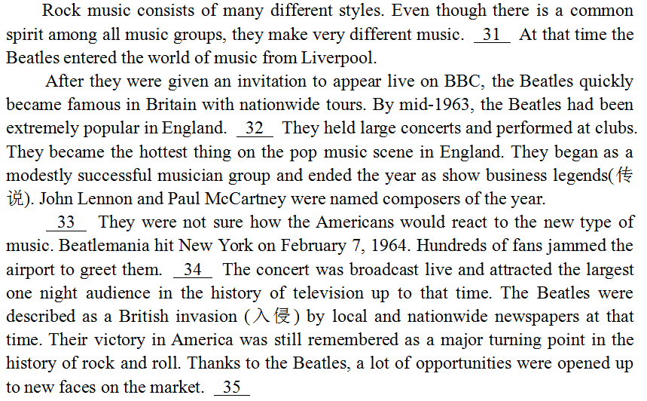
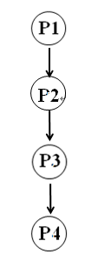
(2) 说明文: 事物演变/说明介绍类型
时间
过程
因果
对比
定义
分类

Slide 11
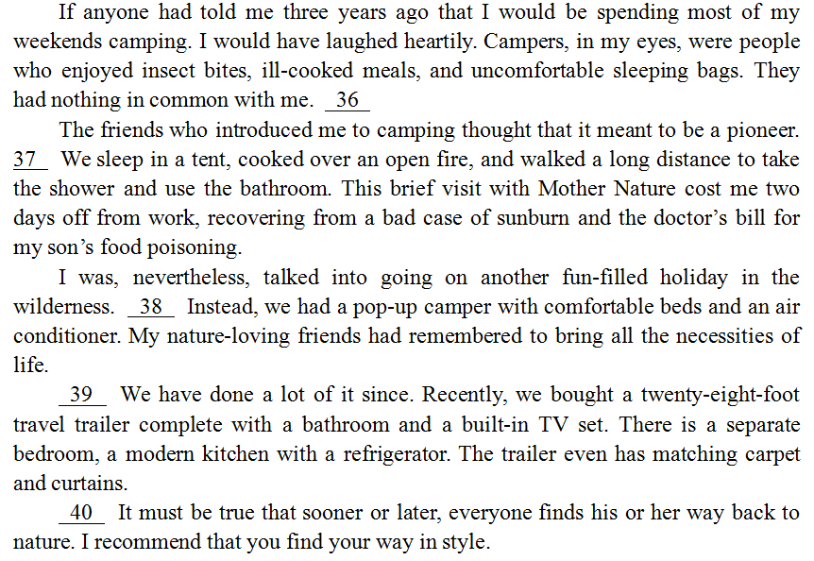
(3) 记叙文:
时间
顺叙
倒叙
插叙

Slide 12
2. 利用句间逻辑关系解题
语篇成分（如：句子、句群、段落）之间的语义逻辑关系，如：次序关系、因果关系、概括与例证关系。
段落内句子之间会构成并列、对应、顺序、分指、重复、转折、解说、因果、总分等逻辑关系，这些逻辑关系有时通过连接词（或词组）体现出来，有时则通过上下句的语意体现出来，理清段落内句子之间的逻辑关系是做出正确选择的重要方法之一。

Slide 13
(1) 转折关系
Have you ever visited a garden that seemed just right for you, where the atmosphere of the garden appeared to total more than the sum of its parts? 1
But it doesn't happen by accident. It starts with looking inside yourself and understanding who you are with respect to the natural world and how you approach the gardening process.
F
Tips：
信号词: however, but, yet
瞻前顾后，重点在前；
A. Know why you garden.
B. Find a good place for your own garden.
C. It's our experience of the garden that matters.
D. It's delightful to see so many beautiful flowers.
E. Still others may simply enjoy being outdoors and close to plants.
F. You can produce that kind of magical quality in your own garden, too.
G. For each of those gardens, write down the strongest memory you have.

Slide 14
(2) 并列关系
Some people may think that a garden is no more than plants, flowers, patterns and masses of color. Others are concerned about using gardening methods that require less water and fewer fertilizers (肥料). 1 . However, there are a number of other reasons that might explain why you want to garden. One of them comes from our earliest years.
E
Tips：
信号词：and, some…others
关注句式、内容上的对等；
A. Know why you garden.
B. Find a good place for your own garden.
C. It's our experience of the garden that matters.
D. It's delightful to see so many beautiful flowers.
E. Still others may simply enjoy being outdoors and close to plants.
F. You can produce that kind of magical quality in your own garden, too.
G. For each of those gardens, write down the strongest memory you have.

Slide 15
(3) 解释关系
Our model of what a garden should be often goes back to childhood. Grandma's rose garden and Dad's vegetable garden might be good or bad, but that's not what's important. 1 —how being in those gardens made us feel. If you'd like to build a powerful bond with your garden, start by taking some time to recall the gardens of your youth.
C
Tips：
信号词：that’s (to say),
for example, :, —
关注解释部分内容；
A. Know why you garden.
B. Find a good place for your own garden.
C. It's our experience of the garden that matters.
D. It's delightful to see so many beautiful flowers.
E. Still others may simply enjoy being outdoors and close to plants.
F. You can produce that kind of magical quality in your own garden, too.
G. For each of those gardens, write down the strongest memory you have.

Slide 16
(4) 因果关系
Secret codes keep messages private. Banks, companies, and government agencies use secret codes in doing business, especially when information is sent by computer.
People have used secret codes for thousands of years. 1 . Code breaking never lags far behind code making. The science of creating and reading coded message is call cryptography.
D
A. It's very hard to break a code without the code book.
B. In any language, some letters are used more than others.
C. Only people who know the keyword can read the message.
D. As long as there have been codes, people have tried to break them.
E. You can hide a message by having the first letters of each word spell it out.
F. With a code book, you might write down words that would stand for others words.
G. Another way to hide a message is to use symbols to stand for specific letters of
the alphabet.

Slide 17
3. 利用词汇复现和指代解题
语篇中的显性衔接和连贯手段，如：通过使用代词、连接词、省略句、替代等手段来实现指代、连接、省略、替代等衔接关系。
语篇和语意的连贯离不开词汇的衔接，词汇的衔接通过词汇的重现、同根词、同义词、反义词、上下位词（或短语）等方式体现出来，在解题时，要充分利用这些信息。
指代是使语意连贯不可或缺的衔接方式，因此，可以利用选项及上下文中的代词来解题。代词可以指代上下文中某个词语、短语或整个句子。特别要留意细节支撑句和上下过渡句选项及其上下文中的代词，弄清它们所指代的是什么，以及所指代的名词与代词的单复数形式。

Slide 18
(1) 词汇复现
Rethink mornings. Now that you know why you want to wake up, consider re-arranging your morning activities. If you want time to have breakfast with your family, save some time the night before by setting out clothes, shoes, and bags.
1 ,That’s a quarter-hour more you could be sleeping if you bought a coffee maker with a timer.
G
Get a sleep specialist.
Find the right motivation.
A better plan for sleep can help.
And consider setting a second alarm.
If the steps you take are working, keep it up.
Stick to your set bedtime and wake-up time, no matter the day.
Reconsider the 15 minutes you spend in line at the café to get coffee.
Tips：
信号词：that’s (to say),
for example, :, —
关注同义词复现；

Slide 19
(2) 代词指代
Lots of people find it hard to get up in the morning and put the blame on the alarm clock. In fact, he key to easy morning wake-up lies in resting your body clock 1 ,That’s Here is how to make one．
C
Get a sleep specialist.
Find the right motivation.
A better plan for sleep can help.
And consider setting a second alarm.
If the steps you take are working, keep it up.
Stick to your set bedtime and wake-up time, no matter the day.
Reconsider the 15 minutes you spend in line at the café to get coffee.
Tips：
信号词: one, it, that, this, those, these
瞻前顾后，重点关注（不可数/可数）名词；

Slide 20
4. 利用句子结构和标点符号解题
“七选五”任务型阅读有时会在一些非常整齐或是有特色的的句子结构中设题，比如排比句式、祈使句、反问句等。在这种情况下，可以运用句子结构解题。
“七选五”阅读理解有时在设题时选项句末不加标点符号，而是把标点符号放在设空之后，并且有时所给的选项既有完整的句子，也有主从复合句中的从句部分或一个做句子成分的短语，在这种情况下，就可以运用标点符号解题。

Slide 21
(1) 句子结构
Our model of what a garden should be often goes back to childhood. Grandma's rose garden and Dad's vegetable garden might be good or bad, but that's not what's important. It’s our experience of the garden that matters—how being in those gardens made us feel. If you'd like to build a powerful bond with your garden, start by taking some time to recall the gardens of your youth. 1 . Then go outside and work out a plan to translate your childhood memories into your grown-up garden. Have fun.
G
A. Know why you garden.
B. Find a good place for your own garden.
C. It's our experience of the garden that matters.
D. It's delightful to see so many beautiful flowers.
E. Still others may simply enjoy being outdoors and close to plants.
F. You can produce that kind of magical quality in your own garden, too.
G. For each of those gardens, write down the strongest memory you have.
Tips：关注“排比句、祈使句”等特殊句式

Slide 22
(2) 标点符号
Interruptions are one of the worst things to deal with while you’re trying to get work done. 1 , there are several ways to handle things. Let’s take a look at them now.
B
If you’re busy, don’t feel bad about saying no
When you want to avoid interruptions at work
Set boundaries for yourself as your time goes
If you’re in the other person’s office or in a public area
It’s important that you let them know when you’ll be available
It might seem unkind to cut people short when they interrupt you
Leave it open when you’re available to talk and close it when you’re not
Tips：
关注“,”，选择“半句话”

Slide 23
5. 总结归纳
1. 利用语篇结构（体裁、篇章结构）解题：
→语篇体裁结构特征（尤其是how-to类型的小标题）
2. 利用段落内句子之间的逻辑关系解题：
→并列、对应、顺序、分指、重复、转折、解说、因果、总分等逻辑关系
3. 利用词汇复现解题
→原词重现、同义词、反义词等
4. 利用指代关系解题：
→代词(this/that/it/those/these)指代
5. 利用句子结构和标点符号解题：
→排比句、祈使句等特殊句型；逗号(,)

Slide 24
四、实战演练
Shoulder pain is common. The shoulder has the most range of movement of any part in the body.
1 .Furthermore, shoulder pain sometimes comes from other areas of the body. Here are some tips to help reduce shoulder pain.
2 Often, the root cause of shoulder pain is simply your overdoing something. If your problem is work related, change to a different activity. If the shoulder pain is exercise-related, then you may be working out too aggressively or with bad form—turn to a personal trainer for help.
Ice your shoulder. The application of ice is useful for almost all acute injuries. 3 Apply ice for 10-15 minutes every hour, then reduce the frequency as the pain and swelling become less strong.
Do some light shoulder stretches. While standing or sitting, reach around the front of your body and seize the opposite elbow. 4 Reach behind your back towards your shoulder and hold it with your other hand. Slowly pull on the hand with the painful shoulder until you feel a stretch.
See your doctor. If your shoulder pain is especially severe, and long-lasting, what else can you do? 5 . Your doctor will discuss a treatment plan according to your pain.
A. Seek medical help. B. Rest your shoulder.
C. Build shoulder strength. D. Consider surgery if necessary.
E. That’s why it’s so likely to suffer from injury.
F. The cold treatment works well when applied to the most painful shoulder.
G. Gently pull on the back of the elbow until you feel a stretch in the shoulder.
E:因果关系
B:小标题
F: 词汇复现
G: 祈使句
A

Slide 25
四、实战演练
Rock music consists of many different styles. Even though there is a common spirit among all music groups, they make very different music. 1 . At that time the Beatles entered the world of music from Liverpool.
After they were given an invitation to appear live on BBC, the Beatles quickly became famous in Britain with nationwide tours. By mid-1963, the Beatles had been extremely popular in England. 2 . They held large concerts and performed at clubs. They became the hottest thing on the pop music scene in England. They began as a modestly successful musician group and ended the year as show business legends (传说). John Lennon and Paul McCartney were named composers of the year.
3 .They were not sure how the Americans would react to the new type of music. Beatlemania hit New York on February 7, 1964. Hundreds of fans jammed the airport to greet them. 4 . The concert was broadcast live and attracted the largest one night audience in the history of television up to that time. The Beatles were described as a British invasion (入侵) by local and nationwide newspapers at that time. Their victory in America was still remembered as a major turning point in the history of rock and roll. Thanks to the Beatles, a lot of opportunities were opened up to new faces on the market. 5 .
A. They decided on a tour to the United States in 1964.
B. Even their hairstyles became major trends at that time.
C. Rock music developed in the 1950s and the early 1960s.
D. However, their songs changed the lives of generations to come.
E. Many rock bands were able to follow in the footsteps of the Beatles.
F. They appeared in the films A Hard Day's Night (1964) and Help! (1965).
G. They performed their first concert in America at CBS television's 53rd street studio.
C:词汇复现
B:解释关系
A: 词汇复现
G: 词汇复现
E： 词汇复现

Slide 26


