Slide 1


感恩遇见，相互成就，本课件资料仅供您个人参考、教学使用，严禁自行在网络传播，违者依知识产权法追究法律责任。
更多教学资源请关注
公众号：溯恩高中英语
知识产权声明

Slide 2

Reading and Thinking
缙云中学 张丹

Slide 3
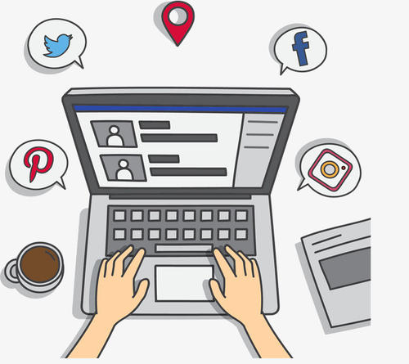

What do you usually do on the Internet?
Did the Internet change your life? How?
stronger?

Slide 4
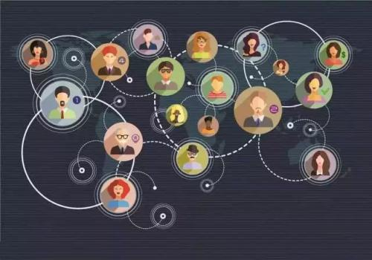
explain
Stronger Together :
How We Have Been Changed by the Internet
: (colon)
be changed by the Internet
examples

Slide 5
 | main idea of each paragraph
Para1 | People's lives have been changed by _______________________ and ___________________.
Para2 | _________________________________________
Para3 | Jan started to _____________________________.
Para4 | Jan started __________________________and set up ______________________.
Para5 | Jan’s life has been greatly ____________ by the ______________.
General idea
online communities
social networks
Jan was changed.
help others online.
Examples
taking online classes
new goals
improved
Conclusion
Internet

Slide 6
Q1: What's the topic sentence?
Q2: What convenience does the Internet bring us?
amazing benefits/ advantages
Much has been written about the wonders of the World Wide Web. There are countless articles telling us how the Internet has made our lives more convenient. We no longer have to wait in line or carry cash around when we go shopping. We can get the most updated information from large databases. We can download software, documents, and images whenever we need them. But the Internet has done much more for people than simply make life more convenient. People's lives have been changed by online communities and social networks.
stress
them. But the Internet has done much more for people than simply make life more convenient. People's lives have been changed by online communities and social networks.

Slide 7
actions
Jan was changed.
feelings
her personality
social network
online communities
Internet
join an online group:
talk about problems,
get support and advice
surf the internet: stream vedios and music, play games, explore the world
career
with only her computer to keep her company
remove the distance between people
seriously ill and jobless
?
feel less lonely and bored
be supported
?
feel lonely
aimless
inspired

Slide 8
Pair work (5 minutes)
Read your paragraph carefully and then work with your deskmate to raise two questions.
Para 3
Q1: ______________________________________
Q2: _____________________________________
exchange & answer
Para 4
Q1: _____________________________________
Q2: _____________________________________
share & appreciate

Slide 9
What can we learn from her experiences?
open-minded; optimistic; responsible
Jan's life has been greatly improved by the Internet. “When you go through tough times, you meet others who are facing similar challenges,” Jan says. “Thinking about other people's situations inspired me to offer help.”
We learn that when we go through tough times, we can find help and support from other people online.
recipient
We also learn that we can feel less lonely by creating or joining communities on the Internet, and that we can even use the internet to achieve our goals.
We learn to think about other people's situations and then offer help.
giver

Slide 10


stronger?
Stronger Together:
How We Have Been Changed by the Internet
...
children in poor countries
...
Jan
59-year-old man
61-year-old woman
...
two friends
daughter
...
...
...

Slide 11
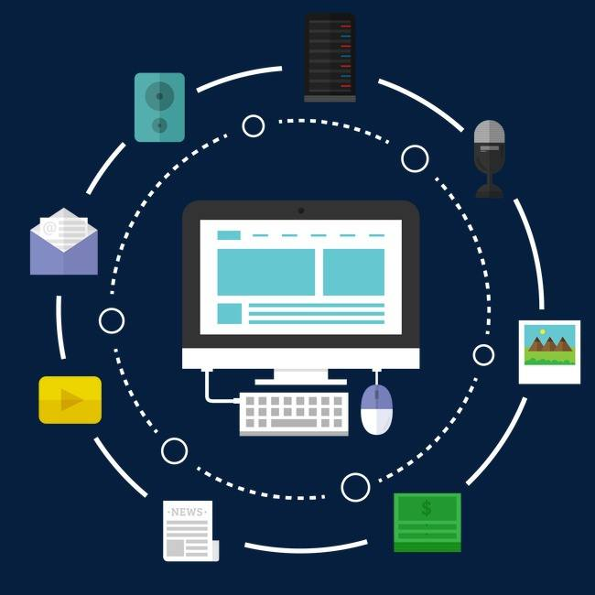
Thank you!

Slide 12
Students' Questions
Para3
1.Why did Jan teach old people how to use computers and the Internet?
2.How does the 61-year-old woman change?
3.Why did Jan start such a club?
4.Whether the people who join the club need to pay for money or not?
Para4
1.What is the meaning of “bridge digital divide”?
2.Why did Jan take classes online?
3.What's the conclusion(effect?) as everyone has access to the Internet and knows how to use it?

