Slide 1


感恩遇见，相互成就，本课件资料仅供您个人参考、教学使用，严禁自行在网络传播，违者依知识产权法追究法律责任。
更多教学资源请关注
公众号：溯恩高中英语
知识产权声明

Slide 2



平凡铸就伟大
每个人都了不起
国家主席习近平二〇二一年新年贺词
吴俊峰
浙江省常山一中

Slide 3
新年问候
1
抗疫精神
2
CONTENTS
重大成果
3
全球命运
4
百年初心
5
美好祝愿
6

Slide 4
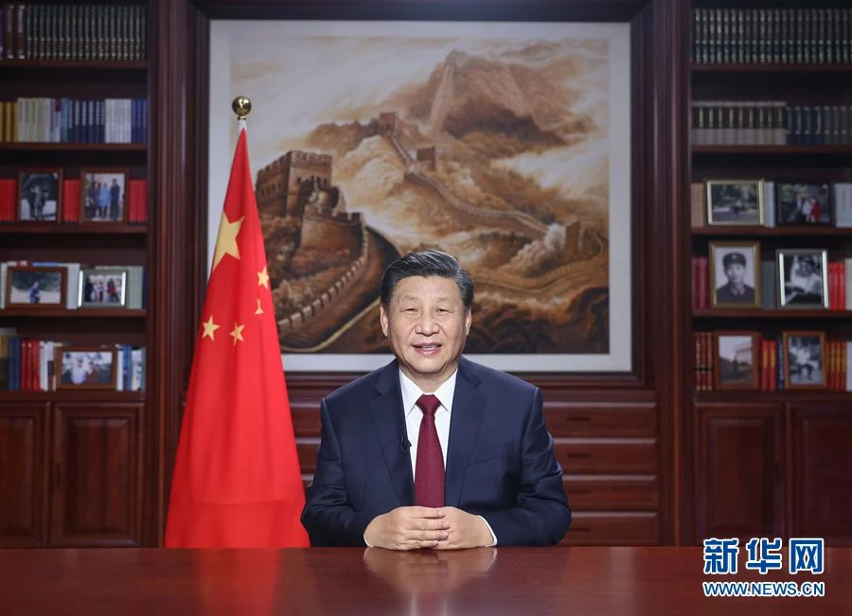
1.问候和祝愿
同志们、朋友们、女士们、先生们，大家好！
Comrades, friends, ladies and gentlemen, greetings to you all!
2021年的脚步越来越近，我在北京向大家致以新年的美好祝福！
The year 2021 is arriving. From China's capital Beijing, I extend my New Year wishes to you all!
is arriving 进行时表将来时
extend “提供；给予；发出；表达”（“表达...之情”还可用 express /convey/send）
to extend an invitation 发出邀请
http://www.sunedu.com

Slide 5
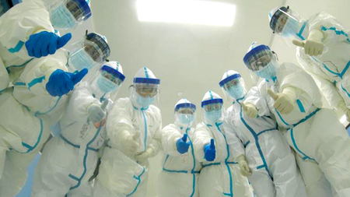
2. 抗疫精神
2020年是极不平凡的一年。面对突如其来的新冠肺炎疫情，我们以人民至上、生命至上诠释了人间大爱，用众志成城、坚忍不拔书写了抗疫史诗。
2020 was an extraordinary year. Facing_{现在分词作状语} the sudden coronavirus pandemic, we put people and their lives first to interpret the great love among humans. With solidarity and resilience, we wrote the epic of our fight against the pandemic.
extraordinary /ɪkˈstrɔːdnri/ adj. 非凡的；特别的
= special / eventful
coronavirus /kəˈrəʊnəvaɪrəs/ n. 冠状病毒
pandemic /pænˈdemɪk/ n. （全国或全球性）流行病
put ... first 把……放在第一位
interpret /ɪnˈtɜːprət/ v. 诠释；说明
solidarity /ˌsɒlɪˈdærəti/ n. 团结，团结一致
resilience /rɪˈzɪliəns/ n. 恢复力；弹力；顺应力
epic /ˈepɪk/ n. 叙事诗；史诗
http://www.sunedu.com

Slide 6
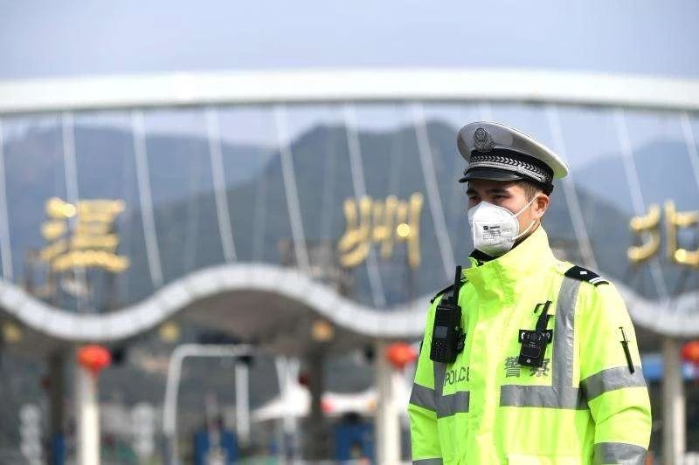
2. 抗疫精神
在共克时艰的日子里，有逆行出征的豪迈，有顽强不屈的坚守，有患难与共的担当，有英勇无畏的牺牲，有守望相助的感动。
During the days when we addressed the hardships together_{定语从句}, we saw the heroic spirit of marching straight to the frontlines, holding posts with tenacity, taking responsibility to get through thick and thin, sacrifices with bravery, and touching moments of helping each other.
address /əˈdres/ v. 设法解决
heroic /həˈrəʊɪk/ adj. 英雄的；英勇的
march /mɑːtʃ/ vi. （坚定地向某地）前进；行军
frontline /ˈfrʌntˌlaɪn/ n. 前线；锋线
hold posts坚守岗位；守住阵地
tenacity /təˈnæsəti/ n. 韧性；不屈不挠
get through thick and thin不畏艰险；风雨同舟
sacrifice/ˈsækrɪfaɪs/ n. 牺牲 v. 牺牲；奉献
http://www.sunedu.com

Slide 7
在共克时艰的日子里，有逆行出征的豪迈，有顽强不屈的坚守，有患难与共的担当，有英勇无畏的牺牲，有守望相助的感动。
During the days when we addressed the hardships together, we saw the heroic spirit of marching straight to the frontlines, holding posts with tenacity, taking responsibility to get through thick and thin, sacrifices with bravery, and touching moments of helping each other.
修辞格
排比
“有逆行出征的豪迈，有顽强不屈的坚守，有患难与共的担当，有英勇无畏的牺牲，有守望相助的感动”，这是典型汉语无主语句型，而且每一个分句的核心名词都比较抽象，直接转换成英文抽象名词不地道。
英文翻译时，把汉语的抽象名词 “豪迈，坚守，担当，牺牲，感动”归纳为“spirit 精神”，再用并列介宾结构解释这些精神，更符合英文表达习惯！
英语中的Parallelism和汉语里的排比相同点表现在：它们都是把结构相同或相似，语义相关，语气一致的几个词、词组或句子排列成串，形成一个整体，也都是为了增强语言的表达能力，使文章在语言和思想上更具表现力。不同之处在于英语中的Parallelism要求两个或两个以上的词语或句子来构成，而汉语则需要三个或三个以上才能构成。
http://www.sunedu.com

Slide 8

2. 抗疫精神
从白衣天使到人民子弟兵，从科研人员到社区工作者，从志愿者到工程建设者，从古稀老人到“90后”、“00后”青年一代，无数人以生命赴使命、用挚爱护苍生，将涓滴之力汇聚成磅礴伟力，构筑起守护生命的铜墙铁壁。
From medical workers to the people's army, from scientific researchers to community workers, from volunteers to those who built the projects_{定语从句}, from seniors to youths born after the 1990s and 2000s, numerous people fulfilled their missions at the cost of their lives and protected humanity with sincere love. They pooled their drops of strength into tremendous power and built an iron wall to safeguard lives.
numerous /ˈnjuːmərəs/adj. 众多的；许多的
fulfill /fʊlˈfɪl/ vt. 履行；实现；满足
mission/ˈmɪʃn/ n. 使命，任务
pool /puːl/ n. 水塘；联营；vi. 联营；集中(资金、知识或设备，供大家分享)
tremendous /trəˈmendəs/adj. 极大的；惊人的
http://www.sunedu.com

Slide 9
从白衣天使到人民子弟兵，从科研人员到社区工作者，从志愿者到工程建设者，从古稀老人到“90后”、“00后”青年一代，无数人以生命赴使命、用挚爱护苍生，将涓滴之力汇聚成磅礴伟力，构筑起守护生命的铜墙铁壁。
From medical workers to the people's army, from scientific researchers to community workers, from volunteers to those who built the projects, from seniors to youths born after the 1990s and 2000s, numerous people fulfilled their missions at the cost of their lives and protected humanity with sincere love. They pooled their drops of strength into tremendous power and built an iron wall to safeguard lives.
排比|比喻
修辞格
① 四个“from ... to... ” 构成短语排比，用 “numerous people”语义承接，呈现聚合型语篇主位推进模式。
② “ They pooled their drops of strength into tremendous power and built an iron wall to safeguard lives.”出现两次隐喻：①动词“pool”作为隐喻的喻体，非常形象地活化了 本体名词“drops of strength”的动作和状态；② “an iron wall”作为隐喻的喻体，描写了本体的特征，而本体是通过相关动词“safeguard” 来体现的。
http://www.sunedu.com

Slide 10
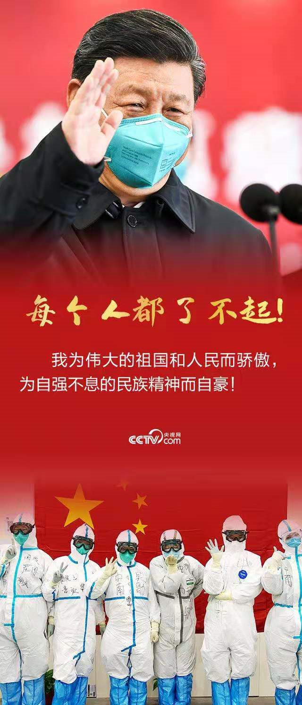
2. 抗疫精神
一个个义无反顾的身影，一次次心手相连的接力，一幕幕感人至深的场景，生动展示了伟大抗疫精神。
Many figures marched ahead without hesitation, many relays were accomplished hand in hand, many scenes showed touching moments, and all these vividly illustrate the great spirit of fighting against the pandemic.
figure /ˈfɪɡər/ n. 数字；人物；（远处人的）轮廓；（隐约可见的）人影
vividly /ˈvɪvɪdli/ adv. 生动地；强烈地
illustrate /ˈɪləstreɪt/ vt. 阐明，举例说明
http://www.sunedu.com

Slide 11
一个个义无反顾的身影，一次次心手相连的接力，一幕幕感人至深的场景，生动展示了伟大抗疫精神。
Many figures marched ahead without hesitation, many relays were accomplished hand in hand, many scenes showed touching moments, and all these vividly illustrate the great spirit of fighting against the pandemic.
修辞格
排比
这一段翻译亮点在于词性转换，把原文的名词“一个个...的身影，一次次...的接力，一幕幕...的场景”短语并列转换成了一个一个英语句子并列，用“ Many figures ..., many relays ..., many scenes...”短语排比，然后用“all these ”承接，呈现聚合型语篇主位推进模式，文脉结构更具有逻辑和条理。
结构修辞格的运用对于表达意义起着非常重要的作用。英语中的Parallelism和汉语中的排比都是把结构相似、语义相关的几个语言单位并列在一起而形成的。恰当地运用排比可以加强语言的气势，突出表达内容，还能使句式整齐，节奏分明，富有感染力。
http://www.sunedu.com

Slide 12
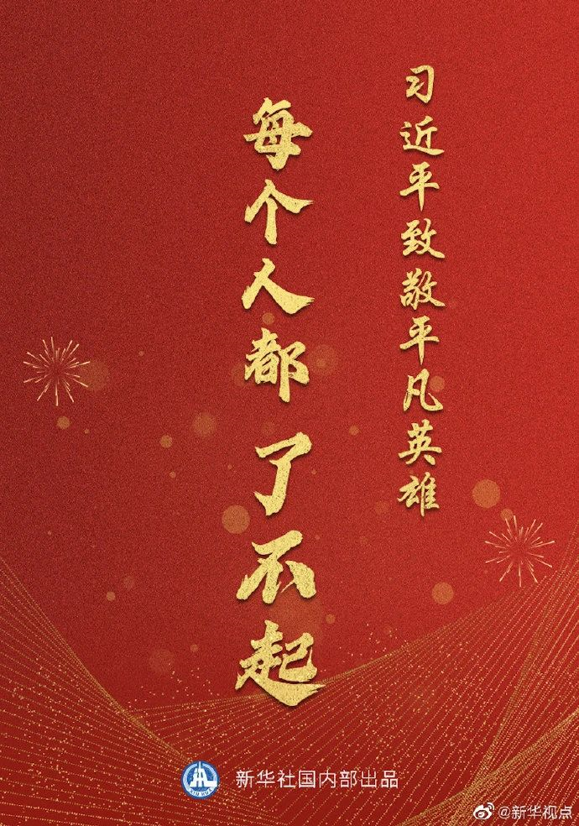
2. 抗疫精神
平凡铸就伟大，英雄来自人民。每个人都了不起！向所有不幸感染的病患者表示慰问！向所有平凡的英雄致敬！我为伟大的祖国和人民而骄傲，为自强不息的民族精神而自豪！
Greatness is forged in the ordinary. Heroes come from the people. Every person is remarkable! Our sympathy goes to all the unfortunate ones infected with the coronavirus! We salute all the ordinary heroes! I am proud of our great motherland and people, as well as the unyielding national spirit.
forge /fɔːdʒ/v. 锻造，铸造；缔造，艰苦做成
remarkable /rɪˈmɑːkəbl/adj. 卓越的；非凡的
salute /səˈluːt/ n. 致敬，欢迎；敬礼 v. 行礼致敬
unyielding /ʌnˈjiːldɪŋ/ adj. 不屈的；坚强的
yield /jiːld/ v. 屈服；放弃
http://www.sunedu.com

Slide 13
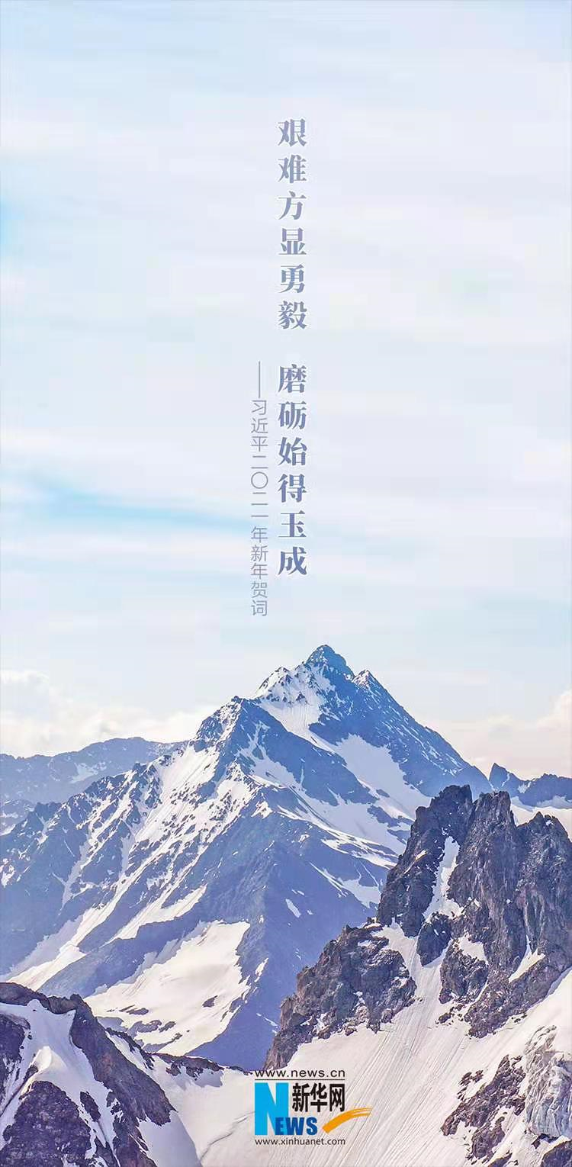
3. 重大成果
艰难方显勇毅，磨砺始得玉成。我们克服疫情影响，统筹疫情防控和经济社会发展取得重大成果。“十三五”圆满收官，“十四五”全面擘画。
Only in hard times can courage and perseverance be manifested_{only+状语位句首，部分倒装}. Only after polishing can a piece of jade be finer_{部分倒装}. We overcame the impact of the pandemic, and made great achievements in coordinating prevention and control and in economic and social development. The 13th Five-Year Plan has been accomplished in full. The 14th Five-Year Plan is being comprehensively formulated.
perseverance /ˌpɜːsəˈvɪərəns/ n. 坚持不懈；不屈不挠； 耐性；毅力
manifest/ˈmænɪfest/ v. 表明，清楚显示（尤指情感、态度或品质）
jade /dʒeɪd/ n. 翡翠；[宝] 碧玉
coordinate /kəʊˈɔːdɪneɪt/ v. 调节，配合；使动作协调
in full 全部；全额；充足
comprehensively /ˌkɒmprɪˈhensɪvli/ adv. 包括地；包括一切地；全面地
formulate /ˈfɔːmjuleɪt/ vt. 规划；制订；用公式表示；明确地表达
http://www.sunedu.com

Slide 14

3. 重大成果
新发展格局加快构建，高质量发展深入实施。我国在世界主要经济体中率先实现正增长，预计2020年国内生产总值迈上百万亿元新台阶。
We are accelerating the pace to set up a new pattern for development, and are deeply implementing high-quality development. China is the first major economy worldwide to achieve positive growth, and its GDP in 2020 is expected to step up to a new level of 100 trillion yuan.
accelerate /əkˈseləreɪt/v. 加速；促进；增加
implement /'ɪmplɪmənt/ vt. 实施，执行；实现，使生效
step up to 走近；接近
trillion /ˈtrɪljən/ n. [数] 万亿 adj. 万亿的
“the first major economy worldwide to achieve positive growth” 被修饰的名词前有序数词、形容词最高级或next, last, only等限定词时候，只能用不定式做后置定语。
http://www.sunedu.com

Slide 15
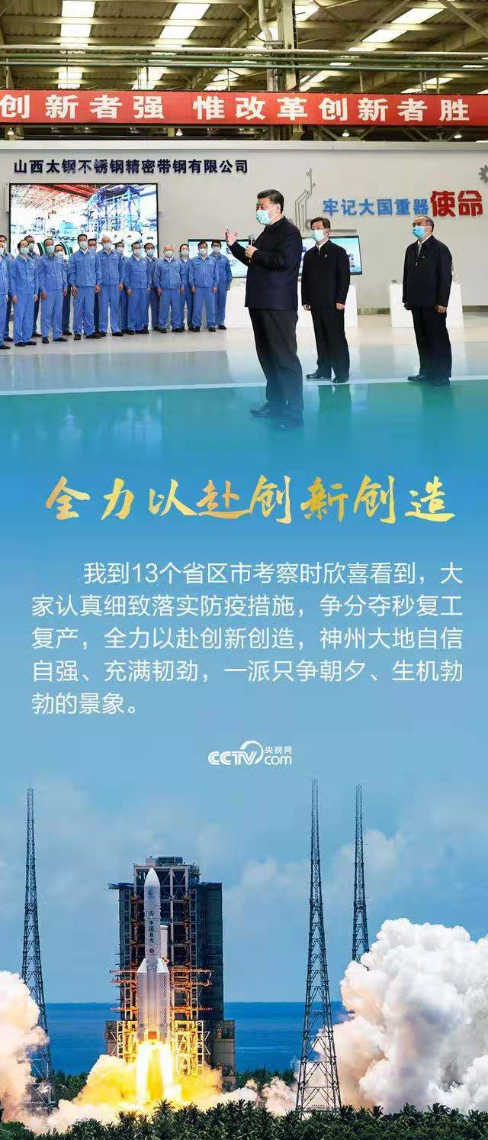
3. 重大成果
粮食生产喜获“十七连丰”。“天问一号”、“嫦娥五号”、“奋斗者”号等科学探测实现重大突破。
China has seen a good harvest in grain production for 17 years in a row. China has seen breakthroughs in scientific explorations like the Tianwen-1 (Mars mission), Chang'e-5 (lunar probe), and Fendouzhe (deep-sea manned submersible).
in a row连续
They have won five championships in a row.
他们已经五次蝉联冠军。
probe /prəʊb/ n. 探针；调查 v. 调查；探测
submersible /səbˈmɜːsəbl/ n.潜水器 adj. 能潜水的
proceed /prəˈsiːd/ vi. 开始；继续进行；发生；行进
vigor /ˈvɪɡər/ n. [生物] 活力，精力
http://www.sunedu.com

Slide 16
粮食生产喜获“十七连丰”。“天问一号”、“嫦娥五号”、“奋斗者”号等科学探测实现重大突破。
China has seen a good harvest in grain production for 17 years in a row. China has seen breakthroughs in scientific explorations like the Tianwen-1 (Mars mission), Chang'e-5 (lunar probe), and Fendouzhe (deep-sea manned submersible).
排比|拟人
修辞格
① “Parallelism(排比)”修辞格的运用：“China has seen...”句子排比，气势磅礴，生动展示了中国改革开放伟大事业的系列成就。
② “China has seen...”采用了”比拟 (personification)”的修辞格，比拟的基础是本体事物和拟作事物之间的可拟性，本体事物和拟作事物之间的桥梁是联想，比拟的翅膀是想象。
汉语是以人为中心的语言，一般认为只有人和动物才能活动；而英语经常将物体看作是能够活动的主体，事物可以“说话、写字、看到、拥有”，人与物是平等的。“事物有生命，可以活动”，这是所有英语思考模式中最基本的原理。后文中“2021 will see the 100th birthday of the Communist Party of China” 类似于此用法。
http://www.sunedu.com

Slide 17
3. 重大成果
海南自由贸易港建设蓬勃展开。我们还抵御了严重洪涝灾害，广大军民不畏艰险，同心协力抗洪救灾，努力把损失降到了最低。
Construction of the Hainan Free Trade Port is proceeding with vigor. We also defeated severe flooding. With the military and civilians heedless of danger and difficulty_{with复合结构}, and standing in unity_{with复合结构}, we managed to minimize the damage of the floods.
proceed /prəˈsiːd/ vi. 开始；继续进行；发生；行进
vigor /ˈvɪɡər/ n. [生物] 活力，精力
heedless of... 不顾......；不理会...... heedless /ˈhiːdləs/ adj. 不注意的；不留心的；不顾
Heedless of time or any other consideration, they began to search the underwater cave. 他们
根本没考 虑时间或任何其他因素就开始寻找水下洞穴了。
“and standing in unity” 的完整形式是“and with the military and civilians standing in unity”，因与前文重复，采用了省略形式。
http://www.sunedu.com

Slide 18
3. 重大成果
我到13个省区市考察时欣喜看到，大家认真细致落实防疫措施，争分夺秒复工复产，全力以赴创新创造，神州大地自信自强、充满韧劲，一派只争朝夕、生机勃勃的景象。
I inspected 13 provincial-level regions and was glad to see people carefully implementing_{宾补} coronavirus prevention and control measures, racing_{宾补} against time to resume work and production, and sparing_{宾补} no efforts to advance innovation. Everywhere were vibrant scenes of confident_{完全倒装}, resilient people making the most of every minute_{独立主格结构}.
see people implementing ..., racing..., and sparing ....现在分词做宾补
resume /rɪˈzjuːm/ vt. （中断后）重新开始，继续
spare no efforts 不遗余力，竭尽全力
innovation /ˌɪnəˈveɪʃn/ n. 创新，革新；新方法
vibrant /ˈvaɪbrənt/ adj. 充满生机的，生气勃勃的；鲜艳的；醒目的；洪亮的；强劲的
resilient /rɪˈzɪliənt/ adj. 弹回的，有弹力的；能复原的；可迅速恢复的
make the most of 充分利用；极为重视；尽量利用
http://www.sunedu.com

Slide 19

3. 重大成果
2020年，全面建成小康社会取得伟大历史性成就，决战脱贫攻坚取得决定性胜利。我们向深度贫困堡垒发起总攻，啃下了最难啃的“硬骨头”。
In 2020, China made the historic achievement of establishing a moderately prosperous society in all respects and achieved decisive success in eradicating extreme poverty. We launched the final assault on the fortress of entrenched rural poverty, and cracked this "hardest nut."
moderately /ˈmɒdərətli/adv. 适度地；中等地
prosperous /ˈprɒspərəs/ adj. 繁荣的；兴旺的
decisive /dɪˈsaɪsɪv/ adj. 决定性的；坚定的
eradicate /ɪˈrædɪkeɪt/ vt. 根除；消灭
assault /əˈsɔːlt/ n. 攻击；袭击 v. 攻击；袭击
fortress /ˈfɔːtrəs/ n. 堡垒；要塞
entrenched /ɪn'trentʃt/ adj. 根深蒂固的
crack /kræk/ v. 使破裂； 破解
the hardest nut to crack最难解决的问题
http://www.sunedu.com

Slide 20
2020年，全面建成小康社会取得伟大历史性成就，决战脱贫攻坚取得决定性胜利。我们向深度贫困堡垒发起总攻，啃下了最难啃的“硬骨头”。
In 2020, China made the historic achievement of establishing a moderately prosperous society in all respects and achieved decisive success in eradicating extreme poverty. We launched the final assault on the fortress of entrenched rural poverty, and cracked this "hardest nut."
修辞格
隐喻
“We launched the final assault on the fortress of entrenched rural poverty, and cracked this hardest nut. ”一句中出现两次隐喻，用 “fortress”和 “this hardest nut” 作为喻体，指代 “extreme poverty和 entrenched rural poverty”。“堡垒” 和“硬骨头”充分发挥了喻体的妙用，由于这些物象的特征，使读者和听众马上联想起描写对象，产生了一种动态的、鲜活的效果，同时体现了革命乐观主义和革命浪漫主义。
三个动词 “eradicate消灭”，“launch the final assault发起总攻”和 “crack破解”与喻体呼应，并形成语义连贯，表达了必胜的信念和决心。
http://www.sunedu.com

Slide 21
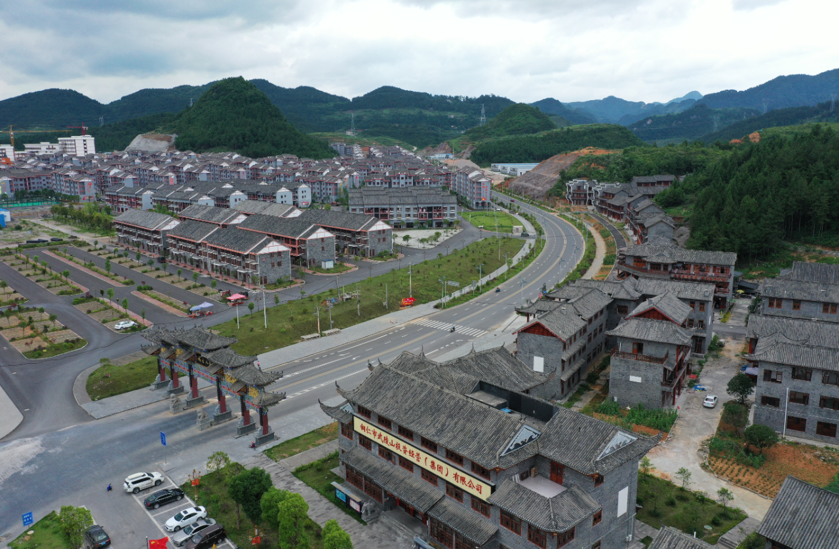
3. 重大成果
历经8年，现行标准下近1亿农村贫困人口全部脱贫，832个贫困县全部摘帽。
Through 8 years, under the current standard, China has eradicated extreme poverty for the nearly 100 million rural people affected_{过去分词作后置定语}, and all the 832 impoverished counties have shaken off poverty.
impoverish/ɪmˈpɒvərɪʃ/ vt. 使贫穷；使枯竭
shake off 摆脱；抖落
http://www.sunedu.com

Slide 22
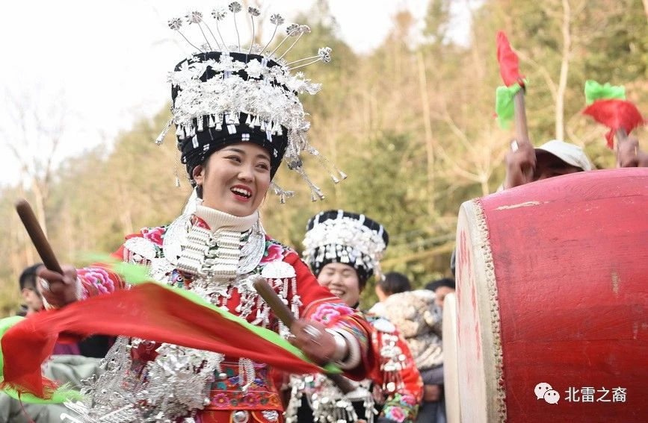
3. 重大成果
这些年，我去了全国14个集中连片特困地区，乡亲们愚公移山的干劲，广大扶贫干部倾情投入的奉献，时常浮现在脑海。我们还要咬定青山不放松，脚踏实地加油干，努力绘就乡村振兴的壮美画卷，朝着共同富裕的目标稳步前行。
These years, I have visited 14 contiguous areas of dire poverty. The unremitting efforts of the folks and the wholehearted contribution of the poverty-eradication cadres often come to my mind. We still need to stay tenacious like a bamboo deeply rooted in the rocks, keep our feet on the ground, and work hard to paint a magnificent picture of rural vitalization, and steadily march ahead towards the goal of common prosperity.
contiguous /kənˈtɪɡjuəs/adj. 连续的；邻近的；接触的
dire /ˈdaɪər/adj. 可怕的；悲惨的；极端的
unremitting/ˌʌnrɪˈmɪtɪŋ/ adj. 不懈的；不间断的；坚忍的
cadre /ˈkɑːdər/ n. 干部；基础结构；骨骼
tenacious /təˈneɪʃəs/ adj. 顽强的；坚韧的；黏着力强的
vitalization/vaɪtlaɪˈzeɪʃn/ n. 赋予生命；鼓舞；激发；振兴
http://www.sunedu.com

Slide 23
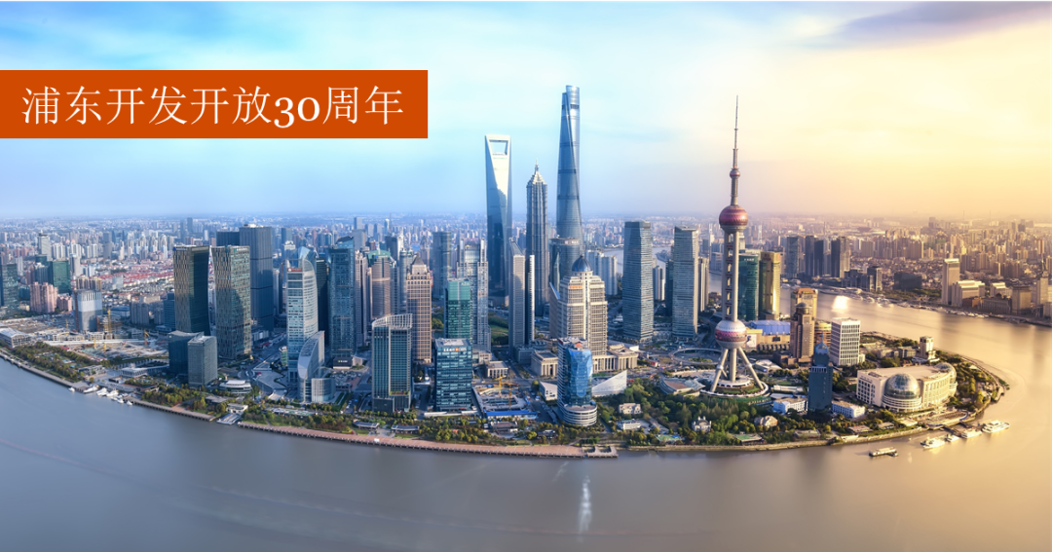
3. 重大成果
今年，我们隆重庆祝深圳等经济特区建立40周年、上海浦东开发开放30周年。置身春潮涌动的南海之滨、绚丽多姿的黄浦江畔，令人百感交集，先行先试变成了示范引领，探索创新成为了创新引领。
This year, we celebrated the 40th anniversary of the Shenzhen Special Economic Zone, among others, and 30 years of the development and opening-up of Pudong in Shanghai. As I stood on the southern coast as the spring tide surged and on the colorful bank of the Huangpu River, my mind was filled with a myriad of thoughts. Pilot trials have become models and leading forces, and explorations to innovate have become leading forces of innovation.
among others 其中；尤其；除了别的之外
surge /sɜːdʒ/ n. 汹涌；波涛 v. 汹涌；蜂拥而来
myriad /ˈmɪriəd/ adj. 无数的；种种的
n. 无数，极大数量；无数的人或物
pilot /ˈpaɪlət/ n. 飞行员 adj. 试点的
innovate/ˈɪnəveɪt/ v. 创新；改革
--innovation/ˌɪnəˈveɪʃn/ n.
http://www.sunedu.com

Slide 24
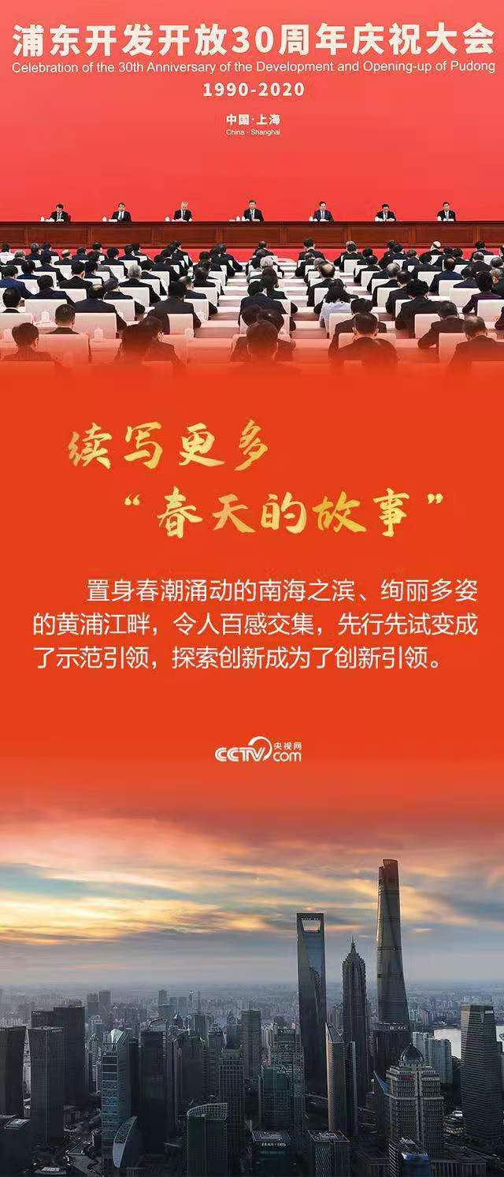
3. 重大成果
改革开放创造了发展奇迹，今后还要以更大气魄深化改革、扩大开放，续写更多“春天的故事”。
The opening-up and reform has created miracles of development. In the future, we should further deepen reform and expand opening-up with greater courage, and create more "Stories of Spring."
miracle /ˈmɪrəkl/n. 奇迹，奇迹般的人或物
http://www.sunedu.com

Slide 25
改革开放创造了发展奇迹，今后还要以更大气魄深化改革、扩大开放，续写更多“春天的故事”。
The opening-up and reform has created miracles of development. In the future, we should further deepen reform and expand opening-up with greater courage, and create more "Stories of Spring."
修辞格
借代
"Stories of Spring" 《春天的故事》歌曲从个人的情感视角审视中国的改革开放巨变。1979年春天，“中国改革开放的总设计师”邓小平在深圳勾勒了改革开放的蓝图；1992年春天再次南巡时，他充分肯定了深圳改革开放的成果，并作出了重要指示，由此掀起了全国改革的大潮，开拓了改革开放的新局面；这段史实在新中国的历史上具有里程碑意义。
借代的修辞作用在于通过换一个反映个体特征的名称来突出本体特征和标志，引发读者的联想，给人造成具体生动的印象。通过具体事件"Stories of Spring" 代替“reform and opening-up”抽象概念，凸显“更大气魄深化改革、扩大开放”，通俗易懂，催人奋进。
后文中的“the small red boat”嘉兴红船，也是借代的修辞格，突出事物的标志——中国共产党的诞生。
http://www.sunedu.com

Slide 26
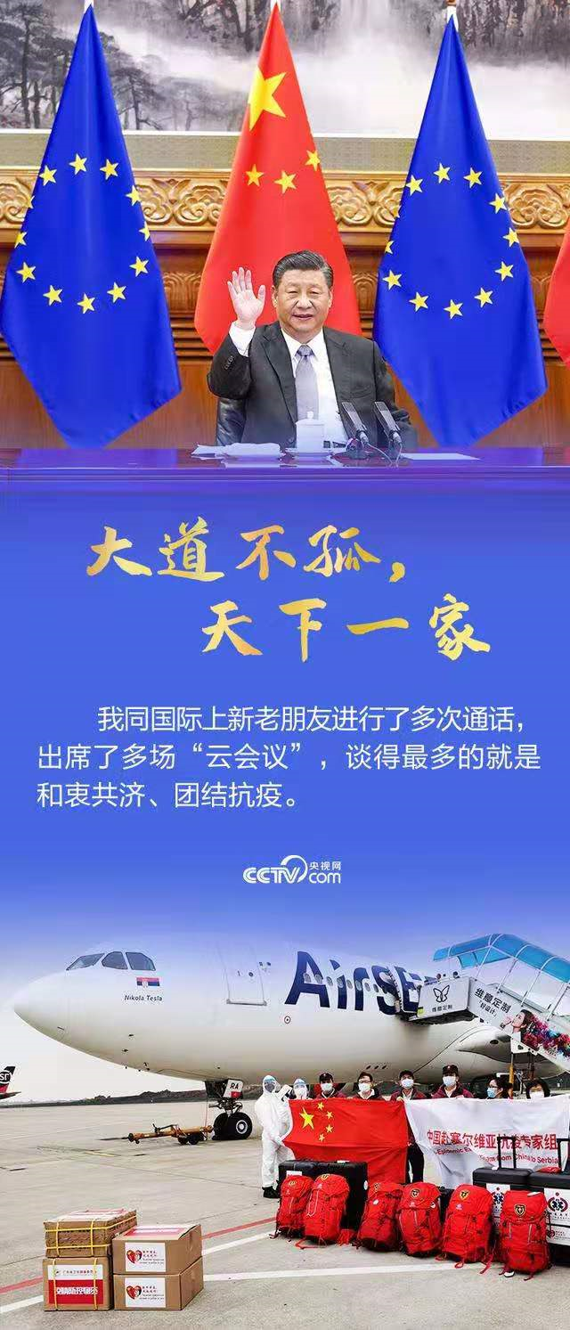
4. 全球命运
大道不孤，天下一家。经历了一年来的风雨，我们比任何时候都更加深切体会到人类命运共同体的意义。我同国际上新老朋友进行了多次通话，出席了多场“云会议”，谈得最多的就是和衷共济、团结抗疫。
We are not alone on the Great Way and the whole world is one family. After a year of hardship, we can understand more than ever the significance of a community with a shared future for mankind_{介词短语作后置定语}. I had many phone calls with friends from the international community, both old and new, and attended many "cloud conferences." What we discussed most_{主语从句} was staying united to combat the pandemic.
more than ever 更加，越发；尤其；超出任何时候
combat /ˈkɒmbæt/n. 战斗；搏斗 v. 与……战斗
http://www.sunedu.com

Slide 27
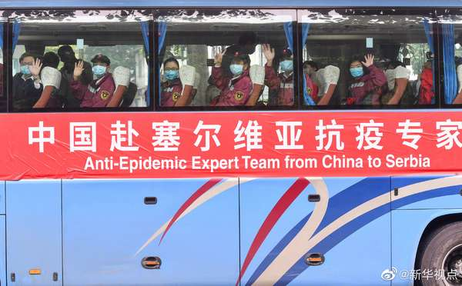
4. 全球命运
疫情防控任重道远。世界各国人民要携起手来，风雨同舟，早日驱散疫情的阴霾，努力建设更加美好的地球家园。
We still have a long way to go in pandemic prevention and control. People from all over the world should join hands and support each other to early dispel the gloom of the pandemic and strive for a better "Earth home."
dispel /dɪˈspel/ vt. 驱散，驱逐；消除（烦恼等）
gloom /ɡluːm/ n. 昏暗；阴暗
strive /straɪv/ vi. 努力；奋斗；抗争
http://www.sunedu.com

Slide 28

5. 百年初心
2021年是中国共产党百年华诞。百年征程波澜壮阔，百年初心历久弥坚。从上海石库门到嘉兴南湖，一艘小小红船承载着人民的重托、民族的希望，越过急流险滩，穿过惊涛骇浪，成为领航中国行稳致远的巍巍巨轮。
2021 will see the 100th birthday of the Communist Party of China. Its 100-year journey surges forward with great momentum. Its original aspiration remains even firmer one hundred years later. From Shikumen in Shanghai to the South Lake in Jiaxing City, the small red boat (where the first CPC congress concluded) bore the great trust of the people and the hope of the nation. The boat has sailed through turbulent rivers and treacherous shoals, and has voyaged across violent tidal waves, becoming a great ship that navigates China's stable and long-term development_{现在分词结果状语}.
momentum /məˈmentəm/ n. 势头；推进力；动力；冲力
aspiration /ˌæspəˈreɪʃn/ n. 渴望；抱负
turbulent /ˈtɜːbjələnt/ adj. 动荡的；湍流的
treacherous /ˈtretʃərəs/ adj. 叛逆的，背叛的；危险的
shoal /ʃəʊl/ n. 浅滩，沙洲
http://www.sunedu.com

Slide 29

5. 百年初心
胸怀千秋伟业，恰是百年风华。我们秉持以人民为中心，永葆初心、牢记使命，乘风破浪、扬帆远航，一定能实现中华民族伟大复兴。
The CPC bears its eternal great cause in mind, and the centenary only ushers in the prime of life. We adhere to putting people at the center, stay true to our original aspiration, keep our mission well in mind, break the waves and sail out for our journey ahead, and we will certainly realize the great rejuvenation of the Chinese nation.
bear... in mind 牢记在心‘；铭记在心
eternal /ɪˈtɜːnl/ adj. 永恒的；不朽的
centenary /senˈtiːnəri/ n. 一百周年纪念（或庆典）
usher /ˈʌʃər/ v. 引导，招待；迎接；开辟
adhere /ədˈhɪər/ v. 坚持；依附
adhere to坚持；粘附；拥护，追随
rejuvenation /rɪˌdʒuːvəˈneɪʃn/ n. 回复青春；复兴
http://www.sunedu.com

Slide 30
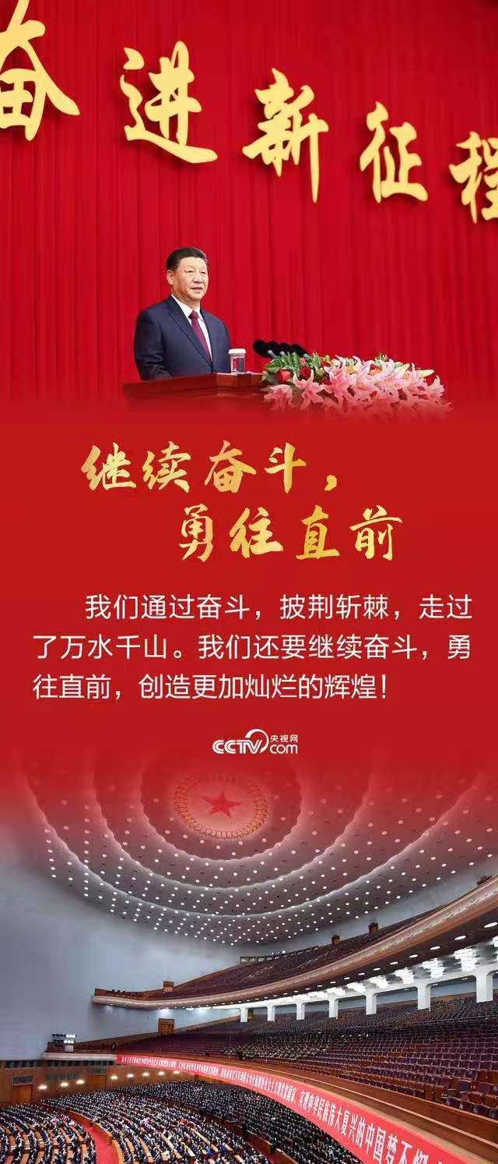
5. 百年初心
站在“两个一百年”的历史交汇点，全面建设社会主义现代化国家新征程即将开启。征途漫漫，惟有奋斗。我们通过奋斗，披荆斩棘，走过了万水千山。我们还要继续奋斗，勇往直前，创造更加灿烂的辉煌！
At the historic crossroad of the "Two Centenary Goals," the new journey of comprehensively building a modern socialist country is about to start. The road ahead is long; striving is the only way forward. We have strived, broken through brambles and thorns, and crossed ten thousand rivers and thousands of mountains. We will continue to strive, march ahead with courage, and create brighter glory!
comprehensively /ˌkɒmprɪˈhensɪvli/adv. 包括地；全面地
bramble /ˈbræmbl/ n. 荆棘；野生黑莓刺丛
thorn /θɔːn/ n. 刺；[植] 荆棘；带刺灌木丛; 带刺的树
glory /ˈɡlɔːri/ n. 光荣，荣誉；赞颂
http://www.sunedu.com

Slide 31
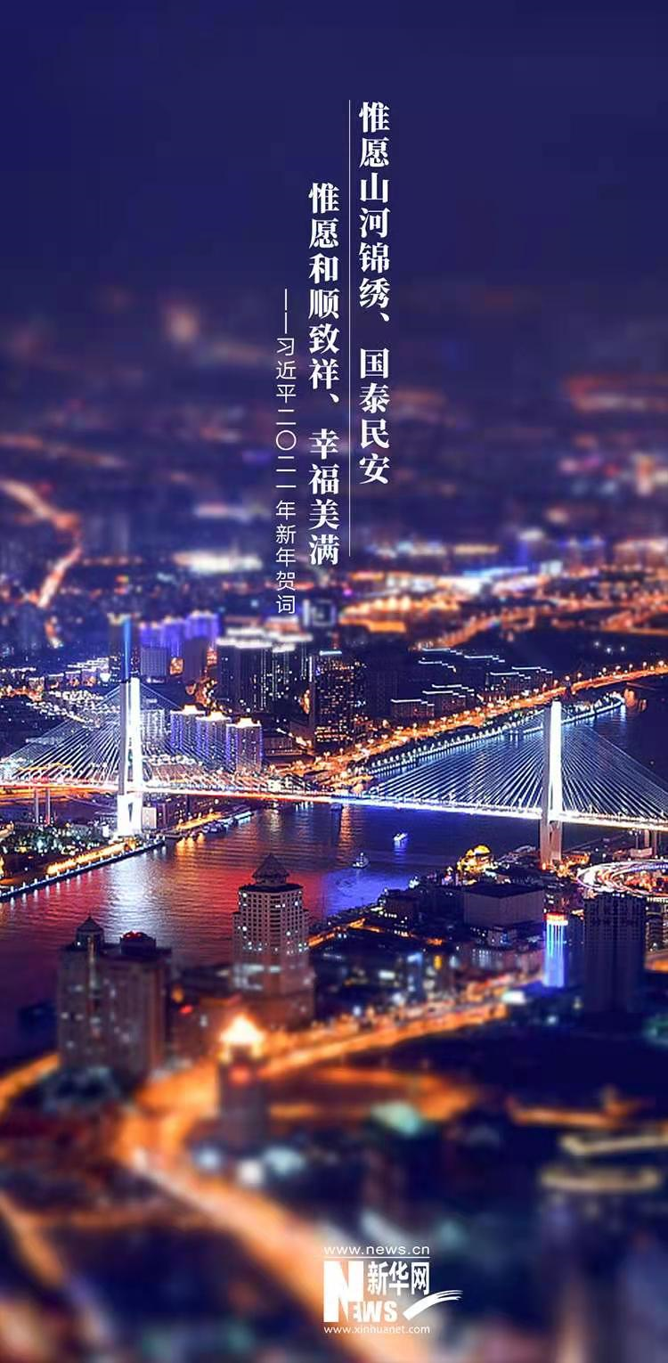
6. 美好祝愿
此时此刻，华灯初上，万家团圆。新年将至，惟愿山河锦绣、国泰民安！惟愿和顺致祥、幸福美满！
At just this moment, the festive lanterns have been lit, and family members gather for reunion. The New Year is coming. I wish our land to be splendid_{宾补}, our country to be prosperous_{宾补}, and our people to live in peace_{宾补}. I wish you all a harmonious, smooth and auspicious year_{宾补}, full of happiness_{宾补}!
谢谢大家！
Thank you!
lit /lɪt/ v. 点亮；点燃；（light 的过去式和过去分词）
prosperous /ˈprɒspərəs/ adj. 繁荣的；兴旺的
auspicious /ɔːˈspɪʃəs/ adj. 吉祥的，吉利的
wish真诚祝福的表达方式：wish接宾语从句_{虚拟语气}
wish sb / sth to do_{宾补}
wish + sb + 名词_{宾补}
http://www.sunedu.com

Slide 32

http://www.sunedu.com

