Slide 1


感恩遇见，相互成就，本课件资料仅供您个人参考、教学使用，严禁自行在网络传播，违者依知识产权法追究法律责任。
更多教学资源请关注
公众号：溯恩高中英语
知识产权声明

Slide 2
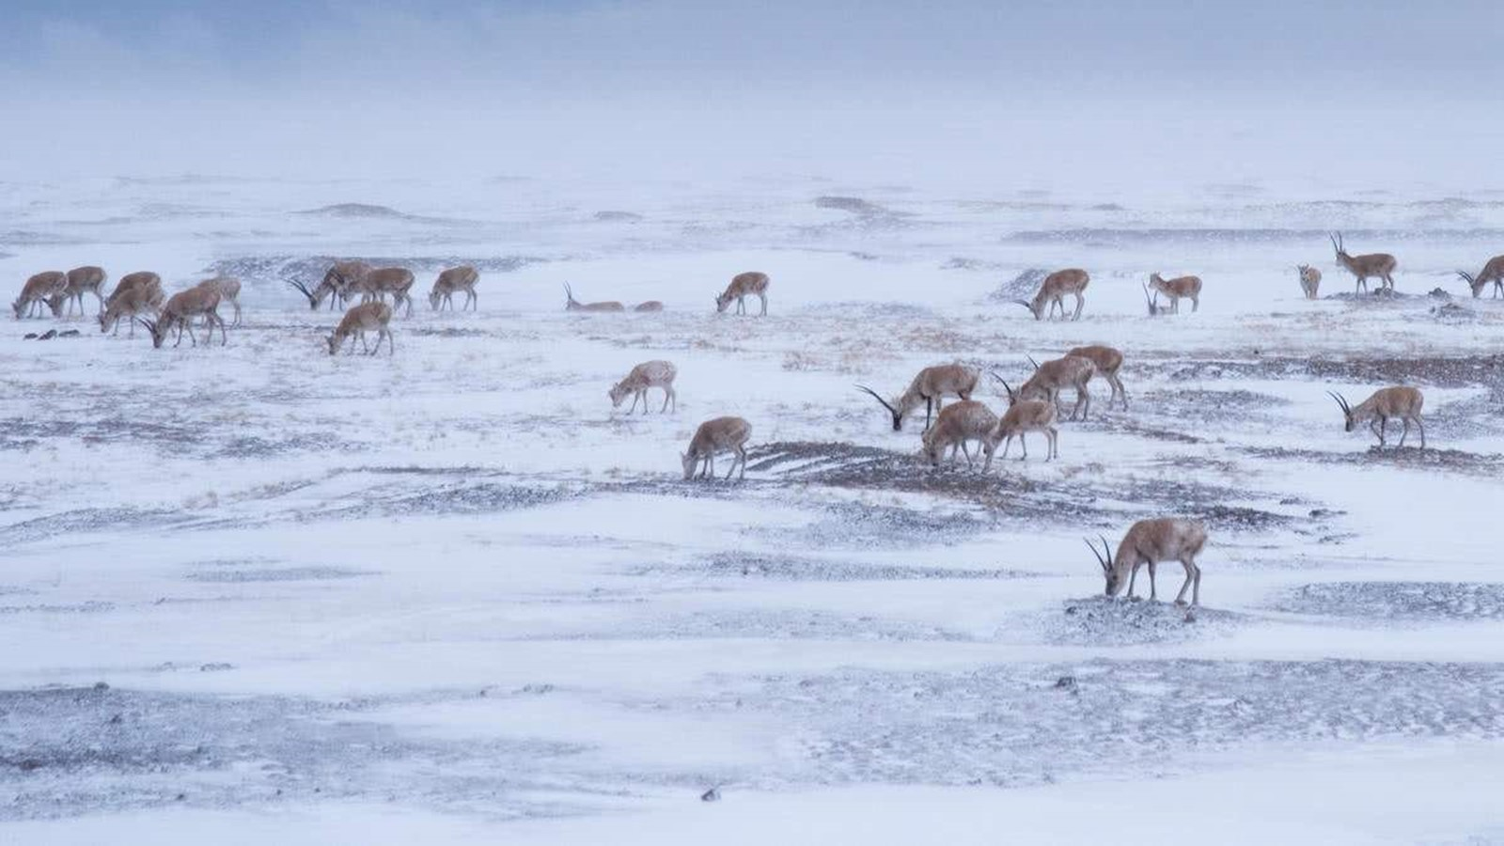
M2U2 Wildlife Protection A Day In The Clouds
 |  | 温溪高级中学 普高英语组 郑丹丹

Slide 3
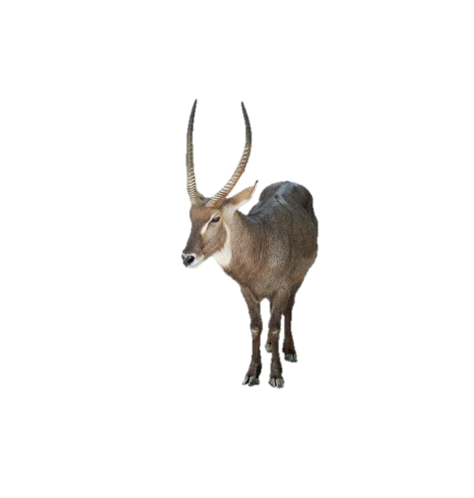
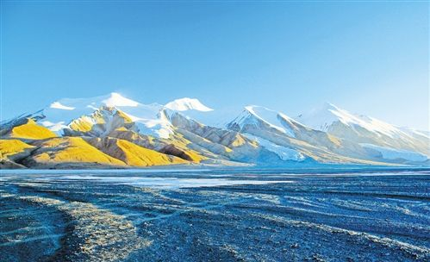
Learning objectives
At the end, you will be able to:
1. master the following new words and phrases:
plain,illegally,attack,threat,remind sb of,
take measures to do, intend to do...
2. know the past and present situation of an animal,
and what the government do for it.
3. make clear writer's attitude and opinion to wildlife protection
4. express your idea to protect wildlife.

Slide 4
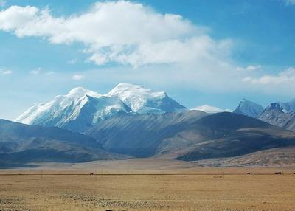
Make A Guess
————Who am I? (Animal)
Is it ________?
Clue1: It has two long but thin horns(角).
One of the habitats
Clue2: It has four feet.
Clue3: It is an endangered species.
Clue4: It can be seen on plains with high altitude.
Tibetan antelopes

Slide 5
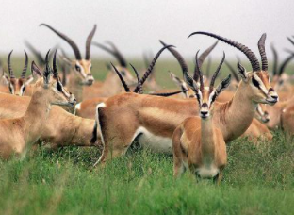
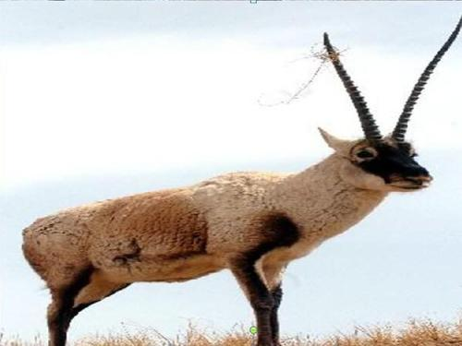
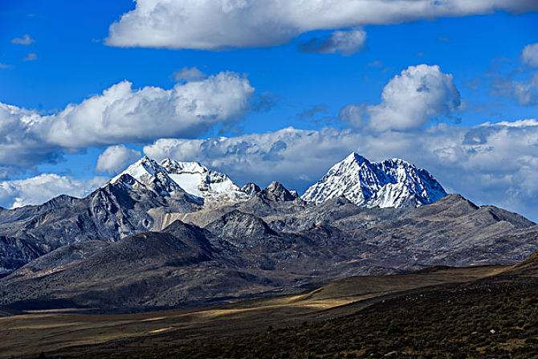
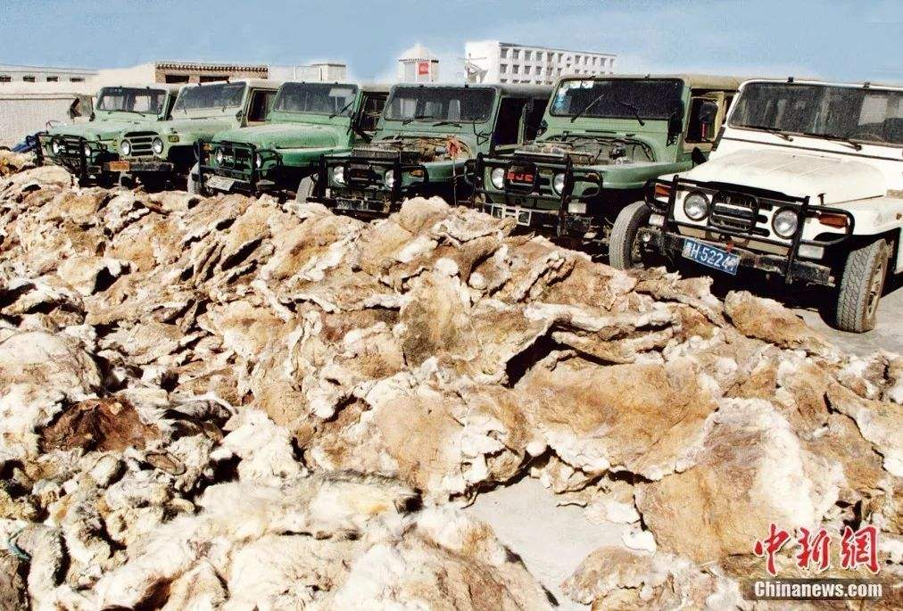
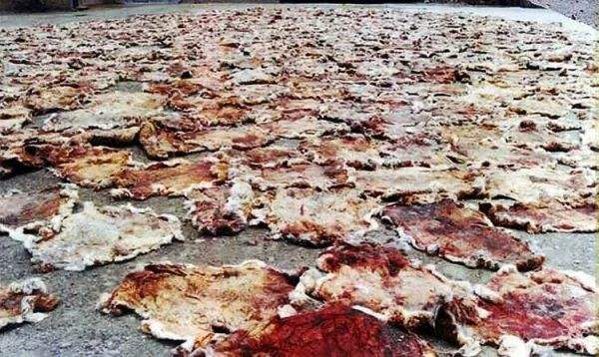

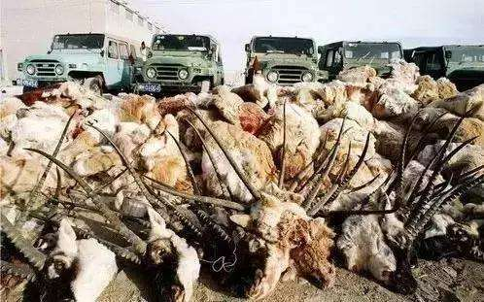
Lead-in
———— Know more about antelopes.
habitat
high altitude
low temperature
thin air
thick fur
villus(绒毛)
An endangered species in 1996. Only 47 thousand antelopes were left.
wraps

Slide 6
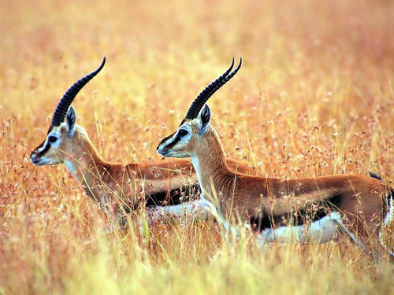
Prediction
A Day In The Clouds
What type of passage is it?
A. Magazine
B. Argumentation(议论文)
C. Description(说明文)
D. Journal(旅行日志)
One day, the writer went to the plain to observe antelopes.
who?
where?
what?
What I see
What I hear
What I reflect

Slide 7
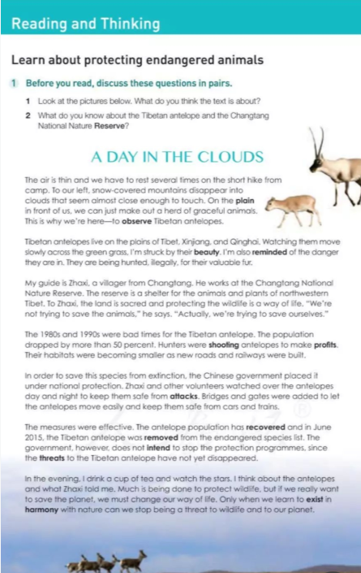
Read for Structure
Para ____: What I see
1-2
3-6
Para ____: What I hear
Para ____: What I reflect
7

Slide 8
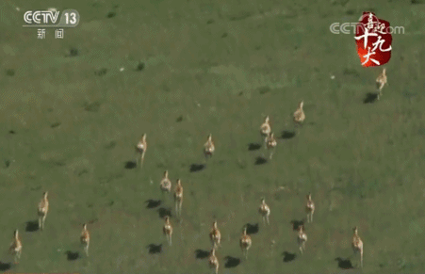
Read for “Eyes”
What did “I” see during the day?
a. snow-covered mountains
Mountain is very high
high enough to touch the clouds
b. A herd of graceful antelopes
Writer’s purpose
moving slowly across …
Feeling:
Present situation: antelopes can be seen moving on the _____, which ______ the writer ____ the danger(being hunted_______) they are in.
Writer is moved/affected/struck.
plain
reminds
of
He is also reminded of the danger they are in.
illegally

Slide 9
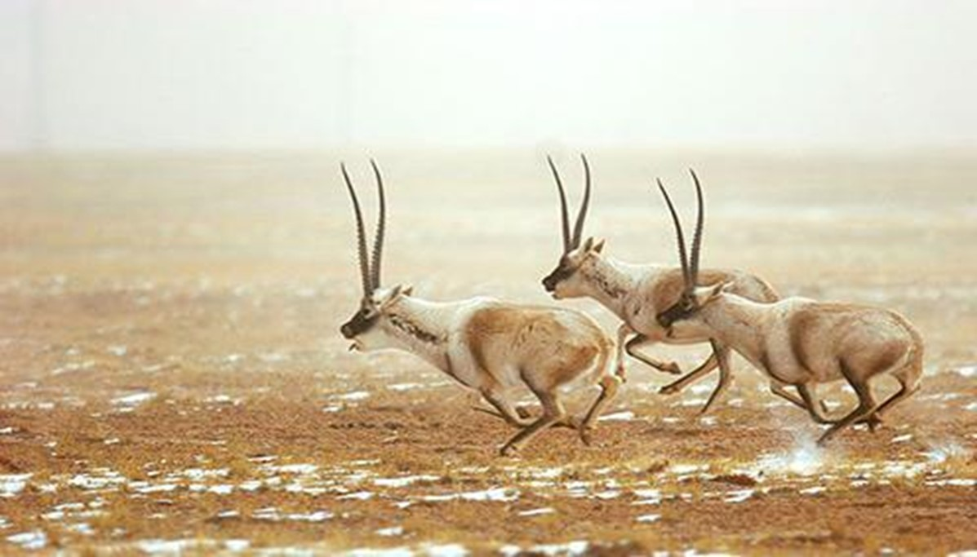
Read for “Ears”
What did “I” hear during the day?
Para 3
The ______ of “my” guide
When? What? Why?
Para 4
Two bad _______
Who? What?
belief
times
way of life
What?
From whom?
Para 6
The_____ of the measures
Para 5
The protective _________
How?
measures
effect

Slide 10
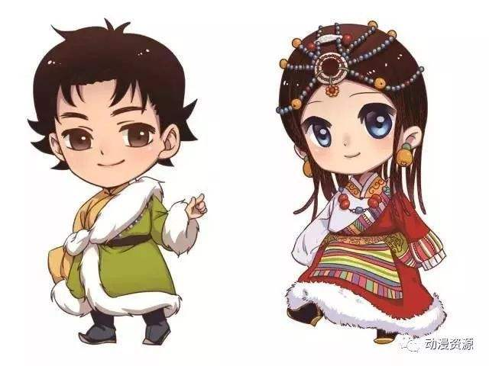
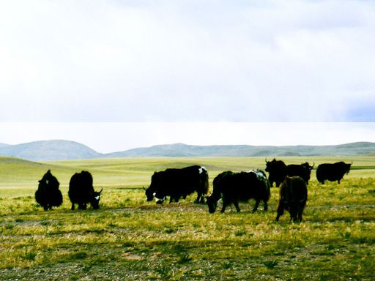
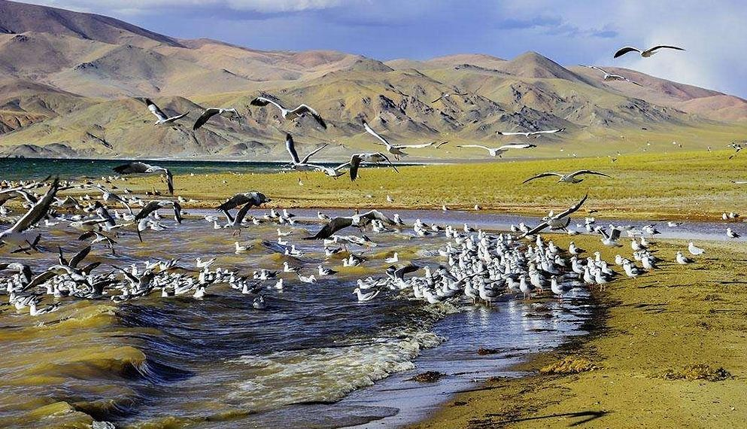
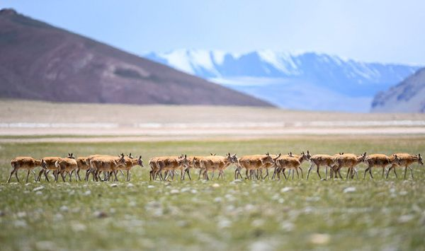
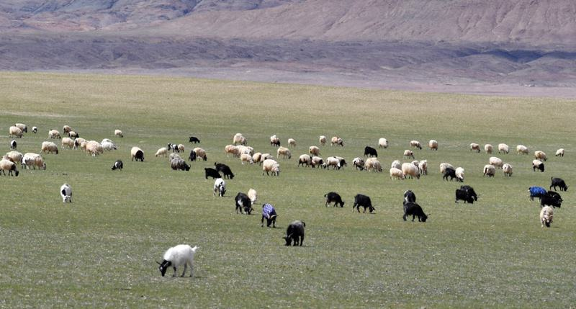
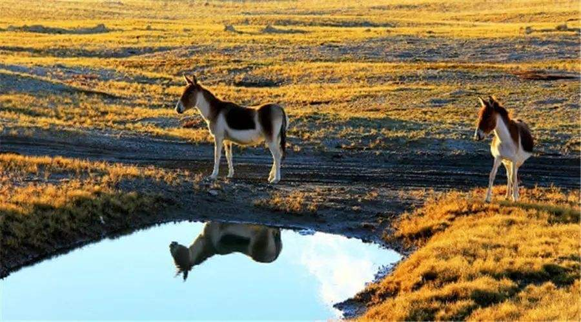
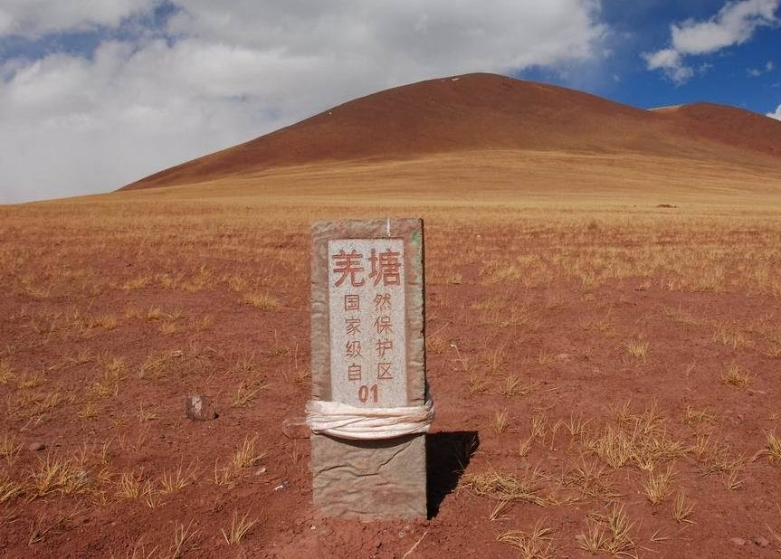
Read for “Ears”
Name:
Identity: Tibetan
(A villager from Changtang)
Job: 1. Guide
2. ________
Belief:
Zhaxi
Protector (Changtang National Nature Reserve)
Saving animals is saving ourselves.

Slide 11
Read for “Ears”
What did “I” hear during the day?
(4-6)
Population
(thousand)
Effective
250
Cruel(残忍的)
a. Government: national protection
During the day, the writer begins to know what antelopes went _______ in the past, such as being shot to ____ ______, and losing their_______. The writer also learns about that the government and people have taken effective ________ to prevent antelopes safe from ______. Luckily, the antelopes were removed _____ the list in 2015. But the government does not intend ______ the programmes, since the ______ have not disappeared. More can be done.
200
200
through
make
profits
170
a. Hunters were shooting…
The government doesn’t intend to stop.
150
recover
drop
b. People: watch over day and night
habitats
b. Habitats were becoming smaller.
measures
100
c. Bridges and gates were…
attacks
60
More can be done
50
47
from
to stop
threats
Then?
1980
1996
2006
2016
Result: It was removed from the endangered species lift.

Slide 12
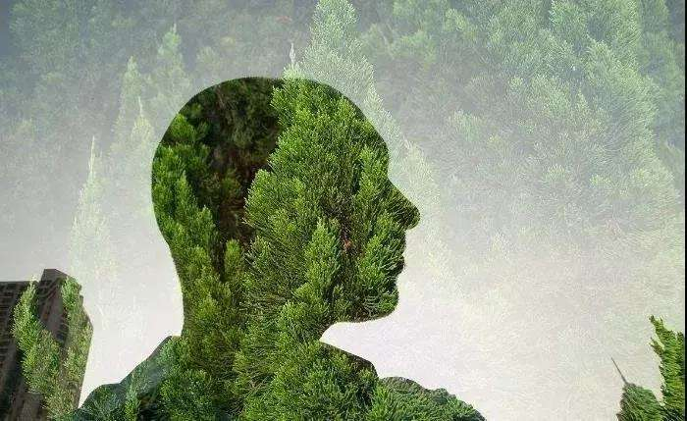
Read for “Heart”
In the evening, how does the writer reflect on the day’s observation?
We must change our way of life to exist in harmony with nature.
VS
Zhaxi’s way of life
How?
Going against nature
Protecting wildlife
DO NOT buy wildlife goods.
DO NOT destroy their habitat.
Join the volunteer protection group.
Lead a greener life.
Spread the news about the illegal hunting.

Slide 13
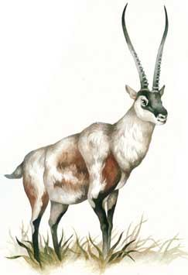
Summary
significant/valuable/exciting…
A ______Day In The Clouds
meaningful
What I see
What I hear
What I reflect

Slide 14
Assignment
With all these efforts, suppose the author goes back to Tibet to observe the antelopes several years later, what will be the enviornment and the relationship between human beings and the Tibetan antelope? Please describle the situations with the useful expressions in the text.
snow-covered mountains; a herd of graceful animals;
move slowly across the green grass; observe Tibetan antelopes;
Watching..., I'm struck by their beauty; can just make out a herd of ...
exist in harmony with nature; The land is sacred.
I drink a cup of tea and watch the stars... the paradise for the wildlife

Slide 15
Sample
To observe Tibetan antelopes, we came to Tibet. There we made out a herd of graceful animals and were struck by their beauty. I was reminded of the danger they are in. They are being hunted illegally for their valuable fur.
To protect them，the Changtang National Nature Reserve was set up, which is the paradise for the animals and plants of northwestern Tibet.
In the 1980s and 1990s，the population dropped badly because of being shot to make profits and the loss of their habitats. In order to prevent this species from extinction, the Chinese government took effective measures to place it under national protection. Its population has recovered and it was removed from the endangered species list. However, the government didn’t intend to give up the protection programs. To save wildlife, we should learn to exist in harmony with nature.

