Slide 1


感恩遇见，相互成就，本课件资料仅供您个人参考、教学使用，严禁自行在网络传播，违者依知识产权法追究法律责任。
更多教学资源请关注
公众号：溯恩高中英语
知识产权声明

Slide 2
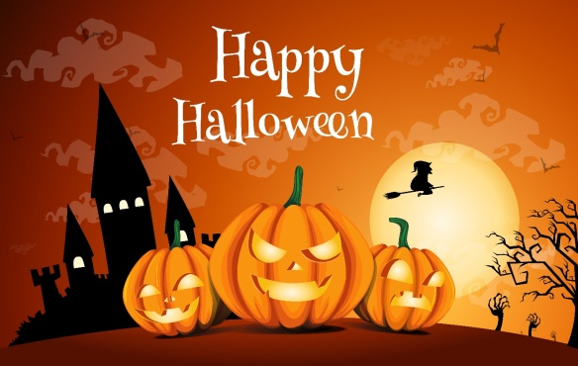
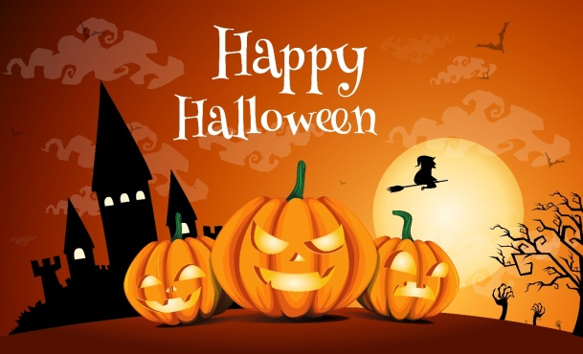
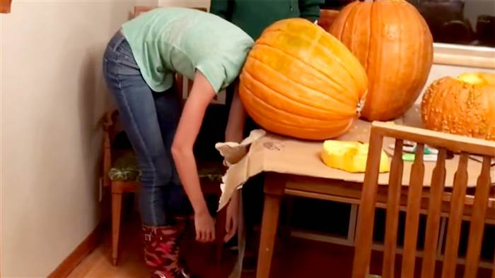
2021年1月浙江英语高考
读后续写讲评
I Got My Head Stuck in a Pumpkin
Thinker, Tiantai High School

Slide 3
试题呈现:
Pumpkin(南瓜) carving at Halloween is a family tradition. We visit a local farm every October. In the pumpkin field, I compete with my three brothers and sister to seek out the biggest pumpkin. My dad has a rule that we have to carry our pumpkins back home, and as the eldest child I have an advantage - I carried an 85 -pounder back last year.
This year, it was hard to tell whether my prize or the one chosen by my 14-year Old brother, Jason, was the winner. Unfortunately we forgot to weigh them before taking out their insides, but I was determined to prove my point. All of us were hard at work at the kitchen table, with my mom filming the annual event. I'm unsure now why I thought forcing my head inside the pumpkin would settle the matter but it seemed to make perfect sense at the time.
With the pumpkin resting on the table hole uppermost, I bent over and pressed my head against the opening. At first I got jammed just above my eyes and then, as I went on with my task, unwilling to quit, my nose briefly prevented entry. Finally I managed to put my whole head into it，like a cork（软木塞）forced into a bottle. I was able to straighten up with the huge pumpkin resting on my shoulders.

Slide 4
My excitement was short-lived. The pumpkin was heavy. "I'm going to set it down, now, "I said, and with Jason helping to support its weight, I bent back over the table to give it somewhere to rest. It was only when I tried to remove my head that I realized getting out was going to be less straightforward than getting in. When I pulled hard, my nose got in the way. I got into a panic as I pressed firmly against the table and moved my head around trying to find the right angle, but it was no use. "I can't get it out!“ I shouted, my voice sounding unnaturally loud in the enclosed space.
Paragraph 1:
I was stuck for five or six minutes though it felt much longer.__________________ __________________________________________________________________________
Paragraph 2:
That video was posted online the Monday before Halloween.___________________ ___________________________________________________________________________

Slide 5
About Halloween:
Halloween is a holiday ________________ each year on October 31. The tradition dates back to the ancient Celtic festival of Samhain, ______ people would light bonfires and wear costumes to scare off ghosts. This day marked the end of summer and the harvest and the ____________ of the dark, cold winter. During the celebration, the Celts wore costumes, typically __________ (consist) of animal heads and skins, and attempted to tell other _________ (people) fortunes.
In the eighth century, Pope Gregory III designated November 1 as a time __________ (honor) all saints. Soon, All Saints Day incorporated some of the traditions of Samhain. The evening before was known as All Hallows Eve, and later Halloween. Over time, Halloween evolved into a day of activities like trick-or-treating, carving jack-o-lanterns, festive gatherings, donning costumes and eating _________.
celebrated
when
beginning
consisting
people’s
to honor
treats

Slide 6
语言积累:
1.找出最大的南瓜
2.规定
3.比…有优势
4.给这一年一度的事件拍视频
5.完全有道理，讲得通
6.把头顶着开口
把头紧压在桌上
把脸紧靠在窗上
7.站直，挺直身子
8. 挡路/道
9.陷入惊恐
1. seek out the biggest pumpkin
2. have a rule that, make it a rule that
3. have an advantage over
4. film the annual event
5. make perfect sense
6. press one’s head against the opening
press one’s head against table
press one’s head against the window
7. straighten up
8. get in the/one’s way
9. get into a panic

Slide 7
语言积累: Appreciate the word rest in different sentences.
1.With the pumpkin resting on the table hole uppermost, I bent over and pressed my head against the opening.
2.I was able to straighten up with the huge pumpkin resting on my shoulders.
3.I bent back over the table to give it somewhere to rest.
4.She let her gaze rest on his face for a moment.
1-3.be supported on/against/in... (靠在…上)
4.(目光)停留在…

Slide 8
文本理解:
Celebrating Halloween is a family tradition. _______ out the biggest pumpkin was an annual ___________ (compete) among the kids in my family.
With the ______ (prize) pumpkin home and ________(rest) on the table hole uppermost, I somehow pressed my head _______ the opening. Though a bit jammed, I managed to put my whole head into the pumpkin, which made me feel ______. But the excitement soon transformed into the ________ to get my head out. After several ______(fail) attempts, even with my ________(brother) help, I was still stuck and got into a ______. Exhausted and helpless, I started to shout ____help.
Seeking
competition
prized
resting
against
proud
struggle
failed
brother’s
panic
for

Slide 9
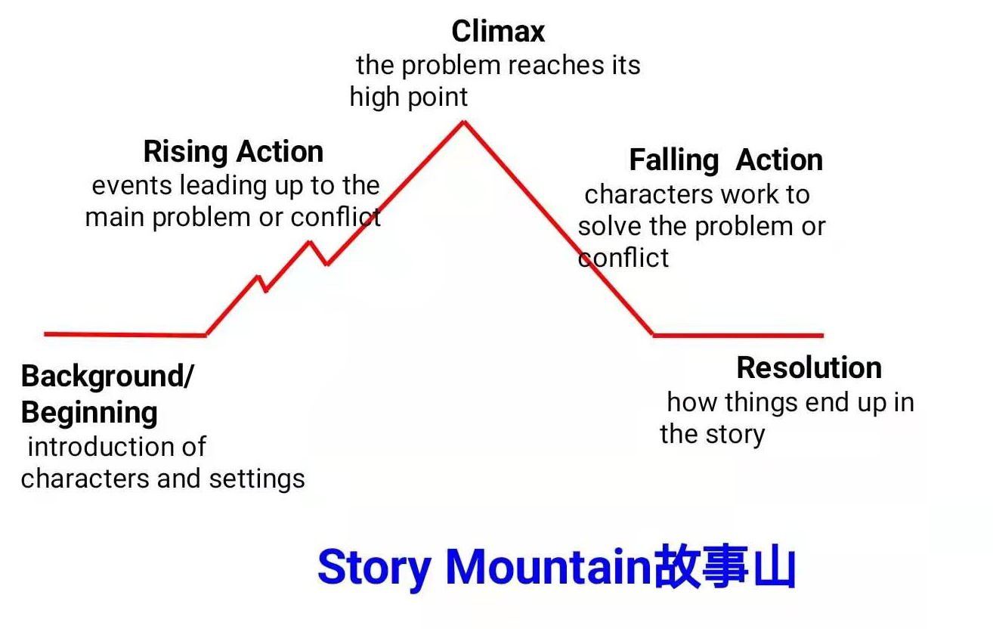
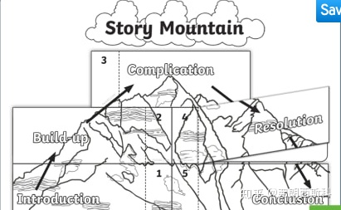
文本理解:
故事山能够帮助迅速理清故事结构，锻炼写作能力。

Slide 10
文本理解:
Climax
I failed to get my head out of the pumpkin after several failed attempts.
Rising Action
I managed to put my head into the hollow pumpkin, feeling proud.
Nervous/Worried
Falling Action
Para1: I was stuck for five or six minutes though it felt much longer.
Proud
?
Background/Beginning
We seek out the biggest pumpkin for the Halloween every year.
Resolution
Para2: That video was posted online the Monday before Halloween
?
Excited
Story Mountain故事山

Slide 11
情节构思:
Paragraph 1:
I was stuck for five or six minutes though it felt much longer.
Paragraph 2:
That video was posted the Monday before Halloween.
1.How did I feel while stuck in the pumpkin?
2.How did I get my head out?
3.How did I feel afterwards?
Who shot the video/ filmed the event?(前文)
What was the video about?
1.How widely was the video shared online?
2.How did the family members react to it?
3.My reflections.

Slide 12
情节构思:
Paragraph 1: I was stuck for five or six minutes though it felt much longer.
1.How did I feel while stuck in the pumpkin?
2.How did I get my head out?
Regretful: How I wished I had not acted so foolishly, making myself a laughing stock of my family.
Shameful: While stuck in the pumpkin, I could well imagine how they would look when my head came out.
Jason rushed to Dad for help. Dad carefully cut the pumpkin open and helped my head out.
Jason’s mind worked fast and he came up with an idea to helped me out. After what seemed like a century, a bright world came into my sight again.
Jason and Dad worked together, tearing pumpkin into two.

Slide 13
情节构思:
Paragraph 1: I was stuck for five or six minutes though it felt much longer.
Paragraph 2: That video was posted the Monday before Halloween.
3.How did I feel afterwards?
I breathed a sigh of relief. But with the messy hair, I stood there, as if the whole world were looking at me.
When I realized that Mother was still shooting and would upload it online, I rushed for the camera in her hand.
1.How widely was the video shared online?
Go viral: Many likes, funny comments
Immediately become a hit
Out of curiosity, people came to our house to take photos with the prized pumpkin
Become sort of a celebrity, easily recognized in public places

Slide 14
情节构思:
Paragraph 2:
That video was posted the Monday before Halloween.
2.How did the family members react to it?
3.My reflections.
Jason: delighted that he became famous overnight
Mother: could never have imagined that her video could receive so many page views and thus grew even crazier about shooting videos.
Dad: occasionally joked about my embarrassment
Though feeling a bit embarrassed, I felt a stronger family bond – a family surrounded by love and fun.
Bathed in the festive atmosphere, I totally forgot the “unforgettable” incident and set out for the trick-or-treating.
I would take it as a treat to add joy and fun to this festive Halloween for everyone.

Slide 15
语料积累:尴尬
1. She put her hands to her cheeks in embarrassment.（动作+情感名词）
--- cover one's mouth/forehead,
2. She stood beside her chair, surprised and embarrassed.（动作+情感形容词）
3.So embarrassed was she that she stood there clumsily, feeling the blood rush to her face.
4. She scratched her head, hoping to find a hole to hide herself.
5.He bit his lips, not knowing where to rest his arms/hands
6. She lowered her body, hesitated for a moment, wondering how to hide her inner embarrassment.
7. She opened her mouth, her face/cheeks turning red/burning hot.

Slide 16

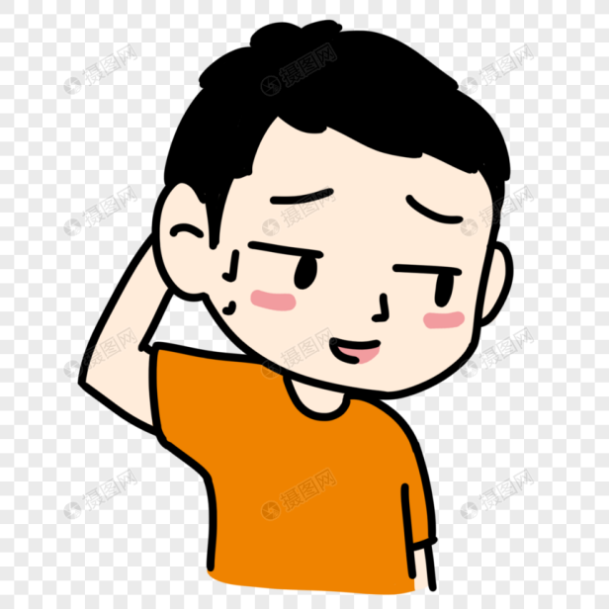
语料积累:尴尬
8. All the air seemed to disappear and she felt as if the whole world were watching her.（环境描写）
9. An embarrassed look appeared on her face. 尴尬的表情
10. Jack's face flushed/burned with embarrassment.
11.A pale pink crept over one's neck.
--A deep blush came up over one's collar.
--A sudden flush spread over one's cheeks.

Slide 17
下水作文:
I was stuck for five or six minutes though it felt much longer. How I wished I had not acted so foolishly, making myself a laughing stock of my family! I could well imagine how they would look when my head came out. Seeing my repeated efforts but in vain, Jason darted out of the room and turned to Dad for help. Seeing me caught in such a situation, Dad was unexpectedly surprised, but soon surprise transformed into laughter. He tried many approaches, and eventually managed to get my head out by carefully cutting the pumpkin open with a knife. Just when I felt relieved to be freed from the pumpkin, I suddenly found that mom should be shooting all that happened to me and would upload it online.
运用虚拟语气，把后悔的心理活动 表达地很生动。
连续4处运用分词状语seeing, making, seeing, caught,，增加了语言的高级感和表达的紧凑感。
运用无灵主语，句式多样化，更生动。
运用语言情节来过渡，使行文自然，文本有生命力。
高级词块:repeated efforts, laughing stock, dart out,
be caught in.

Slide 18
下水作文:
That video was posted online the Monday before Halloween. It went viral immediately. Just within hours, hundreds of likes and funny comments appeared, showing their enthusiasm. Constant streams of curious people even came by to take photos with us and my prized pumpkin. Jason was really excited and Mom was glad that her video should become such a hit and thus grew even crazier about shooting videos. But for me, though a little embarrassed, I soon totally forgot the “unforgettable” incident and set out for the trick-or-treating. I would like to take it as a treat to add joy and fun to this festive Halloween for everyone.
运用分词状语增加了语言的高级感和表达的紧凑感。
较多运用高级词块:go viral, constant streams of, prized, become a hit.
最后一句话的点题很应景，句中的treat巧妙地与万圣节主题trick-or-treat联系起来。

Slide 19
原作的续写部分:
I was stuck for five or six minutes though it felt much, much longer. The video cuts before my rescue – Dad got me to push my head farther into the pumpkin so Mom could reach in and undo the rubber band round my ponytail. I emerged with squash-conditioned hair, a sore chin and my nose plugged with pulp.
That Facebook video went up the Monday before Halloween, and by the end of that day it had over 1,000 views. People asked Mom to put it on YouTube, and by Wednesday morning we were getting 5am calls from TV breakfast shows and then the international media – the video started racking up hundreds of thousands of views. When I went on a youth camp, I was recognised by children I’d never met. The pumpkin also became a minor celebrity. Passers-by and trick-or-treaters would knock and ask, “Which is Rachel’s pumpkin?” before taking selfies with it.
Although our pumpkin carving the following year was a more sedate affair, I wouldn’t say I learned my lesson. A few months later I squeezed myself into a laundry basket during a game of hide-and-seek and became hopelessly jammed. It was Dad who responded to my cries for help.

Slide 20




