Slide 1


感恩遇见，相互成就，本课件资料仅供您个人参考、教学使用，严禁自行在网络传播，违者依知识产权法追究法律责任。
更多教学资源请关注
公众号：溯恩高中英语
知识产权声明

Slide 2

2021年1月浙江高考英语试题听力
语音分析
佳诚高级中学
焦海滨老师制作

Slide 3
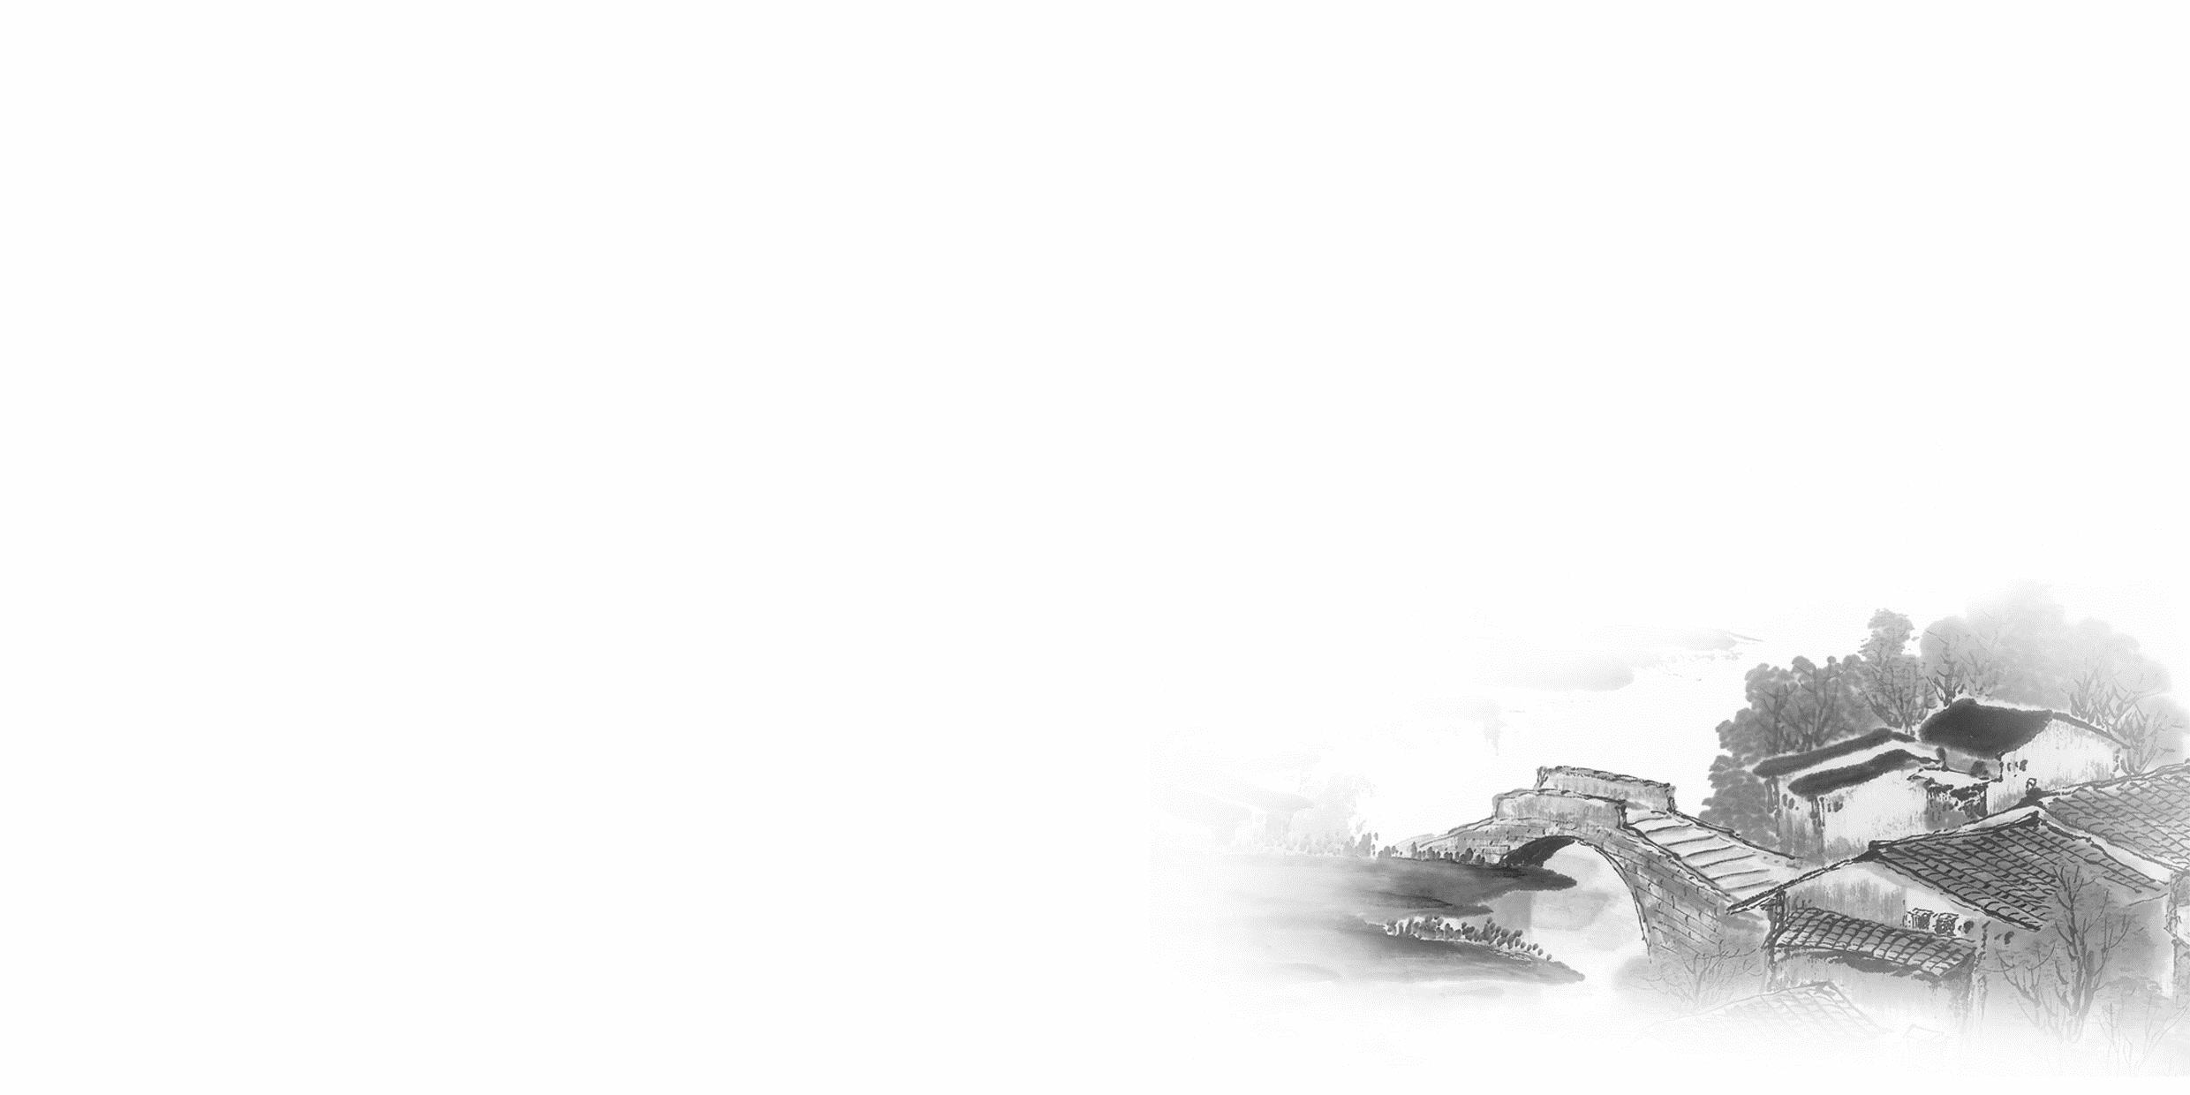

影响听力的因素
心理因素学生在进行听力练习或考试时往往表现为听音时感到紧张、焦虑因而导致无法正常听音。
壹
缺乏背景知识由于没有语言环境，学生很少了解听力材料中的背景知识，无法做出正确的判断、推理、猜测。
贰
叁
学生缺乏听力解题技巧研究发现，很多情况下由于听者未能掌握相关的听力技巧，因而不能很好地理解听力材料。
肆
词汇储备不足一个学生的听、说、读、写要达到一定的水平，必须拥有相应数量的必备词汇。

Slide 4

语音知识对听力的影响
在听力理解的过程中，语音是第一位的，听者首先接受的是语音信息，大脑接受了因素，音节，中音等因素构成的单词，短语和句子后使他们在自己的语言图式中“对号入座”，根据已有的知识结构( 图式 ),开始对该信息进行建构，以理解其意义。

Slide 5
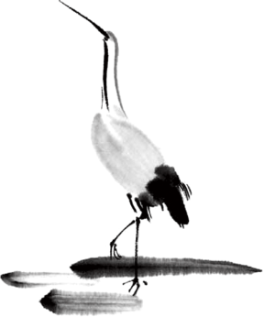
语速的加快主要有一下三种原因
壹
贰
叁
连读
（ 以下用红色标记 )
省音
（ 以下用蓝色标记 ）
变音
（以下用黄色标记 ）

Slide 6
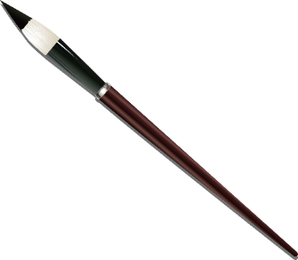

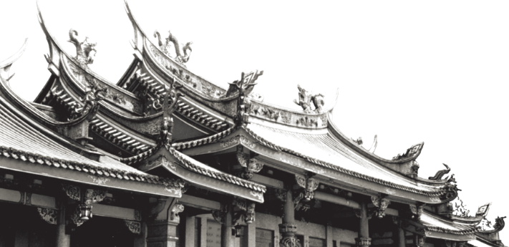
一，连读 （ 以下用红色标记 )
1，“辅音+元音”型连读（异性相吸）
如：I’d like another bowl of rice.
2、“辅音+半元音”型连读英语语音中的/j/和/w/是半元音，如果前一个词是以辅音结尾，后一个词是以半元音，特别是/j/开头，此时也要连读。Thank you .

Slide 7


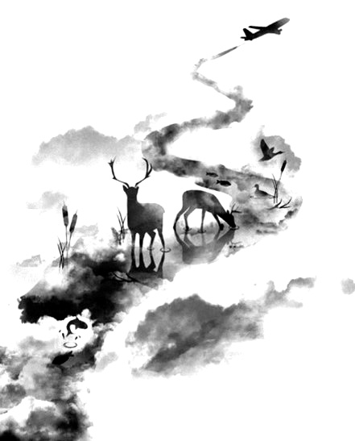
二，省音 （以下用蓝色标记）
01
壹
一、爆破音/b/ /p/ /d/ /t/ /g/ /k/
1.以上任何一个爆破音后面如果紧接着是一个辅音或者半元音，那么这个爆破音将不再发音，仅空半拍就行。如：Good morning!可以发为/gu_'mɔ:niŋ/。
2.以上任何一个爆破音在句尾时，这个爆破音不再发音。如：Good night!最后的/t/音便不再发，整句话可读作/gu_nai_/。

Slide 8
省音 （以下用蓝色标记）
01
二、不完全爆破
① 爆破音中的任何两个爆破音相邻时，前一爆破音失去爆破。如：a big car等。
② 爆破音中的任何一个后接摩擦音f,h,x,sh,s,r时，前面的爆破音失去爆破。
如：I didn't say so.
③ 爆破音后接/t/， /d/， /tr/， /dr /时，前面的爆破音失去爆破。如：a great change等。
④ 爆破音后接/m/, /n/, /l/, /s/时，前面的爆破音失去爆破。如：a bit more expensive等。

Slide 9
省音 （以下用蓝色标记）
01
三、/s/-/z/ /ts/-/dz/ /∫/-/ ʒ / /t∫/-/ dʒ / /θ/-/ ð / ds发/dz以上任何两个音相遇，只读后面的那个音，而前面的音则省略不发。
如：Who is Stone?可把前面一个/z/省掉，只读作/hu i stəun /。

Slide 10
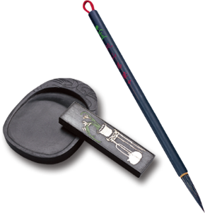
音的变化也是一种连读现象，两个词之间非常平滑的
过渡，导致一个音受临音影响而变化。
主要是以下两种方式：
1、 辅音[d]与[j]相邻时，被同化为[dʒ]：
Would you....?
2、 辅音[t]与[j]相邻时，被同化为[t∫]：
Can’t you？
三.变音
（以下用黄色标记 ）

Slide 11
听力试音材料
M:Hello ! International Friends Club , can I help you ?
W: Oh , hello ! I read about your club in the paper today . And I thought I’d phone to find out a bit more .
M:Yes , certainly . well , we’re a sort of social club for people from different countries . It’s quite a new club .we have about 50 members at the moment but we’re growing all the time .

Slide 12
听力试音材料
W: That sounds interesting .I’m British actually ,and I came to Washington about three months ago ,I’m looking for ways to meet people . . Er ,what kinds of events do you organize ?
M: well , we have social get-togethers ,and sports events ,and we also have language evenings
W: Could you tell me something about the language evenings ?

Slide 13
听力试音材料
M: Yes , every day except Thursday , we have a language evening. People can come and practice their languages .you know , over a drink or something .we have different languages on different evenings . Monday -Spanish; Tuesday- Italian ;Wednesday- German and Friday- French .On Thursday we usually have a meal in a restaurant for everyone who wants to come .

Slide 14
听力试音材料
W:well,that sounds Great , I really need to practice my French .
M: Ok , well if you can just give me your name and address I’ll send you the form and some more information .If you join now ,you can have first month free .

Slide 15
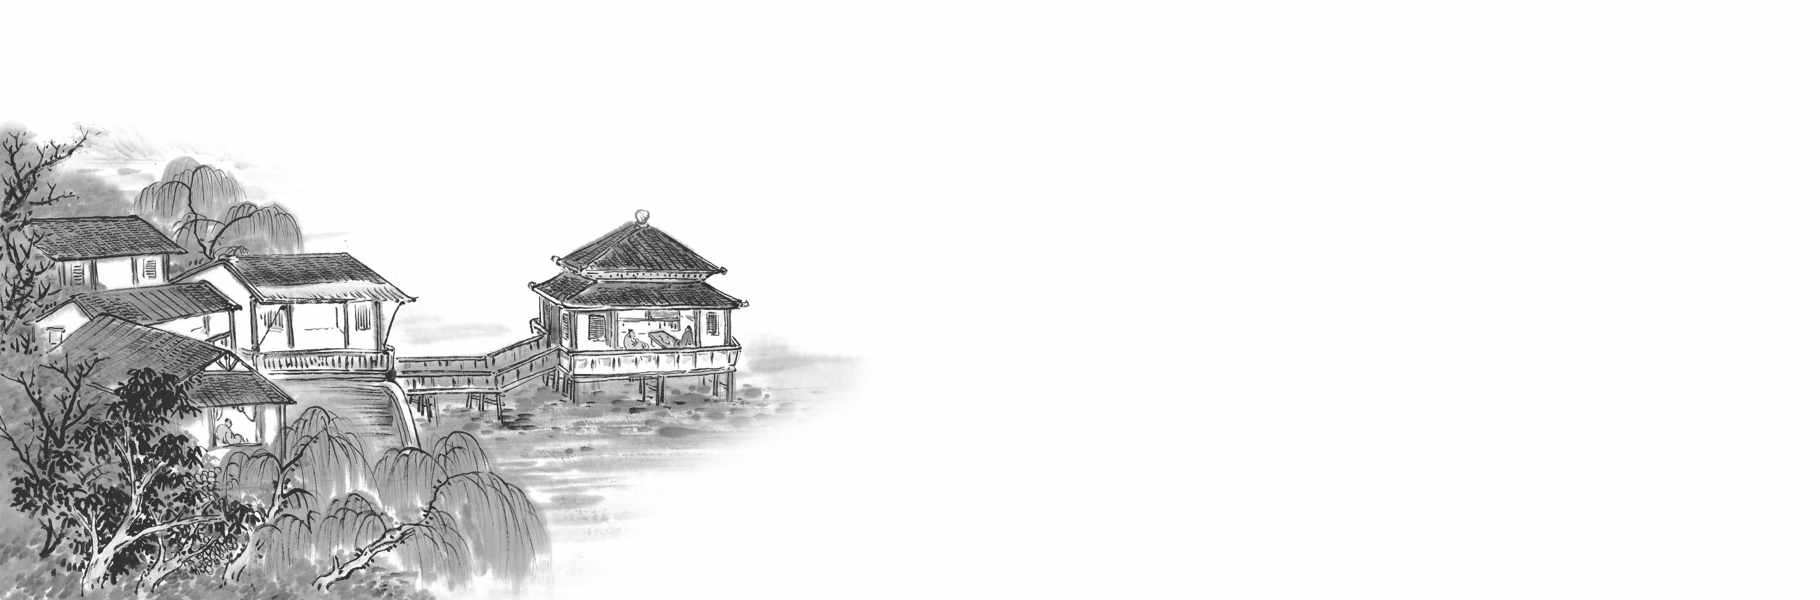

例题
M:Excuse me ,can you tell me how much the shirt is ?
W：Yes, it’s nine-fifteen.
例：How much is the shirt?
A. ￡19.15. B. ￡9.18. C. ￡9.15.

Slide 16

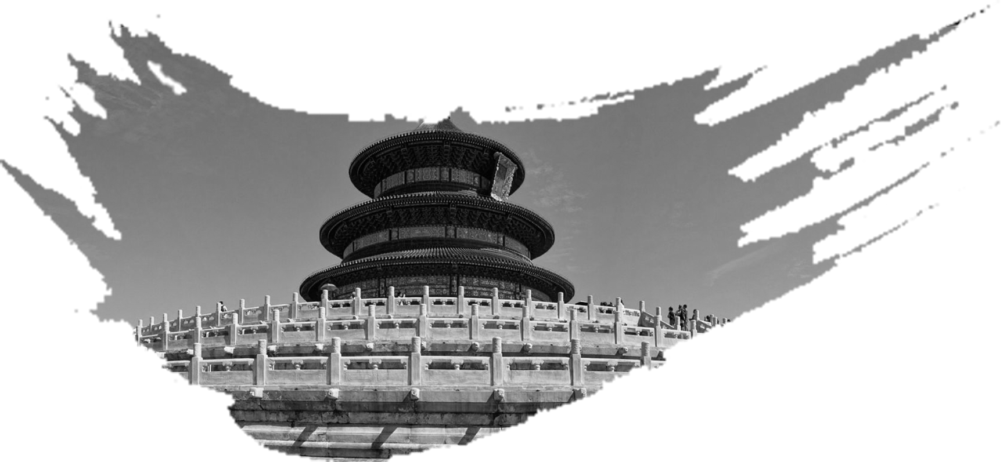
Text 1 31词 谈论昨日活动
M: Did you go to the football game yesterday?
W: No, I couldn’t make it. I was stuck in the lab.
M: You missed a really good game. Our school team played very well.
What did the woman do yesterday?
A. She played football. B. She watched a game. C. She worked in the lab

Slide 17
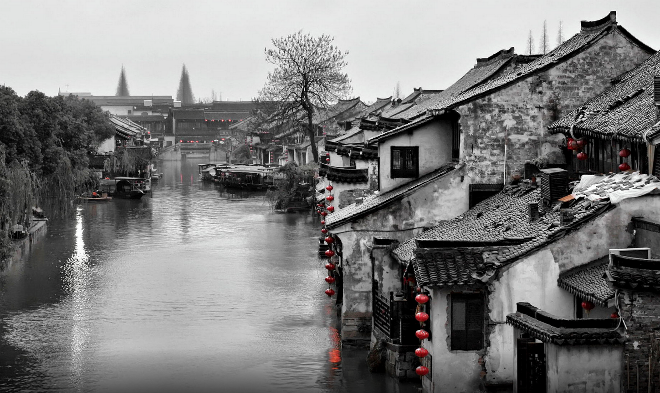

Text 2 Text 2 31词 天气
——————————
Text 2
W: Did you hear the weather forecast for tomorrow?
Is it going to be windy?
M: No. There would be high clouds in the morning and many showers in
the afternoon and evening.
2. What will the weather be like tomorrow evening?
A. Cloudy. B. Rainy. C. Windy.

Slide 18
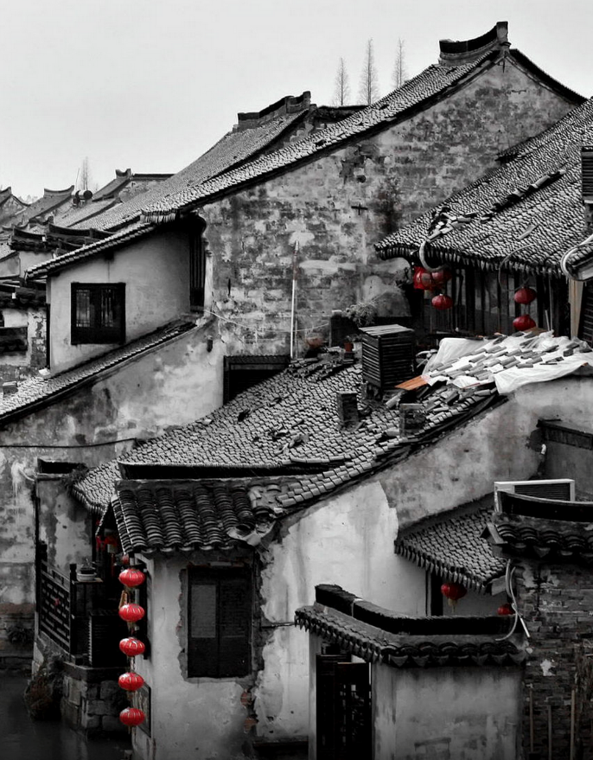
Text 3 41词 周末计划
M: Kate, let’s go for a picnic somewhere this weekend.
W: Good idea. Can Jack go with us? He studied hard for his
exam in the past two weeks.
M: I don’t think so. He’s going on a trip this weekend with his
school.
3.What will Jack do this weekend?
A. Go on a school trip.
B. Have a family picnic.
C. Prepare for an exam.
天人合一
天 下 皆 知 美 之 为 美 ， 斯 恶 已
皆 知 善 之 为 善 ， 斯 不 善 已
有 无 相 生 ， 难 易 相 成 ， 长 短 相 形
高 下 相 盈 ， 音 声 相 和 ， 前 后 相 随
恒 也

Slide 19

T Text 4 40词 取消访问
M: Hello, is it Emma? This is Robert Allen from Johnson’s Electronics.
W: Hello, Robert. What can I do for you?
M: It’s this visit by Mr. Johnson. I’m afraid he’s had an emergency and won’t
be able to make it this time.
4. Why does the man make the call?
A. To arrange a meeting.
B. To cancel a visit.
C. To ask for assistance.

Slide 20
Text 5ext 29词 接机
M: We’ve been waited long?
W: No, just a few minutes. How was the flight?
M: It was fine, thanks. I slept through the whole flight, actually, and I feel much
better.
5. How does the man feel now?
A. Refreshed. B. Anxious. C. Sleepy.

Slide 21
Text 6 55词 晚饭
M: I’m starving. What are we having for dinner tonight, Jane?
W: I’m not sure. Something would come to mind once I start.
M: I feel like eating French fries, or maybe ham sandwich. How about you?
W: Actually, I was thinking of making something healthy, say… fish and
vegetables.
M: Well, in that case, I’ll have whatever you make.

Slide 22
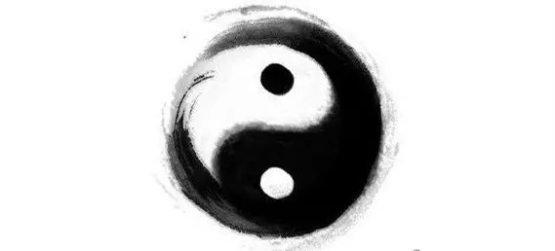
6. What is the probable relationship between the speakers?
Husband and wife.
B. Hostess and guest.
C. Chef and customer.
7. What is the man most likely to have for dinner?
French fries.
B. Ham sandwiches.
C. Fish and vegetables.

Slide 23
Text 7 135词 罗马新规
W: Hello, George. I heard that you’re going to Milan for a business trip next week.
M: Yes, Susan. I’m also planning a trip to Rome for sightseeing after that.
W: Oh, I’m just back from Rome. The city has made some new rules.
M: Really? What rules?
W: For example, people who dress up as Rome soldiers and charged for photos won’t be
allowed near hot tourist spots. And street performers can’t sing or play that music on
public transport. Another rule, that’s tourists can’t eat in common places.
M: That’s good. Eating in comedy is inappropriate and can lead to littering .
W: Rome isn’t the only city to do that. Last year, Florence made a rule saying that a
tourist could face fines about to 500 euros if caught eating in the street.
M: Wow, that’s big money, but it’s understandable.

Slide 24
8. Where will George go after the business trip?
A. Milan. B. Rome. C. Florence.
9. What is banned in Florence?
A. Eating in the street.
B. Dressing up as soldiers.
C. Singing on public transport.
10. What does George think of the new rules?
A. They’re effective.
B. They’re timely.
C. They’re reasonable.
天人合一
天 下 皆 知 美 之 为 美 ， 斯 恶 已
皆 知 善 之 为 善 ， 斯 不 善 已
有 无 相 生 ， 难 易 相 成 ， 长 短 相 形
高 下 相 盈 ， 音 声 相 和 ， 前 后 相 随
恒 也

Slide 25
Text 8 161词 教师劝慰学生
W:Hi, Frank. I heard you plan to withdraw from speech class. Can you tell
me why?
M: Well, Ms. McDaniel. I don’t think I could make it. Public speaking
scares me. I just can’t get in front of a group and talk.
W: What is your fear about speaking in front of a group?
M: I’m afraid I look silly if I forget a word or say something stupid. What if
I shake or turn red?
W: What would happen if you did one of these things?
M: People would laugh at me.

Slide 26
W: Well, Frank. Your fear is really not based on fact . I once asked my
students what they would do if someone in class forgot a word or made a
mistake. They said they would feel bad for the speaker, for then they
would be in the speaker’s shoes some day. Does that make you feel
better?
M: Yeah, I guess.
W: I hope you stay in the class and try a bit more.
M: Okay, thanks, Ms. McDaniel.

Slide 27
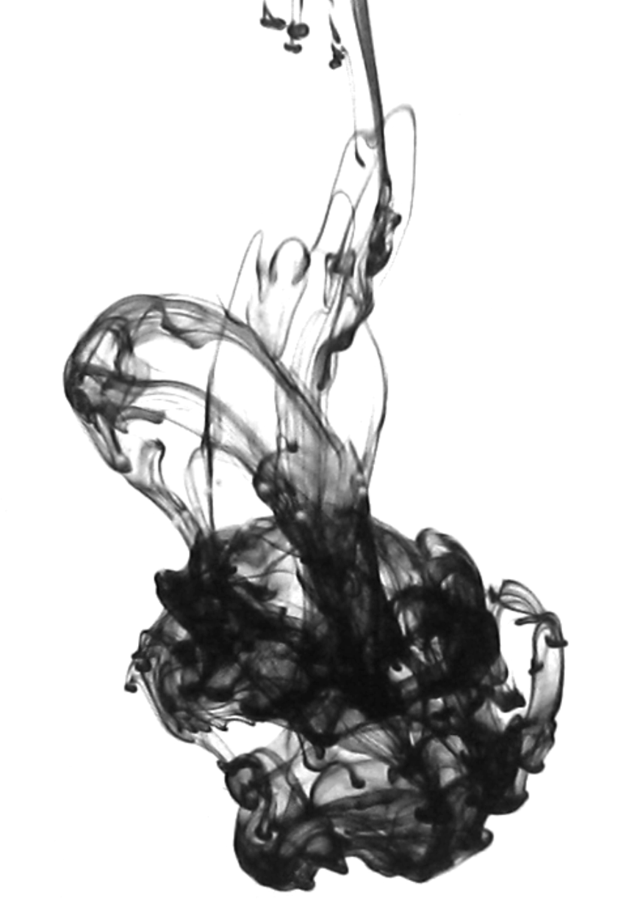
11. Why does Ms. McDaniel talk to Frank?
A. He missed a speech.
B. He failed to pass a test.
C. He wanted to drop a class.
12. How would Ms. McDaniel’s students react if a speaker made a mistake?
A. Laugh at the speaker.
B. Sympathize with the speaker.
C. Persuade the speaker to try again.
13. How does Ms. McDaniel sound?
A. Optimistic. B. Humorous. C. Encouraging.

Slide 28
Text 9 155词 谈论求职者信息
M: How many applications did we get, Mary?
W: Well, overall we got over 200.
M: Wow, that many?
W: Yes. But most of which we can reject right away. People who don’t have the right experience, qualifications, that part of thing.
M: Of course.
W: And so, I drew a short list of 12 candidates.
M: Are we going to interview all of them?
W: I think we should. But certainly, I will let you have a look first.
M: Great. So, who have we got then?

Slide 29
W: Well, I think you got some pretty strong candidates, two in particular.
M: They have the right kind of qualification.
W: I certainly say so. A strong educational background, experience in sales, language skills.
M: Good. I look forward to meeting all of them.
W: So, I’d say you do a set interview for that.
M: Sure.
W: A few general questions, then onto specifics.
We could also ask them to give a short presentation.
M: Great. I’m really looking forward to this.

Slide 30
14. What makes the man surprised?
A. The number of job applicants.
B. The experience of employees.
C. The candidates’ language skills.
15. How many candidates are the speakers going to meet?
A. 2. B. 12. C. 20.
16. What do the speakers talk about at the end of the conversation?
A. Job description.
B. Interview procedure.
C. Candidates’ background.

Slide 31
Text 10
Welcome back, everyone. This is CBA news radio. Here comes
something interesting. Yesterday a teenage girl named Terra Gallo from
Poland, got some unexpected news when she received a handwritten
letter from a fisherman saying that her message in the bottle had been
found in Spain.Gallo and her sister put message into bottles and throw
them into the ocean while visiting their aunt on Monhegan Island three
years ago.

Slide 32
The girls had forgotten about the bottles until they were surprised by the
fisherman’s letter.Gallo, young, 14, studied maps and discovered her
message travels about 3,000 miles. Young’s message asked that whoever
found her bottle should put their own message inside with hers and send it
back out to sea. The fisherman said in his letter that he had carried on girl’s
wishes.
天人合一
天 下 皆 知 美 之 为 美 ， 斯 恶 已
皆 知 善 之 为 善 ， 斯 不 善 已
有 无 相 生 ， 难 易 相 成 ， 长 短 相 形
高 下 相 盈 ， 音 声 相 和 ， 前 后 相 随
恒 也

Slide 33
17. What did Gallo receive yesterday?
A. A call from her sister.
B. A bottle from her aunt.
C. A letter from a stranger.
18. Where did the fisherman find the bottle?
A. On Monhgan Island.
B. At Cumberland.
C. In Spain.

Slide 34
19. How old was Gallo when she threw out the bottle?
A. Eight.
B. Eleven.
C. Fourteen.
20. Where is the bottle now?
A. In the ocean.
B. At Gallo’s home.
C. With the fisherman.

Slide 35
欢迎指导
祝各位考生金榜题名！

