Slide 1


感恩遇见，相互成就，本课件资料仅供您个人参考、教学使用，严禁自行在网络传播，违者依知识产权法追究法律责任。
更多教学资源请关注
公众号：溯恩高中英语
知识产权声明

Slide 2
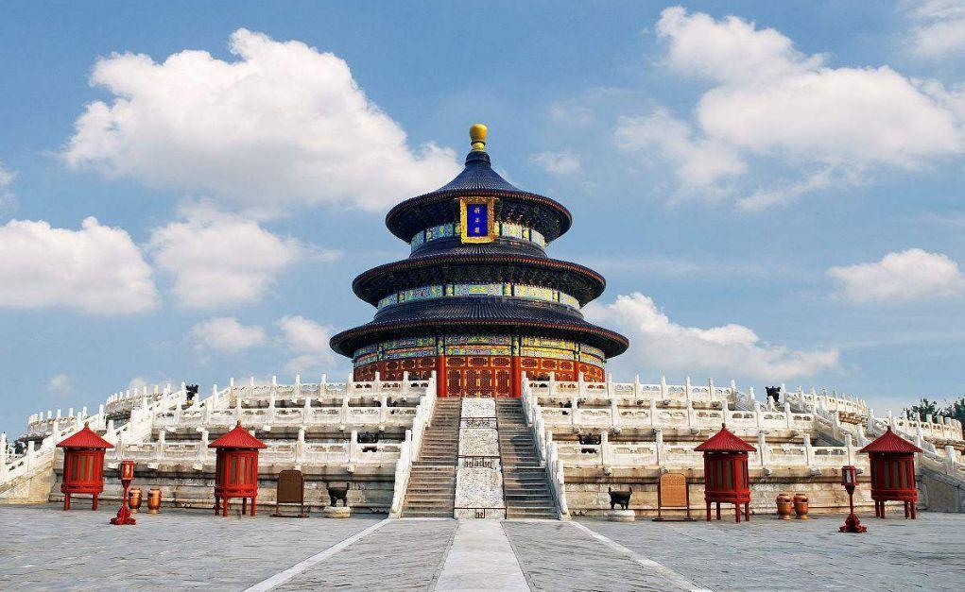
M2U1 Cultural Heritage
Reading & Writing

Slide 3
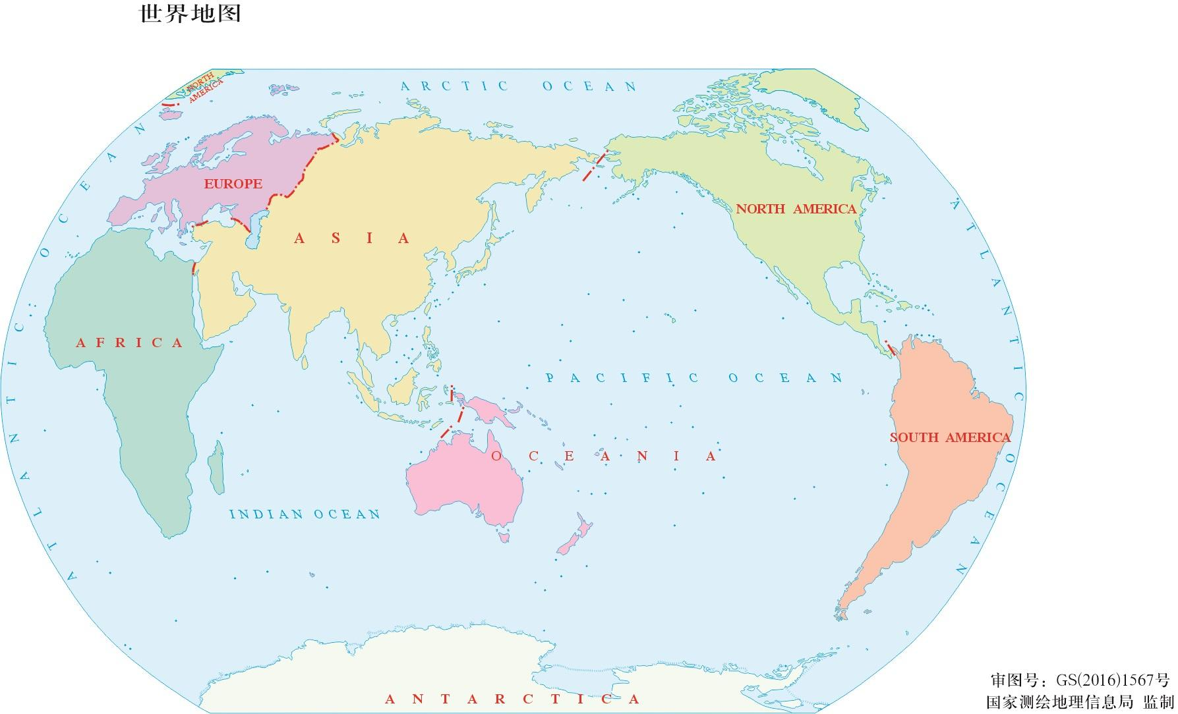
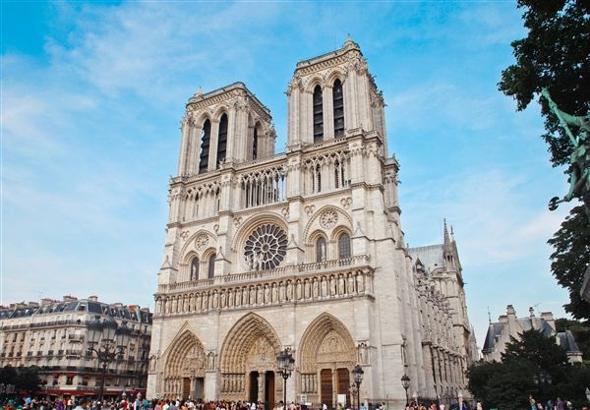
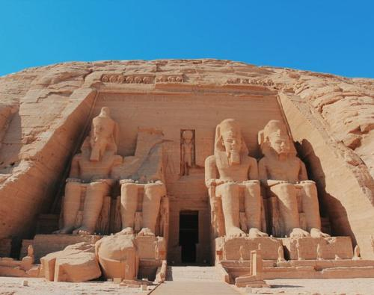
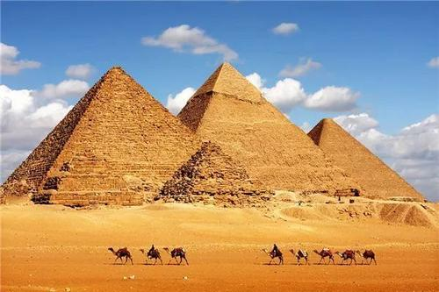
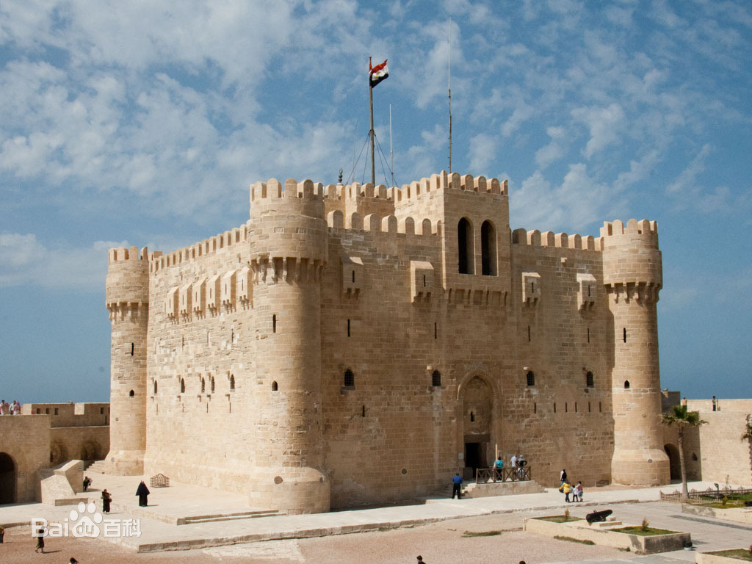
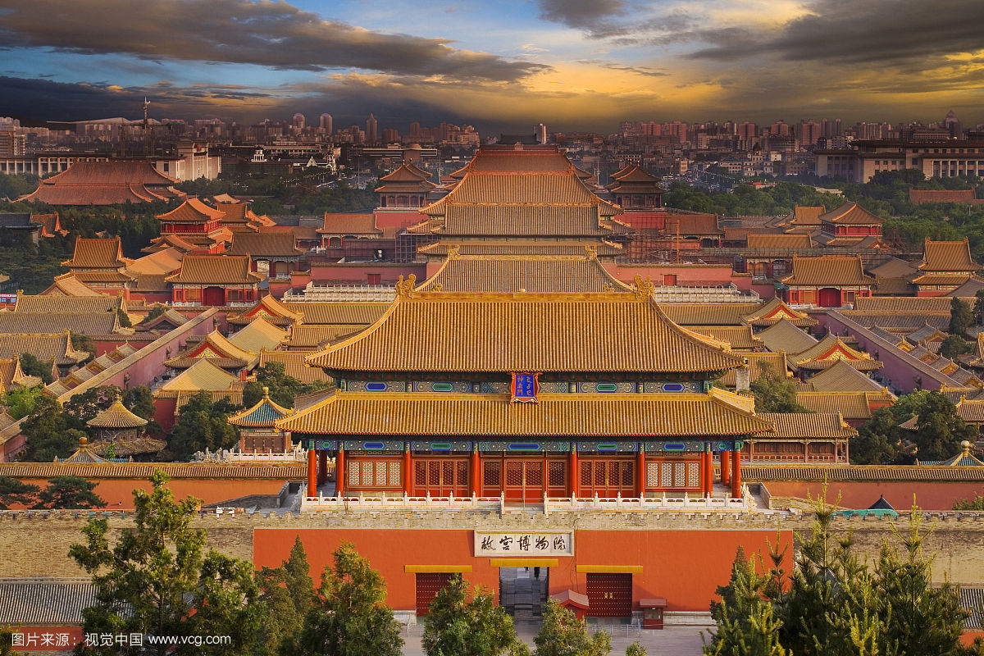
France
one of the four major ancient civilization countries
China
Egypt
one of the four major ancient civilization countries

Slide 4
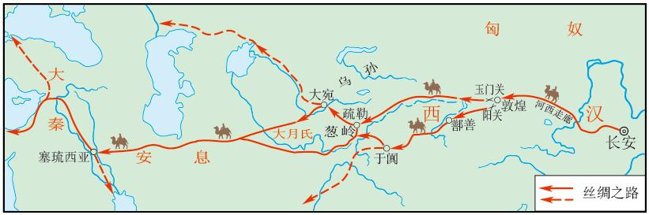
The Silk Road
It was listed on the World Cultural Heritage List in 2014.
Dunhuang
a meeting point for different cultures

Slide 5
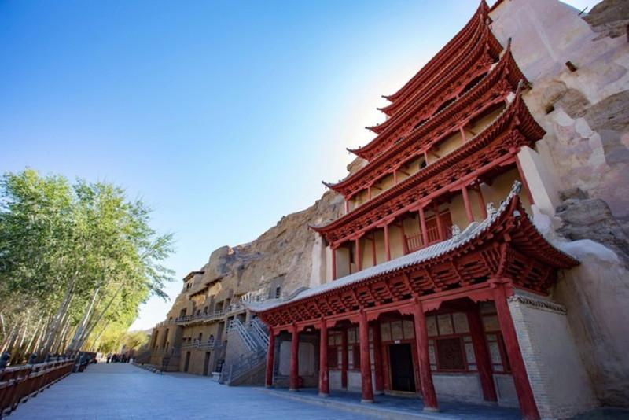
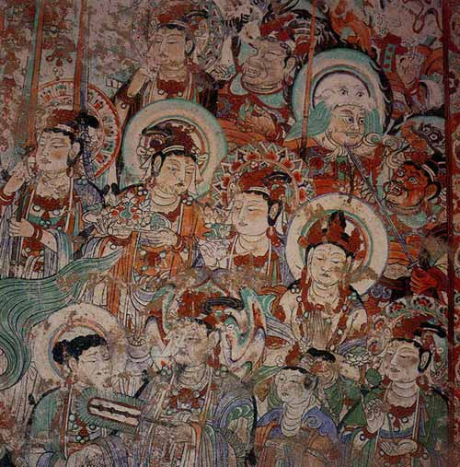
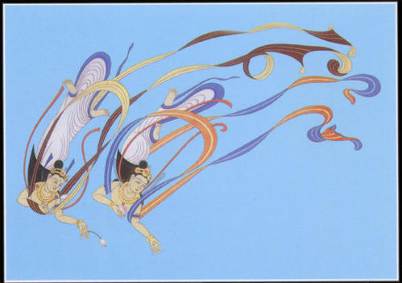
Mogao Caves of Dunhuang
various and colourful murals
It lies in Gansu Province and enjoys great reputation throughout the world.
It was listed on the World Cultural Heritage list in 1987.

Slide 6


Problem?
Solutions?
Meaning?

Slide 7
Problem?
The problem is about how to preserve murals and keep them to the future generations.
Solutions?
preventive protection
digital technique:
(virtual wandering虚拟漫游, augmented reality增强技术, artificial intelligence人工智能…)
Meaning?
Offer richer content.
Promote mural protection technology and site monitoring technology.
Improve cultural exchange internationally.

Slide 8

A news report
What purpose?
purpose
Promoting culture through
digital images
means
Who?
When?
What measure?

Slide 9
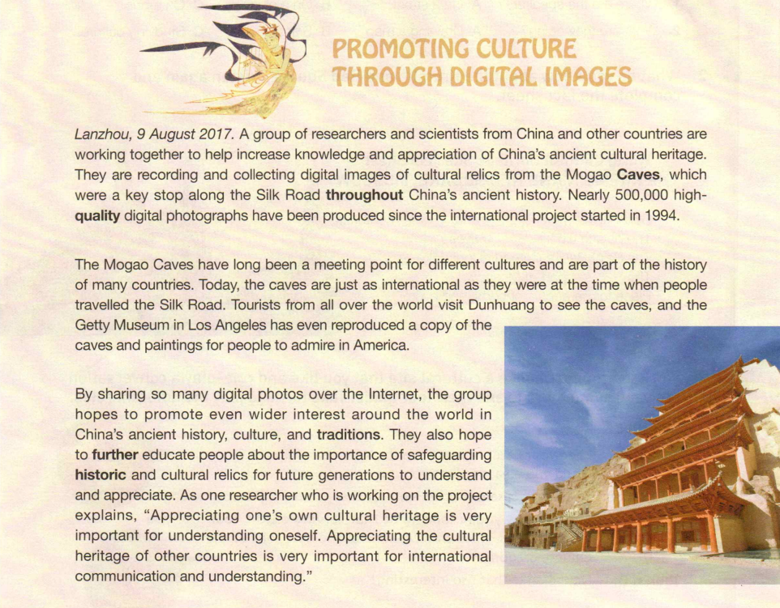

Reading for structure
headline
Who?
When?
What measure?
What purpose?
lead
sentence
main idea
paraphrase
further explanation
a news report
clear structure
body
detailed information
direct &exact
language

Slide 10
Reading Para.1
lead sentence
Lanzhou, 9 August 2017. A group of researchers and scientists from China and other countries are working together to help increase knowledge and appreciation of China’s ancient cultural heritage. They are recording and collecting digital images of cultural relics from the Mogao Caves, which were a key stop along the Silk Road throughout China’s ancient history. Nearly 500,000 high-quality digital photographs have been produced since the international project started in 1994.
a group of…
when/who
why worked
Lanzhou, 9 August 2017
main idea
lead sentence
increase knowledge and appreciation …
explanation
explanation
how helped
how important
what result
record and collect digital images
further information
a key stop along the Silk Road…
paragraph
500,000 high-quality digital photographs

Slide 11
Reading the body (Para.2)
background information
The Mogao Caves have long been a meeting point for different cultures and are part of the history of many countries. Today, the caves are just as international as they were at the time when people travelled the Silk Road. Tourists from all over the world visit Dunhuang to see the caves, and the Getty Museum in Los Angeles has even reproduced a copy of the caves and paintings for people to admire in America.
a technique of news writing
Why can the Mogao Caves have so many murals?
How are the Mogao Caves today? Are they still popular? How?
The Mogao Caves is ___________________________.
multicultural
international
at past
at present
in the future
pass down
pass on
multicultural
international
international
international
multicultural
famous
popular
famous

Slide 12
Heritage is our legacy from the past, what we live with today and what we pass on to the future generations.
——World Heritage Centre

Slide 13
Reading the body (Para.3)
What does the group hope?
By sharing so many digital photos over the Internet, the group hopes to promote even wider interest around the world in China’s ancient history, culture, and traditions. They also hope to further educate people about the importance of safeguarding historic and cultural relics for future generations to understand and appreciate. As one researcher who is working on the project explains, “Appreciating one’s own cultural heritage is very important for understanding oneself. Appreciating the cultural heritage of other countries is very important for international communication and understanding.”
hopes
hope
Appreciating
Appreciating
a technique of news writing
direct quote
Inspiration?
各美其美，美人之美，
美美与共，天下大同。
——费孝通
Culture is a bridge for communication and understanding among different cultures.

Slide 14
Reading for structure
headline
background information
Who?
When?
What measure?
What purpose?
lead
sentence
main idea
paraphrase
further explanation
a news report
direct quote
detailed information
body
obvious writing techniques
clear structure
direct &exact
language

Slide 15
obvious writing techniques
headline
impressive
brief
accurate
lead sentence
summarized
paraphrase
easy-understanding
detailed
body

Slide 16
obvious writing techniques
no comments
persuasive
passive voice
objective
direct
accurate
direct quote

Slide 17
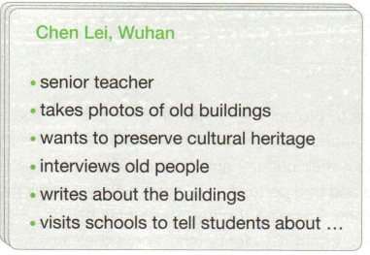
Let’s try to write a news report!
Write a news report about a person or group who works to protect our cultural heritage. You can use the interview notes below or write about a person or group that you know of.
How?

Slide 18

How to write a news report
Polish the writing
Write the lead sentence and news report
Write the headline
Understand the given information

Slide 19

Understand the given information
occupation
main means
purpose
supporting details
headline:
main means
purpose
structure
lead sentence:
occupation
main means
purpose
body:
supporting details

Slide 20
Write the headline
accurate
purpose
brief
impressive
means
Headline:
Preserving cultural heritage through photos
main means
purpose

Slide 21
Write the lead sentence and news report
summarized
who(occupation)
what(behavior)
basic
why(purpose)
easy
-understanding
Lead sentence:
Chen Lei is a senior teacher who takes photos of old buildings in Wuhan in order to preserve the city's culture heritage.
occupation
Writing the lead sentence
main means
purpose

Slide 22
Write the lead sentence and news report
detailed
direct quote
no comments
passive voice
Body part:
Every day, Chen Lei takes his camera and takes photos of old buildings. Besides, he interviewed old people to write stories about the old buildings. When he is free, he visits schools to tell students about the ways of preserving the cultural heritage.
Writing the news report

Slide 23
Preserving cultural heritage through photos
Polish the writing
Chen Lei is a senior teacher who takes photos of old buildings in Wuhan in order to preserve the city's culture heritage.
Every day, Chen Lei takes his camera and takes photos of old buildings. Besides, he interviewed old people to write stories about the old buildings. When he is free, he visits schools to tell students about the ways of preserving the cultural heritage.
Add some reasonable details!
direct quote
numbers
ending

Slide 24
Polish the writing
Preserving cultural heritage through photos
Chen Lei is a senior teacher who takes photos of old buildings in Wuhan in order to preserve the city's culture heritage.
Every day, Chen Lei takes his camera and walks patiently through the older parts of the city. Over the years he has taken thousands of pictures of old buildings to create a record for his fellow citizens in the present and future. Besides, he interviewed over 50 old people to write stories about the old buildings. When he is free, he visits schools to tell students about the ways of preserving the cultural heritage. He said: “The old buildings are alive legacy to date back to the ancient ages and pass on the future.”
Neither people nor buildings last forever, but Chen Lei's photos can help us remember them. The stories that accompany them also help build a picture of life for future generations to hear and add their own stories, too.

Slide 25
Mogao Caves of Dunhuang
various and colourful murals
How to preserve it ?

Slide 26
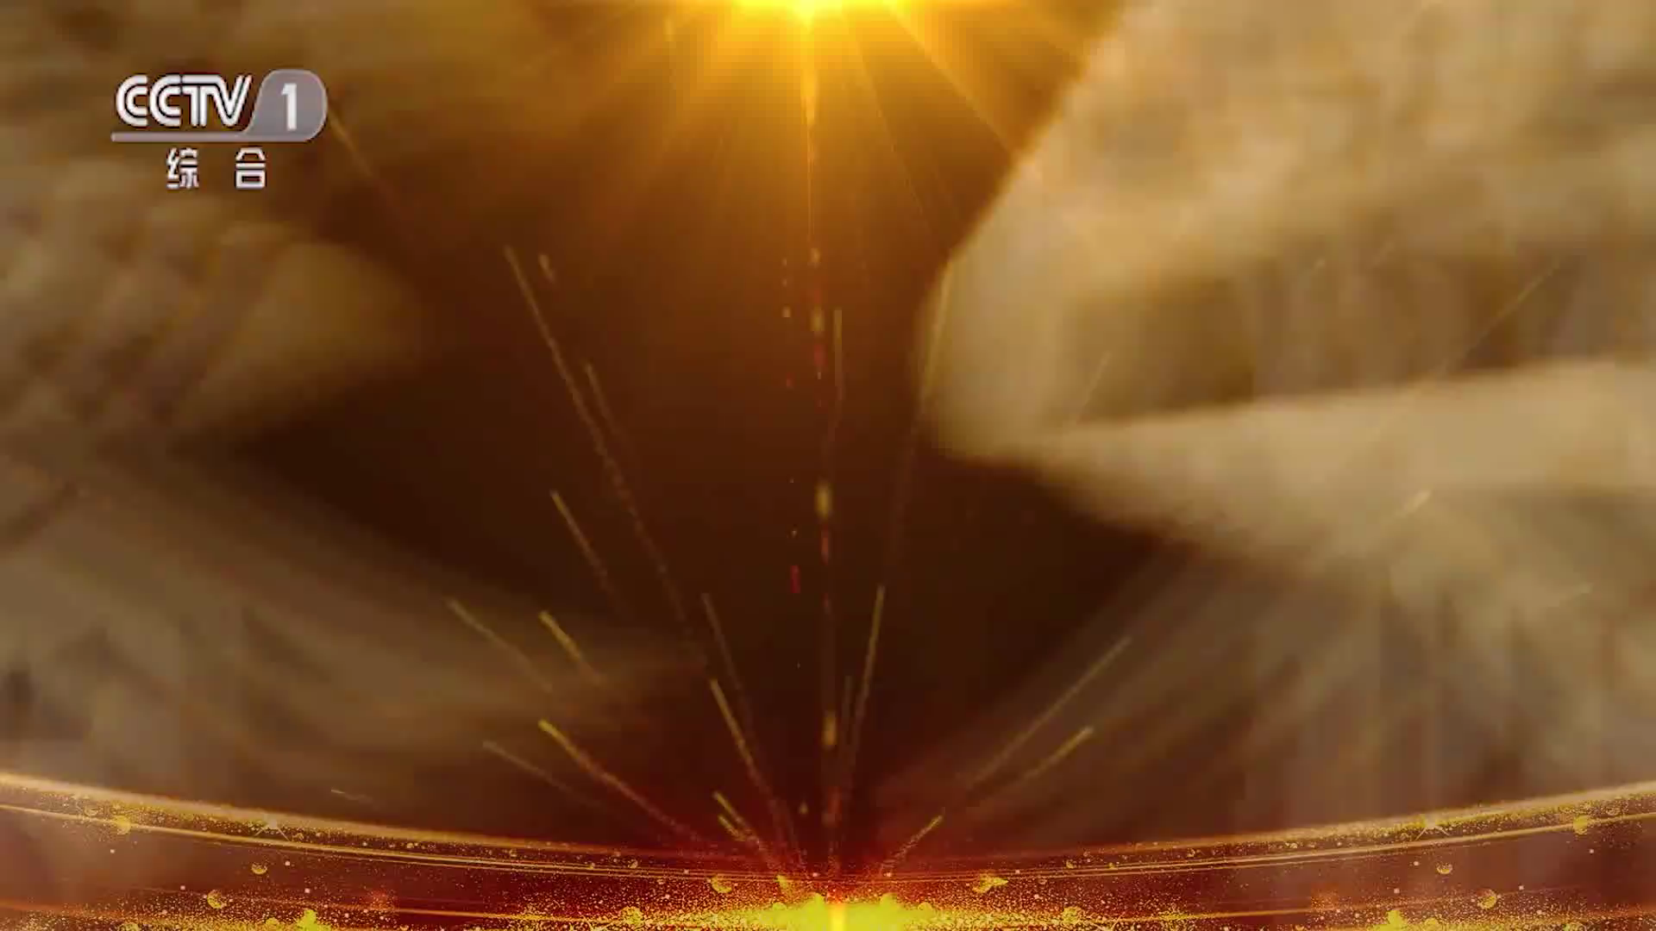

Slide 27
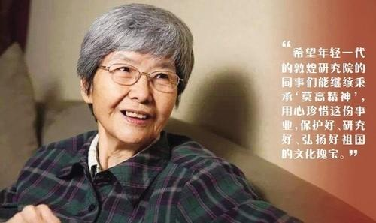
writing task
假设你是李华，英语报的记者。请根据一下要点写一篇新闻报道，介绍一下为保护敦煌做出巨大贡献的考古学家樊锦诗的事迹。
樊锦诗1938年出生于北京，是一名考古学家, 于1963年毕业于北京大学考古学专业。
自毕业后已在敦煌研究所工作50余年，被誉为“敦煌的女儿”，致力于石窟的研究和保护，创造了数字敦煌，收集和录制莫高窟的文化遗迹，对文物保护做出了巨大贡献，被评为“100位新中国成立以来感动中国人物”。
80词左右，可适当增加细节使行文连贯。
参考词汇：100位新中国成立以来感动中国人物（one hundred people moving China since the founding of The People’s Republic of Chian）; 敦煌研究所（Dunhuang Cultural Research Institute）; 考古学家（archaeologist）考古学（archaeology）

Slide 28

Example writing
Fan Jinshi, born in Beijing in 1938，is a famous archaeologist，who devotes all her life to the study and protection of the Mogao Caves.
She graduated from Peking University in 1963, majoring in archaeology. She has been working in Dunhuang Institute for more than 50 years since she graduated. Therefore, she has been regarded as “the daughter of Dunhuang”．She created digital Dunhuang, recording and collecting digital images of cultural relics from the Mogao Caves.
Fan Jinshi has made a great contribution to the protection of cultural relics. In her life, she got many honours, one of which is “one hundred people moving China since the founding of The People's Republic of China”．

