Slide 1


感恩遇见，相互成就，本课件资料仅供您个人参考、教学使用，严禁自行在网络传播，违者依知识产权法追究法律责任。
更多教学资源请关注
公众号：溯恩高中英语
知识产权声明

Slide 2


U1 Cultural Heritage

Slide 3
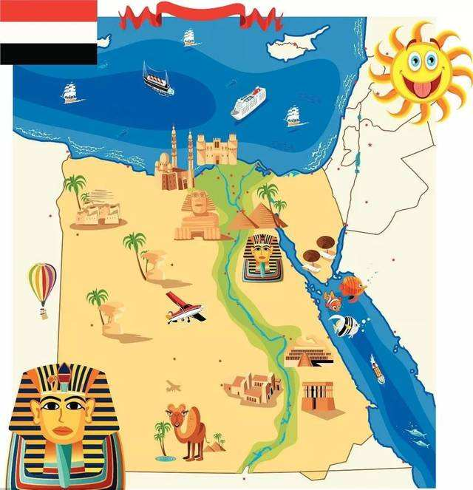
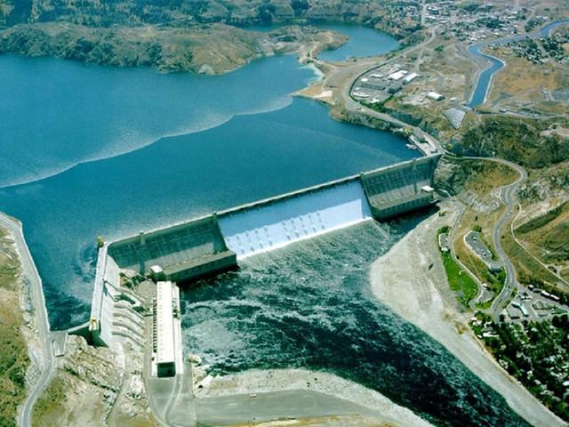
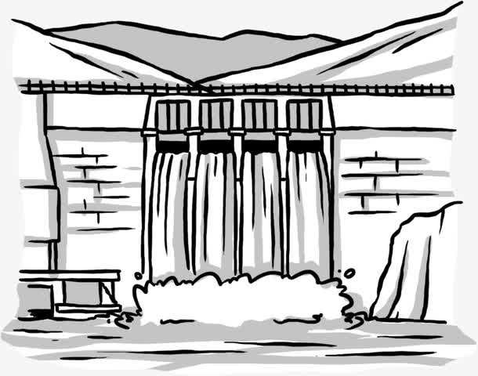

The
Aswan Dam
pyramids
the Sphinx
Why was the Aswan Dam built? Where is it?
When we talk about this country, what can you think of?

Slide 4
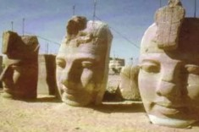
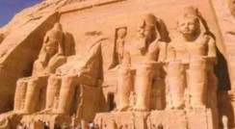
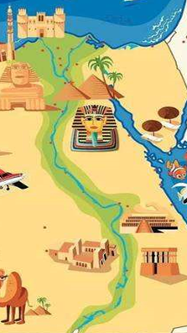
Before moving
After being putting together
What problems might occur when a dam was built across the Nile?
What messages might be included in the text?

Slide 5
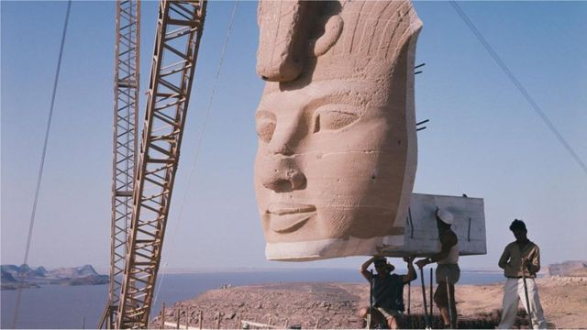
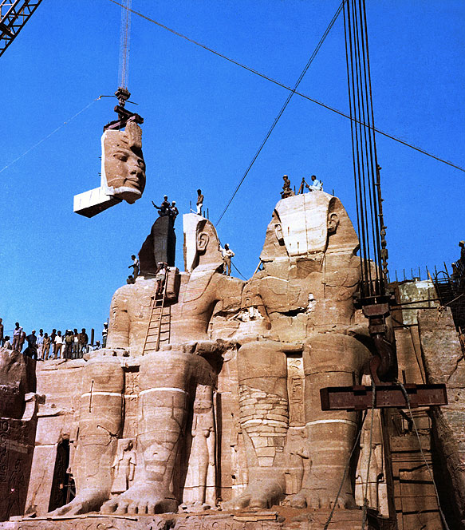

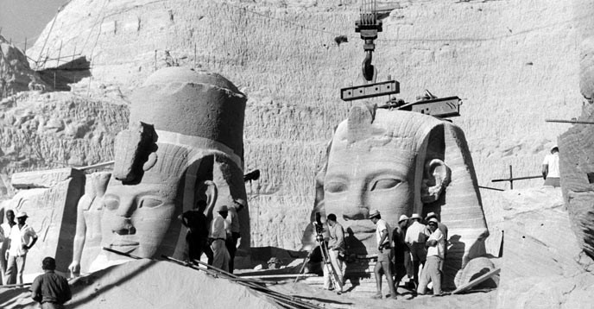
Reading for the structure
Problems:
What problems are mentioned?
Para.1-2
How to balance progress and protection?
Water from the dam would likely cause damage to the cultural relics.
Draw a mind map to show your understanding of how the problems were solved.
Solutions:
Para.3-4
be taken down piece by piece
be moved to other places
be put back together
Significance:
Para.5-6

Slide 6
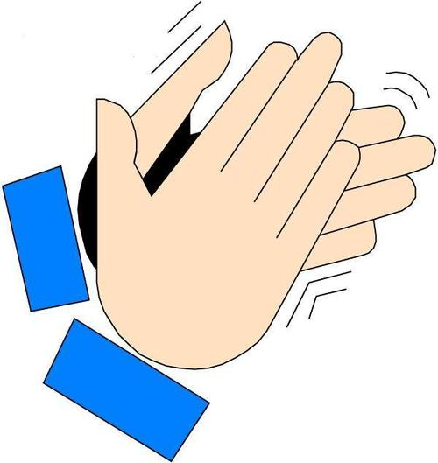
vs
Problems
Progress
Protection
wanted to build
turned to the UN for help
project began
moved the 1st temple
project completed
20 years
the 1950s
1959
1960
1961
1980
establish a committee
be taken down
be moved
be put back together
control floods
produce electricity
supply water
ask for contributions
raise funds
investigate the issue
conduct tests
make a proposal
sign a document
20 years
thousands of…
22 temples
50 countries
$80 million

Slide 7
Reading for the structure
Problems:
What problems are mentioned?
Para.1-2
How to balance progress and protection?
Water from the dam would likely cause damage to the cultural relics.
Solutions:
Draw a mind map to show your understanding of how the problems were solved.
Para.3-4
Why is the Aswan Dam a great success?
Significance:
Para.5-6
What is the spirit of the Aswan Dam project?

Slide 8

Why is the Aswan Dam a great success?
The countries found a new way to balance economic development and protection of cultural relics, which could be possibly done through international cooperation.
What is the spirit of the Aswan Dam project?
international cooperation

Slide 9
Debate
Do you think it worthwhile to spend a lot of time and money to protect these temples. Why or why not?

Slide 10


Worthwhile
Not worthwhile
1. They are priceless and unique treasures.
2. They attract hundreds of thousands of visitors every year, which leads to a rise in national income.
3. They are irreplaceable pieces of Egyptian world history.
4. They witnessed the development of Egypt.
5. …
1. It’s a big burden/pressure to the Egyptians.
2. The old must give way to the new with economic development.
3. Though invisible from the outside, they are not the exact / very ones.
4. …

Slide 11
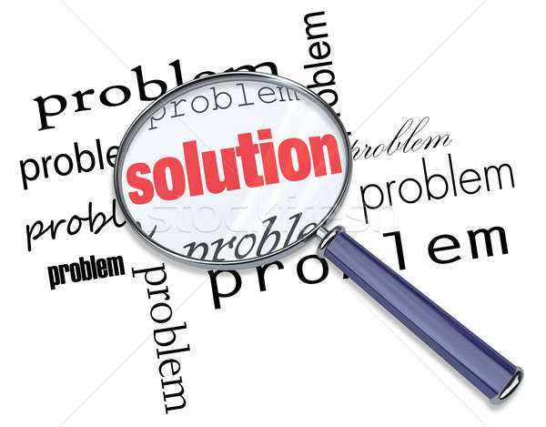

Reading for thinking
Problem solving provides an opportunity for “discovery” and “progress”.

Slide 12

Summary
How to balance economic development and cultural heritage p_________ can be a big challenge. In Egypt, the p________ of building the Aswan Dam met with p_______ for fear of d________ the temples and cultural relics. The government t______ to the UN for help and e__________ a committee to prevent the l____ of cultural heritage and raise f______ internationally. Thanks to the hard work of the g______ community, the project was completed successfully with the cultural heritage preserved.
rotection
roposal
rotests
amaging
urned
stablished
oss
unds
lobal

Slide 13
Thank You!

