Slide 1


感恩遇见，相互成就，本课件资料仅供您个人参考、教学使用，严禁自行在网络传播，违者依知识产权法追究法律责任。
更多教学资源请关注
公众号：溯恩高中英语
知识产权声明

Slide 2
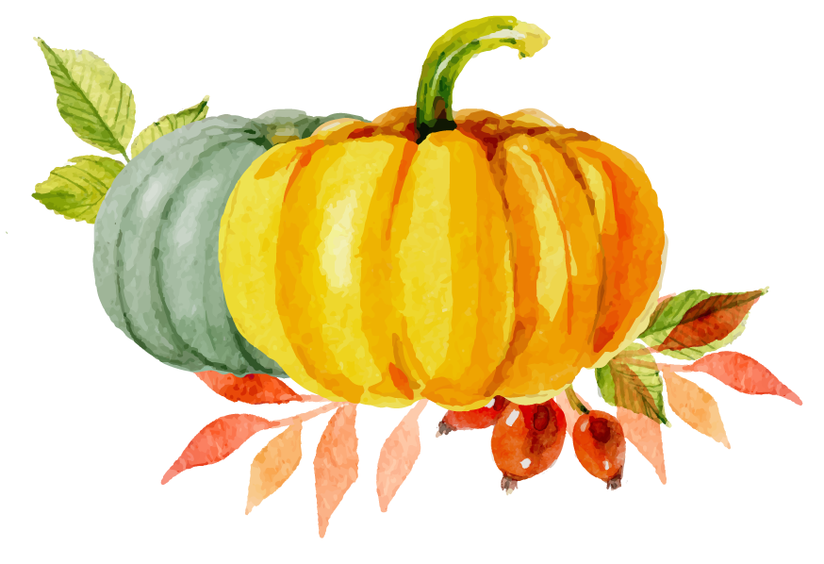
Continuation Writing
2021.1浙江英语高考

Slide 3
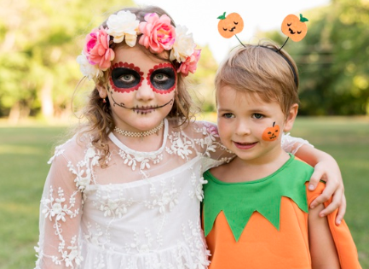
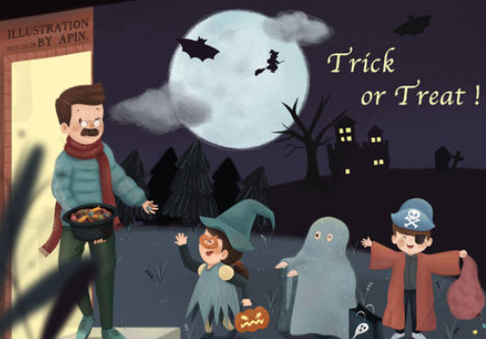
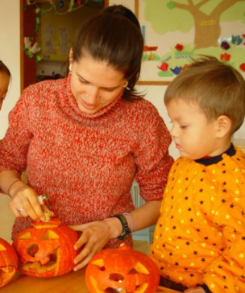
Guessing game
What are traditional Halloween activities?
It is a Western holiday
Halloween
It falls on October 31;
It is a day when the spirits of dead people return
People wear costume.
Children can play trick or treat on their neighbors.
People carve pumpkins.
to scare away the evil spirits...

Slide 4
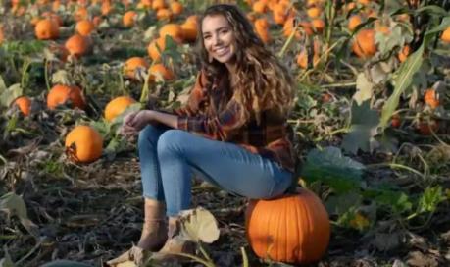

Slide 5
阅读下面短文，根据所给情节进行续写，使之构成一个完整的故事。
Pumpkin(南瓜) carving at Halloween is a family tradition. We visit a local farm every October. In the pumpkin field, I compete with my three brothers and sister to seek out the biggest pumpkin. My dad has a rule that we have to carry our pumpkins back home, and as the eldest child I have an advantage - I carried an 85 -pounder back last year.
This year, it was hard to tell whether my prize or the one chosen by my 14-year. Old brother, Jason, was the winner. Unfortunately we forgot to weigh them before taking out their insides, but I was determined to prove my point. All of us were hard at work at the kitchen table, with my mom filming the annual event. I'm unsure now why I thought forcing my head inside the pumpkin would settle the matter,but it seemed to make perfect sense at the time.
With the pumpkin resting on the table,hole uppermost,I bent over and pressed my head against the opening.At first I got jammed just above my eyes and then,as

Slide 6
I went on with my task,unwilling to quit,my nose briefly prevented entry. Finally I managed to put my whole head into it，like a cork（软木塞）forced into a bottle.I was able to straighten up with the huge pumpkin resting on my shoulders.
My excitement was short-lived.The pumpkin was heavy. "I'm going to set it down, now,"I said,and with Jason helping to support its weight,I bent back over the table to give it somewhere to rest. It was only when I tried to remove my head that I realized getting out was going to be less straightforward than getting in.When I pulled hard,my nose got in the way.I got into a panic as I pressed firmly against the table and moved my head around trying to find the right angle,but it was no use."I can't get it out!"I shouted,my voice sounding unnaturally loud in the enclosed space.
Para.1 I was stuck for five or six minutes though it felt much longer.______
Para.2 That video was posted online the Monday before Halloween._______

Slide 7
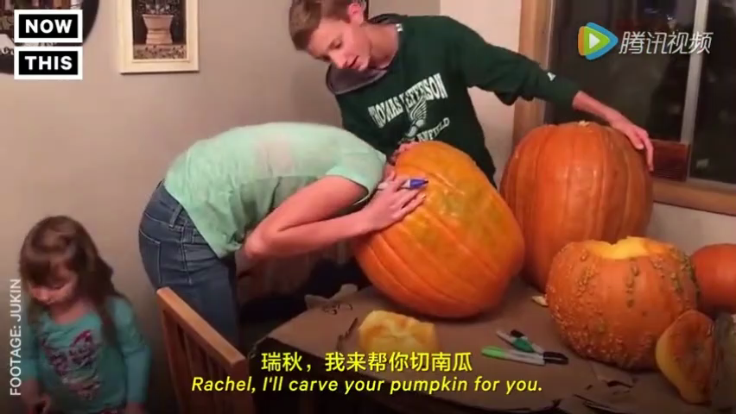
Read the story
Get the main idea (把握故事梗概)
at Halloween
when
where
in the kitchen
?
Story
Jason
dad
mom
I
how
who
why
what
to prove my point as a winner of the biggest pumpkin
I got my head stuck in a pumpkin

Slide 8
Read the characters
Know the main characters (明确主要人物)
dad
I
Jason
mom
makes it a rule to bring home the biggest pumpkin at Halloween.
the eldest child
have an advantage--I carried an 85-pounder back last year
unwilling to quit
my 14-year-old brother
filming the annual event

Slide 9
Read the plot
Clarify the main events (理清主要事件)
a torment: “I can't get it out!”
climax
a dilemma: bent; tried; realized; pulled;shouted
panicked
rising action
falling action
an attempt: bent; pressed; jammed
Solution?
Emotions?
excited
a competition: forgot;
prove; forcing
competitive
a family tradition: visit; seek out; carry
ending
plot
emotions
beginning

Slide 10
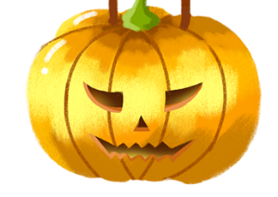
Read the given sentences
Predict the ending (预测故事结尾)
Underlined words:
Object:  pumpkin
Characters：  dad  Jason  mom
Body:  head  nose
Action:  managed  support  rest  pulled
Underlined words:
 pumpkin  dad  Jason  mom  head
 nose  managed  support  rest  pulled
Para.1 It was five or six minutes though it felt much longer.___________________________
______________________________________
Para.2 The video was posted online the Monday before Halloween. _________________________
________________________________________
A dilemma
1. How did I feel? 2. What further efforts did I make?
3. What did my family do to help? 4. What was the result?
1. What response did I get online ?
2. How did I feel?
3. What did I learn?
A delight

Slide 11
list the writing points
List the outline (罗列写作要点)
Para.1
plot | emotions
Para.2
plot | emotions
my attempt to pull my head out
my family offered help
my head was released
my mum captured the whole event
anxious
surprised
reactions from netizens
my reflections on the event
hopeless
delighted
relieved

Slide 12
anxious:
Several fruitless attempts made me edgy/upset(烦躁不安的).
I was getting more nervous every minute.
I lost my cool.(失去冷静)/I began to panic.
Seized by a strong sense of anxiety, I...
physical reaction:
心跳加快
My heart was pounding/thudding.
My stomach fluttered(快速跳动).
With heart in my mouth, I ...
My heart beat in my throat.
My stomach feels upset-like it's full of knots.
My heart beat so violently that I felt almost suffocated(窒息)/fainted.
呼吸不畅：I gulped(因担忧倒吸气) for air; / I sniffed(吸气).
口干脸烫：My throat was dry, face burning up.
Para.1 It was five or six minutes though it felt much longer._____________
Frustrated:
I was furious at my stupid attempt.
“Stupid! You're stupid！”I screamed at myself inside my head.
I couldn't bear to see them stand by and laugh at me.
Their giggles made my blood boil.(生气)
Frustrated/In frustration, I was on the edge of giving up struggling.
I felt my spirits sinkeven lower.
I was wondering what to do next.
I felt so restless.
Exhausted, he flopped down into a chair.
（一屁股坐下）
Plot-my attempt
emotions
relieved:
I heaved a sigh of relief.
I let out a long sigh.
I cheered/sighed with relief.
I burst out cheering.
I gasped for fresh air;
I took a minute to catch my breath and steady myself.
I felt a wave of relief.
呼救
“Help me!”I pleaded(乞求)
I exclaimed (由于痛苦呼喊)/yelled/screamed/
cried /shrieked(尖叫)/bellowed (大喊) /bawled(大喊) for help.
anxious
relieved
摇/挤脑袋
I bobbed my head (上下摆动) like crazy.
I struggled to squeeze/pull my head out of it.
扯/敲/转南瓜
frustrated
I tugged(猛拉)/ banged(敲)/punched the pumpkin furiously /frantically

Slide 13
Para.1 It was five or six minutes though it felt much longer._____________
Plot-efforts from my family
1. 围拢探情况
Jumping to their feet, they huddled(聚/挤) around me.
After a careful study, they began to work on it.
2. 安慰
Jason stepped forward, patted me on the shoulder to ease me.
Sensing my mounting anxiety, Jason put one's arms around one's neck to offer comfort.
3. 出主意
“Let's tug(拉)it down together,”they chirped.
Jason proposed calling the
fire department.
4. 拉/拽/举起
They dragged/pulled /yanked at the pumpkin with all their strength.
Dad rushed to lift it to reduce its weight on my head.

Slide 14
Para.2 The video was posted online the Monday before Halloween. _________
Plot-netizens' reaction
emotions
The video__________ .
They mentioned that on seeing the video they______________
cried out in delight.
They chuckled(咯咯笑)/giggled/
sniggered(窃笑).
roared with laughter.(放声大笑)
provoked abundant attention
caused quite a stir
raised wide attention
They____________.
showed their sympathy.
gave loads of likes(点赞).
shared their own moments of
dilemma.
...
Getting so many responses from strangers, I ______________
was dumbfounded (目瞪口呆的)
couldn't dampen my excitement
...

Slide 15
Para.1 It was five or six minutes though it felt much longer. Trapped in the pumpkin, I gulped for air, my throat dry and face burning up. It was a torment for me. I wrestled with the problem, attempting to squeeze my head out of it, but in vain. So frightened was I that I pulled, and banged the pumpkin frantically. Noticing my mounting fear, Jason proposed calling the fire department, while others roared with laughter which made my blood boil. In great agony, I let out a loud cry which awakened my dad upstairs. Down dashed my dad who got me to push my head farther into the pumpkin so that mom's hand could reach in and loosen my ponytail. My head was finally released and it was then that I realized my mom had been filming the whole time.

Slide 16
Para.2 The video was posted online the Monday before Halloween. When I logged in my Facebook I found myself dumbfounded by the abundant likes I received from those who had seen my video. Browsing their messages, I felt a wave of warmth. The nasty dilemma where I got the pulp-plugged nose, the sore chin by the stubborn pumpkin was melted in the positive responses, the heartfelt comfort as well as the countless similar stories shared by those strangers. Thanks to mom, the video turned out to be a reminder, a captured memorable moment, a recollection of festival happiness, colored by hearty human interactions.

Slide 17
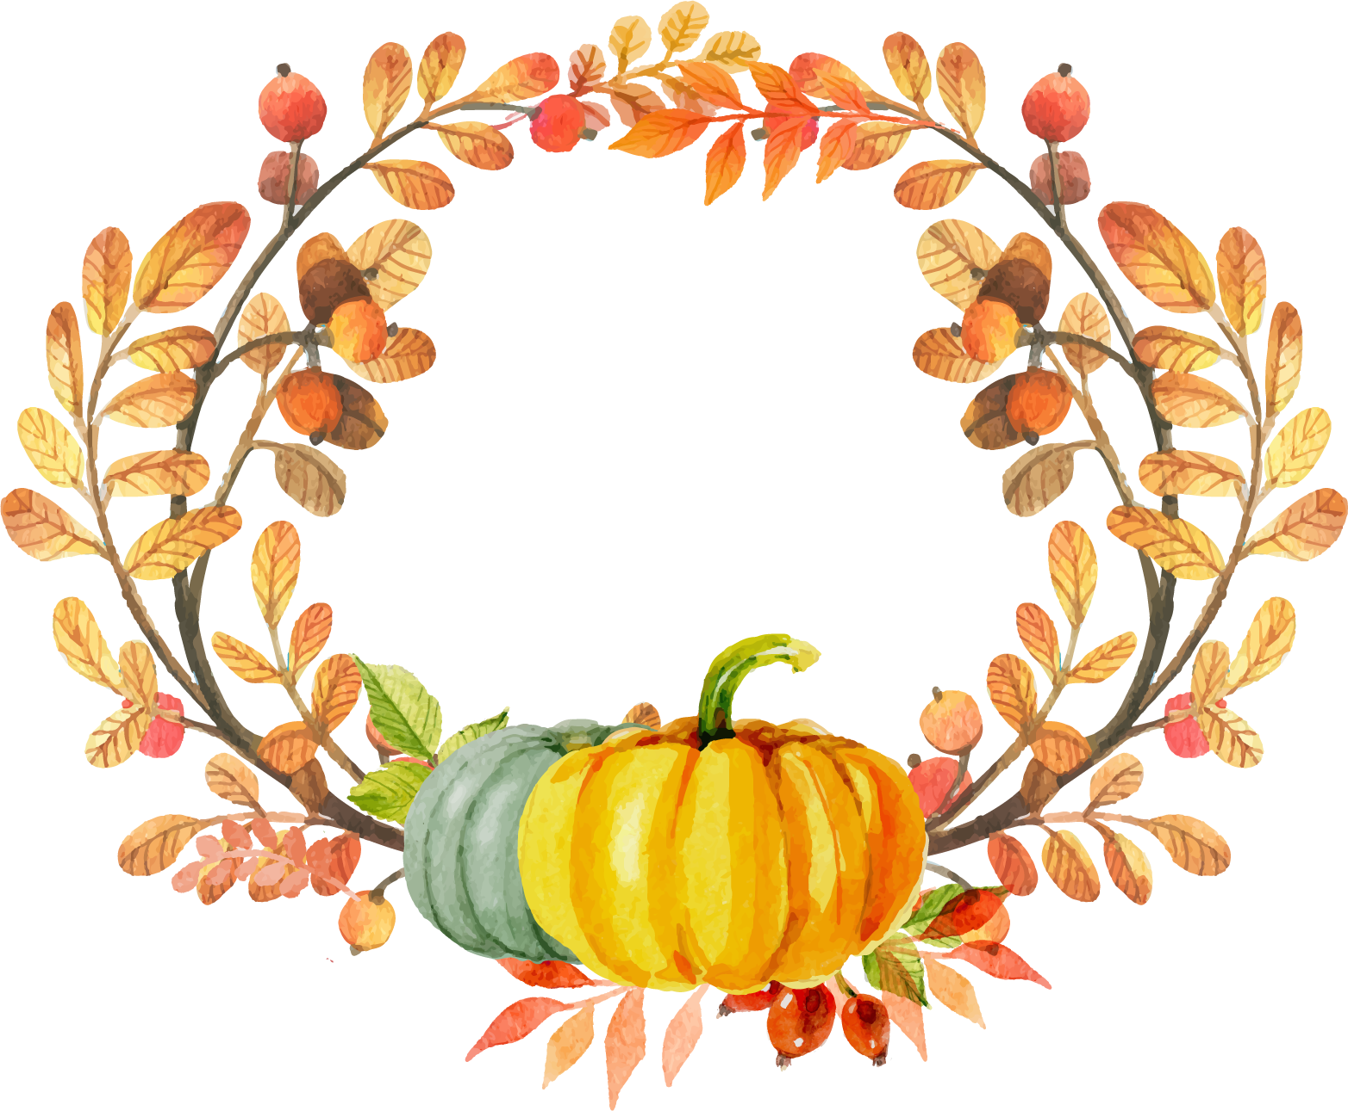
The end
THANK YOU FOR LISTENING

