Slide 1


感恩遇见，相互成就，本课件资料仅供您个人参考、教学使用，严禁自行在网络传播，违者依知识产权法追究法律责任。
更多教学资源请关注
公众号：溯恩高中英语
知识产权声明

Slide 2

The Internet

Slide 3
Learning Objectives
At the end of the class, you will be able to
1. master following new words and phrases: write a blog post, use a search engine, chat with, have a chat with, stream movies, do a survey on
2. know some basic information of internet,especially its development in China
3. train their ability of guessing a new words in the listening by paying attention to the next sentences
4. describe their online habit and make a comment on others' online habits

Slide 4


Lead-in
——Know something about the “Internet”
Q1: What is “internet”?
The Internet is the network that allows computer users to connect with computers all over the world.
Q2: When did “internet” come into existence? Where?
Internet began in America in 1969 under the agreement made by ARPA (美国国防部研究计划署). It was first used for military connection.
Q3: Do you know the development of internet in China?

Slide 5





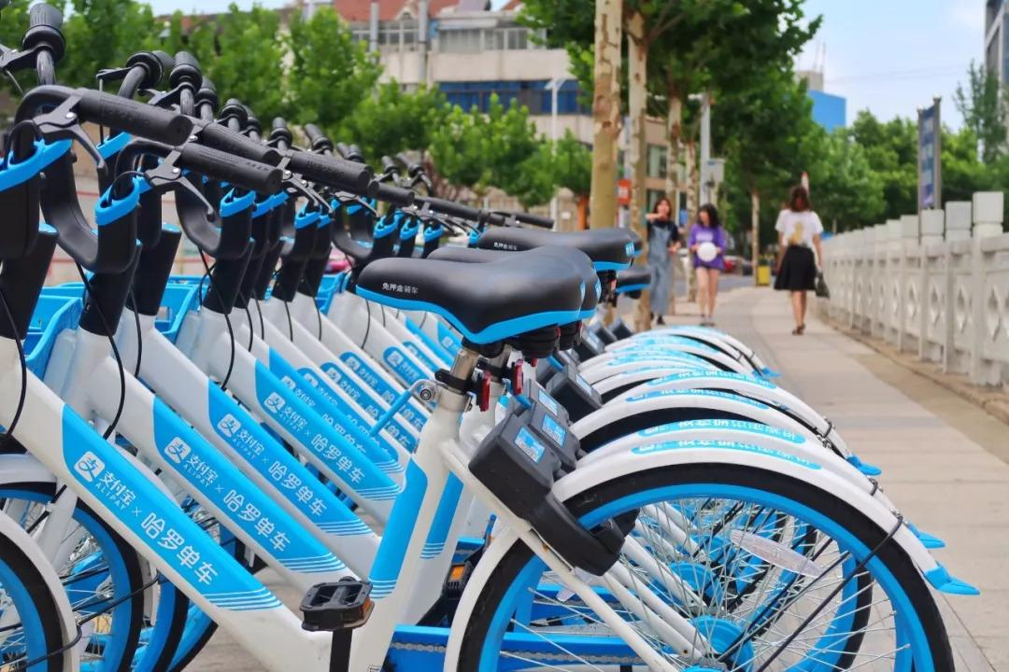

Lead-in
--- The development of internet in China
The establishment of the network information center
1987 1994 1996 1988 1999
China sent the first email
China joined the internet
The establishment of the first Internet company
1997
XinLang, WangYi,Souhu
2000
Do you know the basic function of the internet?
5G
4G
2018 2016 2013 2011 2009 2003

Slide 6








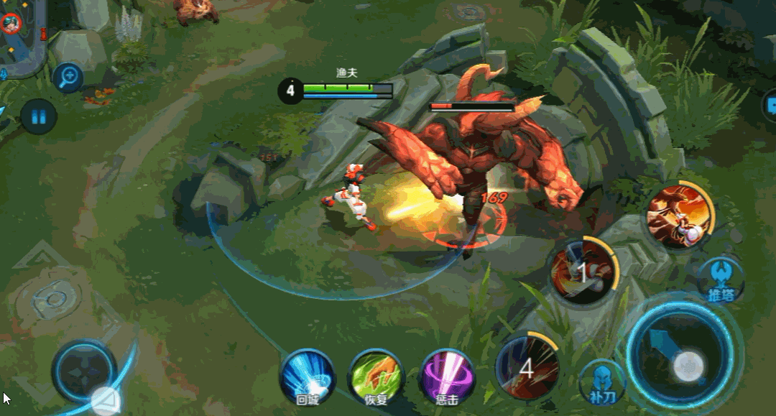
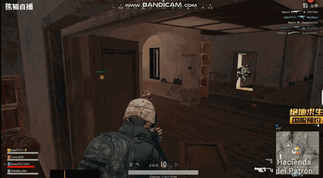



Lead-in
--- The basic function of the internet
chat online
online trade
chat with...
have a chat with...
write a blog post
Sam is doing a survey on online habits
What do you usually do online?
Sharing of resources
online games
use a search engine
stream videos

Slide 7

Listening
--- For time and activities
Name | Time spent online every day | Online activities | Reasons for using the Internet
Anna
Paul
Joe
2 or 3 hours
cheap easy
_____and_____
What can help us to understand the new words?
2 hours or more
to ________
do homework
to ________
________
at least 1 hour
write sth interesting
a. stream videos and music;
c. write blog post
e. use a search engine to find information
b. chat with friends
d. look up information;

Slide 8
Listening
--- For guessing
Use simpler words
Use an example
Compare to something
What can help us to understand the new words?
Pay attention to the next sentence(s) to see if there is a definition.
1 A blog _______ an online diary where you write about something you are interested in. _____________, I like basketball, so I write a lot on my blog about my favorite team.
2 I stream videos and music. __________ , I watch videos and listen to music online.
3 A search engine __________ that helps you find what you're looking for.
is like
Compare to something
For example
Use an example
it's like that is for example
that is to say for instance
namely such as
in other words
That is
Use simpler words
is a tool
Compare to something

Slide 9

Discussion
--- What's your online habit?
online activities
online time
attitude to internet
Report
My deskmate,XXX,usually surfs the internet to...(activities), she/he usually spends _______(time) on the internet in his spare time, and she/he thinks that the internet is ________.In my opinion, his/her way of surfing the internet is______, because______

