Slide 1


感恩遇见，相互成就，本课件资料仅供您个人参考、教学使用，严禁自行在网络传播，违者依知识产权法追究法律责任。
更多教学资源请关注
公众号：溯恩高中英语
知识产权声明

Slide 2


Welcome

Slide 3

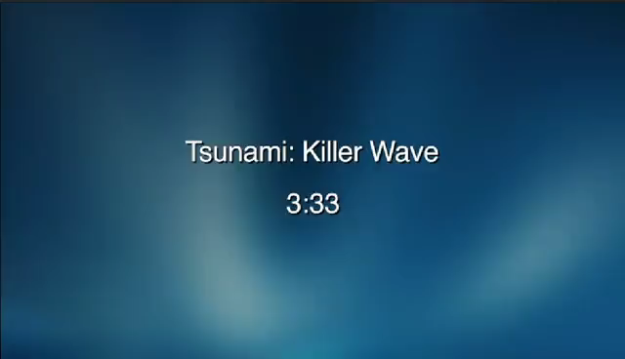

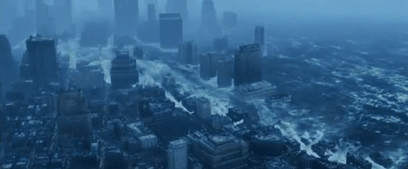

1
Watch and say
What is tsunami?
What natural disaster happened in the video?
sea
A tsunami is a series of waves in the s_____. It is often caused by an e__________. It is very d_______ and can cause great d _______ .
earthquake
dangerous
damage
Now, let's read an article to know more about tsunami.

Slide 4

（人教版2019）B1U4 Reading for Writing
Tsunami Hits Asia Over 6500 Dead
P 54
三明九中张艳娇

Slide 5
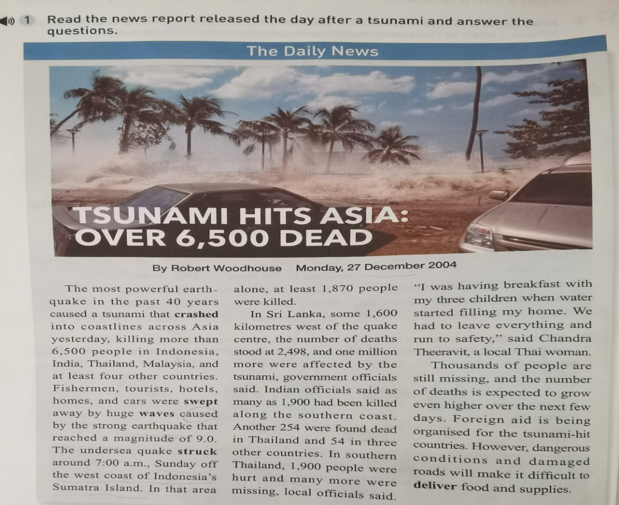
Read and Analyze
2
Check your answers (Exercise1)
1).What is the kind
of text type ?
A news report

Slide 6
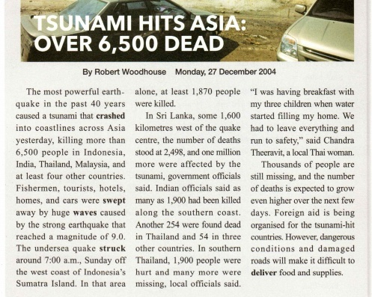
2).What is the structure of the news report?
Check the answers
Headline(tells what happened)
Byline(shows the reporter and date)
Lead( date , place,
event and cause)
Body(more details)
End(effect/
following events)

Slide 7
2
Check your answers (Exercise2)
Check the answers
1). When did the tsunami happen?
On 27 December, 2004.
B.On 26 December, 2004.
2). Why would it be difficult to deliver food and supplies?
A. Because of dangerous conditions.
B. Because of damaged roads.
C. Both A and B.

Slide 8
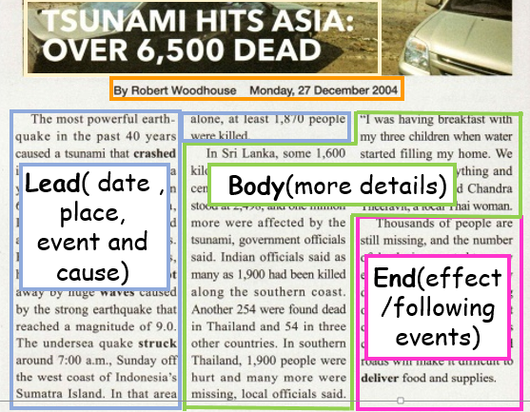
If you are asked to write
a summary of the news report,
What will you do at first?
What main points should be included in a news report ?
A summary is a short statement of main points. A summary only tells the most important information of a longer passage.
Main points should be included in a news report ：date、place、cause、effect、following events.

Slide 9
Read the summary of the news report. Check the main points it includes.
P 55 2
On 26 December 2004, a tsunami killed more than 6,500 tourists, fishermen and other locals in Southeast Asia.(point1) Thousands of people are missing and the number of deaths is expected to grow. (point2)The damage caused by thetsunami is making it difficult for rescue workers to help the survivors.
(point3).
Where do the main points come from?
date
time
place
event
cause
effect
following events

Slide 10
Read the text again and underline main points.
The first
main point
Tips for finding the main points:
1.Pay attention to the first and last sentence of
each paragraph.
2.Ignore the examples or details.
The second
main point
Body
Lead
examples/details
End
The third
main point

Slide 11
What can we do after finding the main points?
1
List the main points
2
Rewrite the main points
Monday, 27 December 2004.The most powerful earthquake …
caused a tsunami … yesterday, killing more than 6500 people in Indonesia, India,Thailand, Malaysia…Fishermen, tourists, hotels , homes and cars were swept away.
Simplify and combine
(summary1)
（Para1）
On 26 December 2004, a tsunami killed more than 6,500 tourists, fishermen and
other locals
in Southeast Asia.
paraphrase
Change the sentence pattern

Slide 12
Steps of summary writing.
1
List the main points
2
Rewrite the main points
Thousands of people are still missing, and the number of deaths is expected to grow. However, dangerous conditions and damaged roads will make it difficult to deliver food and supplies.
Simplify and combine
（Para3）
Thousands of people are missing and the number of deaths is expected to grow. The damage caused by the tsunami is making it difficult for rescue workers to help the survivors.
（summary3）
paraphrase
Change the sentence pattern

Slide 13
What makes a good summary?
I
C
U
nclude all the key points.
ut unnecessary details.
se your own words.
(paraphrase)

Slide 14

3
Summarize and share
THE NIGHT THE EARTH DIDN’T SLEEP
P50

Slide 15
3
Summarize and share
(1). Review the structure.
Part 1 (paragraph1)
A:The effect of the earthquake.
Part 2
(paragraph2＆3)
B:The following events after the earthquake.
Part 3
(paragraph4＆5)
C:date, place and event.

Slide 16
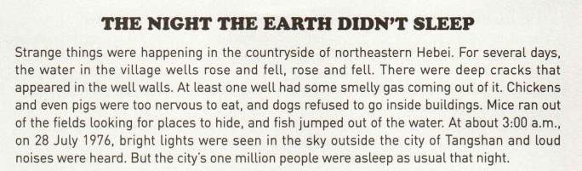
(2). Review the main points of each paragraph.
Part 1 (paragraph1):date, place and event.
Event
Date
Place
An earthquake hit Tangshan China on 28 July 1976.

Slide 17
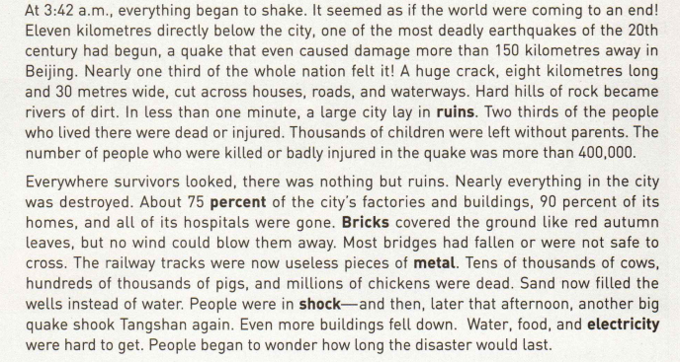
(2). Review the main points of each paragraph.
Part 2 (paragraph2＆3): The effect of the earthquake
Effect
Effect

Slide 18
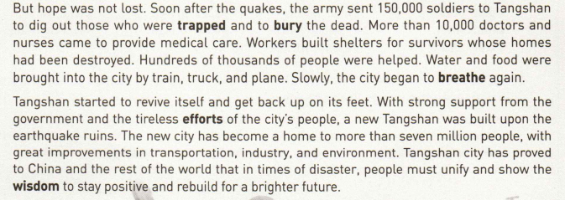
(2). Review the main points of each paragraph.
Part 3 (paragraph4＆5): The following events after the quake
Soldiers and medical workers came and began rescuing and rebuilding the city soon after the quakes.
Following event
Following event

Slide 19
Main points of each paragraph
(para1) Strange things happened in the countryside before the earthquake.
(para1) An earthquake hit Tangshan China on 28 July 1976.
(para2) The number of people who were killed or badly injured in the quake was more than 400,000.
(para3) Nearly everything in the city was destroyed.
(para4) Soldiers and medical workers came and began rescuing and rebuilding the city soon after the quakes.
(para5) With strong support from the government and the tireless efforts of the city's people, a new Tangshan was built upon the earthquake ruins
.

Slide 20
(3). Rewrite the main points of each paragraph (in your own words as possible as you can).
Use synonyms
occurred
Para1.
Strange things happened in the countryside before the earthquake. An earthquake hit Tangshan China on 28 July 1976.
struck
Change the voice
One possible version:
Strange things occurred in the countryside before the earthquake. On 28 July 1976, Tangshan was hit \ struck by an earthquake .

Slide 21
(3). Rewrite the main points of each paragraph(in your own words as possible as you can).
dead
Para2.
The number of people who were killed or badly injured in the quake was more than 400,000.
Change the sentence pattern
One possible version:
More than 400,000 people were dead or injured.

Slide 22
(3). Rewrite the main points of each paragraph(in your own words as possible as you can).
Para3.
Nearly everything in the city was destroyed.
almost
Change the subject
ruined
One possible version:
The city was nearly/almost ruined.

Slide 23
(3). Rewrite the main points of each paragraph(in your own words as possible as you can).
Use synonyms
arrived
started
Para4.
Soldiers and medical workers came and began rescuing and rebuilding the city soon after the quakes.
One possible version:
Soldiers and medical workers arrived and started rescuing and rebuilding work right after the quakes.

Slide 24
(3). Rewrite the main points of each paragraph(in your own words as possible as you can).
with the government’s support/aid
Para5.
With strong support from the government and the tireless efforts of the city's people, a new Tangshan was built upon the earthquake ruins.
Change the voice
One possible version:
Because of the government’s support and the people's efforts, we built a new Tangshan .

Slide 25
(4). Organize the ideas, using conjunctions if necessary.
s
Sample writing
Date
Event
Place
Strange things occurred in the countryside before the earthquake. on 28 July 1976, Tangshan was hit by an earthquake . More than 400,000 people were dead or injured. And the city was nearly ruined.
soldiers and medical workers arrived and started rescuing and rebuilding work right after the quakes. Because of the government’s support and the people's efforts, we have built a new Tangshan .
Then,
Effect
However,
Following events

Slide 26


Summary:What have we learnt?
structure and
main points of a news report
the rules of summary
writing and ways of paraphrasing
How to
write a summary of a news report

Slide 27
W
Homework
1.Review what you have learnt today.
2.Read another news report and
write a summary using the skills
you learnt in class.

Slide 28
Thanks

Slide 29
Paraphrase
Express the meaning of (something written or spoken or the writer or speaker) using different words, especially to achieve greater clarity.

