Slide 1


感恩遇见，相互成就，本课件资料仅供您个人参考、教学使用，严禁自行在网络传播，违者依知识产权法追究法律责任。
更多教学资源请关注
公众号：溯恩高中英语
知识产权声明

Slide 2

Unit 3 The Internet
Reading for Writing
How to write a blog post
东阳中学 周英巧

Slide 3
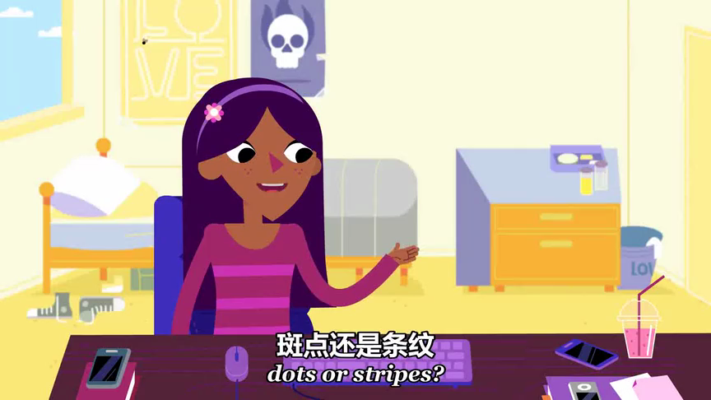

Slide 4
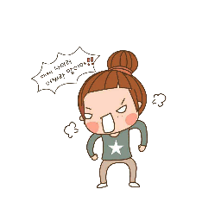
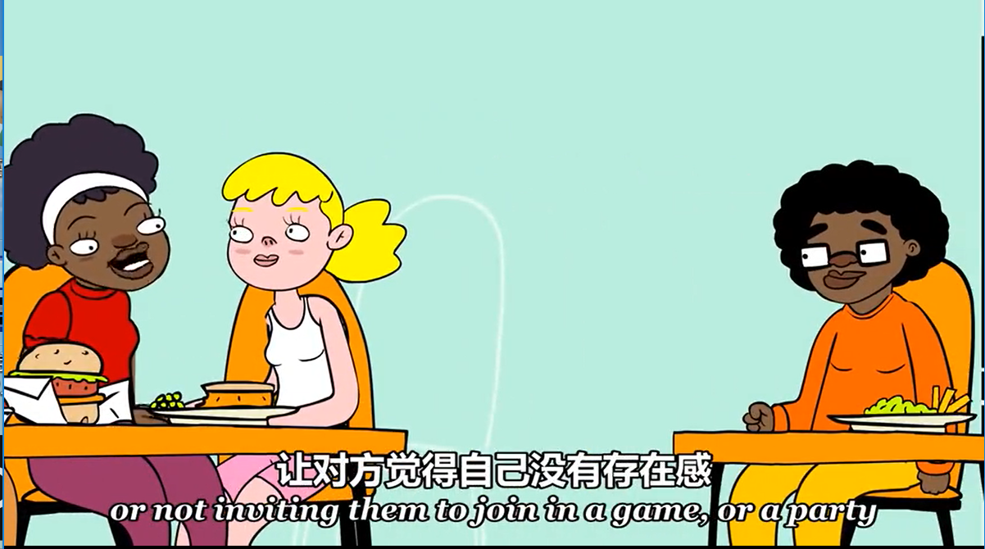




bullying

Slide 5
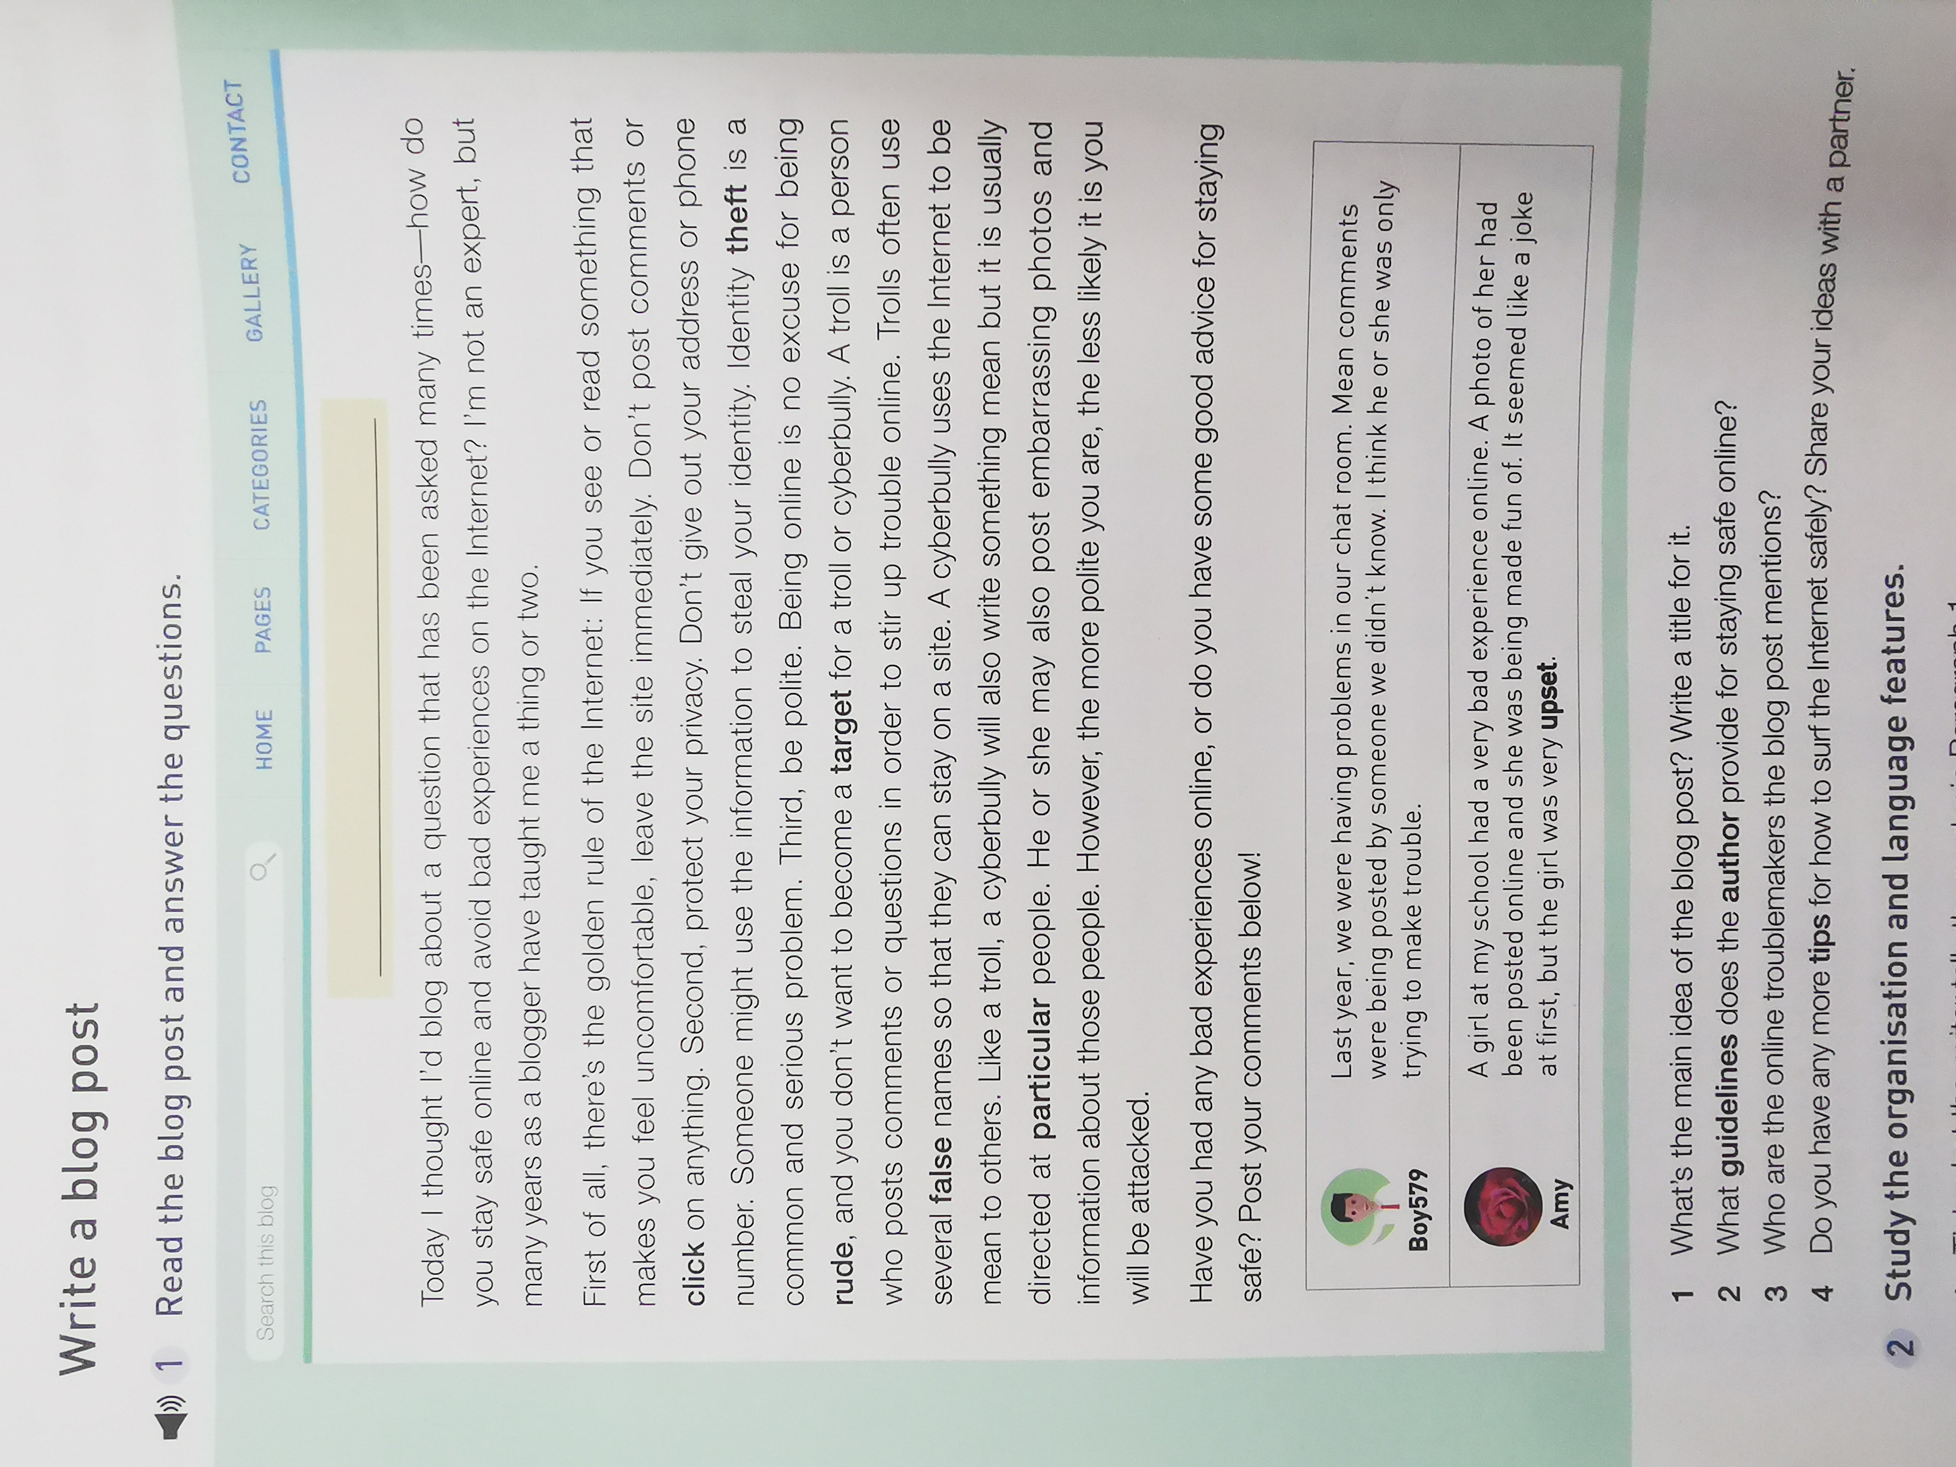
Blogger
Blog
Blog post

Slide 6
1.Where is the blog post from?
Internet.
2.What parts does the blog post include?

Slide 7
?
Title
Beginning
Body
Ending
Comment

Slide 8

What's the main idea of the blog post?
Title
How do you stay safe online and avoid bad experiences on the Internet?
Title?
Tip 1: Use as few words as possible to catch the attention of the readers.
Online Safety
How to stay safe online and avoid bad experiences on the Internet

Slide 9
What information about the author can we get?
Para. 1
He/She is not an _____, but an experienced _______.
expert
blogger
being a blogger for many years

Slide 10
Tick what the writer tells the reader in Para. 1.
Para. 1
Introduction
√
definition of online safety
background information
the writer's knowledge
the topic of the post
“How do you stay safe online and avoid bad experiences on the Internet?”
√
√
√
How?
Tip 2: Ask a question to introduce the topic.

Slide 11

How does the author answer the question?
Para. 2
Body
Body
rules
by giving 3 golden _____
guidelines

Slide 12

Para. 2
What are the guidelines?
dos | don'ts
 | 
 | 
 | 
similarity?
leave the site immediately
post comments/click on anything
protect your privacy
give out your address/
phone number
be polite
Tip3：Use imperative sentences(祈使句) to make the language powerful.

Slide 13
Third rule in Para.2: be polite
don't be rude
don't be a troll
don't ...
don't be a cyberbully
don't stir up trouble
don't be mean to others
don't post embarrassing photos and information
The more polite you are, the less likely it is you will be attacked.

Slide 14

Para. 2
How are the guidelines connected?
First of all
Second
Third
Tip4：Use linking words to express ideas clearly and coherently (连贯地).

Slide 15
Para. 2
How can we explain new words or key terms in Para.2?
Identity Theft
It is a problem...steal your identity.
explanation
A Troll
A troll is a person ... stir up trouble online.
definition
A Cyberbully
Like a troll, a cyberbully will use ... .
comparison
Tip 5: Add details and use skills such as explanation、definition and comparison to make the information clear and understandable.

Slide 16
What does the author ask the readers to do?
Para. 3
make comments
“Have you had any bad experience online, or do you have some good advice for staying safe? Post your comments below!”

Slide 17
Let's write.
请根据以下要点以“ Online Shopping Safety”为题写一篇关于如何安全地网上购物的帖子并发表在你的博客上。词数100左右。
1.挑选你熟悉的购物网站；
2.使用较为复杂的密码；
3.勿使用公共电脑购物……

Slide 18
Title
tell the main idea
Introduction
introduce a topic and introduce oneself
Body
structure
explain the rules
ask others to give comments
Ending
Comments
others' comments

Slide 19
Title
Tip 1: Use as few words as possible to catch the attention of the readers.
Introduction
Tip 2: Ask a question to introduce the topic.
skills
Tip3：Use linking words to express ideas clearly and coherently (连贯地).
Body
Tip4：Use imperative sentences(祈使句) to make the language powerful.
Ending
Tip 5: Add details and use skills such as explanation、definition and comparison to make the information clear and understandable.
Comments

Slide 20
Words and phrases
个人提升
请根据以下要点以“Online Shopping Safety”为题写一篇关于如何安全地网上购物的帖子并发表在你的博客上。词数100左右。
挑选你熟悉的购物网站；
使用较为复杂的密码；
勿使用公共电脑购物……
register v. 注册
record n. 记录
install v. 安装
enter our daily life
throughout the world
be familiar with
shopping account
Use a website you are familiar with.
Use strong passwords.
Don't use public computers.

Slide 21
Let's polish the passage.
□1. Does the writer tell the reader what he/she knows about the topic?
□2. Are the tips and suggestions well organized?
□3. Has the writer defined the new words?
□4. Does the author include examples, comparisons, or explanations?
□5. Does the writer end by asking readers to leave comments and/or suggestions?
□6. Can you find any grammar or spelling mistakes？

Slide 22
Sample writing
Online Shopping Safety
When it comes to shopping online safety, I’m sure that I know one thing or two. My net age is 10 years. Here are some tips for you.
First, use the shopping websites you are familiar with. Download familiar app or software like taobao. Second, when registering a shopping website, use a strong password and keep it well. Third, never use public computers to shop online, or your privacy will be recorded in the computers. Last, install a firewall to watch over your information. A firewall is a kind of software to protect your using Internet.
Have you any good tips about shopping online safely？Your ideas are welcomed below!

Slide 23

Homework
Check and revise your draft blog post and exchange it with your deskmate to find any spelling or grammar mistakes.
Thank
you!

