Slide 1


感恩遇见，相互成就，本课件资料仅供您个人参考、教学使用，严禁自行在网络传播，违者依知识产权法追究法律责任。
更多教学资源请关注
公众号：溯恩高中英语
知识产权声明

Slide 2

Unit 3 The Internet
Period 2 reading and thinking

Slide 3






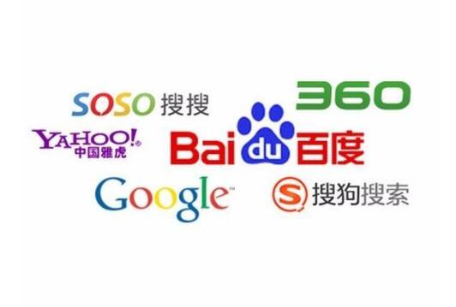

Freetalk
What have we benefitted from the internet?
With the app,xxx, it is more convenient for me to...
The internet
is beneficial to
us
当为强调过去的事情对现在造成影响
Stress the function and significance of the internet for us
How we have been changed by the internet!
With the app,WeChat, it is more convenient for me to chat with my family at my convenience.

Slide 4
Prediction
2. Can you make a prediction of the main idea of the passage?
4. How do you think the writer feels about the topic?
1. How does the author connect these two titles?
3. What kind of passage is it?
Main Title:
Stronger Together
(result)
positive
author's attitude
(reason)
Subtitle:
How We Have Been Changed By The Internet
We have been changed so much by the Internet that it has brought us together and made us stronger.
(narration)

Slide 5
read for structure
Can you divide the passage into three parts?
Para1
Para2
Para3
Para4
Para5
Introduction
Benefits
_______ of the internet to our life
The _______ Joan met and solved
difficulty
Example
Joan started an IT club to _________________
teach older people...
Joan's next ________.
goal
Summary
Joan's life has been _________
greatly improved

Slide 6
read for details
How does the author put forward the benefits?
List examples
General
Shopping without cash or waiting in line.
Benefits
of the internet
Get the most updated information from larger databases (search engines)
Download software,documents,images
What are the author's comments on the internet?
a. made our life more convenient
b. has done much more for people than simply...

Slide 7
read for details
--- Specific Benefits
Joan's life has been changed
The internet helped her deal with the difficulty
She started an IT club to help others
Her next goal is to start a charity website
1.What? 2. Why? 3. How?

Slide 8
reAd for details
--- Specific Benefits
Joan's life has been changed
a. surfed the internet
b. joined the online community
disappointed
upset
lonely
She realized (that one of the greatest benefits of the Internet was its ability to remove the distance that usually exists between people).
The internet helped her deal with the difficulty
sol ve
a. be out of work
b. be stuck at home with only her computer keep her company
她意识到互联网的最大好处之一就是能够消除通常存在于人和人之间的距离感。
due to her sudden illness

Slide 9
reAd for details
--- Specific Benefits
Joan's life has been changed
She started an IT club to help others
She was so inspired by the people she met online that she decided to start an IT club to teach older people how to use computers and the Internet.
Why?
Examples?
她受到网友的启发，决定成立一个IT俱乐部来教年长一些的人们学习使用电脑和互联网
61-year-old woman
started a company together with...
a. was inspired by the people she met online
b. wanted to teach people how to use ...
59-year-old man
now that...,her daughter

Slide 10
reAd for details
--- Specific Benefits
Joan's life has been changed
Gap
people have access to the internet
people haven't access to the internet
She believes (that it is highly important to bridge the digital divide and make sure that everyone has access to the Internet and knows how to use new technology.)
a. to bridge the digital divide
b. make sure that everyone has access to the internet...
Her next goal is to start a charity website
What can we learn from Joan‘s experience？
她认为，消除数字鸿沟，确保每个人都能使用互联网并且知晓如何运用新技术，是非常重要的
a. an organization aiming at help the poor freely
b.an organization aiming at help the poor with charge
Joan is kind and warm-hearted
the poor

Slide 11
reAd for details
--- Inspirations from Joan
Joan's life has been changed
d. When we go through tough times, we can find help and support from others facing similar challenges online.
The internet helped her deal with the difficulty
She started an IT club to help others
Her next goal is to start a charity website
a. Internet can make us feel less lonely and can even help us to achieve our goal
b. We can use internet to help people in need
c. We can make efforts to make the internet be accessible to everyone

Slide 12
reAd for revision
Benefits of the internet to our life
Introduction
structure
（para.1）
总-分-总
The difficulty Joan met and solved
Stronger together: How we have been changed by the Internet
Joan started an IT club to help others
Example
（para.2-4）
Joan's next goal
writing method
Joan's life has been greatly improved
Summary
举例子
（para.5）

Slide 13
reAd for summary
Jan Tchamani，an English teacher in Birmingham，UK，suddenly developed a serious illness. She found herself out of work and 1. (stick) at home. After a while，she discovered that 2. (surf) the Internet could help her feel less lonely and bored. She could do all kinds of things online. She also joined 3. online group where she could talk about her problems and get support and advice 4. others. She realized that one of the greatest 5. (benefit) of the Internet was its ability to remove the distance 6. usually exists between people.7. (inspire) by the people online，she decided to start an IT club and taught older people how to use the Internet. She and her friends organize events and collect money 8. (pay) for private teachers. Jan has started taking online classes to learn more about how to use the Internet to make society 9.______(good)．Jan’s life has been 10. (great) improved by the Internet!
stuck
surfing
an
from
benefits
that
Inspired
to pay
better
greatly

